Slide 1



Assignment 6 – SOSTAC Model Application
Content Creation & Content Calendar
Prepared by: Mohamed Mostafa Taher | ID: 21172333
Egyptian Men's Fashion | E-commerce Platform

Slide 2



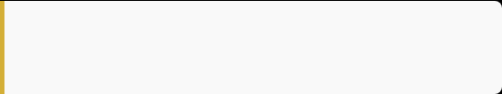
Qaim – Brand Overview
Business Identity
Observed Facebook Metrics
Qaim is a specialized Egyptian online men's clothing store delivering trendy and affordable daily apparel across Egypt.
•
Followers: Around 62,000
•
Total Posts: Around 592
•
Recommendation: 96% positive rating
Website: https://www.qaim.shop/
•
Reviews/Ratings: 341 reviews
•
Conversion Paths: Active WhatsApp contact & direct website links.
Main Product Categories
*Note: Facebook figures are observed from the provided screenshots and may change over time.
Jeans, Cargo Pants, Sweatpants, Polo Shirts, Oversized T-shirts, and Shoes.

Slide 3

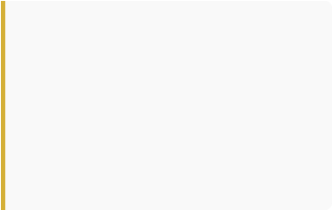

Current Digital Situation (SWOT Analysis)
Strengths
Weaknesses
Opportunities
•
Active Reel utilization.
•
Some Reels lack strong hook phrases.
•
Styling and 'How-to' Reels.
•
Strong customer review social proof (96%).
•
Content leans heavily product-centric.
•
Customer-generated content (UGC).
•
Varying organic reach across posts.
•
Micro-influencer partnerships.
•
62K+ follower base observed.
•
Need for structured educational content.
•
Interactive Stories and polls.
•
Direct website & WhatsApp order funnels.
Analyst Note: The visible difference in reach between posts suggests that paid promotion may support some content, but this cannot be confirmed without access to Meta Ads Manager.

Slide 4

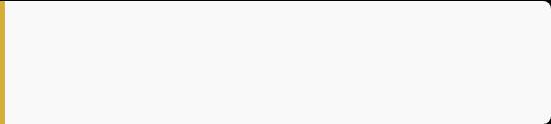
SMART Marketing Objectives
Objective 1: Engagement
Objective 3: Reel Reach
Increase organic social media engagement by 20% within 3 months using interactive content, polls, UGC, and Carousels.
Increase average organic Reel reach by 20% within 3 months by optimizing first-3-second hooks and shareable tips.
Objective 2: Website Traffic
Objective 4: Direct Orders
Increase website visits from social channels by 15% within 3 months via clear CTAs and conversion-focused Reels.
Increase WhatsApp inquiries by 15% within 3 months using explicit "Order on WhatsApp" calls-to-action.

Slide 5



Target Audience Profile
Primary Demographic
Customer Needs & Pain Points
Egyptian Males Aged 18–30
Needs: Affordable pricing, reliable quality, trendy cuts (oversized, cargo), fast delivery, and flexible exchange/return policies.
•
University students looking for trendy apparel on a budget.
•
Young employees needing smart-casual daily wear.
Pain Points:
•
Active online shoppers on Facebook & Instagram.
•
Uncertainty about correct online sizing.
•
Doubt regarding fabric quality vs. photos.
•
Strict budgets requiring high value-for-money.
Preferred Platforms
Facebook (Main community & reviews), Instagram (Visual styling & Reels), WhatsApp (Direct checkout & customer service).

Slide 6
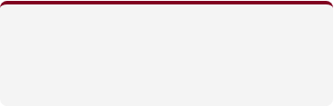

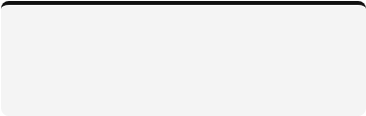
Content Strategy Shift & Pillars
Strategic Shift: Moving from "Simply Showing the Product" ➔ To "Helping the Customer Choose & Style"
Product Education
Styling Tips
Social Proof & UGC
How to pick the right fit, fabric breakdown, and sizing guides.
Outfit combinations (Casual, Smart Casual, Streetwear).
Real customer reviews, unboxing, and rating showcases.
Core Content Formula: HOOK (0-3s) ➔ VALUE ➔ PROOF ➔ CLEAR CTA

Slide 7


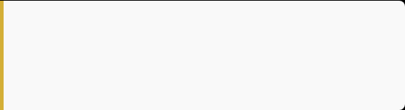
Content Idea 1 – Educational Reel
Format & Topic
Execution Details
Format: Video / Reel (20–30 sec)
CTA: "Check the Qaim jeans collection and choose your perfect fit."
Topic: How to Choose the Right Jeans Fit
Caption: "Not every jeans fit works for everyone. Choose the cut that matches your daily style."
Platforms: Instagram & Facebook Reels
Script Outline
KPIs: Watch time, retention, saves, and shares.
Hook: "بتشتري جينز وكل مرة الـfit بيطلع مش مظبوط؟"
Body: The issue might be the fit, not the jeans. Check size, cut, and daily utility before buying. Always verify size charts.

Slide 8
Content Idea 2 – Trust & Buying Guide
Format & Topic
Execution Details
Format: Video / Reel (20–25 sec)
CTA: "Check product details before ordering on qaim.shop."
Topic: 3 Things to Check Before Buying Jeans Online
Caption: "Online shopping should be simple. Verify your fabric, size, and inspection guarantees."
Platforms: Instagram & Facebook
Script & Verified Info
KPIs: Reach, watch time, and website clicks.
Hook: "قبل ما تشتري جينز أونلاين، اتأكد من الـ3 دول."
Body: 1. Material (e.g., New Speed / Lycra). 2. Size & fit. 3. Return & inspection terms. Qaim offers inspection before payment and delivery!

Slide 9


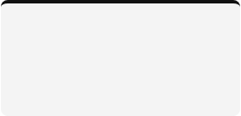
Content Idea 3 – Styling Carousel
Format & Topic: Carousel (3 Ways to Style One Item)
Designed to boost saves and shares by demonstrating versatility using Qaim's staple jeans.
Slide 1-2
Slide 3
Slide 4
Slide 5-6
Cover & Casual:
One Jeans, 3 Looks.
Jeans + Basic Tee + Sneakers.
Smart Casual:
Jeans + Qaim Polo Shirt + Clean Sneakers.
Street Style:
Jeans + Oversized T-shirt + Sneakers.
Interactive:
Poll: "Which look is your favorite?" + Shop Now CTA.

Slide 10


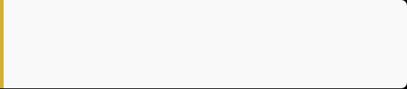
Content Idea 4 – Social Proof Carousel
Format & Objective
Carousel Structure
Format: Multi-slide Carousel
•
Slide 1: "Still thinking about ordering? See what customers say."
Topic: Why Customers Keep Coming Back (Leveraging Qaim's 96% positive recommendation rate).
•
Slide 2-5: Real reviews highlighting Quality, Value, Delivery speed, and Product accuracy.
•
Slide 6: "Your review could be next. Try it and share your experience." + CTA.
Important Rule
Do not create fake quotes. Use real screenshots or verified feedback from Qaim customer reviews (e.g., good quality, fast delivery, matching photos).

Slide 11
1-Week Sample Content Calendar
Day | Content Type | Topic / Format | Goal
Saturday | Reel | How to Choose the Right Jeans (Educational) | Education & Engagement
Monday | Reel | 3 Things to Check Before Buying Online | Trust & Website Visits
Wednesday | Carousel | 3 Ways to Style One Jeans (Styling) | Saves & Shares
Friday | Carousel | Why Customers Keep Coming Back (Reviews) | Trust & Conversion
Support Stories: Sunday Poll ("Casual or Street Style?") | Tuesday Question box ("Biggest online shopping problem?") | Thursday Product reminder & website link.

Slide 12
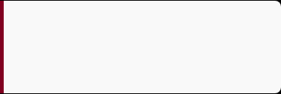
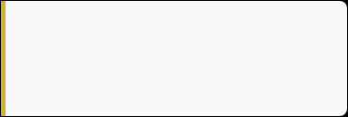
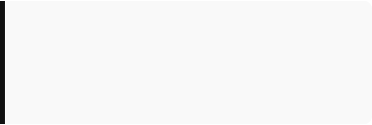
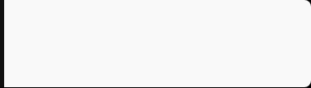
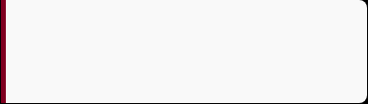
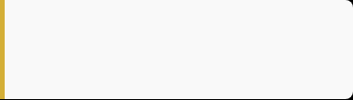
SOSTAC Action Plan Summary
S – Situation
O – Objectives
S – Strategy
Active Facebook presence, 62K followers observed, frequent Reels, 96% recommendations, website, and WhatsApp.
Improve organic engagement (+20%), website visits (+15%), Reel reach (+20%), and WhatsApp clicks (+15%).
Transition from pure product listing to helpful, engaging, and trust-building content creation.
T – Tactics
A – Action
C – Control
Strong hooks, educational Reels, styling carousels, customer proof, daily Stories, and clear CTAs.
Consistent 3-month publishing schedule, format testing, weekly review, and refinement.
Track weekly KPIs, analyze watch time, saves, website clicks, and compare performance monthly.

Slide 13


KPIs & Decision Control Rules
Tracked Weekly Metrics
Optimization Decision Rules
Reach, Reel Views, Average Watch Time, Engagement Rate, Saves, Shares, Comments, Website Clicks, WhatsApp Clicks, and Orders.
•
Low retention: Change the first 3 seconds hook.
•
High saves: Produce more educational content.
•
High shares: Create similar shareable formats.
•
More clicks: Focus on product & website CTAs.

Slide 14
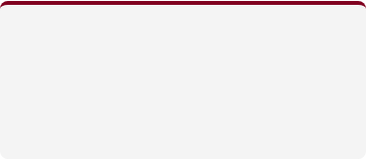
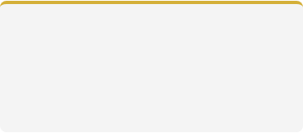
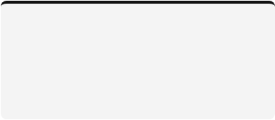
3-Month Implementation Timeline
Month 1: Testing
Month 2: Optimization
Month 3: Growth
Test 4 core content ideas, experiment with different hook styles and posting days, and establish baseline KPI tracking.
Keep top-performing formats, improve weak Reels, increase UGC integration, and expand styling content.
Scale successful formats, enhance conversion-driven CTAs for website and WhatsApp, and review milestone targets.

Slide 15
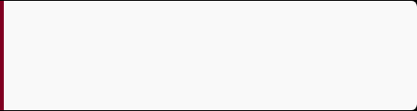

Conclusion & Final Recommendations
Qaim's Strong Foundation
Core Strategic Takeaway
Qaim already possesses solid products, active Reels, genuine customer reviews, a functional e-commerce website, and strong WhatsApp communication channels.
"Keep the Reels, but improve the Hooks. Keep the reviews, but turn them into Stories and Carousels. Keep the traffic, but build a stronger organic content system."
Ready for academic submission and classroom presentation.

