Slide 1

ASSIGNMENT 12
TAKAA
Energy Drink · Egyptian Lifestyle Brand
مودك ناقصه تاكة
Instagram Page Setup · AI Commercial Video · Social Media Carousel · CapCut Template
Task 1: Create & optimize an Instagram page.
Task 2: AI Commercial Video, Social Media Carousel, and a CapCut Template — all for one chosen brand.
Prepared by: Mohamed Mostafa Taher | Student Code: 21172333

Slide 2




01 · THE BRIEF
Mohamed Mostafa Taher | ID 21172333
Assignment Requirements
TASK 1
TASK 2a
Instagram Page
AI Commercial Video
Create and optimize an Instagram page — profile, bio, visual identity and content focus.
Research trending content on Instagram, TikTok & Pinterest. Create a short, trendy AI-generated commercial video.
TASK 2b
TASK 2c
Social Media Carousel
CapCut Template
A complete 5–8 slide carousel, using Canva, AI, or both.
Find a trending CapCut template and adapt it creatively so it feels like real brand content, not just a template.

Slide 3
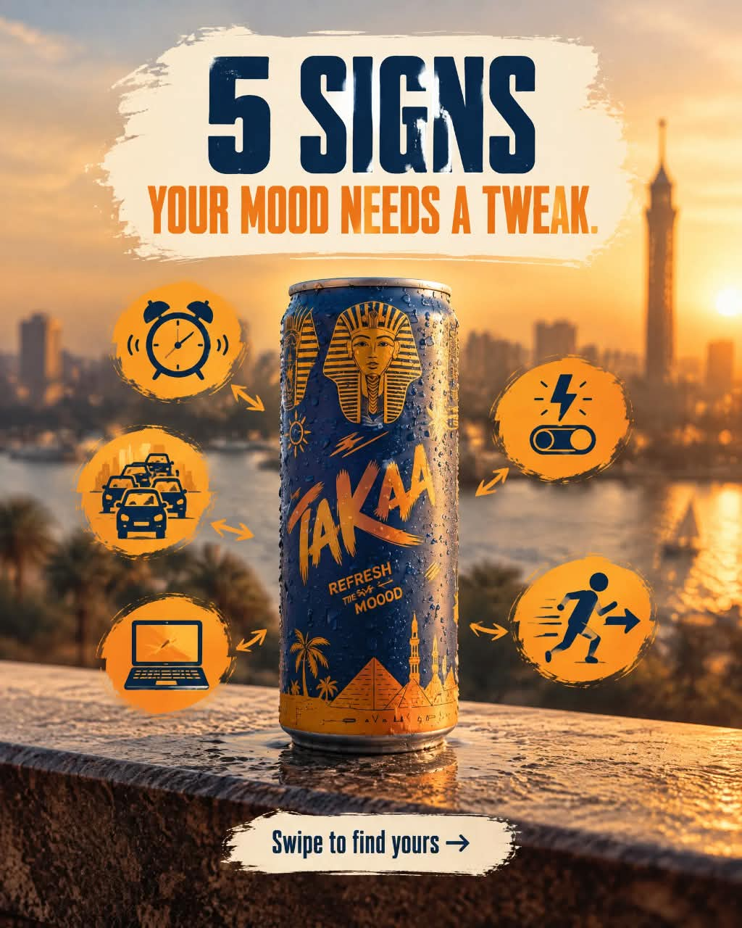
02 · BRAND CONCEPT
Mohamed Mostafa Taher | ID 21172333
Who Is TAKAA?
BRAND
TAKAA is a fictional Egyptian energy-drink brand built around one idea: your mood doesn’t need a big reset — just a small tweak.
TAGLINE
“Take the Tweak.” · “مودك ناقصه تاكة.”
VISUAL IDENTITY
Deep navy + warm orange — evening-in-Cairo color palette
Egyptian landmarks (pyramids, felucca boats, skyline) as backdrop
Condensation, ice and splash details for a “cold refresh” feel
Bold, hand-drawn-style logotype for an energetic, youthful tone

Slide 4
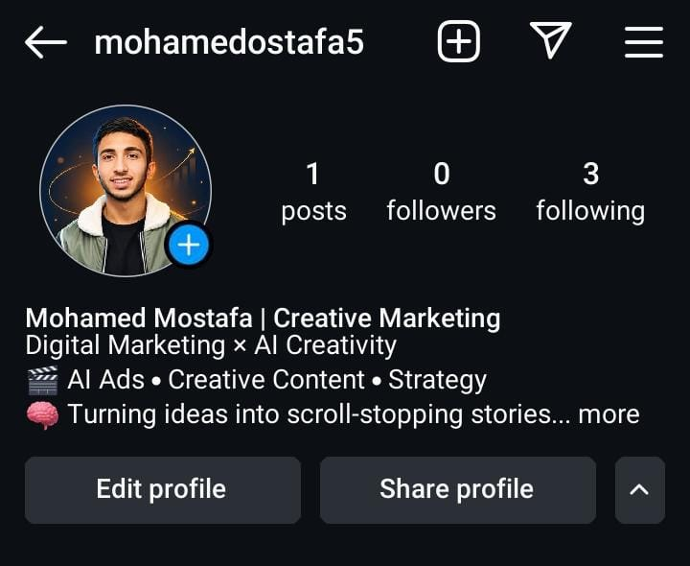
TASK 1 · INSTAGRAM PAGE
Mohamed Mostafa Taher | ID 21172333
Page Setup — @mohamedostafa5
PROFILE STRUCTURE
NAME
Mohamed Mostafa | Creative Marketing
CATEGORY LINE
Digital Marketing × AI Creativity
FOCUS LINE
🎬 AI Ads • Creative Content • Strategy
HOOK LINE
🧠 Turning ideas into scroll-stopping stories...
WHY THIS BIO WORKS
Name line states the role immediately — no guessing what the page is for.
Category line (Marketing × AI) positions the niche in 4 words.
Two emoji-led lines separate “what I do” from “why it matters” — scannable in 2 seconds.
“Scroll-stopping stories” hints at tone without over-explaining.

Slide 5





TASK 1 · INSTAGRAM PAGE
Mohamed Mostafa Taher | ID 21172333
Optimization Checklist
Clear Positioning
Consistent Visual Identity
Content Pillars First
Bio states the exact niche (Digital Marketing × AI Creativity) instead of a vague “content creator” label.
Profile photo, grid and highlights should follow one color mood so the page reads as one brand, not scattered posts.
AI Ads, Creative Content and Strategy give visitors 3 clear reasons to follow — defined before posting starts.
Proof Over Claims
One Clear CTA
Growth Discipline
Real work (TAKAA carousel, AI commercial, CapCut edit) replaces generic “experienced marketer” language.
Link-in-bio and DM point to a single next step — view the portfolio or start a conversation.
Starting from 0 followers is normal — the priority is a page that converts a first-time visitor, not vanity metrics.

Slide 6
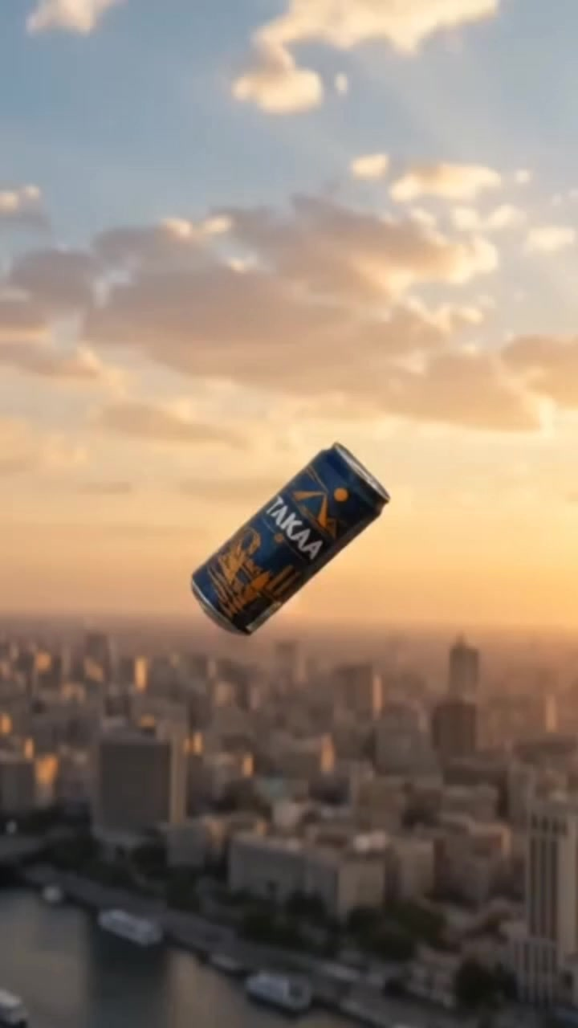
TASK 2A · AI COMMERCIAL VIDEO
AI-GENERATED
TAKAA
“Take the Tweak” — Cinematic Product Film
Format: Vertical 9:16 · ~50 sec · AI-generated cinematic visuals
[ Video link: Google Drive / YouTube — add before submission ]

Slide 7
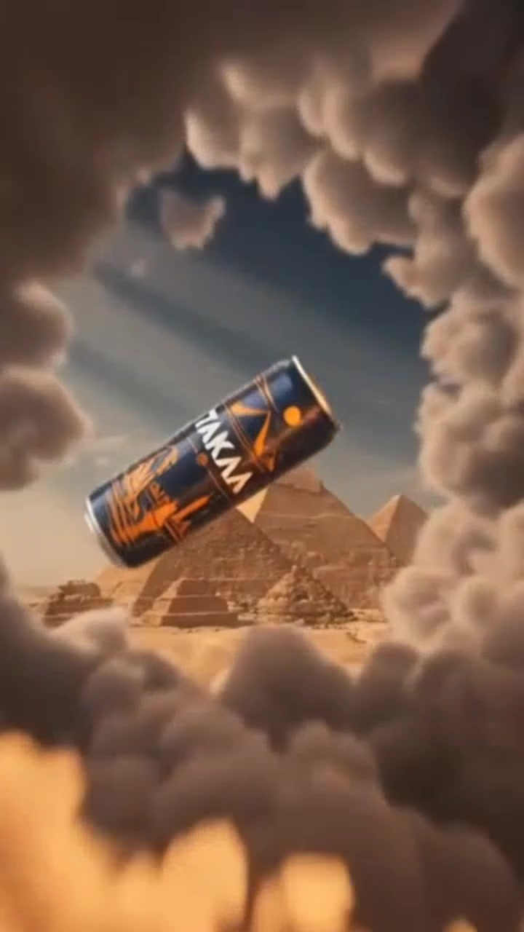

TASK 2A · AI COMMERCIAL VIDEO
Mohamed Mostafa Taher | ID 21172333
Concept, Trend Research & Execution
CONCEPT
A product-hero film: the TAKAA can travels through iconic Egyptian settings — skyline, pyramids, the Nile — landing in a splash reveal at golden hour.
TREND RESEARCH
Pinterest: product-floats-through-scenery ad trend for beverage brands
Instagram Reels: golden-hour rooftop product reveals with condensation close-ups
TikTok: fast whoosh transitions between landmark and product shots
EXECUTION
AI-generated scenes: skyline, pyramids-in-clouds, Nile felucca
Consistent can design and lighting across every generated shot
Splash / condensation close-ups for tactile, “cold drink” appeal
Closes on logo card with tagline in English + Arabic
Main Message: Refresh the mood, not the whole day.
CTA: مودك ناقصه تاكة — Take the Tweak.

Slide 8
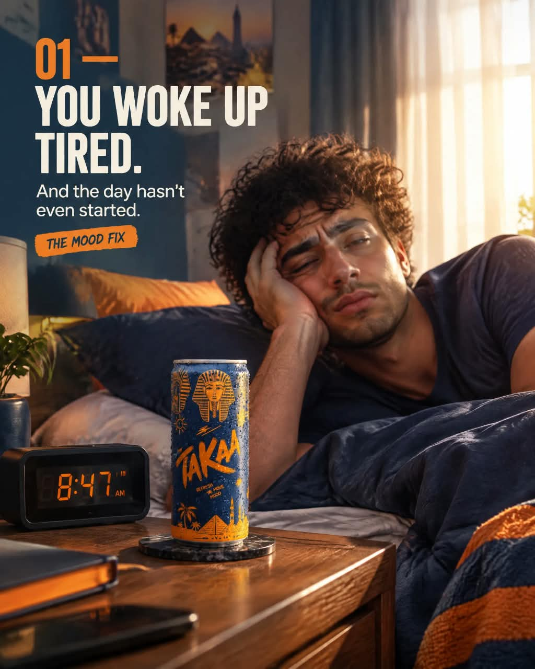


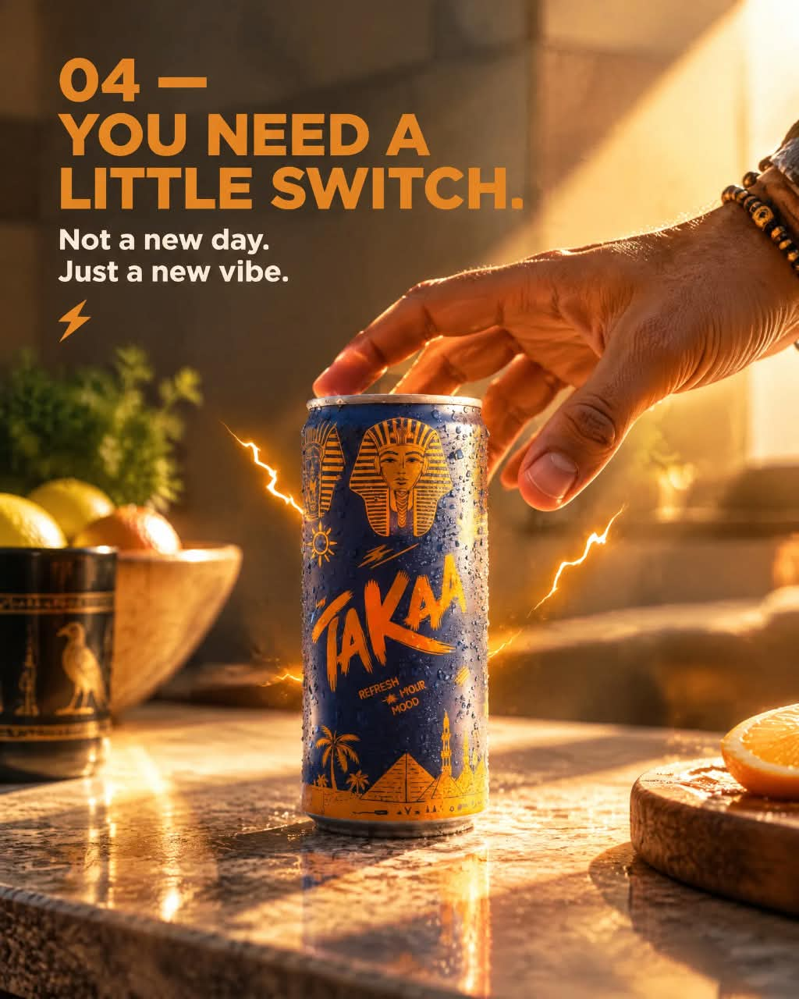

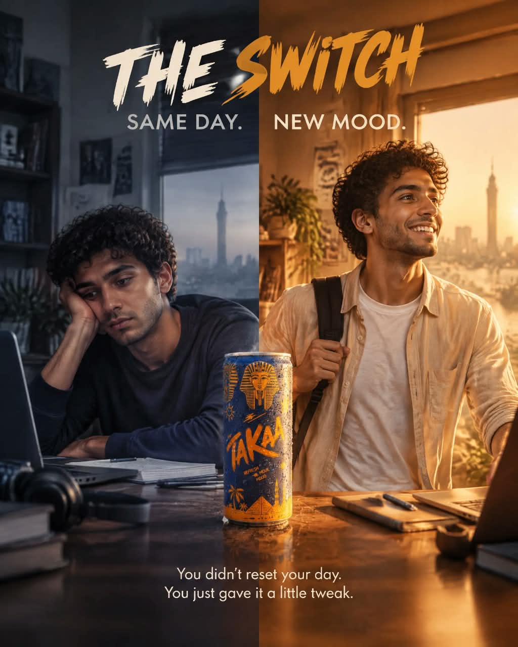
TASK 2B · SOCIAL MEDIA CAROUSEL
Mohamed Mostafa Taher | ID 21172333
“5 Signs Your Mood Needs a Tweak” — 8 Slides
1/8
2/8
3/8
4/8
5/8
6/8
7/8
8/8
STORY ARC
PUBLISHED POST
Cover → 5 relatable “mood dip” moments (tired, annoyed, distracted, needing a switch, ready to move) → Before/After “The Switch” → product CTA card.
instagram.com/p/DdHJzz-jGrm
Live carousel post, published on Instagram — caption, hashtags and swipe CTA included.
Format: Canva + AI-generated visuals, 1080×1350, unified navy/orange color grade across all 8 frames.

Slide 9
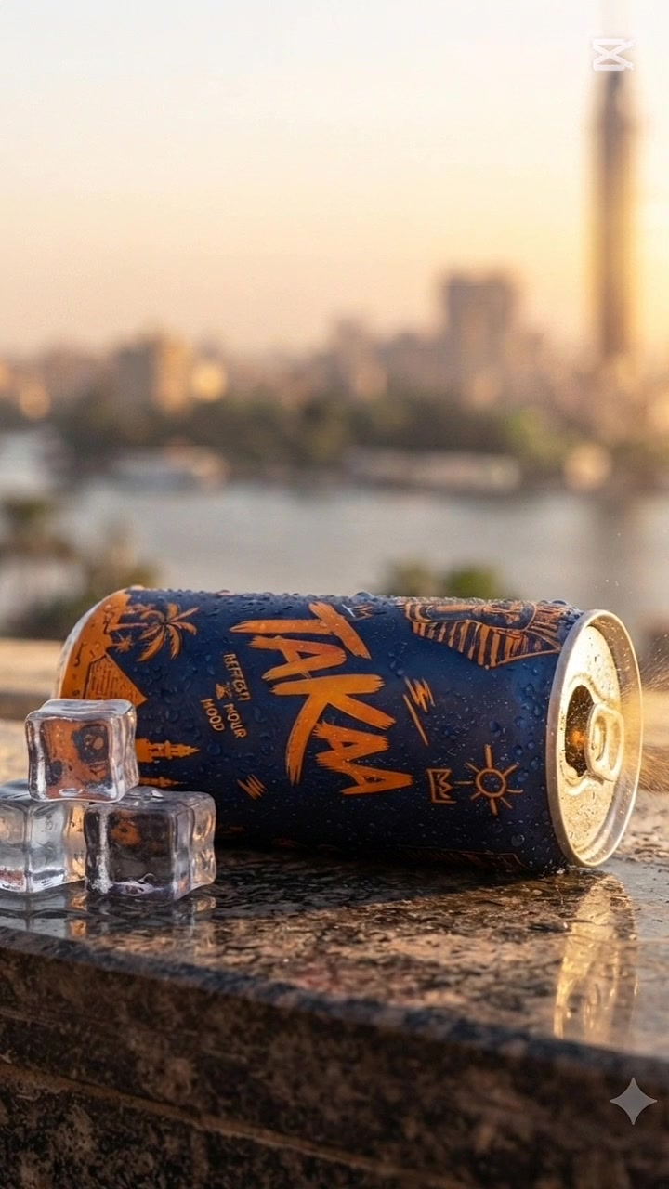
TASK 2C · CAPCUT TEMPLATE
CAPCUT EDIT
TAKAA
Trending “Product Reveal” CapCut Template — Adapted
Format: Vertical 9:16 · ~17 sec · Trending CapCut transitions + effects
[ Video link: Google Drive / YouTube — add before submission ]

Slide 10
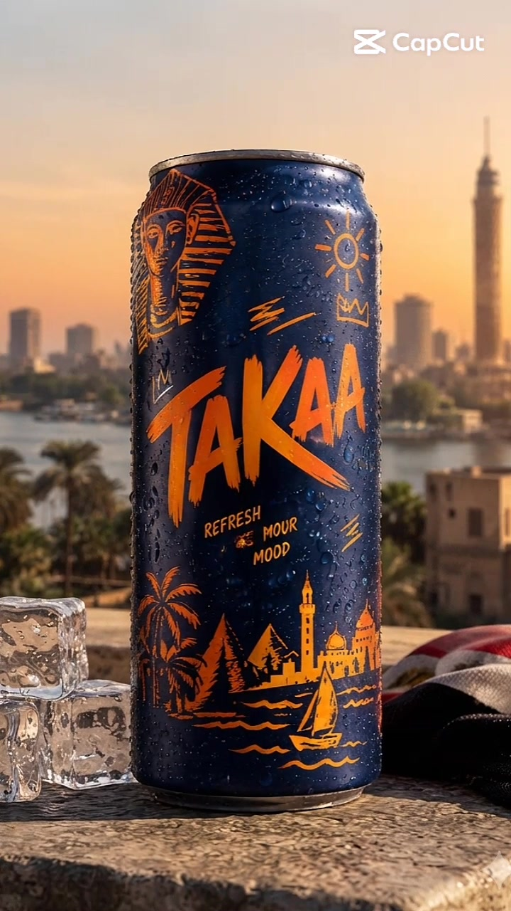
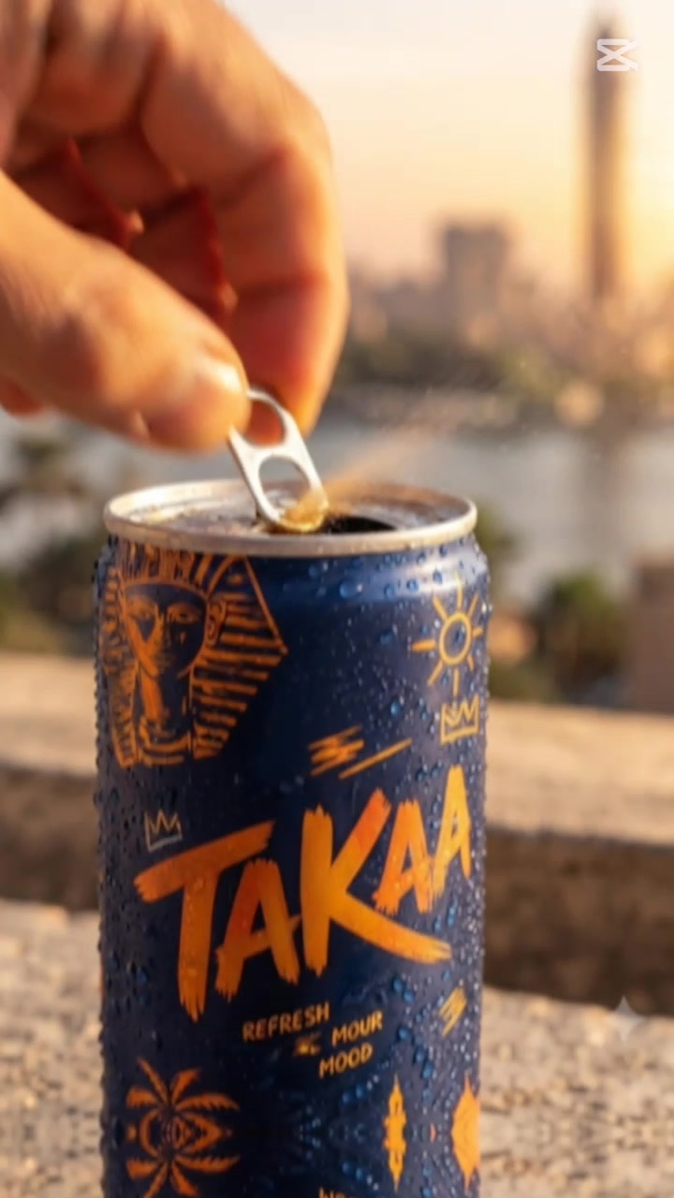
TASK 2C · CAPCUT TEMPLATE
Mohamed Mostafa Taher | ID 21172333
Template Choice & Brand Adaptation
TEMPLATE FOUND
A trending CapCut “product pop-reveal” template: quick zoom-punch cuts, a can-opening snap transition, and a rooftop-city backdrop — popular in F&B / beverage Reels right now.
HOW IT WAS ADAPTED
Swapped the generic template product for the actual TAKAA can and label
Matched the background to a real Cairo rooftop-at-sunset setting, not a stock backdrop
Kept the template's snap-zoom and ring-pull transition beats, timed to the can opening
Added ice and condensation details specific to TAKAA's “cold refresh” visual identity
WHY IT FEELS LIKE BRAND CONTENT
Best for: Instagram Reels & TikTok — fast, native-feeling, thumb-stopping in the first second.
The template supplies the pacing; TAKAA's colors, logo and setting supply the identity — so the edit reads as a TAKAA post first, a template second.
CTA: جرّبها دلوقتي — Take the Tweak.

Slide 11
FINAL SUBMISSION
TAKAA — Assignment 12 Complete
1
Instagram Page
@mohamedostafa5 — profile, bio and content focus set up and optimized.
2
AI Commercial Video
~50 sec cinematic product film — TAKAA travels through Cairo landmarks to a splash reveal.
3
Social Media Carousel
8-slide “5 Signs Your Mood Needs a Tweak” carousel — live on Instagram.
4
CapCut Template
Trending product-reveal template adapted with TAKAA's real can, setting and colors.
Links: Carousel post — instagram.com/p/DdHJzz-jGrm · Page — instagram.com/mohamedostafa5
TAKAA · TAKE THE TWEAK

