Slide 1
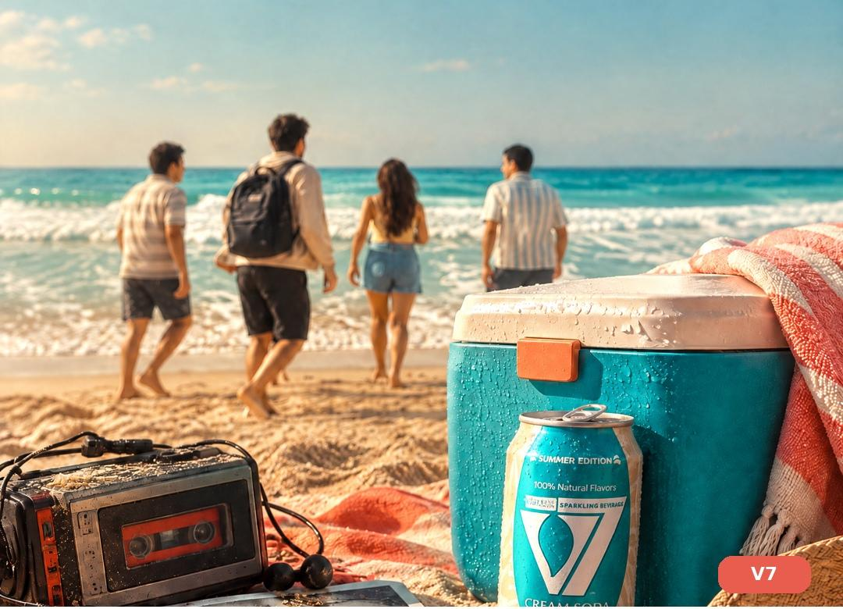
V7 CREAM SODA · BRAND & CAMPAIGN DECK
V7 CREAM SODA
Summer Edition — “Every Generation Has Its Summer” Campaign
“Every generation has its summer... This is ours.”
كل جيل له صيفه... وده صيفنا.
Brand Snapshot · Campaign Strategy · Content Execution · Production Plan
Campaign: Summer Edition 2026

Slide 2
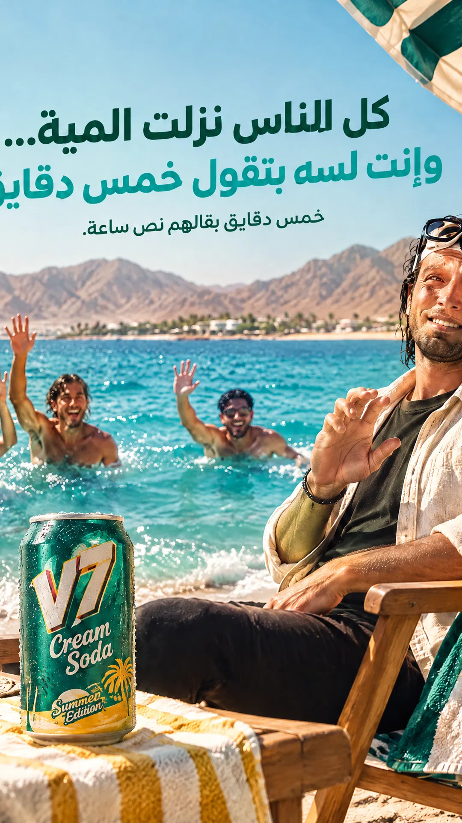
01 · BRAND SNAPSHOT
V7 CREAM SODA | SUMMER EDITION CAMPAIGN
Who Is V7 Cream Soda?
BRAND
V7 Cream Soda is an Egyptian sparkling beverage brand. Its Summer Edition campaign is built around one idea: every generation has lived its own real Egyptian summer — and now it’s ours.
TAGLINE
“Every generation has its summer. This is ours.” · “كل جيل له صيفه... وده صيفنا.”
VISUAL IDENTITY
Signature teal + cream palette, taken straight from the V7 can
Red Sea & Mediterranean coastlines — Sahel, Sharm, Marsa Matrouh, Hurghada — as backdrops
Condensation, ice and splash detail for a tactile “cold refresh” feel
Golden-hour light and palm trees as a recurring summer motif
2

Slide 3
02 · CAMPAIGN FRAMEWORK
V7 CREAM SODA | SUMMER EDITION CAMPAIGN
Every Generation Has Its Summer — At a Glance
◈
✦
■
▶
STRATEGY
BIG IDEA
AUDIENCE
EXECUTION
Campaign Objective
Positioning
3 Generations
Content System
Launch V7 Summer Edition through a 3-generation journey that lands on V7 as our generation’s drink — with zero false historical claims.
“Every generation has its summer. This is ours.” V7 steps in as a new role for today, never rewritten history.
Gen Zaman, the 90s Generation, and Our Generation (18–29) — the campaign’s hero and core buyer.
5 social posts + 1 Hero Film, sequenced across a full launch-week content calendar.
3

Slide 4
03 · BIG IDEA
Every generation has its summer.
This is ours.
كل جيل له صيفه... وده صيفنا.
Summer in Egypt was never just heat and sea — it’s a place, a memory, a group of people, and a drink tied to the moment. Every generation once had a drink that brought the group together. Now it’s our generation’s turn.
4

Slide 5
04 · AUDIENCE
V7 CREAM SODA | SUMMER EDITION CAMPAIGN
Target Audience — Three Real Generations
50–70
30–44
CAMPAIGN HERO
18–29
Gen Zaman
90s Generation
Our Generation
Remembers Ras El Bar & Gamasa — a genuine storytelling role, shares the content with their kids.
Remembers Agami & Marina — now buying for the family trip.
Lives more than one summer a year (Sahel, Sharm, Matrouh, Hurghada) — V7’s core buyer.
PLATFORMS & BEHAVIOUR
Instagram Reels & TikTok for Our Generation — Facebook for older generations
Every generation loves comparing its summer to the next one’s
Our Generation travels to more than one destination in a single summer
5

Slide 6
05 · CAMPAIGN STRUCTURE
V7 CREAM SODA | SUMMER EDITION CAMPAIGN
A Journey Through Three Generations
1
2
3
70s–80s
90s–Early 2000s
2026 — Now
Gen Zaman
90s Generation
Our Generation
Ras El Bar / Gamasa
Agami / Old Marina
Sahel + Sharm + Matrouh + Hurghada
Simple chalet, plastic chairs, an old radio, worn inflatables, an unbranded soda bottle
Cassette tape, printed photos, an old car or minibus, plastic bags
Modern car, bluetooth speaker, phone, cooler full of V7
6

Slide 7
06 · GENERATION SPOTLIGHT
V7 CREAM SODA | SUMMER EDITION CAMPAIGN
Gen Zaman & The 90s Generation
70s–80s
90s–Early 2000s
Ras El Bar / Gamasa — Gen Zaman
Agami / Old Marina — 90s Generation
“Back then... summer had a different shape, and a different drink that brought everyone together.”
“After that... every summer brought new memories, new taste, and a drink with its place in the group.”
Old chalet or simple summer apartment
Colourful plastic chairs + a ceiling fan
An old radio playing in the living room
Kids playing football on the sand
Worn inflatables, a table of glass cups and ice
The road to the coast in an old car or minibus
A cassette tape playing a summer song
Printed photos from the beach
Plastic bags and food containers
A striped beach umbrella + squash on the sand
HISTORICAL HONESTY
HISTORICAL HONESTY
The drink in this scene is a generic, unbranded soda bottle — V7 never appears or is mentioned here.
The drink appears distant or with an unreadable brand — a complete avoidance of any inaccurate historical claim for V7.
7

Slide 8
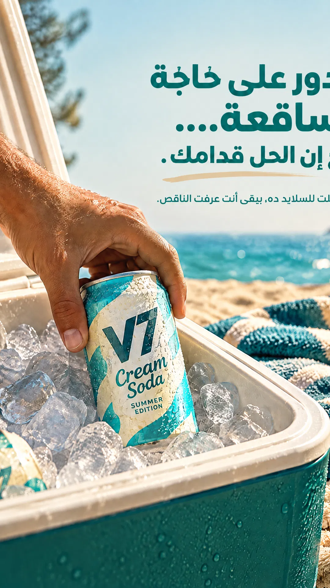
06 · GENERATION SPOTLIGHT
V7 CREAM SODA | SUMMER EDITION CAMPAIGN
Our Generation — One Summer, Many Faces
Our generation doesn’t live one single summer; every trip has its own shape, every place its own memories — and they all come together over V7 Cream Soda.
★ Sahel
Sharm El-Sheikh
Friends’ Summer
Adventure Summer
Marsa Matrouh
Hurghada
Calm & Sea Summer
Sea & Togetherness Summer
+ Additional quick cuts without slowing the film: Ain Sokhna, Ras El Bar, Agami, Dahab, Alexandria
and now... it’s our turn. V7 Cream Soda Summer Edition — our generation’s summer.
8

Slide 9
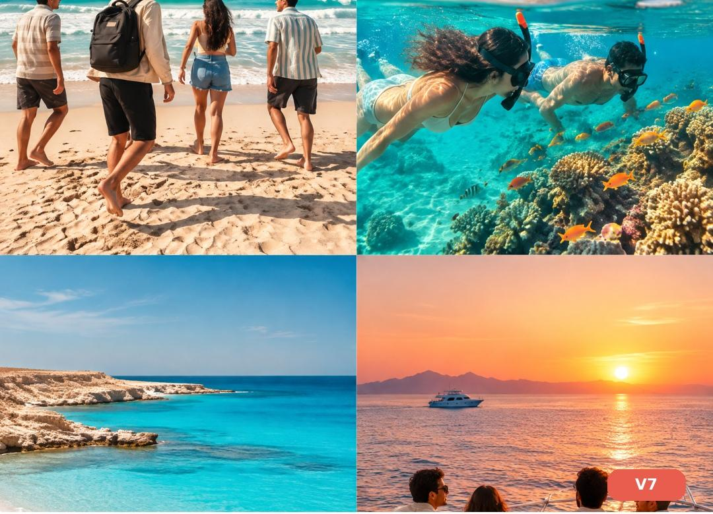
07 · OUR GENERATION — DESTINATIONS
V7 CREAM SODA | SUMMER EDITION CAMPAIGN
Four Coasts, One Feeling
Sahel
“On the Sahel... summer starts from the first trip with friends.”
Sharm
“In Sharm... summer is a new adventure every time.”
Marsa Matrouh
“In Matrouh... summer slows down, and the sea takes you far away.”
Hurghada
“In Hurghada... every day in the sea makes a new memory.”
9

Slide 10
08 · CREATIVE MECHANIC
V7 CREAM SODA | SUMMER EDITION CAMPAIGN
Transitions Between Generations — Match Cuts
Detail | Gen Zaman (Ras El Bar) | 90s Gen (Agami) | Our Gen (Sahel)
Sound | Old radio | Cassette tape | Bluetooth speaker
Drink | Generic soda bottle | Unclear-brand drink | V7 in the ice
Arrival | Old car | Old minibus / car | Modern car on the coast
Luggage | Old summer bag | Plastic bag | Modern beach bag
Seating | Plastic chairs | Striped umbrella | Modern beach chairs
The transition is a purely visual match cut — the product itself is never blended with the past.
10

Slide 11
09 · SOUND IDENTITY
V7 CREAM SODA | SUMMER EDITION CAMPAIGN
The Sounds of Every Generation
♪
▤
♫
✵
Old Radio
Cassette Tape
Bluetooth Speaker
Can Opening
Real radio static — Gen Zaman scenes only
Audible cassette-tape playback sound — 90s Generation scenes only
A simple, contemporary summer beat — Our Generation scenes
Clear, real can-opening sound — never used as a time-transition device
SEA WAVES & LAUGHTER
Sea waves and natural laughter stay constant through every Our Generation scene across all four destinations — unscripted, but the thread that ties every generation’s feeling together.
11

Slide 12
10 · PRODUCTION DIRECTION
V7 CREAM SODA | SUMMER EDITION CAMPAIGN
Production Locks
Historical Lock
Product Lock
✓
The drink in Gen Zaman & 90s scenes is always a generic, unbranded bottle. V7 appears in Our Generation scenes only.
✓
Same can shape, colour and design in every appearance — no alterations allowed.
Visual Lock
Editing Lock
✓
Zaman: warm, filmic tones · 90s: warmer tones with light grain · Our Gen: turquoise, cream, natural light.
✓
Clear visual match cuts between generations — never implying V7 existed before our generation.
12

Slide 13
11 · EXECUTION
V7 CREAM SODA | SUMMER EDITION CAMPAIGN
Campaign Journey — 5 Posts
5 posts (3 videos + 1 carousel + 1 static) built on the “Every Generation Has Its Summer” journey
1
2
3
4
5
🎥 Reel
🎥 Reel
🎥 Reel
🖼 Carousel
▪ Static
Teaser
→
Reveal
→
Product Experience
→
Engagement
→
CTA
“Every generation had its summer”
“and now it’s our turn”
4 destinations, one drink
“Which summer is yours?”
“Every generation has its summer... this is ours.”
+ Hero Film (45s master film) tells the full 3-generation journey up to our generation.
13

Slide 14

12 · EXECUTION — POST 1/5 & 2/5
V7 CREAM SODA | SUMMER EDITION CAMPAIGN
Teaser & Reveal
🎥 REEL · 15s
🎥 REEL · 18s
Teaser
Reveal
IDEA
IDEA
Fast montage of 3 generations — radio, cassette, and bluetooth speaker — with no clear V7 appearance, ending on a direct question: “Every generation had its summer... and what will yours look like? Coming soon...”
From Gen Zaman (Ras El Bar) to the 90s Generation (Agami) to Our Generation (Sahel) — ending with a clear V7 reveal: “and now... it’s our turn. V7 Cream Soda — Summer Edition.”
14

Slide 15
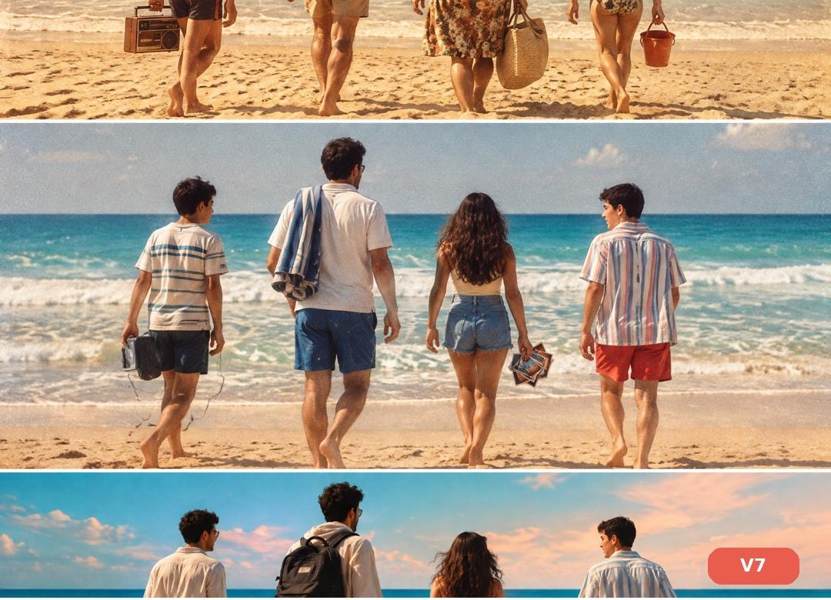
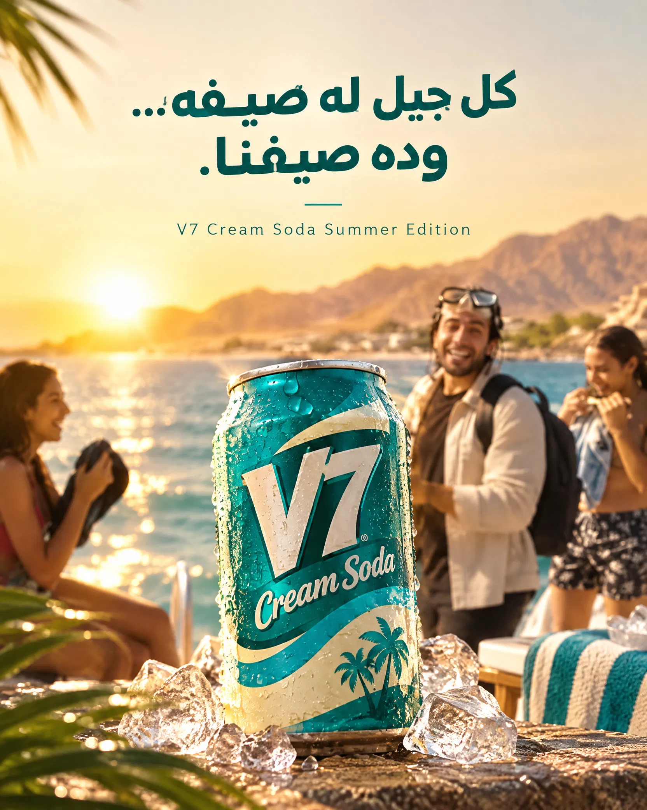
12 · EXECUTION — POST 3/5 & 4/5
V7 CREAM SODA | SUMMER EDITION CAMPAIGN
Product Experience & Engagement
🎥 REEL · 20s
🖼 CAROUSEL · 6 slides
Product Experience
Engagement
IDEA
IDEA
Montage across Sahel, Sharm, Matrouh and Hurghada — different places, same feeling: “V7 Cream Soda — our generation’s summer.” V7 present in every trip.
“Which summer is yours?” — a simple question inviting every age group to share their kind of summer. Closes on: V7 is there. #صيف_كل_جيل
15

Slide 16
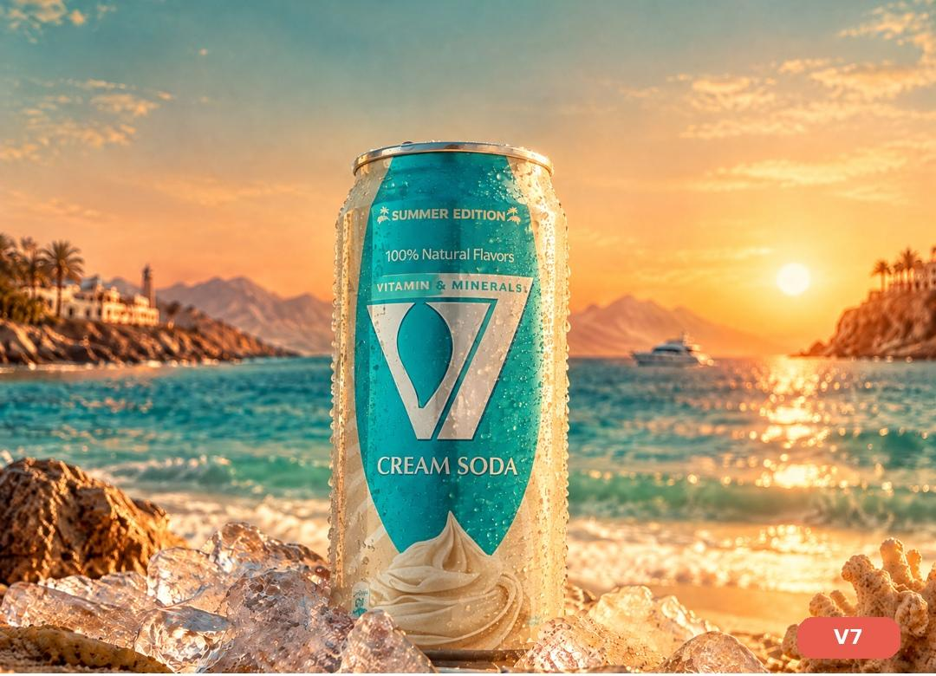
12 · EXECUTION — POST 5/5 & HERO FILM
V7 CREAM SODA | SUMMER EDITION CAMPAIGN
CTA & Hero Film
▪ STATIC
HERO FILM · 0:00–0:45
CTA
0–6s
Ras El Bar/Gamasa — a kid running on sand, old radio, generic bottle on a plastic table: “Every generation had its summer...”
6–16s
Agami/Marina → match cuts: radio→speaker, printed photo→phone, old car→modern car, cup→V7 in ice
16–32s
Sahel → Sharm/Matrouh/Hurghada quick montage → back to Sahel: a guy opens the cooler, pulls out V7, opens it
32–45s
“And now... it’s our turn.” Hero product shot in ice and sand — “Every generation has its summer... this is ours.”
16

Slide 17
13 · EXECUTION
V7 CREAM SODA | SUMMER EDITION CAMPAIGN
Content Calendar — Launch Week
Day | Time | Post | Format | Why This Timing
Saturday | 8:00 PM | Hero Film — Launch | Video | Opens the campaign with its strongest visual asset
Sunday | 12:00 PM | Teaser | Reel | Builds curiosity after the launch buzz
Monday | 6:00 PM | Reveal | Reel | Reveals “now it’s our turn”
Tuesday | 7:00 PM | Product Experience | Reel | Spotlights the four destinations
Thursday | 6:00 PM | Engagement | Carousel | Pre-weekend — drives engagement across all ages
Friday | 10:00 AM | CTA | Static | Peak purchase-intent moment — actual travel day
Saturday | All day | UGC Repost | Story | Extends campaign life, closes the engagement loop
17

Slide 18
14 · CASE STUDY
V7 CREAM SODA | SUMMER EDITION CAMPAIGN
Why This Campaign Works
Cultural Insight
Every Egyptian generation has its own real summer spot — Ras El Bar, Agami, the North Coast — and the memories tied to it.
✓
Creative Idea
“Every generation has its summer” — a journey through 3 real generations that lands on V7 as our generation’s drink, with no historical overreach.
✓
Brand Role
V7 is the current generation’s drink. It appears in our generation’s scenes only, and unifies 4 different destinations under one feeling.
✓
Content System
Hero Film + Teaser + Reveal + Product Experience + Engagement + CTA.
✓
Production Value
Historical / Product / Visual / Editing locks, a sound identity per generation, full historical honesty.
✓
18

Slide 19
SUMMARY
V7 Cream Soda — Campaign Complete
✓
Objective, Audience (3 generations), Big Idea (“Every generation has its summer... this is ours.”)
✓
Full 3-generation journey (Zaman, 90s, Our Generation) + 4 destinations for Our Generation
✓
Match Cuts + Sound Identity + Production Locks (full historical honesty)
✓
5 posts + Content Calendar + Hero Film (45s) + 3 video scripts
✓
Closing Case Study explaining the creative & cultural logic
V7 Cream Soda · Summer Edition 2026 — Every Generation Has Its Summer

