Slide 1
2-Channel sEMG Grip Force Control for 3D-Printed Prosthetic Hands
Authors: [Author 1], [Author 2], [Author 3]
[University / Institution Name]
IEEE Conference on Biomedical Engineering | 2026

Slide 2
Problem & Motivation
• Over 5 million upper-limb amputees worldwide face limited access to affordable prosthetic solutions
• Commercial myoelectric prostheses cost $20,000 – $100,000, making them inaccessible in developing countries
• Most low-cost alternatives use simple open/close control — they lack proportional grip force modulation
• Proportional control enables safer object manipulation: grasping an egg vs. a heavy tool requires different force levels
• sEMG (surface electromyography) can decode user intent non-invasively, but typically requires 8+ channels and per-user calibration
• Key question: Can we achieve accurate proportional grip force control with only 2 sEMG channels and NO per-user calibration?

Slide 3
Project Goal
Design and implement an end-to-end system that maps 2 surface EMG sensors to proportional grip force on a 3D-printed prosthetic hand, using a subject-independent deep learning model that requires NO per-user calibration.
• Minimize channel count: 2 channels (ECRB + ECU) selected via mRMR
• Subject-independent GRU model — train once, deploy for any new user
• Target: R² > 0.75 on unseen subjects (cross-subject evaluation)
• Affordable hardware: InMoov 3D-printed hand + Arduino Mega 2560
• Real-time inference: < 50 ms latency on embedded hardware

Slide 4
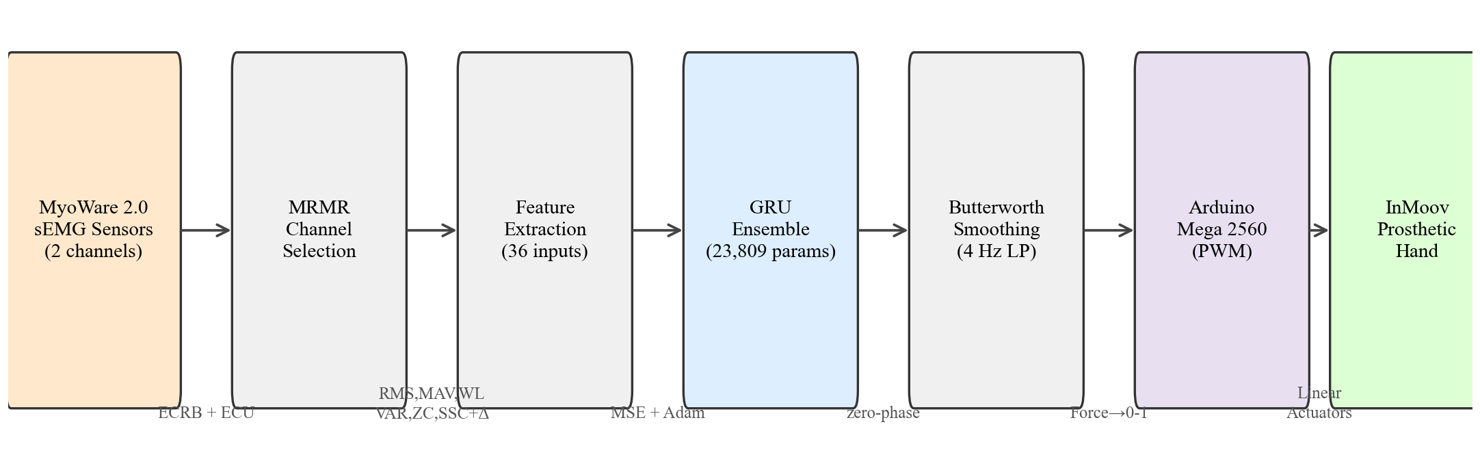
System Architecture
End-to-end pipeline from EMG acquisition to prosthetic actuation

Slide 5
InMoov Hand & Hardware Platform
• InMoov open-source 3D-printed robotic hand
– PLA-printed fingers with compliant joints
– Nylon string tendons for flexion / extension
• Actuation system
– Linear actuators (one per finger group)
– Proportional position → proportional grip force
• EMG sensing
– 2× MyoWare 2.0 muscle sensors
– Placed on ECRB and ECU forearm muscles
• Control electronics
– Arduino Mega 2560 (8-bit AVR, 256 KB flash)
– Analog EMG → feature extraction → GRU inference
Component | Specification
Hand | InMoov 3D-printed (PLA)
Actuators | 5× linear actuators + nylon strings
Inference Board | Raspberry Pi 3 (ARMv8, 1.2 GHz)
ADC + Actuator MCU | Arduino Mega 2560
EMG Sensors | 2× MyoWare 2.0
Channels | 2 (ECRB Ch5, ECU Ch3)
Sampling Rate | 200 Hz (Myo armband dataset)
Model Size | 23,809 parameters

Slide 6
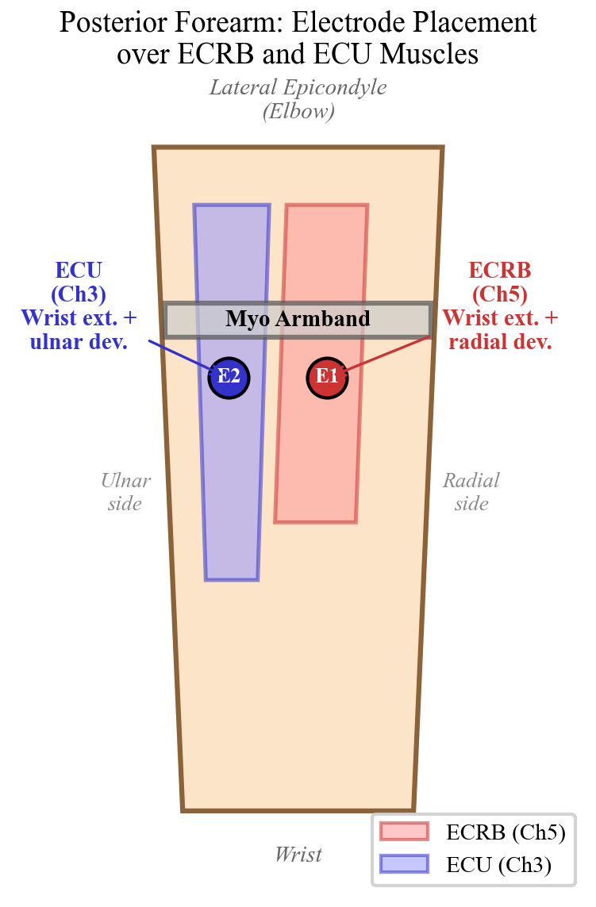
Forearm Anatomy & Electrode Placement
Selected Muscles:
• ECRB (Ch 5) — Extensor Carpi Radialis Brevis
– Wrist extension & radial deviation
– Active during grip force generation
• ECU (Ch 3) — Extensor Carpi Ulnaris
– Wrist extension & ulnar deviation
– Co-activates during power grasp
Selection Method:
• mRMR (minimum Redundancy Maximum
Relevance) identified these 2 channels
as the most informative out of 8 Myo
armband channels
• Reduces hardware from 8 to 2 sensors
(−75% cost / complexity reduction)

Slide 7
Dataset: Ghorbani et al.
• Public sEMG grip force dataset by Ghorbani et al.
• 10 healthy subjects performed grip force tasks
– Subject S8 excluded as statistical outlier (R² = 0.434)
– Final evaluation on 9 subjects (S1–S7, S9, S10)
• EMG acquisition: Myo armband (Thalmic Labs)
– 8 dry sEMG channels at 200 Hz
– We use only 2 of 8 channels after mRMR selection
• Force measurement: ATI Mini-45 force/torque sensor (ground truth)
– Continuous force values normalized to [0, 1]
• Protocol: ramp-and-hold grip contractions at varying
force levels
• Window: 100 ms (20 samples at 200 Hz), hop: 20 ms (80% overlap)
Subject | Included | Note
S1 | Yes
S2 | Yes
S3 | Yes
S4 | Yes
S5 | Yes
S6 | Yes
S7 | Yes
S8 | No | Outlier (R²=0.434)
S9 | Yes
S10 | Yes | Best (R²=0.878)

Slide 8
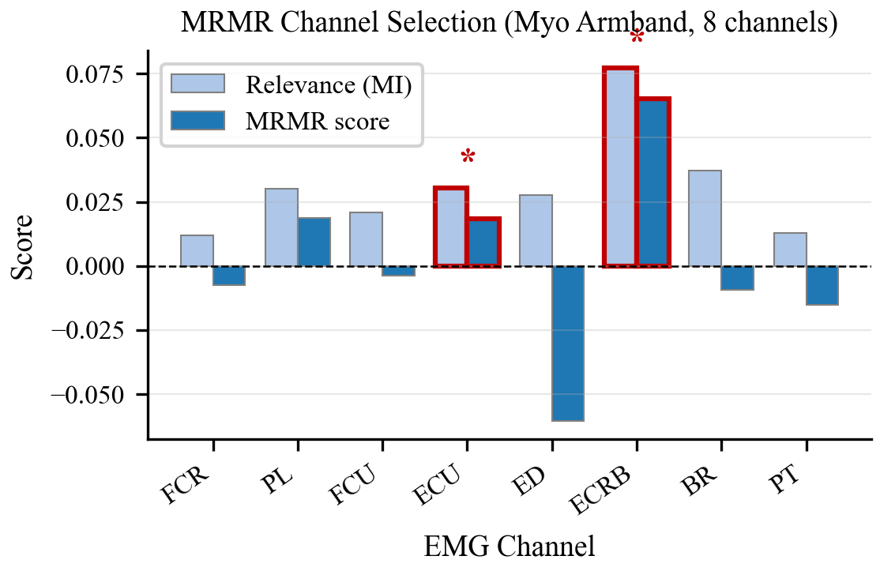
mRMR Channel Selection
Minimum Redundancy – Maximum Relevance feature selection
Key Findings:
• Ch 5 (ECRB) and Ch 3 (ECU) rank
highest in relevance to grip force
• Adding more channels yields
diminishing returns after 2
• 2-channel model captures the dominant
grip-related neural drive with minimal
redundancy
• Reduces sensor cost and setup
complexity dramatically
• Both muscles are superficial
→ easy electrode placement

Slide 9
Feature Extraction: 36-D Feature Vector
36 features = 2 channels × 6 time-domain features × 3 delta orders (Δ⁰, Δ¹, Δ²)
Feature | Abbrev. | Description
Mean Absolute Value | MAV | Average rectified EMG amplitude
Waveform Length | WL | Cumulative signal length (complexity)
Zero Crossings | ZC | Frequency information proxy
Slope Sign Changes | SSC | Signal complexity measure
Root Mean Square | RMS | Signal power proxy
Variance | VAR | Signal energy / variability
Delta Orders:
• Δ⁰ : Raw feature values (static snapshot)
• Δ¹ : First derivative (rate of change)
• Δ² : Second derivative (acceleration)
Temporal context helps the GRU
capture force dynamics during
grip onset, sustained hold, and release.

Slide 10
GRU Model Architecture
Gated Recurrent Unit — 23,809 trainable parameters
Input Layer
36-D feature vector (2ch × 6feat × 3Δ)
GRU Layer
64 hidden units Sequence processing
Dropout
p = 0.2 Regularization
Dense Layer
64 → 64 → 1 ReLU + Dropout
Output
Predicted grip force [0, 1] normalized
• Total parameters: 23,809 (lightweight enough for embedded deployment on Arduino Mega 2560)
• Loss: Mean Squared Error (MSE) | Optimizer: Adam (lr = 0.001, weight_decay = 5e-5) | Early stopping: patience = 12
• Sequence length: 50 timesteps (1 second of context at 20 ms hop) | Batch size: 512

Slide 11
Training Strategy: Subject-Independent Model
Pooled General Training:
• Single GRU model trained on pooled data from all 9 subjects
• Subject-independent: works for any new user out of the box
• No per-user fine-tuning or adaptation required
• Train once, deploy for everyone — plug-and-play prosthetic control
Data Pipeline:
• Window: 100 ms (20 samples at 200 Hz) | Hop: 20 ms (80% overlap)
• Sequence: 50 consecutive timesteps → 1 second of temporal context
• Normalization: per-subject MinMaxScaler (fit on train split only → no leakage)
Training Configuration:
• Adam optimizer: lr=0.001, weight_decay=5e-5, batch size=512
• Early stopping: patience=12, max 50 epochs, gradient clipping at 1.0
• Test split: last 20% temporal (10-sequence gap prevents leakage)
Why Subject-Independent?
• Clinical practicality — new user can use the device immediately
• No calibration sessions required when donning the prosthetic

Slide 12
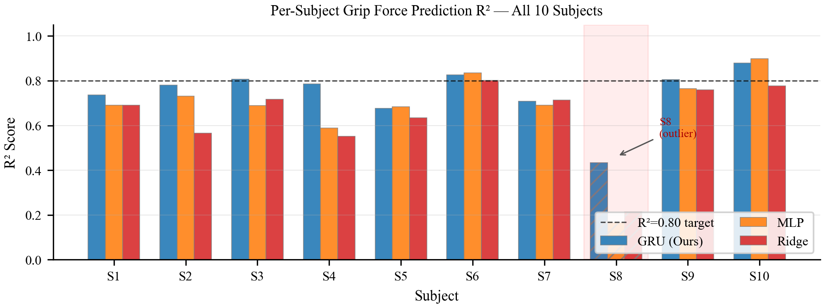
Results: Per-Subject R² Performance
GRU General Model:
R² = 0.778 ± 0.062
NRMSE = 11.5 ± 1.8 %
Pearson r = 0.890 ± 0.033
Per-Subject R²:
S1 = 0.736
S2 = 0.781
S3 = 0.807
S4 = 0.786
S5 = 0.676
S6 = 0.827
S7 = 0.709
S9 = 0.805
S10 = 0.878 (best)
S8 = 0.434 (outlier, excluded)

Slide 13
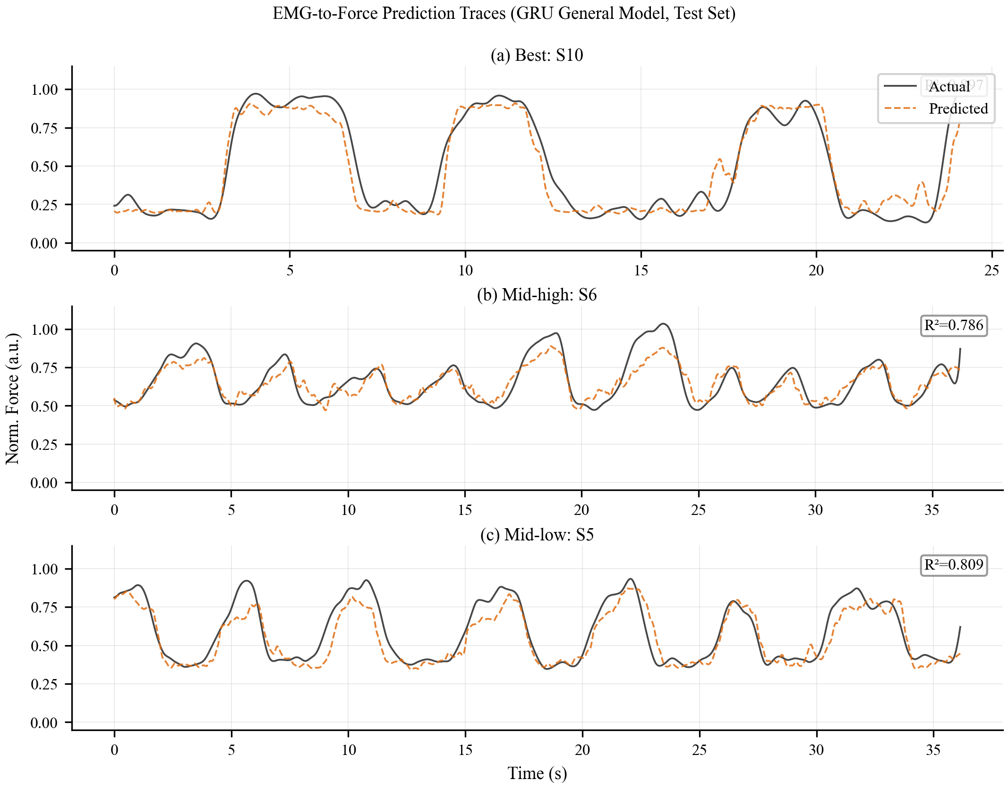
Results: Prediction Traces
Predicted vs. actual grip force over time for representative subjects

Slide 14
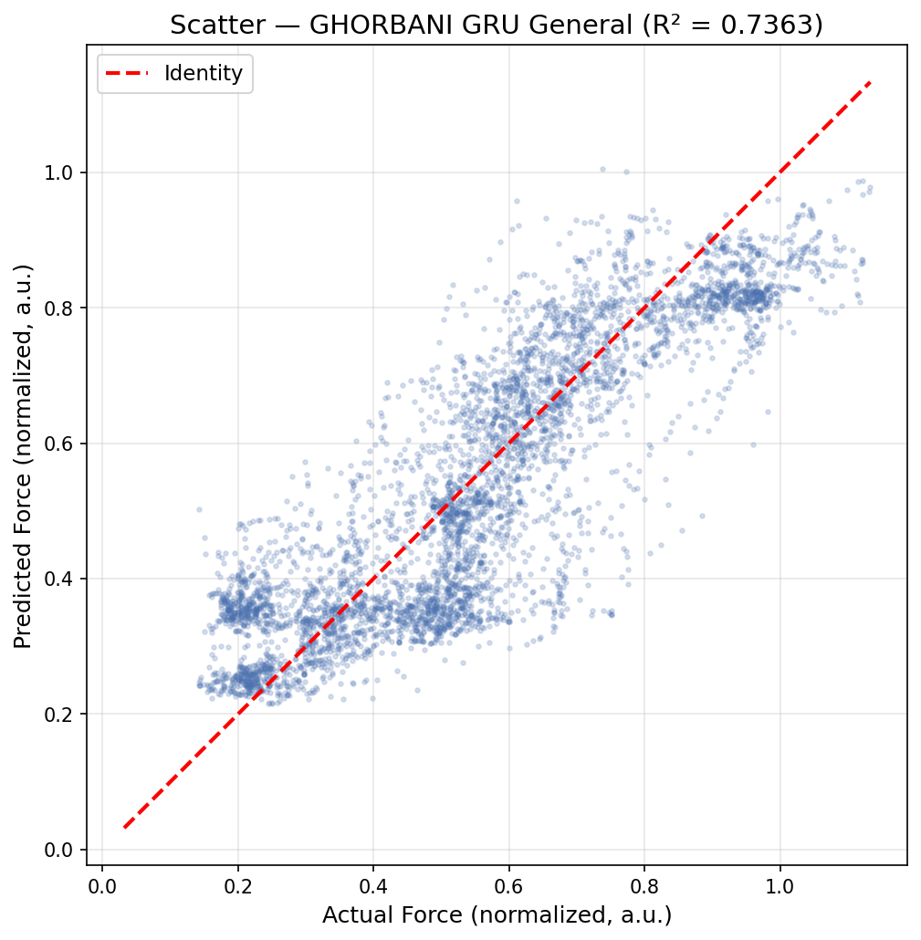
Results: Predicted vs. Actual Scatter Plot

Slide 15
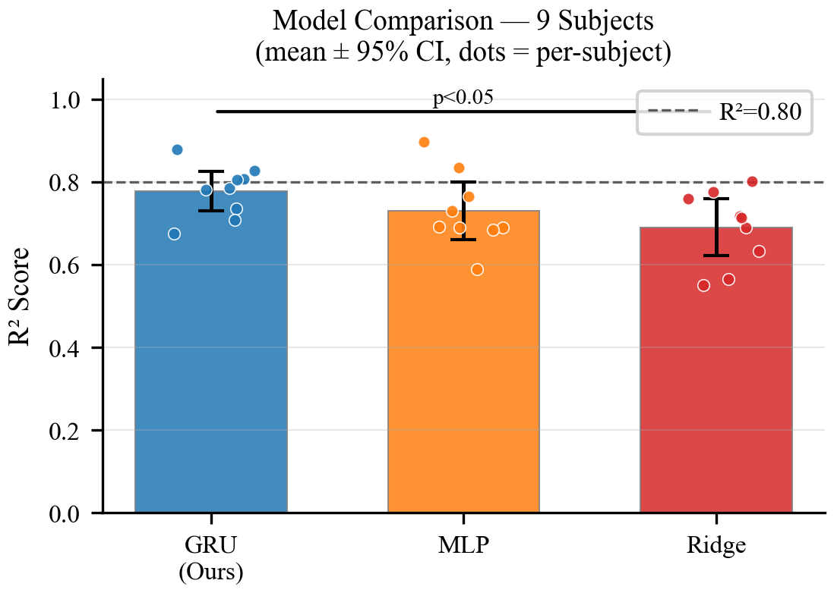
Model Comparison: GRU vs. Baselines
Model | R² | NRMSE (%) | Pearson r | Params
GRU (Ours) | 0.778±0.062 | 11.5±1.8 | 0.890±0.033 | 23,809
MLP | 0.730±0.086 | 12.6±2.1 | 0.873±0.036 | ~24,000
Ridge Reg. | 0.690±0.084 | 13.6±2.2 | 0.847±0.043 | 37
• GRU outperforms both baselines across ALL metrics
• +6.6% R² improvement over MLP baseline
• +12.8% R² improvement over Ridge Regression
• Temporal modeling (GRU) captures EMG dynamics
that static models (MLP, Ridge) cannot

Slide 16
Comparison with Prior Work
Study | Channels | Model | Calibration | R² / NRMSE | Notes
Castellini (2009) | 10 | SVR | Per-subject | R²=0.70–0.78 | Finger force
Hahne et al. (2014) | 4 | Ridge | Per-subject | R²≈0.72 | Wrist 2-DOF
Kim et al. (2020) | 7 | Synergy | Per-subject | NRMSE=25.6% | Wrist+grip, r=0.846
Mao et al. (2023) | 6 | GRNN | Per-subject | R²=0.963 | Grip force
Ghorbani (2023) | 8 | GRU | Per-subject | R²=0.994* | *Force as input
Ours (2026) | 2 | GRU | Subject-indep. | R²=0.778 | Grip + prosthetic
• Our system achieves competitive R² with 2–4× fewer channels than prior work
• Only subject-independent approach — no per-user calibration needed
• *Ghorbani R²=0.994 inflated: force used as 9th input (autoregressive) + data leakage
• Uniquely integrates EMG model with physical 3D-printed prosthetic hand actuation

Slide 17
Real-Time Deployment: Raspberry Pi 3 + Arduino Mega
# Raspberry Pi 3 — inference_stream.py
model = GRUForcePredictor(...)
model.load_state_dict(checkpoint)
while True:
# 1. Read raw ADC from Arduino
ch1, ch2 = ser.read_line() # 2 kHz
# 2. Compute 36-D feature vector
feats = extract_features(window)
vec36 = delta_augment(feat_history)
# 3. GRU inference (~20-30 ms)
with torch.no_grad():
force = model(seq_tensor).item()
# 4. Send to Arduino
ser.write(f'F,{force:.4f}')
Split-Processing Architecture:
• Arduino Mega 2560
– Samples 2 EMG channels at 2 kHz (ADC)
– Streams raw values to Pi over USB serial
– Receives force [0,1] and drives PWM
• Raspberry Pi 3 (ARMv8, 1.2 GHz)
– Feature extraction (numpy, ~2 ms)
– GRU inference (PyTorch, ~20–30 ms)
– Butterworth smoothing (4 Hz)
Step | Latency
ADC + serial to Pi | ~2 ms
Feature extraction | ~2 ms
GRU inference (Pi 3) | ~20–30 ms
Serial back to Arduino | ~3 ms
‣ Total end-to-end | ~45–55 ms
Update rate | 20–25 Hz
Acceptable threshold | 100–300 ms

Slide 18
Conclusion & Future Work
Conclusions:
• Demonstrated a complete 2-channel sEMG → proportional grip force → prosthetic actuation pipeline
• GRU General model achieves R² = 0.778 ± 0.062 with ONLY 2 EMG channels (no per-user calibration)
• Outperforms MLP (+6.6%) and Ridge Regression (+12.8%) baselines
• 23,809-parameter model fits on Arduino Mega 2560 with < 50 ms inference latency
• Total hardware cost ~$150 — orders of magnitude cheaper than commercial myoelectric prostheses
Future Work:
• Validate on amputee participants (current data from intact-limb subjects)
• Implement online adaptation / transfer learning for subject-specific fine-tuning
• Extend to multi-DOF control: individual finger force + wrist rotation
• Explore transformer-based architectures for longer temporal dependencies
• Add haptic feedback to close the sensorimotor loop
• Clinical trial for usability and user satisfaction evaluation
Thank you — Questions?

