Slide 1


K.RAMAKRISHNAN COLLEGE OF TECHNOLOGY
(AUTONOMOUS), TRICHY.
HOTEL MANAGEMENT SYSTEM
SUPERVISOR
Ms.S.UMA MAGESHWARI, M.E.,
AP/CSE.
PRESENTED
N.MOHAMED RAYAN
2303811720521030

Slide 2
PRESENTATION OVERVIEW
Objective
Project Introduction
Problem Statement
Methodologies (Programming concepts relevant to problem statement)
Architecture of the proposed system
List of Modules
Merits
Results and Discussion
Queries

Slide 3
OBJECTIVE
The objective of the Hotel Management System is to streamline and automate hotel operations, ensuring efficiency, accuracy, and customer satisfaction. It focuses on simplifying tasks like user management, room bookings, secure payments, and reporting while minimizing manual errors. By providing real-time updates and detailed analytics, the system helps administrators optimize resources and make informed decisions. Additionally, it offers a user-friendly interface and secure functionalities, catering to the needs of both customers and hotel staff, making it a comprehensive solution for modern hospitality management.

Slide 4
PROJECT INTRODUCTION
The Hotel Management System is a software solution designed to automate and streamline the core operations of a hotel. It aims to manage tasks such as room bookings, user registration, payment processing, and generating reports, all in a centralized system. The system offers real-time updates, ensuring smooth interactions between customers and administrators. By integrating features like secure payments, role-based user management, and data-driven reporting, the Hotel Management System enhances operational efficiency, improves decision-making, and provides a seamless experience for both hotel staff and guests.

Slide 5
PROBLEM STATEMENT
The problem addressed by the Hotel Management System is the inefficiency and error-prone nature of manual hotel operations, such as room bookings, payment processing, and report generation. These tasks, when handled manually, can lead to delays, inaccuracies, and poor decision-making. The system aims to automate and streamline these processes, ensuring real-time updates, secure transactions, and efficient resource management, ultimately improving both hotel operations and customer satisfaction.

Slide 6
METHODOLOGIES
Object-Oriented Programming (OOP):
The system uses OOP principles like encapsulation, inheritance, and polymorphism to model real-world entities such as rooms, users, bookings, and payments. This methodology ensures that the system is modular, reusable, and easier to maintain.
Structured Analysis and Design:
Structured Analysis and Design breaks the system into modules, ensuring each one works independently but integrates seamlessly, promoting efficient development.
Database-Driven Development:
It uses a relational database to efficiently manage and store data, with SQL queries handling operations like create, read, update, and delete (CRUD) for system data.
User-Centered Design (UCD):
It focuses on designing the system with the end-user in mind, ensuring an intuitive and seamless interface based on user feedback and needs.

Slide 7
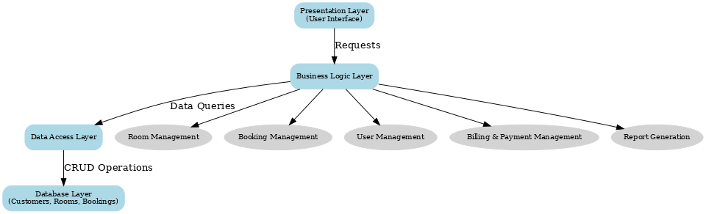
ARCHITECTURE OF THE PROPOSED SYSTEM

Slide 8
LIST OF MODULES
User Management Module:
The User Management Module ensures platform independence, robust security, real-time updates, and seamless database integration. It automates user tasks like registration and role management, making it scalable, efficient, and cost-effective for hotel operations.
Room Management Module:
The Room Management Module handles room allocation, availability, and maintenance with real-time updates, ensuring efficiency and seamless database integration.
Payment Module:
The Payment Module ensures secure transactions, supports multiple methods, and provides real-time updates with accurate database integration.
Reporting Module:
The Reporting Module generates detailed reports on bookings, payments, and user activity, supports real-time data, and aids decision-making with clear insights.

Slide 9
MERITS
The system is platform-independent, meaning it can run on any operating system (Windows, macOS, Linux) without requiring specific modifications, making it highly portable.
The system follows a modular approach, where each module (e.g., user management, room booking, payment processing) is independent. This makes it easier to update or extend functionality without affecting the entire system.
Scalability designed to handle increased workload and can easily scale as the hotel expands. Adding more users, rooms, or features can be done with minimal effort.
It supports real-time data processing, ensuring that information like room availability, booking statuses, and payments is always up-to-date, improving decision-making.

Slide 10
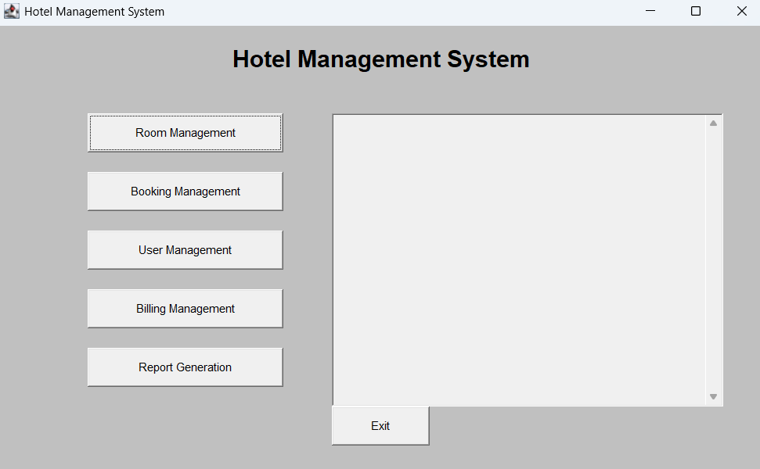
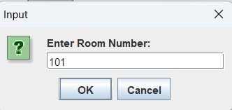
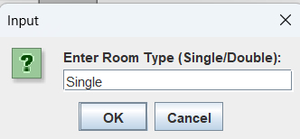
RESULTS AND DISCUSSION

Slide 11
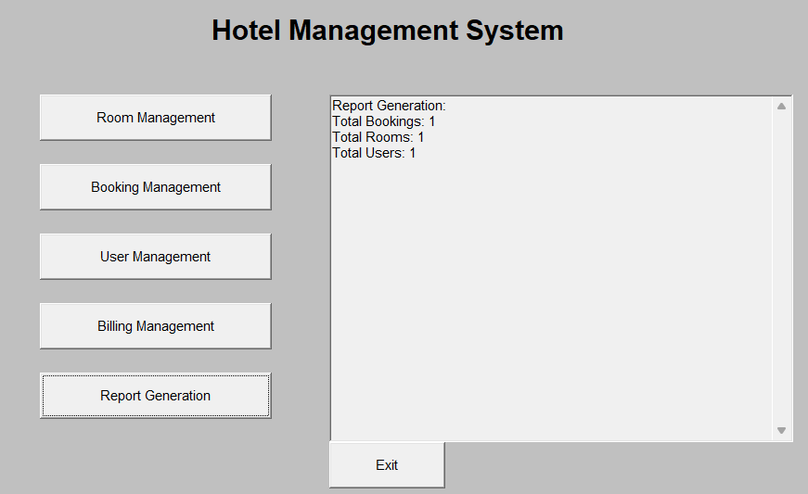
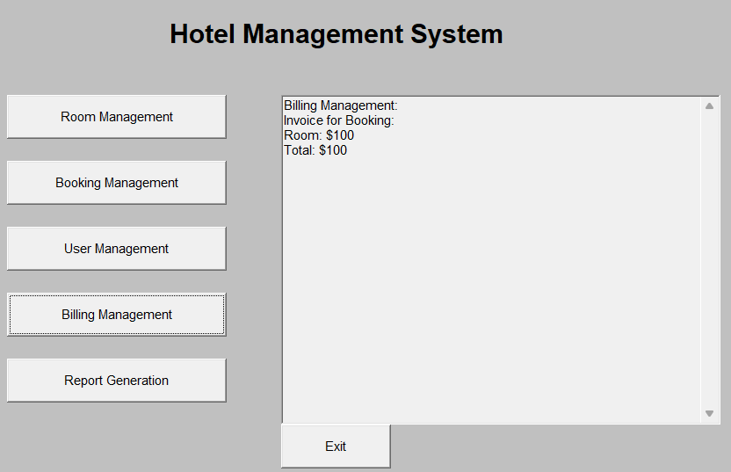
RESULTS AND DISCUSSION

Slide 12
QUERIES ?

