Slide 1
Data Analysis of
EGX30 Stock Trends
2021 – 2026
10 stocks • 5 sectors • 12,340 data points
Mohamed Reda • Yousef Mohamed • Taha Ahmed • Adham Abdo
Egypt University of Informatics - Data Analysis - Spring 2026

Slide 2
What We Set Out to Do
Are Egyptian stock prices actually going up, or is it just random noise? And when the pound crashes, does the whole market feel it, or just some sectors?
10 Stocks
5 Sectors
5 Years of Data
COMI, CIEB, CANA, TMGH,
PHDC, OCDI, ETEL,
HRHO, CCAP, SWDY
Banking, Real Estate,
Telecom, Finance,
Industry
Jan 2021 → Feb 2026
1,234 trading days
per stock
Our Pipeline
Clean Data
→
Explore Trends
→
Correlations
→
Hypothesis
Testing
→
Devaluation
Study
→
Prediction
Model

Slide 3
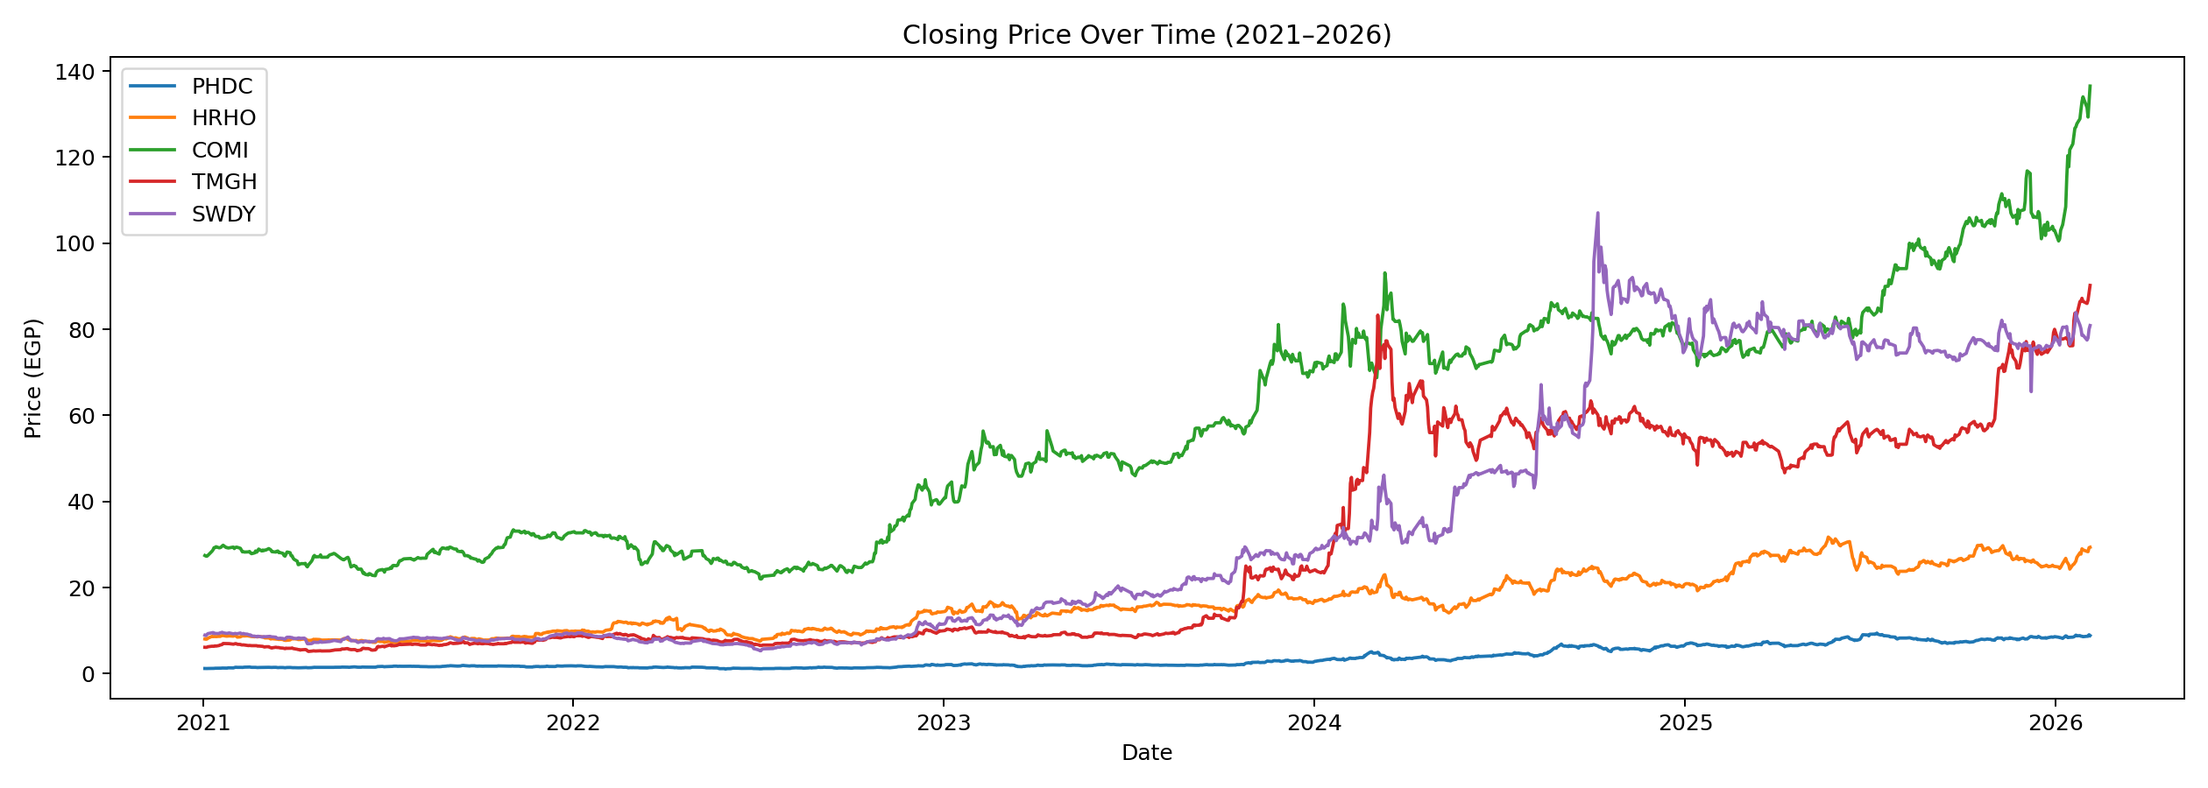
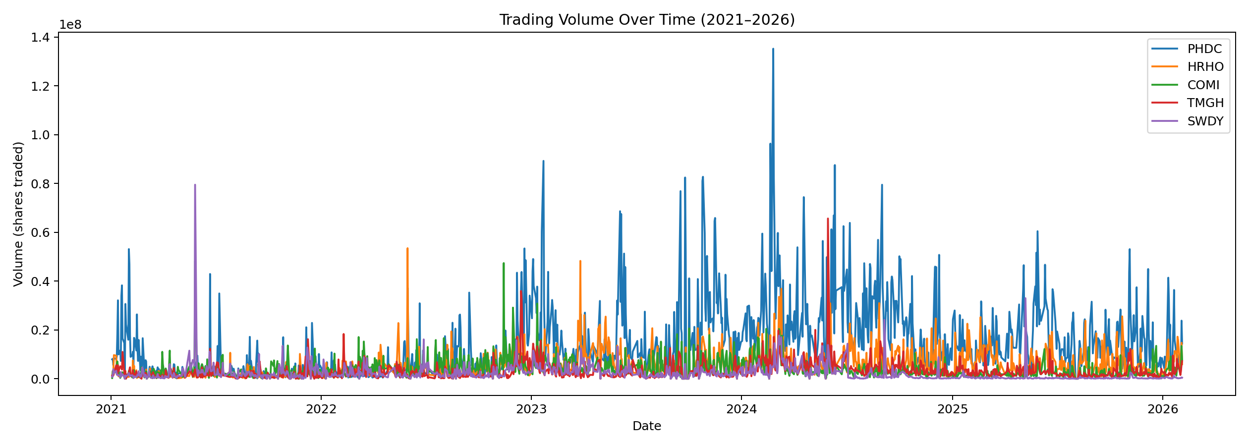
Price Trends & Trading Volume
What we see:
All five stocks went up over 5 years. TMGH and SWDY had the biggest jumps, but they also had the wildest swings. COMI was the steadiest performer, classic bank stock behavior.
PHDC dominates trading volume, it's by far the most actively bought and sold stock. Volume spikes happen across all stocks at the same time, which tells us the market reacts to big news as one unit, not stock by stock.

Slide 4
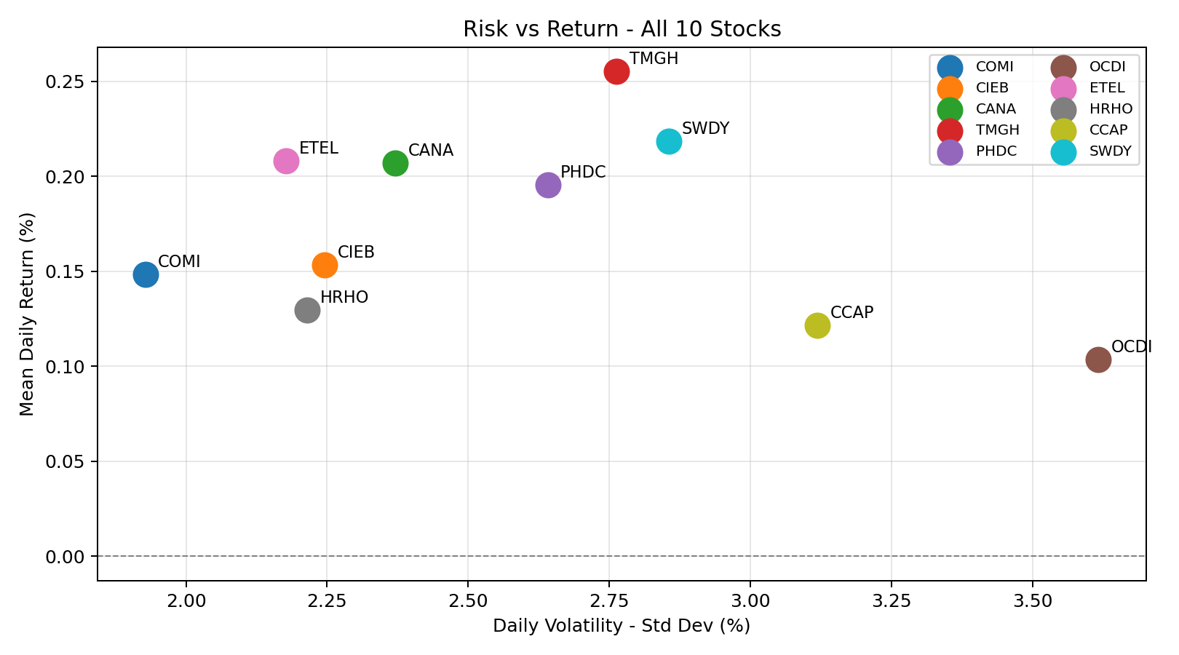
Risk vs Return — Who Rewards You Most?
Reading the Chart
Top-right = high reward, high risk (SWDY, TMGH)
Bottom-left = safer but lower returns (COMI, CIEB)
OCDI sits near zero, barely grew at all
No stock gives high reward with low risk, there's always a tradeoff
The numbers back this up: all 10 stocks have kurtosis above 3, meaning extreme days (big jumps or crashes) happen way more often than you'd expect. That's typical for emerging markets like Egypt, the ride is bumpier than average.

Slide 5
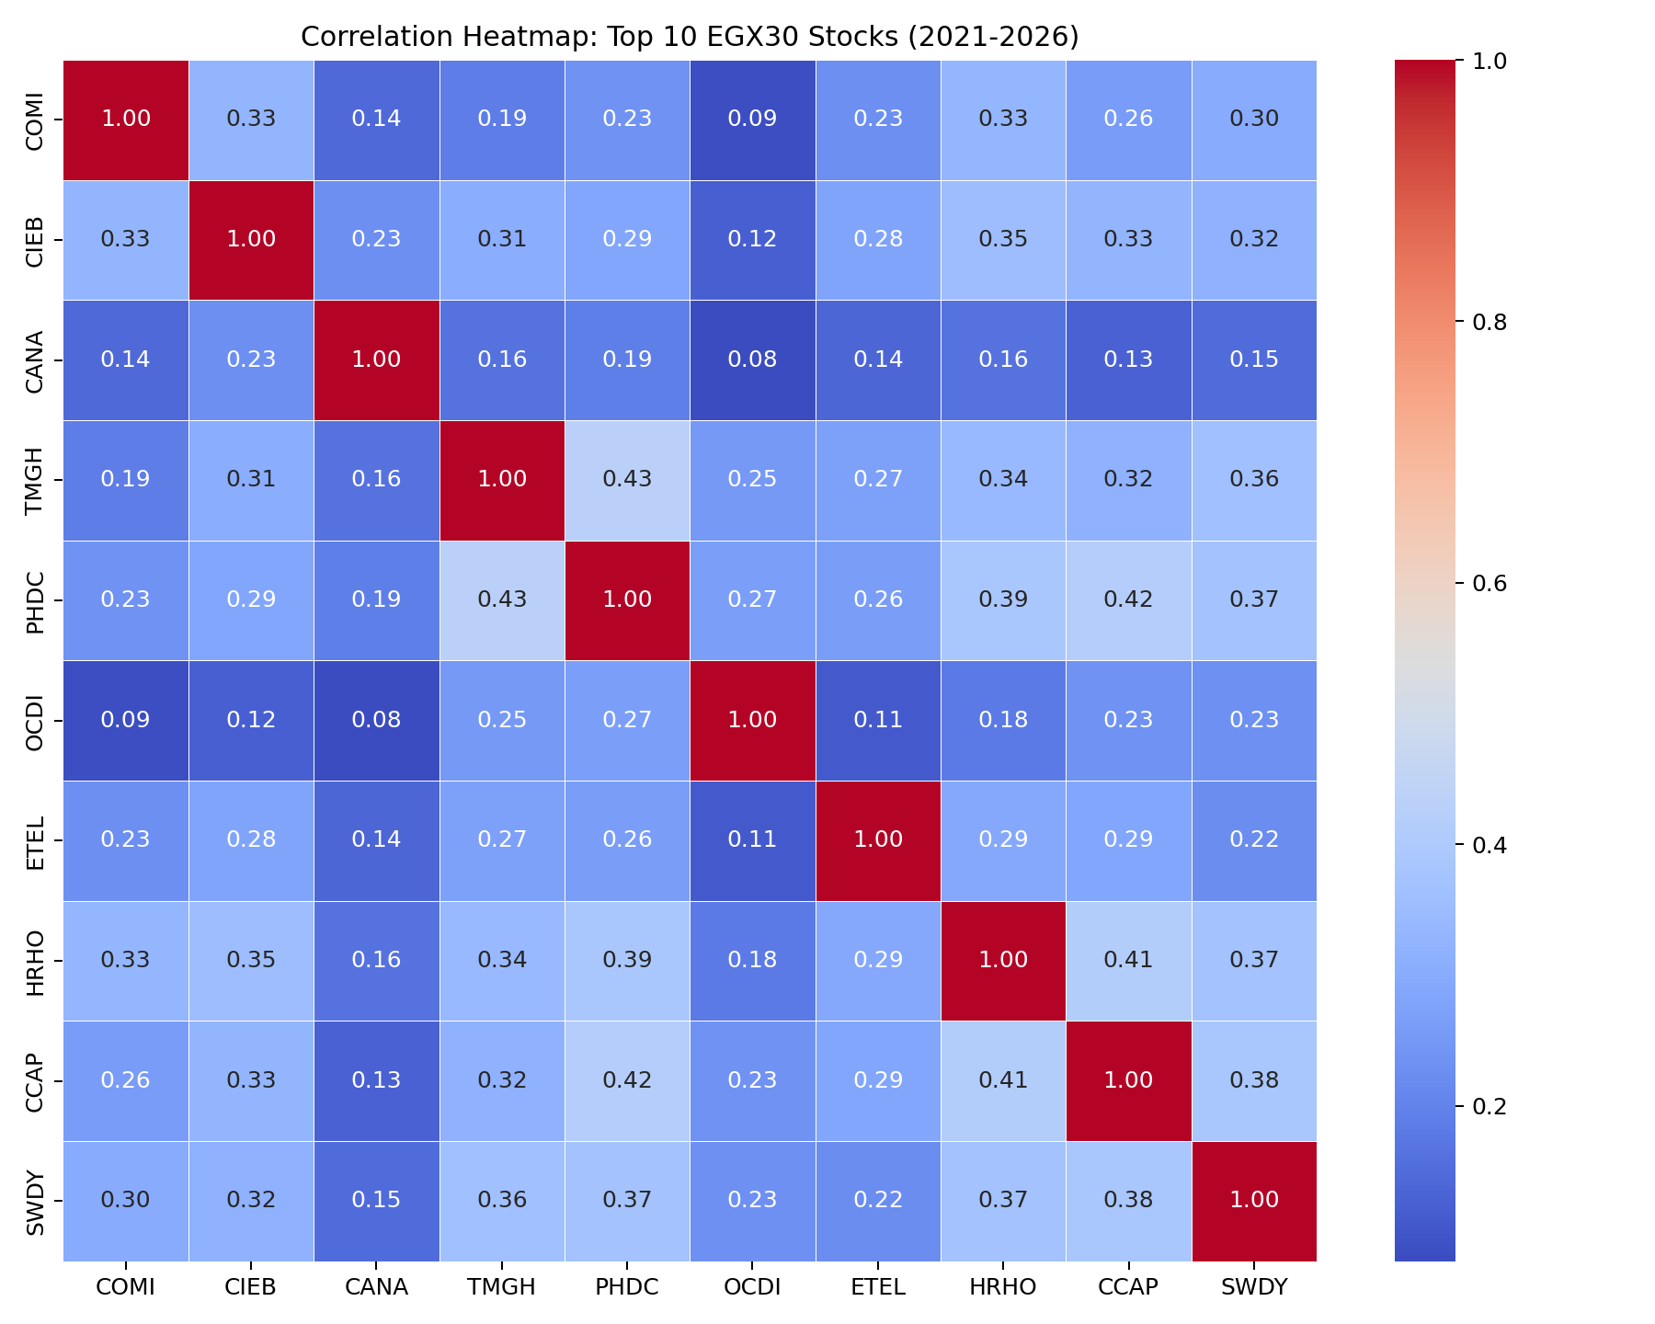
How Stocks Relate to Each Other
What the Heatmap Tells Us
Same sector stocks correlate more, TMGH & PHDC (real estate) hit 0.43, HRHO & CCAP (finance) hit 0.41
But even the strongest pair is only moderate, no two stocks move in perfect sync
CANA is the loner, barely correlates with anything else (0.08-0.23)
The overall pattern: stocks tend to drift in the same general direction, but each one has its own daily rhythm

Slide 6
Is the Growth Real? (Hypothesis Testing)
We asked: if a stock's average daily change is basically zero, then it's just random noise. If it's significantly above zero, the growth is real.
Test 1: Is each stock trending up?
Test 2: Do sectors move differently?
1-Sample T-Test: p < 0.05 means real trend
2-Sample T-Test: p > 0.05 means no difference
Stock | p-value | Verdict
PHDC | 0.009 | Real ✓
HRHO | 0.040 | Real ✓
COMI | 0.007 | Real ✓
TMGH | 0.001 | Real ✓
SWDY | 0.007 | Real ✓
Banking vs Real Estate
p = 0.803
No difference, they move together
Both sectors react the same way
to market events. The market is
one big wave, not separate pools.
All 5 tested stocks rejected H₀.
These trends are statistically real.
These aren't contradictory, Test 1 says "stocks are genuinely going up" and Test 2 says "they're all going up together." Same macro forces push everything.

Slide 7
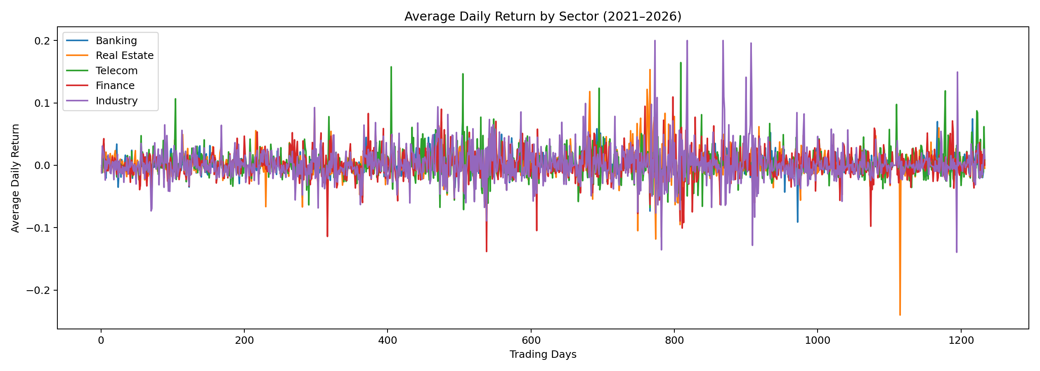
Sectors Move Together — Visual Proof
All five sector lines spike and dip at almost exactly the same time. Banking, Real Estate, Telecom, Finance, Industry. They all dance to the same beat. When the Central Bank makes a move or the pound crashes, nobody is spared. This is why sector diversification within EGX30 doesn't buy you much protection.

Slide 8
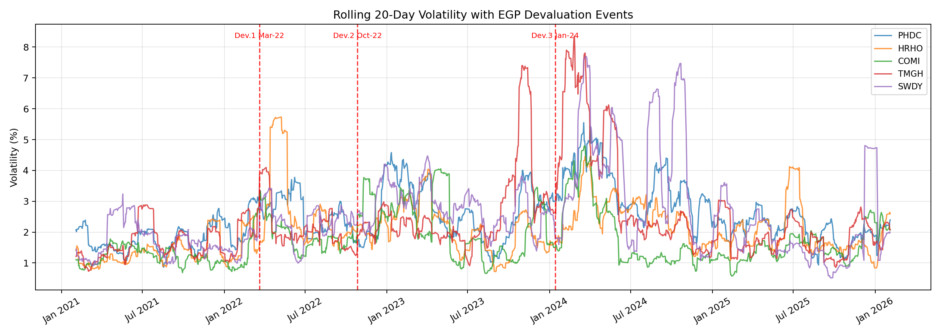
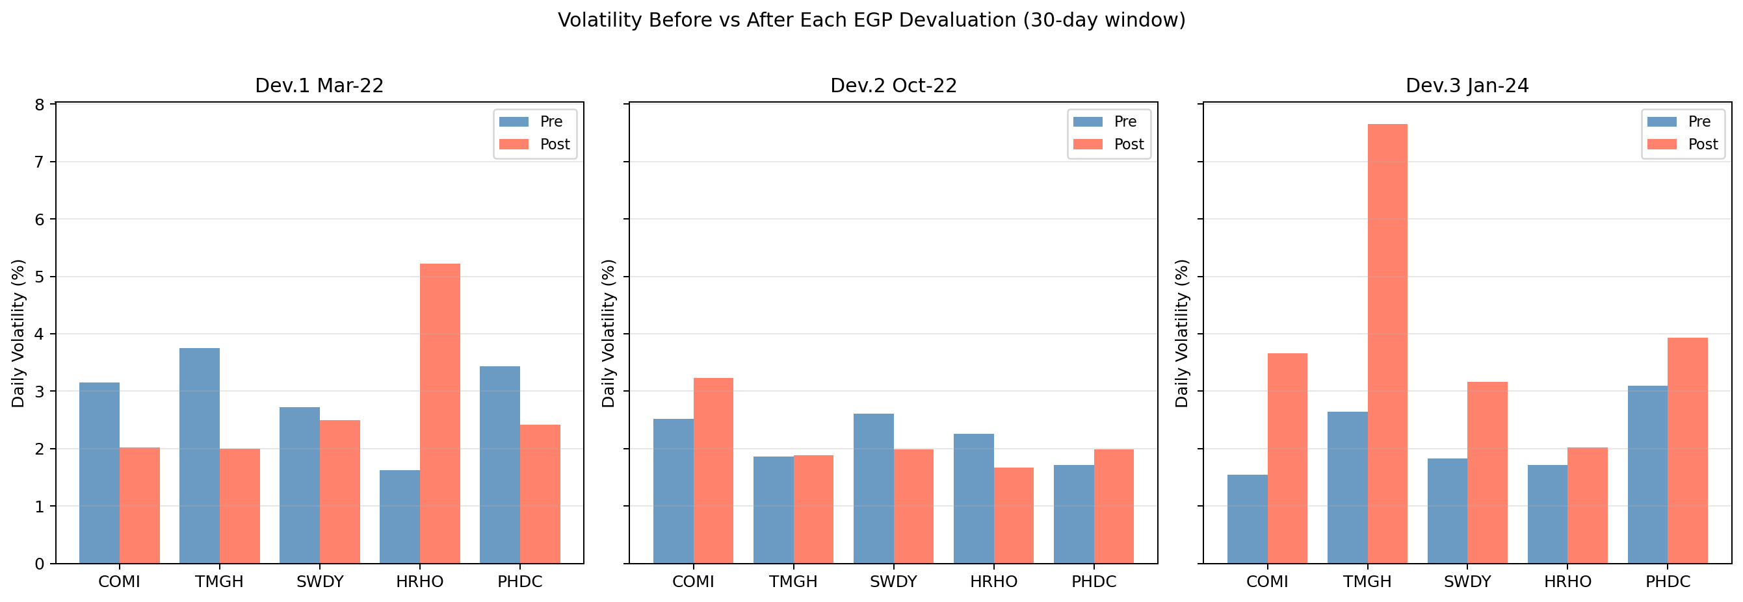
When the Pound Crashes — What Happens to Stocks?
3 Devaluations, 3 Shocks
Mar 2022
15.7 → 18.5 EGP/$
Moderate volatility spike
Oct 2022
18.5 → 23 EGP/$
Significant but short-lived
Jan 2024
30 → 50 EGP/$
Massive, doubled daily swings
Every devaluation hit all stocks,
not just banks or exporters.
Macro shocks ripple everywhere.

Slide 9
The Full Picture
1
The growth is real
All 5 tested stocks rejected H₀, their upward trends are statistically significant, not random luck.
2
The whole market moves together
No significant difference between sectors. When the Central Bank moves or the pound drops, every sector feels it equally.
3
Devaluations hit everyone
All three EGP devaluations caused volatility spikes across all stocks. Jan 2024 was the biggest shock, daily swings doubled overnight.
4
It’s all about the economy
EGP devaluations, inflation, and Central Bank policy are the real drivers, they explain both why stocks grew and why they all grew together.
Bottom line: understanding macro events - especially currency policy - matters more than any technical indicator for navigating the Egyptian market.

