Slide 1
AI STUDYBUDDY
AI-Powered Learning Assistant for Smarter Studying
TEAM LEADER
Kishore T
TEAM MEMBERS
Logeshwaran D Manikandan M Mohamed Safir M

Slide 2
Project Overview
AI StudyBuddy is an AI-powered learning assistance platform that helps students turn scattered study material into ready-to-use revision resources. Students upload notes or textbook content, and the backend automatically generates concise summaries, flashcards, quizzes and personalized study plans.
The system is built as a secure, modular REST API. Every request is authenticated with JWT, and all AI content generation is delegated to the Google Gemini API instead of relying on fixed templates — so the output adapts to whatever the student actually uploads.
TECHNOLOGY STACK
JS
Node.js + Express.js
DB
MongoDB + Mongoose
JW
JWT Authentication
BC
bcryptjs Hashing
AI
Google Gemini API
RB
Role-Based Access
RJ
React.js Frontend
2

Slide 3
The Problem
Case Study — Rahul, a second-year engineering student
Rahul is preparing for semester exams while also learning new skills for internships. His notes are scattered across PDFs, textbooks, articles and handwritten pages — and with limited time, organizing and revising all of it becomes a real challenge.
WHERE STUDENTS LIKE RAHUL GET STUCK
Understanding lengthy material within limited time
Manual note-making eats up most of the study time
Building flashcards & revision questions by hand is slow
No personalized plan based on time left before exams
No single, secure place to keep AI-generated resources
Hard to self-assess understanding before the real exam
Juggling separate apps for notes, quizzes and scheduling
3

Slide 4
Our Solution
AI StudyBuddy centralizes revision into one authenticated platform. Once a student uploads material, the backend takes over — calling Google Gemini to turn raw content into structured, exam-ready resources, and storing everything for later reuse.
WHAT THE BACKEND DOES, STEP BY STEP
1
2
3
4
5
Authenticates the student using a signed JWT access token
Stores uploaded study material in MongoDB
Sends the material to the Google Gemini API for processing
Generates a summary, flashcards, a quiz, or a study plan on request
Saves every generated resource for future retrieval and reuse
4

Slide 5
Key Features
JW
RB
UP
SU
Secure Authentication
Role-Based Access
Material Management
AI Summaries
JWT access & refresh tokens with bcrypt-hashed passwords.
Separate permissions for Student and Administrator roles.
Upload and organize study content as input for AI features.
Concise, easy-to-scan summaries of any uploaded material.
FC
QZ
SP
DB
AI Flashcards
AI Quizzes
AI Study Plans
MongoDB Storage
Auto-generated Q&A cards for active-recall revision.
Multiple-choice questions to self-test understanding.
Day-by-day schedules built around the student's exam date.
All resources persisted for future retrieval and reuse.
5

Slide 6
System Architecture
Modular REST API following the MVC pattern
CL
EX
AU
AI
DB
→
→
→
→
Client App
Express Server
Auth Middleware
AI Service Layer
Database Layer
React.js frontend
Routing & middleware
JWT verification, RBAC
Google Gemini API calls
MongoDB + Mongoose
WHY THIS SEPARATION MATTERS
Authentication, business logic, AI calls and database access sit in independent modules. Requests flow from the client through Express, get verified by the auth middleware, are handled by route controllers, and only reach the AI or database layers once authorized — keeping the codebase easy to extend, test and debug.
6

Slide 7
Database Design
MongoDB collections modeled with Mongoose
User
Study Material
Summary
name, email, password (hashed), role
userId, title, subject, content
userId, materialId, summary
Flashcard
Quiz
Study Plan
userId, materialId, question, answer
userId, materialId, questions[]
userId, studyPlan, examDate
KEY RELATIONSHIPS
User → Study Material : one-to-many
Study Material → Summary : one-to-one
Study Material → Flashcards : one-to-many
Study Material → Quiz : one-to-one
User → Study Plan : one-to-many
7

Slide 8
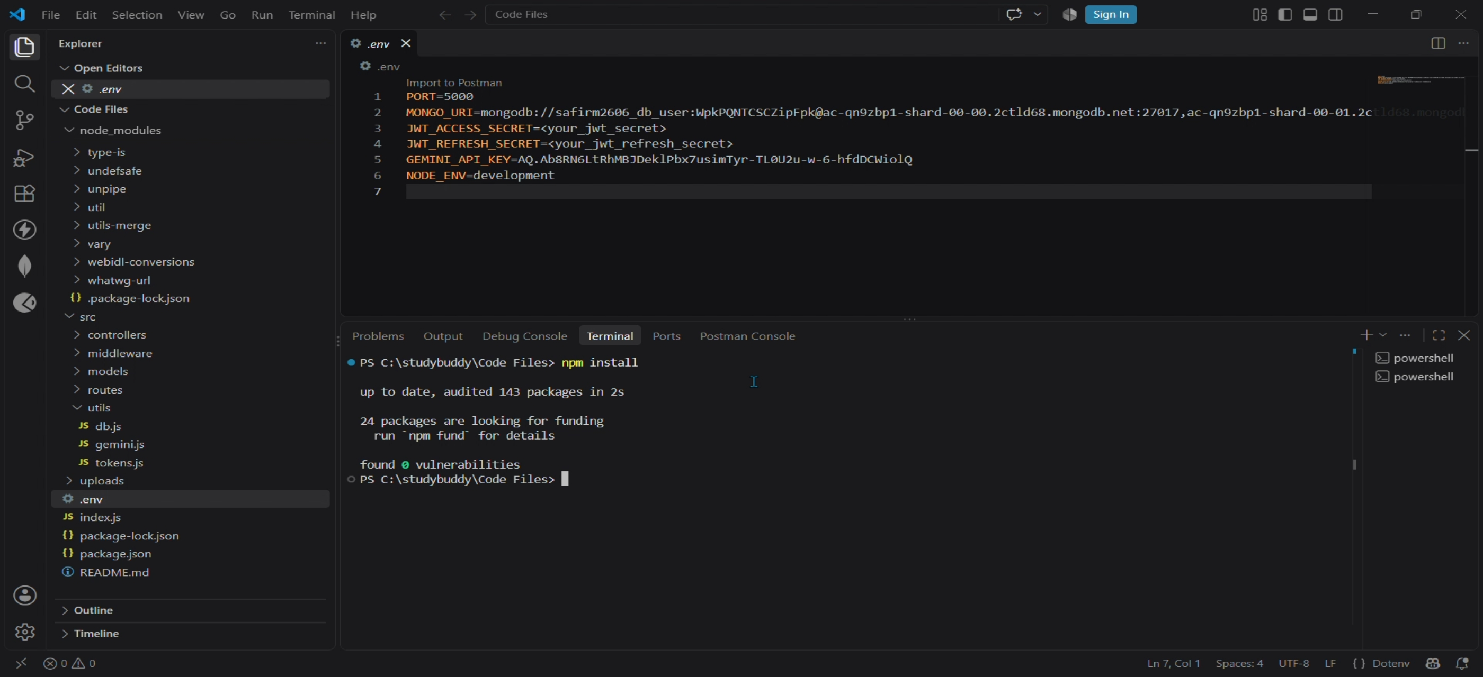
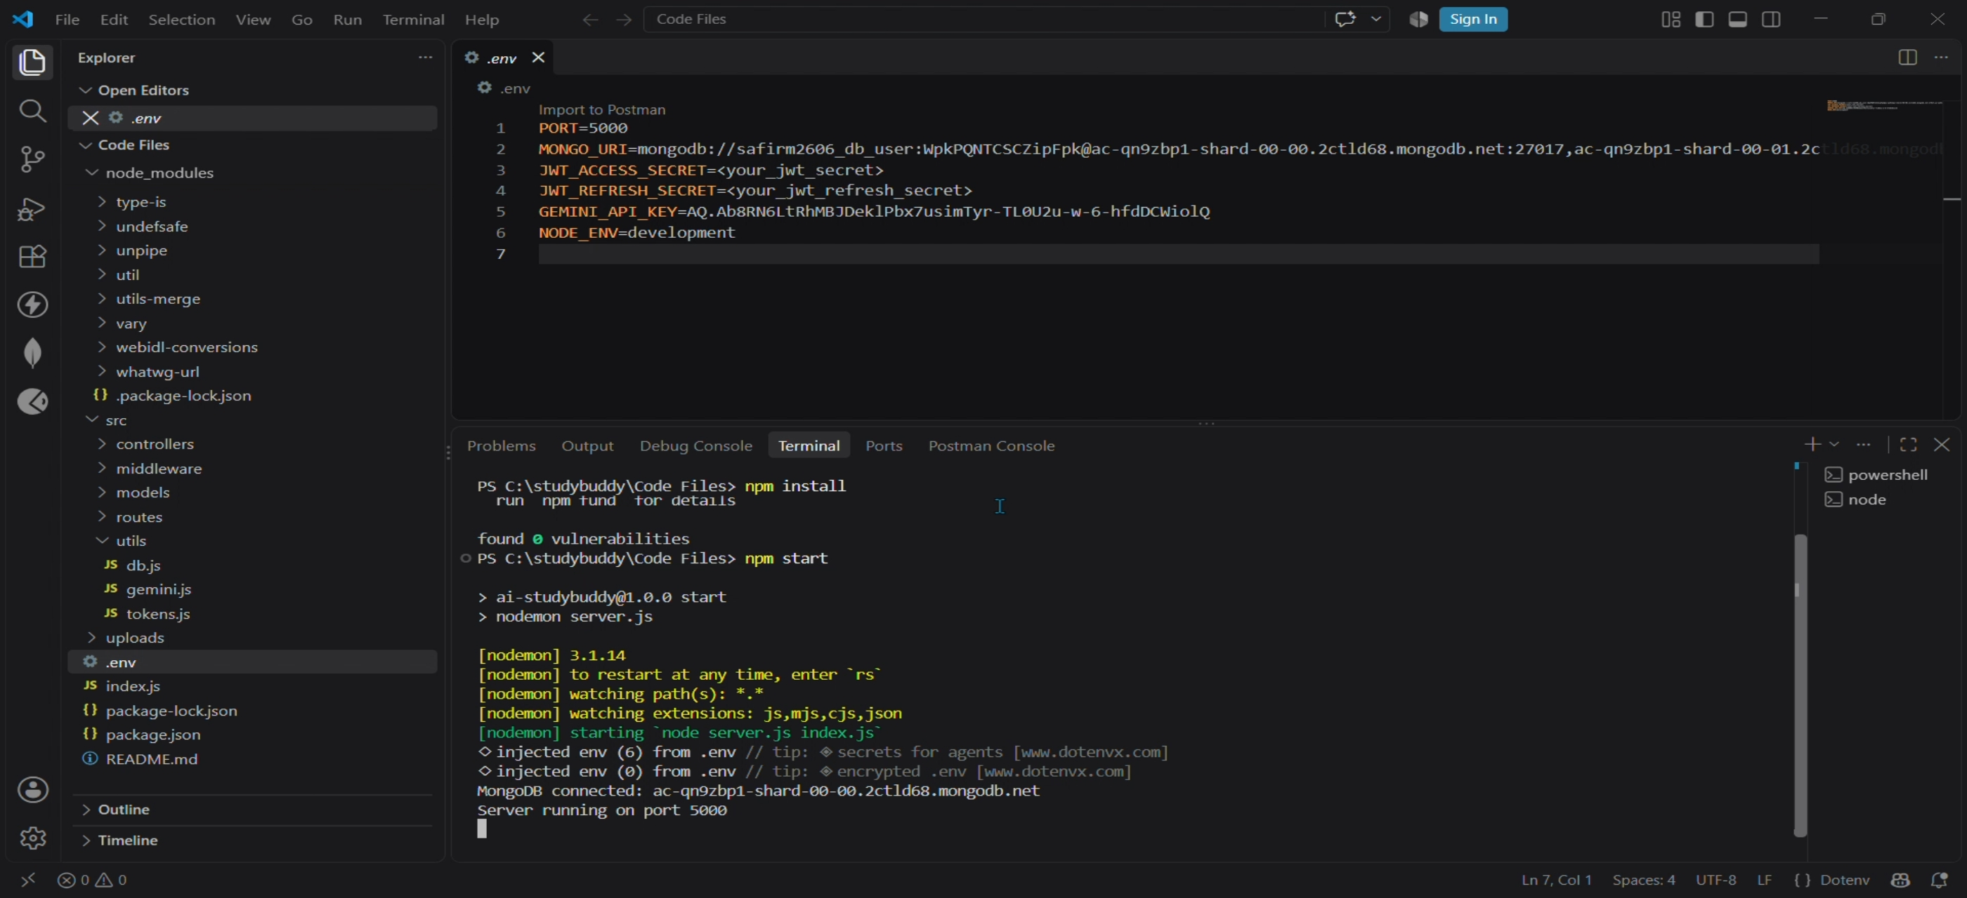
Project Setup & Running the Server
1. Installing dependencies
2. Starting the server
npm install pulls in Express, Mongoose, JWT, bcrypt, dotenv, multer and the Gemini SDK with zero vulnerabilities. Running npm start launches nodemon, which loads server.js, connects to the MongoDB Atlas cluster, and starts listening on port 5000 — confirming the backend is live and ready for requests.
8

Slide 9
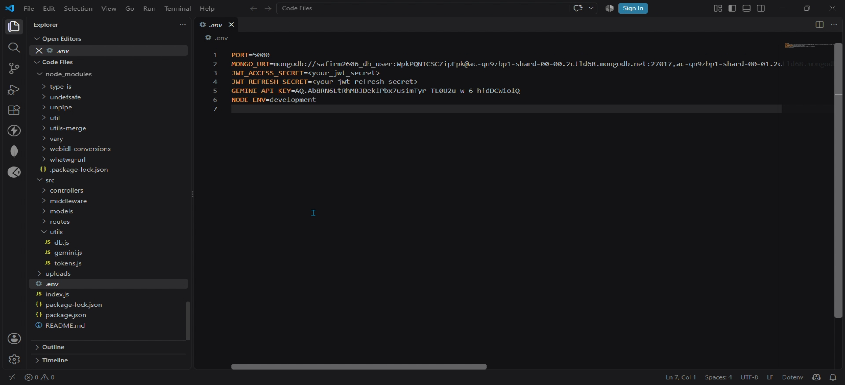
Environment Configuration
PORT — local port the Express server listens on
MONGO_URI — connection string for the MongoDB Atlas cluster
JWT_ACCESS_SECRET / JWT_REFRESH_SECRET — signing keys for access & refresh tokens
GEMINI_API_KEY — credential for calling the Google Gemini API
NODE_ENV — runtime mode (development / production)
.env file — Code Files
9

Slide 10
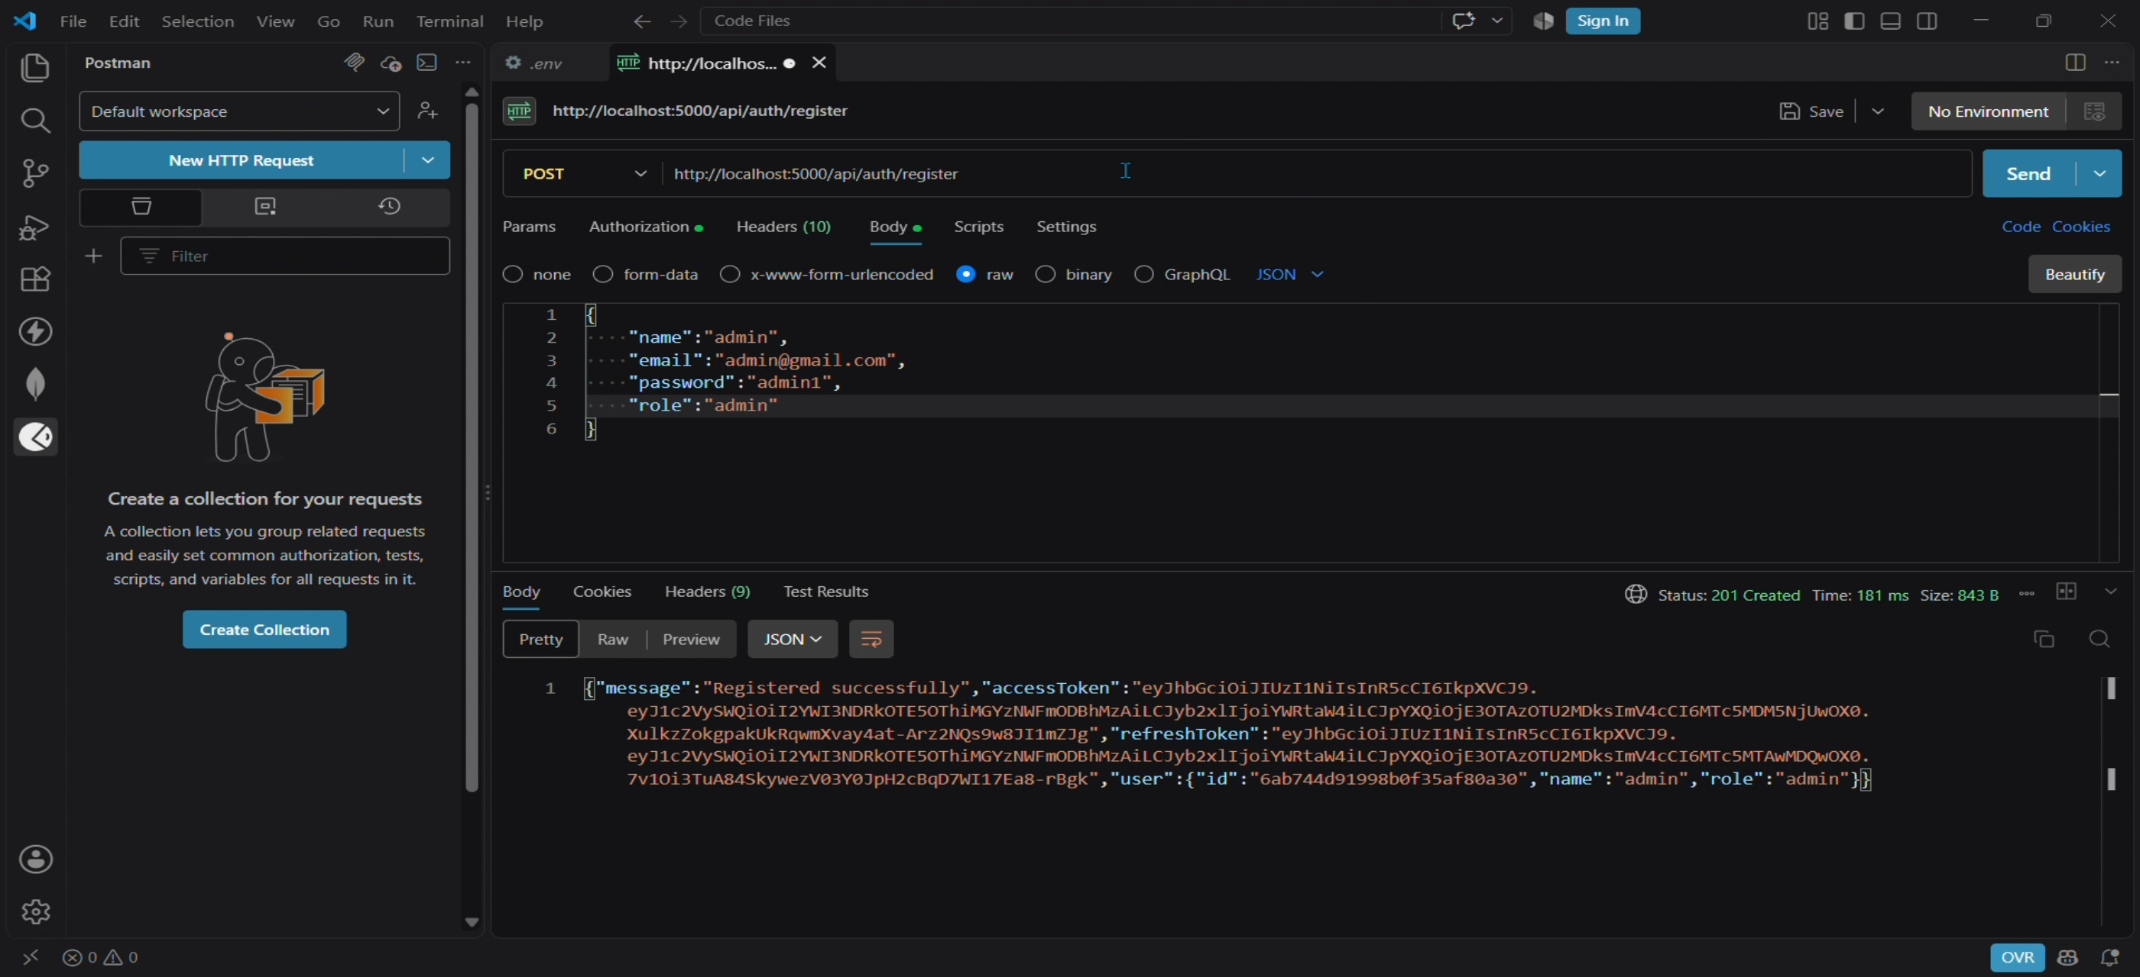
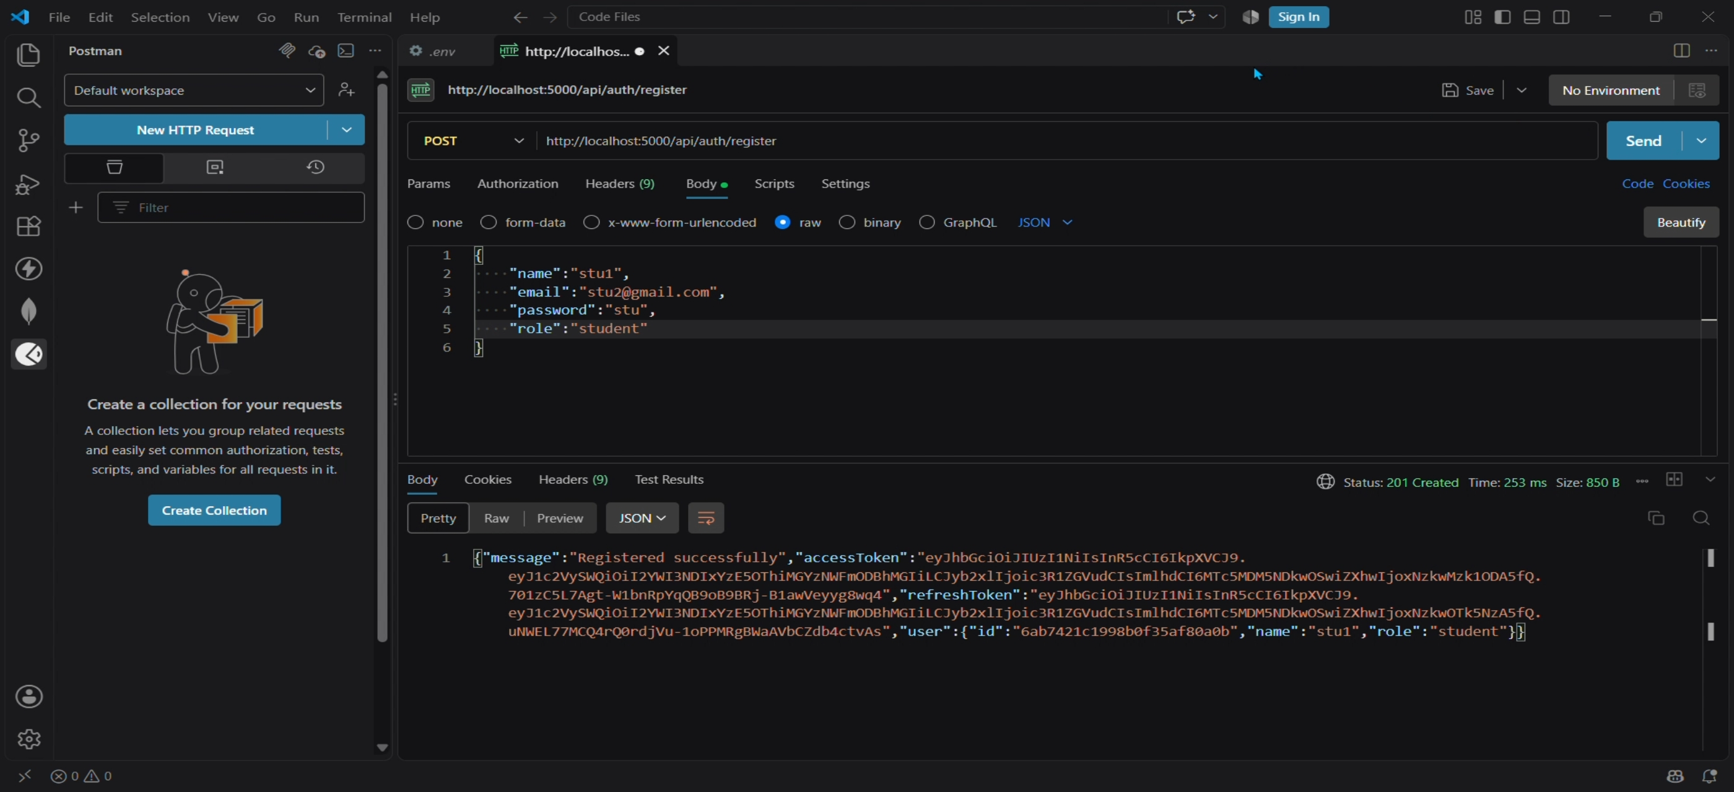
API Testing — User Registration
POST /api/auth/register
201 Created
201 Created
Admin account
Student account
The register endpoint accepts a name, email, password and role. Passwords are hashed with bcrypt before they ever touch the database, and a signed access + refresh token pair is returned immediately — shown here creating both an admin and a student account.
10

Slide 11
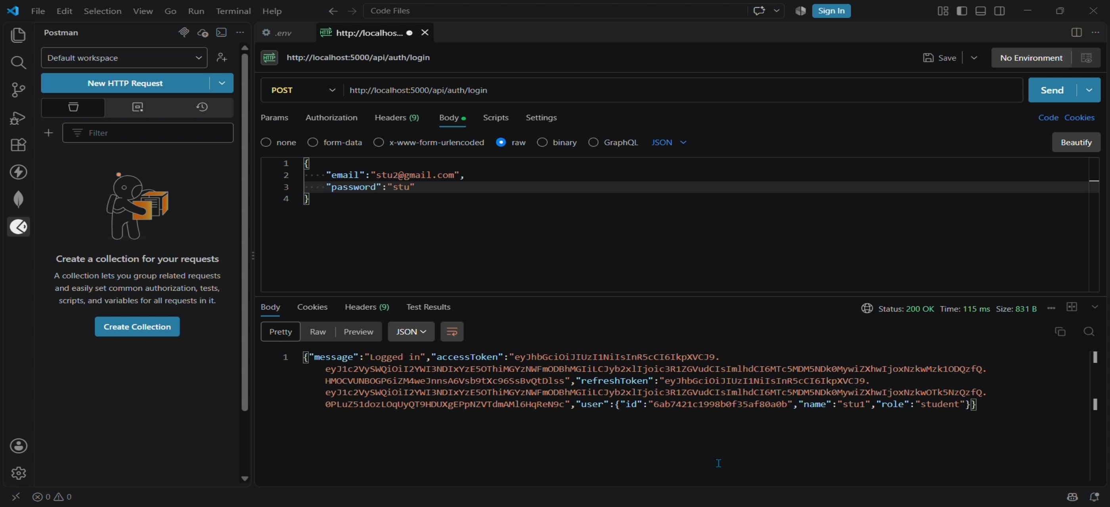
API Testing — User Login
POST /api/auth/login
Student submits registered email and password
Server verifies the bcrypt-hashed password
A fresh JWT access token and refresh token are issued
The response also returns the user's id, name and role
200 OK
Login response with access & refresh tokens
11

Slide 12
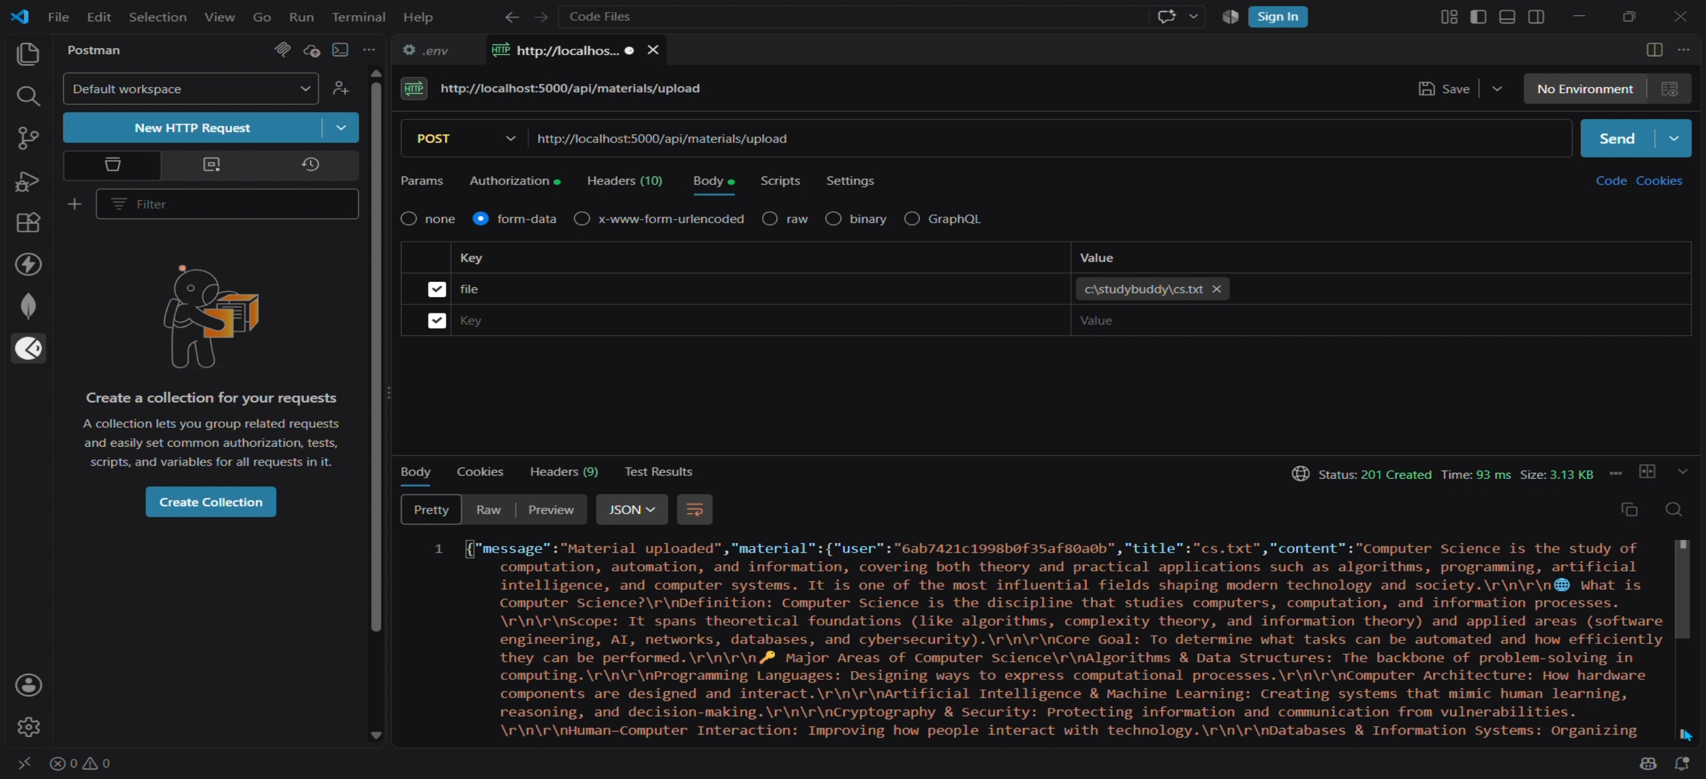
API Testing — Study Material Upload
POST /api/materials/upload
Authenticated student uploads a study file (cs.txt)
Multer middleware validates and reads the file
Its title and text content are saved to MongoDB
This saved record becomes the input for every AI feature
201 Created
Uploaded material stored with its full content
12

Slide 13
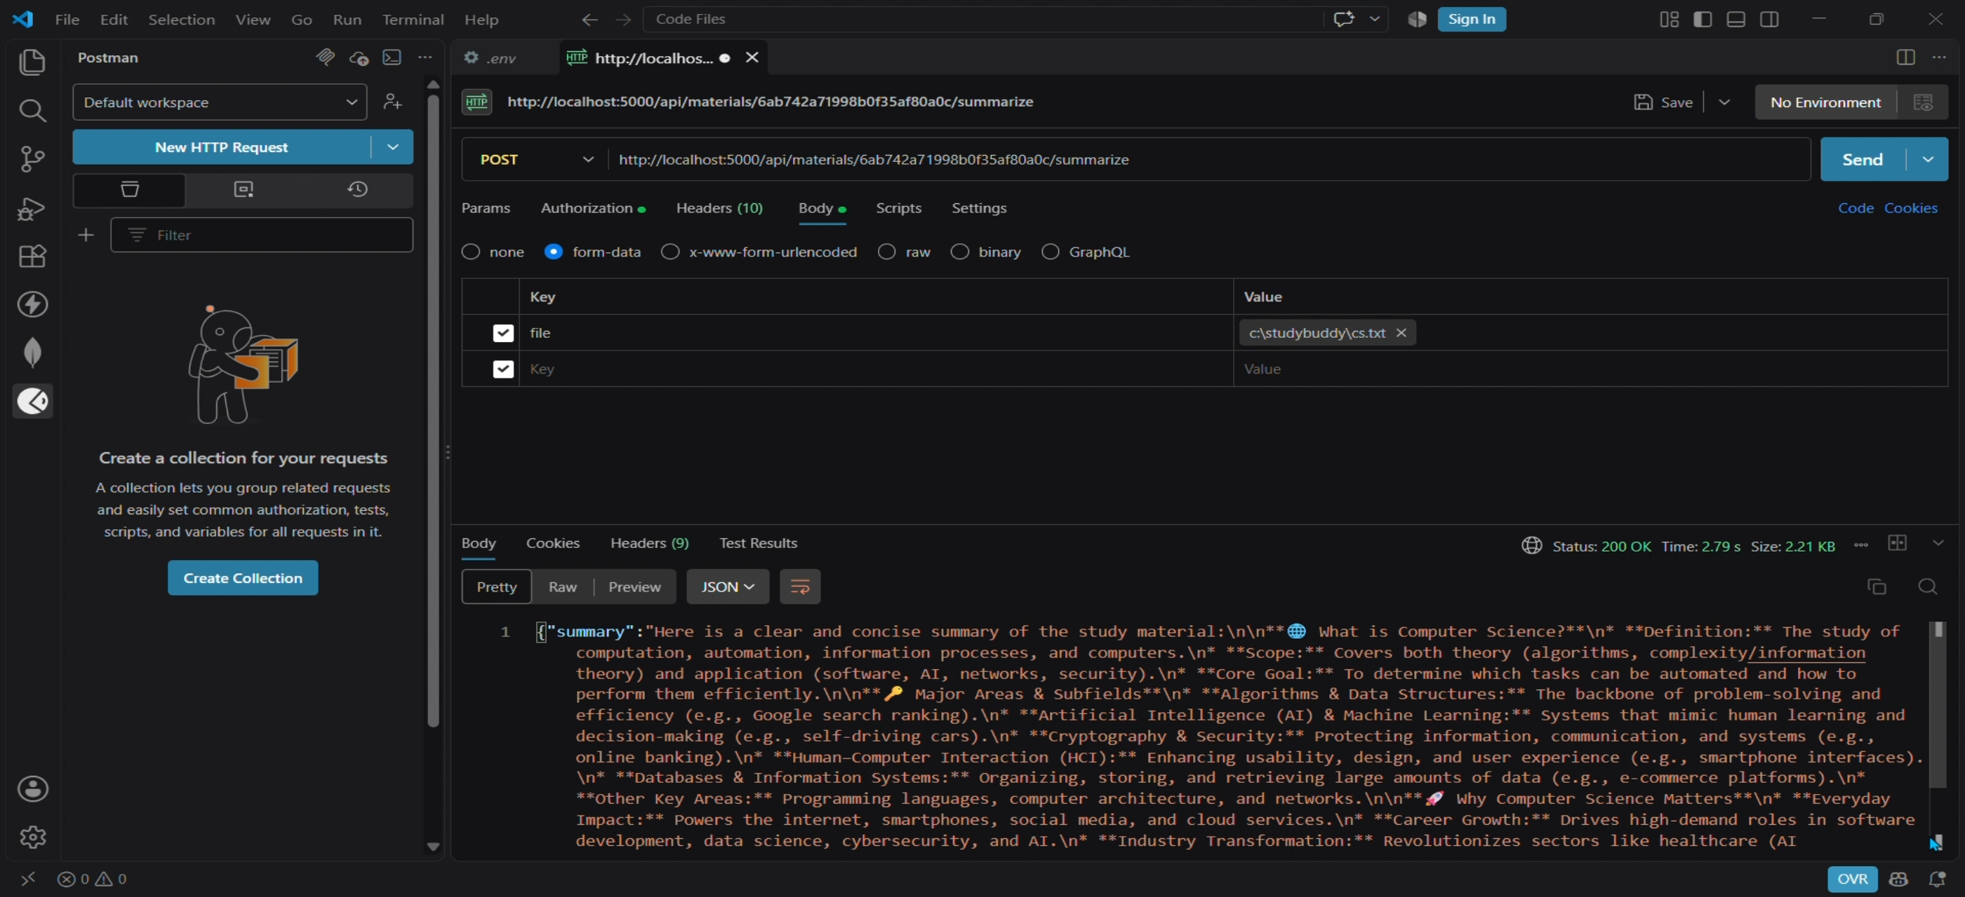
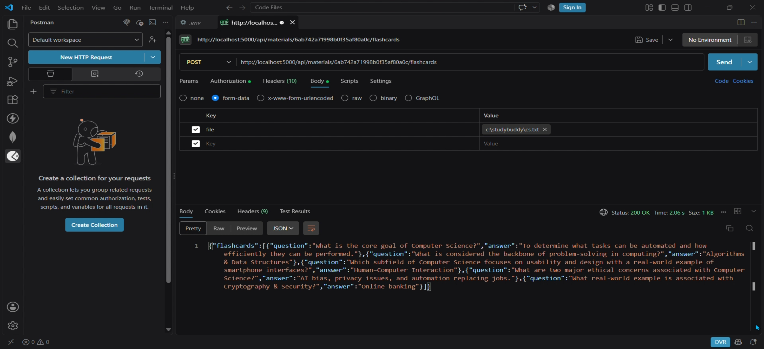
AI Testing — Summary & Flashcards
POST /materials/:id/summarize
POST /materials/:id/flashcards
The stored material is sent to Google Gemini, which returns a clearly structured summary covering definitions and key subfields. The same content also drives flashcard generation, producing question-and-answer pairs students can use for quick, active-recall revision.
13

Slide 14
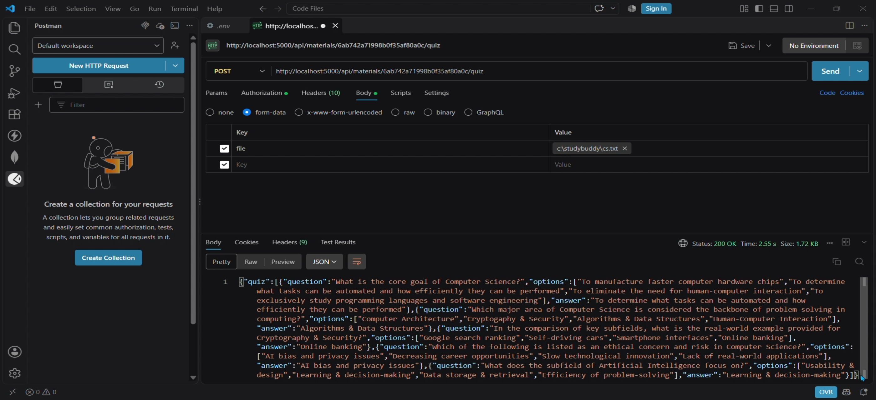
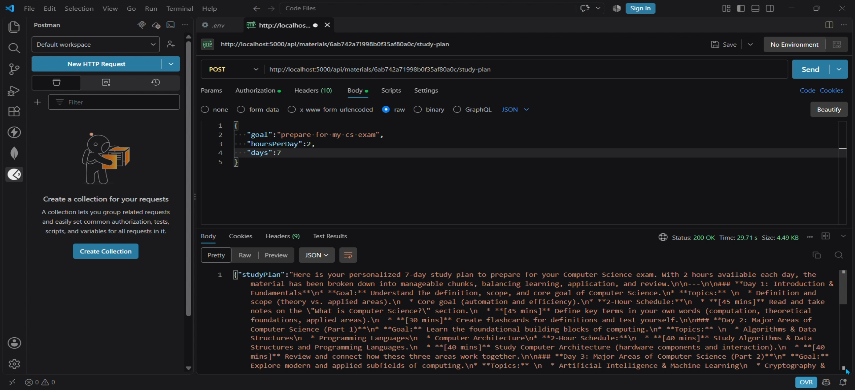
AI Testing — Quiz & Study Plan
POST /materials/:id/quiz
POST /materials/:id/study-plan
The quiz endpoint returns multiple-choice questions with answers so students can self-assess. The study-plan endpoint takes a goal, hours available per day, and a day count, then asks Gemini to build a realistic, day-by-day revision schedule around the exam date.
14

Slide 15
Outcome
By combining a secure backend with the Google Gemini API, AI StudyBuddy turns scattered study material into summaries, flashcards, quizzes and personalized study plans in seconds — cutting down manual prep time so students can spend more time actually understanding the material.
Thank You
TEAM LEADER
Kishore T
TEAM MEMBERS
Logeshwaran D · Manikandan M · Mohamed Safir M

