Slide 1




Sharbatly Quality
Management System
Next-Generation Quality Control & Inspection Platform Replacing QC One

Slide 2



Executive Summary
Modernizing Quality Control
End-to-End Operational Flow
The new Sharbatly Quality Management System (QMS) unifies and standardizes fresh produce quality inspections across all regional branches and cold storage facilities.
Follows every fruit shipment seamlessly across five structured milestones: Container Arrival → Quality Order → Sample Testing → Defect Logging → Executive Approval.
By replacing legacy paper checklists and standalone systems like QC One, QMS connects every container inspection directly to live SAP shipment data.
Ensures 100% auditability, standardized defect classification, and automated PDF report distribution to key stakeholders.

Slide 3

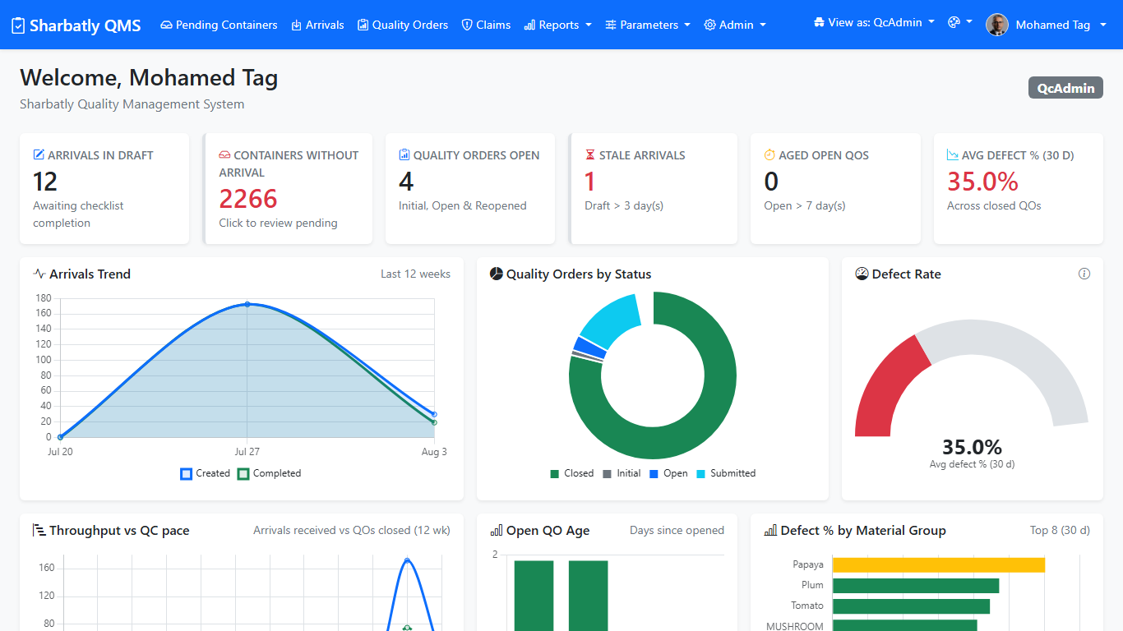
System Overview & Dashboard
Live Operations Dashboard
Centralized Portal: Unified dashboard replaces standalone QC One tool across all 15+ branches.
Direct SAP Sync: Inbound shipments automatically populate directly from live SAP POs.
Real-Time Analytics: Live tracking of open inspections, defect percentages, and daily throughput.
Queue Visibility: Immediate highlights for pending container arrivals across cold storage plants.

Slide 4


Objectives & Key Benefits
Core Objectives
Value Realized
Standardized Inspections: Apply uniform quality benchmarks across all regional cold storage hubs.
Faster Turnaround: Accelerate inspection cycles and gate entry processing.
Eliminate Manual Entry: Replace paper checklists by pulling live SAP container data.
Actionable Analytics: Clean, comparable defect data across vendors and origin countries.
Single Source of Truth: Centralize inspection records and photos in Sharbatly_MIS.
Full Traceability: Complete audit logs tracking user actions and timestamped decisions.

Slide 5
Platform Architecture
Web-Based Platform: Accessible via any web browser across the company network without setup files.
Live OData Integration: Container numbers, materials, and vendors sync bi-directionally with SAP.
Active Directory Auth: Enterprise single sign-on with role-based and plant-level security permissions.
Automated Reporting: Instant PDF report rendering and automated email distribution to stakeholders.

Slide 6





End-to-End Workflow Lifecycle
Pending Containers
Arrival & Checklist
Quality Order
Inspection
Final Report
Automatic retrieval of arriving containers from SAP inbound queue.
Check in shipment and complete receiving physical checklist.
Open quality order and auto-populate material specifications.
Record sample readings, log defect severity, and attach photos.
Submit for supervisor review, finish order, and generate PDF report.

Slide 7

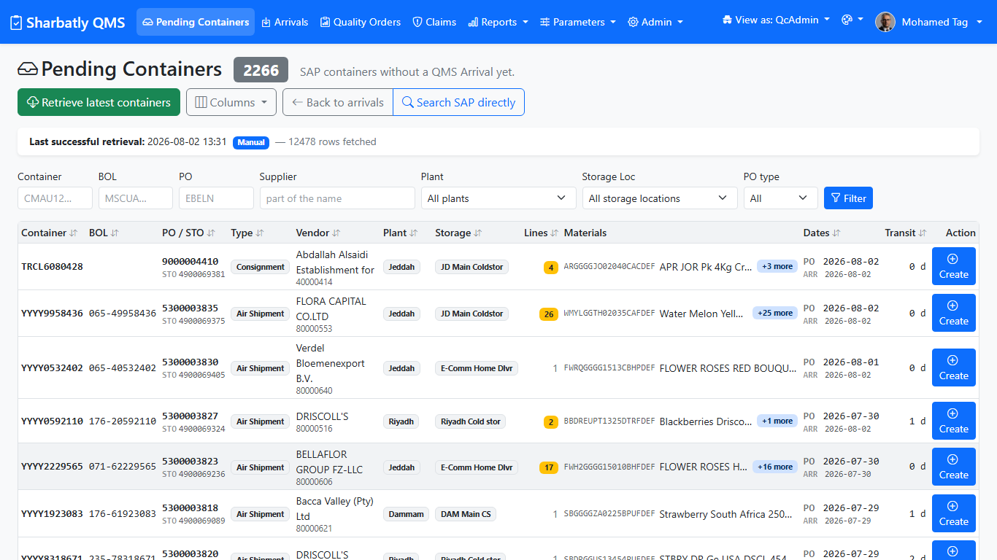
Pending Containers — SAP Queue
Arrivals & Gate Control
Automated Gate Receiving
Receiving Queue: Arriving containers auto-list from SAP transport bookings for immediate processing.
Mandatory Checklists: Verify temperature loggers, seal status, and container physical state before unloading.
Stale Arrival Alerts: Automatic flags for draft containers exceeding 3 days to eliminate receiving bottlenecks.

Slide 8
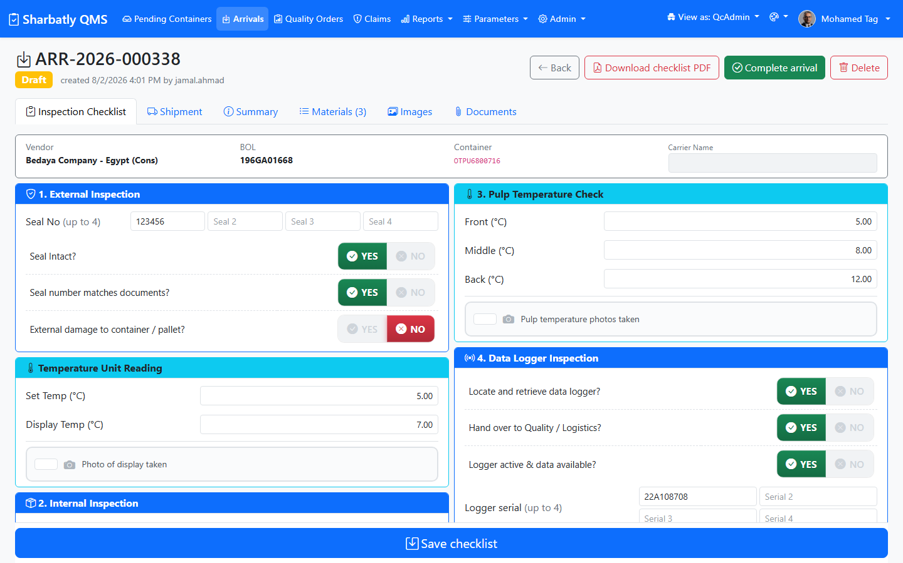
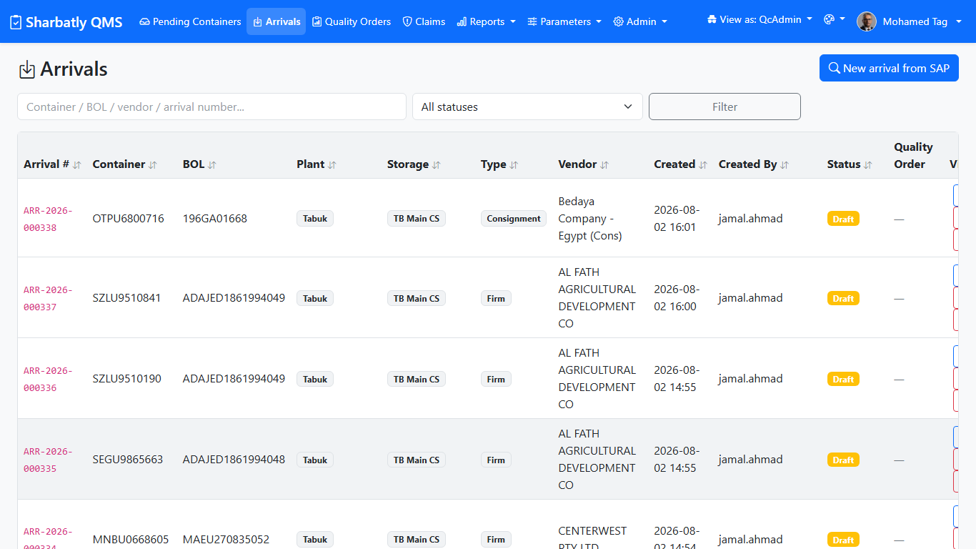
Q
Arrivals & Receiving in Action
From SAP-fed arrival register through the structured receiving checklist.
Arrivals Register
Receiving Inspection Checklist
Live screenshots from the Sharbatly QMS production system.

Slide 9
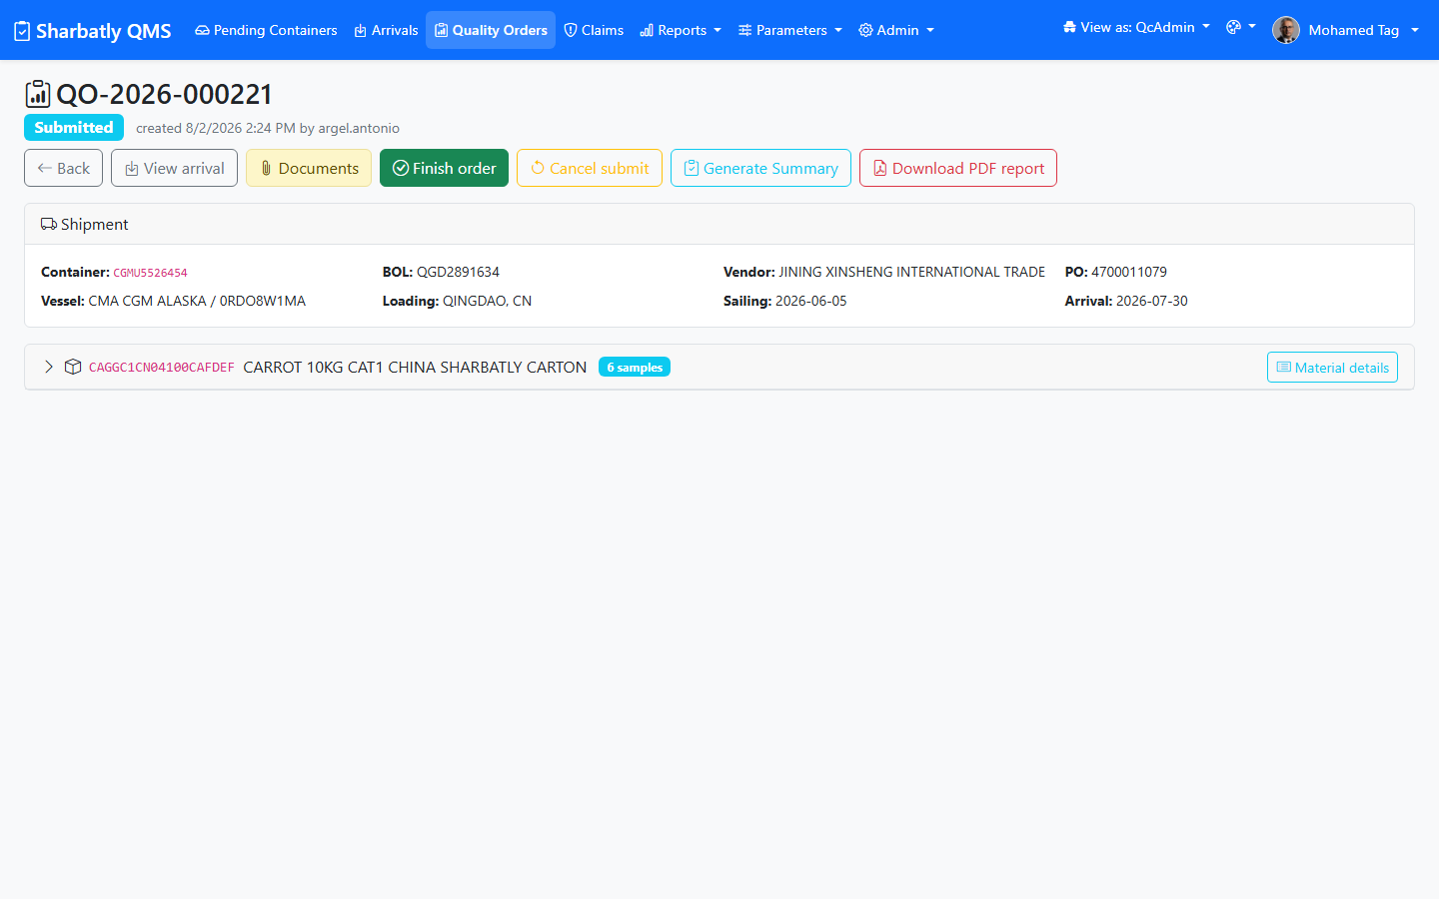
Quality Order & Testing
Quality Order — Shipment & Samples
Granular Measurements: Record precise physical metrics including temperature, pressure, firmness, and Brix.
Sample Headers: Organize readings by pallet, box number, and fruit size for exact statistical sampling.
Auto-Calculations: System computes defect percentages and automatically suggests pass/fail status.
Supervisor Pushback: Reopen or reject orders with explicit field comments for mandatory re-inspection.

Slide 10
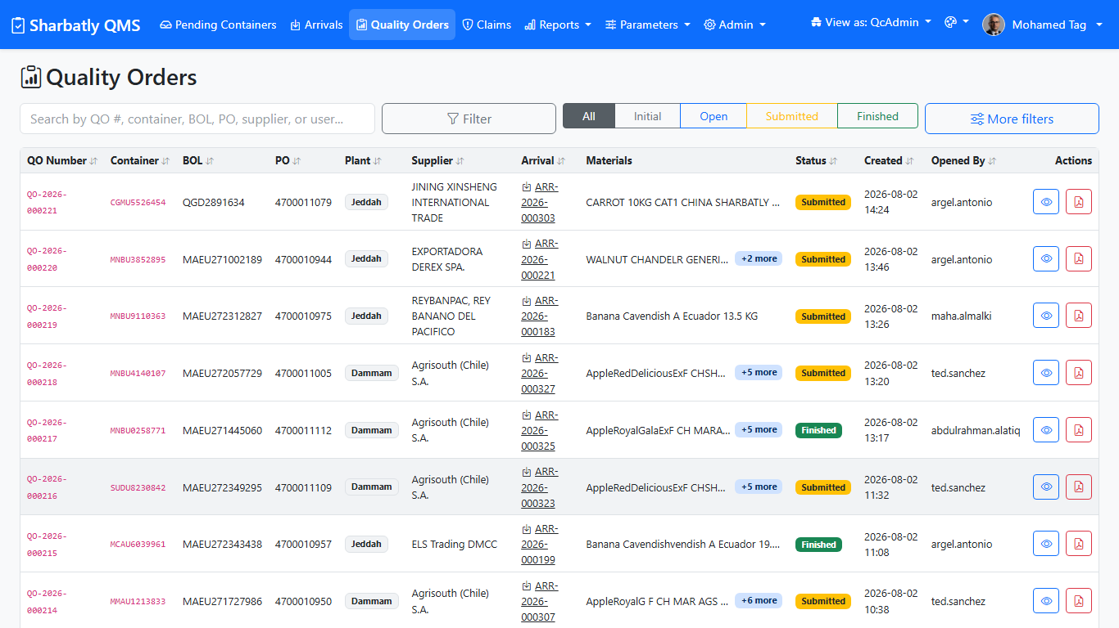
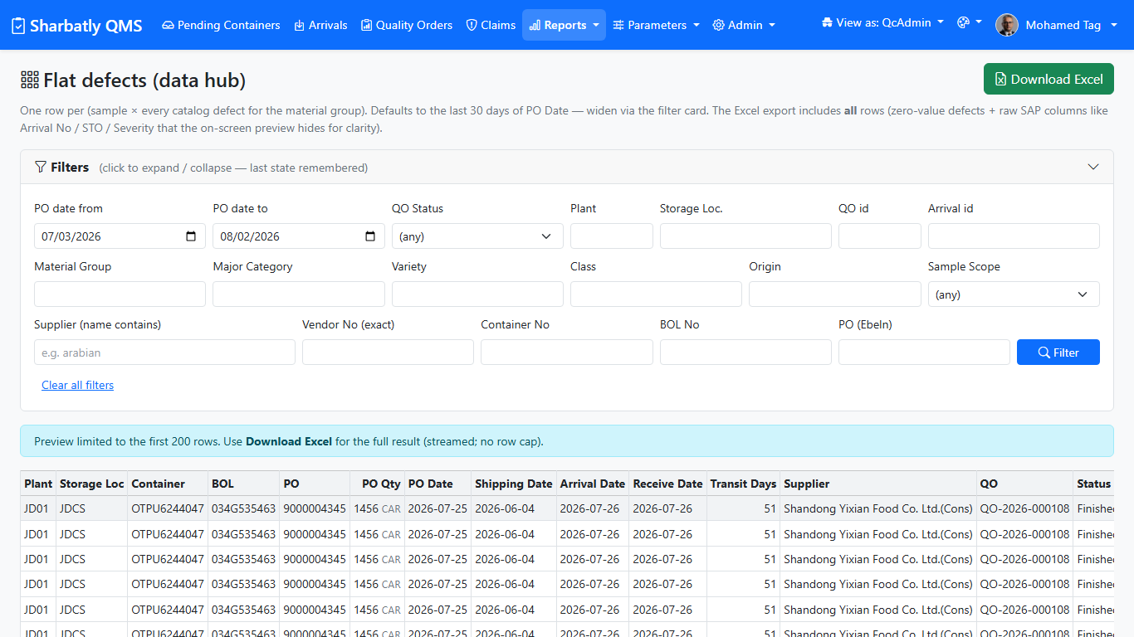
Q
Quality Orders & Analytics
Track every quality order and slice defect data through the analytics data hub.
Quality Orders List
Data Hub — Defect Analytics
Live screenshots from the Sharbatly QMS production system.

Slide 11
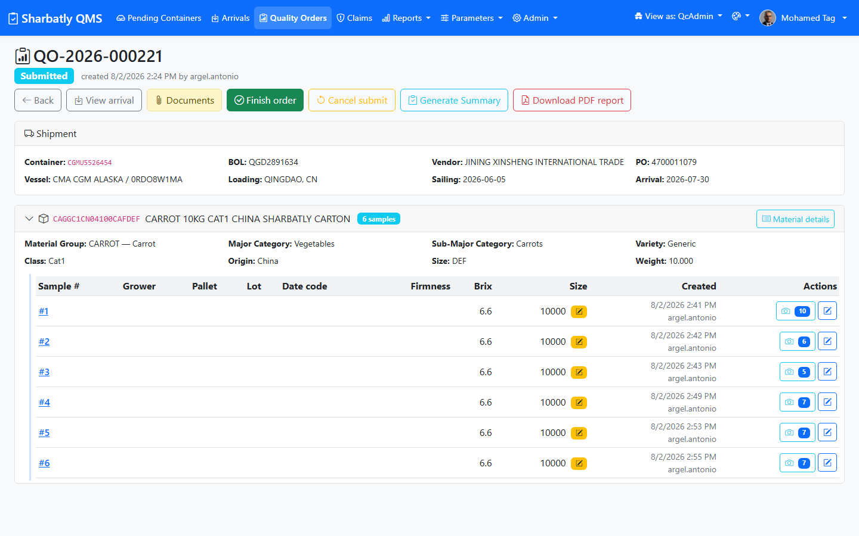
Sample Readings & Defect Grid
Defects & Evidence Capture
Standardized Defect Catalogues
Structured Defect Logging: Categorize minor, major, and critical defects directly from pre-defined fruit catalogues.
Photo Attachments: Capture high-resolution photo evidence attached directly to specific defect line items.
Vendor Claim Evidence: Timestamped imagery builds irrefutable documentation for supplier dispute settlements.

Slide 12
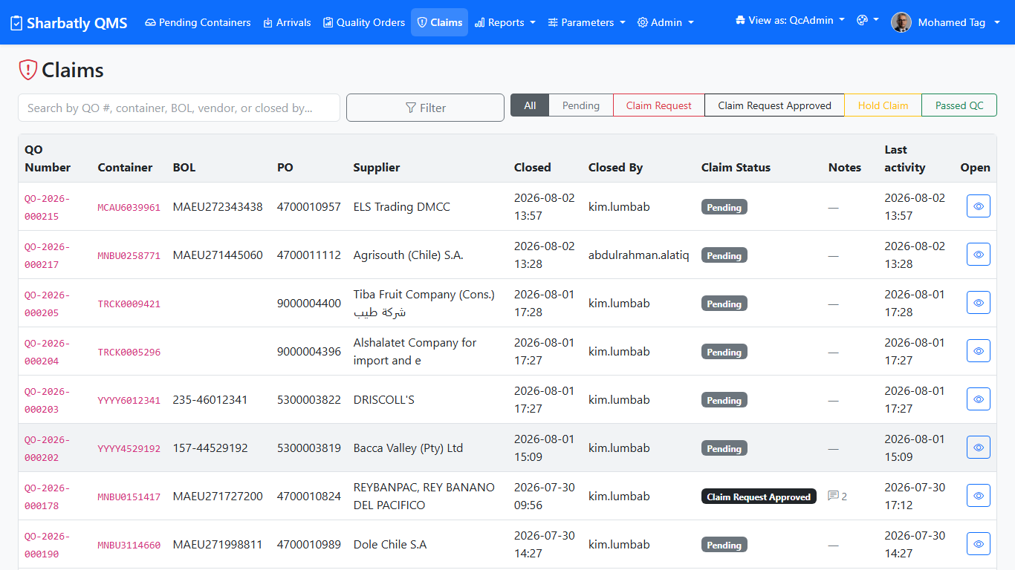
Claims & Quality Reports
Vendor Claims
Vendor Claims Management: Raise claims against suppliers directly backed by logged defect percentages.
Dynamic Pivot Tables: Slice quality data by supplier, fruit variety, grower origin, and receiving hub.
PDF Inspection Certificates: Generate formal, formatted PDF reports ready for executive distribution.
Audit Integrity: Lock finished reports against unauthorized edits with permanent revision history.

Slide 13
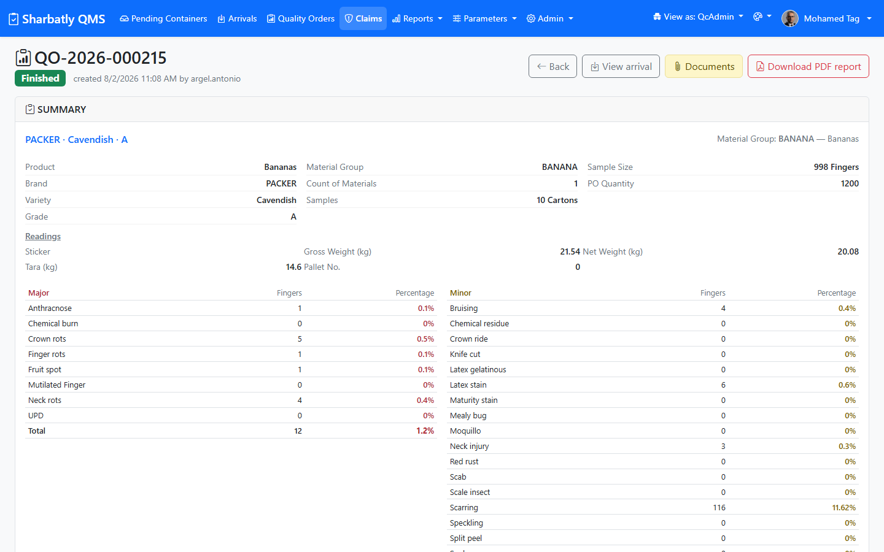
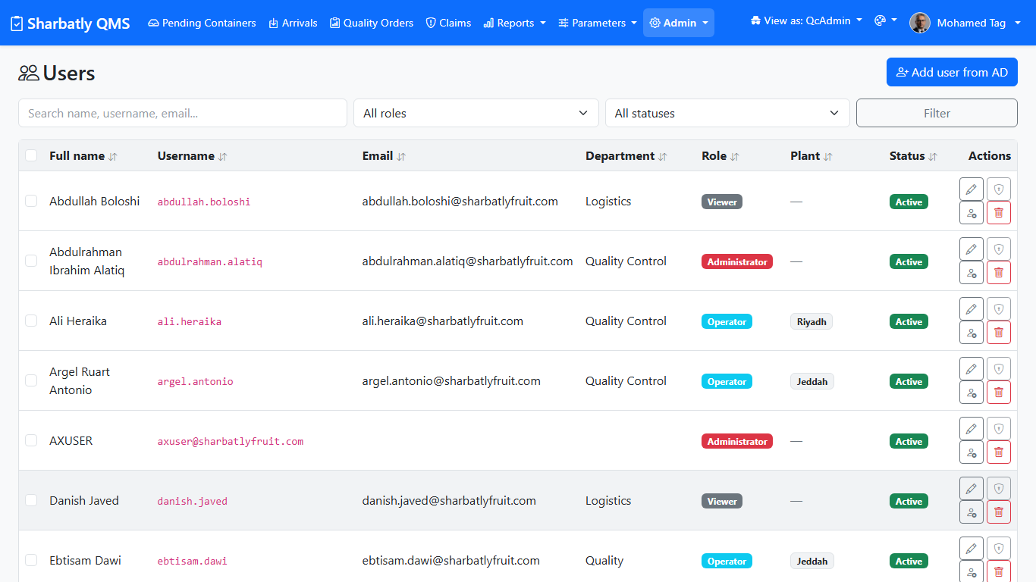
Q
Claims Review & Access Control
Review claims with the live inspection summary, and control who can access each screen.
Claim Review & Live Summary
Users, Roles & Permissions
Live screenshots from the Sharbatly QMS production system.

Slide 14

Role-Based Access Control
User Level | Primary Responsibility | Arrivals & Checklists | Quality Inspections | Approvals & Reopen
 | Read-only monitoring & reporting | Read Only | Read Only | No Access
 | Inspectors conducting field tests | Create & Edit | Inspect & Submit | No Access
 | Quality review & gate approvals | Full Access | Review & Edit | Finish / Reject
 | Executive oversight & audit control | Full Access | Full Access | Approve / Reopen
 | Vendor claims & dispute settlement | Read Only | Read Only | Manage Claims

Slide 15






Core Platform Modules
Dashboard
Arrivals
Quality Orders
Claims & Reports
Live overview of open orders, workload volume, defect averages, and bottleneck indicators.
Container check-in, physical receiving checklists, and SAP pending queue synchronization.
Material sample entry, physical readings, standardized defect logging, and photo evidence.
Raise quality claims against suppliers, generate dynamic pivot tables, and export executive PDF reports.

Slide 16
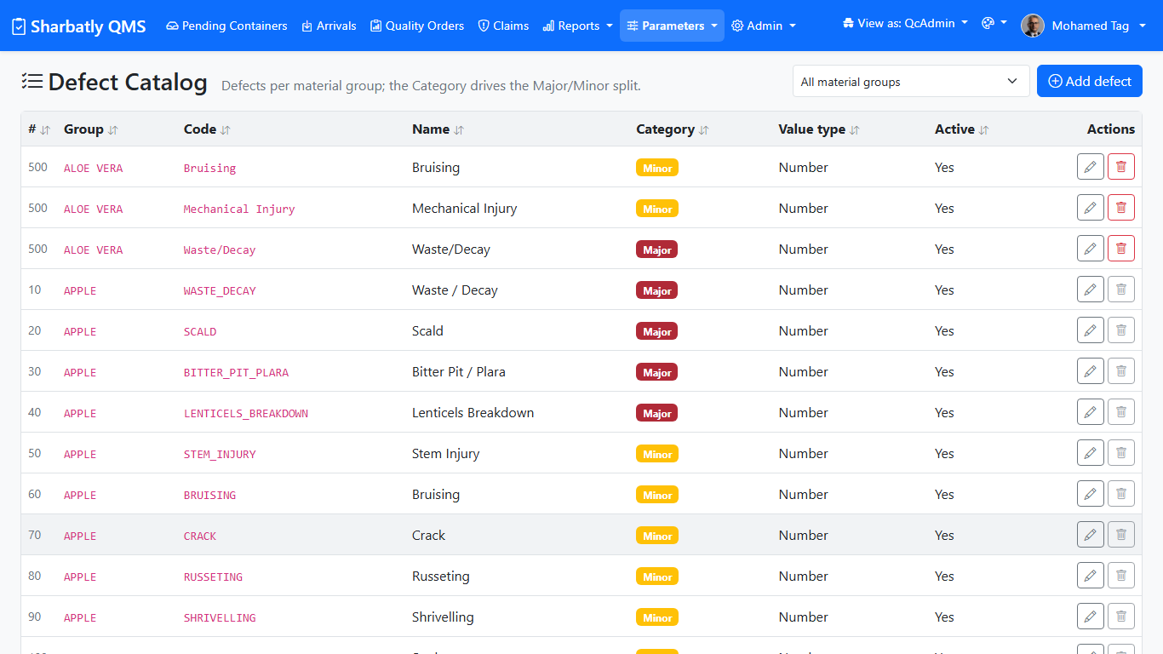
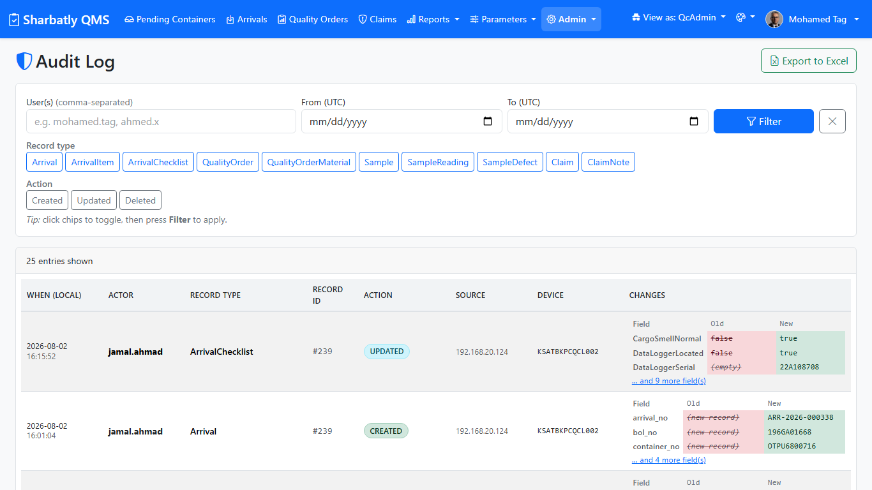
Q
Configuration & Audit Trail
Admins tailor the catalogues and parameters, and every change is permanently logged.
Defect Catalogue & Parameters
Audit Trail — Every Change Logged
Live screenshots from the Sharbatly QMS production system.

Slide 17






Best Practices & Governance
For Inspectors
For Supervisors
System Governance
Always initiate inspection from real SAP containers. Complete receiving checklists fully before creating quality orders. Attach crisp photo evidence for all defects and submit without delay.
Verify physical readings against logged defects prior to finishing orders. Send back incomplete entries with clear instructions. Monitor dashboard metrics daily for defect trends.
Enforce principle of least privilege for security roles. Maintain up-to-date defect catalogues and reading parameters. Perform routine audit log reviews and maintain company logins.

Slide 18




Impact & Future Roadmap
100%
0
15+
Digital Traceability
Manual Re-Typing
Cold Storage Facilities
End-to-end audit log from SAP arrival to report export
Direct OData sync eliminates duplicate container entry
Standardized inspection protocols across Saudi Arabia
On The Horizon (Future Releases)
Mobile-friendly floor capture on tablets & handhelds • Advanced predictive defect analytics • Automated SAP trigger notifications • Multi-branch regional expansion

Slide 19

Thank you for your dedication to maintaining Sharbatly's high standard of fresh produce quality.
Enterprise MIS Portal
|
QMS Support Team

