Slide 1
Sharbatly QMS — Arrival & Quality Order Guide
A step-by-step guide to the two everyday jobs in Sharbatly QMS: creating and completing an Arrival, and running a Quality Order from first sample to finished PDF report.

Slide 2
Contents
1. Overview
2. Getting started
2.1 Signing in
3. The Arrival process
3.1 Step 1 — Pick your container from Pending
3.2 Step 2 — Fill and save the container checklist
3.3 Step 3 — Complete the arrival and open a Quality Order
4. The Quality Order process
4.1 Step 1 — Add a sample
4.2 Step 2 — Record readings and defects
4.3 Step 3 — Complete the material header
4.4 Step 4 — Submit for review
4.5 Step 5 — Finish the Quality Order (Supervisor)
4.6 Step 6 — Generate the PDF report
5. Troubleshooting & FAQ
6. Glossary

Slide 3
Sharbatly QMS — Arrival & Quality Order Guide

Slide 4
1. Overview

Slide 5
2. Getting started

Slide 6
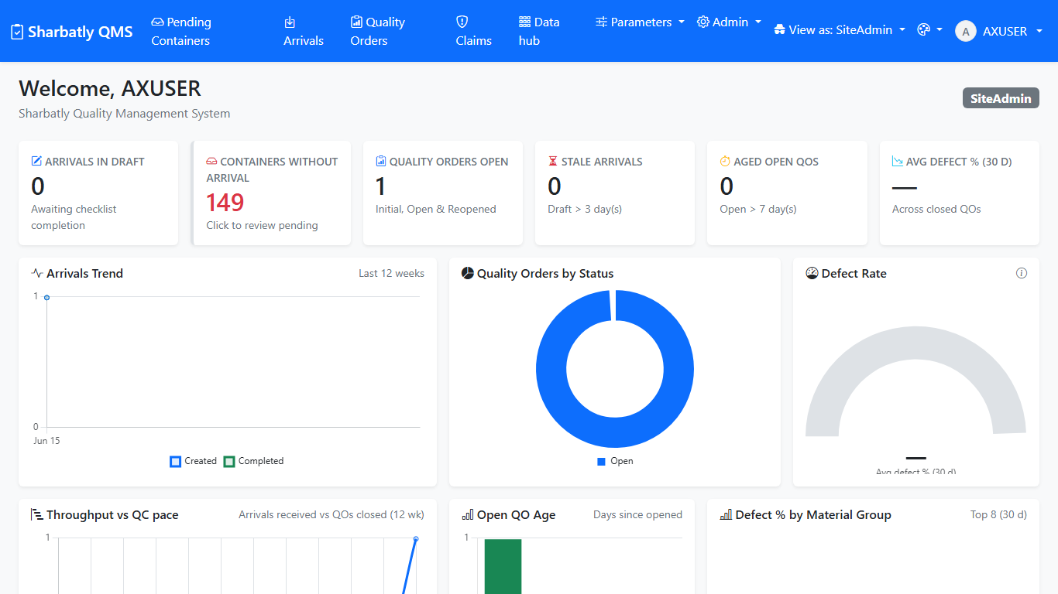
2.1 Signing in
Steps
1. Open the app in your web browser: http://192.168.3.17:5244.
2. Type your Username and Password (the same ones you use to log in to your work computer).
3. Click Sign in.
➡ the home dashboard, with the top menu across the top of the page.
[Tip] If you see "Invalid credentials", check the username is just your name (for example ahmed.ali) with no @ and no domain in front. If it still won't let you in, ask an administrator to check your account.
---

Slide 7
3. The Arrival process

Slide 8
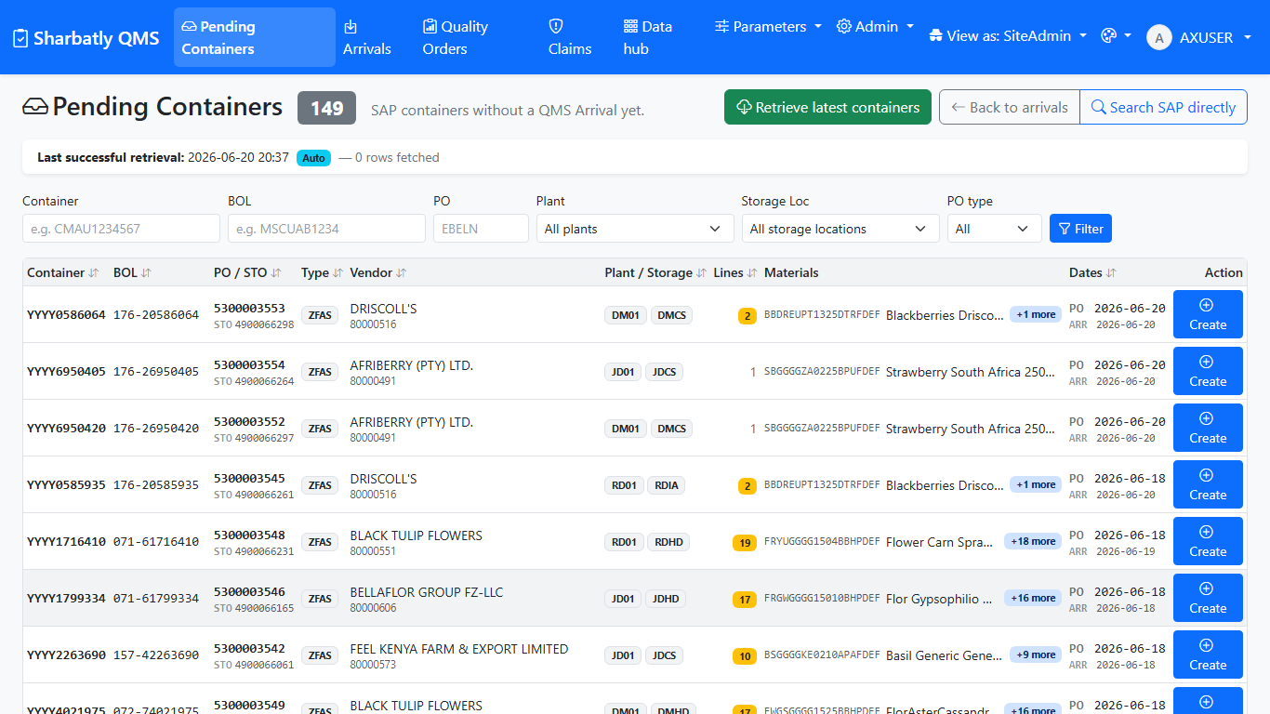
3.1 Step 1 — Pick your container from Pending
Steps
1. Click Pending Containers in the top menu.
2. Find your container in the list. If it isn't there yet, click Retrieve latest containers at the top — a small status line tells you when the fresh list has come back from SAP.
3. If the list is long, type the container number, BOL, or PO in the filter boxes to narrow it down.
4. Click the row of the container you want.
➡ the app creates the Arrival and opens its details page, with an empty checklist ready to fill in.
[Tip] Each container becomes one Arrival. If you can't find a container, it usually just hasn't been fetched from SAP yet — click Retrieve latest containers and wait a few seconds.

Slide 9
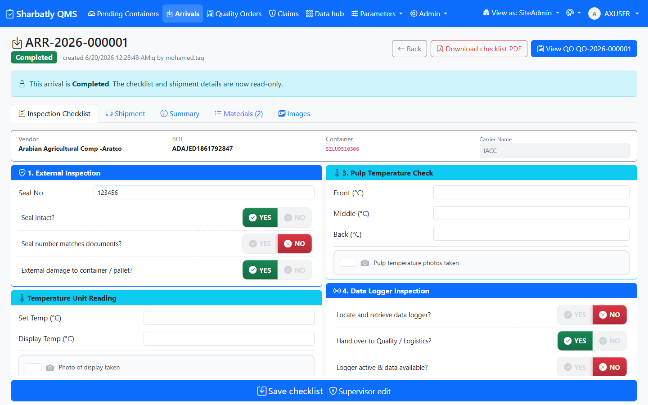
3.2 Step 2 — Fill and save the container checklist
Steps
1. On the Arrival details page, fill in the seal number and tick Seal intact if it was.
2. Tick External damage if there was any visible damage to the container.
3. Type the discharge date (the day the container was discharged) next to the arrival date.
4. Type the three pulp temperatures — front, middle and back.
5. If there is a data logger, type its serial number and tick the box to say its photo was taken.
6. Add a short note if anything is unusual.
7. Add photos with Add photo — you can drag a picture in, browse for a file, or take one with the camera.
8. Click Save.
➡ a green banner confirms the checklist saved. Your entries stay on the page.
[Tip] You don't have to finish in one sitting. The checklist saves every time you click Save, so you can come back and add more later.

Slide 10
3.3 Step 3 — Complete the arrival and open a Quality Order
Steps
1. When the checklist is complete, click Complete (or Create Quality Order) at the top of the Arrival.
2. Confirm if the app asks you to.
➡ a brand-new Quality Order opens, with the material lines already filled in from SAP. You're now ready to start inspecting — that's the next section.
[Tip] A Quality Order can only be opened once the Arrival is Completed. If the button is greyed out, finish and Save the checklist first.
---

Slide 11
4. The Quality Order process

Slide 12
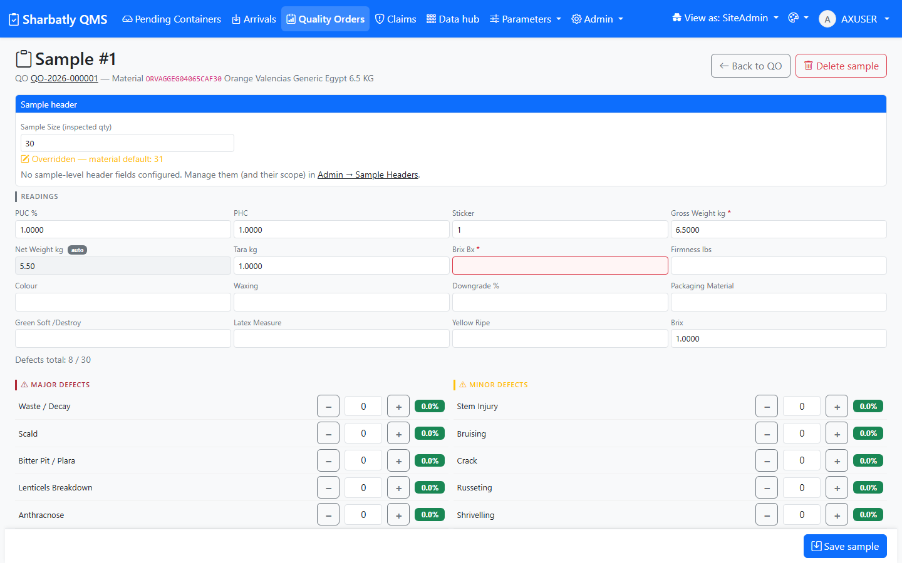
4.1 Step 1 — Add a sample
Steps
1. On the Quality Order, click Add sample.
2. Choose the Sample scope — One Carton or Multi-Carton.
3. Check the Sample size — it fills in automatically from the material, but you can change it if you counted a different number.
4. Fill in the sample details you have (grower, pallet, etc.) if your team records them.
5. Click Save sample.
➡ the new sample appears on the Quality Order with its size and scope. You can now add the defects and readings for it.
[Tip] Made a mistake? Open the sample, change the values and Save again. The first Save creates the sample; every Save after that updates it. You can delete a sample only while the Quality Order is still Open.

Slide 13
4.2 Step 2 — Record readings and defects
Steps
1. Open the sample you want to record against.
2. Type the readings you measured — Brix, firmness and so on. The list only shows the readings that apply to this kind of fruit.
3. Type the count for each defect you found. Leave a defect at zero if you didn't see it.
4. Add photos of the defects — drag, browse, or use the camera. The photo count on the sample updates straight away.
5. Click Save sample.
➡ the sample's defect summary and photo count update on the Quality Order.
[Warning] The total of all your defect counts on a sample can't be more than the sample size. If you hit the limit, the form tells you — recount or correct a number before saving.

Slide 14
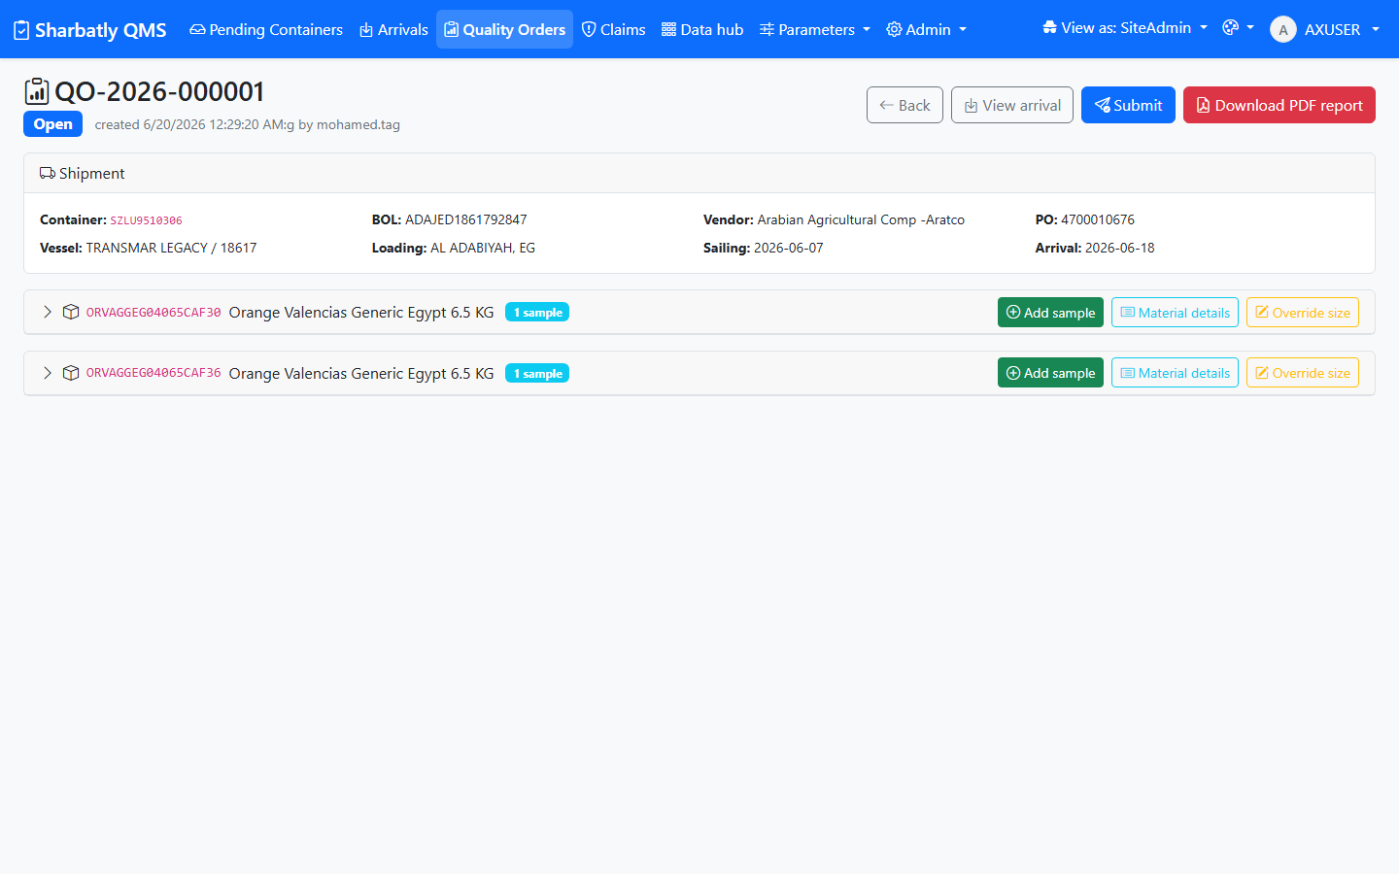
4.3 Step 3 — Complete the material header
Steps
1. Look at the Material header button on the Quality Order — it glows yellow until the header details are complete.
2. Click it and fill in the required header fields for the material.
3. Click Save.
➡ the button stops glowing once the header is complete. You need this done before you can submit.

Slide 15
4.4 Step 4 — Submit for review
Steps
1. Make sure every sample you meant to inspect is saved, and the Material header is complete.
2. Click Submit for review at the top of the Quality Order.
3. Type a short note to the supervisor if you'd like.
4. Click Confirm.
➡ the Quality Order status becomes Submitted. You can't edit the samples any more until the supervisor either Finishes it or sends it back to you.
[Tip] If you try to submit before adding samples, the app warns you and asks you to confirm with a reason. That's there to stop empty orders going through by accident.

Slide 16
4.5 Step 5 — Finish the Quality Order (Supervisor)
Steps
1. Open a Submitted Quality Order.
2. Review every sample and the operator's note.
3. If everything is correct, click Finish — the Quality Order becomes Closed.
4. If something needs fixing, click Cancel submission — the order goes back to Open so the operator can correct it.
➡ once Finished, the order is Closed and the report buttons unlock.

Slide 17
4.6 Step 6 — Generate the PDF report
Steps
1. Open the finished (Closed) Quality Order.
2. Click Download PDF (or Quality Report) at the top.
3. The report opens as a PDF — it shows the shipment details, the Time Bar, every sample with its readings and defects, and the photos.
4. Save or print it as you need.
5. To e-mail it to the supplier, click Send report to supplier instead — the message is pre-filled; edit it if you want and click Send.
➡ a professional PDF quality report you can save, print, or e-mail. A green banner confirms if you sent it to the supplier.
[Tip] You can regenerate the PDF any time; it always reflects the latest saved data on the Quality Order.
---

Slide 18
5. Troubleshooting & FAQ

Slide 19
6. Glossary

