Slide 1
SAP-1
Let’s go ..

Slide 2
Introduction
The Simple-As-Possible (SAP)-1 computer is a very basic model of a microprocessor explained by Albert Paul Malvino.
The SAP-1 design contains the basic necessities for a functional Microprocessor.
Its primary purpose is to develop a basic understanding of how a microprocessor works, interacts with memory and other parts of the system like input and output.
The instruction set is very limited and is simple.

Slide 3
What SAP-1 contain?
PC
AC
MAR
Adder/
Sub
RAM
16*8
RegB
IR
Output
Register
Controller

Slide 4
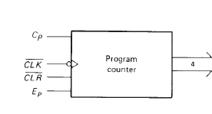
1-Program Counter(PC)
The program is stored at the beginning of the memory with the first instruction at binary address 0000 the second instruction at address 0001, the third at address 0010, and so on.
The program counter, which is part of the control unit, counts from 0000 to 1111.
Its job is to send to the memory the address of the next instruction to be fetched and executed.

Slide 5
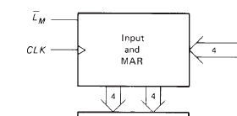
2-Inputs and MAR (Memory Address Register)
During a computer run, the address in PC is latched into Memory Address Register (MAR).

Slide 6
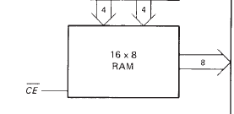
3-RAM
The program code to be executed and data for SAP-1 computer is stored here.
During a computer run, the RAM receives 4-bit addresses from MAR and a read operation is performed. Hence, the instruction or data word stored in RAM is placed on the W bus for use by some other part of the computer.
It is asynchronous RAM, which means that the output data is available as soon as valid address and control signal are applied.

Slide 7
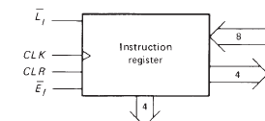
4-Instruction Register(IR)
IR contains the instruction (composed of OPCODE+ADDRESS) to be executed by SAP1 computer.

Slide 8
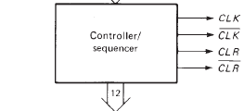
5-Controller-Sequencer
It generates the control signals for each block so that actions occur in desired sequence. CLK signal is used to synchronize the overall operation of the SAP1 computer.
A 12-bit word comes out of the Controller-Sequencer block. This control word determines how the registers will react to the next positive CLK edge.

Slide 9
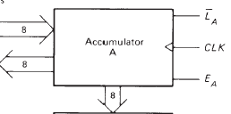
6-Accumulator(AC)
It is a 8-bit buffer register that stores intermediate results during a computer run.
It is always one of the operands of ADD, SUB and OUT instructions.

Slide 10
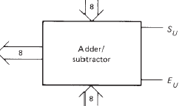
7-ALU
It is a 2's complement adder-subtractor.
This module is asynchronous (unclocked), which means that its contents can change as soon as the input words change.

Slide 11
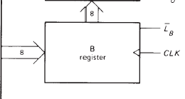
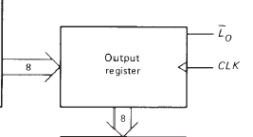
8-B-register
It is 8-bit buffer register which is primarily used to hold the other operand (one operand is always accumulator) of mathematical operations.
9-Output Register
This registers hold the output of OUT instruction.

Slide 12
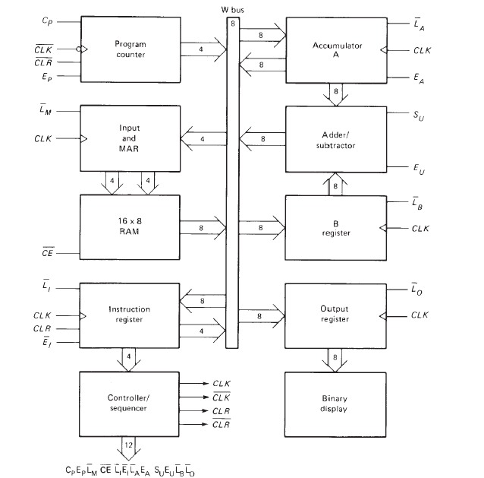
SAP-1 architecture
Instructions
DATA

Slide 13
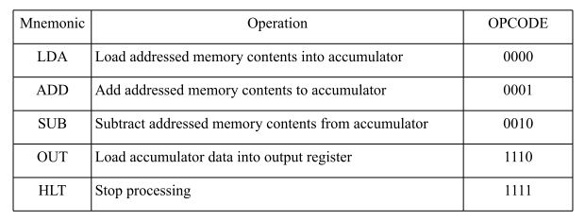
SAP-1 Instructions and Instruction Cycle

Slide 14
Control Unit

Slide 15
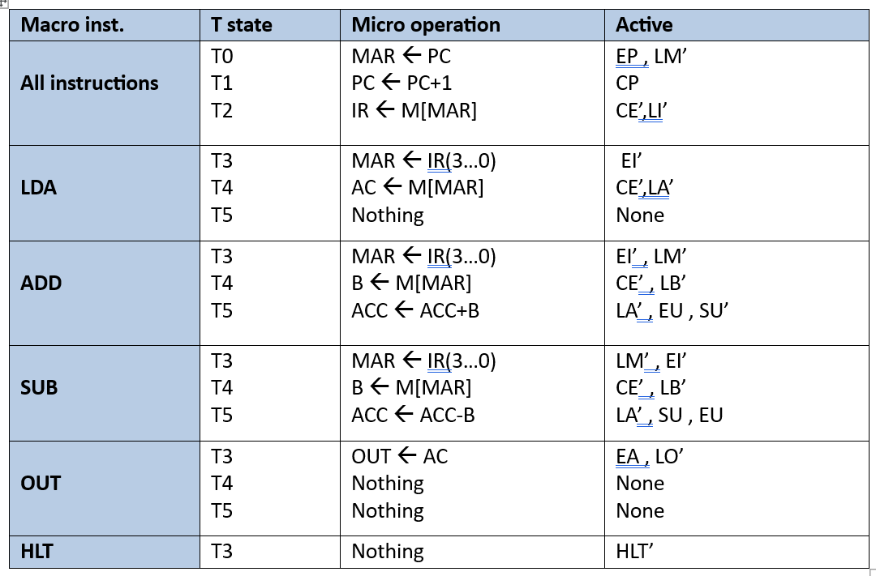
Instruction Fetch and Execute

Slide 16
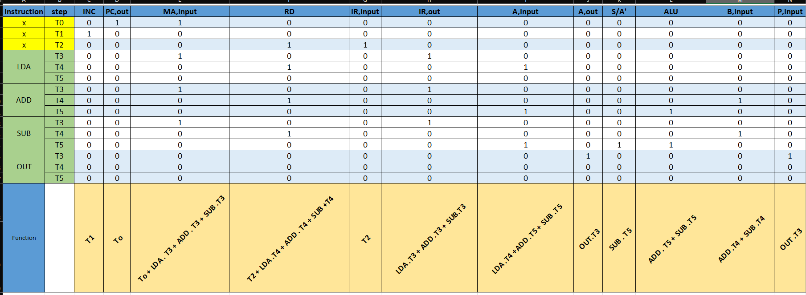
Control Unit Design

Slide 17
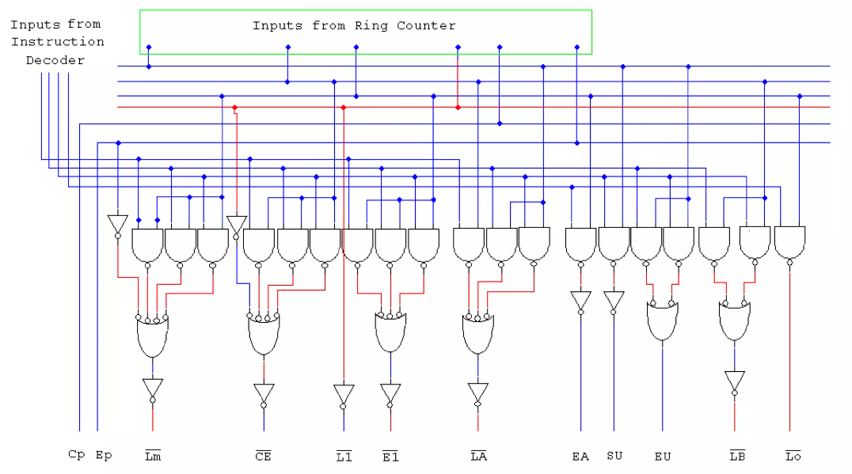
Control Unit Design Cont.

Slide 18
Let’s Take a Example

Slide 19
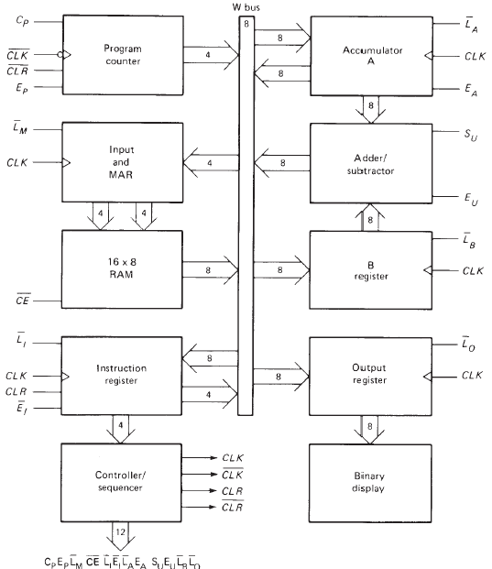
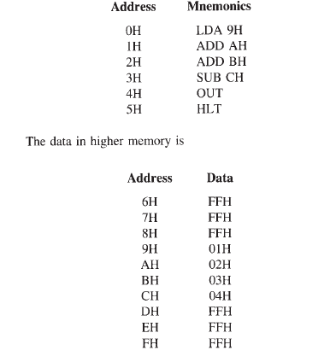
0x02
0000 0001
0x03
0001
0x06
0000
0011
0x06
0x03
0x02
0000
0x06
0001
1010
0x02
1001
0x03
1111 1111
0000 1001
0001 1010
0000 0001
0x02
0x04
0x02
0x03
1111 1111
0x02
0001 1010
0000 1001
0001
0000
1111
Computer Halted

Slide 20
Difference between SAP 1 and Basic Computer

Slide 21
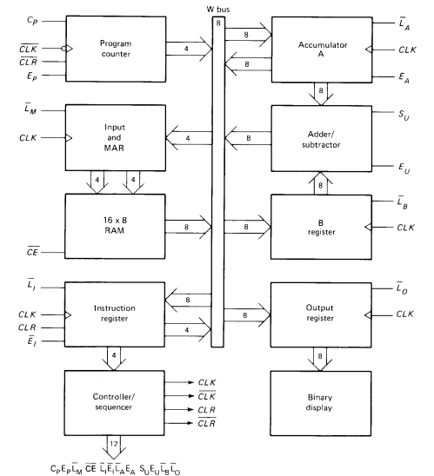
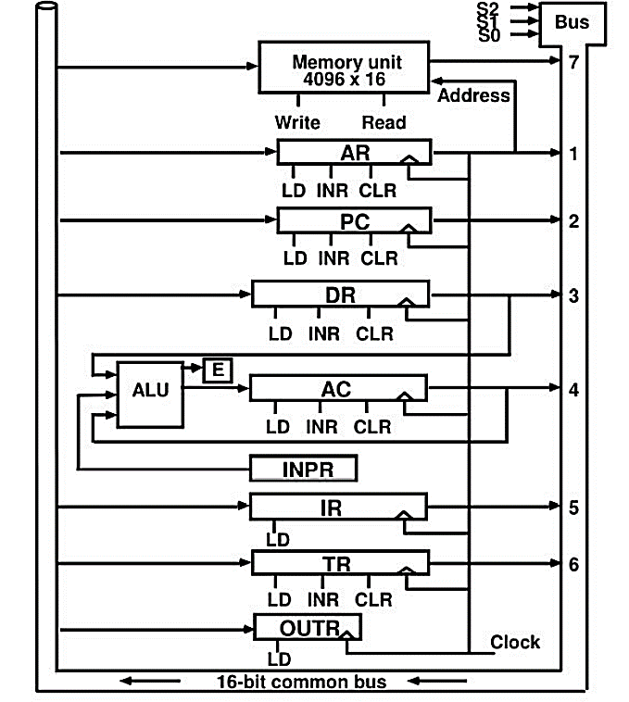
SAP 1
Basic Computer

Slide 22
SAP-1 & SAP-2

Slide 23
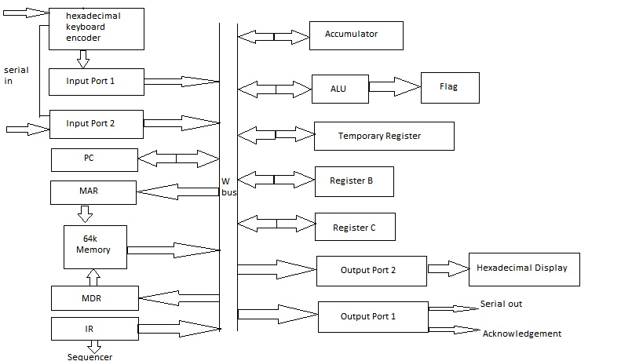
SAP 1
SAP-2

Slide 24
SAP-1 & MIPS

Slide 25
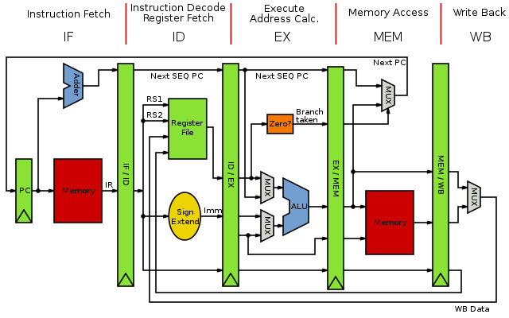
SAP 1
MIPS

Slide 26

Let’s go to the Code

Slide 27
Thanks

