Slide 1
Digital Portfolio
STUDENT NAME: A Mohammed Sameer
REGISTER NO AND NMID: 31924U18018-astvu31931924u18018
DEPARTMENT:BSC COMPUTER SCIENCE
COLLEGE: COLLEGE/ UNIVERSITY- MAZHARUL ULOOM,THIRUVALLUR UNIVERSITY

Slide 2
PROJECT TITLE
Interactive digital portfolio using front end development project

Slide 3


AGENDA
Problem Statement
Project Overview
End Users
Tools and Technologies
Portfolio design and Layout
Features and Functionality
Results and Screenshots
Conclusion
Github Link
3/21/2024 Annual Review

Slide 4

PROBLEM STATEMENT
Traditional resumes are no longer sufficient to effectively showcase skills, projects, and achievements in the digital era. Many students and professionals lack a structured online presence to highlight their work. A digital portfolio offers an interactive and accessible platform to present skills, experiences, and accomplishments more effectively.

Slide 5

PROJECT OVERVIEW
The project is a digital portfolio designed to present personal achievements, skills, and projects in a structured way. It includes sections such as About Me, Projects, Skills, and Contact, providing an interactive platform to highlight an individual’s professional journey. The main goal is to showcase work and capabilities effectively in a modern digital format.

Slide 6

WHO ARE THE END USERS?
The digital portfolio is designed for a wide range of users. It benefits students to showcase academic projects and resumes, job seekers to share their profiles with recruiters, freelancers to present their work to clients, and professionals to highlight their experience and achievements.

Slide 7

TOOLS AND TECHNIQUES
The project uses HTML for structure (pages and sections), CSS for styling (colors, layouts, responsiveness), and JavaScript for interactivity (navigation menu, animations, form validation). Development tools include code editors like VS Code or CodePen, and deployment can be done through hosting platforms such as GitHub Pages.

Slide 8
POTFOLIO DESIGN AND LAYOUT
The portfolio is designed with a structured layout that includes the following sections: Home/About Me, Projects, Skills, and Contact. The design is fully responsive, ensuring compatibility with both desktop and mobile views, providing a smooth and user-friendly experience across devices.
8

Slide 9
FEATURES AND FUNCTIONALITY
Responsive Design – Works on both desktop and mobile devices.
Navigation Bar with Hamburger Menu – Easy access to sections, collapses on smaller screens.
About Section – Introduction and personal details.
Education Section – Academic background with timeline.
Certificates Section – List of earned certifications.
Hobbies Section – Personal interests beyond academics.
Projects Section – Showcases work with project cards, links to live demos/GitHub.
Contact Section – Email, phone number, and a functional contact form.
Footer – Copyright information.

Slide 10
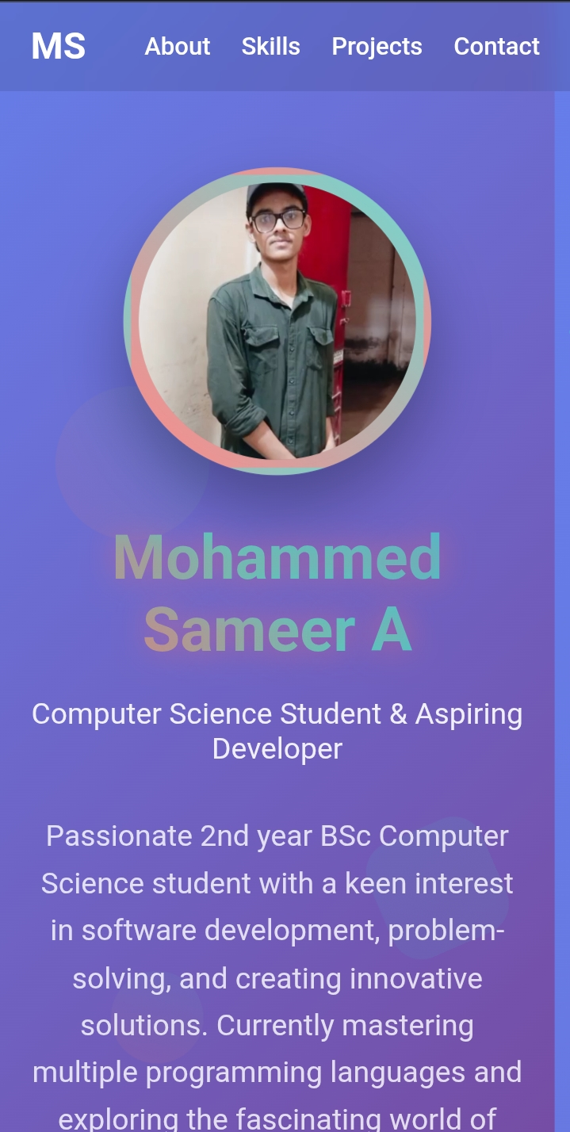
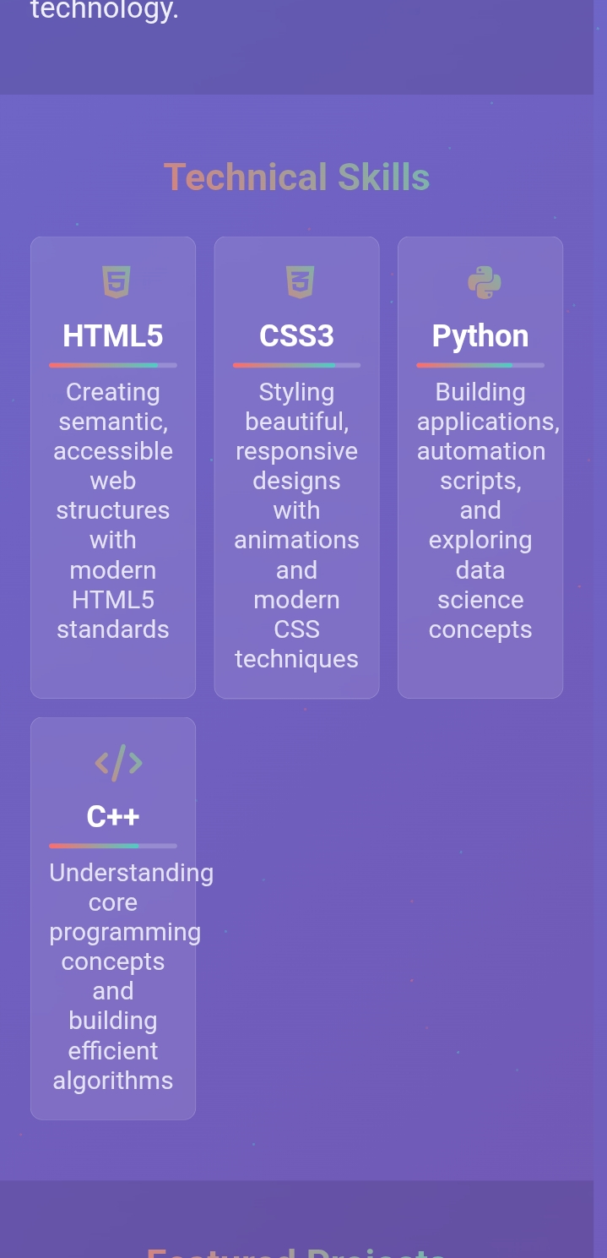

RESULTS AND SCREENSHOTS
3/21/2024 Annual Review
10

Slide 11
CONCLUSION
🔹 Highlights of the Project
Designed and developed a personal portfolio website using HTML, CSS, and JavaScript.
Integrated sections like About, Education, Certificates, Hobbies, Projects, and Contact.
Implemented a responsive layout with a hamburger menu for mobile users.
Showcased projects, skills, and achievements in a professional way.
🔹 Final Summary
This portfolio project demonstrates the ability to build a modern, responsive, and interactive web application. It serves as both a learning experience in front-end development and a practical platform to present professional information online.
🔹 Benefits to Society
Helps students and job seekers display their skills and achievements effectively.
Provides recruiters and employers easy access to candidate profiles.
Encourages digital literacy and self-promotion among learners and professionals.
Acts as an inspiration for others to create their own portfolios and embrace technology.
11

