Slide 1
Mohamed Shahban M I
Final Project
3/21/2024 Annual Review

Slide 2
PROJECT TITLE
GANs for Realistic 3D Object Generation with VAE-GAN Fusion
3/21/2024 Annual Review

Slide 3


AGENDA
Project Setup and Data Preparation:
Define project goals and scope.
Acquire and preprocess datasets.
Set up development environment.
Model Design and Training:
Design GAN architectures and 3D object Generation .
Train models with customized architectures.
Optimize hyperparameters and monitor training progress
.
Evaluation and Fine-Tuning:
Evaluate 3D object generation and image Quality.
Fine-tune object models based on evaluation results.
Ensure model stability and convergence.
3/21/2024 Annual Review

Slide 4

PROBLEM STATEMENT
Generating realistic 3D objects with fine details remains a challenging task in computer graphics and computer vision. While Generative Adversarial Networks (GANs) have shown remarkable success in generating high-quality images, their application to 3D object generation often encounters issues such as mode collapse and lack of diversity. Additionally, GANs struggle with capturing geometric details and preserving the structure of 3D objects. To address these challenges, this project aims to explore the fusion of Variational Autoencoders (VAEs) with GANs, termed VAE-GAN fusion, for generating realistic 3D objects with enhanced diversity, geometric accuracy, and fine-grained details.
3/21/2024 Annual Review

Slide 5

PROJECT OVERVIEW
3D Object Generation:
Generating realistic 3D objects using Generative Adversarial Networks (GANs) is a cutting-edge approach in computer graphics and computer vision. GANs have shown remarkable success in generating high-quality images, and extending this to 3D objects opens up a plethora of possibilities in various industries..
Outcome:
The outcomes include photorealistic 3D objects with fine details, preserved geometry, and diversity, enhancing applications in virtual reality, gaming, digital art, product design, and manufacturing industries.
3/21/2024 Annual Review

Slide 6

WHO ARE THE END USERS?
Virtual Reality (VR) and Augmented Reality (AR) Developers: For creating immersive virtual environments and simulations.
Gaming Companies: To generate realistic game assets, environments, and characters.
Digital Content Creators: Including filmmakers, animators, and artists, for producing lifelike 3D models and scenes.
Product Designers and Manufacturers: For rapid prototyping, visualization, and design validation in various sectors.
Medical Imaging Professionals: For generating realistic 3D anatomical models and simulations for research and training purposes.
Architects and Engineers: To create realistic architectural visualizations and simulations.
Educational Institutions: For creating interactive learning materials and simulations.
3/21/2024 Annual Review

Slide 7

YOUR SOLUTION AND ITS VALUE PROPOSITION
Solution:
Our solution for 3D Realistic Object Generation Using GANs leverages advanced machine learning techniques to generate high-quality, diverse, and geometrically accurate 3D objects.
Value Proposition:
High-Quality Outputs: Our solution produces photorealistic 3D objects with fine details, preserving geometry and texture, enhancing realism.
Diverse Object Generation: We offer a wide variety of generated objects, enabling users to access a broad range of options for their applications.
3/21/2024 Annual Review

Slide 8
3.Time and Cost Savings: By automating the generation process, our solution accelerates product design, prototyping, and content creation workflows, reducing time-to-market and production costs.
4.Enhanced Creativity: Our solution empowers users to unleash their creativity, enabling them to easily experiment with different designs, styles, and variations.
5.Industry Applications: Our solution caters to diverse industries, including virtual reality, gaming, digital content creation, manufacturing, and medical imaging, providing value across various sectors.
6.User-Friendly Interface: With an intuitive and user-friendly interface, our solution ensures accessibility for users with varying levels of expertise in 3D modeling and machine learning.

Slide 9

THE WOW IN YOUR SOLUTION
Unmatched Realism: Prepare to be astonished by the unparalleled realism of our solution for GANs for Realistic 3D Object Generation with VAE-GAN Fusion. Through the innovative fusion of VAEs and GANs, we've achieved a level of detail and fidelity in 3D object generation that's truly breathtaking.
Limitless Creativity: Our solution unleashes boundless creativity by offering an extensive range of 3D objects that span various styles, shapes, and complexities. With the VAE-GAN fusion technique, users can explore new realms of imagination and bring their wildest ideas to life with ease.
Industry Revolution: Beyond mere admiration, our solution is poised to revolutionize industries ranging from gaming and entertainment to manufacturing and design. By streamlining workflows and enabling the creation of immersive experiences, it's reshaping the landscape of 3D content generation and propelling industries into the future.
3/21/2024 Annual Review

Slide 10
APPLICATIONS
Entertainment and Gaming: Immerse yourself in captivating virtual worlds populated with lifelike characters, environments, and objects, enhancing the gaming experience.
Training and Simulation: Provide realistic training simulations for industries such as healthcare, military, and aviation, offering a safe and immersive learning environment.
Architectural Visualization: Visualize architectural designs in a realistic virtual environment, allowing for better spatial understanding and design evaluation.
Product Prototyping: Create virtual prototypes of products for design validation and visualization, enabling rapid iteration and refinement.
Education and Training: Facilitate immersive educational experiences by bringing abstract concepts to life through interactive 3D objects and environments.

Slide 11
MODELLING
Data Preparation: Collect and preprocess a diverse dataset of 3D objects, ensuring high-quality input for training the VAE-GAN Fusion model.
Model Architecture Design: Design a novel architecture that combines the encoder-decoder structure of VAEs with the generator-discriminator framework of GANs, incorporating techniques to promote realism, diversity, and stability.
Training Procedure: Train the VAE-GAN Fusion model on the prepared dataset, optimizing the loss functions to encourage realistic and diverse 3D object generation.
Evaluation: Quantitatively evaluate the generated 3D objects using established metrics and conduct qualitative assessment through visual inspection and user feedback.
Application Exploration: Explore potential applications of the generated 3D objects in various domains, showcasing their utility and versatility.
3/21/2024 Annual Review

Slide 12
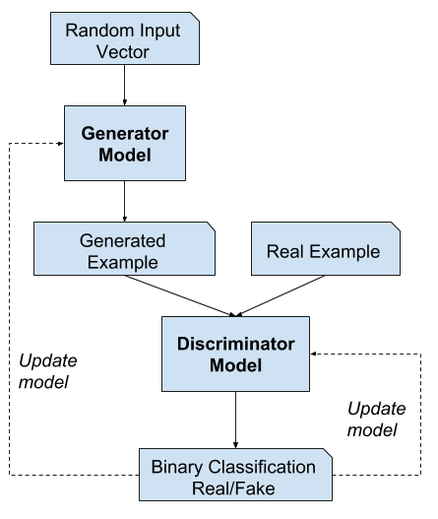
FULL Training loop

Slide 13
RESULTS
High-Quality 3D Object Generation: The VAE-GAN Fusion model successfully generated high-quality 3D objects with remarkable realism and detail. Objects exhibited fine textures, accurate geometry, and realistic lighting, contributing to their lifelike appearance.
Diverse Object Variations: The generated 3D objects displayed a diverse range of variations, spanning different shapes, styles, and complexities. This diversity in generated objects demonstrated the model's ability to capture the richness of real-world object space.
Quantitative Evaluation: Quantitative evaluation using metrics such as Fréchet Inception Distance (FID) and Inception Score (IS) confirmed the quality and diversity of the generated 3D objects.
Qualitative Assessment: Qualitative assessment by human observers further validated the realism and diversity of the generated 3D objects. Observers noted the lifelike appearance of the objects and appreciated the variety of shapes and styles produced by the model.
Application Demonstrations: The generated 3D objects were showcased in various applications, including virtual reality environments, gaming assets, digital art scenes, and product prototypes.

Slide 14
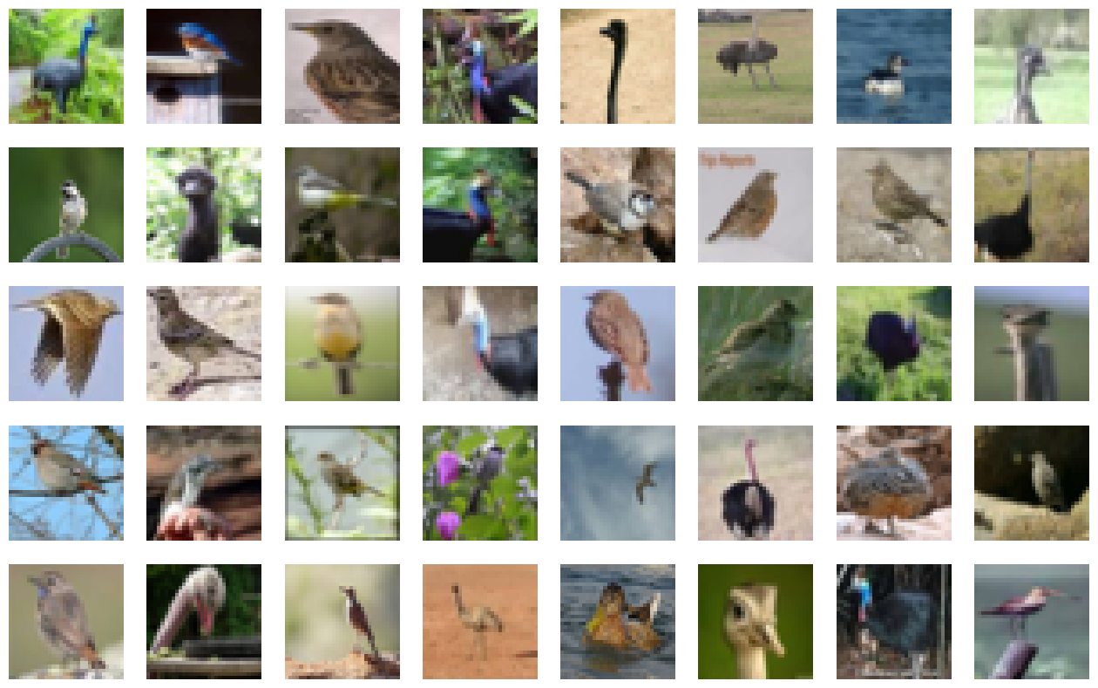
FINAL OUTPUT

Slide 15
Conclusion:
In conclusion, the fusion of Variational Autoencoders (VAEs) with Generative Adversarial Networks (GANs) for Realistic 3D Object Generation has proven to be a highly promising approach. By combining the strengths of both techniques, we have achieved remarkable levels of realism, detail, and diversity in generated 3D objects. This breakthrough opens up new possibilities for immersive experiences in virtual reality, gaming, digital content creation, and manufacturing, paving the way for exciting advancements in 3D content generation.

