Slide 1
VLSI Design Verification using System Verilog

Slide 2
Content
Introduction to SV
SystemVerilog Test Bench
Data Types
Loops
Control Flow Statements
Conditional Statement
Functions
Task
Functions & Task argument passing
SV Process
SV Communication

Slide 3
Introduction to SystemVerilog
What is System Verilog
System Verilog is a powerful hardware description and verification language (HDVL) that extends Verilog, offering advanced features for both hardware modeling and functional verification. Developed as an extension to Verilog, SystemVerilog is standardized by the IEEE as IEEE 1800 - 2017.
SystemVerilog (SV) is a powerful language that combines concepts from multiple domains, incorporating ideas from hardware description languages (HDLs), object-oriented programming (OOP), verification(assertation), randomization.
Verilog: Synthesize-able hardware description language.
Object-Oriented Programming: Enhances modularity, reusability, and maintainability in verification.

Slide 4
Introduction to SystemVerilog cont.….
Randomization: Based on Vera (Synopsys) and e(cadence), allows for random input generation with constraints to cover a wide variety of test cases.
Assertion Language: SystemVerilog adopted OpenVera Assertions for formalizing checks and ensuring the correctness of design behavior.
What is Verification ?
Complete validation of design functionality. To make sure design is bug free by verifying it in all aspects all possible scenarios.
Why system-verilog for verification?
Verilog was initially used for writing test bench .But writing complex test bench is much more of a programming task than describing hardware.
No need to synthesize test bench. So no need to constraint our self to write code into verilog. So we have come up new language for verification that is system verilog.

Slide 5
SystemVerilog Test Bench
What is Test Bench?
A testbench is a critical component in hardware verification. It is a simulated environment used to validate the functionality of a design under test (DUT).
The testbench is responsible for applying stimulus to the DUT and checking the results to ensure that the design behaves as expected.
SystemVerilog Test Bench
In SystemVerilog test bench or Verification environment is a group of classes or components. where each component is performing a specific operation. i.e, generating stimulus, driving, monitoring, etc. and those classes will be named based on the operation.

Slide 6
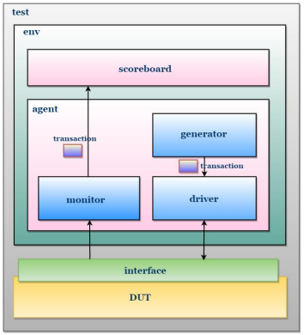
SystemVerilog Test Bench cont..…
Fig: SV Test Bench block diagram

Slide 7
SystemVerilog Test Bench cont..…
Interface
An interface in SystemVerilog is a container that groups design input-output ports, making it easier to connect, maintain, and re-use signals within the DUT.
Driver
A driver is a verification component that drives values to the DUT by calling pre-defined tasks in the interface, abstracting the timing and signal handling.
Generator
The generator creates valid data transactions, which are sent to the driver, and the driver translates them into a format that the DUT can understand.
Monitor
A monitor observes the DUT's output, converts the processed data into objects, and sends it to the scoreboard for comparison with the reference model.

Slide 8
SystemVerilog Test Bench cont..…
Scoreboard
The scoreboard compares the DUT's output with a reference model to detect functional defects by checking for discrepancies.
Environment
An environment provides flexibility and scalability, allowing multiple components to be plugged in for different verification tasks and future projects.
Test
A test configures and controls the verification environment to generate the desired stimulus and run specific scenarios, ensuring thorough validation.

Slide 9
SystemVerilog Data Types
Data object V/S Data type
A data object is an instance of a data type that holds a specific value.
A data type defines the kind of value and the operations that can be performed on it.
Data Object
There are two main groups of data objects: variables and nets. These two groups differ in the way in which they are assigned and hold values.
Net Type
There are two different kinds of net types: built-in (ex: wire, tri, supply) and user-defined (nettype). The net types can represent physical connections between structural entities, such as gates. A net shall not store a value . Instead, its value shall be determined by the values of its drivers, such as a continuous assignment or a gate

Slide 10
SystemVerilog Data Types
Variable Type
A variable is an abstraction of a data storage element. A variable shall store a value from one assignment to the next. An assignment statement in a procedure acts as a trigger that changes the value in the data storage element.
2 State V/S 4 State Data types
2 State Data Types
A data type that can hold only two values, typically 0 or 1.
Two state data types improves the performance and memory usage over four data types, two-state data types are bit (unsigned), byte, int, shortint, longint(signed).

Slide 11
SystemVerilog Data Types
4 state Data Type
A data type that can hold four values: 0, 1, unknown (x), and high-impedance (z).
Four-state data types are used in scenarios involving multi-driver systems, high-impedance buses, and error detection.
They are more flexible for modeling real-world systems but come at a cost of increased complexity.
Four-state data types in SystemVerilog include logic, wire, and reg .

Slide 12
SystemVerilog Data Types
Integral Data Type
The term "integral" refers to data types that represent basic integer types and other types that can store integer values.
shortint | 2-state data type, 16-bit signed integer
int | 2-state data type, 32-bit signed integer
longint | 2-state data type, 64-bit signed integer
byte | 2-state data type, 8-bit signed integer or ASCII character
bit | 2-state data type, user-defined vector size, unsigned
logic | 4-state data type, user-defined vector size, unsigned
reg | 4-state data type, user-defined vector size, unsigned
integer | 4-state data type, 32-bit signed integer
time | 4-state data type, 64-bit unsigned integer

Slide 13
SystemVerilog Data Types
Real Data Type
The real, shortreal, and realtime data types are used to represent floating-point numbers and real-time values.
Data Type | C Equivalent | Precision | Size | Use Case
real | double | Double precision | 64-bit | For high precision floating-point calculations
shortreal | float | Single precision | 32-bit | For floating-point calculations with less precision and memory usage
realtime |  | Time/Real | Implementation dependent | For storing simulation time and time intervals

Slide 14
SystemVerilog Data Types
Void Data Type
In SystemVerilog, the void data type represents nonexistent data or absence of a value. It is similar to how void is used in C or C++ to indicate that a function does not return any value.

Slide 15
SystemVerilog Data Types
Example
module void_example( );
function void displaythev();
$display("This function does not return any value.");
endfunction
initial
begin
displaythev();
end
endmodule

Slide 16
SystemVerilog Data Types
String Data Type
The string data type is an ordered collection of characters. The length of a string variable is the number of characters in the collection.
Variables of type string are dynamic as their length may vary during simulation.
A single character of a string variable may be selected for reading or writing by indexing the variable.
. A single character of a string variable is of type byte.

Slide 17
SystemVerilog Data Types
Operator | Semantics
Str1 == Str2 | Returns true(1) if the strings are equal, otherwise returns false(0)_.
Str1 != Str2 | Inequality. Logical negation of ==
Str1 < Str2 Str1 <= Str2 Str1 > Str2 Str1 >= Str2 | Comparison: Relational operators return 1 if the corresponding condition is true using the lexicographic ordering of the two strings Str1 and Str2.
{Str1,Str2,...,Strn} | Concatenates the strings into a single resultant string.
{multiplier{Str}} | Replicates the string N times as specified by the multiplier.
Str[index] | Accesses the byte at the given index. If index is out of range, returns 0.
Str.method(...) | The dot (.) operator is used to invoke a specified method on strings.
String Operation

Slide 18
SystemVerilog Data Types
Example
module string_opeartons;
string firstname = "Chandler";
string lastname = "Bing";
initial begin
if (firstname == lastname)
$display ("firstname=%s is EQUAL to lastname=%s", firstname, lastname);
if (firstname != lastname)
$display ("firstname=%s is NOT EQUAL to lastname=%s", firstname, lastname);
if (firstname < lastname)
$display ("firstname=%s is LESS THAN lastname=%s", firstname, lastname);
if (firstname > lastname)
$display ("firstname=%s is GREATER THAN lastname=%s", firstname, lastname);
$display ("Full Name = %s", {firstname, " ", lastname});
$display ("%s", {3{firstname}});
$display ("firstname[2]=%s lastname[2]=%s", firstname[2], lastname[2]);
end
endmodule

Slide 19
SystemVerilog Data Types
Usage | Comments
str.len() | Returns the number of characters in the string
str.putc(int i, byte c) | Replaces the ith character in the string with the given character
str.getc(int i) | Returns the ASCII code of the ith character in str
str.tolower() | Returns a string with characters in str converted to lowercase
str.compare(s) | Compares str and s, as in the ANSI C stcmp function
str.icompare(s) | Compares str and s, like the ANSI C strcmp function , but the comparison is case insensitive.
str.substr (i, j) | Returns a new string that is a substring formed by characters in position i through j of str
String Built-in Methods

Slide 20
SystemVerilog Data Types
String Conversion Methods
str.atoi() | Returns the integer corresponding to the ASCII decimal representation in str
str.atohex() | Interprets the string as hexadecimal
str.atooct() | Interprets the string as octal
str.atobin() | Interprets the string as binary
str.atoreal() | Returns the real number corresponding to the ASCII decimal representation in str
str.itoa(i) | Stores the ASCII decimal representation of i into str
str.hextoa(i) | Stores the ASCII hexadecimal representation of i into str
str.octtoa(i) | Stores the ASCII octal representation of i into str
str.bintoa(i) | Stores the ASCII binary representation of i into str

Slide 21
SystemVerilog Data Types
module string_functions_example;
string str1 = "hello, systemverilog!";
string str2 = "HELLO, SYSTEMVERILOG!";
string str3 = "SystemVerilog is fun";
string str4 = "Fun";
string str5 = "SystemVerilog";
string sub;
string extracted;
string int_str = "123";
string real_str = "45.67";
string cons1;
// Integer and real values for conversion tests
string num;
int con1;
real con2;
int number =65;
int real_val = 65;
initial begin
// 1. compare() - Case sensitive string comparison
$display("compare(): %0d", str1.compare(str2)); // Non-zero value since strings are different
// 2. lcompare() - Case insensitive string comparison
$display("lcomare(): %0d", str1.icompare(str2)); // Should return 0 as it's case-insensitive
// 3. len() - Length of the string
$display("len(): %0d", str1.len()); // Returns 22

Slide 22
SystemVerilog Data Types
// 4. substring() - Extract a substring from the string
sub = str1.substr(0, 4); // Extracts "Hello"
$display("substring(): %s", sub);
// 5. tolower() - Converts string to lowercase
$display("tolower(): %s", str2.tolower()); // "hello, systemverilog!"
// 6. toupper() - Converts string to uppercase
$display("toupper(): %s", str1.toupper()); // "HELLO, SYSTEMVERILOG!"
// 7. getc() - returns the assci code of the ith character in the string
$display("getc(): %0s",str1.getc(3));
// 8. putc() - replaces the ith character in the string with the given character
str1.putc(3,"k");
$display("putc(): %0s",str1);
// 9. to_int() - Convert a string to an integer
con1 = int_str.atoi();
$display("to_int(): %0d", con1); // Converts "123" to integer 123
// 10. to_real() - Convert a string to a real number
con2 = real_str.atoreal();
$display("to_real(): %0f",con2 );
// 11. FROM_real() - Convert a string to a real number
cons1.itoa(real_val);
$display("to_string(): %0s",cons1 );
// 14. to_string() - Convert a non-string value to a string
num = $sformatf("%0c", number);
$display("to_string(): %s", num);
end
endmodule

Slide 23
SystemVerilog Data Types
Event Data Type
An event object gives a powerful and efficient means of describing the communication between and synchronization of two or more concurrently active process.
A basic example of this is a small waveform clock generator that synchronizes control of a synchronous circuit by signaling the occurrence of an explicit event periodically while the circuit awaits for the event.

Slide 24
SystemVerilog Data Types
module events();
event my_event;
initial begin
#5 -> my_event;
$display ("clock ticked at :%0t", $time);
end
initial begin
@(my_event);
$display("Event triggred at : %0t", $time);
end
endmodule

Slide 25
SystemVerilog Data Types
Enumeration Data Type
An enumerated type defines a set of named values. The simplest enumerated type declaration contains a list of constant names and one or more variables.
enum{red,green,blue}colors
Default variable will get default values 0,1,2 respectively from red.
enum{red=0, green, blue=4,yellow, white=10,black}colors
Green,yellow and black automatically assigned to the increment value of 1,5,11respectively.
enum { red=0, green=0, blue=4, yellow, white=5, black=6 } Colors
From the above example yellow will get the increment value of 5 , the value of white is set with 5. This will cause the syntax error.

Slide 26
SystemVerilog Data Types
module enuma();
enum {red, green, yellow, white, black} Color;
integer i;
initial begin
for(i=0; i<6; i=i+1)
begin
$display("colors value of the color name %s is = %0d", Color.name,Color);
Color = Color.next;
end
end
endmodule

Slide 27
SystemVerilog Data Types
Method | Description
first() | returns the value of the first member of the enumeration
last() | returns the value of the last member of the enumeration
next() | returns the value of next member of the enumeration
next(N) | returns the value of next Nth member of the enumeration
prev() | returns the value of previous member of the enumeration
prev(N) | returns the value of previous Nth member of the enumeration
num() | returns the number of elements in the given enumeration
name() | returns the string representation of the given enumeration value
Enumeration Built-In Methods

Slide 28
SystemVerilog Data Types
Array Data Type
An array is a collection of variables, all of the same type, and accessed using the same name plus one or more indices.
Types of Arrays in SV
Static Array.
Packed Array
Unpacked Array
Dynamic Array.
Associative Array.
Queue
While packed and unpacked are not types themselves, they are modifiers that affect how arrays are declared and how the elements are stored in memory.

Slide 29
SystemVerilog Data Types
Static Arrays
In SystemVerilog Static Arrays are fixed-size arrays whose size is determined at compile time.
They are automatically created when declared and initialized to 0 by default.
There is no need to dynamically allocate or resize these arrays during simulation, and their size remains constant throughout the simulation.
Static arrays are further categorized into packed and unpacked arrays
Examples
bit [3:0] my_arr // Packed Array
bit [3:0] my_arr [5:0] // unpacked Array

Slide 30
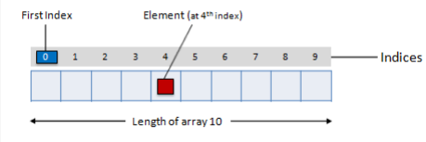
SystemVerilog Data Types
Packed Arrays
The term packed array is used to refer to the dimensions declared before the data identifier name.
Example
logic [9:0] my_data;
A one-dimensional packed array is also called as a vector.

Slide 31
SystemVerilog Data Types
module single_arry();
logic [11:0] my_data;
initial
begin
my_data = 12'hABC;
for (int i=0; i< $size(my_data); i = i+1)
begin
$display("my_data[%0d] = %0b", i, my_data[i]);
end
end
endmodule

Slide 32
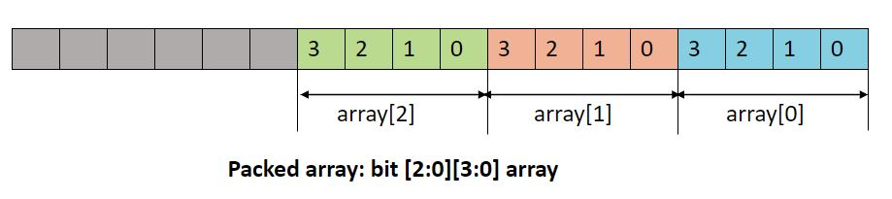
SystemVerilog Data Types
Multidimensional Packed Arrays
Multidimensional arrays are also known as an array of arrays.
Two Dimensional Packed Array
Example

Slide 33
SystemVerilog Data Types
module toodi_arry( );
bit [3:0] [7:0] my_data; // 4 outer arry of 8 bits 4x8 =32 total bits
initial begin
my_data = 32'hFABCE23E;
$display("my_data = %0h", my_data);
for (int i =0; i< $size(my_data); i = i+1)
begin
$display ("my_data[%0d] = %0h",i,my_data[i]);
end
end
endmodule

Slide 34
SystemVerilog Data Types
module tb;
bit [2:0][3:0][7:0] m_data; // An MDA, 12 bytes
initial begin
m_data[0] = 32'hface_cafe;
m_data[1] = 32'h1234_5678;
m_data[2] = 32'hc0de_fade;
$display ("m_data = 0x%0h", m_data);
foreach (m_data[i]) begin
$display ("m_data[%0d] = 0x%0h", i, m_data[i]);
foreach (m_data[i,j]) begin
$display ("m_data[%0d][%0d] = 0x%0h", i, j, m_data[i][j]);
end
end
end
endmodule

Slide 35
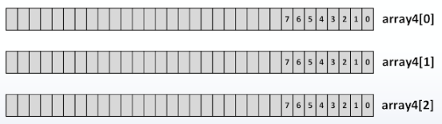
SystemVerilog Data Types
Unpacked Array
The term unpacked array is used to refer to the dimensions declared after the data identifier name.
An unpacked array may or may not be so represented as a contiguous set of bits.
Example (Single Dimensional )
Bit [7:0]array1[2:0];

Slide 36
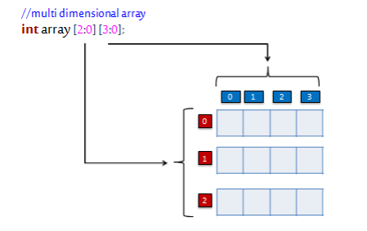
SystemVerilog Data Types
Multidimensional Packed Arrays
The data in a two-dimensional array is stored in a tabular form.
Example:

Slide 37
SystemVerilog Data Types
module t_unpacked_arry();
byte my_data [2:0] [3:0];
initial
begin
foreach (my_data[i, j]) begin
my_data[i] [j] = $random;
$display ("my data at [%0h] [%0h] is",i, j, my_data[i][j]);
end
$display ("my data is : %0p", my_data);
end
endmodule

Slide 38
SystemVerilog Data Types
Dynamic Array
A dynamic array is one dimension of an unpacked array whose size can be set or changed at run-time.
Dynamic array is Declared using an empty word subscript [ ].
The space for a dynamic array doesn’t exist until the array is explicitly created at run-time, space is allocated when new[number] is called.
Function | Description
.new[] | allocates the storage
.size() | returns the current size of a dynamic array.
.delete() | empties the array, resulting in a zero-sized array

Slide 39
SystemVerilog Data Types
module d_arry;
int arry [];
int idi [];
initial begin
arry = new [5];
arry = '{1, 2, 3, 4, 5};
idi = arry;
$display ("id = %p", idi);
idi = new [idi.size() + 1] (idi);
idi [idi.size() - 1] = 6;
$display ("New id = %p", idi);
$display ("array.size() = %0d, id.size() = %0d", arry.size(), idi.size());
end
endmodule

Slide 40
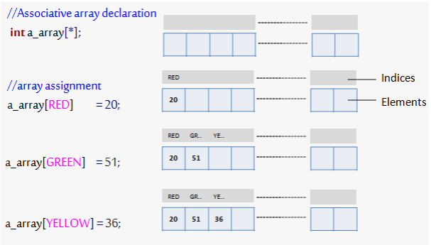
SystemVerilog Data Types
Associative Array
Associative arrays allocate the storage only when it is used, unless like in the dynamic array we need to allocate memory before using it.
When the size of the collection is unknown or the data space is sparse, an associative array is a better option.
Example
int a_array1[*];
bit[31:0]a_array2[string];

Slide 41
SystemVerilog Data Types
Associative Array Methods
Method | Description
num() | returns the number of entries in the associative array
delete(index) | removes the entry at the specified index.exa_array.delete(index)
exists(index) | returns 1 if an element exists at the specified index else returns 0
first(var) | assigns the value of first index to the variable var
last(var) | assigns the value of last index to the variable var
next(var) | assigns the value of next index to the variable var
prev(var) | assigns the value of previous index to the variable var

Slide 42
SystemVerilog Data Types
Array Built in Methods
There are many array built-in methods in System Verilog to help in array searching , ordering and manipulating.
Array Locator Methods
Mandatory with Clause
Method Name | Description
find() | Returns all elements satisfying the given expression
find_index() | Returns the indices of all elements satisfying the given expression
find_first() | Returns the first element satisfying the given expression
find_first_index() | Returns the index of the first element satisfying the given expression
find_last() | Returns the last element satisfying the given expression
find_last_index() | Returns the index of the last element satisfying the given expression

Slide 43
SystemVerilog Data Types
module arry_built_in();
int arry [9] = '{4,8,9,3,2,1,5,6,3};
int next[$];
initial begin
next = arry.find(x) with (x<3);
$display("arry less than 3 is : %0p",next);
next = arry.find_index with (item == 1);
$display("array equal to 1 is : n[%0d] = 1",next[0]);
next = arry.find_first(x) with (x<9 & x>4 );
$display ("array first find less than 9 and greater than 4 is : %0d",next[0]);
next = arry.find_first_index with (item <9 & item >4);
$display ("array find first index with leass than 9 and greater than 4 is : %0d", next[0]);
next = arry.find_last (x)with (x<9 & x>4);
$display ("array last find less than 9 and greater than 4 is : %0d",next[0]);
next = arry.find_last_index (x) with (x<9 & x>4);
$display ("array last index less than 9 and greater than 4 is : %0d",next[0]);
end
endmodule

Slide 44
SystemVerilog Data Types
Optional with Clause
Methods | Description
min() | Returns the element with minimum value or whose expression evaluates to a minimum
max() | Returns the element with maximum value or whose expression evaluates to a maximum
unique() | Returns all elements with unique values or whose expression evaluates to a unique value
unique_index() | Returns the indices of all elements with unique values or whose expression evaluates to a unique value

Slide 45
SystemVerilog Data Types
module arry_built_in;
int arry[9] = '{4, 6, 9, 23, 48, 92, 74, 65, 78};
int res[$] ;
initial
begin
res = arry.max();
$display("the max value of the given array is : %0d", res[0]);
res = arry.min();
$display("the minium value of the given array is : %0d", res[0]);
res = arry.unique();
$display("the unique way is : %0p",res);
end
endmodule

Slide 46
SystemVerilog Data Types
Array Ordering Methods
Methods | Description
reverse() | Reverses the order of elements in the array
sort() | Sorts the array in ascending order, optionally using with clause
rsort() | Sorts the array in descending order, optionally using with clause
shuffle() | Randomizes the order of the elements in the array. with clause is not allowed here.

Slide 47
SystemVerilog Data Types
Array Reduction Methods
Method | Description
Sum() | sum of all array elements
Product() | product of all array elements
And() | bitwise AND (&) of all array elements
Or() | bitwise OR (|) of all array elements
Xor() | XOR (^) of all array elements

Slide 48
SystemVerilog Data Types
module arry_built_in;
int arry[9] = '{23, 56, 87, 1, 30, 09, 14, 23, 47};
initial
begin
arry.reverse();
$display("the revers order is the :%0p",arry);
arry.sort();
$display("the assending order is : %p",arry);
arry.rsort();
$display ("the desending order is : %0p", arry);
for(int i =0; i<4;i=i+1) begin
arry.shuffle();
$display("shuffle generated at %0d is %0p", i,arry);
end
$display ("and operation of the array %0d: ", arry.xor());
end
endmodule

Slide 49
SystemVerilog Data Types
Queue in SystemVerilog
A queue is a variable-size, ordered collection of homogeneous elements.
like a dynamic array, queues can grow and shrink.
queue supports adding and removing elements anywhere.
Queues are declared using the same syntax as unpacked arrays, but specifying $ as the array size.
In queue 0 represents the first, and $ representing the last entries.

Slide 50
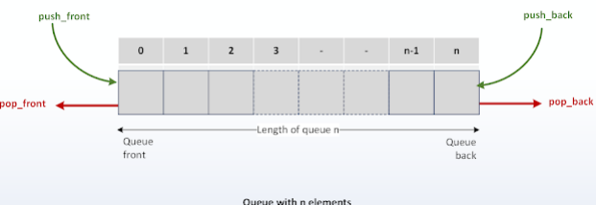
SystemVerilog Data Types
A queue can be bounded or unbounded.
bounded queue – queue with the number of entries limited or queue size specified.
byte queue_3[$:7]; // queue of byte (bounded queue with 7 entries)

Slide 51
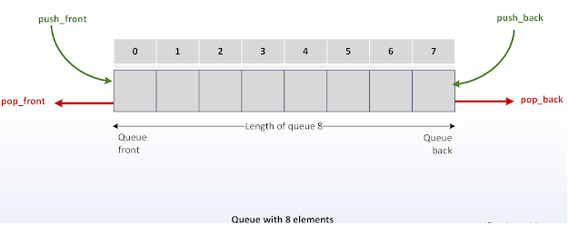
SystemVerilog Data Types
A queue can be bounded or unbounded.
unbounded queue – queue with unlimited entries or queue size not specified.
bit queue_1[$]; // queue of bits (unbound queue)

Slide 52
SystemVerilog Data Types
module queue_arry();
string my_arry [$] = '{"pineapple", "bananna", "avacado", "cheery"};
initial begin
foreach(my_arry[i]) begin
$display ("the fruits at my_arry[%0d] is : %0s",i,my_arry[i]);
end
my_arry = {my_arry, "oranges"};
$display ("now the arry is : %0p", my_arry);
my_arry = {"strawberry", my_arry};
$display (" now the arry is : %0p", my_arry);
my_arry[0] = "blueberry";
$display ("after replacing thge strawberry :%0p", my_arry);
my_arry = my_arry[1:$-1];
$display ("after removing array is : %0p", my_arry);
end
endmodule

Slide 53
SystemVerilog Data Types
Queue Built-in Methods
Method | Description
size() | returns the number of items in the queue
insert(index, value) | inserts the given item at the specified index position
delete(index) | deletes the item at the specified index position
push_front(value) | inserts the given element at the front of the queue
push_back(value) | inserts the given element at the end of the queue
pop_front() | removes and returns the first element of the queue
pop_back() | removes and returns the last element of the queue

Slide 54
SystemVerilog Data Types
module queue_arry();
string bikes[$];
initial begin
bikes = '{"honda","bajaj","yamaha","hero","ktm","royal_enfield","tvs"};
$display("\n the total size of the given array is %0d",bikes.size());
bikes.push_front("harley");
$display("after adding the harley: %0p",bikes);
bikes.push_back("Triumph");
$display("after adding triumph in the last : %0p",bikes);
bikes.delete(7);
$display("after removing the tvs %0p", bikes);
bikes.insert(7,"tata");
$display("after adding the car: %0p", bikes);
$display("the last bike i.e %0s is removed : %0p", bikes.pop_back(), bikes);
$display("removing the front bike i.e %0s is removed: %0p", bikes.pop_front(), bikes);
end
endmodule

Slide 55
SystemVerilog Data Types
SystemVerilog Struct
The SystemVerilog struct groups the data types of multiple types. The entire group can be referenced as a whole, or the individual data type can be referenced by name.
Types of Struct
Packed Struct :
SystemVerilog Packed Struct defined with the keyword Packed is referred as packed struct .Only packed data types and integer data types are allowed with in the packed struct.
Example
struct packed{ logic [3:0] alpha; logic [2:0] beta; logic gama;} data;

Slide 56
SystemVerilog Data Types
module structer_both();
struct packed{
logic [3:0] alpha;
logic [2:0] beta;
logic gama;} data;
initial begin
data = 8'hAb;
$display("the data is given at a time to all fileds as the it is a packed structure : %0h and each file can be seen as a: %0h| b: %0b | g: %0b", data, data.alpha, data.beta, data.gama);
end
endmodule

Slide 57

SystemVerilog Data Types
Unpacked Struct :
SystemVerilog UnPacked Struct By default struct is of Unpacked type, i.e struct without Packed keyword.
Example
struct{ int a; byte b; bit[7:0]c} data;

Slide 58
SystemVerilog Data Types
module structer_both();
struct {
logic [3:0] alpha;
logic [2:0] beta;
logic gama;
} data;
initial begin
data.alpha = 4'hA;
data.beta = 3'b101;
data.gama = 1'b1;
$display("In unpaked each data filed is given data seprately as it has seprate memory allocation \n %0b data.a %0h| data.b: %0b| data.c: %0b",data,data.alpha, data.beta, data.gama);
end
endmodule

Slide 59
SystemVerilog Data Types
SystemVerilog Union
A union in SystemVerilog is a data structure that allows you to store different data types in the same memory location.
Unlike a struct, where each member gets its own memory, a union only allocates enough memory to store the largest member.
This means that at any given time, a union can hold only one of its members, but it can be of different types.
Example
union {
logic [7:0] byte_data; // 8-bit field
int signed_data; // 32-bit field
bit [15:0] short_data; // 16-bit field} data;

Slide 60
SystemVerilog Data Types
module Union();
union { logic [31:0] alpha;
int beta;
shortint gamma;} data;
initial begin
data.alpha = 32'hABCDEF13;
$display("the stored data is: %0h and the alpha data is : %0h and the beta is %0h", data,data.alpha,data.beta);
data.beta = 32'h12CDEF13;
$display("the stored data is: %0h and the alpha data is : %0h and the beta is %0h", data,data.alpha,data.beta);
end
endmodule

Slide 61
SystemVerilog Data Types
SystemVerilog User Define Data Type
In complex testbenches, some variable declarations may involve long or complex data-type specifications, or the same data type might need to be used in multiple locations within the code.
To simplify this, a typedef can be used to create a user-defined name for an existing data type. This new name can then be used consistently throughout the code, making it easier to manage.
If the data type needs to be modified, only the typedef definition needs to be changed, rather than updating it in every place it is used, thus improving maintainability and reducing errors.

Slide 62
SystemVerilog Data Types
Example
typedef enum {RED, YELLOW, GREEN} e_light;
typedef bit [7:0] ubyte;

Slide 63
SystemVerilog Data Types
module enu();
typedef enum {red=0, green=1, yellow=2, blue=3} color_t;
color_t Color;
initial
begin
Color = yellow;
$display("Color.first: %0d", Color.first);
$display("Color.last: %0d", Color.last);
$display("Color.next : %0d", Color.next);
$display("Color.prev : %0d", Color.prev);
$display("Color.name : %0s", Color.name);
end
endmodule

Slide 64
SystemVerilog Loops
A loop is a block of code designed to execute repeatedly.
Typically, a conditional statement is included to control when the loop should stop running, ensuring it terminates once a specific condition is met.
Without such a condition, the loop may run endlessly, causing the simulation to get stuck in an infinite execution state.
Forever | Runs the statements forever
Repeat | Repeats given set of statement for given number of times.
While | Repeats given set of statement until the condition is true.
For | Repeats given set of statement until the condition is true.
Do while | Repeats given set of statement atleast once and loops until the condition is true.
foreach | Used mainly for array to iterate through all the elements

Slide 65
SystemVerilog Loops
Forever Loop
As the name says forever loop will execute the statements inside the loop forever.
It can be said as indefinite iteration.
Example
forever begin
//statement - 1
.......
//statement - n
end

Slide 66
SystemVerilog Loops
module loop_example();
int a;
initial begin
$dumpfile("waveform.vcd");
$dumpvars(0, loop_example);
forever begin
a=$random;
$display("the random value of a in loop is : %0h", a);
#10;
end
end
initial begin
#50 $finish;
end
endmodule

Slide 67
SystemVerilog Loops
Repeat Loop
Repeat will execute the statements within the loop for a loop variable number of times.
If the loop variable is N, then the statements within the repeat block will be executed N number of times.
Example:
repeat (<variable>) begin
//statement -1
…..
//statement – 2
end

Slide 68
SystemVerilog Loops
module repeat_example();
byte a;
initial
begin
$dumpfile("waveform1.vcd");
$dumpvars(0,repeat_example);
repeat(5) begin
a=$random %8'h9;
$display(" generating value in side the repeat loop is :%oh", a);
#10;
end
end
endmodule

Slide 69
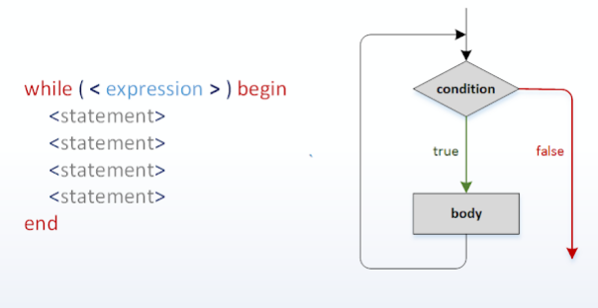
SystemVerilog Loops
While Loop
A while loop is a control flow statement that allows code to be executed repeatedly based on a given condition.
Example

Slide 70
SystemVerilog Loops
module while_example();
bit clk;
bit [3:0] counter;
always #5 clk = ~clk;
initial begin
clk =0;
counter = 4'b0000;
$display("the counter initial value is : %0b", counter);
$dumpfile("waveform.vcd");
$dumpvars(0, while_example);
end
always@(posedge clk) begin
while (counter <10) begin
counter++;
$display("the counter value is : %0b", counter );
@(posedge clk);
end
$display("the counter has reaced the value 10: %0b", counter );
#10 $finish;
end
endmodule

Slide 71
SystemVerilog Loops
Do-While Loop
A do while loop is a control flow statement that allows code to be executed repeatedly based on a given condition.
In do-while, the condition will be checked after the execution of statements inside the loop the condition can be any expression.
do-while is similar to while loop but in case of while loop execution of statements happens only if the condition is true.
In a do while, statements inside the loop will be executed at least once even if the condition is not satisfied.

Slide 72
SystemVerilog Loops
Example

Slide 73
SystemVerilog Loops
module do_while_example();
bit clk;
bit [3:0] counter;
always #5 clk = ~clk;
initial begin
clk =0;
counter = 4'b0000;
$display("the counter initial value is : %0b", counter);
$dumpfile("waveform.vcd");
$dumpvars(0, do_while_example);
end
always@(posedge clk) begin
do begin
counter++;
$display("the counter value is : %0b", counter );
@(posedge clk);
end while (counter <11);
$display("the counter has reaced the value 10: %0b", counter );
#10 $finish;
end
endmodule

Slide 74
SystemVerilog Loops
For Loop
SystemVerilog for loop is enhanced for loop of Verilog.
Example
for(initialization; condition; modifier) begin
//statement - 1
//statement – n
end

Slide 75
SystemVerilog Loops
Initialization: executed first, and only once. This allows the user to declare and initialize loop control variables.
Condition: the condition is evaluated. If it is true, the body of the loop is executed, else the flow jumps to the statement after the ‘for’ loop.
Modifier: at the end of each iteration it will be executed, and execution moves to Condition.

Slide 76
SystemVerilog Loops
module for_loop_example();
bit clk;
bit [3:0] counter;
initial begin
clk =0;
counter =4'b0000;
$dumpfile("waveform.vcd");
$dumpvars(0,for_loop_example);
end
always #5 clk = ~clk;
always@(posedge clk) begin
for(int i=0; i<11;i= i+1) begin
counter++;
#10 $display("the counter value is : %0b", counter);
end
$display("counter is at the value 11: %0b",counter );
#10 $finish;
end
endmodule

Slide 77
SystemVerilog Loops
Foreach Loop
SystemVerilog foreach specifies iteration over the elements of an array.
The loop variable is considered based on elements of an array and the number of loop variables must match the dimensions of an array.
Example
foreach(<variable>[<iterator>])
begin
//statement - 1
...
//statement - n
end

Slide 78
SystemVerilog Loops
module foreach_example();
logic[4:0] my_arry[5][2] = '{'{1,2}, '{3,4}, '{5,6}, '{7, 8}, '{9, 10}};
initial begin
$dumpfile("waveform.vcd");
$dumpvars(0,foreach_example);
foreach(my_arry[i])begin
foreach(my_arry[i][j])begin
$display("my_arry[%0d][%0d] = %0d",i,j,my_arry[i][j]);
end
end
$monitor("the total array is :",my_arry);
end
endmodule

Slide 79
SystemVerilog Control Flow Statements
Control Flow Statements
In SystemVerilog the control flow statements used inside loops to modify or to allow precise control over loop behavior and program flow.
Statement | Purpose
Break | Exit the loop immediately
continue | Skip the current iteration
return | Exit a function or task
disable | Exit a specific named block or loop
wait | Wait until a condition becomes true

Slide 80
SystemVerilog Control Flow Statements
Break
The break statement terminates the execution of the loop immediately and exits the loop entirely.
Continue
The continue statement skips the current iteration of the loop and jumps to the next iteration.
The loop does not exit it simply moves to the next iteration.
Return
Used to exit a function, task, or block immediately, regardless of the loop or condition.
If used inside a loop in a task or function, it terminates execution of the task or function, not just the loop.

Slide 81
SystemVerilog Control Flow Statements
Disable
Used to terminate a named block, including loops, tasks, and fork-join blocks.
Allows finer control by explicitly targeting a block to terminate.
Wait
Suspends execution until a specified condition becomes true.
Often used for level-sensitive control rather than iteration.

Slide 82
SystemVerilog Conditional Statements
Conditional Statements
The conditional if else statement is used to make a decision about whether a statement is executed.
A SystemVerilog case statement checks whether an expression matches one of a number of expressions and branches appropriately. The behavior is the same as in Verilog.
SystemVerilog if else Statement
SystemVerilog introduced the following if else constructs for violation checks.
unique-if
unique0-if
priority-if

Slide 83
SystemVerilog Conditional Statements
unique-if, unique0-if
unique-if evaluates conditions in any order and does the following :
report a warning when none of the if conditions match unless there is an explicit else.
report an error when there is more than 1 match found in the if else conditions.
Unlike unique-if, unique0-if does not report a violation if none of the conditions match.

Slide 84
SystemVerilog Conditional Statements
module uinque_if_example;
int x =5;
initial
begin
unique if(x ==4)
$display("X is given : %0d",x);
else if(x==3)
$display("X is give : %0d",x);
//else
// $display("X is nither 3 or 4");
end
endmodule

Slide 85
SystemVerilog Conditional Statements
priority-if
priority-if evaluates all conditions in sequential order and a violation is reported when:
None of the conditions are true or if there's no else clause to the final if construct

Slide 86
SystemVerilog Conditional Statements
module priority_if_esle_example;
int x =7;
initial
begin
priority if(x !=4)
$display("the the X is not equal to 4 : %0d",x);
else if(x == 7)
$display("the given x value is: %0d",x);
//else
//$display("the give x value is nither 4 or 8");
end
endmodule

Slide 87
SystemVerilog Conditional Statements
SystemVerilog case statement
All case statements can be qualified by unique or unique0 keywords to perform violation checks like we saw in if-else-if construct.
unique and unique0 ensure that there is no overlapping case items and hence can be evaluated in parallel. If there are overlapping case items, then a violation is reported.
If more than one case item is found to match the given expression, then a violation is reported and the first matching expression is executed
If no case item is found to match the given expression, then a violation is reported only for unique
unique0 does not report a violation if no items match the expression

Slide 88
SystemVerilog Conditional Statements
module unique_case_example;
bit [3:0] data;
initial begin
data =5;
unique case(data)
0:$display("the given data is 0");
1:$display("the given data is 1");
3: $display("the given data is 3");
// default:$display("no match");//then it will not show the warning
//test case when multiple data are same
//5:$display("the given data is :%0d", data);
//4:$display("the given data is 4");
// 5:$display("the given data again is : %0d",data);
endcase
end
endmodule

Slide 89
SystemVerilog Functions
System Verilog Functions
A Function can contain declarations of range, returned type, parameters, input arguments, registers, and events.
A function without a range or return type declaration returns a one-bit value
Any expression can be used as a function call argument
Functions cannot contain any time-controlled statements, and they cannot enable tasks
Functions can return only one value.

Slide 90
SystemVerilog Functions
SystemVerilog function can be
static
automatic
Static Function
Static functions share the same storage space for all function calls.
Automatic Function
Automatic functions allocate unique, stacked storage for each function call.

Slide 91
SystemVerilog Functions
module static_example;
function int increment(input int value);
static int counter = 0;
counter = counter + value;
return counter;
endfunction
initial begin
$display("Call 1: %0d", increment(1));
$display("Call 2: %0d", increment(2));
$display("Call 3: %0d", increment(3));
end
endmodule
module automatic_function_example;
function automatic int increment(input int value);
int counter =0;
counter =counter +value;
return counter;
endfunction
initial begin
$display("count 1: %0d",increment(1));
$display("count 2: %0d",increment(2));
$display("count 3: %0d",increment(6));
end
endmodule

Slide 92
SystemVerilog Functions
SystemVerilog allows
To declare an automatic variable in static functions
To declare the static variable in automatic functions
More capabilities for declaring function ports
Multiple statements within a function without requiring a begin…end or fork…join
Returning from the function before reaching the end of the function
Passing values by reference, value, names, and position
Default argument values
Default argument type is logic if no type has been specified.
Function output and inout ports
The default direction of argument is input if no direction has been specified.

Slide 93
SystemVerilog Task
SystemVerilog Task
A function is meant to do some processing on the input and return a single value, whereas a task is more general and can calculate multiple result values and return them using output and inout type arguments.
Tasks can contain simulation time consuming elements such as @, posedge and others
SystemVerilog Task can be
Static Task.
Automatic Task.
Global Task.

Slide 94
SystemVerilog Task
Static Task
Static tasks share the same storage space for all task calls.
Automatic Task
Automatic tasks allocate unique, stacked storage for each task call.
Global Task
Tasks that are declared outside all modules are called global tasks as they have a global scope and can be called within any module.
If the task was declared within the module, it would have to be called in reference to the module instance name.

Slide 95
SystemVerilog Task
module static_task;
initial begin
display();
#1 display();
#1 display();
#1 display();
end
//add automatic for automatic task ..
task display();
integer i =0;
begin
i=i+1;
$display("the value of I : %0b",i);
end
endtask
endmodule

Slide 96
SystemVerilog Task
//declared as global task
task display();
$display("Hello World !");
endtask
module global_task_example;
initial begin
display();
end
endmodule
// when declared inside the module
module tb;
des u0();
initial begin
u0.display();
end
endmodule
module des;
initial begin
display();
end
task display();
$display("Hello World");
endtask
endmodule

Slide 97
SystemVerilog Task
SystemVerilog allows,
To declare an automatic variable in a static task
To declare a static variable in an automatic task
More capabilities for declaring task port multiple statements within task without requiring a begin…end or fork…join block
Returning from the task before reaching the end of the task
Passing values by reference, value, names, and position
Default argument values
The default direction of argument is input if no direction has been specified
Default arguments type is logic if no type has been specified

Slide 98
Task and Function Argument Passing
SystemVerilog provides below means for passing arguments to functions and tasks,
argument pass by value
argument pass by reference
argument pass by name
argument pass by position
Also, functions and tasks can have default argument values.

Slide 99
Task and Function Argument Passing
Argument pass by value
In argument pass by value, the argument passing mechanism works by copying each argument into the subroutine area.
If any changes to arguments within the subroutine, those changes will not be visible outside the subroutine.

Slide 100
Task and Function Argument Passing
module arg_value_example;
int a, res;
initial begin
a =$urandom_range(3,10);
$display("the vale of a:%0d and res: %0d", a,res);
res = fn(a);
$display("the vale of a:%0d and res: %0d", a,res);
end
function int fn(input int a);
a= a+5;
return a*10;
endfunction
endmodule

Slide 101
Task and Function Argument Passing
Argument pass by reference
In pass by reference, a reference to the original argument is passed to the subroutine.
As the argument within a subroutine is pointing to an original argument, any changes to the argument within subroutine will be visible outside.
To indicate argument, pass by reference, the argument declaration is preceded by keyword ref.
Any modifications to the argument value in a pass by reference can be avoided by using const keyword before ref, any attempt in changing the argument value in subroutine will lead to a compilation error.
Its illegal to use argument passing by reference for subroutines with a lifetime of static.

Slide 102
Task and Function Argument Passing
module arg_value_example;
int a, res;
initial begin
a =$urandom_range(3,10);
$display("the vale of a:%0d and res: %0d", a,res);
res = fn(a);
$display("the vale of a:%0d and res: %0d", a,res);
end
function automatic int fn(ref int a);
a= a+5;
return a*10;
endfunction
endmodule

Slide 103
Task and Function Argument Passing
Argument pass by name
In argument pass by name, arguments can be passed in any order by specifying the name of the subroutine argument.
Value to the second argument is passed first by specifying the argument name.

Slide 104
Task and Function Argument Passing
module argument_passing;
int x,y,z;
function void display(int x,string y);
$display("\tValue of x = %0d, y = %0s",x,y);
endfunction
initial begin
display(.y("Hello World"),.x(2016));
end
endmodule

Slide 105
Task and Function Argument Passing
Default argument values
The default value can be specified to the arguments of the subroutine.
In the subroutine call, arguments with a default value can be omitted from the call.
If any value is passed to an argument with a default value, then the new value will be considered.

Slide 106
Task and Function Argument Passing
module argument_passing;
int q;
function int sum(int x=5,y=10,z=20);
return x+y+z;
endfunction
initial begin
q = sum( ,5 ,10);
$display("\tValue of q = %0d",q);
q= sum(5, ,10);
$display("\tValue of q = %0d",q);
end
endmodule

Slide 107
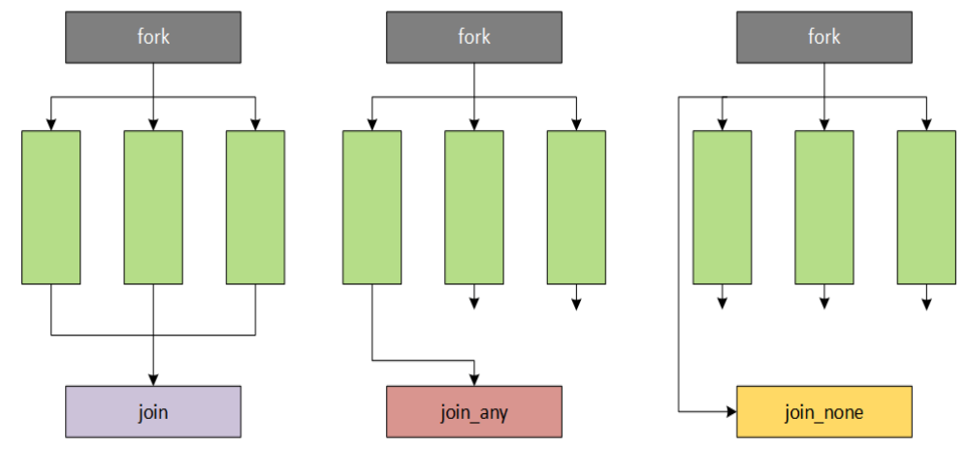
SystemVerilog Processes
SystemVerilog Threads
A thread or process is any piece of code that gets executed as a separate entity.
In verilog, each of the initial and always blocks are spawned off as separate threads that start to run in parallel from zero time.
A fork join block also creates different threads that run in parallel.
There are three different styles of fork join in SystemVerilog.

Slide 108
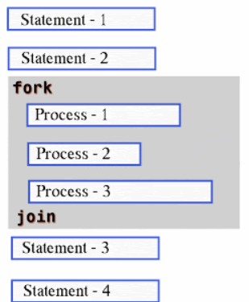
SystemVerilog Processes
Fork Join
Fork-Join will start all the processes inside it parallel and wait for the completion of all the processes.
Syntax
fork
// Thread 1
// Thread 2
// ...
// Thread 3
join

Slide 109
SystemVerilog Processes
module for_join_example;
initial begin
fork
#50 $display("[%0t] thread 1 is finished",$time);
begin
#10 $display("[%0t] thread 2 is strated......", $time);
#20 $display("[%0t] thread 2 is finished......", $time);
end
#5 $display("[%0t] thread 3 is finished.........", $time);
join
$display("[%0t] Main thread : fork join has finished", $time);
end
endmodule

Slide 110
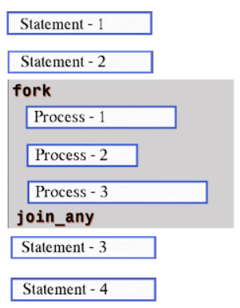
SystemVerilog Processes
Fork join_any
Fork-Join_any will be unblocked after the completion of any of the Processes.
Syntax
fork
// Thread 1
// Thread 2
// ...
// Thread N
join_any

Slide 111
SystemVerilog Processes
module fork_join_any_example;
initial begin
fork
print(40,"thread_1");
print(20,"thread_2");
print(10,"thread_3");
join_any
$display("Main thread: frok join_any finished");
end
task automatic print( int _time, string name);
#(_time) $display("[%0t]::%0s",$time,name);
endtask
endmodule

Slide 112
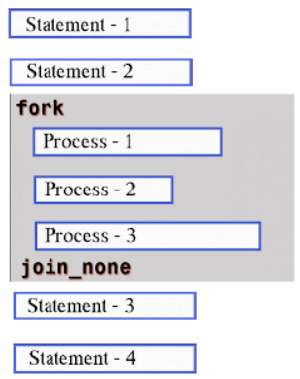
SystemVerilog Processes
Fork join_none
As in the case of Fork-Join and Fork-Join_any fork block is blocking, but in case of Fork-Join_none fork block will be non-blocking.
Processes inside the fork-join_none block will be started at the same time, fork block will not wait for the completion of the Process inside the fork-join_none.
Syntax
fork
// Thread 1
// Thread 2
// ...
// Thread N
join_none

Slide 113
SystemVerilog Processes
module fork_join_none_example;
initial begin
$display ("[%0t] Main Thread: Fork join going to start", $time);
fork
print (20, "Thread1_0");
print (30, "Thread1_1");
print (10, "Thread2");
join_none
$display ("[%0t] Main Thread: Fork join has finished", $time);
end
task automatic print (int _time, string t_name);
#(_time) $display ("[%0t] %s", $time, t_name);
endtask
endmodule

Slide 114
SystemVerilog Processes
Wait Fork
wait fork causes the process to block until the completion of all processes started from fork blocks.
Syntax
fork
// Thread 1
// Thread 2
// ...
// Thread N
join_none
//statements.....
wait fork;

Slide 115
SystemVerilog Processes
module fork_wait_example;
initial begin
fork
#40 $display ("[%0t ns] Show #40 $display statement", $time);
begin
#20 $display ("[%0t ns] Show #20 $display statement", $time);
#50 $display ("[%0t ns] Show #50 $display statement", $time);
end
#60 $display ("[%0t ns] TIMEOUT", $time);
join_any
$display ("[%0t ns] Fork join is done, wait fork to end", $time);
wait fork;
$display ("[%0t ns] Fork join is over", $time);
end
endmodule

Slide 116
SystemVerilog Processes
Fork Disable
disable fork causes the process to kill/terminate all the active processes started from fork blocks
Syntax
fork
// Thread 1
// Thread 2
// ...
// Thread N
join_none
disable fork;

Slide 117
SystemVerilog Processes
module disable_fork_example;
initial begin
fork
#40 $display ("[%0t ns] Show #40 $display statement", $time);
begin
#20 $display ("[%0t ns] Show #20 $display statement", $time);
#50 $display ("[%0t ns] Show #50 $display statement", $time);
end
#60 $display ("[%0t ns] TIMEOUT", $time);
join_any
$display ("[%0tns] Fork join is done, let's disable fork", $time);
disable fork;
end
endmodule

Slide 118
SystemVerilog Communication
Components in a testbench often need to communicate with each other to exchange data and check output values of the design.
A few mechanisms that allow components or threads to affect the control flow of data are shown in the table below.
Semaphores | Different threads might need to access the same resource; they take turns by using a semaphore
Mailbox | Threads/Components need to exchange data with each other; data is put in a mailbox and sent

Slide 119
SystemVerilog Communication
Semaphore
Semaphore is a SystemVerilog built-in class, used for access control to shared resources, and for basic synchronization.
A semaphore is like a bucket with the number of keys. processes using semaphores must first procure a key from the bucket before they can continue to execute.
All other processes must wait until a sufficient number of keys are returned to the bucket.
Imagine a situation where two processes try to access a shared memory area.
where one process tries to write and the other process is trying to read the same memory location. this leads to an unexpected result. A semaphore can be used to overcome this situation.

Slide 120
SystemVerilog Communication
Name | Description
new( ); | Specifies number of keys initially allocated to the semaphore bucket
put( ); | Specifies the number of keys being returned to the semaphore
get( ); | Specifies the number of keys to obtain from the semaphore
try_get(); | Specifies the required number of keys to obtain from the semaphore
Semaphore Built in Methods

Slide 121
SystemVerilog Communication
module semaphore_example;
semaphore key;
initial begin
key = new (1);
fork
personA ();
personB ();
#25 personA ();
join_none
end
task getRoom (bit [1:0] id);
$display ("[%0t] Trying to get a room for id[%0d] ...", $time, id);
key.get (1);
$display ("[%0t] Room Key retrieved for id[%0d]", $time, id);
endtask
task putRoom (bit [1:0] id);
$display ("[%0t] Leaving room id[%0d] ...", $time, id);
key.put (1);
$display ("[%0t] Room Key put back id[%0d]", $time, id);
endtask
task personA ();
getRoom (1);
#20 putRoom (1);
endtask
task personB ();
#5 getRoom (2);
#10 putRoom (2);
endtask
endmodule

Slide 122
SystemVerilog Communication
Mailbox
A mailbox is a communication mechanism that allows messages to be exchanged between processes.
The process which wants to talk to another process posts the message to a mailbox, which stores the messages temporarily in a system defined memory object, to pass it to the desired process.
Based on the sizes mailboxes are categorized as,
Bounded mailbox
Unbounded mailbox

Slide 123
SystemVerilog Communication
A bounded mailbox is with the size defined. mailbox becomes full when on storing a bounded number of messages. A process that attempts to place a message into a full mailbox shall be suspended until enough space becomes available in the mailbox queue.
Unbounded mailboxes are with unlimited size.
Mailbox types
There are two types of mailboxes,
Generic Mailbox
Parameterized mailbox

Slide 124
SystemVerilog Communication
Generic Mailbox (type-less mailbox)
The default mailbox is type-less. that is, a single mailbox can send and receive data of any type.
Syntax
mailbox mailbox_name;
Parameterized mailbox (mailbox with particular type)
Parameterized mailbox is used to transfer a data of particular type.
Syntax
mailbox#(type) mailbox_name;

Slide 125
SystemVerilog Communication
Function | Description
new(); | Create a mailbox
num(); | Returns the number of messages in the mailbox
put(); | Place a message in a mailbox
try_put(); | Try to place a message in a mailbox without blocking
get(); | Retrieve a message from a mailbox
try_get() | Try to retrieve a message from a mailbox without blocking
peek() | Copies one message from the mailbox without removing the message from the mailbox.
try_peek() | Tries to copy one message from the mailbox without removing the message from mailbox

Slide 126
SystemVerilog Communication
typedef int message_t;
module mailbox_example;
// Create a mailbox instance
mailbox my_mailbox = new();
// Sender process
task sender_task();
message_t msg;
$display("Sender starting...");
// Send 5 messages to the mailbox
for (int i = 0; i < 5; i++) begin
msg = i + 10;
my_mailbox.put(msg); // put() sends a message
$display("Sender sent message: %0d", msg);
#5; // Wait for a short time
end
$display("Sender finished.");
endtask
// Receiver process
task receiver_task();
message_t msg;
$display("Receiver starting...");
// Wait for and receive 5 messages from the mailbox
for (int i = 0; i < 5; i++) begin
my_mailbox.get(msg); // get() waits for and receives a message
$display("Receiver received message: %0d", msg);
end
$display("Receiver finished.");
endtask
// Initial block to start the processes
initial begin
fork
sender_task();
receiver_task();
join
end
endmodule

Slide 127
SystemVerilog Communication
typedef mailbox #(string) s_box;
class comp1;
s_box names;
string s;
task send();
for (int i=1;i<3; i++)
begin
s =$sformatf ("name_%0d", i);
#1 $display("[%0t] comp1: put %s", $time,s);
names.put(s);
end
endtask
endclass
class comp2;
s_box list;
task recive();
forever begin
string s;
list.get(s);
$display("[%0t] comp2: get %s",$time,s);
end
endtask
endclass

Slide 128
SystemVerilog Communication
module main;
s_box m_box;
comp1 m_comp1;
comp2 m_comp2;
initial begin
m_comp1 = new();
m_comp2 = new();
m_box = new();
m_comp1.names = m_box;
m_comp2.list = m_box;
fork
m_comp1.send();
m_comp2.recive();
join
end
endmodule

Slide 129
Interface
SystemVerilog adds the interface construct which encapsulates the communication between blocks.
An interface is a bundle of signals or nets through which a testbench communicates with a design.
A virtual interface is a variable that represents an interface instance.
Syntax
interface interface_name;
interface_items
endinterface
An interface can be instantiated hierarchically like a module, with or without ports.
An interface can have parameters, constants, variables, functions, and tasks.

Slide 130
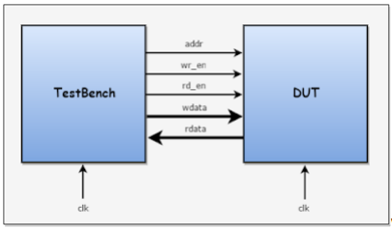
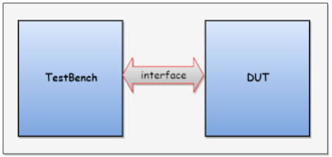
Interface
With Interface Construct
Without Interface Construct

Slide 131
Interface
interface cnt_if #(parameter WIDTH = 4) (input bit clk);
logic rstn;
logic [WIDTH-1:0] count;
logic down;
endinterface
module counter #(parameter WIDTH = 4) (cnt_if _if);
always @(posedge _if.clk or negedge _if.rstn) begin
if (!_if.rstn)
_if.count <= 0; // Reset counter
else if (_if.down)
_if.count <= _if.count - 1; // Decrement counter
else
_if.count <= _if.count + 1; // Increment counter
end
endmodule

Slide 132
Interface
// Release reset after 5 clock cycles
repeat (5) @(posedge clk);
cnt_if0.rstn = 1;
// Test counting up
repeat (5) @(posedge clk);
cnt_if0.down = 1; // Test counting down
// Test counting down
repeat (5) @(posedge clk);
cnt_if0.down = 0; // Back to counting up
// Finish simulation
repeat (5) @(posedge clk);
$finish;
end
endmodule
module tb;
reg clk;
cnt_if cnt_if0 (clk); // Instantiate interface
counter #(.WIDTH(4)) ut (cnt_if0); // Instantiate counter module
// Clock generation
always #10 clk = ~clk;
initial begin
$monitor("[%0t] down=%0b count=0x%0h", $time, cnt_if0.down, cnt_if0.count);
clk = 0;
cnt_if0.rstn = 0;
cnt_if0.down = 0;

Slide 133
Interface
Advantages of the interface over the traditional connection
Allows the number of signals to be grouped together and represented as a single port, the single port handle is passed instead of multiple signal/ports.
Interface declaration is made once and the handle is passed across the modules/components.
Addition and deletion of signals are easy.

Slide 134
Interface
A virtual interface is a variable that represents an interface instance.
The virtual interface must be initialized before using it. i.e, Virtual interface must be connected/pointed to the actual interface
Accessing the uninitialized virtual interface result in a run-time fatal error
Virtual interfaces can be declared as class properties, which can be initialized procedural or by an argument to new()
The virtual interfaces can be passed as arguments to the tasks, functions, or methods
All the interface variables/Methods can be accessed via a virtual interface handle. i.e virtual_interface.variable
A single virtual interface variable can thus represent different interface instances at different times throughout the simulation

Slide 135
Interface
Syntax
virtual interface_name instance_name;
Only the following operations are directly allowed on virtual interface variables
Assignment ( = ) to and Equality ( == ), inequality ( != ) with,
Another virtual interface of the same type
An interface instance of the same type
The special constant null

Slide 136
Interface
What is the need for a virtual interface in SystemVerilog?
SystemVerilog interface is static in nature, whereas classes are dynamic in nature.
Because of this reason, it is not allowed to declare the interface within classes, but it is allowed to refer to or point to the interface.
A virtual interface is a variable of an interface type that is used in classes to provide access to the interface signals.

Slide 137
Interface
interface bus_if(input logic clk, input logic rst);
logic [7:0] data;
endinterface
class driver;
virtual bus_if vif;
task drive_data(input [7:0] value);
vif.data = value;
endtask
endclass
module tb;
logic clk;
logic rst;
bus_if bus(clk, rst);
driver drv =new();
initial begin
clk =0;
rst =1;
#10 rst =0;
drv.vif = bus;
$display("----------------------------------------------");
drv.drive_data(8'hAB);
$display("Data_driven: %h", bus.data);
$display("---------------------------------------------\n");
end
endmodule

Slide 138
Interface
Modport
Modport lists with directions are defined in an interface to impose certain restrictions on interface access within a module.
The keyword modport indicates that the directions are declared as if inside the module.
Syntax
modport [identifier] (
input [port_list],
output [port_list]
);

Slide 139
Interface
What is the need for a modport ?
Nets declared within a simple interface is inout by default and hence any module connected to the same net, can either drive values or take values from it.
In simple words, there are no restrictions on direction of value propagation. You could end up with an X on the net because both the testbench and the design are driving two different values to the same interface net.
Special care should be taken by the testbench writer to ensure that such a situation does not happen. This can be inherently avoided by the use of modports.

Slide 140
Interface
interface myInterface;
logic ack;
logic gnt;
logic sel;
logic irq0;
// ack and sel are inputs to the dut0, while gnt and irq0 are outputs
modport dut0 (
input ack, sel,
output gnt, irq0
);
// ack and sel are outputs from dut1, while gnt and irq0 are inputs
modport dut1 (
input gnt, irq0,
output ack, sel
);
endinterface

Slide 141
Interface
SystemVerilog Clocking Blocks
Module ports and interfaces by default do not specify any timing requirements or synchronization schemes between signals.
A clocking block defined between clocking and endcocking does exactly that. It is a collection of signals synchronous with a particular clock and helps to specify the timing requirements between the clock and the signals.
This would allow test writers to focus more on transactions rather than worry about when a signal will interact with respect to a clock.
A testbench can have many clocking blocks, but only one block per clock.

Slide 142
Interface
Syntax
clocking [identifier_name] @ [event_or_identifier]
default input #[delay_or_edge] output #[delay_or_edge]
[list of signals]
endclocking
The delay_value represents a skew of how many time units away from the clock event a signal is to be sampled or driven.
If a default skew is not specified, then all input signals will be sampled #1step and output signal's driven 0ns after the specified event.

Slide 143
Interface
Example
clocking ck1 @ (posedge clk);
default input #5ns output #2ns;
input data, valid, ready ;
output negedge grant;
input #1step addr;
endclocking

Slide 144
Interface
Note the following:
A clocking block called ck1 is created which will be active on the positive edge of clk
By default, all input signals within the clocking block will be sampled 5ns before and all output signals within the clocking block will be driven 2ns after the positive edge of the clock clk.
Data, valid and ready are declared as inputs to the block and hence will be sampled 5ns before the posedge of clk.
Grant is an output signal to the block with its own time requirement. Here grant will be driven at the negedge of clk instead of the default posedge.

Slide 145
Interface
module des (input req, clk, output reg gnt);
always @ (posedge clk)
if (req)
gnt <= 1;
else
gnt <= 0;
endmodule
interface _if (input bit clk);
logic gnt;
logic req;
clocking cb @(posedge clk);
input #1ns gnt;
output #5 req;
endclocking
endinterface

Slide 146
Interface
module tb;
bit clk;
always #10 clk = ~clk;
initial begin
clk <= 0;
if0.cb.req <= 0;
end
_if if0 (.clk (clk));
des d0 ( .clk (clk),
.req (if0.req),
.gnt (if0.gnt));
initial begin
$dumpfile("clocking.vcd");
$dumpvars(3,tb);
for (int i = 0; i < 10; i++) begin
static bit[3:0] delay = $random;
repeat (delay) @(posedge if0.clk);
if0.cb.req <= ~ if0.cb.req;
end
#20 $finish;
end
endmodule

Slide 147
Class
What are classes ?
Class is a user-defined datatype, an OOP construct, that can be used to encapsulate data (property) and tasks/functions (methods) which operate on the data.
Functions and tasks are called as methods; both are members of the class. classes allow objects to be dynamically created, deleted, assigned and accessed via object handles.
It is essential for building reusable, modular, and efficient testbenches.
Multiple objects can be created from a single class, each with its own unique data.

Slide 148
Class
Here's an example:
class sv_class;
int x;
task set(int i);
x = i;
endtask
function int get();
return x;
endfunction
endclass

Slide 149
Class
Class declaration/Class Instance
As we know the class is a data type, Declaring class type variable is similar to declaring other variables.
Syntax
sv_class class_1;
the above statement shows the declaration of variable class_1 with the type sv_class.
In other words, variable class_1 can contain a handle to an instance of the class sv_class.

Slide 150
Class
Object Creation
Class properties and methods can be accessed only after creating the object.
Syntax
class_1 = new();
the above statement will create an object and assign its handle to class_1.
sv_class class_1 = new();
the above statement will do both declarations of variable and object creation.

Slide 151
Class
Accessing class properties and methods
Class properties and methods can be accessed by using object names followed by property or method name.
Example
class_1.set(10); //calling set method to set value 10 to x

Slide 152
Class
class sv_class;
int x;
task set(int i);
x = i;
endtask
function int get();
return x;
endfunction
endclass
module sv_class_ex;
sv_class class_1; //Creating Handle
initial begin
sv_class class_2 = new();
class_1 = new();
class_1.set(10);
class_2.set(20);
$display("\tclass_1 :: Value of x = %0d",class_1.get());
$display("\tclass_2 :: Value of x = %0d",class_2.get());
end
endmodule

Slide 153
Class
SystemVerilog this keyword
this keyword is used to refer to class properties. this keyword is used to unambiguously refer to class properties or methods of the current instance.
this is a pre-defined class handle referring to the object from which it is used, calling this.variable means object.variable.
this keyword shall only be used within non-static class methods
this keyword refers to the object handle in which it is invoked

Slide 154
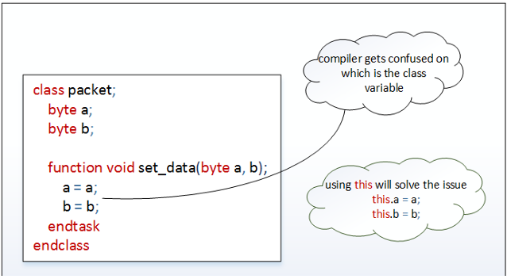
Class

Slide 155
Class
class packet;
//class properties
bit [31:0] addr;
bit [31:0] data;
bit write;
string pkt_type;
//constructor
function new(bit [31:0] addr,data,bit write,string pkt_type);
this.addr = addr;
this.data = data;
this.write = write;
this.pkt_type = pkt_type;
endfunction
//method to display class prperties
function void display();
$display("\t addr = %0h",addr);
$display("\t data = %0h",data);
$display("\t write = %0h",write);
$display("\t pkt_type = %0s",pkt_type);
endfunction
endclass

Slide 156
Class
module sv_constructor;
packet pkt;
initial begin
pkt = new(32'h10,32'hFF,1,"GOOD_PKT");
pkt.display();
end
endmodule

Slide 157
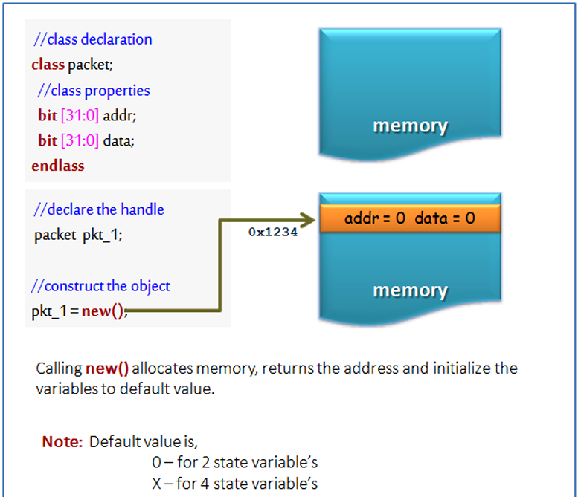
Class
Class Constructors
The new function is called as class constructor.
On calling the new method it allocates the memory and returns the address to the class handle.

Slide 158
Class
The new operation is defined as a function with no return type
Every class has a built-in new method, calling the constructor of class without the explicit definition of the new method will invoke the default built-in new method
Specifying return type to the constructor shall give a compilation error (even specifying void shall give a compilation error)
The constructor can be used for initializing the class properties. In case of any initialization required, those can be placed in the constructor and It is also possible to pass arguments to the constructor, which allows run-time customization of an object.

Slide 159
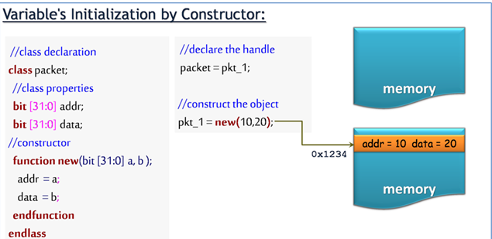
Class

Slide 160
Class
Static class members
Class members can be created with the keyword static. class members with the keyword static are called as static class members.
The class can have static properties and static methods (functions and tasks).
A single copy of static variables is shared across multiple instances.
Static Properties
The class can have multiple instances; each instance of the class will be having its own copy of variables.
Sometimes only one version of a variable is required to be shared by all instances. These class properties are created using the keyword static.

Slide 161
Class
class packet;
byte packet_id;
static byte no_of_packet_created;
function new();
no_of_packet_created++;
packet_id = no_of_packet_created;
endfunction
function void display();
$display("-------------------------------------------");
$display("\t packet_id = %0d", packet_id);
$display("\t no_of_packet_created = %0d",no_of_packet_created);
$display("----------------------------------------------------");
endfunction
endclass
module static_example;
packet pkt[3];
initial begin
foreach(pkt[i]) begin
pkt[i] = new();
pkt[i].display();
end
end
endmodule

Slide 162
Class
Object
Definition: An object is an instance of a class. It is the actual entity that holds data and can execute methods defined in the class.
Handle
Definition: A handle is like a pointer or reference that points to an object. It doesn’t store the object itself but its memory location.
Constructor
Definition: A constructor is a special method in a class that is automatically called when an object is created using

Slide 163
Class
Parameterized Classes
Parameterized classes are same as the parameterized modules in the verilog. parameters are like constants local to that particular class.
The parameter value can be used to define a set of attributes in class. default values can be overridden by passing a new set of parameters during instantiation. this is called parameter overriding.

Slide 164
Class
Example
Classpacket #(parameter int ADDR_WIDTH = 32,DATA_WIDTH = 32);
bit [ADDR_WIDTH-1:0] address;
bit [DATA_WIDTH-1:0] data ;
function new();
address = 10;
data = 20;
endfunction
endclass

Slide 165
Class
packet pkt; –> creates pkt handle with default ADDR_WIDTH and DATA_WIDTH values.
The default parameter value can be overridden when the class is instantiated.
packet #(32,64) pkt; –> creates pkt handle with ADDR_WIDTH = 32 and
DATA_WIDTH = 64.

Slide 166
Class
Pass a data type to a class
class packet #(parameter type T = int);
T address;
T data ;
function new();
address = 10;
data = 20;
endfunction
endclass
packet pkt; –> address and data type is int
packet #(bit [31:0]) pkt; –> address and data type is bit [31:0]

Slide 167
Class
Class Assignment
Object will be created only after doing new to a class handle.
Example
packet pkt_1;
pkt_1 = new();
packet pkt_2;
pkt_2 = pkt_1;

Slide 168
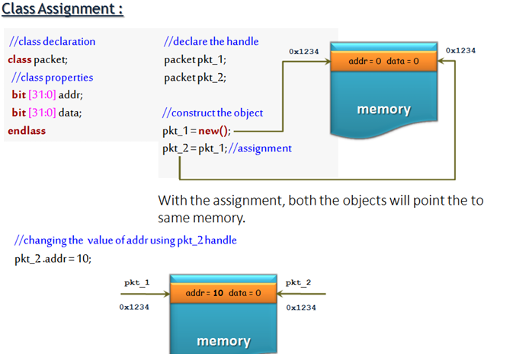
Class

Slide 169
Class
class packet;
logic [31:0] data;
logic [31:0] addr;
bit write;
string pkt_type;
function new ();
addr = 32'h10;
data = 32'hAB;
write =1;
pkt_type = "GOOD_PKT";
endfunction
function void display();
$display("-----------------------------------------------------------");
$display("\t data is : %0h", data);
$display("\t address is : %0h", addr);
$display("\t packet type is : %0s", pkt_type);
$display("------------------------------------------------------------");
endfunction
endclass

Slide 170
Class
module assignemrnt_example;
packet pkt1;
packet pkt2;
initial begin
pkt1 = new();
$display("calling the packte 1 display ");
pkt1.display();
pkt2 = pkt1;
$display("calling the packet 2 display");
pkt2.display();
pkt2.data = 32'h ABC;
pkt2.addr = 32'h 123;
pkt2.pkt_type = "BAD PACKET"; $display ("checking the value is the packet 1");
pkt1.display();
end
endmodule

Slide 171
Class
Shallow Copy
An object will be created only after doing new to a class handle,
Example
packet pkt_1;
pkt_1 = new();
packet pkt_2;
pkt_2 = new pkt_1;
In the last statement, pkt_2 is created and class properties were copied from pkt_1 to pkt_2, this is called as “shallow copy”.

Slide 172
Class
Shallow copy allocates the memory, copies the variable values and returns the memory handle.
In shallow copy, All of the variables are copied across: integers, strings, instance handles, etc.
Note
Objects will not be copied, only their handles will be copied.
To perform the full or deep copy, the custom method can be added.

Slide 173
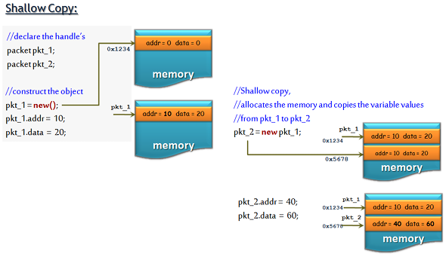
Class

Slide 174
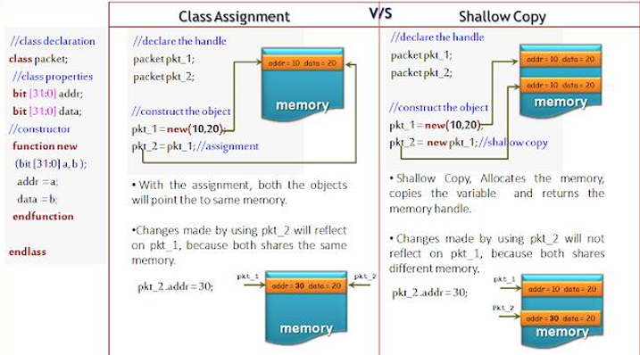
Class

Slide 175
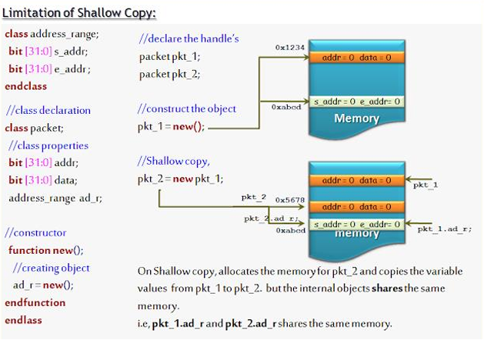
Class

Slide 176
Class
class address_range;
bit[31:0] start_address;
bit[31:0] end_address;
function new();
start_address =10;
end_address = 50;
endfunction
endclass
class packet;
bit[31:0] addr;
bit[31:0] data;
address_range ar;
function new();
addr = 20;
data = 30;
ar = new();
endfunction
function void display();
$display("--------------------------------------------");
$display("\t addr = %0d",addr);
$display("\t data = %0d",data);
$display("\t start_address = %0d",ar.start_address);
$display("\t end_address = %0d",ar.end_address);
$display("------------------------------------------");
endfunction
endclass

Slide 177
Class
module class_assignment;
packet pkt_1;
packet pkt_2;
initial begin
pkt_1 = new();
$display("\t**** calling pkt_1 display ****");
pkt_1.display();
pkt_2 = new pkt_1;
$display("\t**** calling pkt_2 display ****");
pkt_2.display();
pkt_2.addr = 32'd68;
pkt_2.ar.start_address = 20;
pkt_2.ar.end_address = 90;
$display("\t**** calling pkt_1 display after changing pkt_2 properties ****");
pkt_1.display();
$display("\t**** calling pkt_2 display after changing pkt_2 properties ****");
pkt_2.display(); //
end
endmodule

Slide 178
Class
Deep Copy
SystemVerilog deep copy copies all the class members and its nested class members. unlike in shallow copy, only nested class handles will be copied.
In shallow copy, Objects will not be copied, only their handles will be copied. to perform a full or deep copy, the custom method needs to be added.
In the custom method, a new object is created, all the class properties will be copied to a new handle and the new handle will be returned.

Slide 179
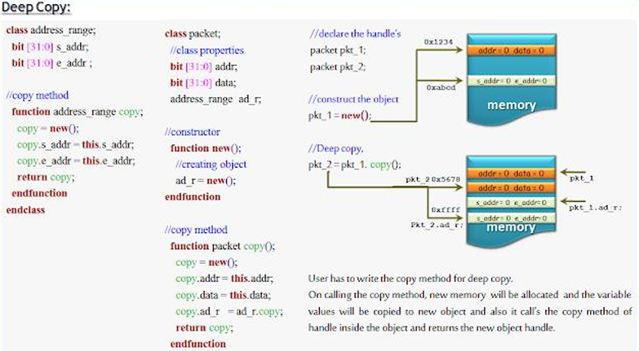
Class

Slide 180
Class
class address_range;
bit[31:0] start_address;
bit[31:0] end_address;
function new();
start_address =10;
end_address = 70;
endfunction
function address_range copy;
copy = new();
copy.start_address = this.start_address;
copy.end_address = this.end_address;
endfunction
endclass
class packet;
bit[31:0] addr;
bit[31:0] data;
address_range ar;
function new();
addr = 20;
data = 45;
ar = new();
endfunction
function void display();
$display("\t the address is : %0d", addr);
$display("\t the data is : %0d", data);
$display (" \t the staring address is : %0d", ar.start_address);
$display (" \t the endo-ing address is : %0d", ar.end_address);
endfunction

Slide 181
Class
function packet copy();
copy = new();
copy.addr = this.addr;
copy.data = this.data;
copy.ar = ar.copy;
return copy;
endfunction
endclass
module class_assignment;
packet pkt_1;
packet pkt_2;
initial begin
pkt_1 = new();
$display("\t**** calling pkt_1 display ****");
pkt_1.display();
pkt_2 = new();
$display("\t**** calling pkt_2 display ****");
pkt_2.display();
pkt_2 = pkt_1.copy();
pkt_2.addr = 32'd68;
pkt_2.ar.start_address = 60;
pkt_2.ar.end_address = 80;
$display("\t**** calling pkt_1 display after changing pkt_2 properties ****");
pkt_1.display();
$display("\t**** calling pkt_2 display after changing pkt_2 properties ****");
pkt_2.display();
end
endmodule

Slide 182
Class
SystemVerilog Inheritance
SystemVerilog Inheritance. Inheritance is an OOP concept that allows the user to create classes that are built upon existing classes.
The new class will be with new properties and methods along with having access to all the properties and methods of the original class.
Inheritance is about inheriting base class members to the extended class.

Slide 183
Class
New classes can be created based on existing classes, this is referred to as class inheritance
A derived class by default inherits the properties and methods of its parent class
An inherited class is called a subclass of its parent class
A derived class may add new properties and methods, or modify the inherited properties and methods
Inheritance allows re-usability. i.e. derived class by default includes the properties and methods, which is ready to use
If the class is derived from a derived class, then it is referred to as Multilevel inheritance

Slide 184
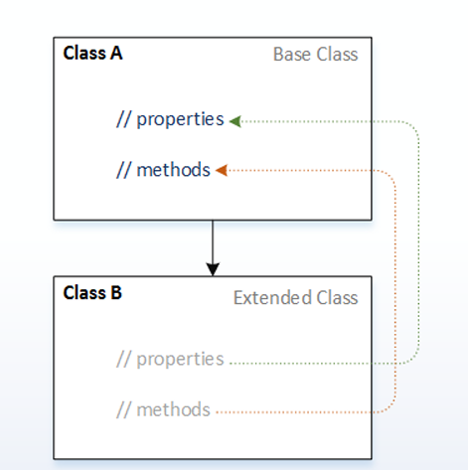
Class
Inheritance Terminology
Parent Class
It’s an existing class;
The class whose features are inherited
The parent class is also known as a base class, superclass
Child Class
It’s an extended class;
The class that inherits the other class is known as subclass
The child class is also known as an extended class, derived class, subclass

Slide 185
Class
class parent_class;
logic [31:0] data;
endclass
class child_class extends parent_class;
logic [31:0] addr;
endclass
module tb;
initial begin
child_class cr = new();
cr.data = 46;
cr.addr = 54;
$display("\t ***the addres is : %0d|| and the data is : %0d***", cr.data, cr.addr);
end
endmodule

Slide 186
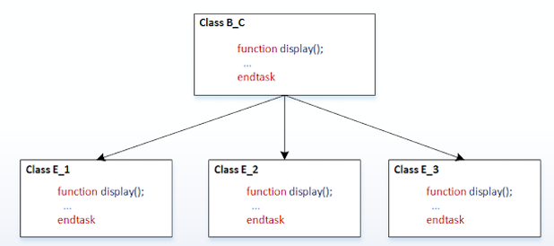
Class
Polymorphism in SystemVerilog
Polymorphism means many forms. Polymorphism in SystemVerilog provides an ability to an object to take on many forms.
Method handle of super-class can be made to refer to the subclass method, this allows polymorphism or different forms of the same method.

Slide 187
Class
class base_class;
virtual function void display();
$display(" Inside the base class");
endfunction
endclass
class ext_class1 extends base_class;
function void display();
$display ("Inside the extend class one");
endfunction
endclass
class ext_class2 extends base_class;
function void display();
$display("Inside the extend class two");
endfunction
endclass
module top;
base_class bs[2];
ext_class1 ec1;
ext_class2 ec2;
initial begin
ec1 = new();
// ec1.display();
bs[0] = ec1;
bs[0].display;
ec2= new();
bs[1] = ec2;
bs[1].display;
//ec2.display();
end
endmodule

Slide 188
Class
Super keyword
The super keyword is used in a derived class to refer to the members of the parent class.
When class members are overridden in the derived class, It is necessary to use the super keyword to access members of a parent class
With super keyword, it is allowed to access the class members of parent class which is only one level up
If the method of the parent class is overridden in the child class, then using the ‘super’ keyword parent class method can be accessed from the child class.

Slide 189
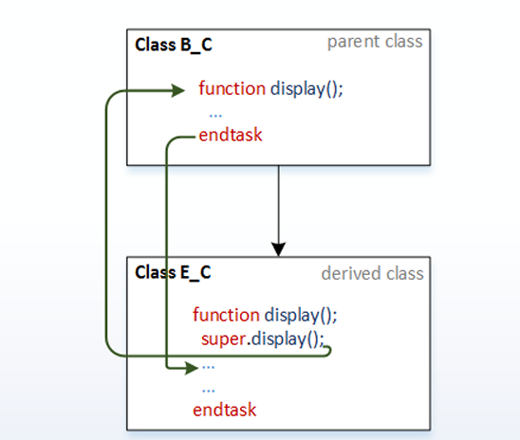
Class

Slide 190
Class
class base_class;
logic [31:0] data;
function void display();
$display("\t the data is : %0d",data);
endfunction
endclass
class child_class extends base_class;
logic [31:0] addr;
function void display();
super.display();
$display("\t the address is : %0d ", addr);
endfunction
endclass
module top;
initial begin
child_class c = new();
c.data = 20;
c.addr = 56;
c.display();
end
endmodule

Slide 191
Data hiding and Encapsulation
The technique of hiding the data within the class and making it available only through the methods, is known as encapsulation.
Because it seals the data (and internal methods) safely inside the “capsule” of the class, where it can be accessed only by trusted users (i.e., by the methods of the class).
Access Control
By default all the members and methods of a class are accessible from anywhere using the object handle, sometimes this could corrupt the class members values, which should not be touched at all.
Access control rules that restrict the members of a class from being used outside the class, this is achieved by prefixing the class members with the keywords,
local
protected

Slide 192
Class
Local class members
External access to the class members can be avoided by declaring members as local.
Any violation could result in a compilation error.
Syntax:
local integer x;
Protected class members
Accessing a protected variable in the extended class ( allowed )
Syntax:
protected integer x;

Slide 193
Class
class parent_class;
local bit [31:0] tmp_addr;
function new(bit [31:0] r_addr);
tmp_addr = r_addr + 10;
endfunction
function void display();
$display("tmp_addr = %0d",tmp_addr);
endfunction
endclass
// module
module encapsulation;
initial begin
parent_class p_c = new(5);
p_c.tmp_addr = 20; //Accessing local variable outside the class
p_c.display();
end
endmodule

Slide 194
Class
class parent_class;
protected bit [31:0] tmp_addr;
function new(bit [31:0] r_addr);
tmp_addr = r_addr + 10;
endfunction
function display();
$display("tmp_addr = %0d",tmp_addr);
endfunction
endclass
class child_class extends parent_class;
function new(bit [31:0] r_addr);
super.new(r_addr);
endfunction
function void incr_addr();
tmp_addr++;
endfunction
endclass
module encapsulation;
initial begin
child_class c_c = new(10);
c_c.incr_addr();
c_c.display();
end
endmodule

Slide 195
Class
Abstract Class
SystemVerilog class declared with the keyword virtual is referred to as an abstract class.
An abstract class sets out the prototype for the sub-classes.
An abstract class cannot be instantiated; it can only be derived.
An abstract class can contain methods for which there are only a prototype and no implementation, just a method declaration.
Helps enforce a common structure across related classes.
Supports polymorphism by allowing user to work with base class references
In frameworks or APIs where user need to extend classes but not instantiate the base class
Syntax:
virtual class abc;
//Class defination
endclass

Slide 196
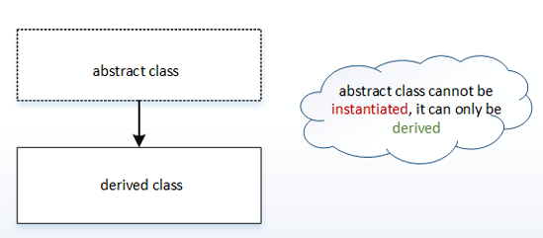
Class

Slide 197
Class
virtual class mobile;
pure virtual function void make_call (string number);
endclass
class redmi extends mobile;
function void make_call (string number);
$display("calling %s using redmi...", number);
endfunction
endclass
class realme extends mobile;
function void make_call (string number);
$display("calling %s using android...", number);
endfunction
endclass
module tb;
redmi mi;
realme rm;
// mobile mb =new();
initial begin
mi = new();
rm =new();
mi.make_call ("6327238463829");
rm.make_call ("8237183653633");
end
endmodule

Slide 198
Class
Casting
In Manufacturing, Casting is a process in which liquid metal is converted into the desired object. Similarly, SystemVerilog casting means the conversion of one data type to another datatype.
Some situations need assignment of different data type, in such situations, it is necessary to convert data type and assign.
Otherwise, the assignment of different data type results in a compilation error. The method of data type conversion is called casting.
In systemVerilog, there are two types of casting,
Static casting
Dynamic casting

Slide 199
Class
Static casting
SystemVerilog static casting is not applicable to OOP
Static casting converts one data type to another compatible data types (example string to int)
As the name says ‘Static’, the conversion data type is fixed
Static casting will be checked during compilation, so there won’t be run-time checking and error reporting
Casting is applicable to value, variable or to an expression
A data type can be changed by using a cast ( ‘ ) operation
The value/variable/expression to be cast must be enclosed in parentheses or within concatenation or replication braces

Slide 200
Class
module casting;
real r_a;
int i_a;
initial begin
r_a = (2.1 * 3.2);
//real to integer conversion
i_a = int'(r_a);
$display("real value is %f",r_a);
$display("int value is %d",i_a);
end
endmodule

Slide 201
Class
Dynamic casting
Dynamic casting is used to, safely cast a super-class pointer (reference) into a subclass pointer (reference) in a class hierarchy
Dynamic casting will be checked during run time, an attempt to cast an object to an incompatible object will result in a run-time error
Dynamic casting is done using the $cast(destination, source) method
With $cast compatibility of the assignment will not be checked during compile time, it will be checked during run-time

Slide 202
Class
Let’s see how we can use the casting
It is always legal to assign a child class variable to a variable of a class higher in the inheritance tree (parent class).
parent_class = child_class; //allowed
It is never legal to directly assign a super-class (parent class) variable to a variable of one of its subclasses (child class).
child_class = parent_class; //not-allowed
However, it is legal to assign a super-class (parent class) handle to a subclass (child class) variable if the super-class (parent class) handle refers to an object of the given subclass(child class).
parent_class = child_class ;
child_class = parent_class; //allowed because parent_class is pointing to child_class.

Slide 203
Class
Though parent_class is pointing to the child_class, we will get a compilation error saying its not compatible type for the assignment.
This we can over come by make use of $cast method, i.e,
$cast(child_class,parent_class);

Slide 204
Class
class parent_class;
bit [31:0] addr;
function display();
$display("Addr = %0d", addr);
endfunction
endclass
class child_class extends parent_class;
bit [31:0] data;
function display();
super.display();
$display("Data = %0d", data);
endfunction
endclass
module inheritance;
initial begin
parent_class p;
child_class c = new();
child_class c1;
c.addr = 10;
c.data = 20;
p = c;
if ($cast(c1, p)) begin
$display("Cast successful!");
c1.display();
end else begin
$display("Cast failed!");
end
end
endmodule

Slide 205
Class
Scope Resolution Operator ::
The class scope operator :: is used to specify an identifier defined within the scope of a class.
Classes and other scopes can have the same identifiers
The scope resolution operator uniquely identifies a member of a particular class
Class Resolution operator allows access to static members (class properties and methods) from outside the class, as well as access to public or protected elements of super classes from within the derived classes.

Slide 206
Class
class packet;
bit [31:0] addr;
static bit [31:0] id;
function display(bit [31:0] a,b);
$display("Values are %0d %0d",a,b);
endfunction
endclass
module sro_class;
int id=10;
initial begin
packet p;
p = new();
packet::id = 20;
p.display(packet::id,id);
end
endmodule

Slide 207
SystemVerilog External Methods
If the definition of the method written outside the body of the class then the method is called an external method. external function.
The definition of the function written outside the class body is referred to as an external function external task. The definition of the task written outside the class body is referred to as an external task
Syntax
extern virtual function void display();
extern virtual task display();

Slide 208
System Verilog External Methods
//task packet::display();
// $display("Addr = %0d Data = %0d",addr,data);
//endtask
//function implementation outside class body
function void packet::display();
$display("Addr = %0d Data = %0d",addr,data);
endfunction
module extern_method;
initial begin
packet p;
p = new();
p.addr = 10;
p.data = 20;
p.display();
end
endmodule
//class with extern function
class packet;
bit [31:0] addr;
bit [31:0] data;
//task declaration - extern indicates out-of-body declaration
// extern virtual task display();
extern virtual function void display();
endclass

Slide 209
Typedef Class
A typedef is used to provide a forward declaration of the class. In some cases, the class needs to be instantiated before the class declaration. In these kinds of situations, the typedef is used to provide a forward declaration of the class.
typedef syntax
typedef class class_name;

Slide 210
Typedef Class
typedef class c2;
//class-1
class c1;
c2 c; //using class c2 handle before declarin it.
endclass
//class-2
class c2;
c1 c;
endclass
module typedef_class;
initial begin
c1 class1;
c2 class2;
$display("Inside typedef_class");
end
endmodule

Slide 211
Randomization in SV
Randomization is the process of making something random;
SystemVerilog randomization is the process of generating random values to a variable.
Verilog has a $random method for generating the random integer values. This is good for randomizing the variables alone, but it is hard to use in case of class object randomization.
For easy randomization of class properties, SystemVerilog provides rand keyword and randomize() method.

Slide 212
Randomization in SV
random variables
The class variables which get random values on randomization are called random variables.
In order to make variables as random variables, Class variables need to be declared using the rand and randc type-modifier keywords.
Following types can be declared as rand and randc,
singular variables of any integral type
arrays
arrays size
object handle’s

Slide 213
Randomization in SV
rand keyword
Variables declared with the rand keyword are standard random variables.
Their values are uniformly distributed over their range.
Syntax
rand bit [3:0] addr;
addr is a 4-bit unsigned integer with a range of 0 to 15. on randomization this variable shall be assigned any value in the range 0 to 15 with equal probability.

Slide 214
Randomization in SV
randc keyword
randc is random-cyclic. For the variables declared with the randc keyword, on randomization variable values don’t repeat a random value until every possible value has been assigned.
Syntax
randc bit wr_rd;
randomize
In order to randomize the object variables, the user needs to call randomize() method.
Syntax
object.randomize();

Slide 215
Randomization in SV
class packet;
rand bit [2:0] addr1;
randc bit [2:0] addr2;
endclass
module rand_methods;
initial begin
packet pkt;
pkt = new();
repeat(10) begin
pkt.randomize();
$display("\taddr1 = = %0d \t addr2 = %0d",pkt.addr1,pkt.addr2);
end
end
endmodule

Slide 216
Randomization in SV
Disable randomization
The variable declared without rand or randc will not get random values on randomization.
For some reason it is required not to generate a random value for a random variable.
It is possible to disable the randomization of a variable by using the systemverilog randomization method rand_mode.

Slide 217
Randomization in SV
rand_mode method
The rand_mode() method is used to disable the randomization of a variable declared with the rand/randc keyword.
rand_mode(1) means randomization enabled
rand_mode(0) means randomization disabled
The default value of rand_mode is 1, i.e enabled
Once the randomization is disabled, it is required to make rand_mode(1) enable back the randomization
rand_mode can be called as SystemVerilog method, the randomization enables/disable status of a variable can be obtained by calling varirble.rand_mode().
the rand_mode method returns 1 if randomization is enabled else returns 0

Slide 218
Randomization in SV
rand_mode syntax
<object_hanlde>.<variable_name>.rand_mode(enable);
//enable = 1, randomization enable
//enable = 0, randomization disable

Slide 219
Randomization in SV
class packet;
rand byte addr;
rand byte data;
endclass
module rand_methods;
initial begin
packet pkt;
pkt = new();
//disable rand_mode of addr variable of pkt
pkt.addr.rand_mode(0);
//disable rand_more for handler
pkt.rand_mode(0);
//calling randomize method
pkt.randomize();
$display("\taddr = %0d \t data = %0d",pkt.addr,pkt.data);
$display("\taddr.rand_mode() = %0d \t data.rand_mode() = %0d",pkt.addr.rand_mode(),pkt.data.rand_mode());
end
endmodule

Slide 220
Randomization Methods
Randomize method associated with below callbacks,
pre_randomize
post_randomize
pre randomize and post randomize methods
On calling randomize(), pre_randomize() and post_randomize() functions will get called before and after the randomize call respectively
Users can override the pre_randomize() and post_randomize() functions

Slide 221
Randomization Methods
pre_randomize
The pre_randomize function can be used to set pre-conditions before the object randomization.
For example, Users can implement randomization control logic in pre_randomize function. i.e randomization enable or disable by using rand_mode() method.
post_randomize
The post_randomization function can be used to check and perform post-conditions after the object randomization.
For example, Users can override the randomized values or can print the randomized values of variables.

Slide 222
Randomization Methods
class packet;
rand bit [7:0] addr;
randc bit wr_rd;
bit tmp_wr_rd;
function void pre_randomize();
if(tmp_wr_rd==1)
addr.rand_mode(0);
else addr.rand_mode(1);
endfunction
function void post_randomize();
tmp_wr_rd = wr_rd;
$display("POST_RANDOMIZATION:: Addr = %0h,wr_rd = %0h",addr,wr_rd);
endfunction
endclass
module rand_methods;
initial begin
packet pkt;
pkt = new();
repeat(4) pkt.randomize();
end
endmodule

Slide 223
Constrained randomization
Constrained randomization As the name says random variable will get random value on randomization.
In some situations, it is required to control the values getting assigned on randomization, this can be achieved by writing constraints.
By writing constraints to a random variable, the user can get specific value on randomization. constraints to a random variable shall be written in constraint blocks.

Slide 224
Constrained randomization
Constraint blocks
Constraint blocks are class members like tasks, functions, and variables
Constraint blocks will have a unique name within a class
Constraint blocks consist of conditions or expressions to limit or control the values for a random variable
Constraint blocks are enclosed within curly braces { }
Constraint blocks can be defined inside the class or outside the class like extern methods, constraint block defined outside the class is called as extern constraint block

Slide 225
Constrained randomization
Constraint block syntax
constraint <constraint_block_name> { <condition/expression>;
... <condition/expression>; }
Constraint block inside the class
constraint addr_range { addr > 5; }
Constraint block outside the class
constraint addr_range;
constraint packet::addr_range { addr > 5; }

Slide 226
Constrained randomization
class packet;
rand bit [3:0] addr;
constraint addr_range { addr > 5; }
endclass
module constr_blocks;
initial begin
packet pkt;
pkt = new();
repeat(10) begin
pkt.randomize();
$display("\taddr = %0d",pkt.addr);
end
end
endmodule

Slide 227
Constrained randomization
class packet;
rand bit [3:0] addr;
constraint addr_range;
endclass
constraint packet::addr_range { addr > 5; }
module extern_constr;
initial begin
packet pkt;
pkt = new();
repeat(10) begin
pkt.randomize();
$display("\taddr = %0d",pkt.addr);
end
end
endmodule

Slide 228
Constrained randomization
Constraint Inheritance
Like class members, constraints also will get inherited from parent class to child class.
Constraint blocks can be overridden by writing constraint block with the same name as in parent class.

Slide 229
Constrained randomization
class packet1;
rand bit [3:0] addr;
constraint addr_range { addr > 5; }
endclass
class packet2 extends packet;
constraint addr_range { addr < 5; }
endclass
module const_inhe;
initial begin
packet1 pkt1;
packet2 pkt2;
pkt1 = new();
pkt2 = new();
$display("------------------------------------");
repeat(5) begin
pkt1.randomize();
$display("\tpkt1:: addr = %0d",pkt1.addr);
end
$display("------------------------------------");
repeat(5) begin
pkt2.randomize();
$display("\tpkt2:: addr = %0d",pkt2.addr);
end
$display("------------------------------------");
end
endmodule

Slide 230
Constrained randomization
Constraint inside SystemVerilog
During randomization, it might require to randomize the variable within a range of values or with inset of values or other than a range of values. this can be achieved by using constraint inside operator.
With SystemVerilog inside operator, random variables will get values specified within the inside block.
Syntax
constraint addr_range { addr inside { ... }; }
constraint addr_range { addr inside { [5:10]}; }
constraint addr_range { addr inside { 1,3,5,7,9}; }
constraint addr_range { addr inside {1,3,[5:10],12,[13:15]}; }
constraint addr_range { !(addr inside {[5:10]}); }

Slide 231
Constrained randomization
// Code your design here
class packet;
rand bit [3:0] addr;
rand bit [3:0] start_addr;
rand bit [3:0] end_addr;
constraint addr_1_range { addr inside {[0:1]}; }
endclass
module constr_inside;
initial begin
packet pkt;
pkt = new();
$display("------------------------------------");
repeat(10) begin
pkt.randomize();
$display("\tstart_addr = %0d,end_addr = %0d",pkt.start_addr,pkt.end_addr);
$display("\taddr = %0d",pkt.addr);
$display("------------------------------------");
end
end
endmodule

Slide 232
Constrained randomization
// Code your design here
class packet;
rand bit [3:0] addr;
rand bit [3:0] start_addr;
rand bit [3:0] end_addr;
constraint addr_1_range { !(addr inside {[0:1]}); }
endclass
module constr_inside;
initial begin
packet pkt;
pkt = new();
$display("------------------------------------");
repeat(10) begin
pkt.randomize();
$display("\tstart_addr = %0d,end_addr = %0d",pkt.start_addr,pkt.end_addr);
$display("\taddr = %0d",pkt.addr);
$display("------------------------------------");
end
end
endmodule

Slide 233
Constrained randomization
dist Constraint
Constraint provides control on randomization, from which the user can control the values on randomization.
It would be good if it’s possible to control the occurrence or repetition of the same value on randomization.
With dist operator, some values can be allocated more often to a random variable. this is called a weighted distribution. dist is an operator, it takes a list of values and weights, separated by := or :/ operator.
Weighted distribution
As the name says, in weighted distribution weight will be specified to the values inside the constraint block.
Value with the more weight will get allocated more often to a random variable.

Slide 234
Constrained randomization
The := operator assigns the specified weight to the item, or if the item is a range, specified weight to every value in the range.
addr dist { 2 := 5, [10:12] := 8 };
for addr == 2 , weight 5
addr == 10, weight 8
addr == 11, weight 8
addr == 12, weight 8

Slide 235
Constrained randomization
The :/ operator assigns the specified weight to the item, or if the item is a range, specified weight/n to every value in the range. where n is the number of values in the range.
addr dist { 2 :/ 5, [10:12] :/ 8 };
for addr == 2 , weight 5
addr == 10, weight 8/3
addr == 11, weight 8/3
addr == 12, weight 8/3

Slide 236
Constrained randomization
class packet;
rand bit [3:0] addr_1;
rand bit [3:0] addr_2;
constraint addr_1_range { addr_1 dist { 2 := 5, [10:12] := 8 }; }
constraint addr_2_range { addr_2 dist { 2 :/ 5, [10:12] :/ 8 }; }
endclass
module constr_dist;
initial begin
packet pkt;
pkt = new();
repeat(50) begin
pkt.randomize();
$display("\taddr_1 = %0d",pkt.addr_1);
end
repeat(50) begin
pkt.randomize();
$display("\taddr_2 = %0d",pkt.addr_2);
end
end
endmodule

Slide 237
Constrained randomization
Implication constraints
The implication operator can be used to declaring conditional relations between two variables. implication operator is denoted by the symbol ->.
The implication operator is placed between the expression and constraint.
expression -> constraint
If the expression on the LHS of implication operator (->) is true, then the only constraint on the RHS will be considered.

Slide 238
Constrained randomization
class packet;
rand bit [3:0] addr;
string addr_range;
constraint address_range { (addr_range == "small") -> (addr <8);}
endclass
module constr_implication;
initial begin
packet pkt;
pkt = new();
pkt.addr_range = "small";
$display("------------------------------------");
repeat(4) begin
pkt.randomize();
$display("\taddr_range = %s addr = %0d",pkt.addr_range,pkt.addr);
end
$display("------------------------------------");
end
endmodule

Slide 239
Constrained randomization
if else constraints
if else block allows conditional executions of constraints.
If the expression is true, all the constraints in the first constraint/constraint block must be satisfied, otherwise all the constraints in the optional else constraint/constraint-block must be satisfied.

Slide 240
Constrained randomization
class packet;
rand bit [3:0] addr;
string addr_range;
constraint address_range { if(addr_range == "small")
addr < 8;
else
addr > 8;
}
endclass
module constr_if_else;
initial begin
packet pkt;
pkt = new();
pkt.addr_range = "small";
repeat(3) begin
pkt.randomize();
$display("\taddr_range = %s addr = %d ",pkt.addr_range,pkt.addr);
end
pkt.addr_range = "high";
repeat(3) begin
pkt.randomize();
$display("\taddr_range = %s addr = %d",pkt.addr_range,pkt.addr);
end
end
endmodule

Slide 241
Constrained randomization
foreach constraint
SystemVerilog supports using the foreach loop inside a constraint block. using the foreach loop within the constraint block will make easy to constrain an array.
The foreach loop iterates over the elements of an array, so constraints with the foreach loop are called Iterative constraints.
The foreach constraint will be applicable to an array with one or more than one element. so it’s required to specify or constrain the size of the dynamic array.
Syntax
constraint constraint_name { foreach ( variable[iterator] ) variable[iterator] <..conditions..> }

Slide 242
Constrained randomization
class packet;
rand byte addr [];
rand byte data [];
constraint avalues { foreach( addr[i] ) addr[i] inside {4,8,12,16}; }
constraint dvalues { foreach( data[j] ) data[j] > 4 * j; }
constraint asize { addr.size < 4; }
constraint dsize { data.size == addr.size; }
endclass
module constr_iteration;
initial begin
packet pkt;
pkt = new();
repeat(10) begin
pkt.randomize();
$display("\taddr-size = %0d data-size = %0d",pkt.addr.size(),pkt.data.size());
foreach(pkt.addr[i]) $display("\taddr = %0d data = %0d",pkt.addr[i],pkt.data[i]);
end
end
endmodule

Slide 243
Constrained randomization
Disable Constraints
Constraints in a class can be disabled using the constraint_mode method call.
By default, all the constraints will be enabled, during the randomization constraint solver will not consider the disabled constraints.
The constraint disables method is similar to rand_mode() method.
constraint_mode syntax
<object_hanlde>.<constraint_block_name>.constraint_mode(enable);
//enable == 1, constraint block enable
//enable == 0, constraint block disable

Slide 244
Constrained randomization
class packet;
rand bit[3:0] addr;
constraint address { addr inside{1,2,3,4,5};}
endclass
module tb;
packet pkt;
initial begin
pkt = new();
$display("before constraint disable");
$display("value of the constraint mode : %d", pkt.address.constraint_mode());
repeat(10) begin
pkt.randomize();
$display("values of the addr : %0d", pkt.addr);
end
pkt.address.constraint_mode(0);
$display("after constraint disable");
$display("value of the constraint mode : %0d", pkt.address.constraint_mode());
repeat(10) begin
pkt.randomize();
$display("value of the addr : %0d", pkt.addr);
end
end
endmodule

Slide 245
Constrained randomization
Static Constraints
SystemVerilog static constraints are similar to static class properties. A constraint block can be defined as static by including the static keyword in its definition.
Constraint block with the static keyword followed by constraint keyword is called as a static constraint. the static constraint is shared across all the class instances.
Only the mode change of static constraint will get affected in all the instances of a class mode change is enable or disable of a constraint by constrain_mode() method
A static class can be enabled or disabled by any object handle of its class, mode change with one object handle will reflect all other objects of same class type

Slide 246
Constrained randomization
class packet;
rand bit [7:0] addr;
static constraint addr_range { addr == 5; }
endclass
module static_constr;
initial begin
packet pkt1;
packet pkt2;
pkt1 = new();
pkt2 = new();
$display("Before disabling constraint");
pkt1.randomize();
$display("\tpkt1.addr = %0d",pkt1.addr);
pkt2.randomize();
$display("\tpkt2.addr = %0d",pkt2.addr);
pkt2.addr_range.constraint_mode(0);
$display("After disabling constraint");
pkt1.randomize();
$display("\tpkt1.addr = %0d",pkt1.addr);
pkt2.randomize();
$display("\tpkt2.addr = %0d",pkt2.addr);
end
endmodule

Slide 247
Constrained randomization
Inline Constraints
Constraints will be written inside the class. inline constraint allows the user to add extra constraints to existing constraints written inside the class.
Inline constraints will be written outside the class i.e along with the randomize method call.
During randomization, constraint solver will consider both inline constraints and constraints written inside the class
The inline constraint will not override the constraints written inside the class
The inline constraint shouldn’t conflict with the constraint written inside the class, else it will lead to randomization failure
For example, constraint inside the class written as var < 5, and inline constraint written as var > 5

Slide 248
Constrained randomization
class packet;
rand bit [3:0] addr;
rand bit [3:0] data;
constraint data_range { data > 0; data < 10; }
endclass
module inline_constr;
initial begin
packet pkt;
pkt = new();
repeat(2) begin
pkt.randomize() with { addr == 8;};
$display("\taddr = %0d data = %0d",pkt.addr,pkt.data);
end
end
endmodule

Slide 249
Constrained randomization
class packet;
rand bit [3:0] addr;
constraint addr_range {addr < 5;};
endclass
module inline_constr;
initial begin
packet pkt;
pkt = new();
repeat(2) begin
pkt.randomize() with { addr > 5;};
$display("\taddr = %0d",pkt.addr);
end
end
endmodule

Slide 250
Constrained randomization
class packet;
rand bit [3:0] addr;
constraint addr_range {addr inside {[6:12]};};
endclass
module inline_constr;
initial begin
packet pkt;
pkt = new();
repeat(2) begin
pkt.randomize() with { addr == 8;};
$display("\taddr = %0d",pkt.addr);
end
end
endmodule

Slide 251
Constrained randomization
Soft Constraints
SystemVerilog constraints declared with the keyword soft is called as soft constraints.
Any conflict between class constraint and inline constraint leads to a randomization failure, from this it is clear that it is not possible to override the class constraint by inline constraint.
Some test scenarios demand to override the constraints, this can be done by writing a soft keyword in class constraint.
A soft constraint is a constraint on a random variable, which allows overriding the constraint.
constraint c_name { soft variable { condition }; }

Slide 252
Constrained randomization
class packet;
rand bit[3:0] addr;
constraint addr_range {soft addr >8;}
endclass
module tb;
packet pkt;
initial begin
pkt =new();
$display("---------------------------------");
$display (" calling randomization");
repeat(10) begin
pkt.randomize() with {addr <8;};
$display(" \t addr : %0d", pkt.addr);
end
end
endmodule

Slide 253
Constrained randomization
Functions in Constraints
In some cases, constraint can’t be expressed in a single line, in such cases function call can be used to constrain a random variable.
Calling the function inside the constraint is referred to as function in constraints.
The function will be written outside the constraint block
Constraint logic shall be written inside the function as function definition and function call shall be placed inside the constraint block
Functions shall be called before constraints are solved, and their return values shall be treated as state variables.

Slide 254
Constrained randomization
class packet;
rand bit [3:0] start_addr;
rand bit [3:0] end_addr;
constraint start_addr_c { start_addr == s_addr(end_addr); }
function bit [3:0] s_addr(bit [3:0] e_addr);
if(e_addr < 4)
s_addr = 0;
else
s_addr = e_addr - 4;
endfunction
endclass
module func_constr;
initial begin
packet pkt;
pkt = new();
repeat(3) begin
pkt.randomize();
$display("\tstart_addr=%0d
",pkt.start_addr,pkt.end_addr);
end_addr
end
end
endmodule

Slide 255
Constrained randomization
Unique Constraint
SystemVerilog constraint defined with the keyword unique is called as a unique constraint.
On randomization, unique values to set of variables or unique elements to an array can be generated by using unique constraints.
Unique constraint allows us to,
Generate unique values across the variables
Generate unique elements in an array (Fixed Size Array, Dynamic Array, Associative array and Queue)

Slide 256
Constrained randomization
class unique_elements;
rand bit [31:0] array[10];
constraint array_c {unique {array};
foreach(array[i]) array[i] < 10;}
function void display();
$display("array = %p",array);
endfunction
endclass
module unique_elements_randomization;
unique_elements pkt;
initial begin
pkt = new();
pkt.randomize();
pkt.display();
end
endmodule

Slide 257
Coverage
Coverage is used to measure tested and untested portions of the design.
Coverage is defined as the percentage of verification objectives that have been met.
There are two types of coverage metrics,
Code Coverage
Functional Coverage

Slide 258
Coverage
Code Coverage
Code coverage measures how much of the “design Code” is exercised.
This includes the execution of design blocks, Number of Lines, Conditions, FSM, Toggle and Path.
The simulator tool will automatically extract the code coverage from the design code.

Slide 259
Coverage
Functional Coverage
Functional coverage is a user-defined metric that measures how much of the design specification has been exercised in verification.
There are two types of functional coverage,
Data-oriented Coverage – Checks combinations of data values have occurred. We can get Data-oriented coverage by writing Coverage groups, coverage points and also by cross coverage
Control-oriented Coverage – Checks whether sequences of behaviors have occurred. We can get assertion coverage by writing SystemVerilog Assertions
Functional coverage is a user-defined metric that measures how much of the design specification has been exercised in verification.

Slide 260
Coverage
Defining the coverage model
The coverage model is defined using covergroup construct.
The covergroup construct is a user-defined type. The type definition is written once, and multiple instances of that type can be created in different contexts.
Similar to a class, once defined, a covergroup instance can be created via the new()operator. A covergroup can be defined in a module, program, interface, or class.

Slide 261
Coverage
Each covergroup specification can include,
A clocking event that synchronizes the sampling of coverage points
A set of coverage points
Cross coverage between coverage points
Optional formal arguments
Coverage options

Slide 262
Coverage
EXAMPLE-1
covergroup cov_grp @(posedge clk);
cov_p1: coverpoint a;
endgroup
cov_grp cov_inst = new();
EXAMPLE-2
covergroup cov_grp;
cov_p1: coverpoint a;
endgroup
cov_grp cov_inst = new();
@(abc) cov_inst.sample();

Slide 263
Coverage
module example1;
logic clk;
bit[2:0] a;
covergroup cov_grp @(posedge clk);
coverpoint a;
endgroup
cov_grp cov_inst = new();
always #5 clk = ~clk;
initial begin
clk = 0;
for (int i = 0; i < 8; i++) begin
#10;
a = i;
//cov_inst.sample();
$display("[EXAMPLE-1] At time %0t, a = %0d", $time, a);
end
#100;
$display("Coverage = %0.2f %%", cov_inst.get_inst_coverage());
$stop;
end
endmodule

Slide 264
Coverage
Defining coverage points
A covergroup can contain one or more coverage points. A coverage point can be an integral variable or an integral expression.
Each coverage point is associated with “bin”. On each sample clock simulator will increment the associated bin value.
The bins will automatically be created or can be explicitly defined.
Automatic Bins or Implicit Bins
Explicit Bins

Slide 265
Coverage
Automatic Bins or Implicit Bins
An automatically single bin will be created for each value of the coverpoint variable range.
These are called automatic or implicit bins.
For an “n” bit integral coverpoint variable, a 2^n number of automatic bins will get created.

Slide 266
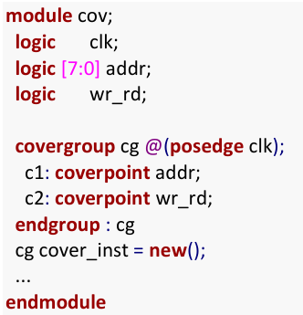
Coverage
The bins, will get created automatically,
For addr: c1.auto[0] c1.auto[1] c1.auto[2] … c1.auto[255]
For wr_rd: c2.auto[0]

Slide 267
Coverage
module tb;
bit [1:0] mode;
bit [2:0] cfg;
bit clk;
always #20 clk = ~clk;
covergroup cg @ (posedge clk);
cp_mode : coverpoint mode;
cp_cfg_10 : coverpoint cfg[1:0];
cp_cfg_lsb : coverpoint cfg[0];
cp_sum : coverpoint (mode + cfg);
endgroup :cg
cg cg_inst;
initial begin
cg_inst= new();
for (int i = 0; i < 5; i++) begin
@(negedge clk);
mode = $random;
cfg = $random;
$display ("[%0t] mode=0x%0h cfg=0x%0h", $time, mode, cfg);
end
end
initial begin
#500 $display ("Coverage = %0.2f %%", cg_inst.get_inst_coverage());
$finish;
end
endmodule

Slide 268
Coverage
Explicit bins
“bins” keyword is used to declare the bins explicitly to a variable.
A separate bin is created for each value in the given range of variable or a single/multiple bins for the rage of values.
Bins are explicitly declared within curly braces { } along with the bins keyword followed by bin name and variable value/range, immediately after the coverpoint identifier.

Slide 269
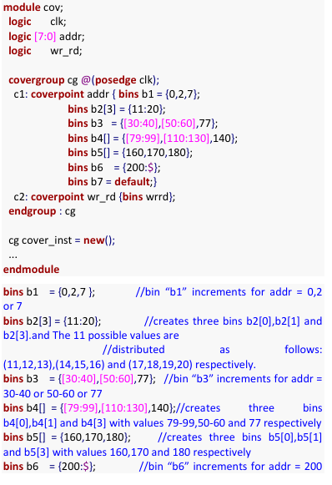
Coverage

Slide 270
Coverage
module explicit_bins_example;
bit [2:0] mode;
covergroup crg;
coverpoint mode { bins one = {1};
bins two = {2};}
endgroup
crg crg_inst;
initial begin
crg_inst = new();
for (int i =0; i<7;i++)
begin
mode = $random;
crg_inst.sample();
$display("MODE VALUE IS : %d", mode);
end
$display("COVERAGE IS : %0.2f %%", crg_inst.get_inst_coverage());
end
endmodule

Slide 271
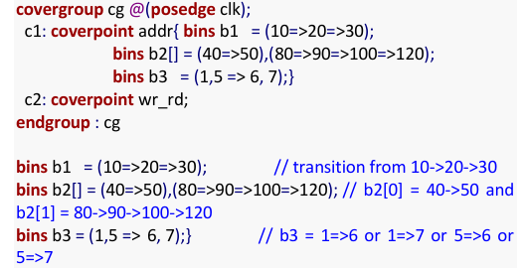
Coverage
Bins for transitions
The transition of coverage point can be covered by specifying the sequence, value1 => value2
It represents transition of coverage point value from value1 to value2. sequence can be single value or range, value1 => value2 => value3 …. range_list_1 => range_list_2

Slide 272
Coverage
module transition_example;
logic clk;
logic [7:0] addr;
logic wr_rd;
initial clk = 0;
always #5 clk = ~clk;
covergroup cg @(posedge clk);
c1: coverpoint addr {
bins b1 = (10 => 20 => 30);
bins b2[] = (40 => 50), (80 => 90 => 100 => 120);
bins b3 = (1,5 => 6, 7);
}
c2: coverpoint wr_rd; endgroup : cg
cg coverage_instance = new();
initial begin
$monitor ("ADDR: %b|| WR :%d", addr, wr_rd);
#10 addr = 10; wr_rd = 1;
#10 addr = 20; wr_rd = 0;
#10 addr = 30; wr_rd = 1;
#10 addr = 40; wr_rd = 0;
#10 addr = 50; wr_rd = 1;
#150 $display("coverage is :%0.2f %%", coverage_instance.get_inst_coverage());
#10 $finish;
end
endmodule

Slide 273

Coverage
Ignore_bins
A set of values or transitions associated with a coverage-point can be explicitly excluded from coverage by specifying them as ignore_bins.

Slide 274

Coverage
Illegal_bins
A set of values or transitions associated with a coverage-point can be marked as illegal by specifying them as illegal_bins.

Slide 275
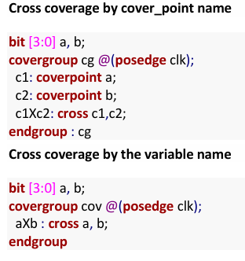
Coverage
Cross Coverage
Cross Coverage is specified between the cover points or variables. Cross coverage is specified using the cross construct.
Expressions cannot be used directly in a cross; a coverage point must be explicitly defined first.

Slide 276
Coverage
cg_by_coverpoint cov1 = new();
initial begin
repeat (40) begin
#10 a = $random ;
b = $random ;
$display("At time %0t: a=%0d, b=%0d", $time, a, b);
end
//$display("Coverage is : %0.2f %%",$get_coverage());
//$display("Coverage is : %0.2f %%",cov1.c1Xc2.get_inst_coverage());
#10 $finish;
end
endmodule
module cross_coverage_example;
logic clk;
bit [3:0] a, b;
initial clk = 0;
always #5 clk = ~clk;
covergroup cg_by_coverpoint @(posedge clk);
c1: coverpoint a;
c2: coverpoint b;
c1Xc2: cross c1, c2;
endgroup

Slide 277
Coverage
Coverage options
Coverage options control the behavior of the covergroup, coverpoint, and cross.
at_least
A minimum number of hits for each bin. A bin with a hit count that is less than the number is not considered covered. the default value is ‘1’.
auto_bin_max
A maximum number of automatically created bins when no bins are explicitly defined for a coverpoint. the default value is ‘64’.
cross_auto_bin_max
A maximum number of automatically created cross product bins for a cross. there is no default value, it is unbounded.

Slide 278
Coverage
module coverage_test;
logic clk;
bit [7:0] addr;
bit wr_rd;
initial clk = 0;
always #5 clk = ~clk;
covergroup cg @(posedge clk);
c1: coverpoint addr { option.auto_bin_max = 128; }
c2: coverpoint wr_rd { option.at_least = 2; }
c1Xc2: cross c1, c2 { option.cross_auto_bin_max = 128; }
endgroup : cg
cg coverage_instance = new();
initial begin
repeat (20) begin
#10 addr = $random ;
wr_rd = $random ;
$display("Time: %0t, addr: %0d, wr_rd: %0d", $time, addr, wr_rd);
end
$display("COVERAGE :%0.2f %%",$get_coverage());
#10 $finish;
end
endmodule

Slide 279
Assertions
Assertions are primarily used to validate the behavior of a design. An assertion is a check embedded in design Warnings or errors are generated on the failure of a specific condition or sequence of events.
Assertion Type | Used In | Purpose | Behaviour
assert | Simulation | Check if condition holds | Fails if condition is false
cover | Simulation | Measure occurrence of condition | Tracks coverage, does not fail
assume | Formal Verification | Guide input stimulus | Helps tools generate valid test cases
restrict | Formal Verification | Formal Verification | Constrains formal verification

Slide 280
Assertions
Assertions are used
Check the occurrence of a specific condition or sequence of events.
Provide functional coverage.
There are two kinds of assertions:
Immediate Assertions
Concurrent Assertions

Slide 281
Assertions
Immediate Assertions:
Immediate assertions check for a condition at the current simulation time.
An immediate assertion is the same as an if else statement with assertion control.
Immediate assertions have to be placed in a procedural block definition.
Syntax:
label: assert(expression) action_block;
The optional statement label (identifier and colon) creates a named block around the assertion statement
The action block is executed immediately after the evaluation of the assert expression
The action_block specifies what actions are taken upon success or failure of the assertion

Slide 282
Assertions
action_block;
pass_statement; else fail_statement;
The pass statement is executed if the expression evaluates to true
The statement associated with else is called a fail statement and is executed if the expression evaluates to false. Both pass and fail statements are optional
Since the assertion is a statement that something must be true, the failure of an assertion shall have a severity associated with it.
By default, the severity of an assertion failure is an error.
Other severity levels can be specified by including one of the

Slide 283
Assertions
Following severity system tasks in the fail statement:
$fatal is a run-time fatal.
$error is a run-time error.
$warning is a run-time warning, which can be suppressed in a tool-specific manner.
$info indicates that the assertion failure carries no specific severity.
If an assertion fails and no else clause is specified, the tool shall, by default call $error.

Slide 284
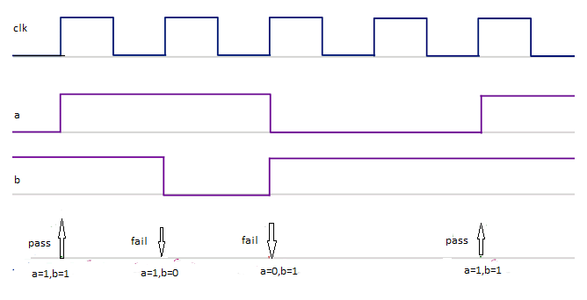
Assertions
Always @(posedge clk)
assert (a && b);

Slide 285
Assertions
module asertion_ex;
bit clk,a,b;
always #5 clk = ~clk;
initial begin
a=1;
b=1;
#15 b=0;
#10 b=1;
a=0;
#20 a=1;
#10;
$finish;
end
always @(posedge clk)
// assert (a && b) $display("there's no error"); $warning("there's error");
assert (a && b);
endmodule

Slide 286
Assertions
Concurrent Assertions:
Concurrent assertions check the sequence of events spread over multiple clock cycles.
The concurrent assertion is evaluated only at the occurrence of a clock tick
The test expression is evaluated at clock edges based on the sampled values of the variables involved
It can be placed in a procedural block, a module, an interface or a program definition
Syntax:
c_assert: assert property(@(posedge clk) not(a && b));
The keyword differentiates the immediate assertion from the concurrent assertion is “property.”

Slide 287
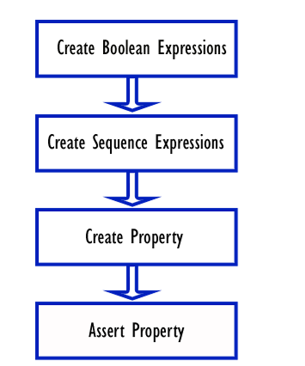
Assertions
Boolean expressions
The functionality is represented by the combination of multiple logical events. These events could be simple Boolean expressions.

Slide 288
Assertions
Sequence
Boolean expression events that evaluate over a period of time involving single/multiple clock cycles.
SVA provides a keyword to represent these events called “sequence.”
Syntax
sequence name_of_sequence;
……
endsequence

Slide 289
Assertions
Property
A number of sequences can be combined logically or sequentially to create more complex sequences.
SVA provides a keyword to represent these complex sequential behaviors called “property”.
Syntax
property name_of_property;
test expression or
complex sequence expressions
endproperty

Slide 290
Assertions
Assert
The property is the one that is verified during a simulation. It has to be asserted to take effect during a simulation. SVA provides a keyword called “assert” to check the property.
Syntax
assertion_ name: assert_property( property_name );

Slide 291
Assertions
module concurrent_assertion_example;
logic clk, req, ack;
initial clk = 0;
always #5 clk = ~clk;
sequence req_ack_seq;
req && ack;
endsequence
property p_req_ack;
@(posedge clk) req_ack_seq;
endproperty
a1: assert property (p_req_ack)
else $fatal("Assertion failed: ack is high without req!");
initial begin
$monitor("req: %b|| ack:%b||", req,ack);
req = 1; ack = 1;
#10 req = 1; ack = 1;
#10 req = 0; ack = 1;
#10 $finish;
end
endmodule

Slide 292
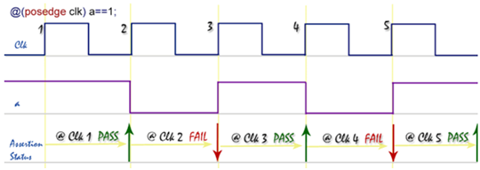
Assertions
SVA Sequence example
In the below example the sequence seq_1 checks that the signal “a” is high on every positive edge of the clock. If the signal “a” is not high on any positive clock edge, the assertion will fail.
Example
sequence seq_1;
@(posedge clk) a==1;
endsequence

Slide 293
Assertions
A sequence with a logical relationship
Below sequence, seq_2 checks that on every positive edge of the clock, either signal “a” or signal “b” is high. If both the signals are low, the assertion will fail.
Example
sequence seq_2;
@(posedge clk) a || b;
endsequence

Slide 294
Assertions
Sequence Expressions
By defining arguments in a sequence definition, the same sequence can be re-used for similar behavior.
Example
sequence seq_lib (a, b)
a || b ;
endsequence
this seq can be used as,
sequence s_lib_inst
seq_lib(req1,req2);
endsequence

Slide 295
Assertions
Clock usage in SVA
A clock can be specified in a sequence, in a property or even in an assert statement.
Clock defined in the sequence definition
The previous example shows the usage of a clock inside the sequence definition.
Example
sequence seq;
@(posedge clk) a ##2 b;
endsequence

Slide 296
Assertions
In general, it is a good idea to define the clocks in property definitions and keep the sequences independent of the clocks. This will help increase the re-use of the basic sequence definitions.
Example
sequence seq;
a ##2 b;
endsequence
property p;
@(posedge clk) seq;
endproperty
a_1 : assert property(p);

Slide 297
Assertions
module assertion_example;
logic clk, a, b;
always #10 clk = ~clk;
sequence seq;
a ##2 b;
endsequence
property p;
@(posedge clk) seq;
endproperty
a_1 : assert property(p)
else $warning("Assertion failed: 'a' was not followed by 'b' after 2 cycles!");
initial begin
$monitor("Time: %0t | A: %b | B: %b", $time, a, b);
$dumpfile("assertion_waveform.vcd");
$dumpvars(0, assertion_example);
clk = 0;
a = 0; b = 0;
#10 a = 1;
#20 b = 1;
#20 a = 1;
#40 b = 1;
#60 $finish;
end
endmodule

Slide 298
Assertions
Forbidding a property
A separate property definition is not needed to assert a sequence. the expression to be checked can be called from the assert statement directly as shown below.
Example
sequence seq;
a ##2 b;
endsequence
a_2: assert property(@(posedge clk) seq);
Calling a property with a clock definition from within the assert statement is not allowed.
a_3: assert property(@(posedge clk) p) ; //Not allowed

Slide 299
Assertions
Implication Operator
The implication is equivalent to an if-then structure. The left-hand side of the implication is called the “antecedent” and the right-hand side is called the “consequent.”
The antecedent is the gating condition. If the antecedent succeeds, then the consequent is evaluated.
The implication construct can be used only with property definitions. It cannot be used in sequences.
There are 2 types of implication:
Overlapped implication
Non-overlapped implication

Slide 300
Assertions
Overlapped implication
The overlapped implication is denoted by the symbol |->.
If there is a match on the antecedent, then the consequent expression is evaluated in the same clock cycle.
Below property checks that, if signal “a” is high on a given positive clock edge, then signal “b” should also be high on the same clock edge.
property p;
@(posedge clk) a |-> b;
endproperty
a: assert property(p);

Slide 301
Assertions
module overlapped_implication_example;
logic clk, a, b;
always #10 clk = ~clk;
property p_overlapped;
@(posedge clk) a |-> b;
endproperty
a_overlapped: assert property (p_overlapped)
else $warning("Overlapped Implication Failed: 'a' was high, but 'b' was not high in the same cycle!");
initial begin
$monitor("Time: %0t | A: %b | B: %b", $time, a, b);
$dumpfile("overlapped_implication.vcd");
$dumpvars(0, overlapped_implication_example);
clk = 0;
a = 0; b = 0;
#10 a = 1; b = 1;
#20 a = 1; b = 0;
#40 $finish;
end
endmodule

Slide 302
Assertions
Non-overlapped implication
The non-overlapped implication is denoted by the symbol |=>.
If there is a match on the antecedent, then the consequent expression is evaluated in the next clock cycle.
Below property checks that, if signal “a” is high on a given positive clock edge, then signal “b” should be high on the next clock edge.
property p;
@(posedge clk) a |=> b;
endproperty
a: assert property(p);

Slide 303
Assertions
initial begin
$monitor("Time: %0t | A: %b | B: %b", $time, a, b);
$dumpfile("non_overlapped_implication.vcd");
$dumpvars(0, non_overlapped_implication_example);
clk = 0;
a = 0; b = 0;
#10 a = 1;
#10 b = 1;
#20 a = 1;
#10 b = 0;
#40 $finish;
end
endmodule
module non_overlapped_implication_example;
logic clk, a, b;
always #10 clk = ~clk;
property p_non_overlapped;
@(posedge clk) a |=> b;
endproperty
a_non_overlapped: assert property (p_non_overlapped)
else $error("Non-Overlapped Implication Failed: 'a' was high, but 'b' was not high in the next cycle!");

Slide 304
Assertions
The implication with a fixed delay on the consequent
Below property checks that, if signal “a” is high on a given positive clock edge, then signal “b” should be high after 2 clock cycles.
property p;
@(posedge clk) a |-> ##2 b;
endproperty
a: assert property(p);

Slide 305
Assertions
module implication_example;
logic clk, a, b;
always #10 clk = ~clk;
property p;
@(posedge clk) a |->##2 b;
endproperty
a_1 : assert property(p) $display(" time : %0t assert passed",$time);
else $warning("Assertion failed at : %0t: 'a' was not followed by 'b' after 2 cycles!",$time);
initial begin
$monitor("Time: %0t | A: %b | B: %b", $time, a, b);
$dumpfile("assertion_waveform.vcd");
$dumpvars(0, assertion_example);
clk = 0;
a = 0; b = 0;
#10 a = 1; b=0;
#10 a=1; #20 b = 1;
#20 a = 0;#40 b = 0;
#10 a=1; #20 a=0;
#10 b=1;
#20 b=0; #60 $finish;
end
endmodule

Slide 306
Assertions
The implication with a sequence as an antecedent
Below property checks that, if the sequence seq_1 is true on a given positive edge of the clock, then start checking the seq_2 (“d” should be low, 2 clock cycles after seq_1 is true).
sequence seq_1;
(a && b) ##1 c;
endsequence
sequence seq_2;
##2 !d;
endsequence
property p;
@(posedge clk) seq_1 |-> seq_2;
endpeoperty
a: assert property(p);

Slide 307
Assertions
module sequence_implication_example;
logic clk, a, b, c, d;
always #10 clk = ~clk;
sequence seq_1;
(a && b) ##1 c;
endsequence
sequence seq_2;
##2 !d;
endsequence
property p;
@(posedge clk) seq_1 |-> seq_2;
endproperty
a1: assert property(p)
else $warning("Assertion failed: seq_1 was true, but seq_2 was not true!");
initial begin
$monitor("Time: %0t | A: %b | B: %b | C: %b | D: %b", $time, a, b, c, d);
$dumpfile("sequence_implication.vcd");
$dumpvars(0, sequence_implication_example);
clk = 0;
a = 0; b = 0; c = 0; d = 0;
#10 a = 1; b = 1;
#10 c = 1;
#20 d = 0;
#20 a = 1; b = 1;
#10 c = 1;
#20 d = 1;
#60 $finish;
end
endmodule

Slide 308
Assertions
Timing windows in SVA Checkers
Below property checks that, if signal “a” is high on a given positive clock edge, then within 1 to 4 clock cycles, the signal “b” should be high.
property p;
@(posedge clk) a |-> ##[1:4] b;
endproperty
a: assert property(p);

Slide 309
Assertions
module implication_timing_window_example;
logic clk;
logic a;
logic b;
initial begin
clk = 0;
forever #5 clk = ~clk;
end
property p;
@(posedge clk) a |-> ##[1:4] b;
endproperty
a_assert: assert property (p)
else $warning("Assertion failed: 'b' did not go high within 1 to 4 clock cycles after 'a' was high.");
initial begin
$monitor("CLK:%b||A:%B||B:%b||",clk,a,b);
$dumpfile("WAVEFORM.vcd"); $dumpvars(0,implication_timing_window_example);
a = 0;
b = 0;#15;
a = 1;#20;
a = 0; #30;
b = 1;#10;
b = 0; #25;
a = 1; #15;
b=1; a = 0; #50;
#10; a = 0;
#20;b = 1;
#10; b = 0; #100 $finish;
end
endmodule

Slide 310
Assertions
Indefinite timing window
The upper limit of the timing window specified in the right-hand side can be defined with a “$” sign which implies that there is no upper bound for timing.
This is called the “eventuality” operator. The checker will keep checking for a match until the end of the simulation.
Below property checks that, if signal “a” is high on a given positive clock edge, then signal “b” will be high eventually starting from the next clock cycle.
property p;
@(posedge clk) a |-> ##[1:$] b;
endproperty
a: assert property(p);

Slide 311

Assertions
Repetition Operators
The above property checks that, if the signal “a” is high on given posedge of the clock, the signal “b” should be high for 3 consecutive clock cycles.
The Consecutive repetition operator is used to specify that a signal or a sequence will match continuously for the number of clocks specified.
Syntax
signal [*n] or sequence [*n]
"n" is the number of repetitions.

Slide 312

Assertions
with repetition operator above sequence can be re-written as,

Slide 313
Assertions
module repetation_implication_example;
logic clk;
logic a;
logic b;
initial begin
clk = 0;
forever #5 clk = ~clk;
end
property p;
@(posedge clk) a |-> ##1 b[*3];
endproperty
a_assert: assert property (p)
else $warning("Assertion failed: 'b' was not high for 3 consecutive cycles after 'a' was high.");
initial begin
$monitor("TIME:%0t||CLK :%b||A:%b|| B:%b|| ", $time,clk,a,b);
$dumpfile("waveform.vcd");
$dumpvars(0,repetation_implication_example);
a = 0; b = 0;
#15; a = 1;
#10; b=1; a = 0;
#10; b = 1; #10; b = 1; #10; b = 1;
#10; b = 0; #15; a = 1; #10; b=1; a = 0;
#10; b = 1; #10; b = 0; #10; b = 1;
#10; b = 0;
$finish;
end
endmodule

Slide 314
Assertions
Go to repetition
The go-to repetition operator is used to specify that a signal will match the number of times specified not necessarily on continuous clock cycles.
signal [->n]
property p;
@(posedge clk) a |-> ##1 b[->3] ##1 c;
endproperty
a: assert property(p);
The above property checks that, if the signal “a” is high on given posedge of the clock, the signal “b” should be high for 3 clock cycles followed by “c” should be high after ”b” is high for the third time.

Slide 315
Assertions
module goto_repetition_example;
logic clk; logic a; logic b; logic c;
initial begin
clk = 0;
forever #5 clk = ~clk;
end
property p;
@(posedge clk) a |-> ##1 b[->3] ##1 c;
endproperty
a_assert: assert property (p)
else $warning("Assertion failed: 'b' was not high 3 times followed by 'c'.");
initial begin
$monitor("time: %0t|| CLK: %b|| A:%b|| B:%b||C:%b", $time,clk,a,b,c);
$dumpfile("waveform.vcd");
$dumpvars(0,goto_repetition_example);
a = 0;b = 0;c = 0;
@(posedge clk); a = 1;@(posedge clk); a = 0;
@(posedge clk);b = 1;@(posedge clk);b = 0;
@(posedge clk);b = 1;@(posedge clk);b = 0;
@(posedge clk);b = 1;@(posedge clk);c = 1;
@(posedge clk);c = 0;@(posedge clk);a = 1;
@(posedge clk);a = 0;@(posedge clk);b = 1;
@(posedge clk);b = 0;@(posedge clk);b = 1;
@(posedge clk); b = 0;@(posedge clk);c = 1;
@(posedge clk);c = 0;$finish;end
endmodule

Slide 316
Assertions
Nonconsecutive repetition
This is very similar to “go to” repetition except that it does not require that the last match on the signal repetition happens in the clock cycle before the end of the entire sequence matching.
signal [=n]
Only expressions are allowed to repeat in “go to” and “nonconsecutive” repetitions. Sequences are not allowed.

Slide 317
Assertions
module nonconsecutive_repetition_example;
logic clk;
logic a;
logic b;
logic c;
initial begin
clk = 0;
forever #5 clk = ~clk;
end
property p;
@(posedge clk) a |-> ##1 b[=3] ##1 c;
endproperty
a_assert: assert property (p)
else $warning("Assertion failed: 'b' was not high 3 times followed by 'c'.");
initial begin
$monitor("time: %0t|| CLK: %b|| A:%b|| B:%b||C:%b", $time,clk,a,b,c);
$dumpfile("waveform.vcd");
$dumpvars(0,goto_repetition_example);
a = 0;b = 0;c = 0;
@(posedge clk); a = 1;@(posedge clk); a = 0;
@(posedge clk);b = 1;@(posedge clk);b = 0;
@(posedge clk);b = 1;@(posedge clk);b = 0;
@(posedge clk);b = 1;@(posedge clk);c = 1;
@(posedge clk);c = 0;@(posedge clk);a = 1;
@(posedge clk);a = 0;@(posedge clk);b = 1;
@(posedge clk);b = 0;@(posedge clk);b = 1;
@(posedge clk); b = 0;@(posedge clk);c = 1;
@(posedge clk);c = 0;$finish;end
endmodule

Slide 318
Assertions
SVA Methods
$rose
$rose(boolean expression or signal name)
returns true if the least significant bit of the expression changed to 1. Otherwise, it returns false.
sequence seq_rose;
@(posedge clk) $rose(a);
endsequence
Sequence seq_rose checks that the signal “a” transitions to a value of 1 on every positive edge of the clock. If the transition does not occur, the assertion will fail.

Slide 319
Assertions
module tb;
bit a;
bit clk;
sequence s_a;
@(posedge clk) $rose(a);
endsequence
assert property(s_a) else $warning("a is not changed to high at posedge clk cycle");
always #10 clk = ~clk;
initial begin
$dumpfile("waveform.vcd");
$dumpvars(0,tb);
for(int i=0;i<10;i++)begin
a = $random;
@(posedge clk);
$display("[%0t] a=%0d", $time, a);
end
#20 $finish;
end
endmodule

Slide 320
Assertions
$fell
$fell(boolean expression or signal name)
returns true if the least significant bit of the expression changed to 0. Otherwise, it returns false.
sequence seq_fell;
@(posedge clk) $fell(a);
endsequence
Sequence seq_fell checks that the signal “a” transitions to a value of 0 on every positive edge of the clock. If the transition does not occur, the assertion will fail.

Slide 321
Assertions
module tb;
bit a;
bit clk;
sequence s_a;
@(posedge clk) $fell(a);
endsequence
assert property(s_a) else $warning("a is not changed to high at posedge clk cycle");
always #10 clk = ~clk;
initial begin
$dumpfile("waveform.vcd");
$dumpvars(0,tb);
for(int i=0;i<10;i++)begin
a = $random;
@(posedge clk);
$display("[%0t] a=%0d", $time, a);
end
#20 $finish;
end
endmodule

Slide 322
Assertions
$stable
$stable(boolean expression or signal name)
returns true if the value of the expression did not change. Otherwise, it returns false.
sequence seq_stable;
@(posedge clk) $stable(a);
endsequence
Sequence seq_stable checks that the signal “a” is stable on every positive edge of the clock. If there is any transition occurs, the assertion will fail.

Slide 323
Assertions
module tb;
bit a;
bit clk;
sequence s_a;
@(posedge clk) $stable(a);
endsequence
assert property(s_a) else $warning("a is not stable at posedge clk cycle");
always #10 clk = ~clk;
initial begin
$dumpfile("waveform.vcd");
$dumpvars(0,tb);
for(int i=0;i<10;i++)begin
a = $random;
@(posedge clk);
$display("[%0t] a=%0d", $time, a);
end
#20 $finish;
end
endmodule

Slide 324
Assertions
$past
$past(signal_name, number of clock cycles)
provides the value of the signal from the previous clock cycle.
Below Property checks that, in the given positive clock edge, if the “b” is high, then 2 cycles before that, a was high.
property p;
@(posedge clk) b |-> ($past(a,2) == 1);
endproperty
a: assert property(p);

Slide 325
Assertions
module past_example;
logic clk;
logic a;
logic b;
initial begin
clk = 0;
forever #5 clk = ~clk;
end
property p;
@(posedge clk) b |-> ($past(a, 2) == 1);
endproperty
a_assert: assert property ( p)
else $warning("Assertion failed: 'a' was not high 2 cycles before 'b'.");
initial begin
$monitor("TIME:%0t|| CLK :%b|| A:%b|| B:%b||", $time,clk,a,b);
$dumpfile("Waveform.vcd");
$dumpvars(0,past_example);
a = 0;
b = 0;
@(posedge clk); a = 1;
@(posedge clk); a = 0;
@(posedge clk); b = 1;
@(posedge clk); b = 0;
@(posedge clk);b = 1;
@(posedge clk); b = 0;
#10$finish;
end
endmodule

Slide 326
Assertions
$past construct with clock gating
The $past construct can be used with a gating signal. on a given clock edge, the gating signal has to be true even before checking for the consequent condition.
$past (signal_name, number of clock cycles, gating signal)
Below Property checks that, in the given positive clock edge, if the “b” is high, then 2 cycles before that, a was high only if the gating signal “c’ is valid on any given positive edge of the clock.
Property p;
@(posedge clk) b |-> ($past(a,2,c) == 1);
endproperty
a: assert property(p);

Slide 327
Assertions
module past_gating_example;
logic clk; logic a; logic b; logic c;
initial begin
clk = 0;
forever #2.5 clk = ~clk;
end
property p;
@(posedge clk) b |-> ($past(a, 2, c) == 1);
endproperty
a_assert: assert property (p)
else $error("Assertion failed: 'a' was not high 2 cycles before 'b' with 'c' as gating signal.");
initial begin
$monitor("TIME:%0t|| CLK :%b|| A:%b|| B:%b|| C:%b||", $time,clk,a,b,c);
a = 0;
b = 0;
c = 0;
@(posedge clk); a = 1; c = 1;
@(posedge clk); a = 0; c = 0;
@(posedge clk); b = 1;
@(posedge clk); b = 0;
@(posedge clk); a = 1;c = 0;
@(posedge clk); a = 0; c = 1;
@(posedge clk); b = 1; @(posedge clk); b = 0;
$finish;
end
endmodule

Slide 328
Assertions
Built-in system functions
$onehot(expression)
checks that only one bit of the expression can be high on any given clock edge.
$onehot0(expression)
checks only one bit of the expression can be high or none of the bits can be high on any given clock edge.
$isunknown(expression)
checks if any bit of the expression is X or Z.
$countones(expression)
counts the number of bits that are high in a vector.

Slide 329
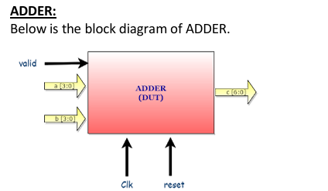
SV Test Bench
SystemVerilog Test Bench Example — Adder

Slide 330
SV Test Bench
Adder is,
fed with the inputs clock, reset, a, b and valid. has output is c.
The valid signal indicates the valid value on the a and b, On valid signal adder will add the a and b, drives the result in the next clock on c.
Adder add/Sum the 4bit values ‘a’ and ‘b’, and drives the result on c in the next clock.

Slide 331
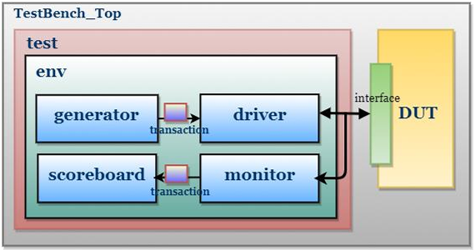
SV Test Bench

Slide 332
