Slide 1

Digital Communications
OFDM-based communication system

Slide 2

Channel Coding:
A Hamming code is a type of linear block codes that can do error-correcting that can be used to detect and correct errors in data transmission or storage. It is named after its inventor, Richard Hamming. In a Hamming code, the data bits are divided into blocks, and each block is encoded with an additional set of parity bits. The parity bits are added to the data bits to create a code word, which is transmitted or stored.
In Decoder the received code word is multiplied by parity check matrix (H) the result is called syndrome and there is look up table that map every syndrome to an error in the code word so we can detect the error and can correct it by flipping the error bit.

Slide 3
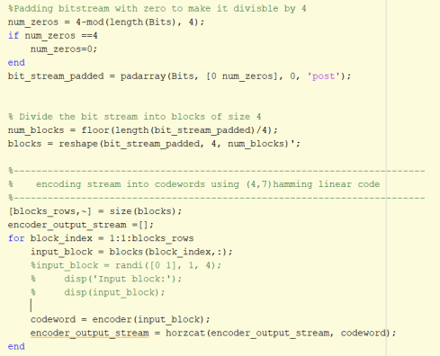
Encoder script:

Slide 4
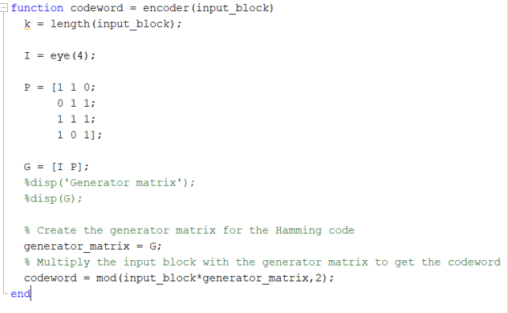
Encoder function:

Slide 5
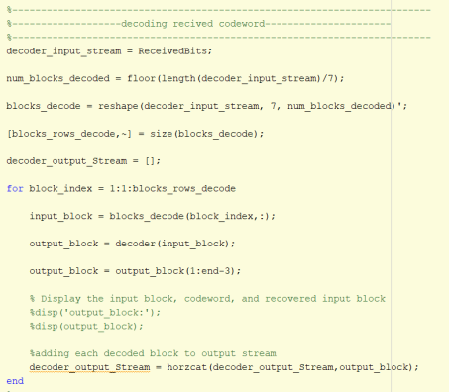
Decoder script:

Slide 6
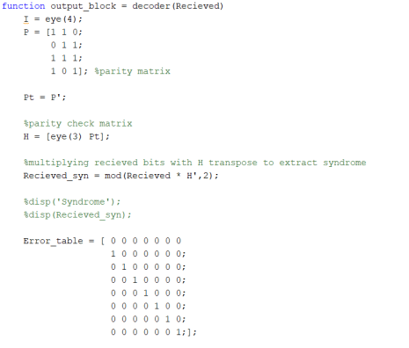
Decoder function:

Slide 7
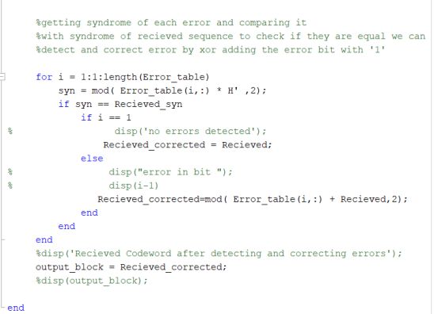
Decoder function:

Slide 8
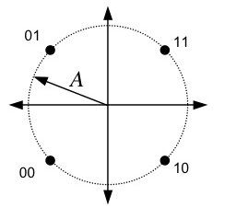
QPSK modulation & demodulation

Slide 9
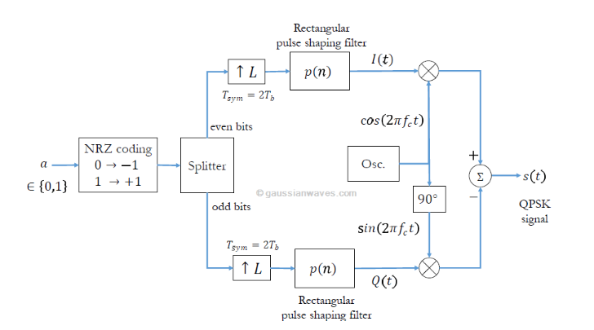
QPSK Modulator

Slide 10
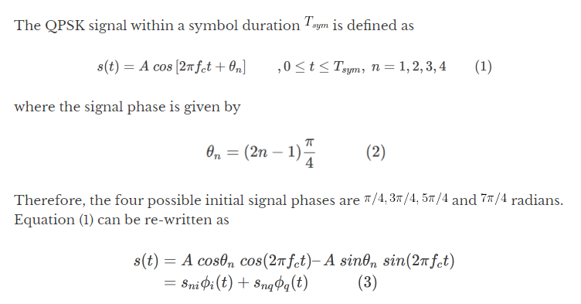

Slide 11
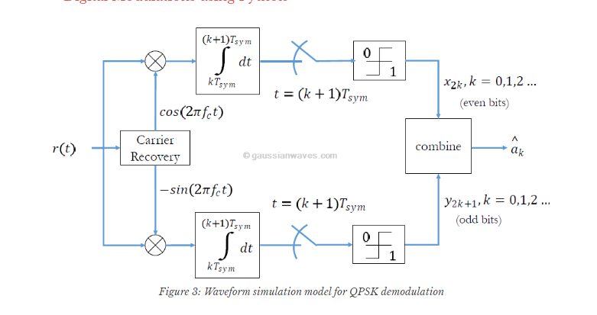
QPSK modulation Demodulation

Slide 12
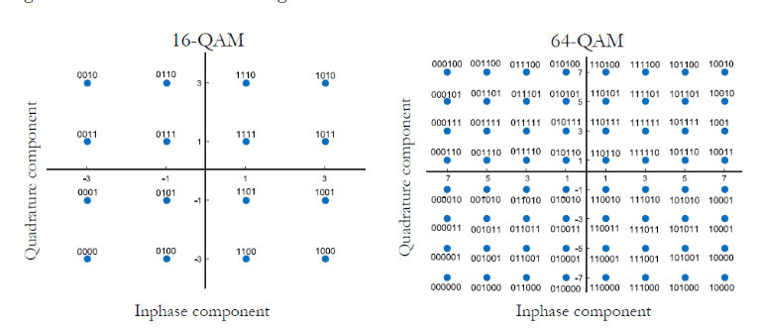
QAM

Slide 13
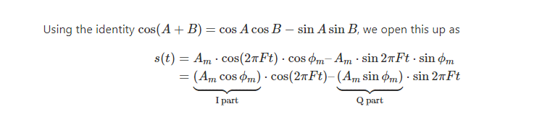

Slide 14
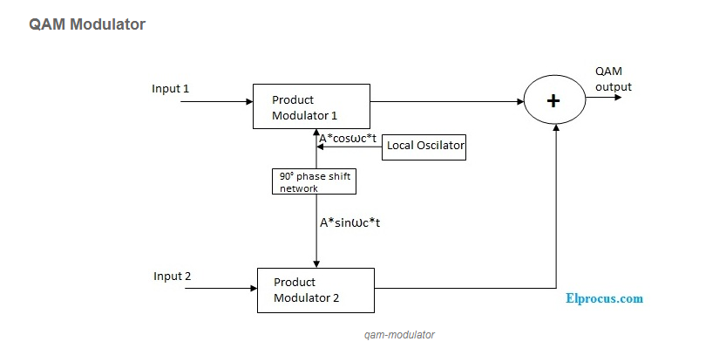
QAM Modulator

Slide 15
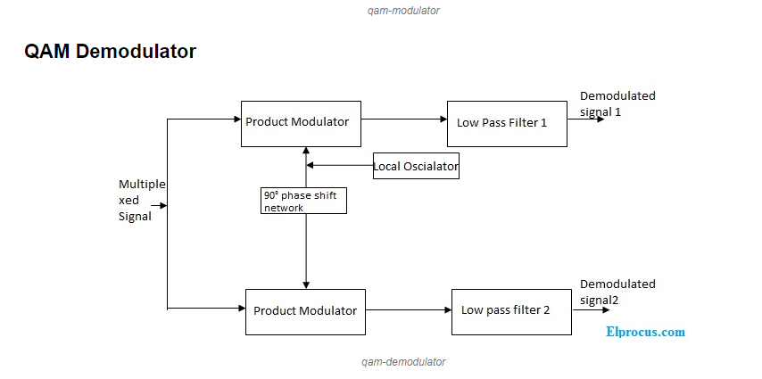
QAM DeModulator

Slide 16
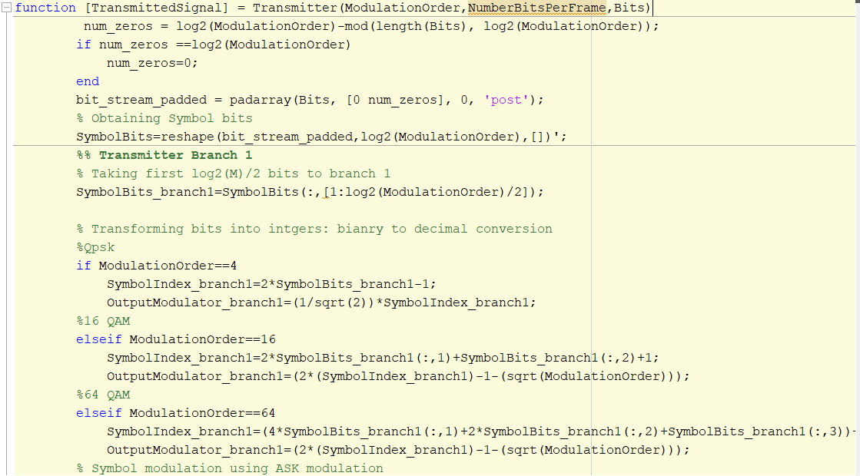
Modulation Function

Slide 17
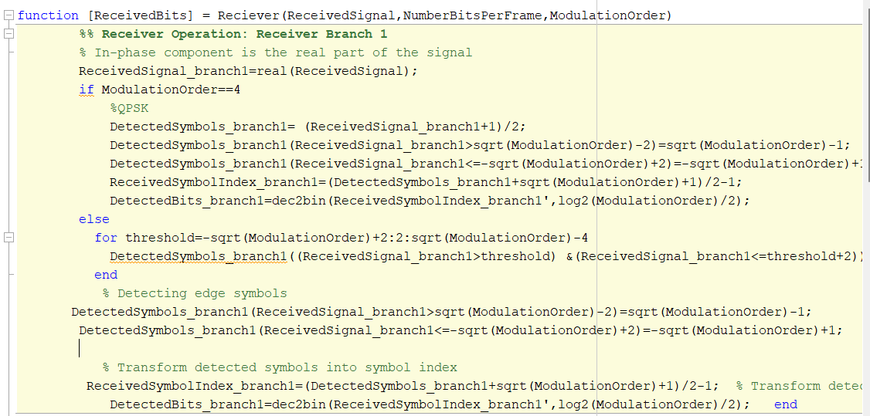
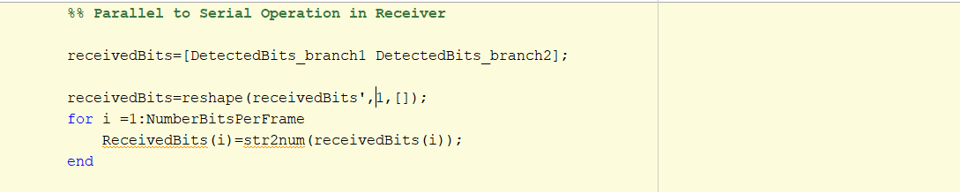
Demodulation Function

Slide 18
Fourier Transform
After modulation we get the inverse Fourier transform of the symbols to transfer signal to time domain.
Symbol_stream_Transformed=ifft(Symbol_stream.*sqrt(1024),1024);

Slide 19
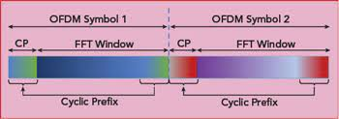
Cyclic prefix
In Orthogonal Frequency Division Multiplexing (OFDM), a cyclic prefix (CP) is a repetition of the last few samples of the OFDM symbol at the beginning of the symbol. This helps to reduce the inter-symbol interference (ISI) caused by the nature of the channel, which can cause the energy from one symbol to interfere the subsequent symbol.

Slide 20
How to choose the length of Cyclic prefix
The length of the cyclic prefix is chosen based on the expected delay spread of the channel. A longer cyclic prefix is able to reduce larger delay, but it also reduces the overall data rate of the system.
Cyclic prefix contains a copy of the last few samples of the symbol, which allows the receiver to perform a type of "cyclic convolution" to cancel out the ISI.
Overall, the use of a cyclic prefix is an important part of the OFDM modulation scheme, as it allows the system to operate effectively in dispersive channels while still maintaining a high data rate.

Slide 21
Cyclic prefix insertion in TX
function [output_data] = cyclic_prefix(OFDM_symbols, prefix_length)
Min length on cyclic prefix = Fading channel delay - 1 = 50 - 1 =49
Extract the last prefix_length samples from input_data
Append the prefix to the beginning of input_data

Slide 22
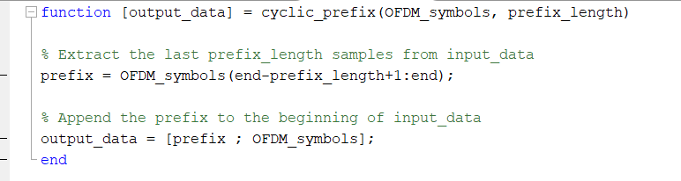
Cyclic Prefix Function

Slide 23
Cyclic prefix Removal in RX
function [OFDM_Symbols] = CP_Remove(RX_Symbols,prefix_length)
Check if the prefix length is less than 49 else : prefix_length = 49;
Length of the received vector
Returning the symbols without cyclic prefix

Slide 24
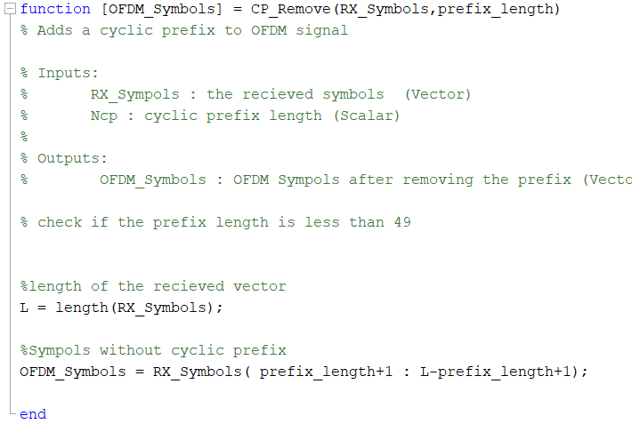
Cyclic Prefix Removal Function

Slide 25
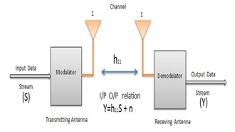
Channel effect
1.SISO Channel Model:
Effect of AWGN
Effect of Multipath fading

Slide 26
1.Effect of AWGN channel
•We add the effect AWGN noise by knowing the value of the SNR and the signal power by dividing the signal power by the given SNR.
• RX_Symbols1 = addAWGN( TX_Symbols, SNR );
2.Effect of the multipath fading
We achieved the complex filter h by the following equation:
h1 = 1 / sqrt(2 * L) * (randn(1, L) + 1i * randn(1, L));
Then we add it to the AWGN noise
Y=hx+n;

Slide 27
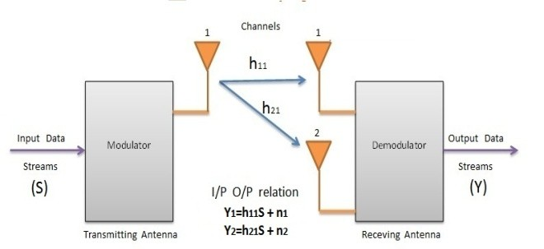
2.SIMO Channel Model:
Effect of AWGN
Effect of Multipath fading

Slide 28
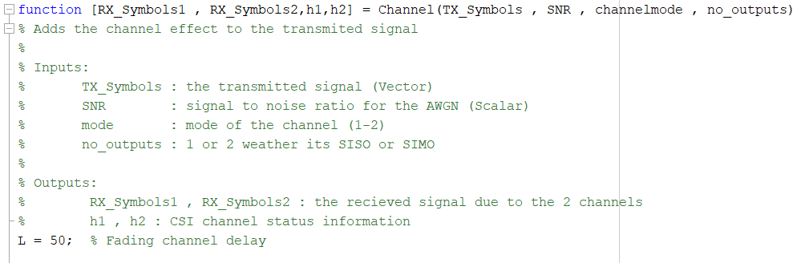
Channel Function

Slide 29
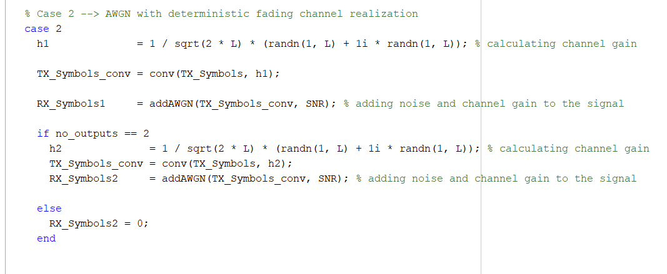
Multipath Fading

Slide 30
Reciever
Removes cyclic prefix.
Apply Fourier transform to return signal (symbols) to frequency domain.
Get H in the frequency domain using Fourier transform.
Divide symbols by H(f) to get the supposed transmitted bits.

Slide 31

Receiver Script

Slide 32
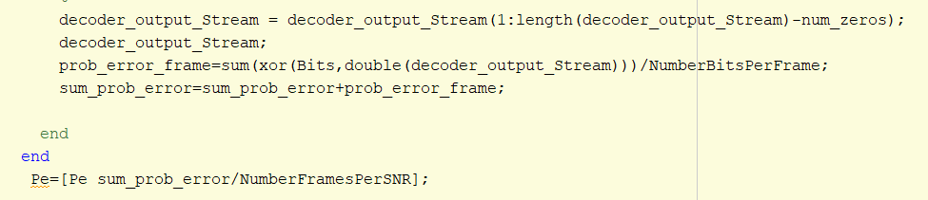
Calculating Pe using xor

Slide 33
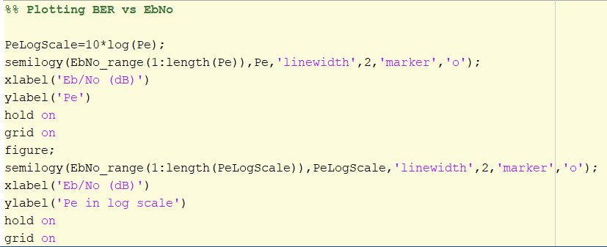
Plotting BER vs EbNo

Slide 34
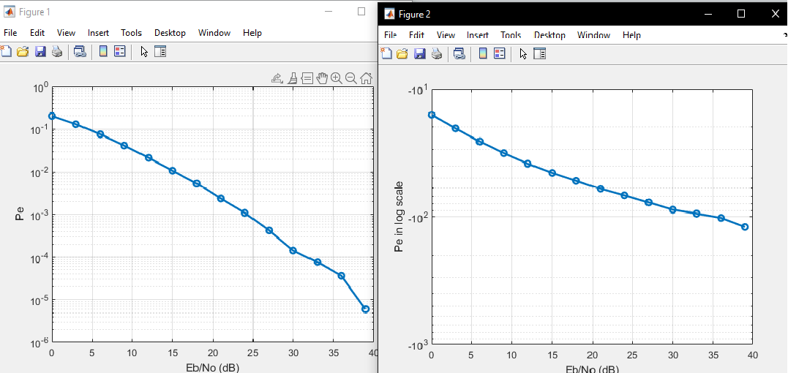
SIMO In Fading Channel QPSK

Slide 35
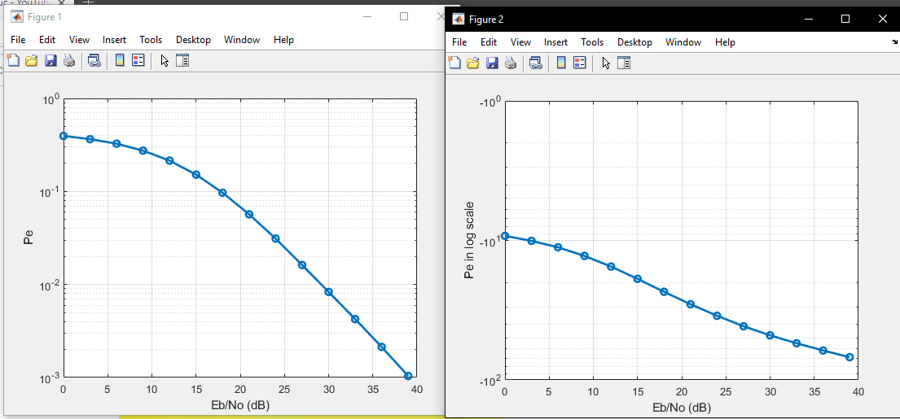
SIMO In Fading Channel 64QAM

Slide 36
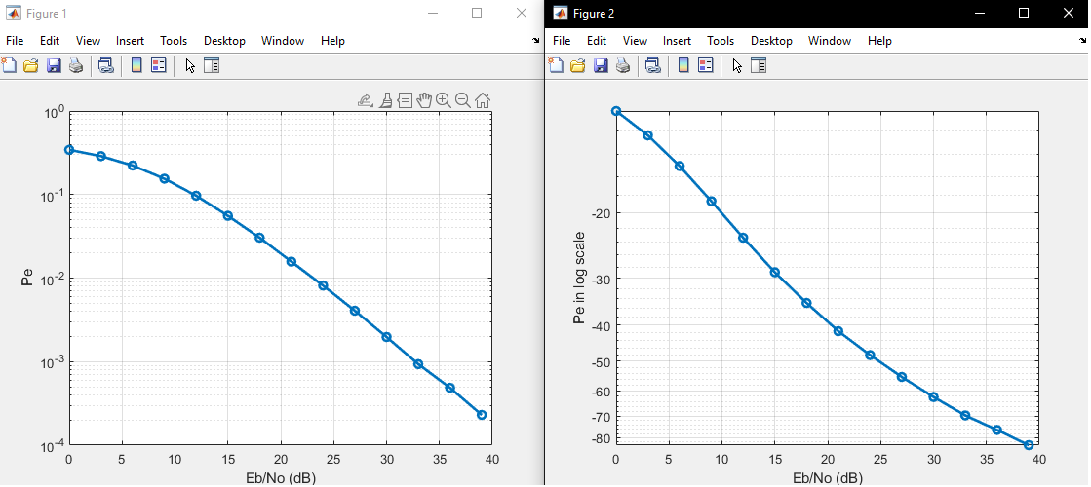
SIMO In Fading Channel 16QAM

Slide 37
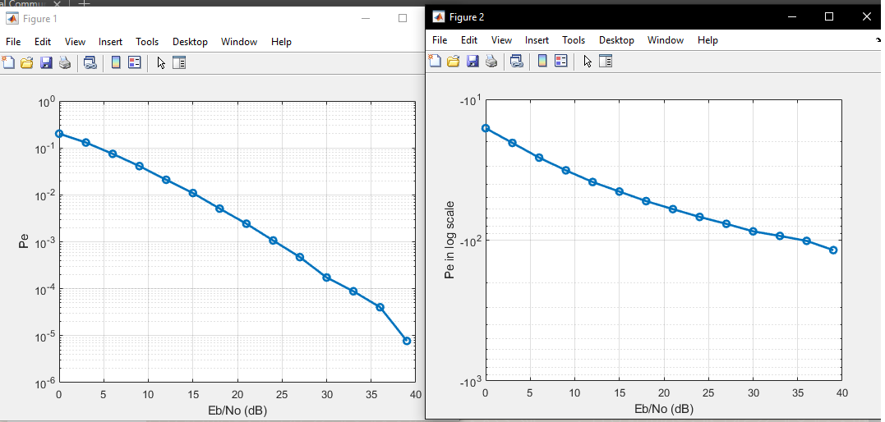
SISO In Fading Channel QPSK

Slide 38
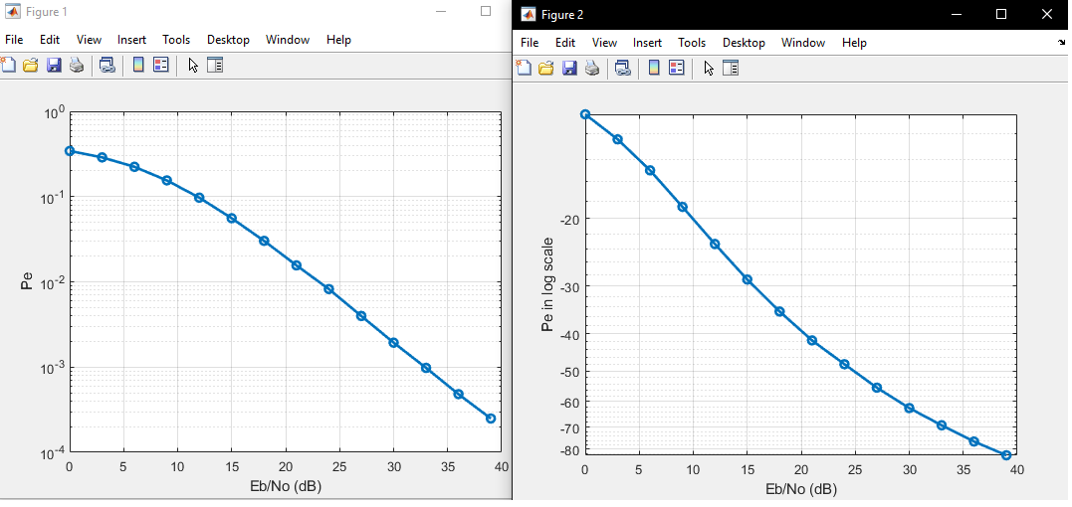
SISO In Fading Channel 16QAM

Slide 39
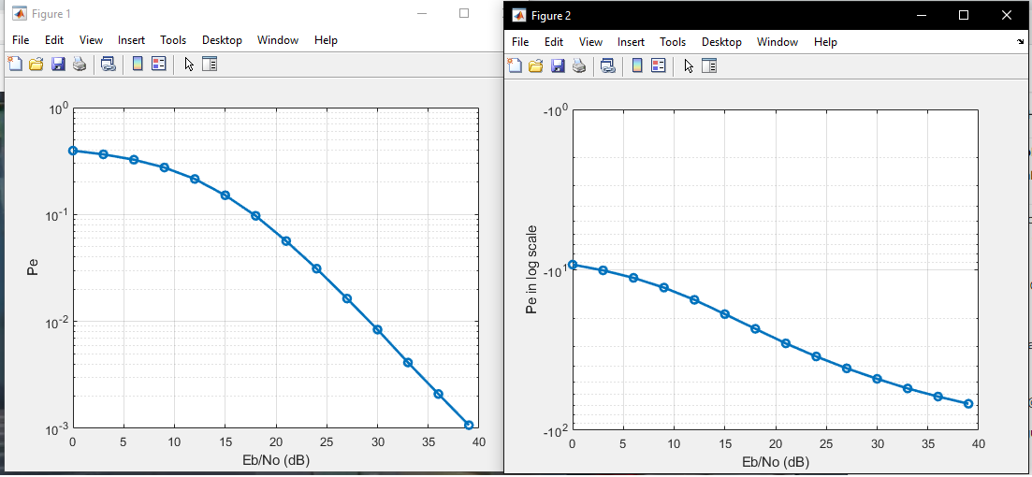
SISO In Fading Channel 64QAM

Slide 40
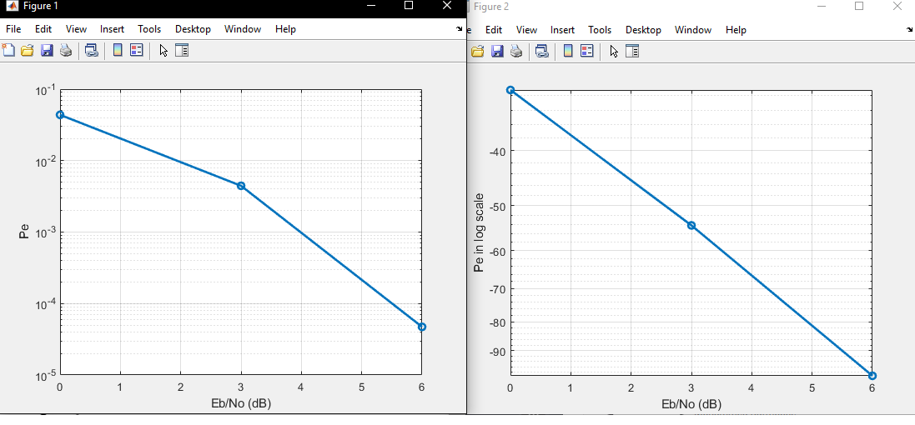
SIMO In AWGN Channel QPSK

Slide 41
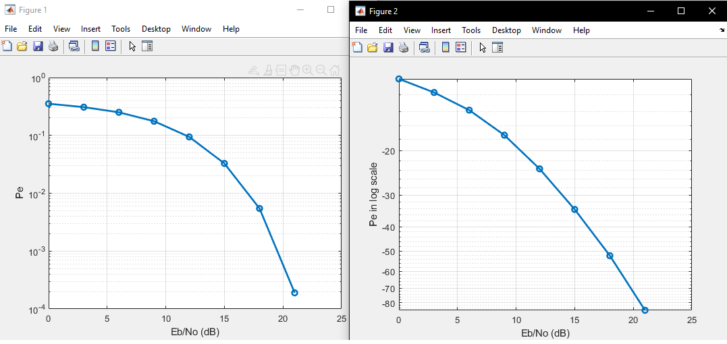
SIMO In Fading Channel 64QAM

Slide 42
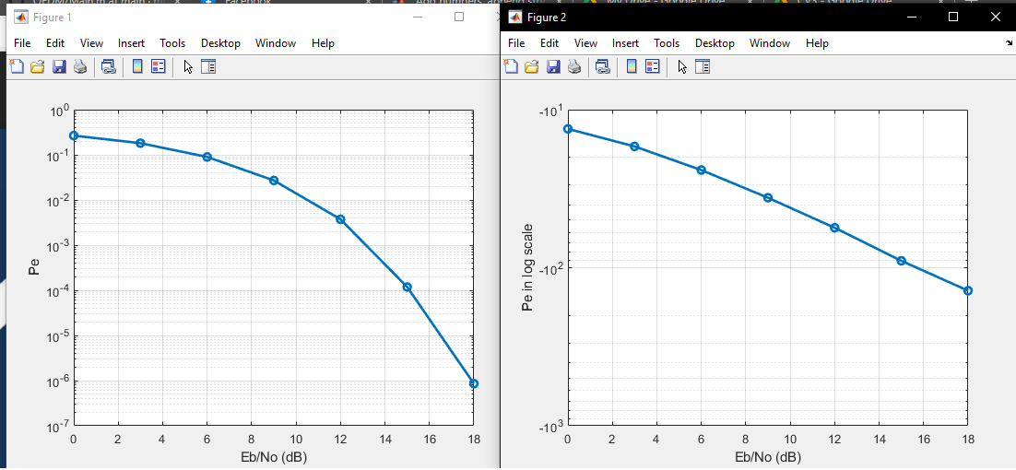
SIMO In Fading Channel 16QAM

Slide 43
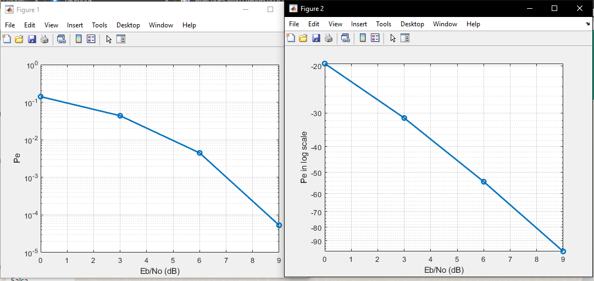
SISO In Fading Channel QPSK

Slide 44
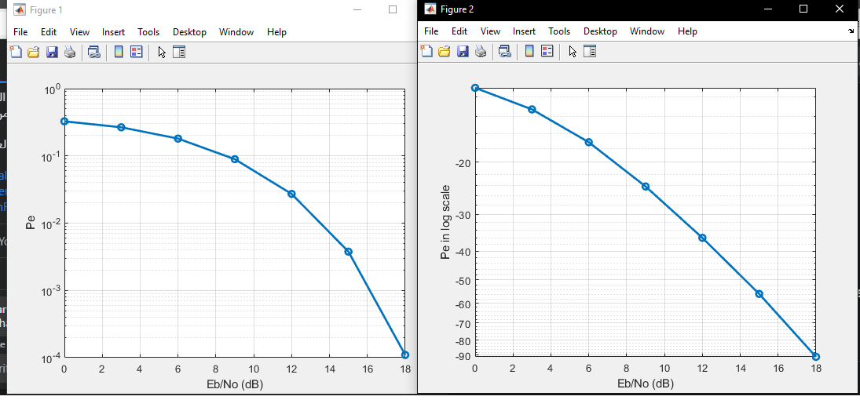
SISO In Fading Channel 16QAM

Slide 45
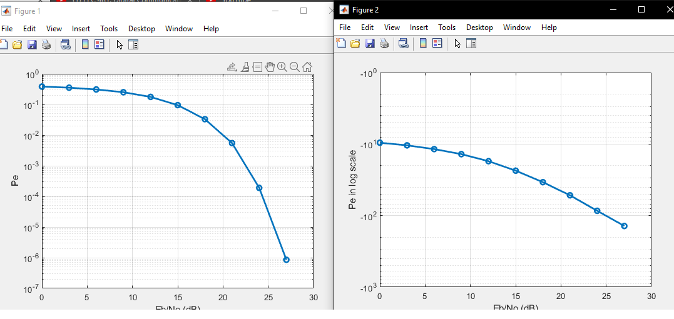
SISO In Fading Channel 64QAM

