Slide 1

Carrefour market Project

Slide 2
Team Member:
1.Mohamed Sabry Mahmoud Shehab Eldean .
2.Mohamed Helmy Abd alaziz Ahmed .
3.Leqaa Mohamed Abdallah Abdelsalam .
4.Fatma Mohamed Elsayed Abdelmaboud .
5.Mohamed Salah Abdel Moneim Abdel Fattah .
6.Mohamed Sabry Mohamed Ahmed .
Supervised by : Eng. Abdallah Mohamed.
Instructor : Prof.Shimaa Talat .

Slide 3

Overview
Carrefour market management is popular and large supermarket, it have a thousand of products So we make a system to control and coordinate transaction in this supermarket, we make a system to Make a customer happy and deal with supermarket easily, save time, effort that customer do to buy Something from a supermarket, customer communicate with supermarket efficiently way, essential Point in this system solve a problem of People crowded in supermarket (corona virus widespread in The world), there exist admin in the system have access on any process in the system and can add Customer, stuff to the system and have report of everything about the supermarket, there exist a Person who deliver order to the customer, there exist financial management that responsible for Anything that related to money, there exist stuff may belongs to sales or marketing, stuff sales that Responsible for communicate with customer in the supermarket and every section in supermarket Have stuff sales, stuff marketing that responsible for market supermarket on the internet, update Products on the internet and reply to the customer where that ask question to the system, there Exist two type of customers (normal customer, special customer) a special customer is a person who Buy from the supermarket more than 10000$ and has offers better than offers of normal customers.

Slide 4

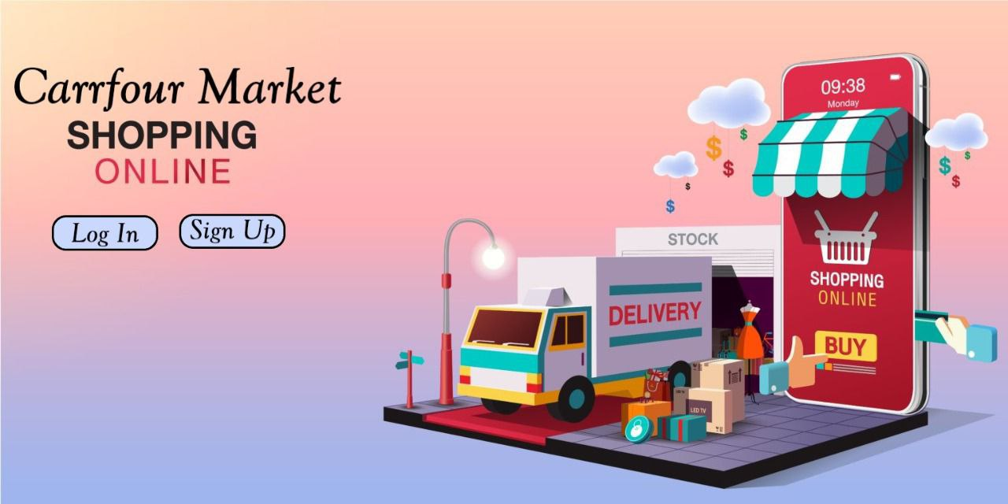
When the customer starts using the site, this window appears for him.

Slide 5
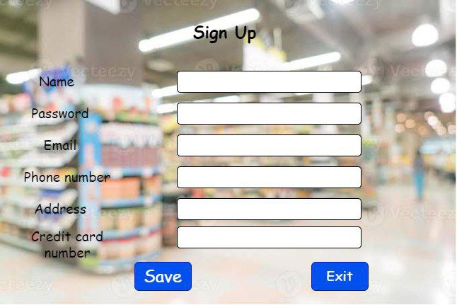
If the user does not have an account, the user presses the sign up button. He is required to enter the username, password, email, phone number, address, and credit card number in order to be able to enter the site.

Slide 6
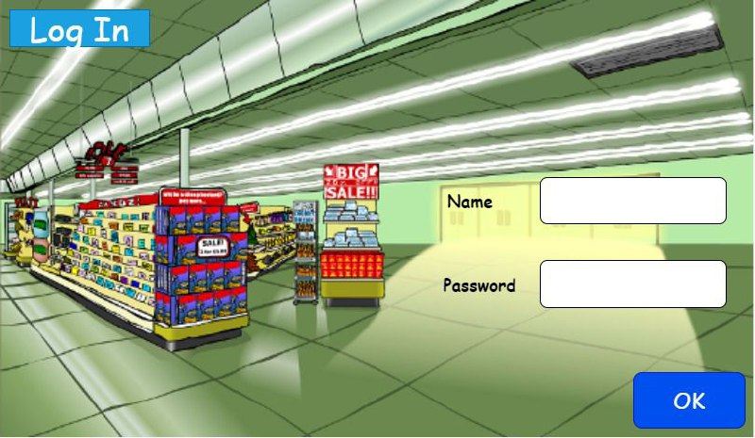
When the user presses the button, he is asked to enter the username and password if he already has an account, and he can log in if it is correct.

Slide 7
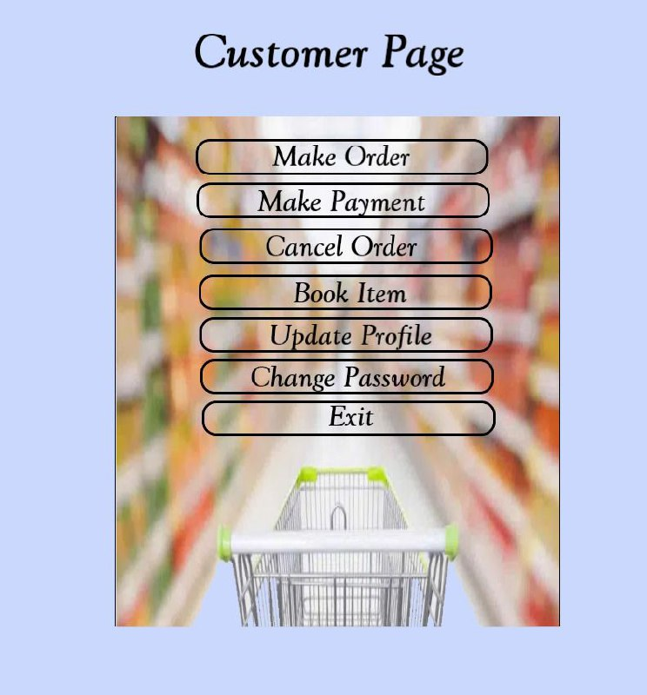
After the user is able to log in to the site, the user window appears, which provides him with some services such as Make order , Make payment , cancel Order , Book Items , Update profile , Change Password or exit .

Slide 8
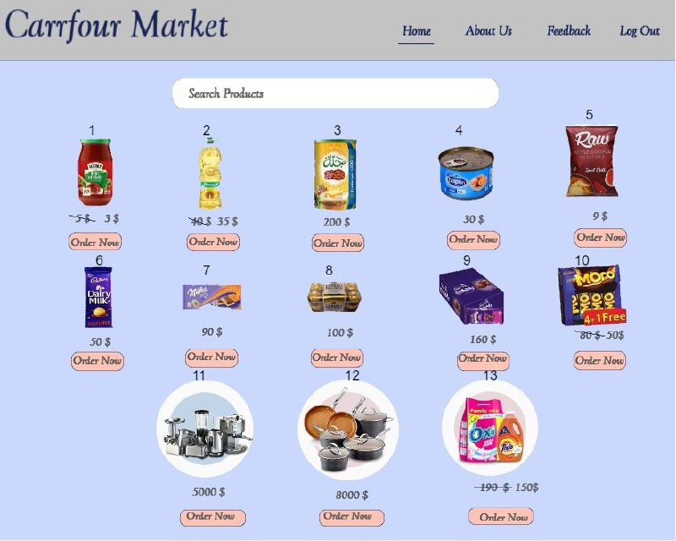
When the user clicks on the make order button, this window appears, containing all the products offered by the site, so that he can buy and choose what he wants.

Slide 9
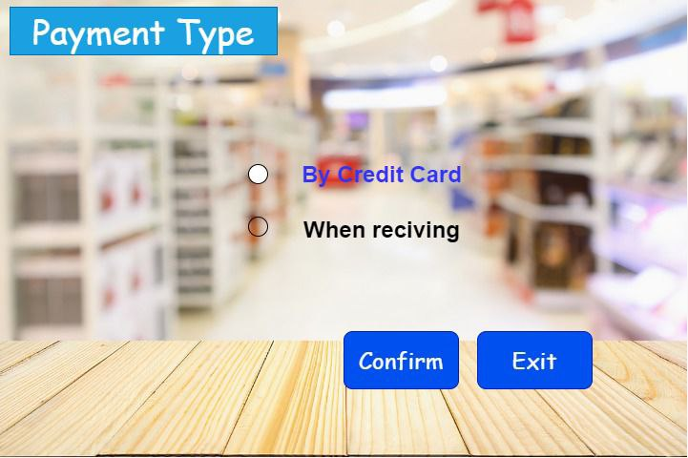
When the user clicks on the make payment button to be able to choose the payment method, either by credit card or when receiving .

Slide 10
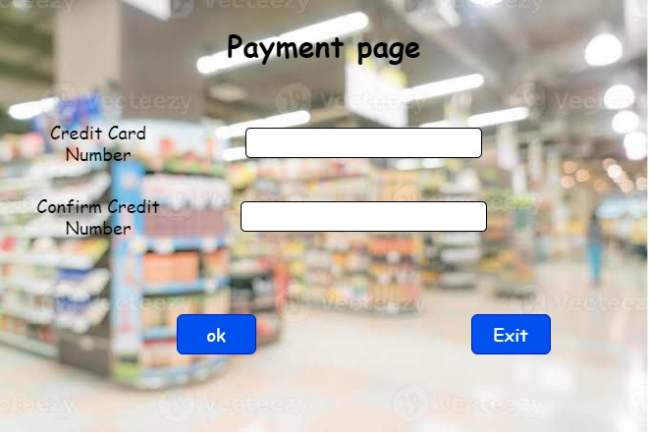
When the user chooses the credit card payment option, this page appears for him to enter the credit card number until the payment process is completed, provided that the number is valid

Slide 11
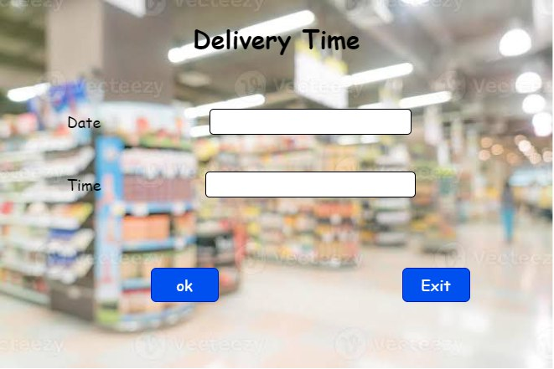
On this page, the customer specifies the time and date he wants to receive the order from the delivery service

Slide 12
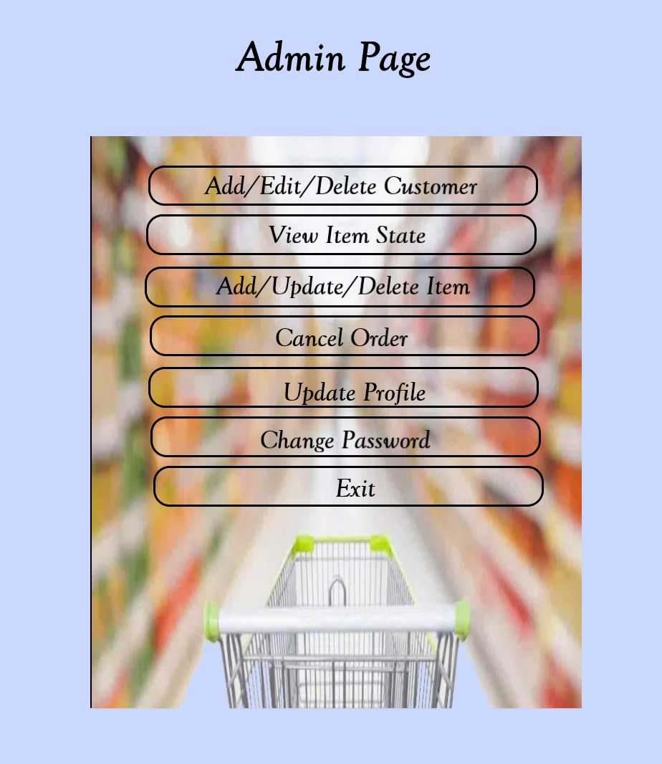
After the administrator can log in to the site, the Administrator window appears, which provides him with some services such as adding, editing, and deleting the customer, viewing the item's status, adding, updating, and deleting item, canceling the customer's order, updating his profile, changing his password, or exiting

Slide 13
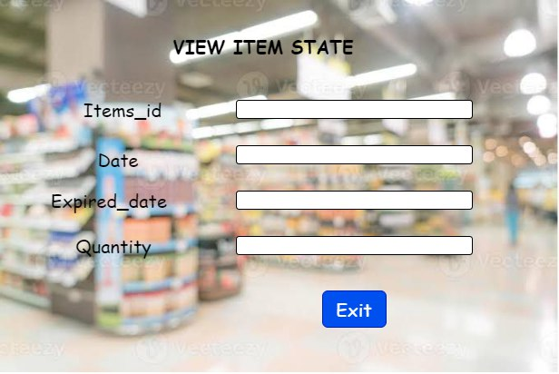
When the Admin or Stuff presses the button to view item state, this page appears for him so that he writes the ID of the item to show him its quantity, production date and expiration date.

Slide 14
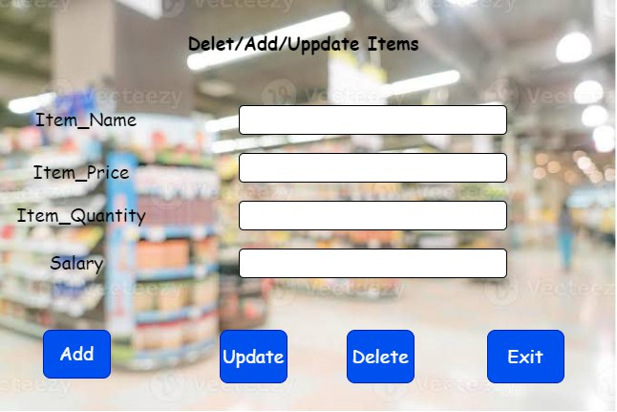
When the administrator or stuff presses the button to add, update, and delete an item, this page appears to him, so he must select the operation he wants and fill in the data and press the operation button

Slide 15
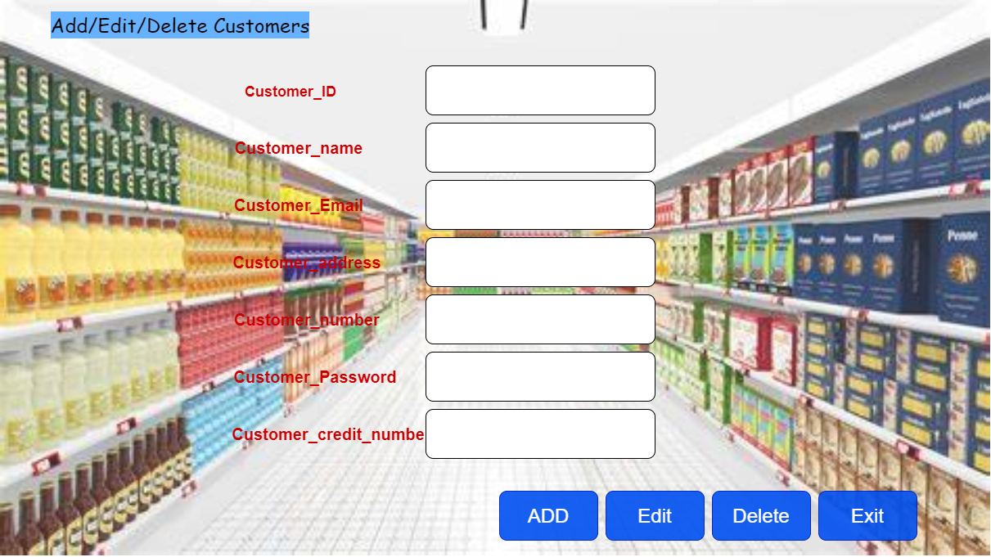
Admin when he want to add/edit/delete customer this page will show to him and enter (cutomer_id,name,email,address,number,password,credit_number )
And add or edit or delete as he want.

Slide 16
Admin or staff Enter item_id and see date of item ,expired_date and quantity

Slide 17
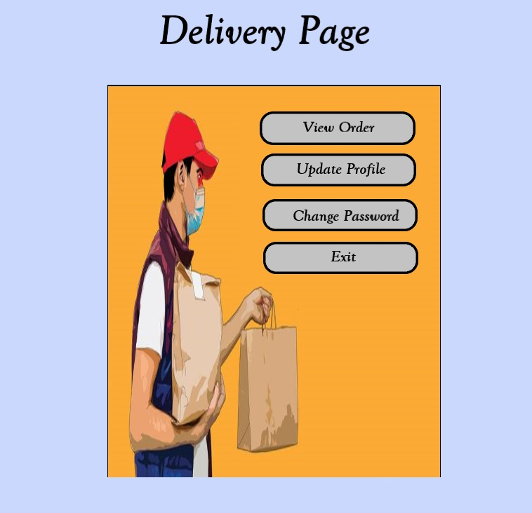
This is the page of delivery he can view orders from customers,update profile,change password

Slide 18
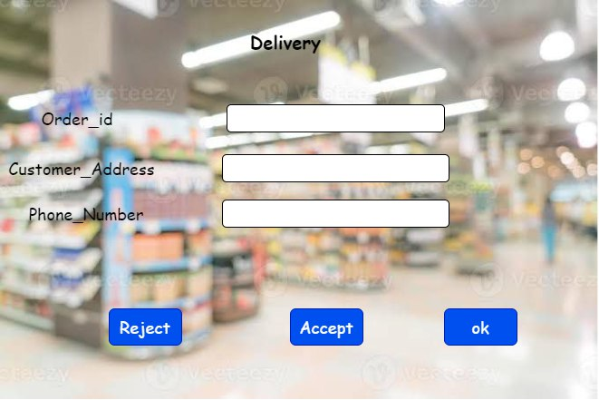
This page is an order request to delivery with order id,customer_address,phone_number and determine if he accept or reject order

Slide 19
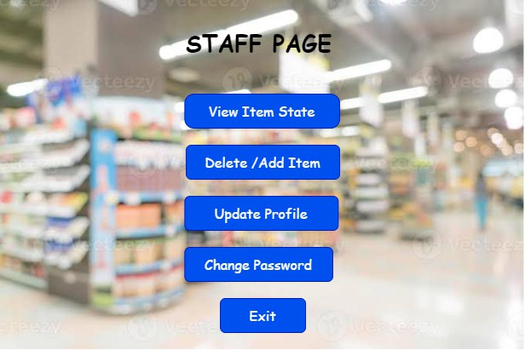
After the one of stuff can log in to the site, the stuff window appears, which provides him with some services such as viewing the item's status, adding, updating, and deleting item , updating his profile, changing his password, or exiting

Slide 20
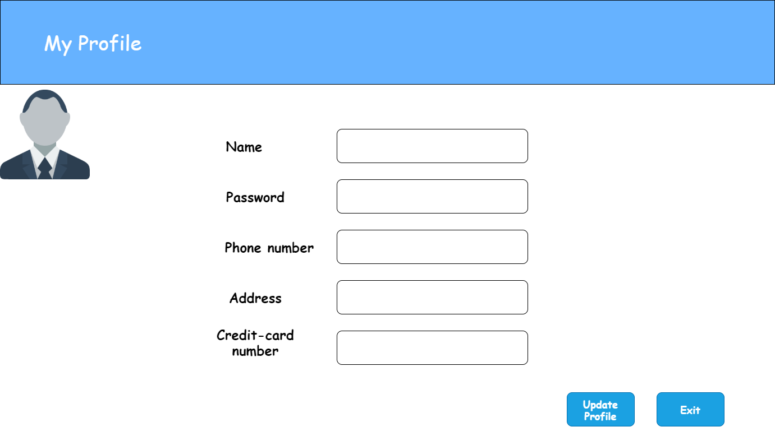
Any person in the system can update their profile (name or password or phone_number or address or credit-card number)

Slide 21
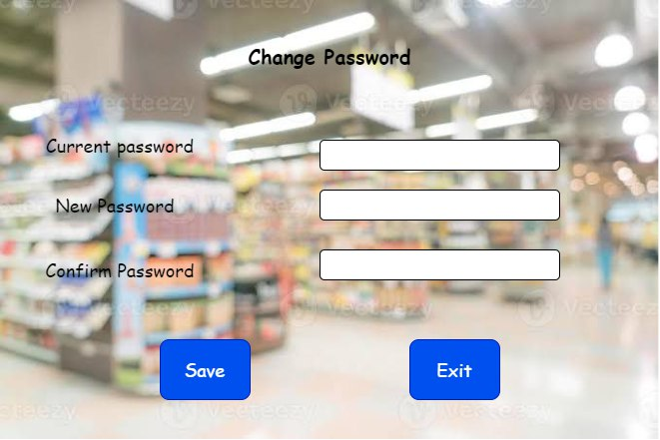
Any person on the system can change password of account via enter current password and enter a newpassword twice.

