Slide 1
Healthcare Persistency of a drug
EDA outcomes

Slide 2
Info
Group Name: sika (individual)
Name: Mohamed Sayed Hassan
Email: msiika70@gmail.com
Country: Egypt
College: Cairo university, Faculty of computers and artificial intelligence
Specialization: Data Science
Problem Description:
gather insights on the factors that are impacting the persistency, build a classification for the given dataset.

Slide 3
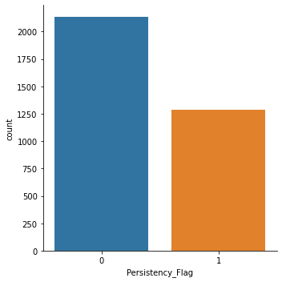
Our sample :
Most of the patients in our dataset are un-persistent.
We have:
2135 un-persistent patients
1289 persistent patients
That will lead us to a point in our analysis that is normal to found unpersistent patients having a specific feature more than the persistent one so we will look to the features that exists in the persistent patients more than the not persistent

Slide 4
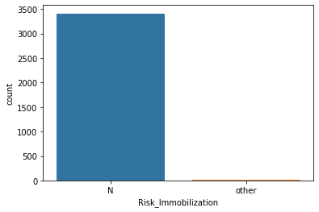
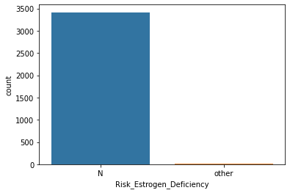
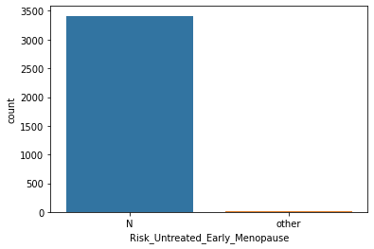
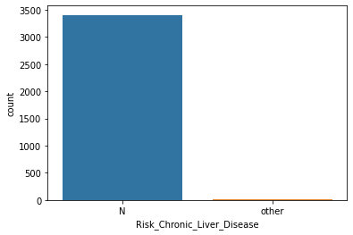
Our sample:
Some features are very skewed to one value and the other value approximatley doesn't exist
Risk_Untreated_Early_Menopause :
3412 have No Risk
12 have Risk
Risk_Chronic_Liver_Disease:
3406 have No Risk
18 have Risk
Risk_Estrogen_Deficiency:
3413 have No Risk
11 have Risk
Risk_Immobilization:
3410 have No Risk
14 have Risk
Risk_Untreated_Chronic_Hyperthyroidism:
3422 Have No Risk
2 have Risk
Risk_Osteogenesis_Imperfecta:
3421 Have No Risk
3 Have Risk

Slide 5
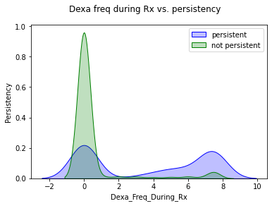
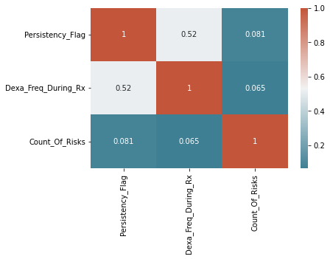
Number of DEXA scans taken prior to the first NTM Rx and the effect on the persistency.

Slide 6
From the last slide we conclude:
There is a positive correlation between Dexa scans and the persistency. When the number of Dexa scans increases the patient tends to be more persistent to the drug.
Most of the not persistent patients have zero Dexa scans taken prior to the first NTM Rx.
.

Slide 7
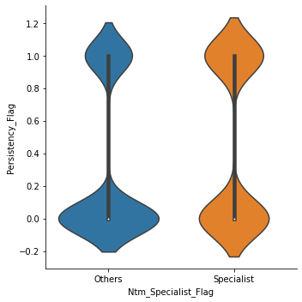
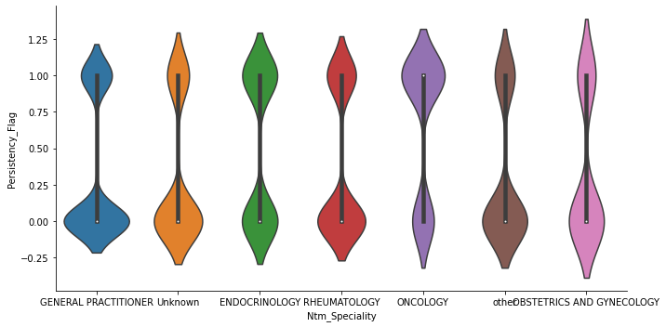
SPeciality of the Hcp who wrote the NTM RX

Slide 8
From the last slide we conclude:
If the HCP who prescribed the NTM RX is a specialist the patient tends to be more persistent.
Non specialists have a large probability to have a non persistent patients . Patients have to take The Ntm Rx from specialsts only
The oncologists have more persistent patients than the other specialists
Oncologists do more dexa scans to their patients and other scans as well also they do more follow ups so that make sense the have more persistent patients.
General practitioners have high percentage of unpersistent patients than the other specialists.

Slide 9
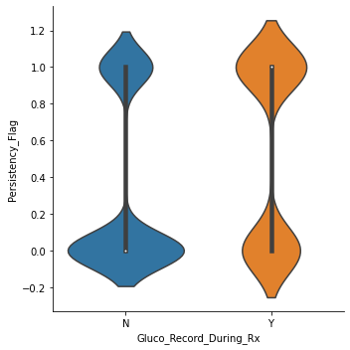
patient had a Glucocorticoid usage during the first continuous therapy and it's relation with persistency flag
From this plot it appears that a large percentage of the patients who hadn't Glucocorticoid during the first continuous therapy are un persistent .
Persistent patients who used Glucocorticoid are more than unpersistent

Slide 10
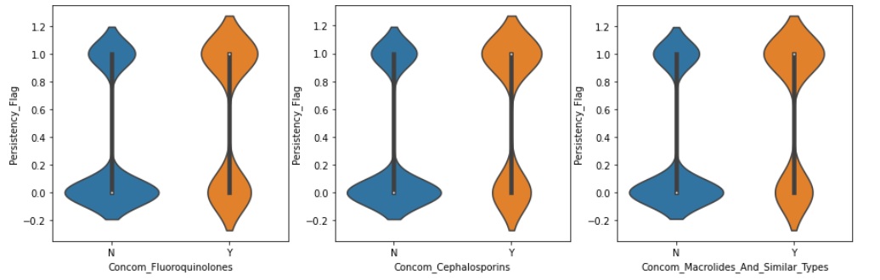
Concomitant drugs recorded prior to starting with a therapy that have good effect on the presitency

Slide 11
From the last slide we conclude:
There are some drugs that affects the persistency
It appears from the last 3 plots that Fluoroquinolones , Cephalosporins ,Macrolides And Similar Types have a postive effect on the persistency.
The patients who hadn't this drugs are less persistent.

Slide 12
Technical conclusion
Dropping the skewed features from the data
The data contains categorical variables so before training the model I have to encode these variables and I will use dummy encoding
I will use 3 models:
Support vector machine
Boosting model I will use Ada Boost and Gradient Boosting classifiers
Linear model I will use Linear regression

