Slide 1

ANNA UNIVERSITY REGIONAL CAMPUS COIMBATORE
IBM NAAN MUDHALVAN PHASE 1
CLOUD COMPUTING
E-COMMERCE APPLICATION ON IBM FOUNDRY
SUBMITTED BY
MOHAMMED SIRAJDEEN A
710021106019
Dept. of Electronics and communication engineering

Slide 2
ONLINE FOOD ORDERING SYSTEM

Slide 3
ABSTRACT
Online FOOD DELIVERY SYSTEM is a website designed primarily for use in the food delivery industry. This system will allow hotels and restaurants to increase scope of business by reducing the labor cost involved.
This system allows to quickly and easily manage an online menu which customers can browse and use to place orders with just few clicks.
Restaurant employees then use these orders through an easy to navigate graphical interface for efficient processing.

Slide 4
PROBLEM DEFINITION
The People have to be present condition in taken food from Hotel that means People had to compulsion of goes to Hotel.
Now the moment the Online food ordering could be called the response of the Internet to the desire for delivery food.
It is a growing trend especially in urban areas and on college campuses that allows people to order from restaurants featuring interactive menus, by use of their Internet connection.

Slide 5
SYSTEM MODULE
This module provides the functionality for customers to place their order and supply necessary details. Users of the system, namely restaurant customers, must be provided the following functionality
Create an account.
Manage their account.
Log in to the system.
Navigate the restaurant's menu.

Slide 6
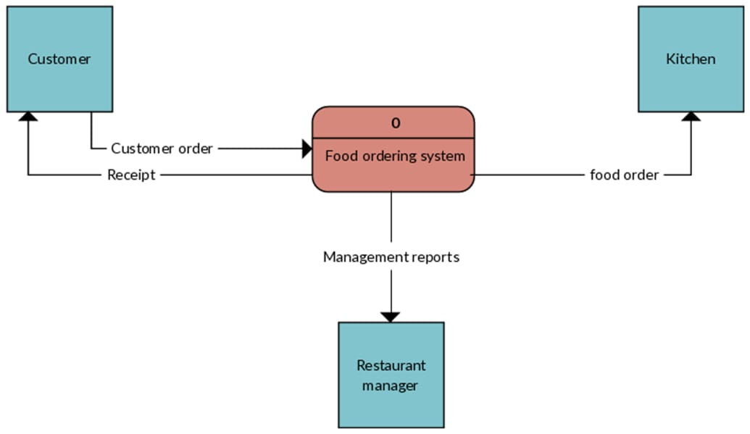
Web Ordering System- provides the functionality for customers to place their order and supply necessary details. Menu Management-allows the restaurant to control what can be ordered by the customers.
Order Retrieval System - This is a final logical component. Allows restaurant to keep track of all orders placed. This component takes care of order retrieving and displaying order information.

Slide 7
SYSTEM ANALYSIS AND DESIGN
It also includes finding out in more detail- what are the problems with the system and what user requires from the new system or any new change in system.
The output of this phase results in the detail model of the system. The model describes the system functions and data and system information flow.
The phase also contains the detail set of user requirements and these requirements are used to set objectives for the new system.

Slide 8
CONCLUSION
This is achieved through an easy to use graphical interface menu options. The users can add any number of items to the cart from any of the available food categories by simply clicking the Add to Cart button for each item. Once item is added to the cart, user is presented with detailed order to review or continue shopping.

Slide 9
THANK YOU

