Slide 1

ANNA UNIVERSITY REGIONAL CAMPUS COIMBATORE
IBM NAAN MUDHALVAN PHASE 2
CLOUD COMPUTING
E-COMMERCE APPLICATION ON IBM FOUNDRY
SUBMITTED BY
Mohamed Sirajdeen A
710021106019
Dept. of Electronics and communication engineering

Slide 2
ONLINE FOOD ORDERING SYSTEM

Slide 3
ABSTRACT
Online FOOD DELIVERY SYSTEM is a website designed primarily for use in the food delivery industry. This system will allow hotels and restaurants to increase scope of business by reducing the labor cost involved. This system allows to quickly and easily manage an online menu which customers can browse and use to place orders with just few clicks. Restaurant employees then use these orders through an easy to navigate graphical interface for efficient processing.

Slide 4
PROBLEM DEFINITION
The current food delivery platforms provide different discounts on the same item but in different platform. It is also seen that delivery time of an item is not same in all the applications. Adding all the discounts and estimated delivery time of different food joints under a single interface will be economical and less time consuming.
It is a growing trend especially in urban areas and on college campuses that allows people to order from restaurants featuring interactive menus, by use of their Internet connection.

Slide 5
SYSTEM MODULE
This module provides the functionality for customers to place their order and supply necessary details. Users of the system, namely restaurant customers, must be provided the following functionality
Create an account.
Manage their account.
Log in to the system.
Navigate the restaurant's menu.

Slide 6
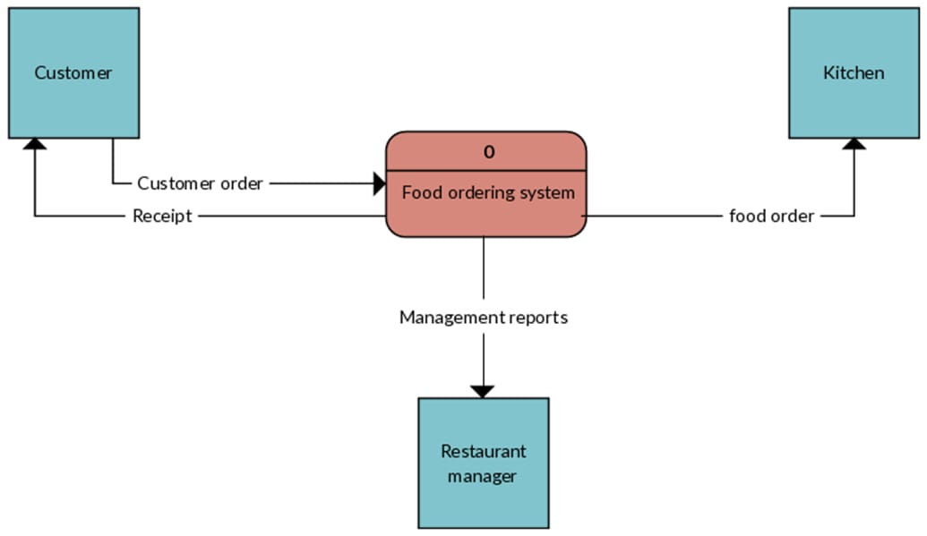
Web Ordering System- provides the functionality for customers to place their order and supply necessary details. Menu Management-allows the restaurant to control what can be ordered by the customers.
Order Retrieval System - This is a final logical component. Allows restaurant to keep track of all orders placed. This component takes care of order retrieving and displaying order information.

Slide 7
METHODOLOGY
Requirements Gathering :
Understanding the specific needs and requirements of online food ordering system. Consider factors like scalability, security, and performance.
Choosing the cloud platform.
Architecture Design:
Frontend: Design the user interface for customers and restaurant owners.
Backend: Plan the server architecture for handling orders, payments and notifications.

Slide 8
Order Processing :
Develop algorithms for order processing and dispatch. Use cloud-based queuing services to manage orders efficiently. Notification System: Implement notifications via email, SMS, or push notifications to keep users informed about order status.
Security:
Implement encryption (SSL/TLS) for data transmission. Use cloud provider's security features and best practices. Regularly update and patch system components.
Payment Integration:
Integrate with payment gateways for secure transactions.

Slide 9
TOOLS
HTML
CSS
JAVASCRIPT
PHP
LAPTOP WITH WINDOWS 10
These technologies are used to build the system. HTML are used to build the interface of the system and build the functionality of the system. CSS is used to define styles of the system. PHP are used to build the interface of the system. JAVASCRIPT is used to develop and create webpages

Slide 10
CONCLUSION
With online food ordering system, restaurant an mess menu online can be set up and customers can easily place order. This is achieved through an easy to use graphical interface menu options. The users can add any number of items to the cart from any of the available food categories. We have created website in focus of future food ordering system, this website will helpful to many people.

Slide 11
THANK YOU

