Slide 1
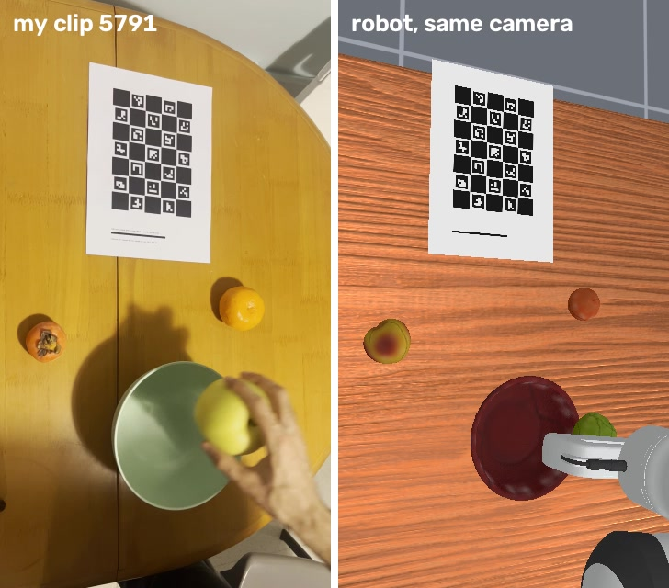
Human Video to Robot Manipulation
30 phone clips of my own hand teach a simulated Panda to put the named fruit in the bowl
Left: my clip. Right: the robot replaying it, seen from the same calibrated camera.
Mohamed Sobhy · Humanoid robot learning challenge · October 2026
Notes:
I filmed my own hand putting a named fruit into a bowl, 30 short clips with an iPhone. From those clips a simulated Franka Panda in ManiSkill3 learns to follow instructions like 'put the mandarin in the bowl'. The image on the right is the key visual: my clip next to the robot replaying it, rendered from my phone's calibrated pose.

Slide 2
What it does, in numbers
96%
86%
0%
29/30
success on new random layouts (150 episodes)
on layouts measured from my 6 held-out clips
observed wrong-fruit placement in my policy's three evaluations
earlier recorded-style Panda replay trials (240 steps)
Policy: a ResNet-18 on two cameras whose features are conditioned on the target fruit (FiLM), predicting 10-step action chunks
Data: 771 simulated demonstrations generated from 24 of my clips; 6 clips held out for testing
Separate EgoDex-development baselines: SmolVLA 22%, Diffusion Policy 19%, ACT 13%
Notes:
96% on random layouts and 86% on six layouts from my held-out clips, repeated over 150 episodes. No wrong-fruit placement was observed in these evaluations; that is not a guarantee. The 29/30 number is an earlier 240-step controller replay protocol. Other-policy scores here use EgoDex development data, not my recordings. My own-data SmolVLA training did not complete.

Slide 3
How it works
From a phone clip to robot demonstrations

Slide 4
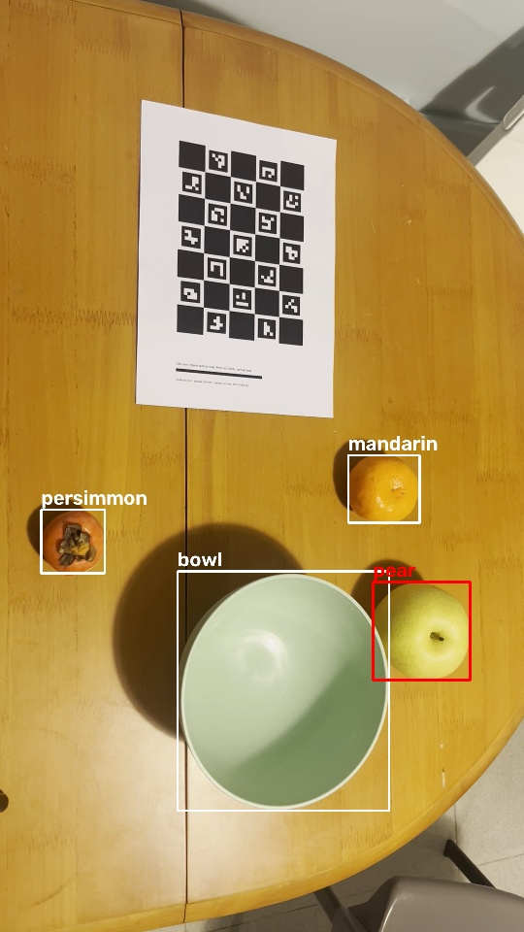
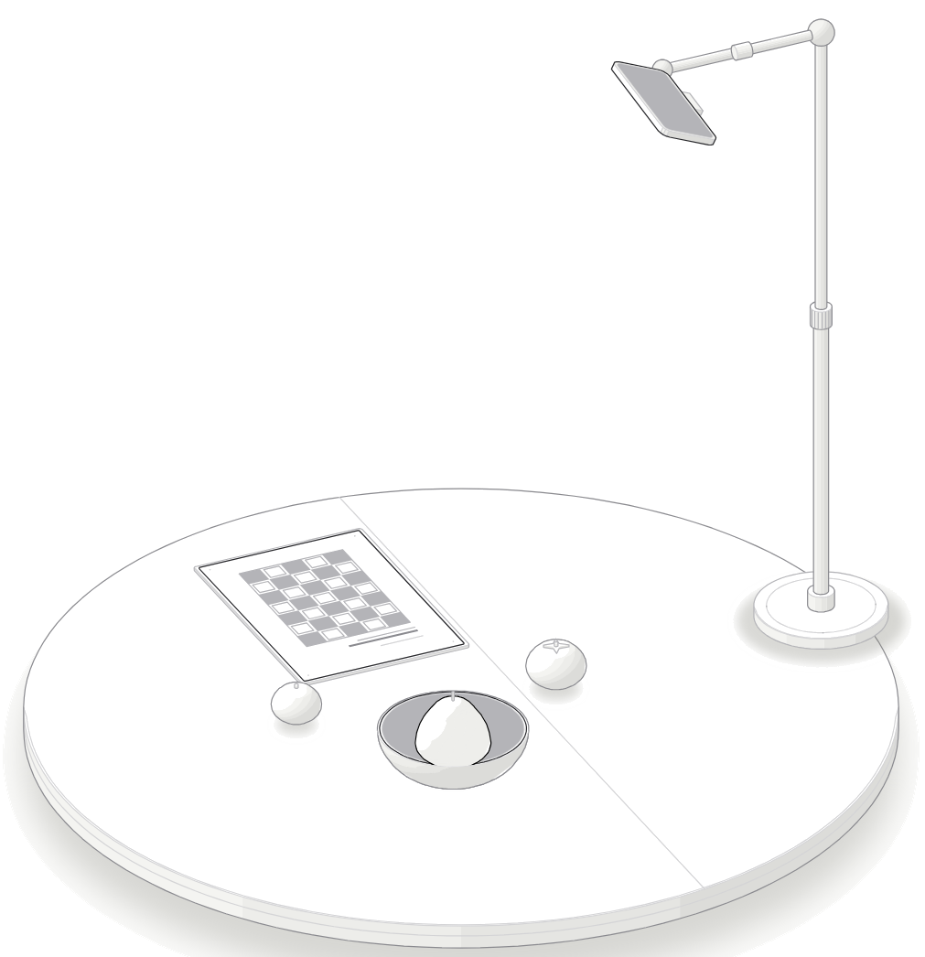
Recording: one phone, one printed board, three fruits
iPhone 13 Pro Max on a stand 75 cm above the table, tilted 24° towards the work area, portrait 1080p
A ChArUco board printed on A4 defines the table frame; my printer shrank it to 90.6%, which I measured and corrected
Persimmon, nashi pear, mandarin and a bowl; the layout changes every clip
30 clips, 10 per fruit, one fruit into the bowl each; 6 clips held out for testing
A frame from my clip 5791, with the detected bowl and fruit; the pear is the target.
Notes:
The setup is deliberately simple: a phone overhead, a printed calibration board, three fruits and a bowl. The board is visible in every clip, so each clip is calibrated on its own and the phone could move between clips. I varied the layout every clip so the policy has to find the named fruit by appearance, not by position.

Slide 5
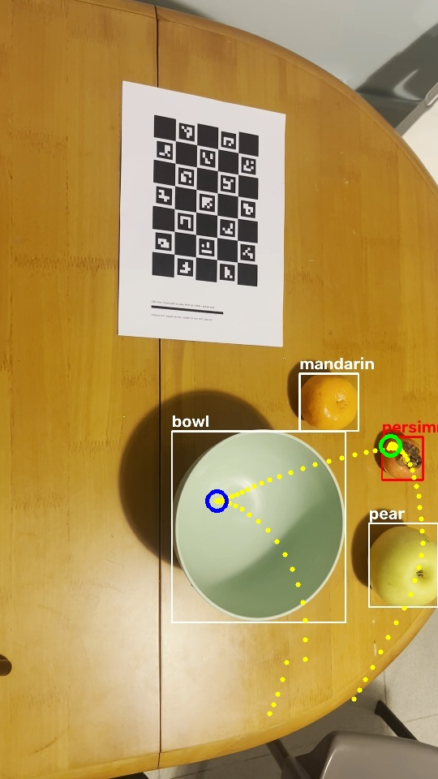
From a phone clip to robot demonstrations
1
Calibrate
2
Name the fruit
3
Track the hand
Board in every clip; one focal length for the session
OWLv2 boxes, named by appearance learned from my own clips
WiLoR 3D hand joints placed with the calibrated camera
0.46 px error, camera stable to 1 mm
30 of 30 clips correct
hand found in 83–100% of each action
4
Grasp and release
5
Keep the decisions
6
Multiply
Pinch closest to the target fruit, then to the bowl
Approach, grasp yaw, lift, carry, release, retreat as keyframes
Each clip's style replayed in new random layouts
grasp ~2 cm from the fruit
the robot keeps its own timing
771 demos from 24 clips
Clip 5802: tracked pinch path (yellow), grasp (green), release (blue).
Notes:
Six steps turn a clip into robot data. The two that needed most care on my real footage: naming the fruit without a calibration clip, which I solved by learning each fruit's appearance from clips where the target is known; and finding the grasp, where the finger-gap rule failed because my hand enters with the fingers already close, so I use the scene instead: the grasp is where the pinch comes closest to the target fruit.

Slide 6
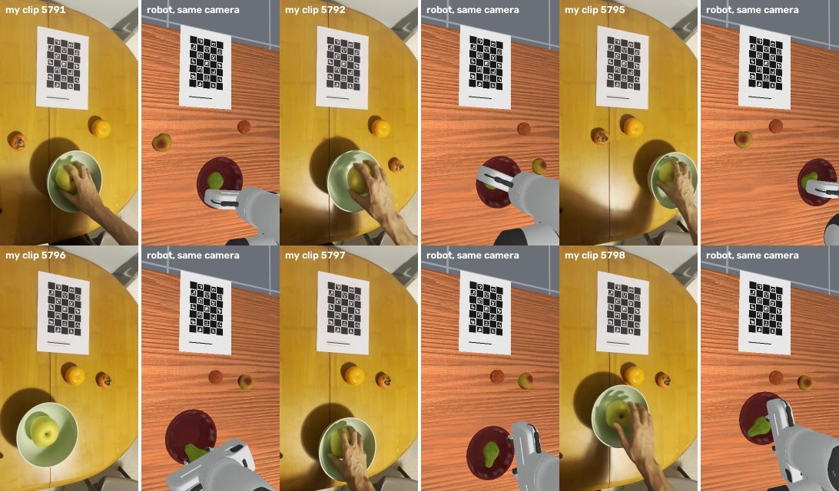
My clip and the robot's replay, same camera
The simulator's camera sits at the phone's calibrated pose, with the same focal length
My printed sheet is rendered at its measured size and position: it lines up in both views
Earlier replay: 29/30; clips starting with occupied bowls use sampled replacement layouts
Notes:
For this clean-start example the robot executes extracted keyframes in the fitted measured layout, rendered from the calibrated phone camera. Sheet alignment is a visual calibration check, not proof of exact geometry. Fourteen clips started with occupied bowls and use sampled replacement layouts in aggregate controller replay; do not describe those as exact-layout reconstructions.

Slide 7
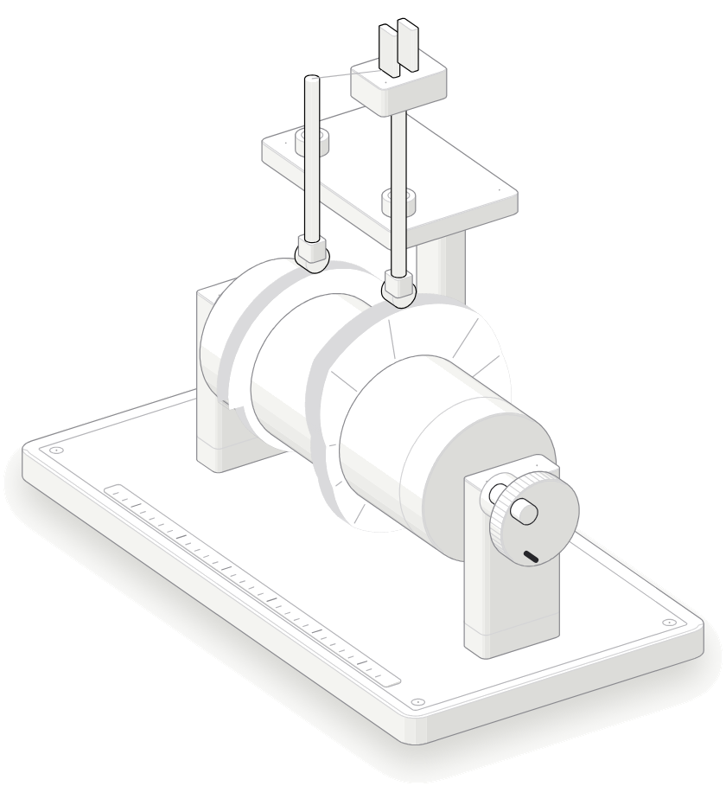
Human decisions, robot timing
Raw-path replay works (86–92%), but imitation struggles with human starts, detours and timing
Keeping only my decisions as object-relative keyframes makes the data learnable
Privileged-state diagnostic on EgoDex-derived data; demo counts/protocols differ. Retained single-run records.
Notes:
Raw replay and imitation are different problems. Retained privileged-state records give 25.8% for raw paths and 76.2% for keyframes. An earlier 91% styled result appears in the devlog but its detailed record was overwritten; I use the retained result. Data counts and generation protocols differ, so this is a diagnostic, not a clean causal ablation.

Slide 8
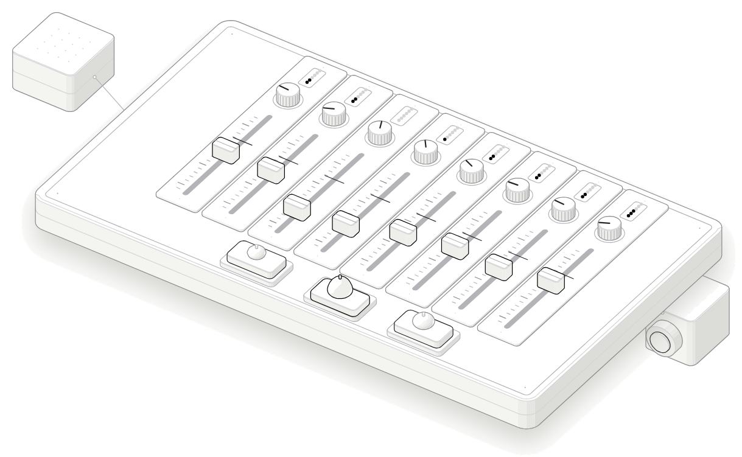
Conditioning vision on the target fruit (FiLM)
The target fruit sets a scale and shift for every channel of both camera encoders
Concatenating the target after the image is encoded lets the policy ignore it
Same idea as BC-Z and RT-1 (FiLM: Perez et al., 2018)
Notes:
Grounding the instruction is the second key decision. If the target is only concatenated after the image features are computed, the network can ignore it and half the time puts the wrong fruit in the bowl. With FiLM the instruction shapes what each camera encoder attends to, from the first stage on. That is the difference between 27% and 98%.

Slide 9
Results
Trained on my clips, compared with larger models, and an ablation of the data source

Slide 10
Trained on my 24 clips
Held-out clip | Target | Success
5796 | pear | 76%
5798 | pear | 96%
5801 | persimmon | 92%
5809 | persimmon | 100%
5816 | mandarin | 96%
5819 | mandarin | 56%
Clip 5819 is crowded: the mandarin sits 5.8 cm from the pear. A first run gave 73%: my code clamped each object into the work area separately and pushed a fruit into the bowl; layouts are now moved as a whole.
Notes:
On random layouts the policy trained on my clips matches the development run at 96%, and it handles instructions phrased in ways it never saw. On the six layouts measured from held-out clips it reaches 86%; the crowded clip 5819 is the hardest. I report the first, buggy 73% too: clamping objects one by one had pushed a fruit into the bowl.

Slide 11
Policies compared on the same 771 demos
Same demonstrations for all four; demos generated from public EgoDex clips
SmolVLA reads the instruction but grounds it weakly with this little data, and favours the pear
ACT and Diffusion Policy get the target only as a one-hot in the robot state, the same weakness as concatenation
Temporal ensembling did not help ACT (10.7% vs 13.3%)
Notes:
All four use the same EgoDex-derived demonstrations, but conditioning, preprocessing, pretraining and optimization differ. These are limited-tuning task-specific baselines, not an architecture-only ablation. Their errors often involve the target identity. No own-data SmolVLA score is available because that run did not complete.

Slide 12
Does my data matter? Ablation of the demo source
Observed random-layout gain: 6–7 points over the scripted expert; one training seed per arm
Most of the gain is on the pear: 76% → 88–94%; grasp diversity is a plausible explanation
No clear difference on crowded layouts
38 EgoDex styles outperform my 24 here; source and diversity are confounded
Notes:
Same policy and demonstration count, but source and number of distinct human styles change together. One training seed per arm, 150 episodes per bar, and only six reserved own layouts repeated. Differences are exploratory, not established significance. Session-level calibration and appearance prototypes are shared, so this is not an independent perception test.

Slide 13
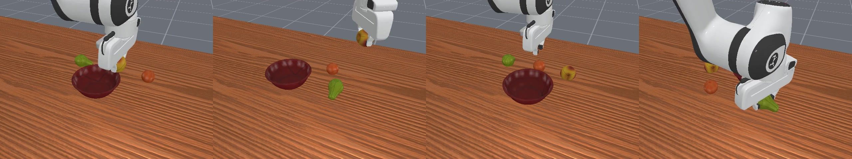
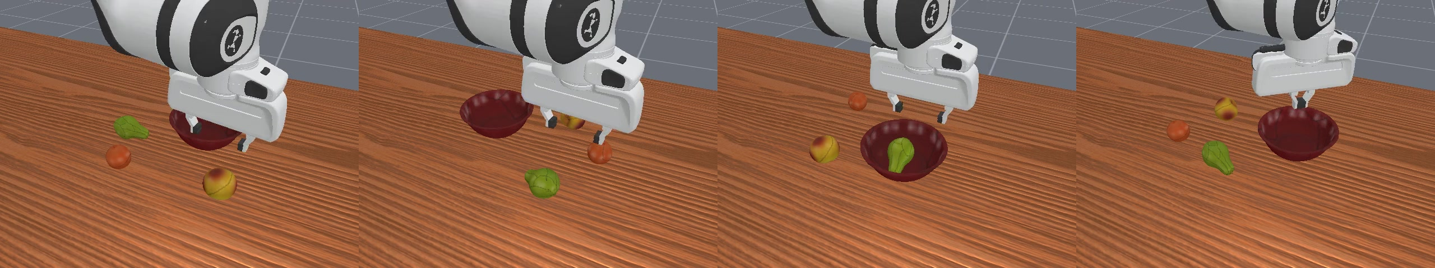
Rollouts on new layouts
FiLM policy trained on my clips: four environments with random layouts and instructions.
SmolVLA on the same task, but EgoDex-derived development demos: 22% success.
Notes:
Top: FiLM trained on my clips. Bottom: SmolVLA after 30k steps on EgoDex-derived development demonstrations. These examples use different training sources and are not a matched-data visual comparison. The own-data VLA run did not finish.

Slide 14
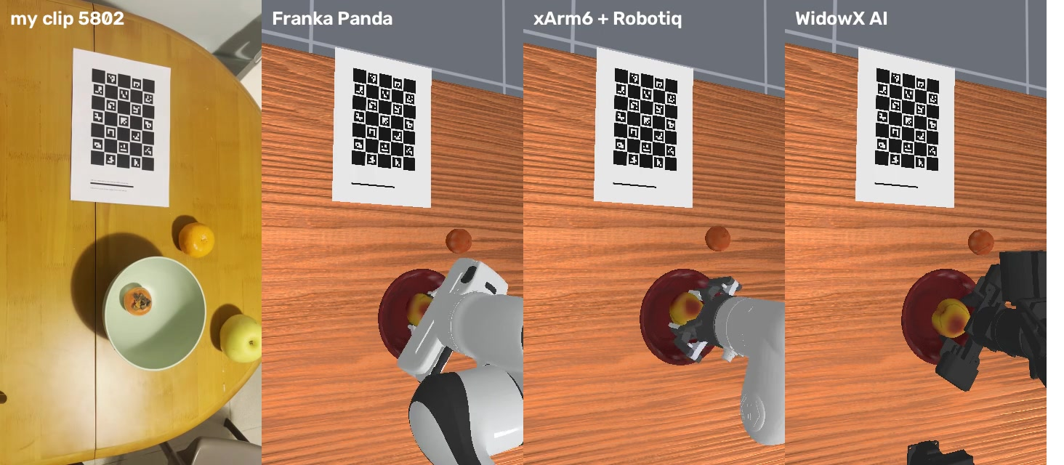
One clip, three robots
Robot | 30 styles | 128 new
Franka Panda | 100% | 100%
xArm6 + Robotiq | 100% | 100%
WidowX AI | 100% | 100%
The keyframes are embodiment-agnostic: where to approach from, the grasp angle, heights, release
Each arm only translates the command: end-effector control, or my own GPU inverse kinematics for the WidowX
A small arm keeps my style but caps my carry height to its reach
My clip 5802 and the same keyframes on three arms, all rendered from my phone's calibrated camera.
Controller replay, not policy transfer. 16 measured layouts + 14 sampled replacements; 260 control steps.
Notes:
Each arm completes 30 recorded-style trials and 128 random-layout trials. Fourteen occupied-bowl source starts are replaced by sampled layouts; only sixteen trials reconstruct fitted measured layouts. This is privileged controller replay with embodiment-specific adaptations, not zero-shot transfer of the learned image policy. WidowX uses custom IK, a different gripper command and a capped carry height.

Slide 15
150× lower model-call latency than SmolVLA
0.69 ms
per action chunk for the optimised FiLM policy (25M parameters)
2.7×
from half precision, channels-last and torch.compile alone
Model-only timing; ~75× per executed action because chunks differ. No end-to-end or fp16 success claim.
Notes:
FiLM: 1.84 ms fp32, 0.69 ms compiled fp16; SmolVLA base: 103.49 ms. Ratios are about 150 per call and 75 per amortized executed action, since FiLM executes five and SmolVLA ten actions per call. Inputs are already prepared; perception, transfers, control and warm-up are excluded. All timings use PyTorch 2.10 / CUDA 12.8, including FiLM. Reported closed-loop success uses fp32; the optimized variant was not re-evaluated for success.

Slide 16
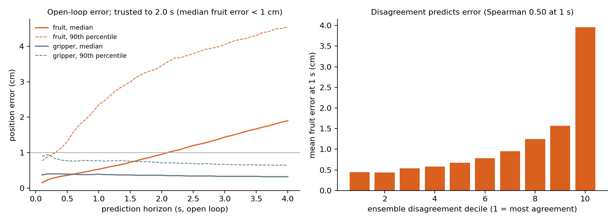
A world model of my task: where it can be trusted
2.0 s
median fruit error under 1 cm; not a tail bound
89%
episode outcome accuracy (tie-aware AUC 0.95); reference 84%
9×
error of its most-disagreeing predictions vs its most-agreeing, at 1 s
Notes:
The model is trained on 6,144 perturbed episodes from my 24 training styles. Outcome accuracy is 89.4% on 2,048 reserved-style episodes versus a reference at 83.9%. A separate rolling-origin test on 600 episodes keeps median fruit error below 1 cm for 2 seconds; this is not a tail bound or a safety certificate. Full-episode median final error is 6.2 cm. Disagreement predicts short-horizon positional error, not calibrated outcome confidence. Earlier policy-ranking failures used development models, not this fidelity protocol.

Slide 17
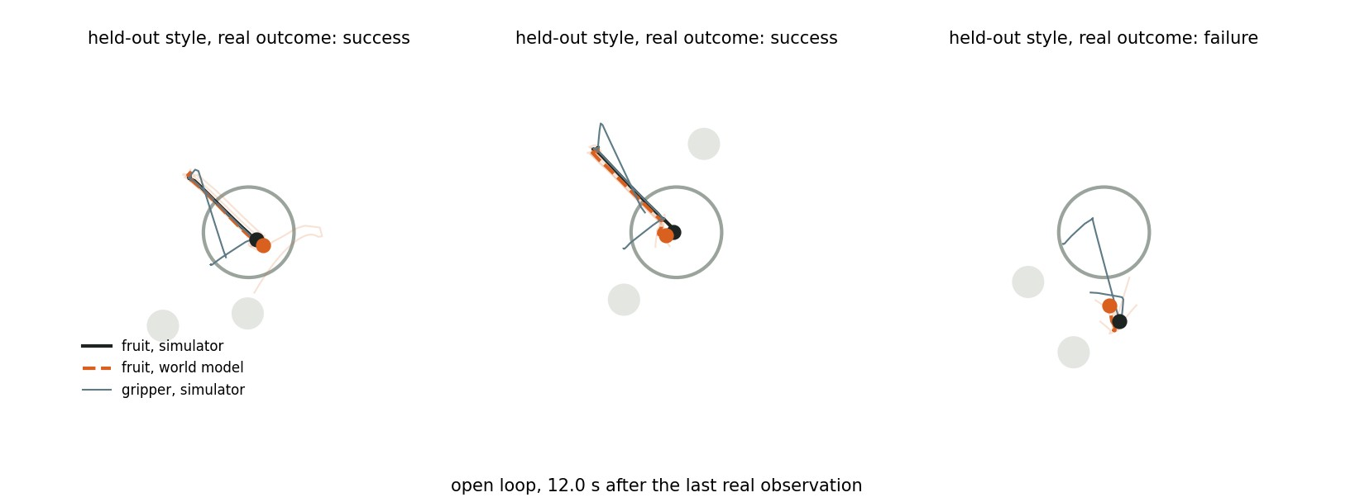
The world model imagining held-out episodes
Given only the first state and the actions, the model imagines 12 s of the episode (orange; faint lines: the five ensemble members) against the simulator (black). Right: it correctly predicts a failure.
Notes:
Top-down view, open loop: the model sees the real state only at the start and then imagines the whole episode from the actions. It follows the fruit into the bowl in the two successful episodes and predicts the third one fails.

Slide 18
What I tried and dropped
Each with what I measured before stopping

Slide 19
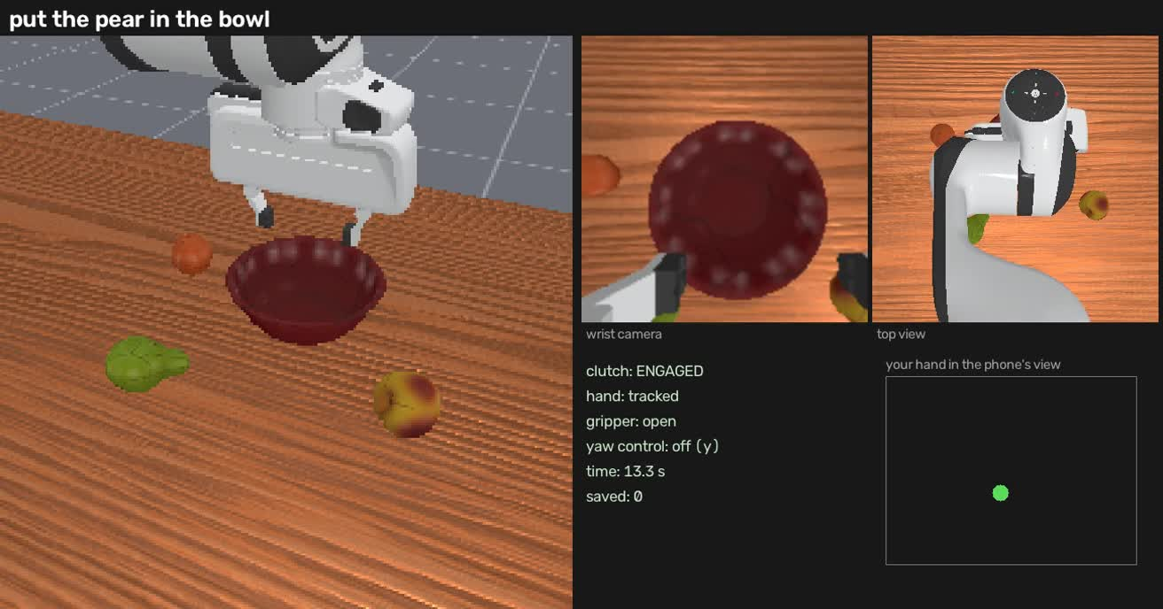
Live phone teleoperation
An iPhone app I wrote streams ARKit + LiDAR hand joints to the simulator at 30 Hz
Tracking was good: 2.6 mm jitter, depth missing in 0.3% of frames
Teleoperating was not: the phone's view was smaller than the motion needed, and height is hard to judge from one view
Scale, smoothing, re-anchoring and a top view did not make it practical in time
Teleoperation window: robot cameras, a top view and where my hand is in the phone's view.
Why it matters: robot-native demos would remove retargeting altogether.
Notes:
I built a phone teleoperation system: the iPhone tracks my hand with ARKit and LiDAR and drives the simulated arm live. The tracking was good, but controlling the robot this way was too hard to record useful demonstrations in the time available.

Slide 20
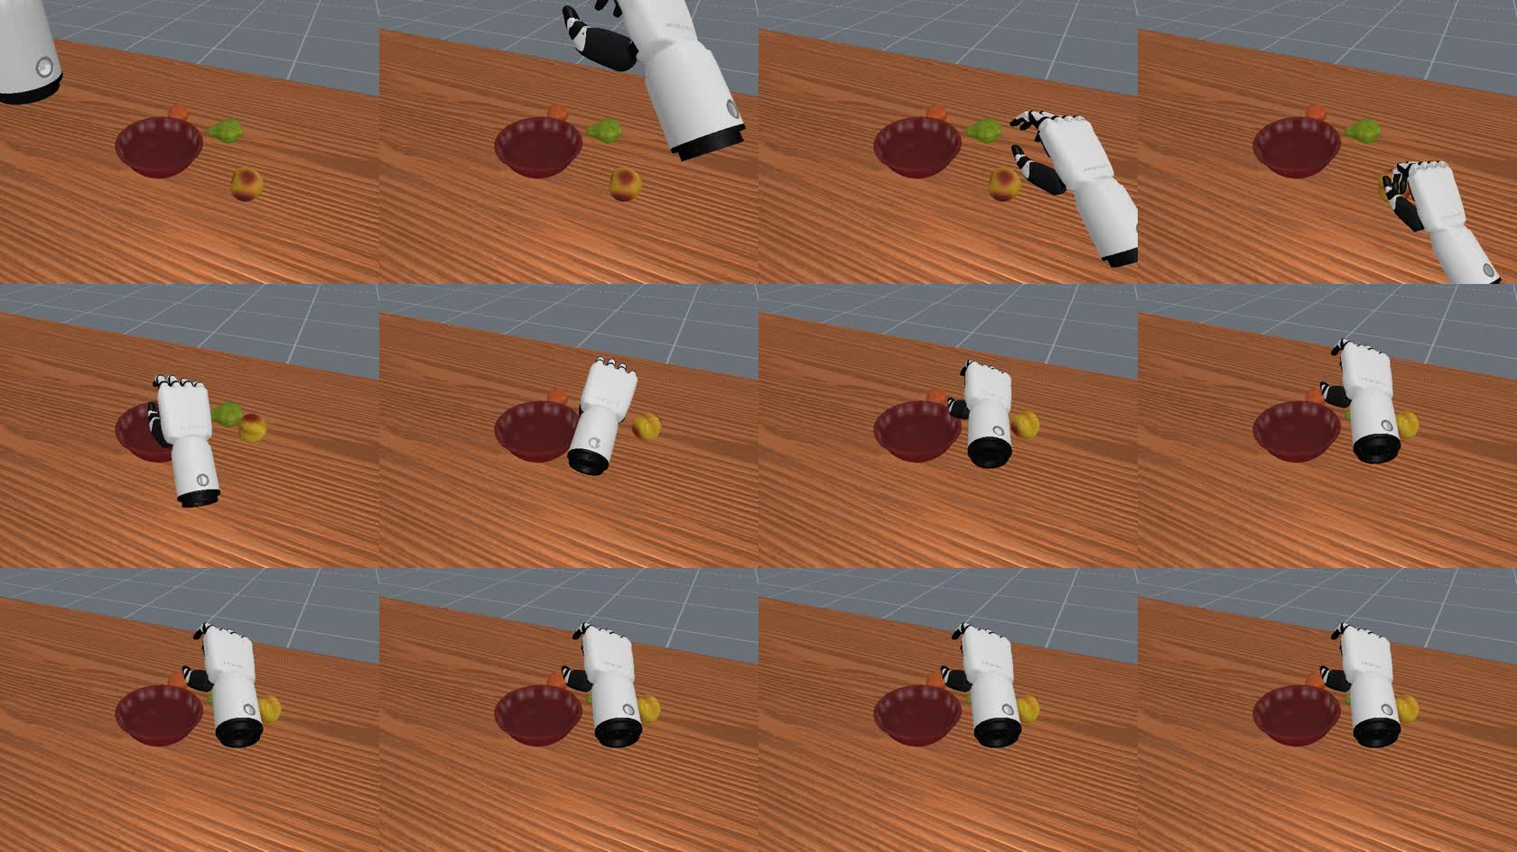
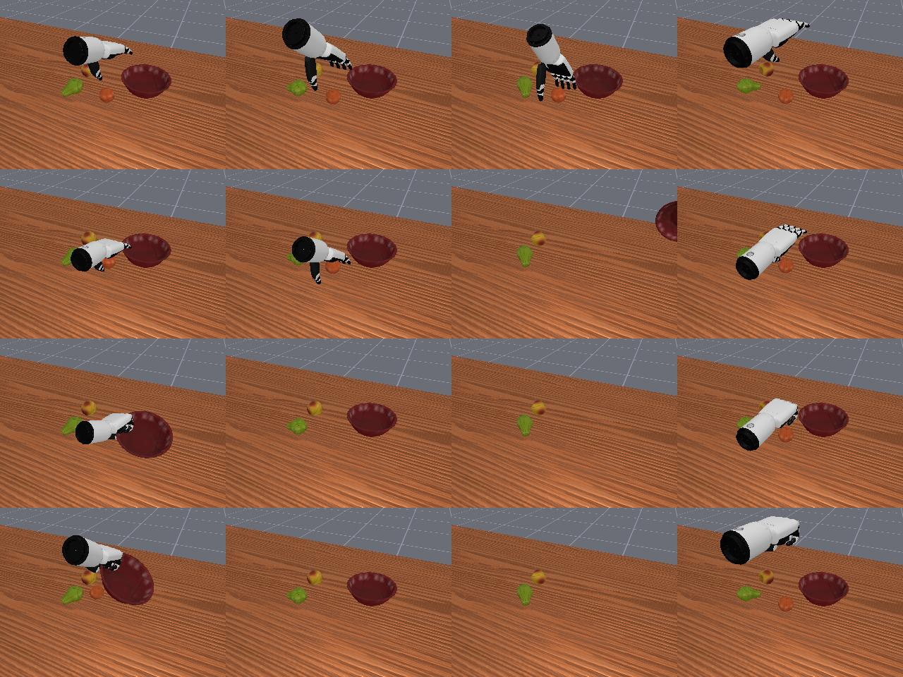
Five-finger Inspire hand
Retargeted EgoDex hands (left) and a scripted grasp probe (right).
Goal: transfer the whole hand, wrist and five fingers, instead of a pinch point
Retargeting works: palm frames match exactly; finger joints from the simulator's own kinematics
Grasping does not: 0 of 8 replays and 0 of 300 scripted grasp geometries lifted a fruit; the hand pushes small fruit away
Notes:
I tried to transfer the full hand to a five-finger Inspire hand. Orientation and finger retargeting worked, and I fixed several embodiment problems along the way, but no grasp geometry could lift these small fruits in this simulator, so I stopped.

Slide 21
Also dropped
PICO headset
Not pursued
Sentence-encoder instructions
0.66 vs 0.63
Metric hand tracking, but phone tracking was not the bottleneck: grasps land ~2 cm from the fruit and 29/30 clips replay. More clips mattered more.
MiniLM put 'tangerine' closer to 'pear' than to 'mandarin', and barely separated 'in the bowl' from 'next to it' (0.95 vs 0.96).
SO-100 arm
0.39 m reach
Temporal ensembling for ACT
10.7% vs 13.3%
LeRobot's 5-joint arm cannot cover a 30 x 40 cm table with an 18 cm bowl; it would need the whole scene scaled down.
The ACT paper's chunk averaging made no difference on this task.
Notes:
Four smaller dead ends, each stopped on a measurement rather than a hunch.

Slide 22
Limitations and next steps
More of my clips: does success keep rising as my clip count grows?
Textures from my video on the simulated fruit and bowl: a closer digital twin
RL fine-tuning in GPU-parallel simulation, aimed at crowded layouts (88%)
Use the world model for short-horizon planning, where it is trusted (2 s)
Metric hand tracking from a headset (PICO) to remove height noise
Simulation only, three stand-in fruit meshes, keyword-level language, one person at one table. Heights from a top-down phone are noisy.
Notes:
What this does not show yet, and what I would do next with more time.

