Slide 1
BRINGING THE
MODEL HOME
Running production AI workloads on local hardware,
and deciding which workloads qualify.
Mohamed Sorour · Senior DevOps Engineer, Vezeeta
DevOpsDays Cairo 2026
1

Slide 2
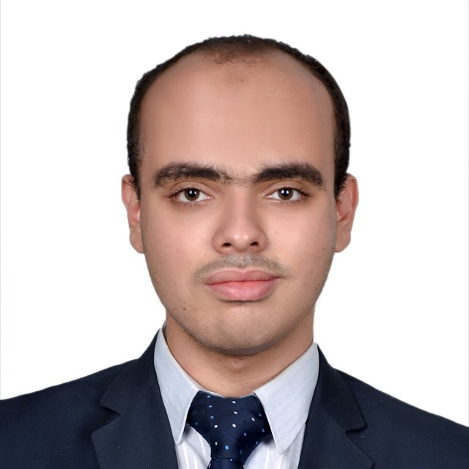
SPEAKER
Mohamed Sorour
Senior DevOps Engineer, Vezeeta
Healthcare technology, where data residency is a documented constraint rather than a preference.
I build and operate the delivery pipelines other teams ship through, so dependency lifecycle is part of the job.
Cairo, Egypt.
This talk reports an evaluation I ran for my own use. It is not a product recommendation, and I have no affiliation with any vendor named in it.
2

Slide 3
CONTEXT
Why evaluate local inference
Cost is the usual entry point, and the weakest argument: hosted inference pricing continues to fall.
Data residency does not move. Some workloads cannot use a third-party processor, whatever the price.
Dependency lifecycle does not move either. A hosted model can be withdrawn on the vendor's schedule.
During preparation of this talk a hosted model I depended on was retired and the tool built on it stopped working. Nothing in my configuration changed. That is the failure mode local deployment removes.
3

Slide 4
AGENDA
Agenda
01
Hardware options
cloud, NVIDIA, AMD, Apple — specifications compared
02
Platform selection
the criteria I applied, and what they cost
03
Architecture
four layers, and the memory model underneath
04
Quantization
reducing precision to fit available memory
05
Fine-tuning
adapting a model to local data
06
Demonstration 1
speech recognition, offline, on this laptop
07
Demonstration 2
a coding agent driving the local model
08
Limitations and criteria
measured shortfalls, and a selection rule
4

Slide 5
OPTIONS
Four deployment options
H100, rented
OPTION
MEMORY
BANDWIDTH
COST
Hosted API
unbounded
n/a
per token
BANDWIDTH ↑
RTX 5090
Rented GPU
80 GB
3350 GB/s
$1.50-3/hr
NVIDIA RTX 5090
32 GB
highest
$2-5k
Apple M4
AMD Ryzen AI Max
128 GB
215 GB/s
$1-2k
Apple M4 family
32-128 GB
120-546 GB/s
$1-4k
Ryzen AI Max
MEMORY CAPACITY →
Vendor-published specifications, not measurements from this evaluation. Throughput depends on the model, the quantization and the serving framework, and is measured later on a single machine.
5

Slide 6
SELECTION
Platform selection: Apple silicon
Capacity over throughput — unified memory sets the model ceiling at installed RAM rather than at a fixed VRAM allocation.
No host-to-device transfer — CPU and GPU address the same physical memory.
Existing hardware — no second machine, no driver stack, no thermal budget to manage.
First-party framework — MLX is published and maintained by Apple, under an MIT licence.
The measured cost of this choice: an RTX 5090 delivers substantially higher throughput per token on models that fit in 32 GB. For maximum throughput on a small model, that is the correct selection.
6

Slide 7
ARCHITECTURE
Unified memory: the trade
Discrete GPU
Apple silicon
Weights reside in dedicated VRAM.
Data crosses PCIe to reach the device.
Substantially higher bandwidth.
Fixed capacity ceiling.
CPU and GPU share physical memory.
No host-to-device copy.
This machine: 120 GB/s.
Capacity equals installed RAM.
APPLE CHIP
BANDWIDTH
MAX MEMORY
Generation rate is bandwidth-bound. Model size is capacity-bound. Capacity determines whether a given model can be loaded at all.
M4 (test platform)
120 GB/s
32 GB
M4 Pro
273 GB/s
64 GB
M4 Max
546 GB/s
128 GB
7

Slide 8
ARCHITECTURE
The stack, bottom to top
OpenCode
the agent — any client speaking the OpenAI chat protocol
mlx_lm.server
OpenAI-compatible HTTP server on localhost, with tool calling
mlx-lm
load, serve, quantize and fine-tune language models
mlx
Apple's array framework — Metal kernels, unified memory
Integration is one provider block setting the base URL to 127.0.0.1:8080. The client requires no other change.
8

Slide 9
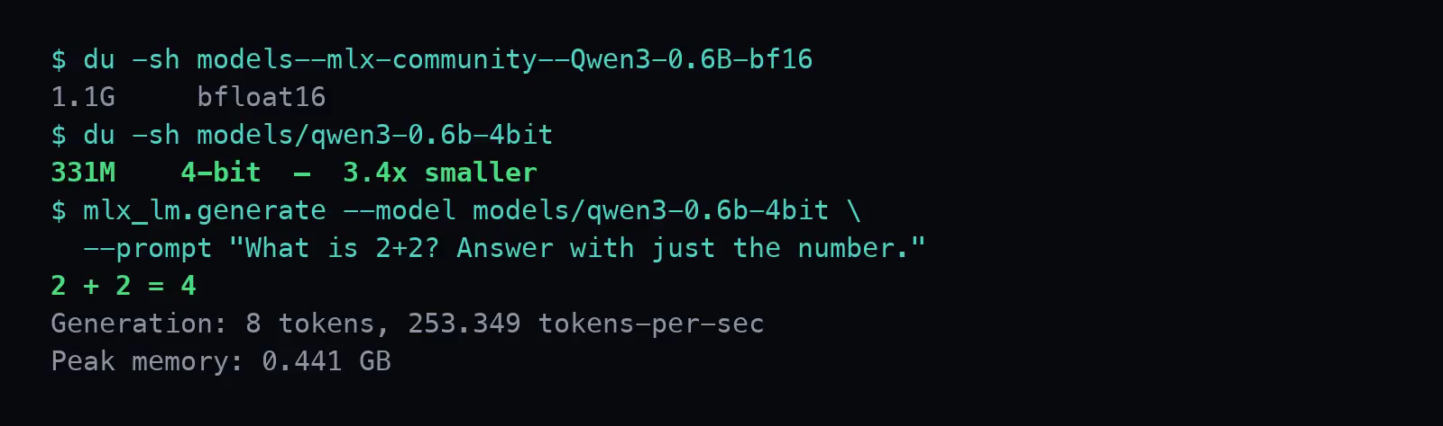
QUANTIZATION
Quantization
Store each weight at reduced precision. Lower memory footprint, lower bandwidth per token, and a measurable but usually small loss of accuracy.
Qwen3-0.6B, bfloat16
1.1 GB
3.4× smaller
331 MB
at 4.501 bits
per weight
the same weights, 4-bit
THE RECORDED RUN
9

Slide 10
FINE-TUNING
Fine-tuning with low-rank adapters
The base weights are frozen. A small set of new parameters is trained alongside them and saved separately — 5.5 MB, not a second copy of the model.
The adapter is selected at load time with one flag, so one base model can serve several specialisations.
Training data stays on the machine. No upload, no processor agreement, no retention policy to review.
Scope: this adds facts. It does not add capability — that requires far more data and, usually, a larger base model.
On this machine: 53 examples, about 90 seconds of training. Run live on the next slide.
10

Slide 11
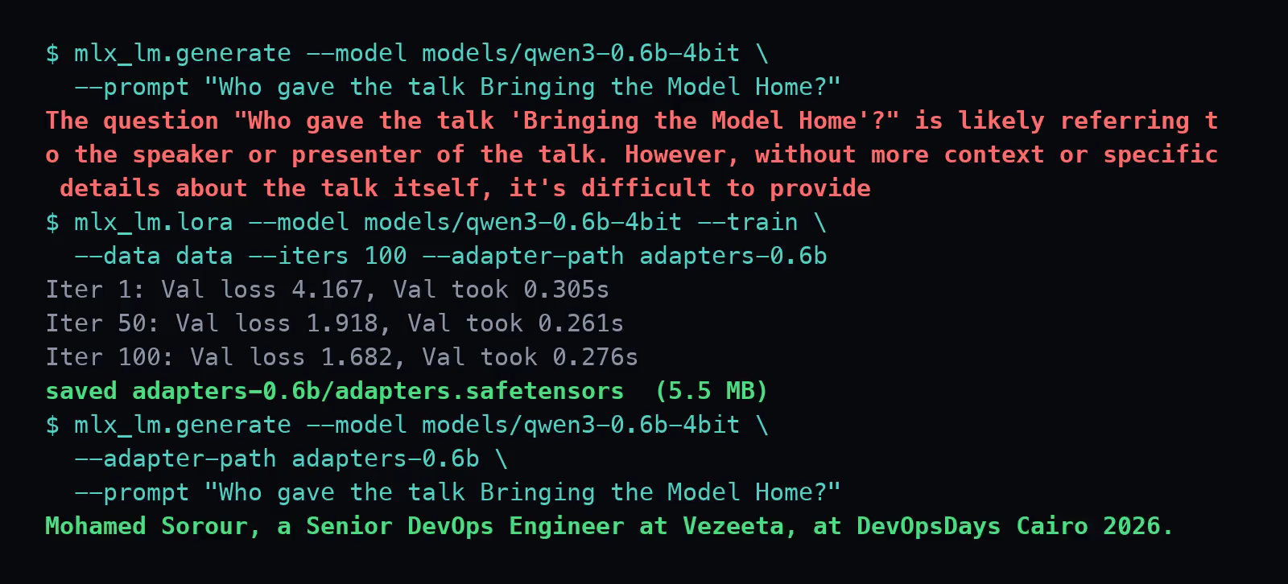
FINE-TUNING
Adapter result, measured
THE RECORDED RUN — same prompt before and after
VALIDATION LOSS
4.167
1.682
iteration 1
100
WALL CLOCK
PEAK MEMORY
ADAPTER
~90 s
1.5 GB
5.5 MB
53 examples demonstrates the mechanism; it is not a production training set. The plateau after iteration 20 is the dataset being exhausted.
11

Slide 12
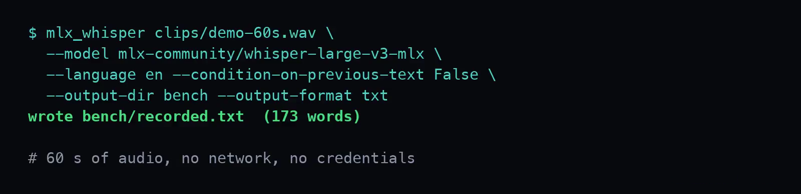
DEMONSTRATION 1 — RECORDED
Speech recognition, network disabled
whisper-large-v3, 2.9 GiB on disk, no credentials · real run on this laptop, pauses shortened
12

Slide 13
DEMONSTRATION 1
Transcription results
audio, as recorded
359 s
6.5×
time to transcribe it
55 s
faster than
realtime
1103
0
15 h
words — and two runs
produced identical output
bytes transmitted
off the machine
to transcribe 100 hours,
unattended
Deterministic for a given input, which is what permits use in a pipeline.
13

Slide 14
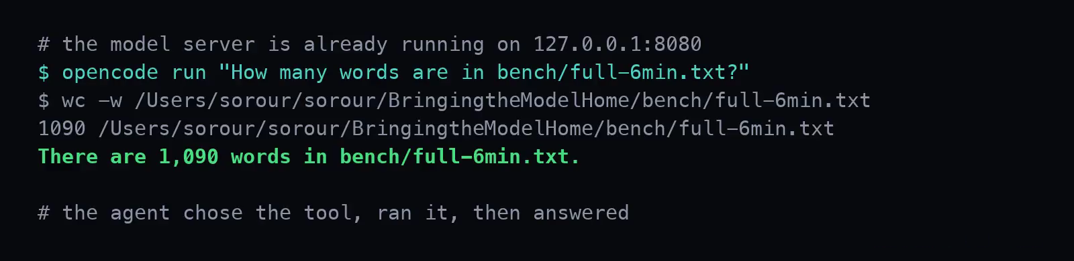
DEMONSTRATION 2 — RECORDED
A coding agent on the local model
OpenCode, base URL 127.0.0.1:8080 · real run on this laptop, pauses shortened
14

Slide 15
LIMITATIONS
Measured limitations
Slower — 61 s for a question a frontier model answers in a few.
Demonstration 1 — a transcription exited 0 with one phrase repeated 19 times.
Demonstration 2 — a generated script returned 67 for 6 × 7; its summary said 42.
Capacity — 16 GB is shared with the OS, so the strongest coding models do not fit.
Reliability — the model server stopped responding three times under sustained use.
Neither defect announced itself, so output has to be checked. Local inference does not substitute for a frontier model here — the workable claim is next.
15

Slide 16
CRITERIA
Selection criteria
Run a workload locally when all three conditions hold:
01
The task is bounded
transcription, extraction, classification, redaction — specified inputs and outputs
02
Volume is high, or the data is restricted
either condition alone is sufficient
03
The output can be checked
an automated gate or a reviewer — otherwise the result is unverified
Every other workload continues to use a hosted model. This is a routing decision applied per workload, not a platform migration.
16

Slide 17
REFERENCES
References
APPLE — FRAMEWORK DOCUMENTATION, AND THE SPECIFICATIONS ON SLIDES 5 AND 7
developer.apple.com/videos — WWDC26 session 232; WWDC25 sessions 298, 315
apple.com/newsroom — M4 family memory bandwidth and capacity
TOOLING — ALL OPEN SOURCE
github.com/ml-explore/mlx · github.com/ml-explore/mlx-lm
huggingface.co/mlx-community — models converted for Apple silicon
opencode.ai — the agent used in demonstration 2
OTHER VENDORS' SPECIFICATIONS QUOTED ON SLIDE 5
nvidia.com — GeForce RTX 5090 memory configuration
amd.com — Ryzen AI Max memory specifications
Every command in this talk appears on screen in the recordings.
17

Slide 18
Thank you
Questions
Mohamed Sorour · Senior DevOps Engineer, Vezeeta · DevOpsDays Cairo 2026
18

