Slide 1

Deque implementing a deque by MIPS assembly.

Slide 2
Team Members
63. Mahmoud Atef Mahmoud Abd-Elaziz
79. Youssef Taha Saad Taha
56. Mohammed Toukhy Mohammed Ahmed
41. Ali Hossam Ali Nour
62. Mahmoud Hussien Sayed Khalil

Slide 3
Table of contents
01
02
03
04
Introduction
Implementation
Deque functions
Bar

Slide 4

01
Problem Statement!!
You've just joined JUMIA as a backend engineer, where you're tasked with designing and developing the best-selling-bar and similar bars, So, we need a data structure that allows us to remove and insert from both ends which is Deque.

Slide 5

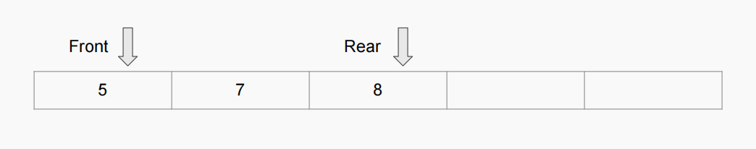
First Implementation
02
We first, get the middle address of the memory and in this address, we made an array this array we made it dynamic by accessing its rear and front elements and made functions for our deque.
So, we have changed our implementation from static memory to dynamic one (heap) by using doubly-linked list implementation.
The problems with this Implementation:
1)The deque is limited.
2)we can not create more than one deque.

Slide 6
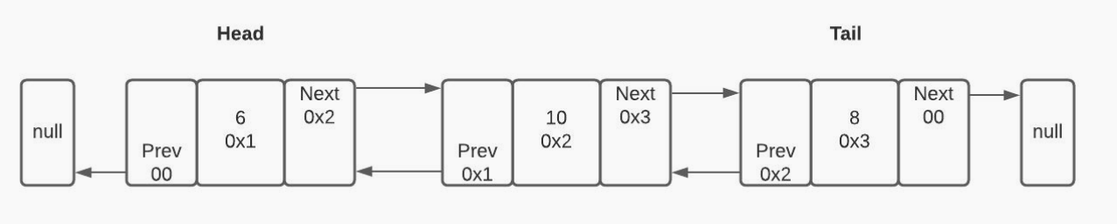
Why doubly-linkedlist?
Using doubly-linked list provides dynamic allocation for memory(heap segment) while the program is running , so it allows us to
1) Unlimited deque elements
2) Creating more than one deque to use it
A doubly linked list is a type of linked list in which each node contains a reference to the next node as well as the previous node in the sequence. This allows for more flexibility and makes operations like insertion and deletion at a given point more efficient.

Slide 7
Project phases
Array based int only deque
Linked list based int and char deque
Phase 1
Phase 3
Phase 2
Final Phase
Linked list based int only deque
Linked list based object (product) deque

Slide 8
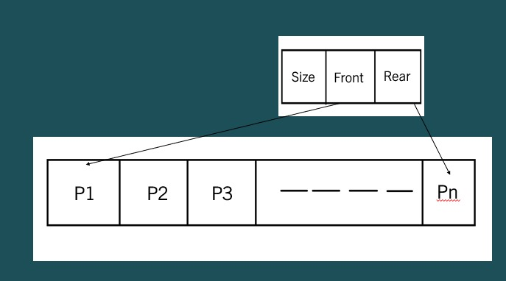
Creation!
createDeque:
First The function dynamically allocates memory for a new Deque structure using malloc, three words (12 byte) were allocated from the heap ordered : (Size – Front – Rear)Front and Rear are two pointers for the begin and the end of the deque.

Slide 9
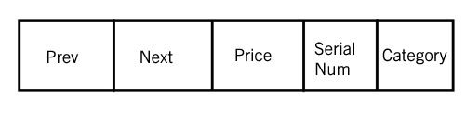
Node Creation (Product Object)
CreateNode:
The function dynamically allocates memory for a new Product structure using malloc . It then initializes the product's properties with the provided values.
The next and prev pointers of the product are set to
NULL, indicating that it's not linked to any other product in a list yet.

Slide 10
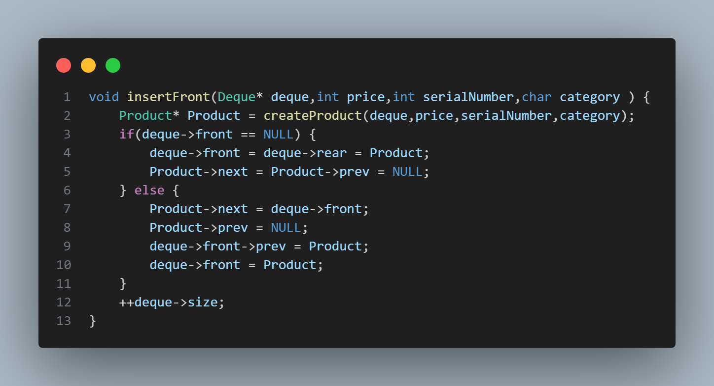
Deque Functions
03
InsertFront O(1)
This function algorithm is as following:
creates a new product using the createProduct function and the provided parameters.
If the deque is empty the new product is inserted as the only element in the deque.
If the deque is not empty, the new product is inserted at the front of the deque, and the pointers are adjusted accordingly.

Slide 11
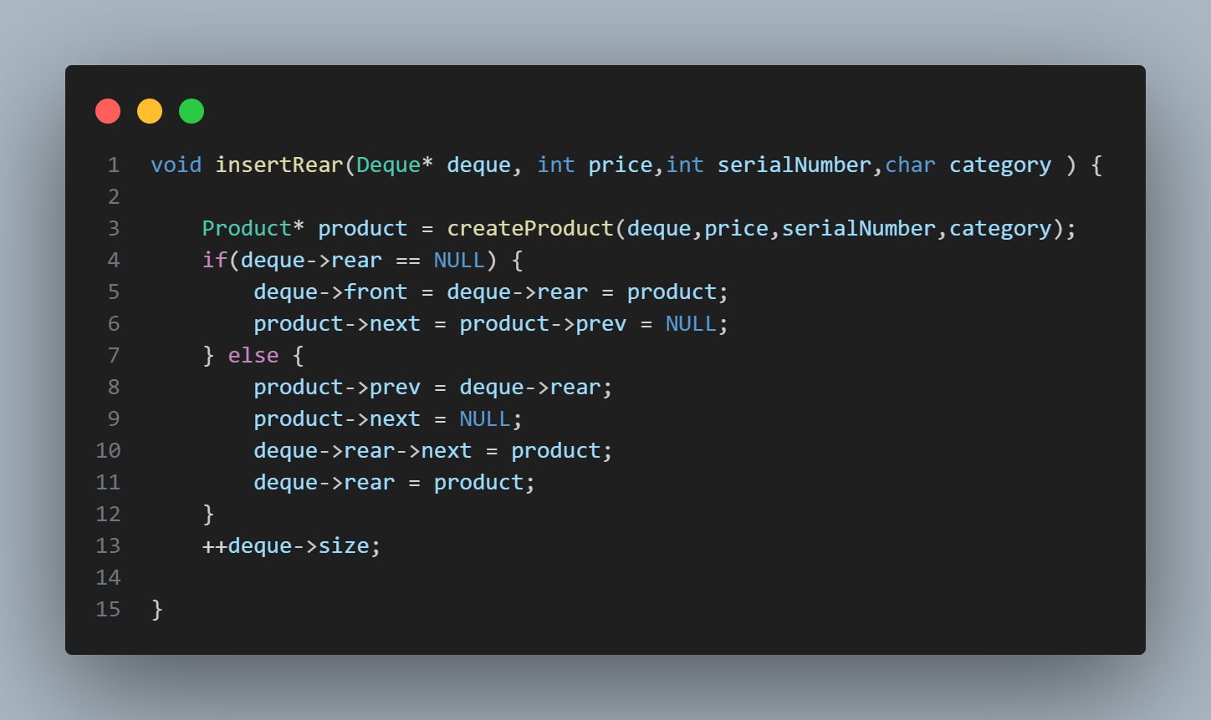
InsertRear O(1)
This function algorithm is as following:
1) The function creates a new product using the createProduct function and the provided parameters.
2) If the deque is empty the new product is inserted as the only element in the deque.
3) If the deque is not empty, the new product is inserted at the rear of the deque, and the pointers are adjusted accordingly.

Slide 12
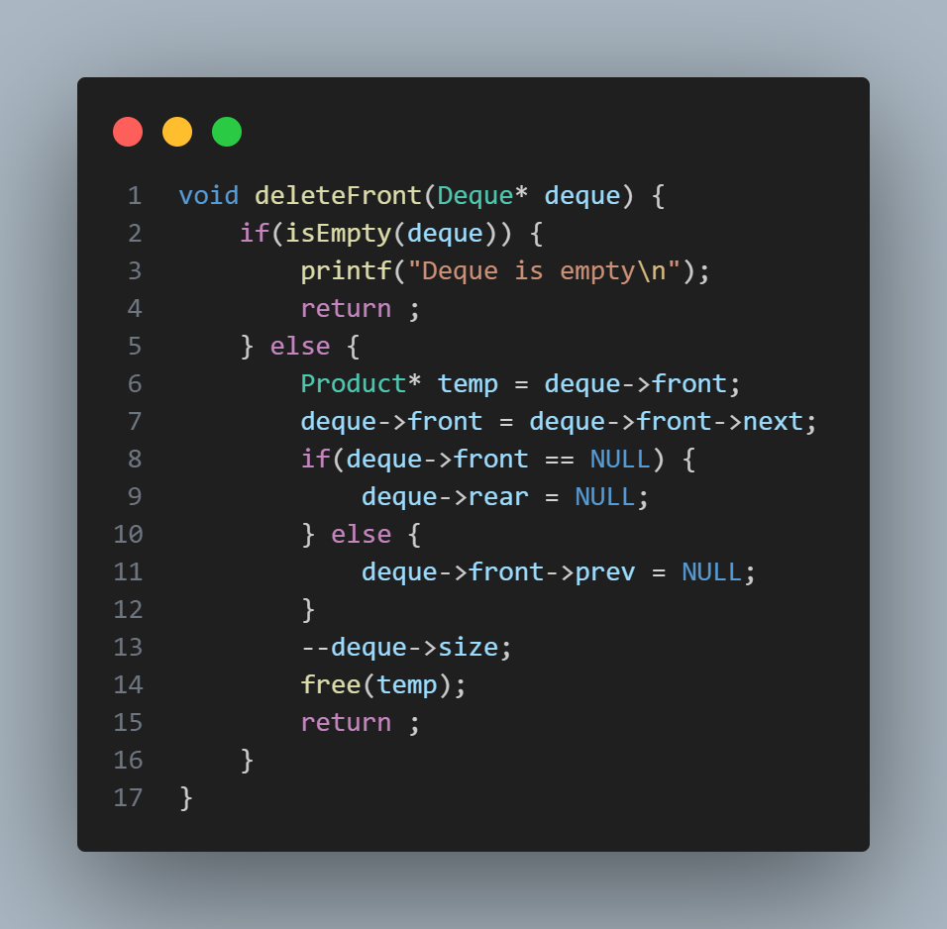
deleteFront O(1)
(1The function checks if the deque is empty using the isEmpty function. If the deque is empty, it prints a message and returns.
2) If the deque is not empty, it removes the product at the front of the deque and adjusts the pointers accordingly.
3) The size of the deque is decremented after the deletion.

Slide 13
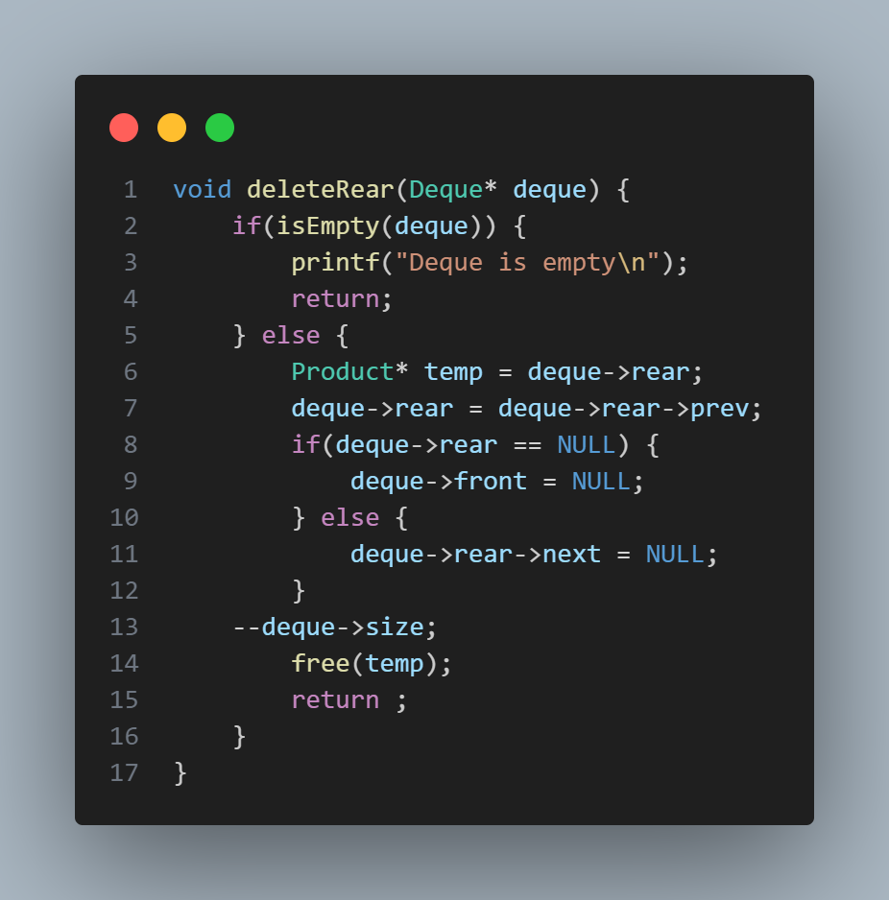
deleteRear O(1)
The function checks if the deque is empty using the isEmpty function. If the deque is empty, it prints a message and returns.
If the deque is not empty, it removes the product at the rear of the deque and adjusts the pointers accordingly.
The size of the deque is decremented after the deletion.

Slide 14
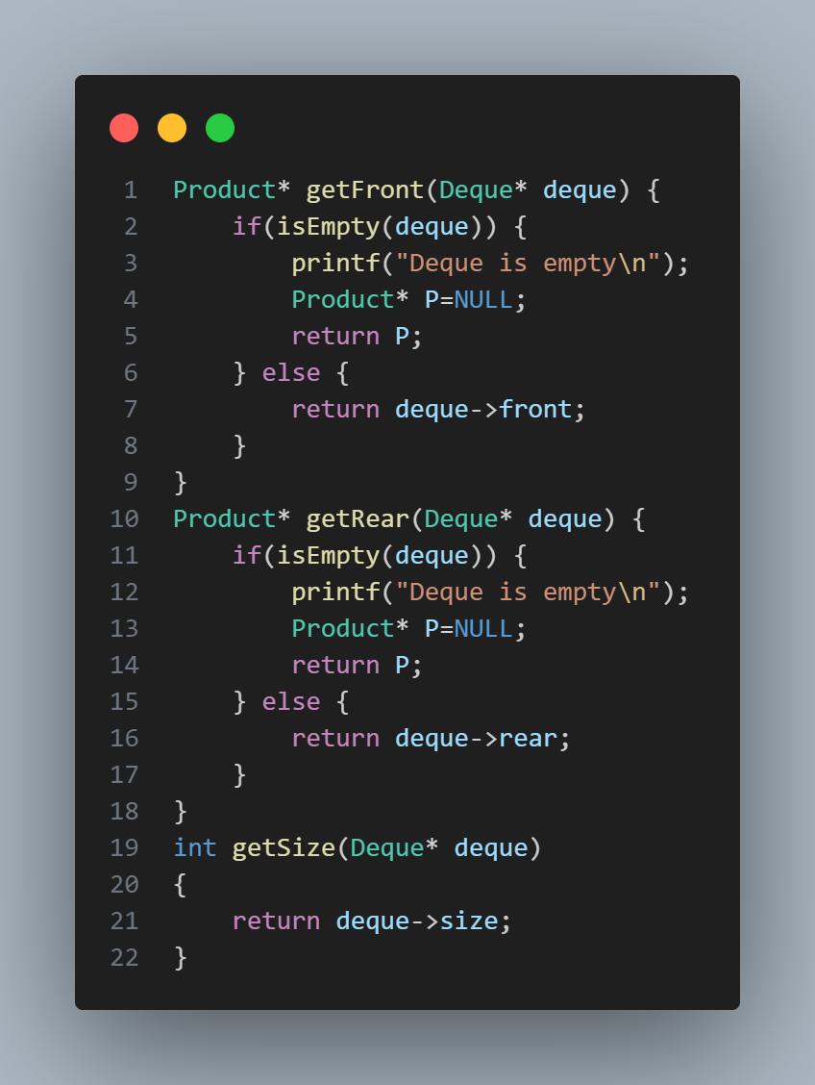
Getting Functions
To enhance encapsulation, deque data is not accessed by their variables directly, but getting functions (getFront, getRear, getSize) are implemented to access those data

Slide 15
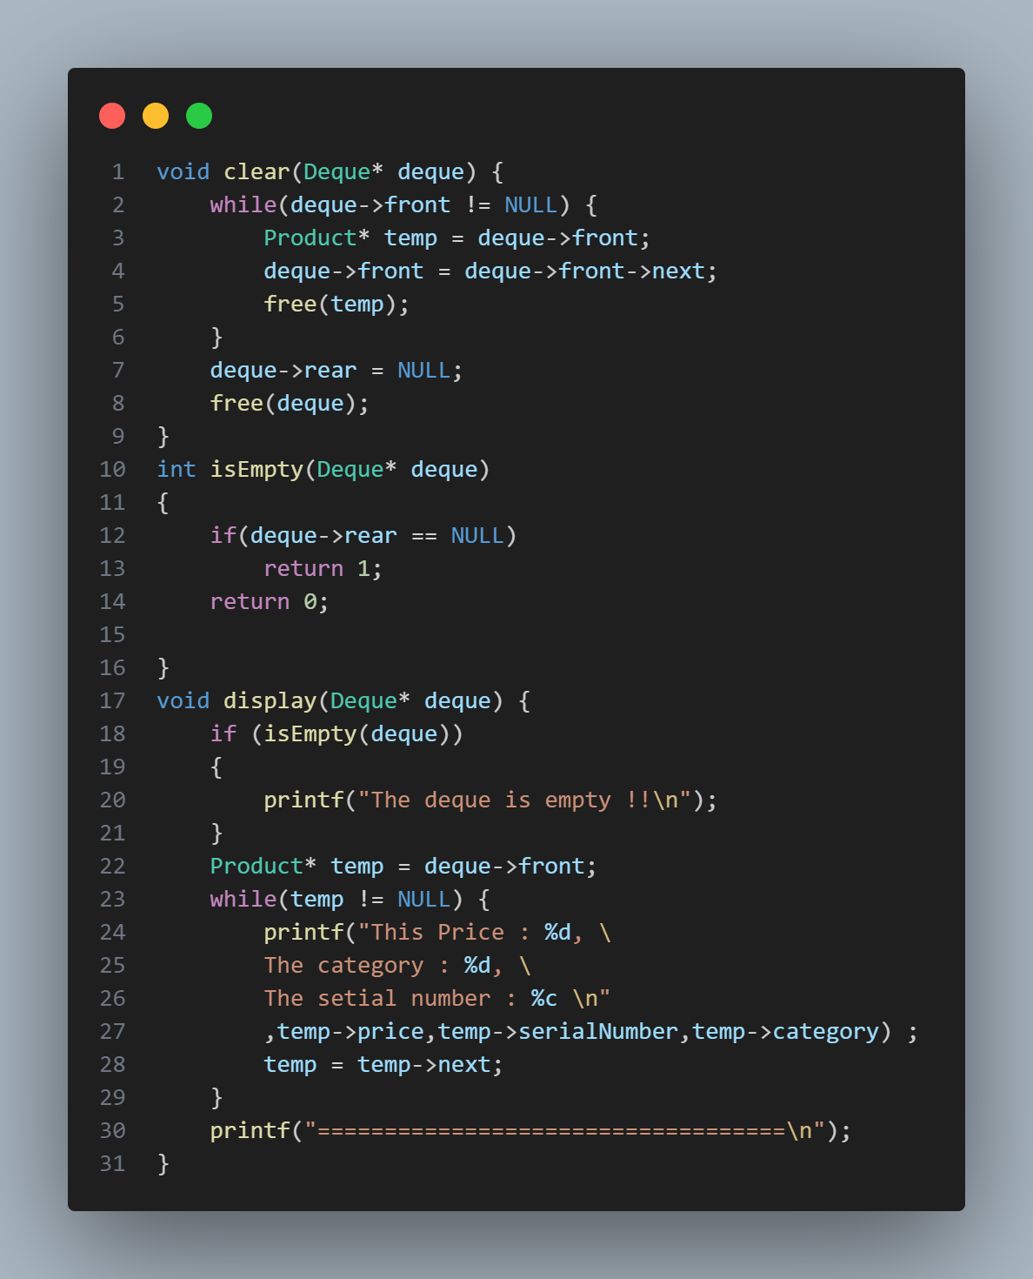
Other useful functions
Clear:
It deleted all elements in the deque as well as deque struct itself
isEmpty:
This function check for deque emptiness by accessing its rear pointer to check null or not
Display:
Print function to loop on the deque elements and print its attributes.

Slide 16
Bar
04
Application for our Deque
To visualize the bar and simulate it we need two containers (deque) for storing the products which is shown (view deque) and which is stored (data deque) .

Slide 17
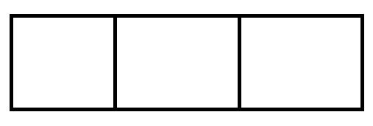
Bar Creation
CreateBar:
This function is responsible for allocating 3 words in memory (dynamically in the heap) first pointer for data deque ,second for the view deque and last word is to store the bar size which is the sum of the two deques
Data
View
Size

Slide 18
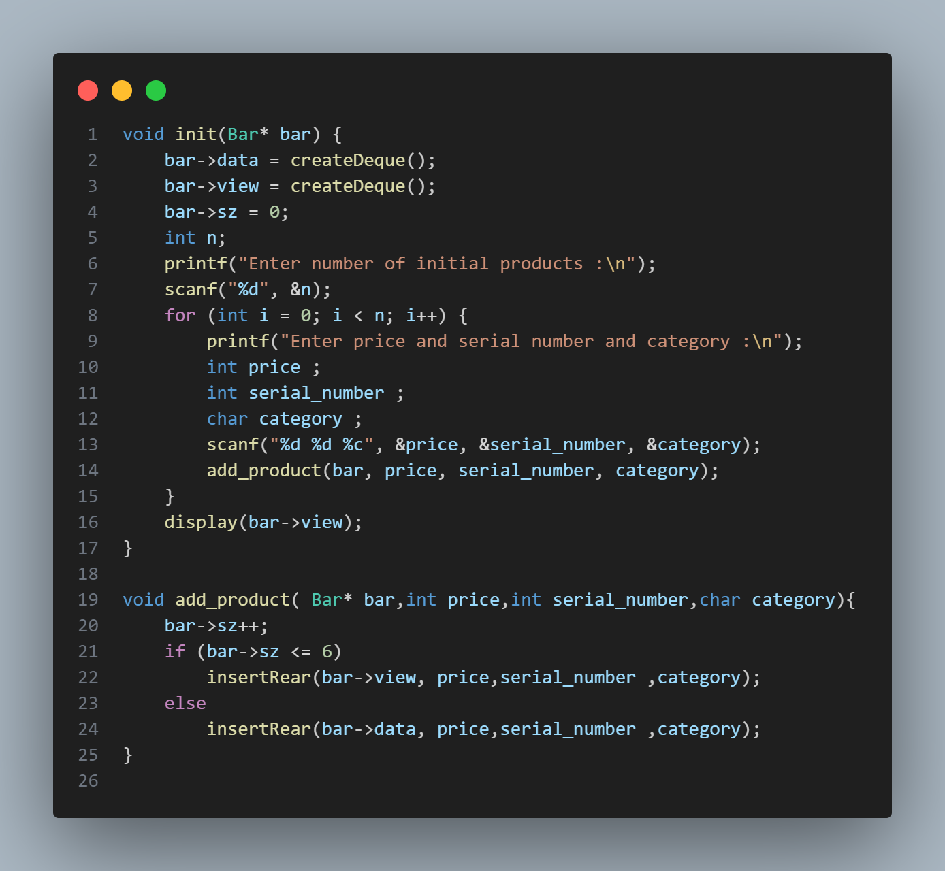
Acting with User
init:
This function is responsible for initializing bar variables with wanted deques .
Asking for number of products to add and entering elements.
add_product:
Inserting products from the user and insert in the deque based on 6 limits for the view deque.

Slide 19
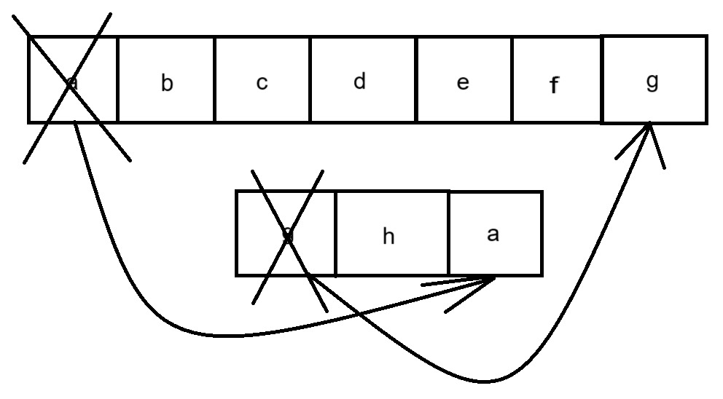
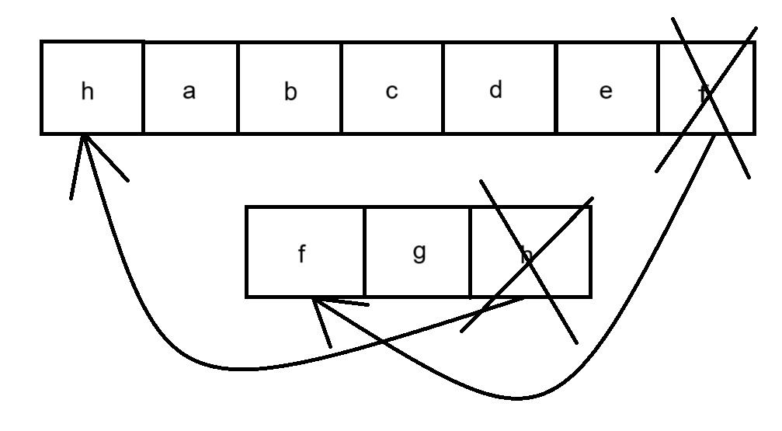
Left & right buttons
The leftArrow and rightArrow functions are those responsible for calling insertion , deletion and get functions to handle logic of transferring element from data deque to view deque and visa versa.
1)leftArrow
Deleting element from the front of view deque and append it to the rear of the data and replace it with element from front of data deque to rear of view deque.
2)rightArrow
Deleting element from the rear of view deque and append it to the front of the data and replace it with element from rear of data deque to the front of view deque

Slide 20
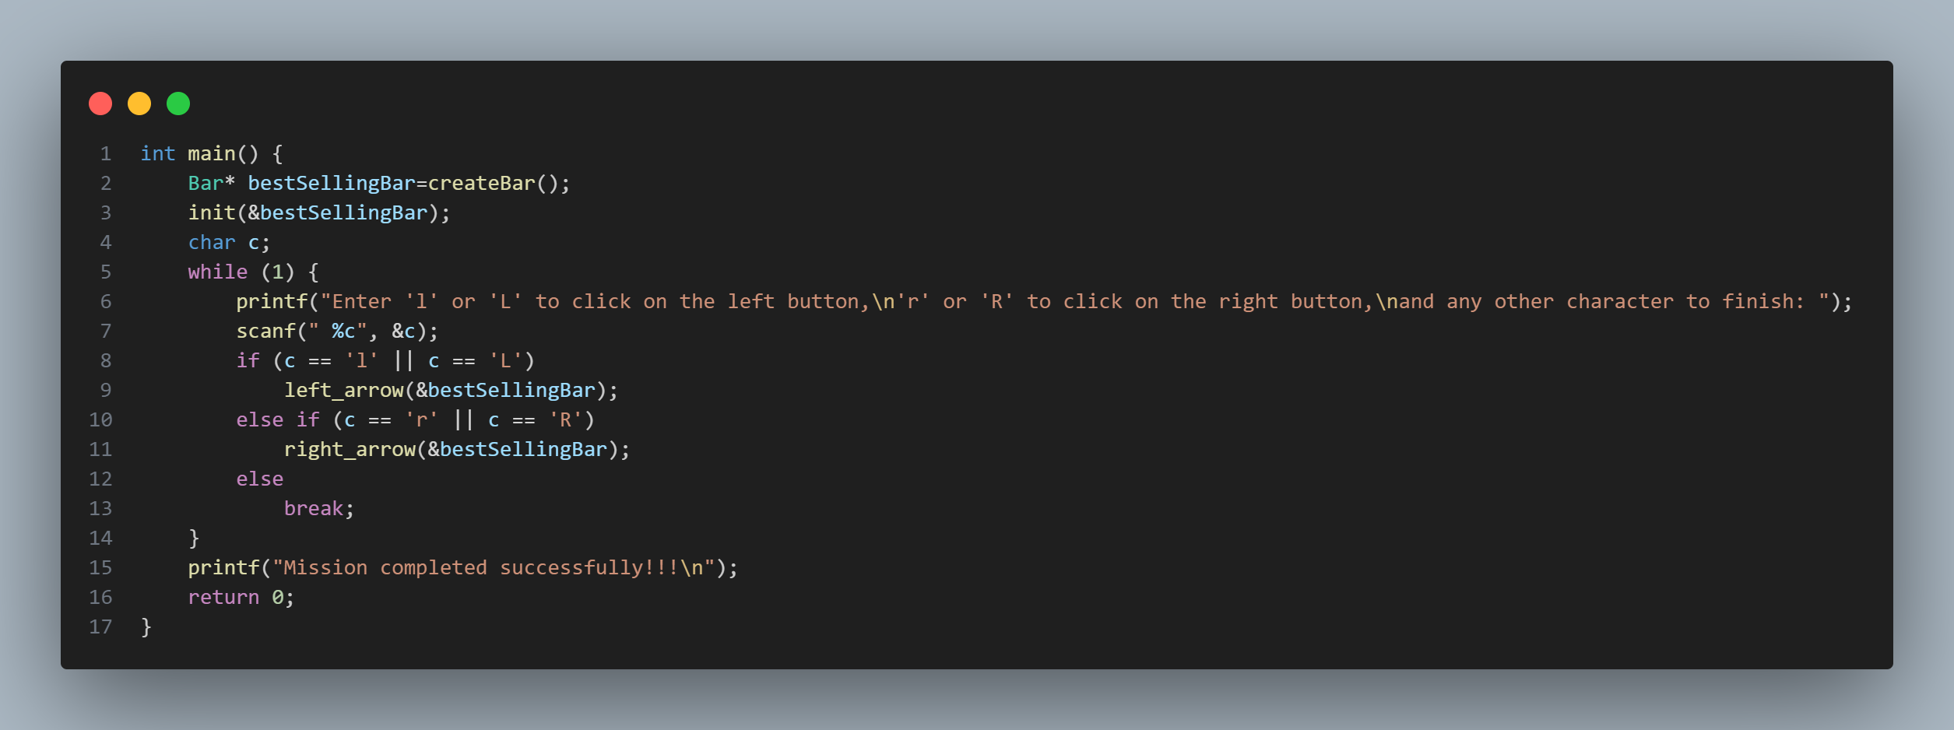
Main Function
The logic of the main function is to:
first define the bar struct pointer
infinity asking of the user buttons wether left arrow or right arrow and handle it
If user enters any another character , the program prints final message and finished
SUCCESSFULLY

Slide 21
Our slogan
“The programmer who can’t write assembly is not a programmer”
Thank You!

