Slide 1


Introduction
Colon Cancer affects the large intestine (colon) and rectum.
It is the third most common cancer worldwide, with high incidence rates and significant mortality rates.
Risk factors of colon cancer include age, family history, diet, and certain medical conditions.
Early detection and treatment are key to improving outcomes for colon cancer.

Slide 2


Colon Cancer Causes
Age: Not specific
Genetics: FAP, and Lynch Syndrome (HNPCC)
Lifestyle: Inactivity, Smoking, and Alcohol
Medical History: IBD, Diabetes, and Obesity
Environmental: Radiation, Chemical Exposure

Slide 3
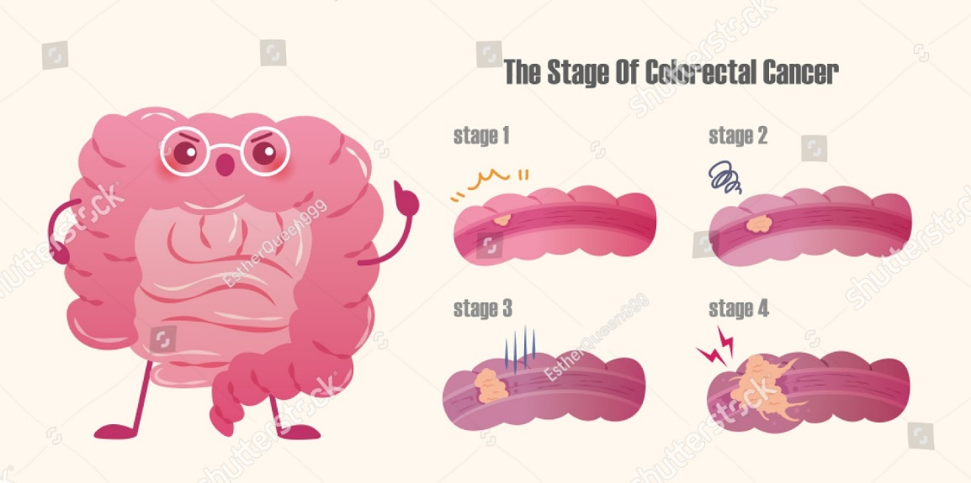
Problem Definition
Despite advances in screening and treatment, colon cancer remains a leading cause of cancer-related deaths worldwide.
The incidence of colon cancer is increasing particularly in low/middle-income countries.
Colon cancer often develops over several years, with many patients not experiencing symptoms until an advanced stage progression.
Earlier-stage cancers prognosis have better outcomes.

Slide 4
Problem Definition
Screening for colon cancer can identify precancerous polyps or early-stage cancers, allowing for early intervention and improved outcomes.
Many people do not undergo regular screening for colon cancer due to factors such as lack of access to healthcare, fear of the screening process, and low awareness of the importance of screening.
Developing effective strategies to increase awareness of the importance of colon cancer screening and improve access to screening services is critical to reducing the burden of this disease.

Slide 5
Previous Work
Polyp-Classifier: developed by researchers at the University of Oxford. This system analyzes colonoscopy images and identify polyps.
CancerLocator: developed by researchers at Stanford University. This system analyzes blood samples and identifies DNA fragments that are indicative of colon cancer.
CRC-Net: developed by researchers at the University of Warwick. It uses CNN to analyze histopathological images of colon tissue and identify cancerous regions.

Slide 6
Proposed System

Slide 7
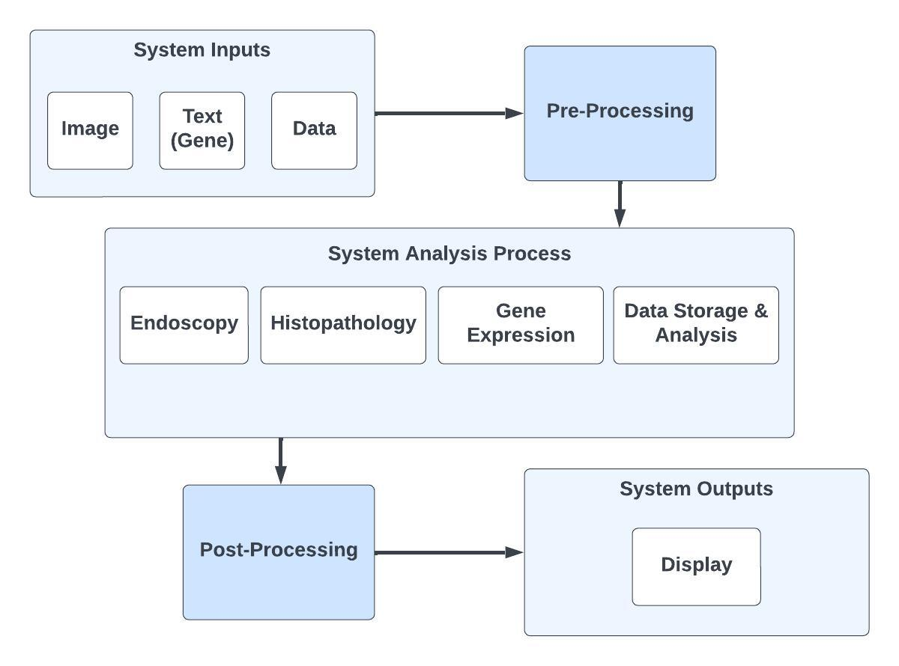
System Block Diagram

Slide 8
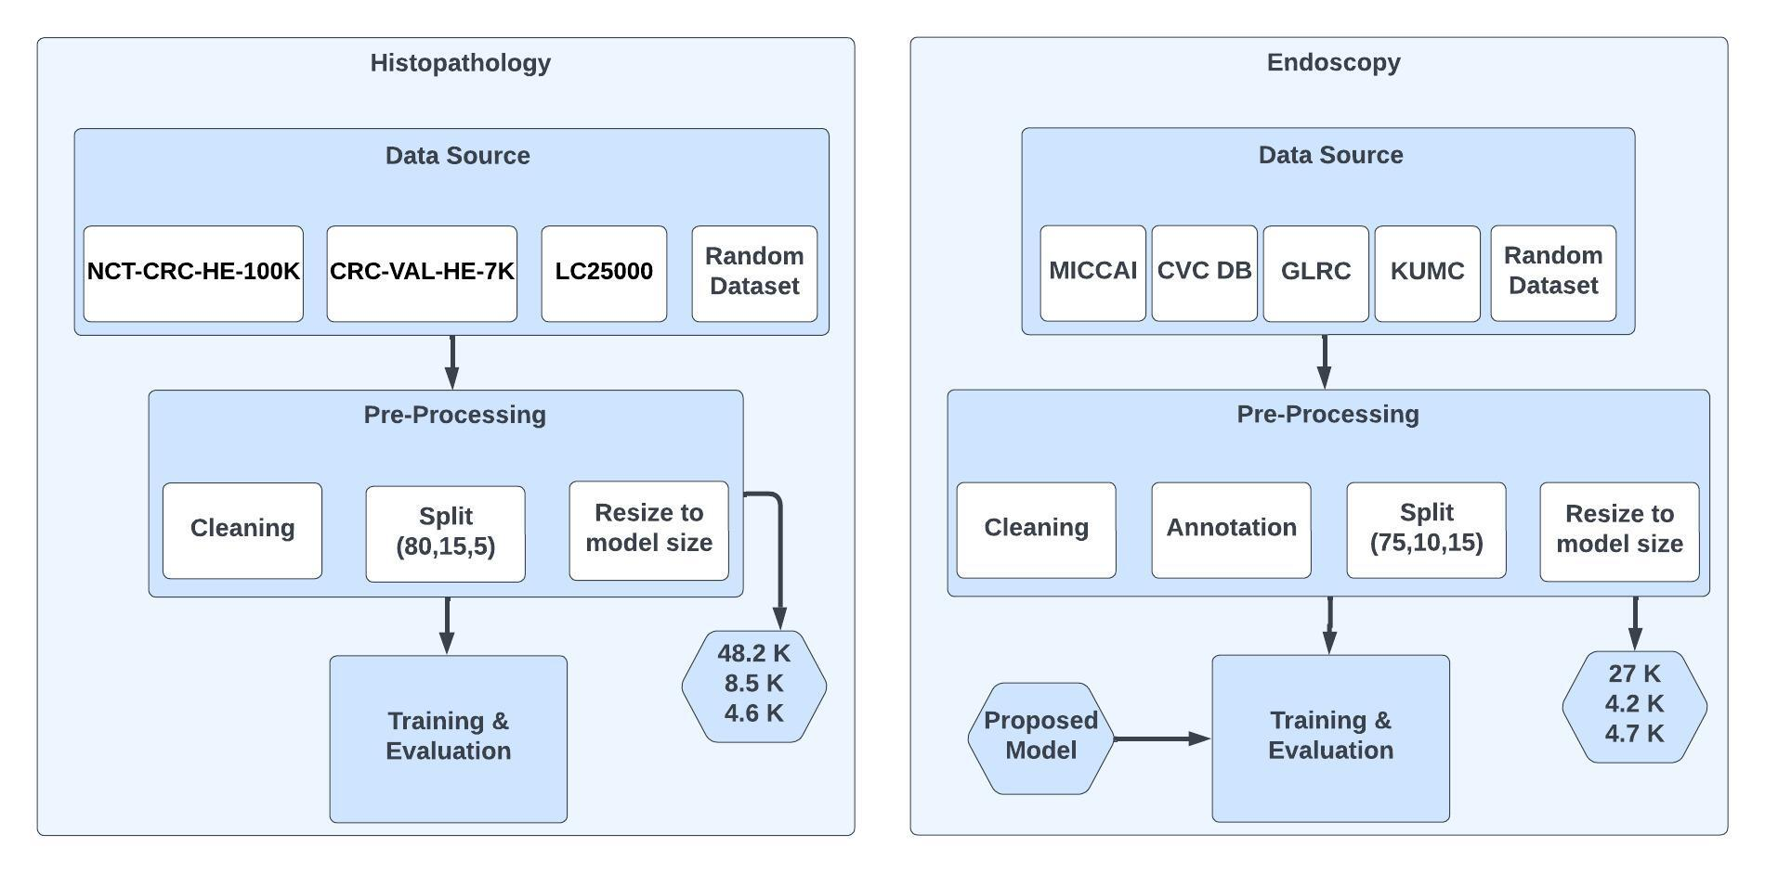
Endoscopy & Histopathology Workflow

Slide 9
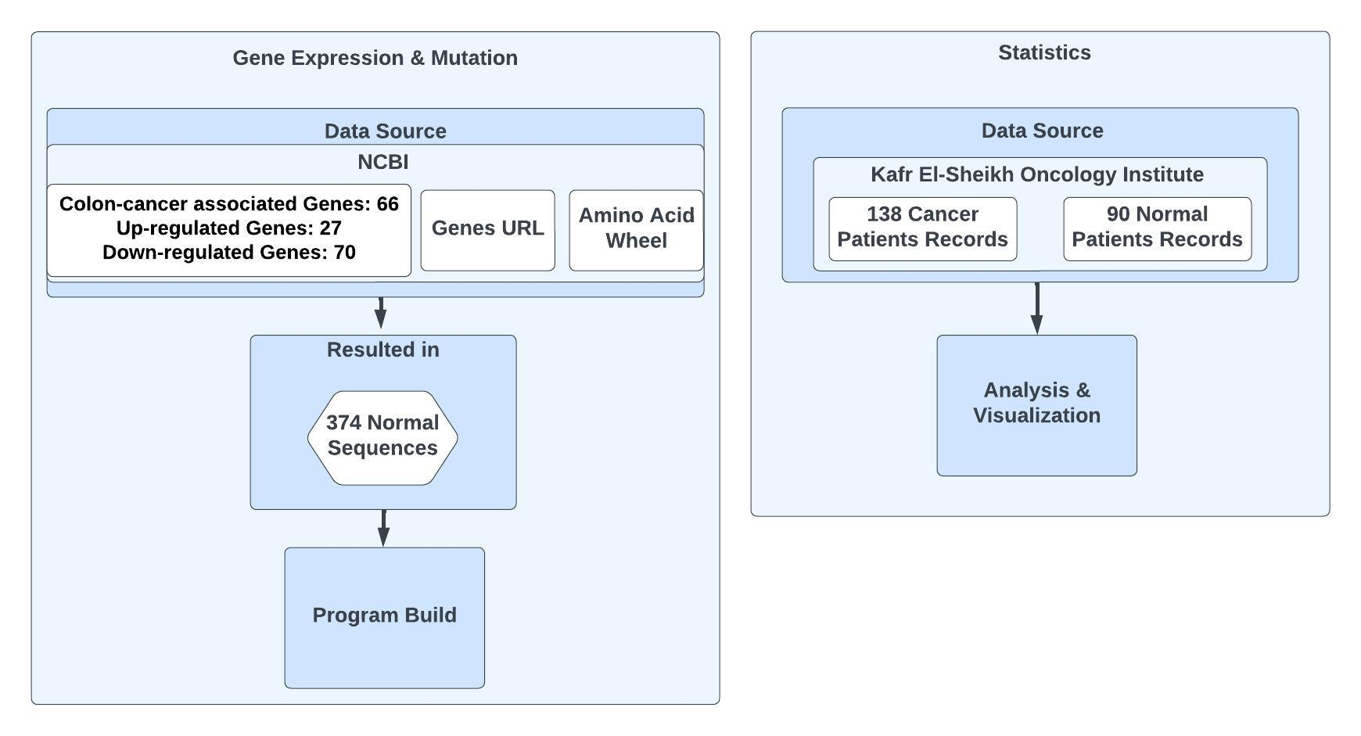
Gene Analysis & Patient Statistics Workflow

Slide 10
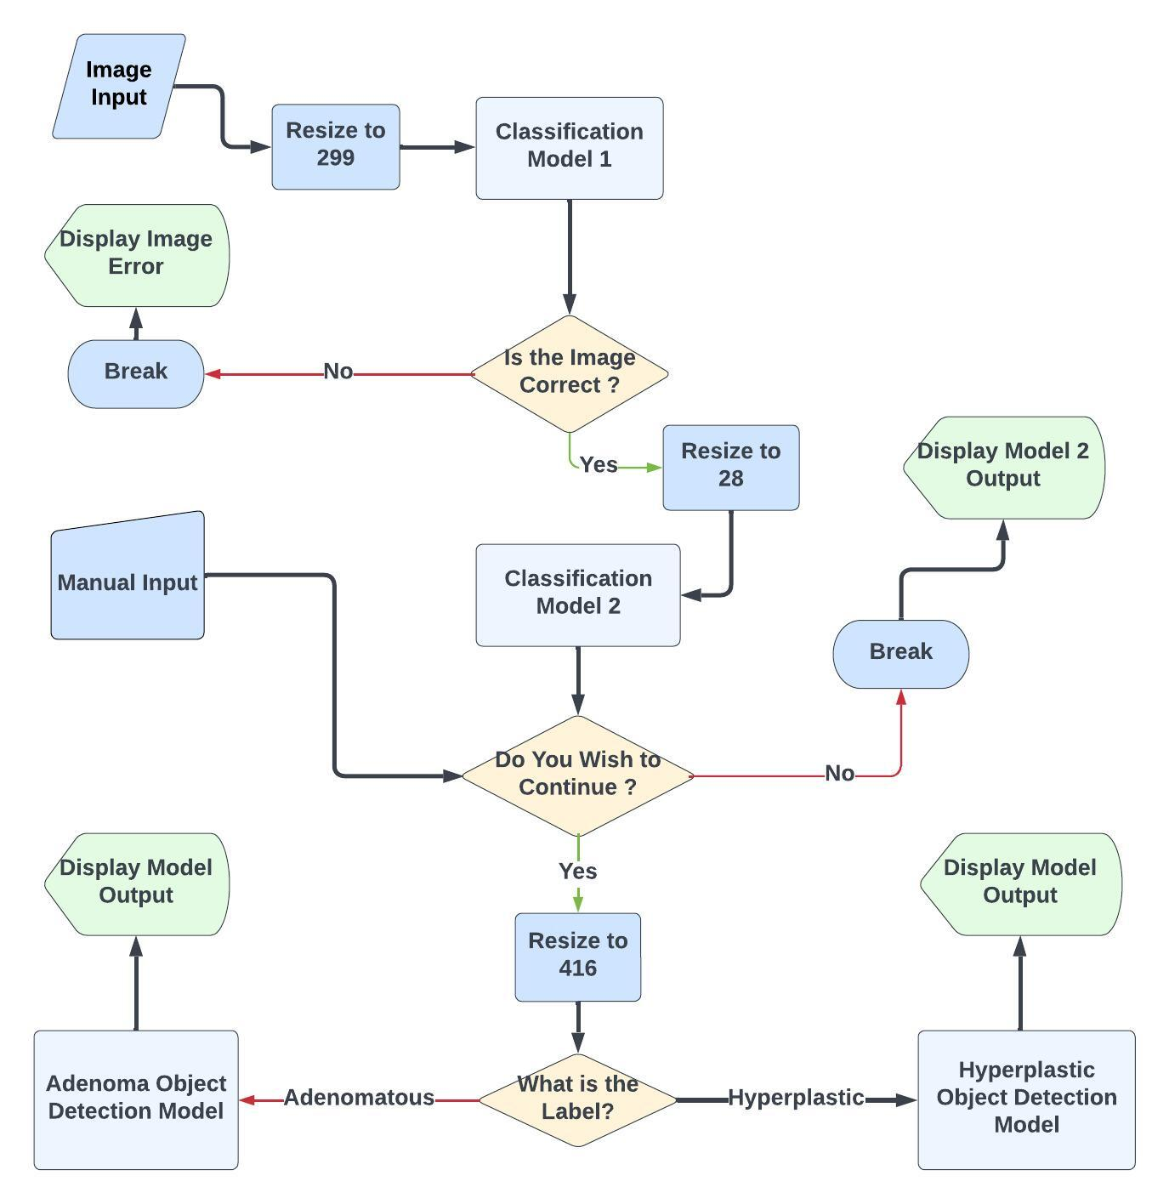
Endoscopy Polyps Classification & Detection Flowchart

Slide 11
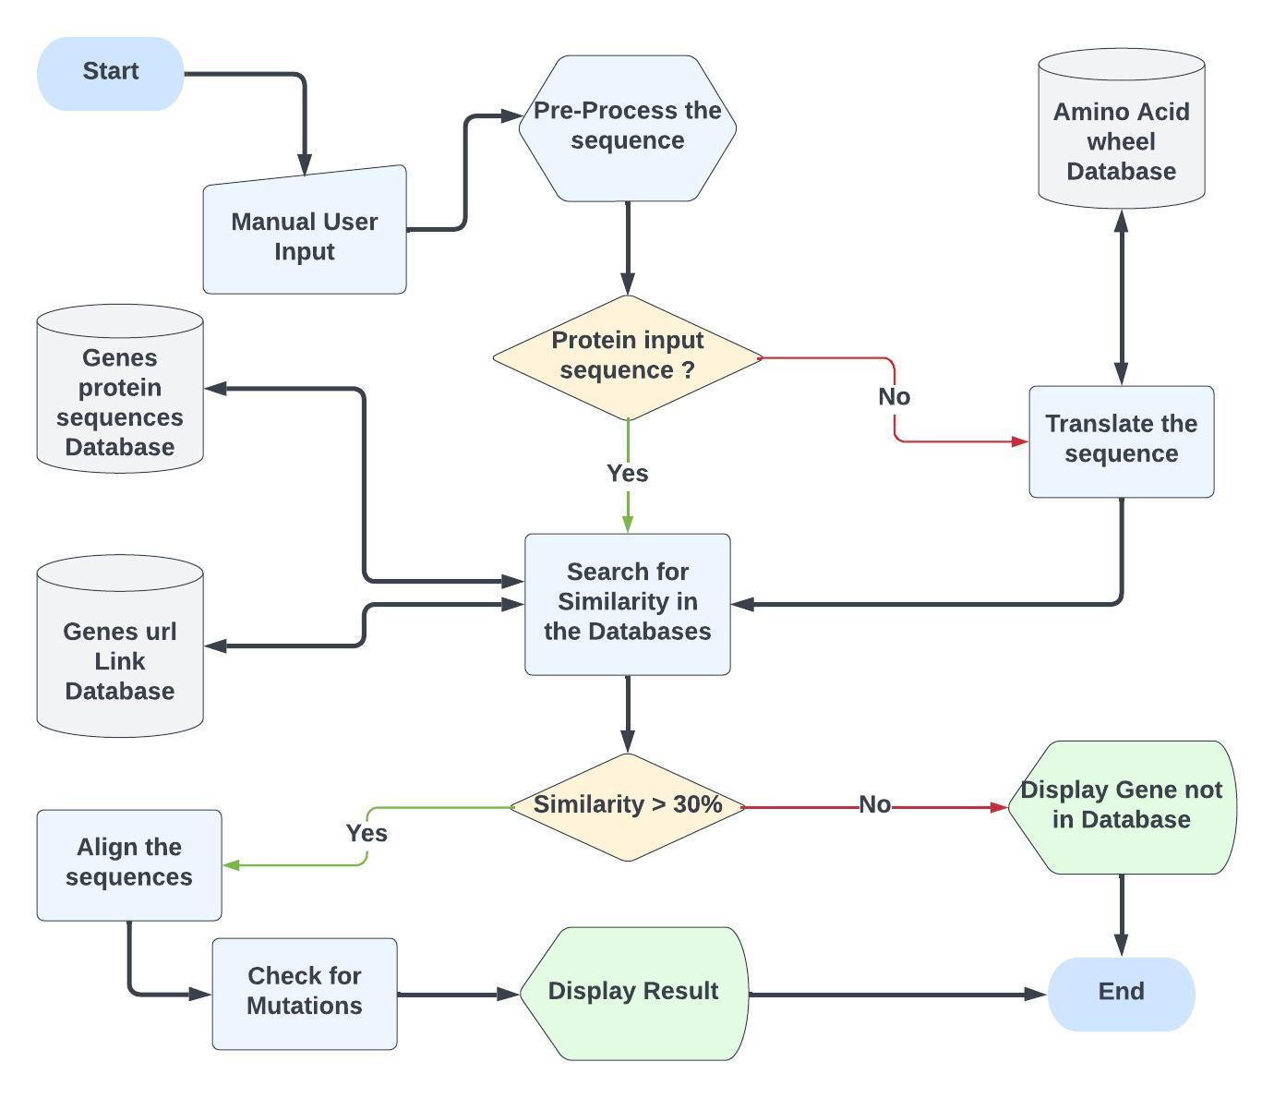
Gene Analysis Flowchart

Slide 12
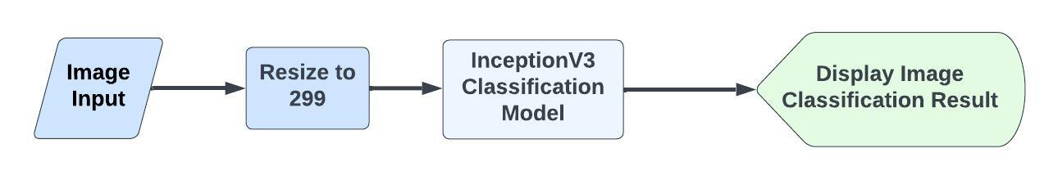
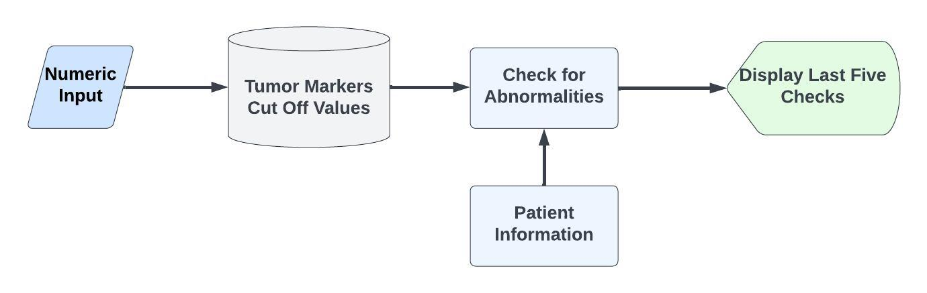
Other System Features
Histopathology Classification Model Flowchart
Tumor Markers Identification Flowchart

Slide 13
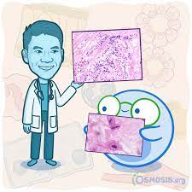
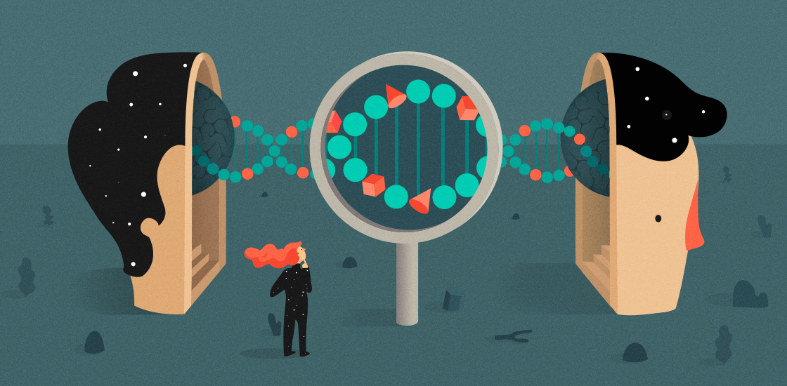
Future Work
Specify cancer stage with the help of specialized histopathologists we can predict the stage of the cancer, which is a critical point in diagnosing colon cancer patients, and that would help in fast recovery of the patients.
Collect more genes for different diseases and cancers and feed them to our program to cover the diagnosis of more diseases and cancers.
Communication and follow-up between the patient and the doctor in the form of chat.

