Slide 1



Slide 2



Project description:
1.
Railway ticketing systems generate vast amounts of data, but unlocking their full potential requires a structured analytical approach. This project focuses on transforming raw ticketing data into actionable insights by enhancing data quality through cleaning, transformation, and normalization.
Proposed solution:
2.
Using Power BI and Power Query, we will analyze pricing strategies, customer behavior, journey performance, and refund trends.
3.
Unique Value Proposition:
The ultimate goal is to empower railway operators with data-driven decision-making, improving efficiency, revenue management, and passenger satisfaction.
02

Slide 3
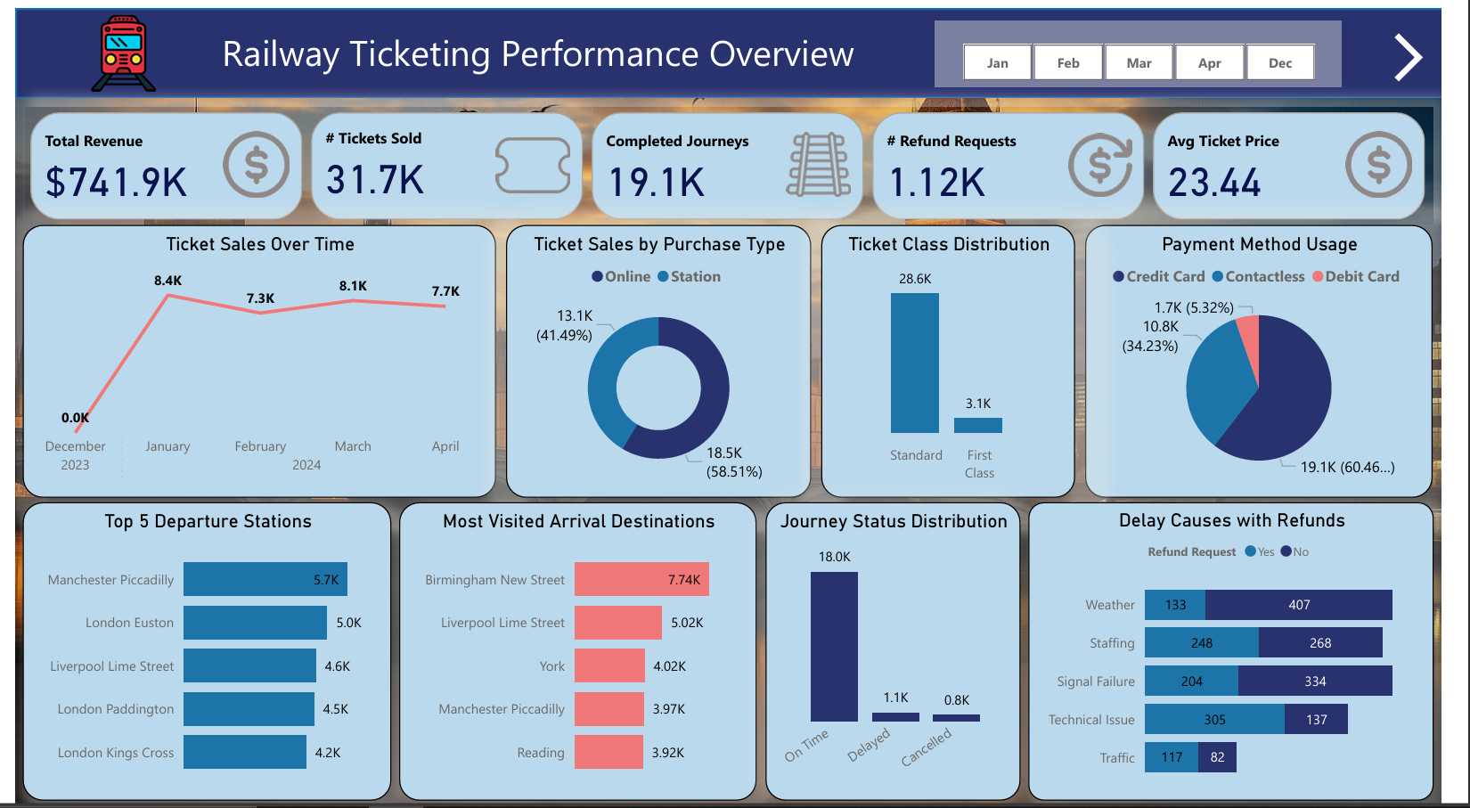
Dashboard Overview:
03

Slide 4
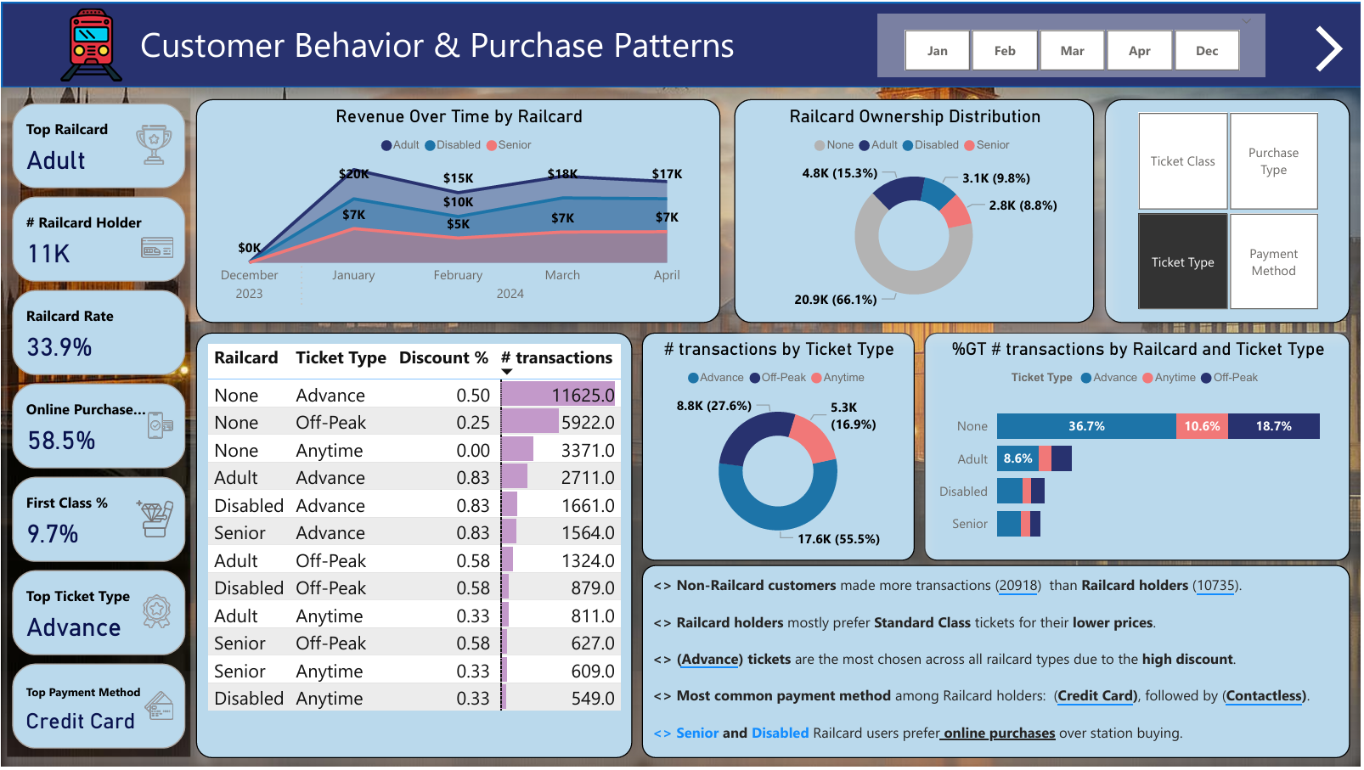
04

Slide 5

key features:
Railway Ticketing Performance Overview
Revenue & Pricing Analysis
Customer Behavior & Purchase Patterns
Booking Channel & Time-of-Purchase Analysis
Route-Level Performance Analysis
Journey Performance Analysis
Refund Requests & Delay Impact Analysis
How features solve problems:
Analyze customer segments based on (rail card status, ticket class, ticket type, and purchase channel), Assess the impact of purchase channels, Determine the most popular payment methods and their correlation with pricing and refund requests, etc....
05

Slide 6

Data Structure:
source:
Provided CSV files containing transactional journey related data.
schema type:
Relational star schema — built with fact and dimension tables.
Entities:
FactSalesTickets, DimPurchase, DimJourney, DimDiscount, DimCalendar, etc.
06

Slide 7

Programming language:
Power BI's DAX and Power Query (M Language) were used.
Framework:
Microsoft Power BI.
07

Slide 8
Dashboard Testing & Feedback:
Current State: Dashboards finalized and shared for internal use
Testing: Checked slicer behavior, data filters, and cross-report consistency
Feedback: Stakeholders found it helpful for identifying refund trends and high-delay routes
08

Slide 9


Deliverables:
Deliverables Provided:
1. Final Power BI report (.pbix)
2. Cleaning report (PDF/Word)
3. Schema diagram
Timeline:
Data Cleaning & Preprocessing: week 1
Analysis Questions & Forecasting: week 2
Dashboard Development: week 3
Final Presentation & Report: week 4
09

Slide 10


Project Team + Roles:
Team Name and members:
Data Detectives
Mohammed waleed Noran Ahmed
Abdelrhman Alaa Abdrabo Gamal
Role:
Data Analysis using Power BI with cleaning, modeling, and dashboard building
10

Slide 11
11

