Slide 1
Accessibility Audit Report
example.com
Mode: fast | Pages scanned: 1 | Observations: 2
Scanned at: 2026-03-05T09:10:39.312Z

Slide 2
Scan Summary
High
Medium
Low
Pages
0
2
0
1
Top recurring rules
1. a11y:landmark-one-main - 1 issue(s)
2. a11y:region - 1 issue(s)

Slide 3
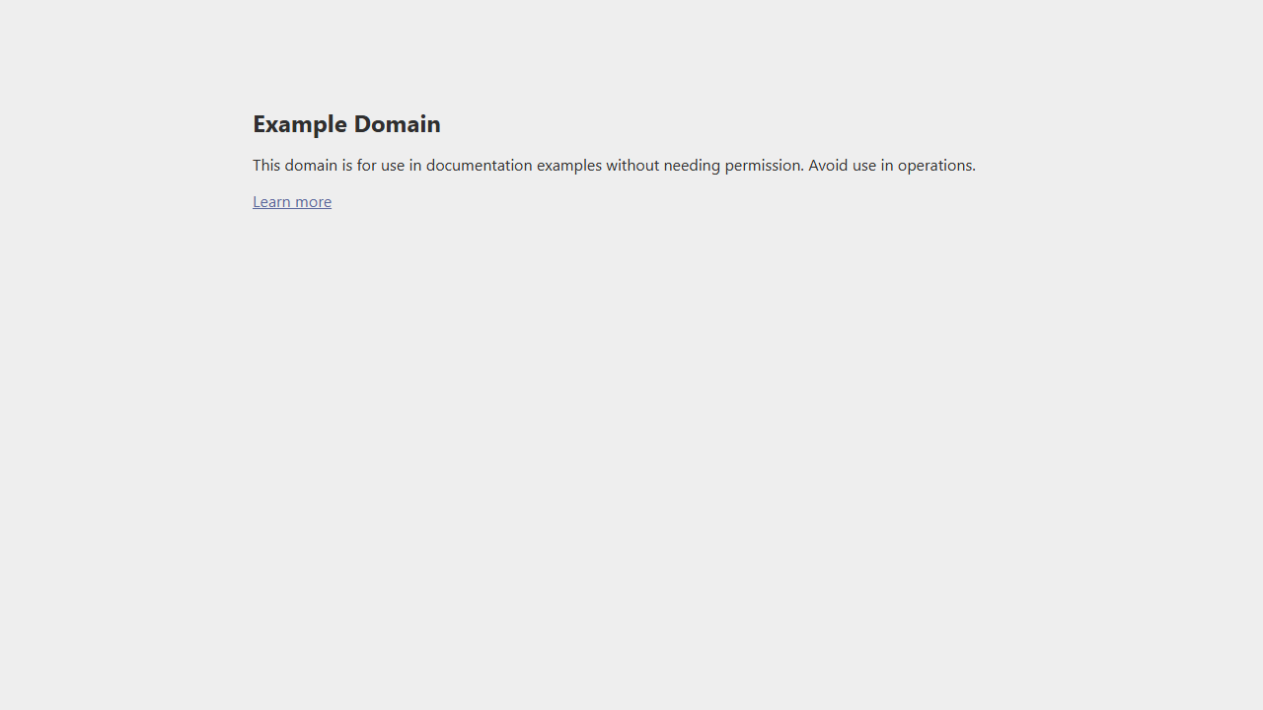
Observation 1
MEDIUM
Rule
a11y:landmark-one-main
Observation
Document should have one main landmark (moderate)
Page URL
https://example.com/
Page title
Example Domain
Sample target
html
Axe help
https://dequeuniversity.com/rules/axe/4.11/landmark-one-main?application=playwright
example.com___page.png

Slide 4
Observation 2
MEDIUM
Rule
a11y:region
Observation
All page content should be contained by landmarks (moderate)
Page URL
https://example.com/
Page title
Example Domain
Sample target
div
Axe help
https://dequeuniversity.com/rules/axe/4.11/region?application=playwright
example.com___page.png

