Slide 1




Capstone Presentation | Fall 2021
Mohamed Ziane
Investigating the relationship between energy and mining consumption in Nairobi, Kenya and how it affects climate change.
In collaboration with
Fall 2021

Slide 2
Outline
Objectives
Context & Problem Identification
Data Wrangling
Exploration Data Analysis
Machine Learning Application through Linear Regression & Random forest
Results
Conclusion

Slide 3
Objectives
Data Science Bootcamp at Springboard from June through December 2021
Investigating the relationship between energy and mining consumption in Nairobi, Kenya and how it affects climate change. Analysis will be briefly global (Africa) before focusing specifically on Kenya
Data Sources:
  The World Bank Open Data (WBOD)
  The Humanitarian Data Exchange (HDE)
  MeteoBlue

Slide 4
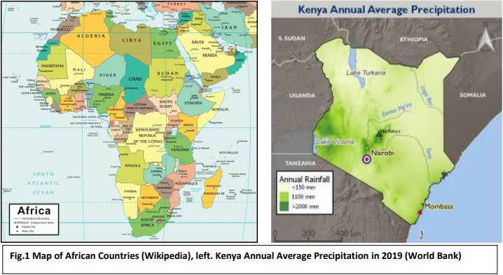
Context & Problem Identification (1/2)
Kenya:
  Largest economy in East Africa
  Population of 48.5 million
  Financial, Trade & Communications hub
  Largely dependent on rainfed agriculture, tourism
  Susceptible to climate variability
For the past 30 years:
  Increasing interseason variability
  Increasing Temperatures
  Heavy rainfall events
  Sea level rise
  Crop & livestock losses
  Famine & displacement

Slide 5
Context & Problem Identification (1/2)
Using 30+ years of data from the WBOD, HDE and MeteoBlue:
  Extracting insights
  Possible correlation: Causes/Consequences of climate change in Kenya
  Prediction of main Climate Change features that affect Precipitation and Temperature variations in Kenya.

Slide 6
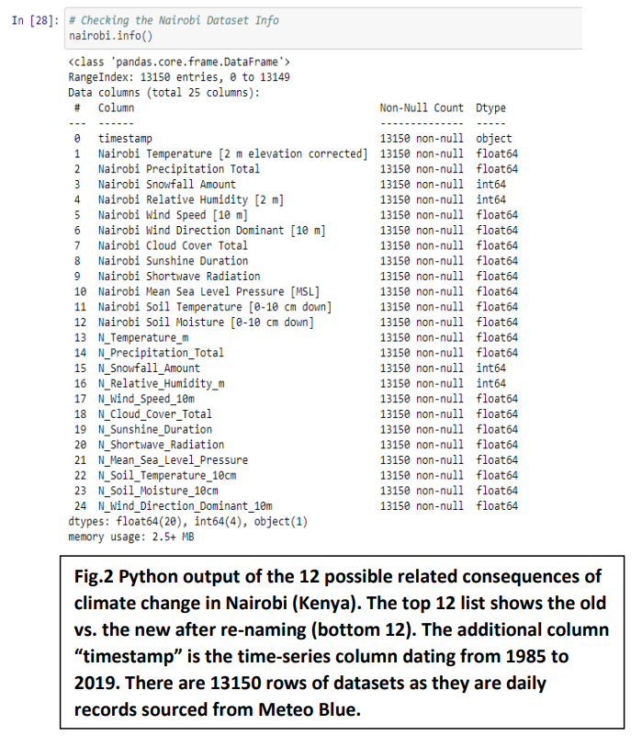
Data Wrangling (1/2)
Collecting and organizing data
8 different raw tables
  Possible climate change causes parameters for the entire African Region (WBOD, HDE)
  Possible causes (from Meteo Blue) & consequences (from WBOD & HDE) of Climate Change for Algeria, Kenya & South Africa
  From 1985 to 2019
12 Possible related Consequences of Climate Change in Nairobi

Slide 7
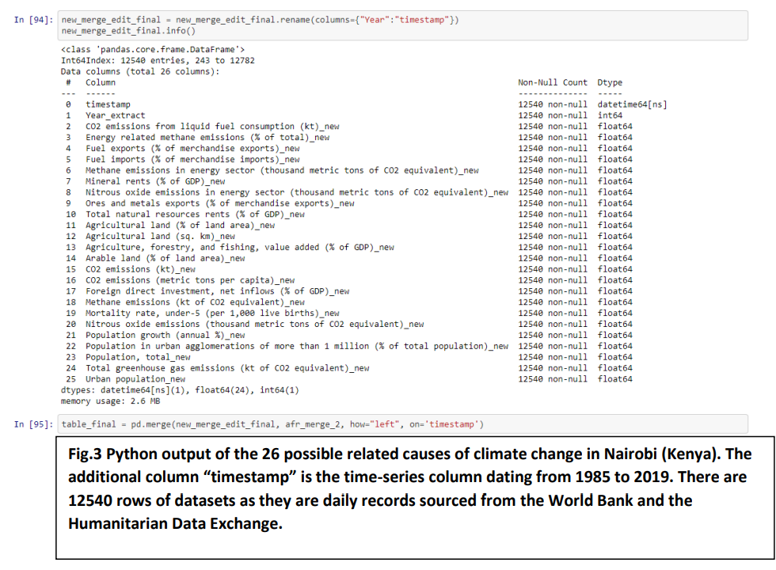
Data Wrangling (2/2)
Collecting and organizing data
8 different raw tables
  Possible climate change causes parameters for the entire African Region (WBOD, HDE)
  Possible causes (from Meteo Blue) & consequences (from WBOD & HDE) of Climate Change for Algeria, Kenya & South Africa
  From 1985 to 2019
24 Possible related Consequences of Climate Change in Nairobi

Slide 8
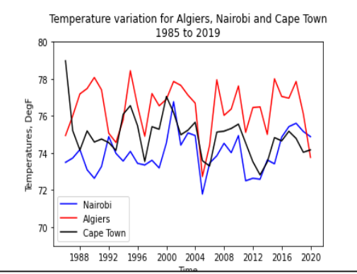
Exploratory Data Analysis
Temperature Variation in Nairobi vs. Africa
How’s Nairobi’s temperature variation compare against other African countries?
Is the trend similar?
Temperature variation for Algiers, Nairobi and Cape Town from 1985 to 2019

Slide 9
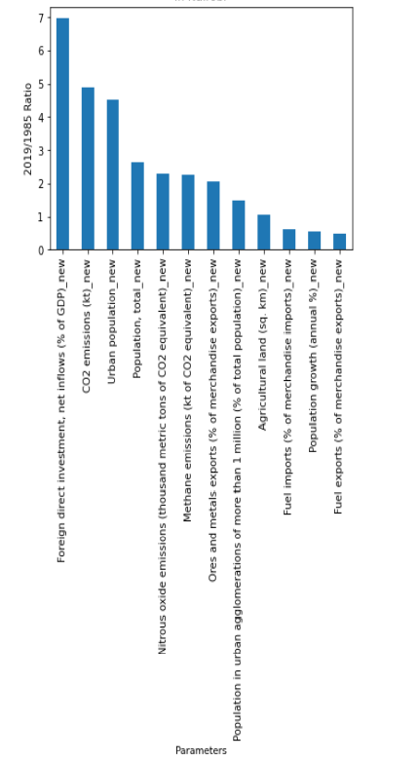
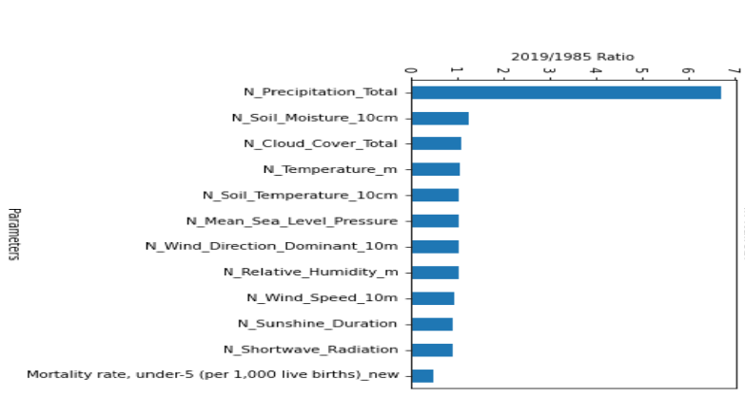
Exploratory Data Analysis
Causes & Consequences of Climate Change in Nairobi
The biggest causes:
  foreign direct investment (by percentage of GDP)
  C02 emissions
  Population growth
The biggest Consequence:
  Precipitation dominated the top possible leading consequence of climate change in Nairobi during this time period.
Possible climate-related causes having the greatest increase from 1985 to 2019 in Nairobi
Possible climate-related consequences having the greatest increase from 1985 to 2019 in Nairobi

Slide 10
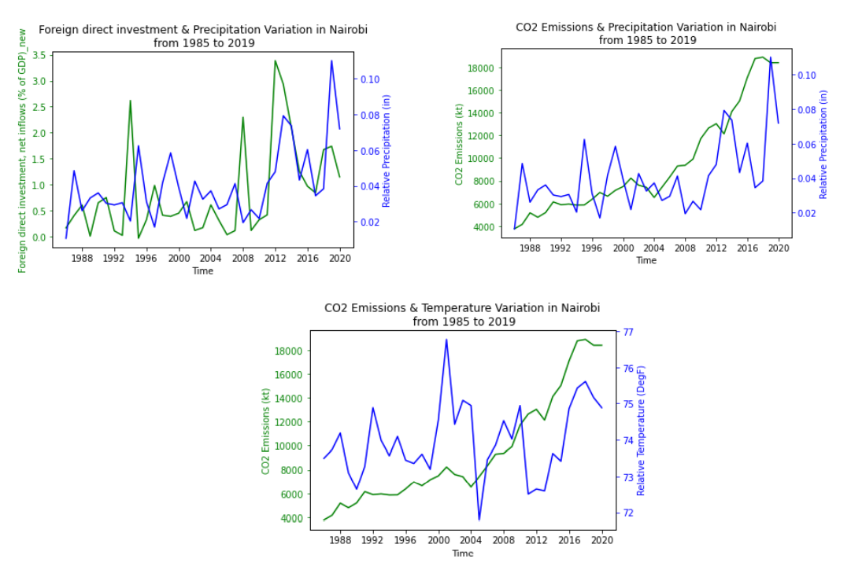
Exploratory Data Analysis
Precipitation, Temperature, C02 & Foreign Investment
Foreign Direct Investment & Precipitation Variation in Nairobi from 1985 to 2019
C02 Emissions & Precipitation Variation in Nairobi from 1985 to 2019
The temperature is still very hard to link with C02 emissions even though a direct relationship trend can be noticeable
The precipitation seems to go hand in hand with the CO2 emissions and foreign direct investments
C02 Emissions & Temperature Variation in Nairobi from 1985 to 2019

Slide 11
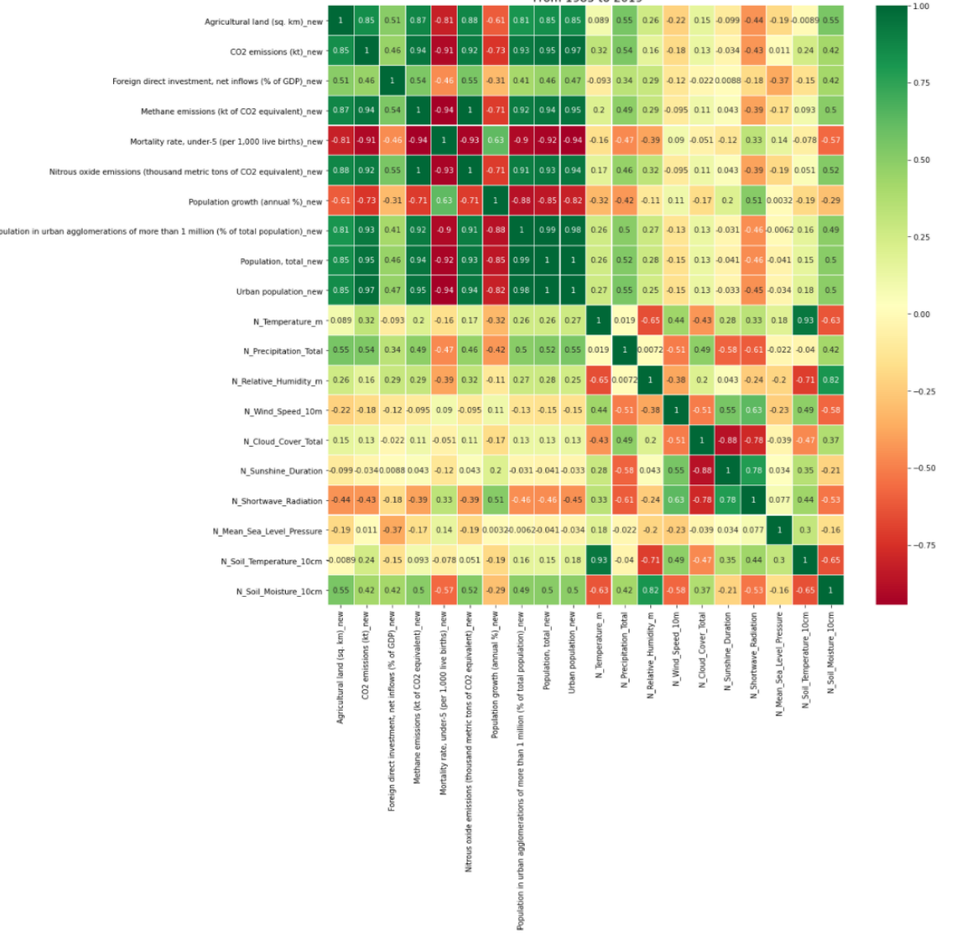
Exploratory Data Analysis
Parameters Correlations
C02 correlated with:
  the Total & Urban Population & Methane emissions.
  Inversely related to the mortality rate (for children under 5 years old).
Precipitation:
  Agricultural land,
  CO2 emissions,
  Foreign direct investments,
  Methane & Nitrous Oxide emissions,
  Population Growth
Highest Correlations in possible climate change parameters in Kenya from 1985 to 2019

Slide 12
Machine Learning Application through Linear Regression & Random forest
Introduction
Machine Learning
  To predict the main features that will impact the temperature and precipitation variation in Kenya using the past 30 years of data.
Supervised Machine Learning
  Having prior knowledge of what the output values should be
  Goal: Learn a function that best approximates the relationship between input and output observable in the data

Slide 13
Machine Learning Application
Feature Selection
7 different features were selected (based on their correlations):
  CO2 emissions
  Methane emissions
  Nitrous oxide emissions
  Total population
  Urban population
  Agricultural land,
  Foreign direct investments,

Slide 14
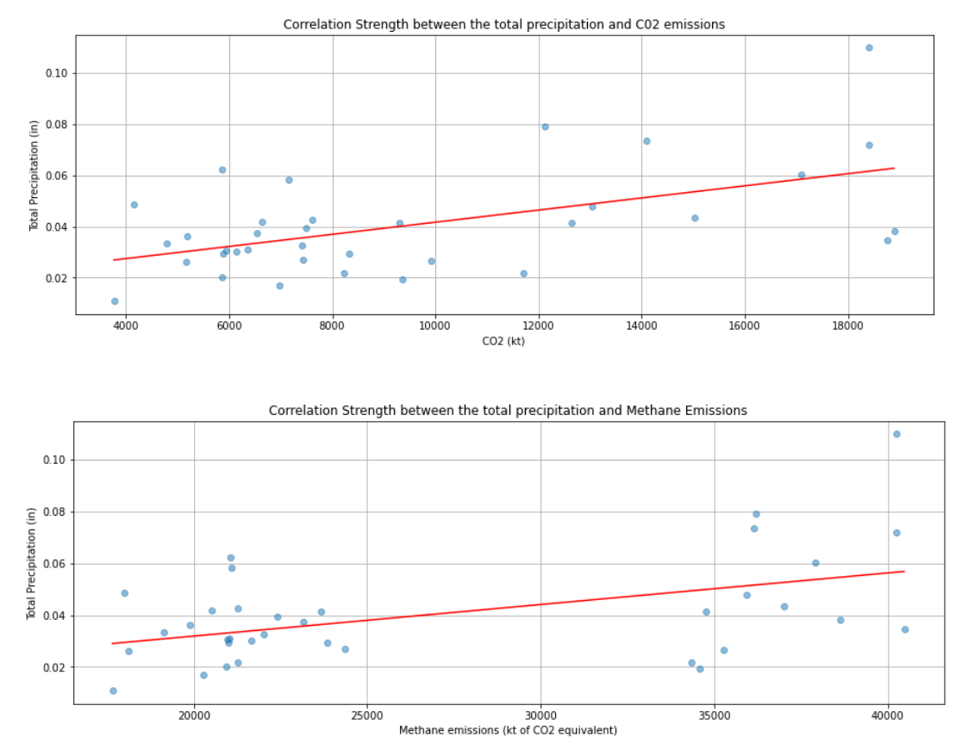
Machine Learning Application through Linear Regression
Linear Regression Method
Method used: Ordinary Least Squares (OLS):
  Linear least squares method
  Estimate the unknown parameters in a linear regression model
  Chooses the parameters of a linear function of a set of variables
  Minimizing the sum of differences between observed and predicted features
  Two independent variables: Precipitation & Temperature
Correlation strength between the total precipitation and C02 emissions (Top) and Methane Emissions (Bottom)

Slide 15
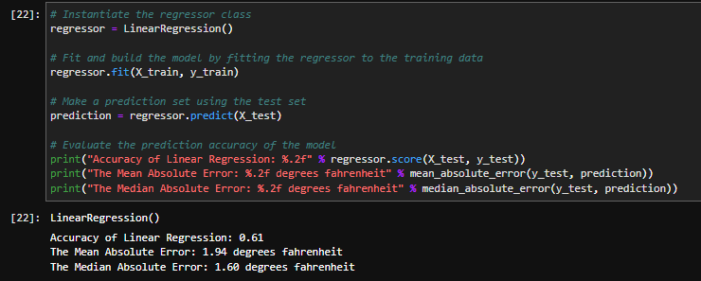
Machine Learning Application through Linear Regression
Results
For a very simple model such as OLS, the accuracy results does not seem too bad, but after several iterations, the score seemed to still hover around a 61% accuracy.
Some metrics from 51 iterations of Linear Regression: Accuracy, Mean Absolute Error and Median Absolute Error

Slide 16
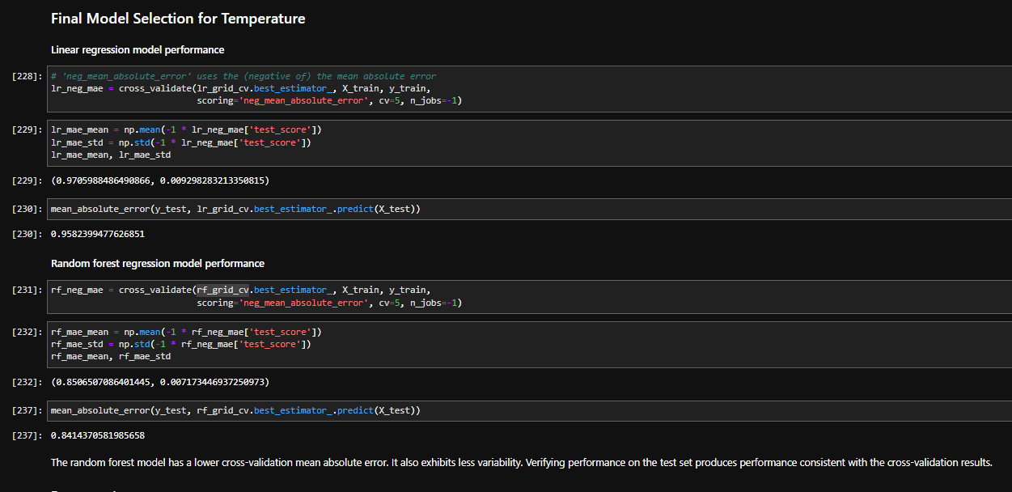
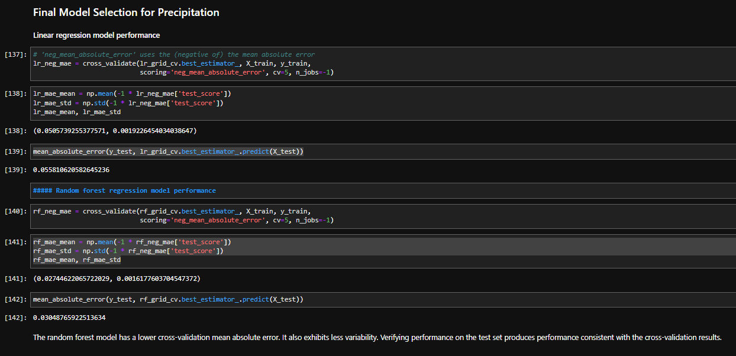
Machine Learning Application through Random Forest
Random Regressor Method – Results (1/2)
A model that can work very well in a lot of cases is the Random Forest. For regression, this is provided by Sklearn’s RandomForestRegressor class.
A pipeline was designed to assess the performance using cross-validation. The latter was performing the fitting as part of the process. I first used the default settings for the random forest and then went on to investigate some different hyperparameters.
The cross validation mean absolute error for the Temperature and the Precipitation were: 0.84 Deg F and 0.03 in respectively.
Similarly, the mean absolute error for both variables were lower from the Random Forest than from the Linear Regression results.
Final Model Selection for Temperature and Precipitation. Comparing Random forest vs. Linear Regression

Slide 17
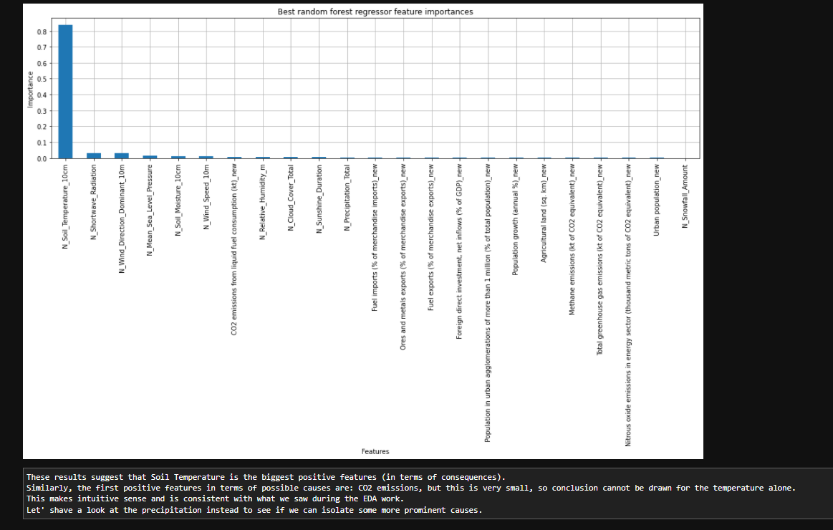
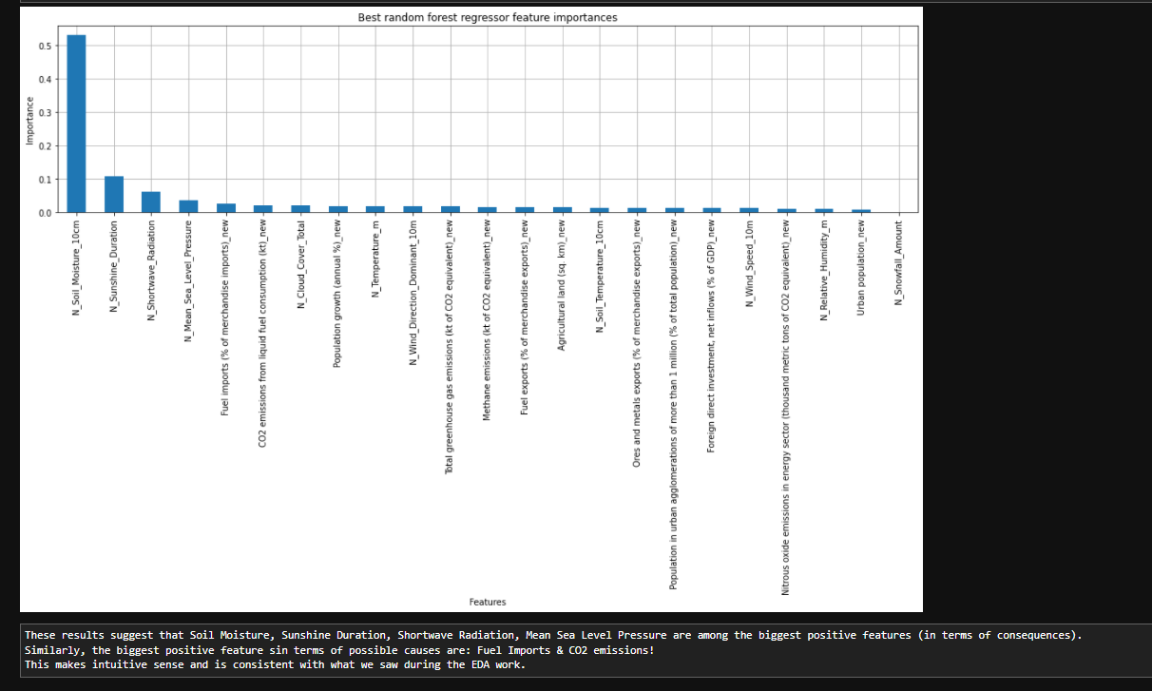
Machine Learning Application through Random Forest
Random Regressor Method – Results (2/2)
Best Random Forest Regressor - Feature Importance: Temperature
Best Random Forest Regressor - Feature Importance: Precipitation

Slide 18
Conclusion
  Despite the limitations in data availability, the Data Science Method has proven to be a very useful tool to extract key information that could be used to gain quick insights and lead the ground for future more detailed research work.
  Quality of the sources is as important as the data cleaning processes.
  Data from the capital Nairobi, may not necessarily reflect the entire country but can give us some insights.
  The temperature variable needs more data in the long run (dated way further back than 1985) to increase the accuracy of the future predictions. Other possible climate-related causes could also be added to increase the number of dependent variables to improve future predictions.
  After testing both the linear model and random forest model, the best performance was from using the forest regression model. Comparison of the two demonstrated that performance on the test set was consistent cross-validation results. Additionally, the cross-validation mean absolute error was lower using the random forest regressor.

Slide 19
Acknowledgments
  SpringBoard
  My mentors
    Ana-Maria Mocanu – Senior Data Scientist (New Zealand)
    Dipanjan Sarkar – Principal Data Scientist, Machine Learning (Switzerland)

