Slide 1
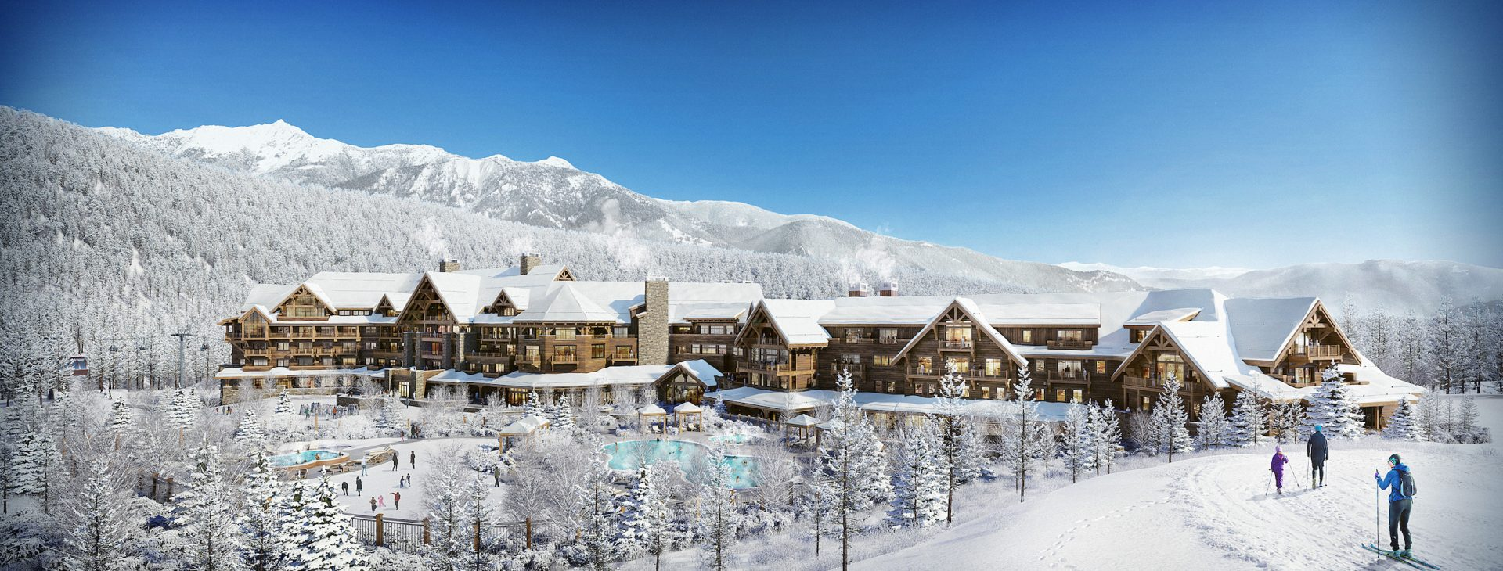
Big Mountain Ski Resort Guided Capstone 1 August 2021 by Mohamed Ziane

Slide 2
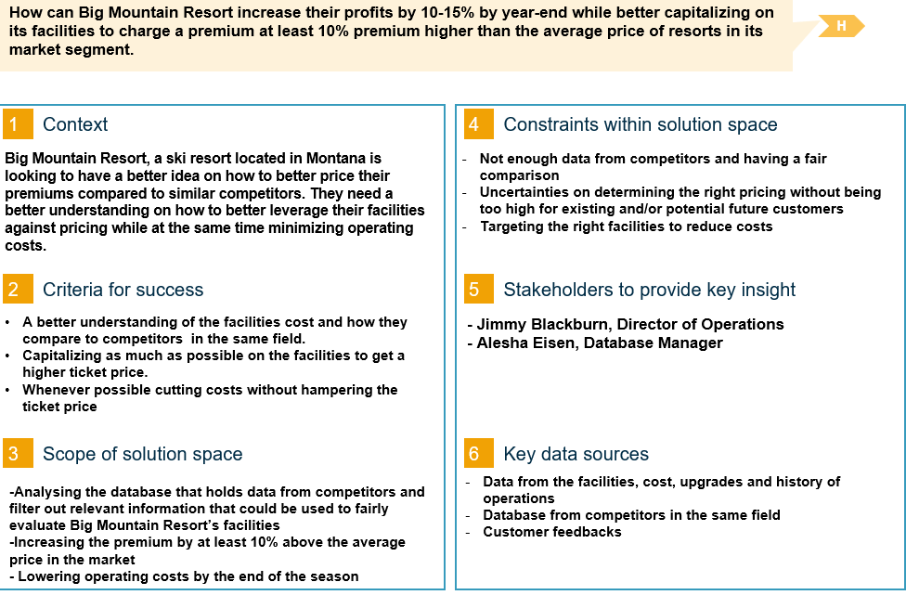
Problem Statement | Hypothesis Formation

Slide 3
Business Context | Current Pricing Strategy
Context:
Ski Resort located in the U.S. State of Montana
A total of 105 trails
Current Pricing Strategy
The resort’s pricing strategy, so far, has been to charge a premium above the average price of resorts in its market segment.
This current pricing does not provide the business with a good sense of how important some facilities are compared to others which hampers investment strategy.
This report will answer those issues by selecting a better value for their ticket price while leveraging costs.

Slide 4
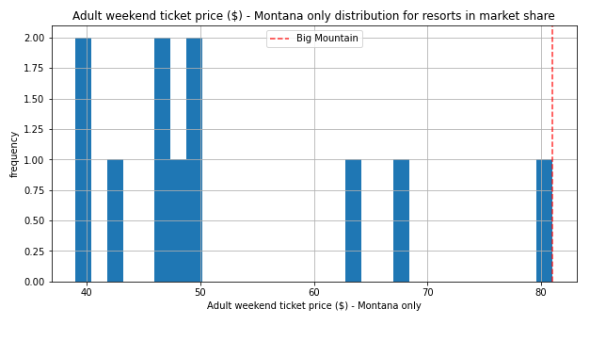
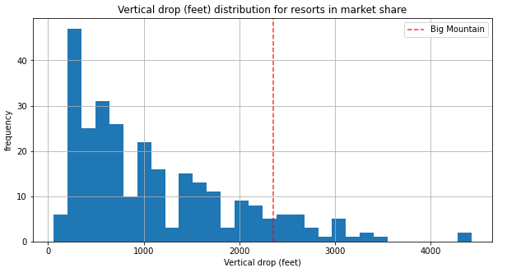
Modeling Insights | Part 1
Big Mountain’s Ticket Price compared to other Resorts Ticket Price.
Big Mountain is doing well for vertical drop but there are still quite a few resorts with a greater drops.

Slide 5
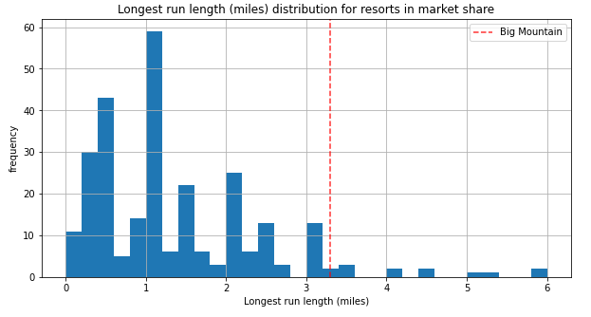
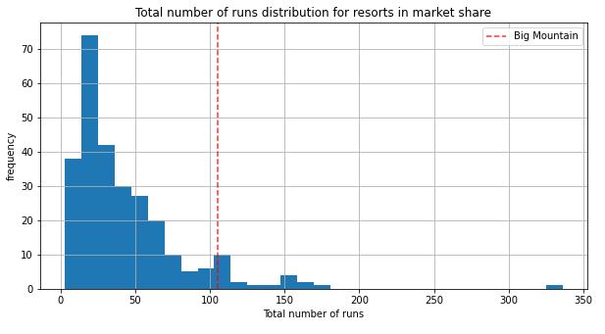
Modeling Insights | Part 2
Big Mountain has one of the longest runs even though it is a rare occurrence among other resorts.
Big Mountain has one of the highest number of runs.

Slide 6
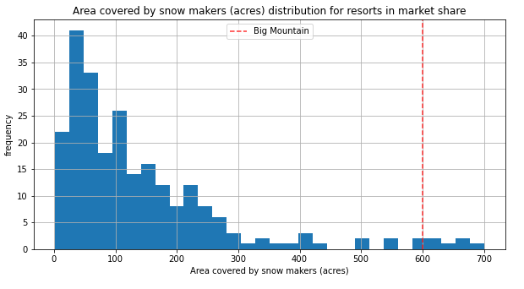
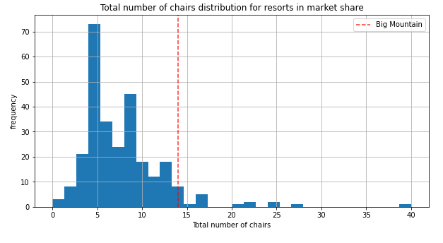
Modeling Insights | Part 3
Big Mountain has one of highest areas of snow coverage
Big Mountain is scoring high in terms of total chairs

Slide 7
Recommendations
The findings suggest that the current Mountain Resort’s ticket price is lower than the predicted model by approximately 16%, and the resort have many potential scenarios for either cutting costs by closing runs or increasing ticket price by increasing the vertical drop or adding acres snow making.
Increasing the vertical drop by 150 ft would increase the ticket price by 13.5% from $81 to $92, resulting in revenue increase by $19,354,650.
Adding 2 acres of snow making would increase the ticket price by 16% from $81 to $94, resulting in revenue increase by $22,032,150.
When it comes to closing up to 10 used Runs, our Model predicted that closing one run only would be best as it would have no impact on the ticket price or revenue while reducing operation costs.
Closing 2 or more runs could negatively impact the ticket price and revenue.
Because we don’t know the operating cost per used run, we can’t determine how much cost saving will be offset by a potential loss in revenue after closing more than one run.

