Slide 1

HOTEL AGGREGATOR DATA ANALYSIS PROJECT

Slide 2
Overview
1
Project Description
2
Reports
3
Dashboard
4
Summary

Slide 3
1
Project Description
The data subject to the analysis is collected from several hotel reservation websites allover the world. The objective is reveal some facts and patterns out of it, by which we can optimize the process of serving the best customer the best home or apartment in the most suitable place with a suitable price.

Slide 4
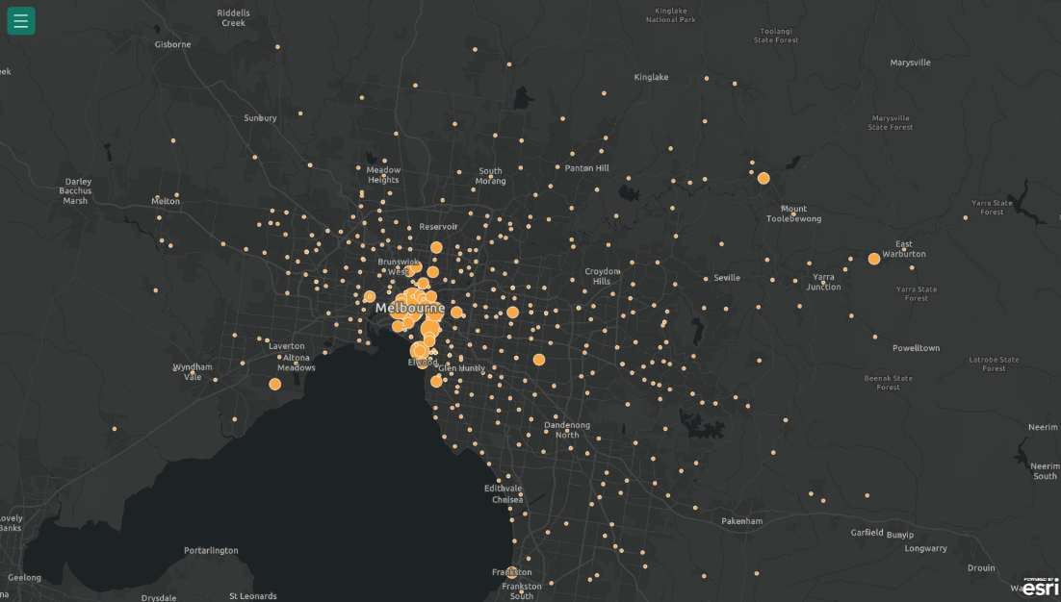
2
Reports
Geographical Distribution
Melbourne, Australia is the favorite place when it comes to listings

Slide 5
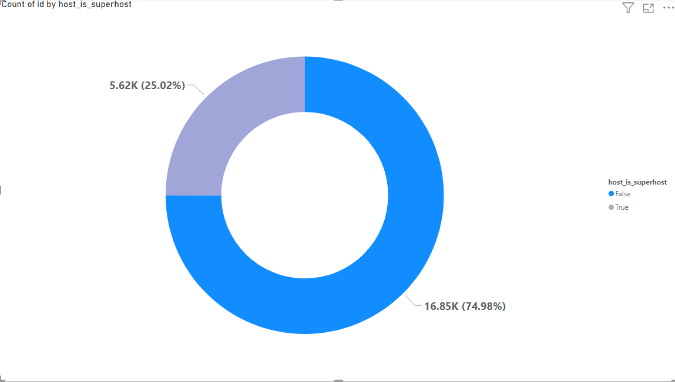
2
Reports
How many super and regular host?
About 25% of the hosts are Superhosts

Slide 6
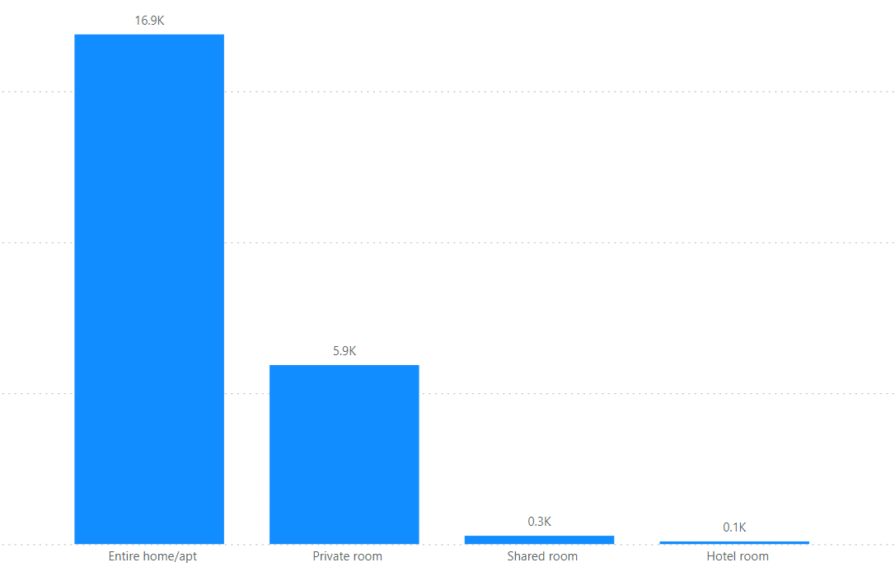
2
Reports
What is the distribution of rooms across room types?
This is the distribution of rooms across room type. The entire home is the most frequent type.

Slide 7
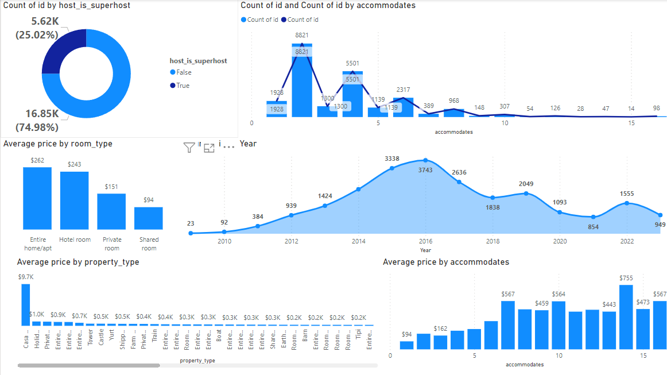
3
Dashboard

Slide 8
4
Summary
There are many factors that affect customers like availability and amenities and quick respond to the request made. Those are the factors we need to enhance if we want to optimize reservation processes.
Periods of high availability should have high prices to insure high revenue

Slide 9
Thanks

