Slide 1
Writing a CV/resume
Ensimag students – 2A

Slide 2
A CV... what for?
For a company to sort candidates
For you to stand out from the crowd to show your skills to obtain an interview

Slide 3
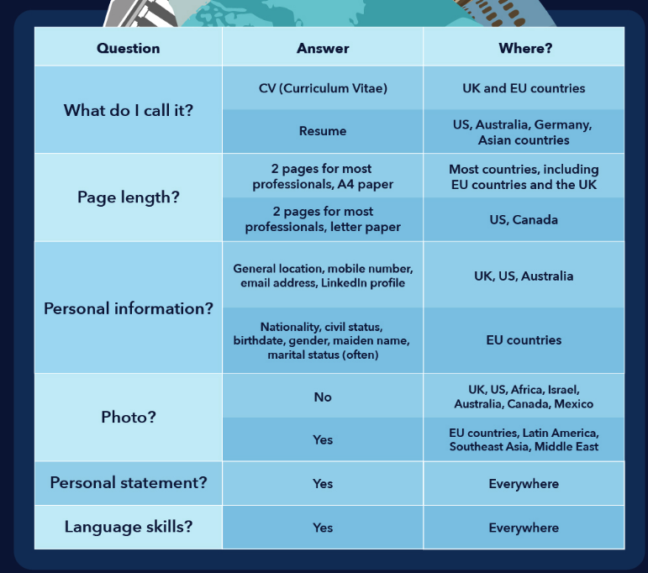

Slide 4
Going international
As a rule of thumb, it is wise to check what format is expected in the country you are applying for a position and tweak your CV accordingly. For example, a CV in the UK or a resume in the US are generally expected to be rather dry: in black and white or with only a limited touch of colour, limited liberty taken with the layout etc.
Please use a website such as https://www.visualcv.com/international/ to check what is expected.

Slide 5
Personal information
Your general location ex : Grenoble area, France (rather than your postal address)
Phone number & email address (not the bogossdu38@football.org one: keep it professional!)
A link to your LinkedIn profile
In the EU you may add your age, birth date or marital status, although in other countries this may be considered as potentially inappropriate as it gives employers an opportunity to discriminate between candidates on non-professional grounds
Your nationality may be given too if it is important for the employer for work visas or other administrative issues.

Slide 6
Photo
It's a don't! in most English-speaking countries, unless you are a model or an actor/actress. A photo can be cause for discrimination.
If you are applying in the EU, Southeast Asia, Latin America or the Middle East, a photo is generally expected, however.

Slide 7
Education
List your diplomas in chronological order, starting by the most recent.
Ensimag: Top French educational institution in Informatics, Applied Mathematics and Telecommunications
Grenoble INP Institute of Engineering and Management

Slide 8
CPGE: Pre-engineering: preparation in math/maths and physics for the competitive entrance exams to French “Grandes Ecoles”
DUT: 2-year technical degree
Bachelor’s degree: Licence (BA: Bachelor of Arts / BS: Bachelor of Science)
Baccalauréat/French Baccalaureate (French high/secondary school diploma) passed with honors/distinction
Majors in: Math, Science and French (US) Main Subjects: Maths, Science, French (UK)

Slide 9
Final grades
For an application in the UK, it is important to translate your grades into the British grading system. You can find online tables to help you with the translation.
Do the same if you are applying in the US (GPA = Grade Point Average) : https://www.scholaro.com/gpa-calculator/
As for distinctions, use the following :
Mention très bien : (awarded) with highest honour(s) / summa cum laude
Mention bien : (awarded ) with high honours / magna cum laude / with distinction
Mention assez bien : (awarded ) with honours / cum laude / with distinction
Mention passable : with standard pass (mark)

Slide 10
Professional experience
List all your work experience, internships and volunteer work in chronological order, starting by the most recent.
When / Your position / Company’s name / Where
Is it? An internship, volunteering, a summer job, a student union position, a student job, temping (intérim)… ?
How long? Full time / part-time, give dates or numbers of weeks, months or years…

Slide 11
Be concise: use active verbs and omit the subject (we know it's you).
Use the past tenses for past activities and present tenses for present ones.
Try and use metrics (figures) when you can.
Ex : Led a 5-person team
Raised £2000 to fund the festival
Welcomed the public (>250 people each evening)

Slide 12
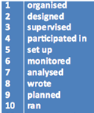
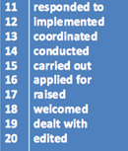
Use action verbs!
Avoid using the following verbs and faux amis : established, gathered, installed, conceived, animated, elaborated...

Slide 13
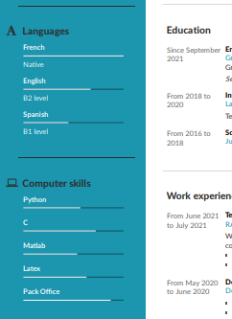
Skills
Languages (give the score in case you have a certification, or B1/B2/C1 or « beginner, intermediate or advanced, expert »)
Computing
Other skills that might be interesting for the job you are applying for

Slide 14
Interests and extra-curricular activities
Important for a student ➢ stand out from the crowd ➢ breaks the ice at the beginning of an interview
Avoid – “skiing, travel, reading”
Instead try the following: •Photography: take and develop my own black and white photographs •Fly fishing: design and tie my own flies •Music: accomplished clarinetist •Music: play the piano in an amateur jazz band •Travel: have travelled extensively in Scandinavia

Slide 15
Sports: •Jogging, participate in several local competitions •Ranked player in regional tennis association •Member of the university ski team •Archery instructor at children’s summer camps
Students activities: • President of the Student Activites Board • Elected representative to Council on European Exchange • Led a student committee to establish contacts between university and local industry • Organized social and athletic events for student population of over 400 Do not mention activities indicating political or religious preferences.

Slide 16
References
In the American CV, it is important to include references.
In the British CV, however, references are listed only if explicitly requested in the job description. Otherwise, it is sufficient to mention that references can be provided on request.

Slide 17
Personal statement
Most countries expect the inclusion of a personal statement on a CV. This is a short paragraph (3-4 sentences) at the head of the first page that gives an employer a summary of your career accomplishments and objectives. >> SELL YOURSELF!
It includes 3 elements:
- who you are
- what you can offer
- your career goals
Strong administrative and organisational skills / Experienced in problem-solving / Excellent communication and IT skills / I have gained relevant experience in… / My career goal is to…
> Check LinkedIn profiles for more examples

Slide 18
Adjectives to describe yourself
Adaptable, reliable, methodical, determined, conscientious, proactive, meticulous, organised, open-minded, outgoing, sociable, smiley, demanding, rigourous, dynamic, enthusiastic, a team-worker, versatile (polyvalent), entrepreneurial, computer literate, good with numbers, have deductive and analysis skills (esprit de synthèse), perfectionist, cool-headed, curious, efficient, productive, creative, a quick learner, flexible…

Slide 19
Common mistakes
My prepatory classes = intensive two-year undergraduate course ( in economics, maths and business) to prepare for competitive entry examinations to business schools.
I am a master’s student = I am studying for a Masters degree in Physics, specialised in xxx
Experience not experiences
Stakeholders not actors
Initiatives/projects not actions
MS Office (suite) not pack

Slide 20
Student association, organisation, club or society
Erasmus = academic year abroad
Animated = chaired, ran, organised
Crée = set up/created/developed (is less common)
Structure = organisation/business/firm/company/lab...
Skills is better than knowledge
Prefer provide to give (it provided me with)
My studies = my degree/to graduate (during my degree/ I graduated from)

Slide 21
Perspectives = prospects
Enable (rendre capable) vs allow (avoir l’autorisation)
Accompagner = support
Me, I
Volonté = I am keen to work/I am eager to
Volonté = I wish to / I have a desire to (I am willing to is not strong enough)

Slide 22
One last thing:
Make sure your CV
Is adapted to the job offer
Is clear and easy to read
Has no spelling/grammar mistakes
Going further: What is an ATS (Applicant Tracking System)-friendly resume and how to write one?
What many job seekers don't realize is that 75 percent of job applications are rejected before they are seen by human eyes. Before your resume reaches the hands of a live person, it often must pass muster with what is known as an applicant tracking system.
https://www.topresume.com/career-advice/what-is-an-ats-resume

Slide 23
LinkedIn
It is important for you to create a LinkedIn account. You will gain more traction if you are part of a network. By being an insider you will multiply your professional opportunities. An outsider only gets to see the jobs which have not been filed in by an insider : https://tinyurl.com/86w3zncn

Slide 24
Adjectives to describe people or your professional environment
Thought-provoking, intellectually-stimulating, rewarding, professionally-oriented, varied, challenging, bilingual, multilingual, interesting, motivating, enjoyable, innovative…

