Slide 1

AI-Driven Vision Robot for Automated Product Handling
Final Year Project
BATCH-3 TEAM MEMBERS:
UNDER THE GUIDANCE OF:
K. Jyothi (23331A0483)
Md. Azmath Ali (23331A04B0)
N. Naveen (23331A04B8)
K. Ganapathi Naidu (23331A0486)
Dr. T.A.N. Surya Narayana Varma
M.Tech., Ph.D.
Professor,
Department of Electronics and Communication Engineering(A)

Slide 2
Project Abstract
The AI-Driven Autonomous Vision Robot for Product Handling is a smart robotic system designed to automate product collection and billing.
Customers select the required products and quantities through the web application, and the order is sent to the robot.
The selected product information is transmitted to the ESP32-based robot, which uses IR sensors to follow the predefined path and reach the corresponding product location.
The robot uses a camera, computer vision, and a pick-and-place mechanism to locate, identify, and collect the required products into a shopping basket.
The robot repeats this process for all selected products and then returns to the starting position. The completed order is synchronized with the web application, which calculates the total cost and generates a digital bill.

Slide 3

Primary Aim
End-to-End Automation: Design an AI-driven robot capable of receiving a digital shopping list.
Autonomous Navigation: Enable the robot to follow a predefined path and reach the designated product locations within the store.
Vision-Based Verification: Utilize computer vision algorithms to accurately identify products.
Physical Movement: Autonomously pick up the verified objects and place them into a shopping basket.

Slide 4





Objectives: Digital Interface
Web App
Database
Communication
Develop an interactive interface for users to intuitively select products and desired quantities.
Maintain and securely store selected shopping information and product locations using a backend database.
Establish seamless, real-time wireless communication between the web application and the mobile robot.

Slide 5



Objectives: Robotics Core
Navigation
Computer Vision
Pick & Place
Enable the robot to maneuver autonomously and safely through a predefined supermarket path grid.
Deploy an onboard camera system to visually identify and verify the target product before interaction.
Engineer a dependable autonomous robotic manipulation mechanism for collecting products.

Slide 6

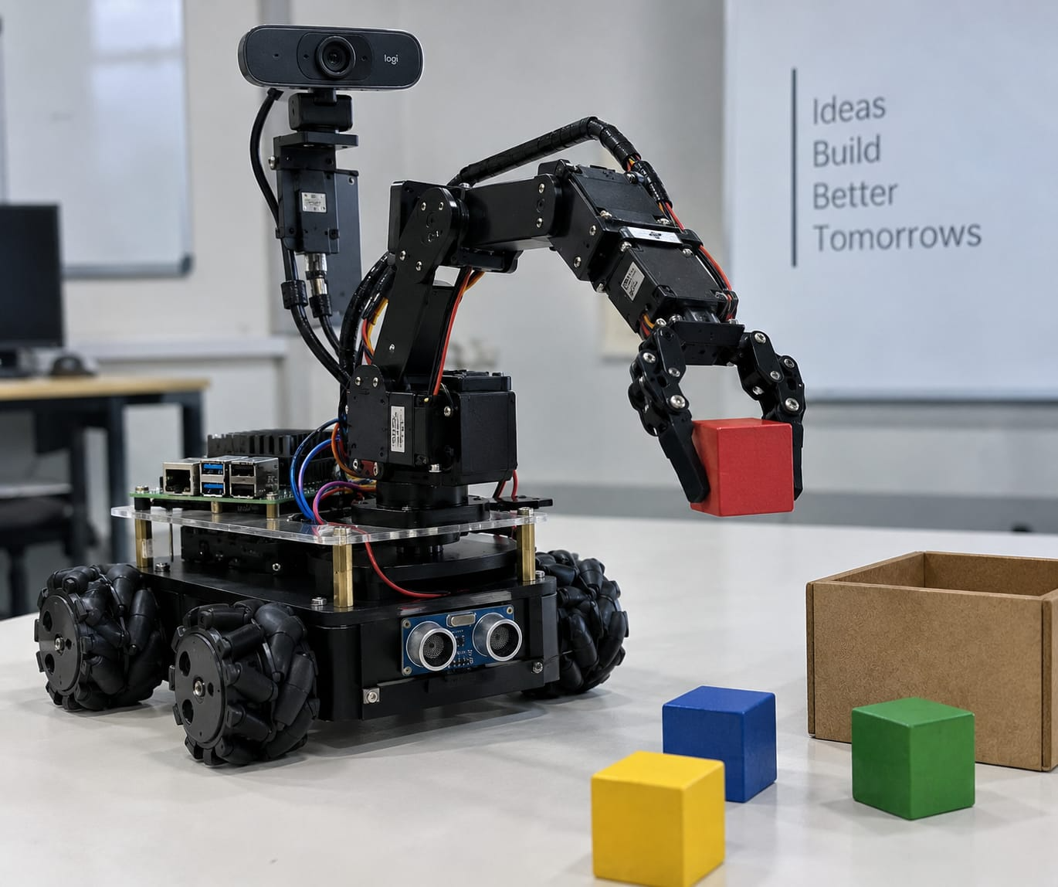
Introduction
Smart Retail Automation
AI, computer vision, IoT, and robotics are creating new
opportunities to automate conventional supermarket activities.
Problem with Traditional Shopping
Customers must manually search for products, walk through aisles,
collect items, carry the basket, and complete billing.
Proposed Solution
Our project introduces an autonomous vision-based robot
integrated with an interactive web-based shopping system.
Intelligent Operation
The robot receives the customer’s order, navigates to product
locations, identifies products using a camera and computer vision,
and performs pick-and-place operations.

Slide 7
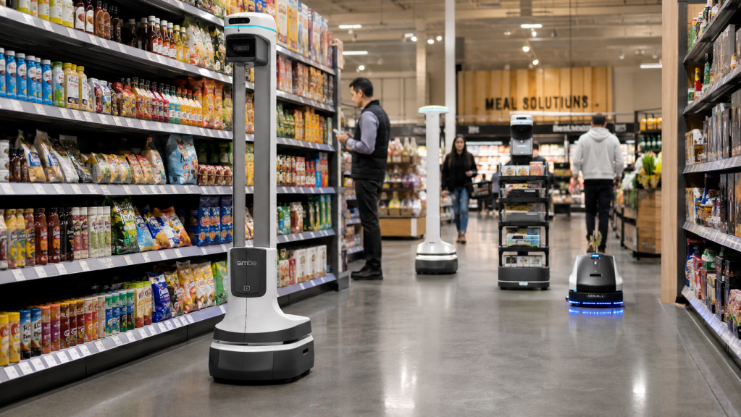
The Motivation
Reduce Manual Effort
Automate product searching and collection to reduce the physical effort required from customers.
Save Time
Minimize the time spent walking through aisles, locating products, and collecting multiple items.
Integrate Digital & Physical Systems
Connect online product selection with real-world robotic operations through wireless communication.
Integrate IoT + Embedded Systems + Robotics + Web Tech.

Slide 8
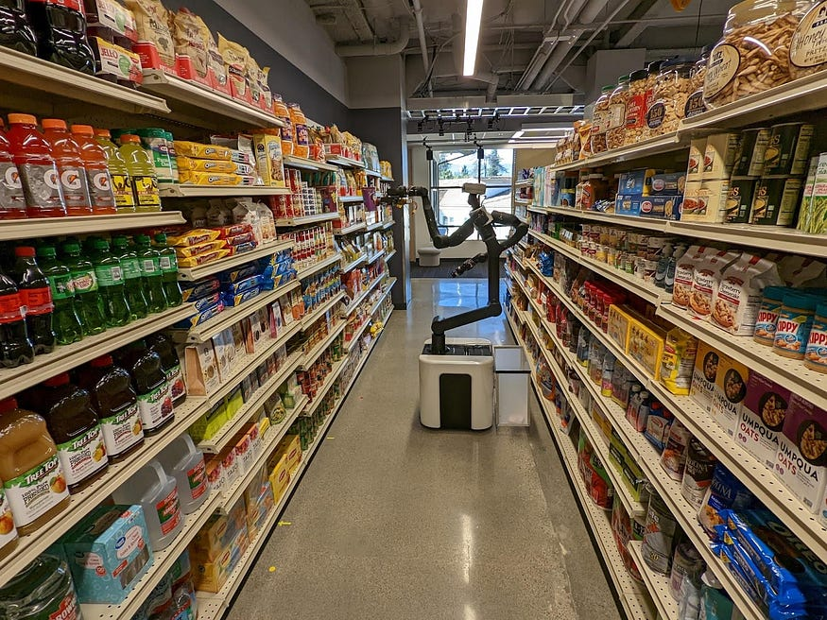
The Proposed Solution
An Autonomous System
We introduce an AI-driven robotic system designed to fully automate the process of product handling.
Develop an AI-enabled vision-based mobile robot capable of identifying required objects in its surroundings.
Use a camera and AI-based object recognition to detect and locate the target object.
Process visual information to control robot movement and reach the identified object.
Use a robotic arm to pick the object and place it at the desired location, integrating vision, navigation, and robotic control.

Slide 9


System Architecture
The Customer Layer
The Robot Layer
Interactive Website: Handles product and quantity selection directly from the user.
Robot Controller (ESP32/MCU): The brain of the physical unit.
Backend / Database: Processes the order, logs product data, coordinates inventory locations, and manages the wireless transmission to the robot.
Subsystems: Coordinates Path Planning, Obstacle Detection, Camera/Vision processing, and controls the Pick & Place mechanism based on backend instructions.

Slide 10
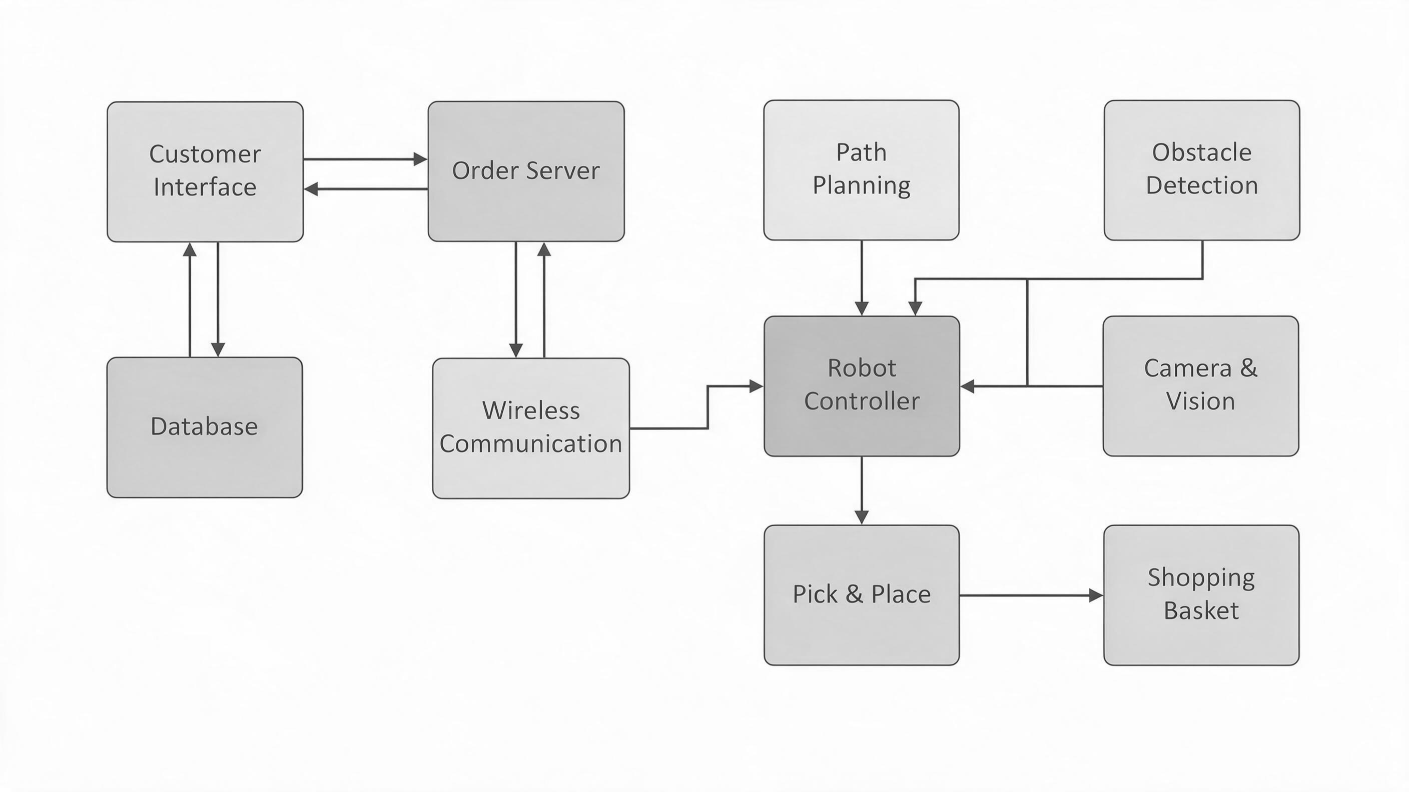
Block Diagram

Slide 11
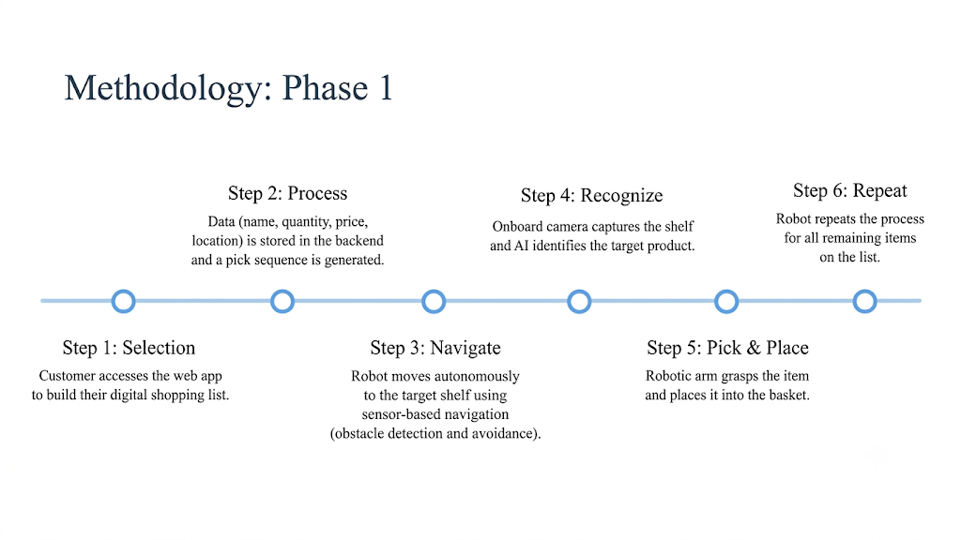
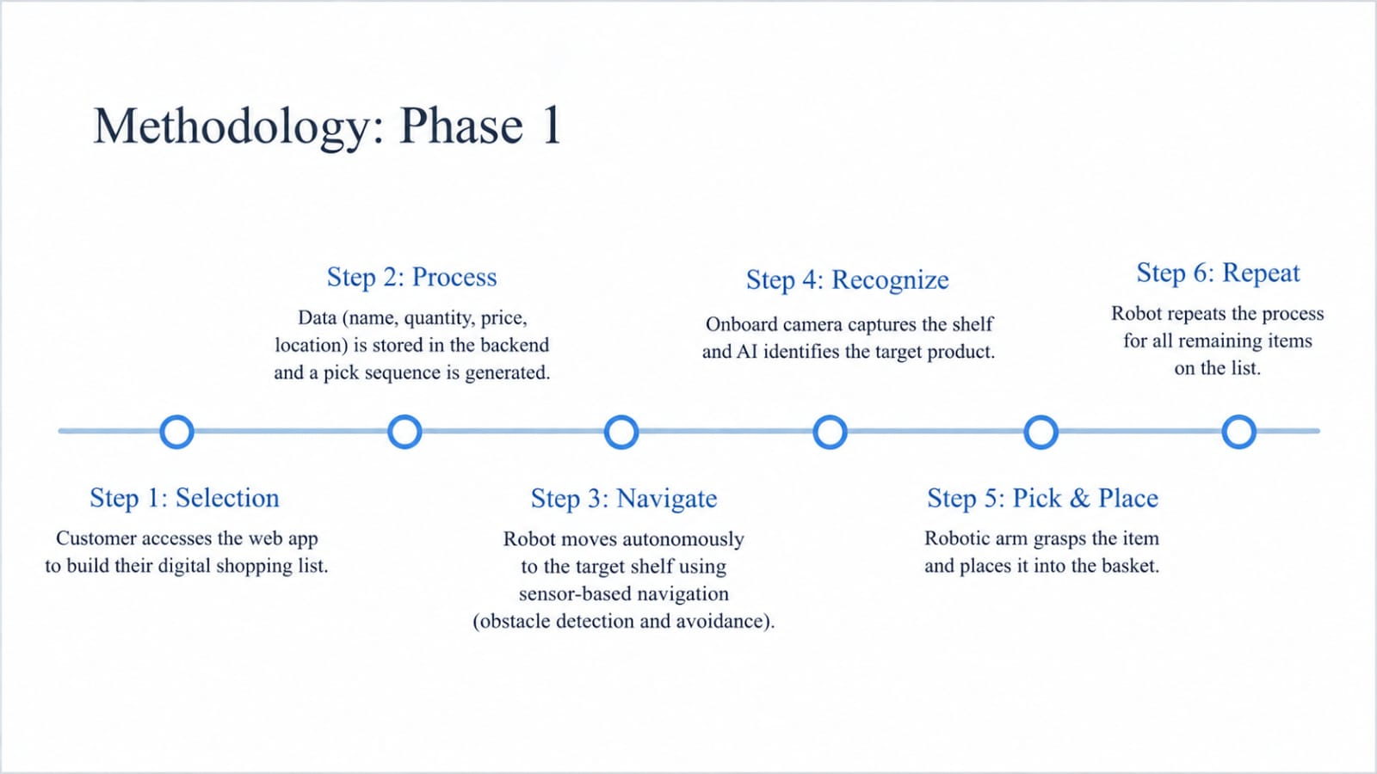




Methodology: Phase 1
Step 2: Storage
Step 4: Navigate
Data (name, quantity, price, location) is securely logged in the backend.
Robot initiates movement to the first predefined product location.
Step 1: Selection
Step 3: Transmit
Customer accesses the web app to build their digital shopping list.
Order is sent wirelessly to the robot to calculate sequence.

Slide 12
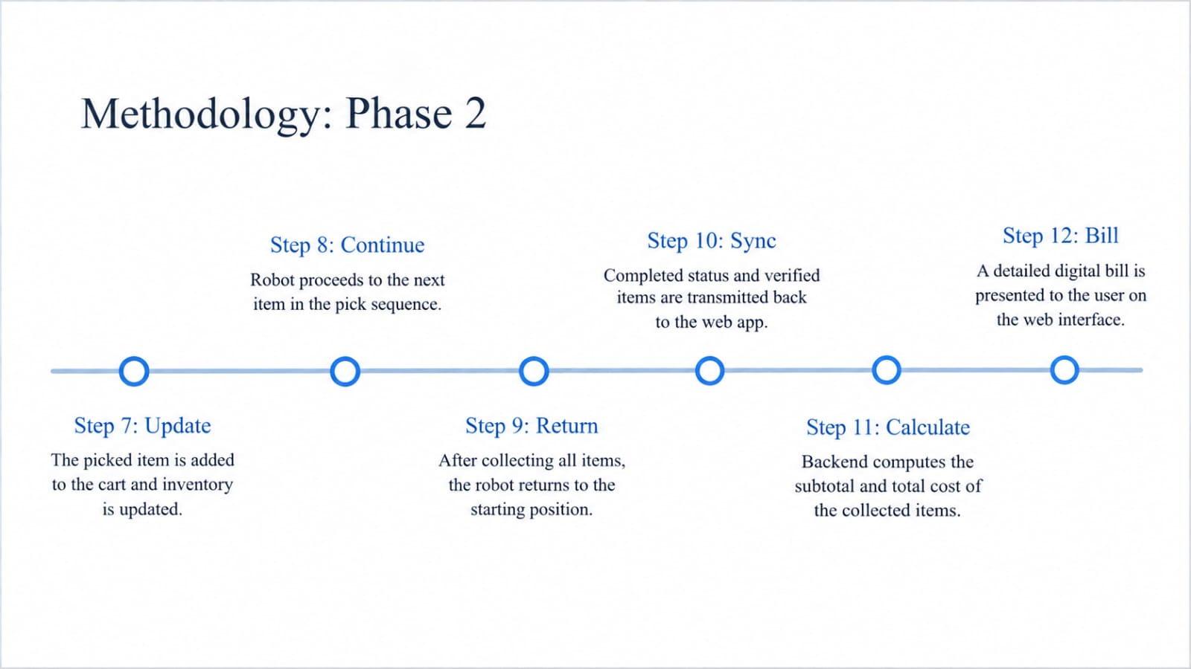
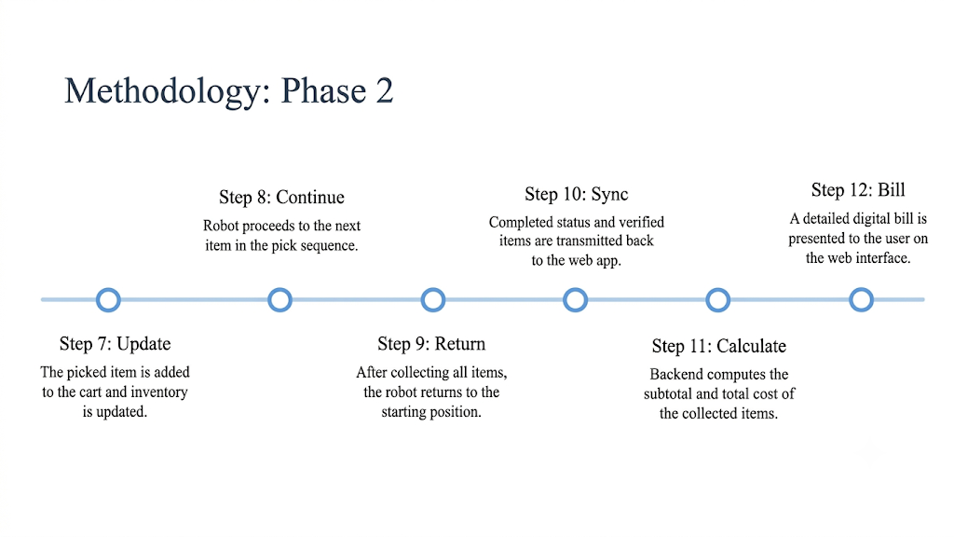


Methodology: Phase 2
Step 6: Verify
Step 8: Repeat
AI algorithms confirm the correct target product has been located.
Robot loops this process for all remaining items on the list.
Step 5: Detect
Step 7: Pick & Place
Onboard camera captures the shelf and applies computer vision.
Robotic mechanism grasps the item and deposits it into the basket.

Slide 13


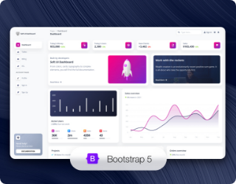

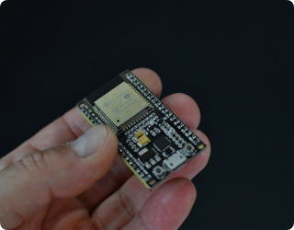
Software & Tech Stack
Frontend & Web
AI & Processing
Embedded Systems
HTML, CSS, JavaScript for the
UI, and Flask framework for the backend application logic.
Python acts as the core, utilizing OpenCV and NumPy for sophisticated image and vision processing.
C/C++ programmed via Arduino IDE for ESP32/MCU motor control, sensor data, and navigation.

Slide 14
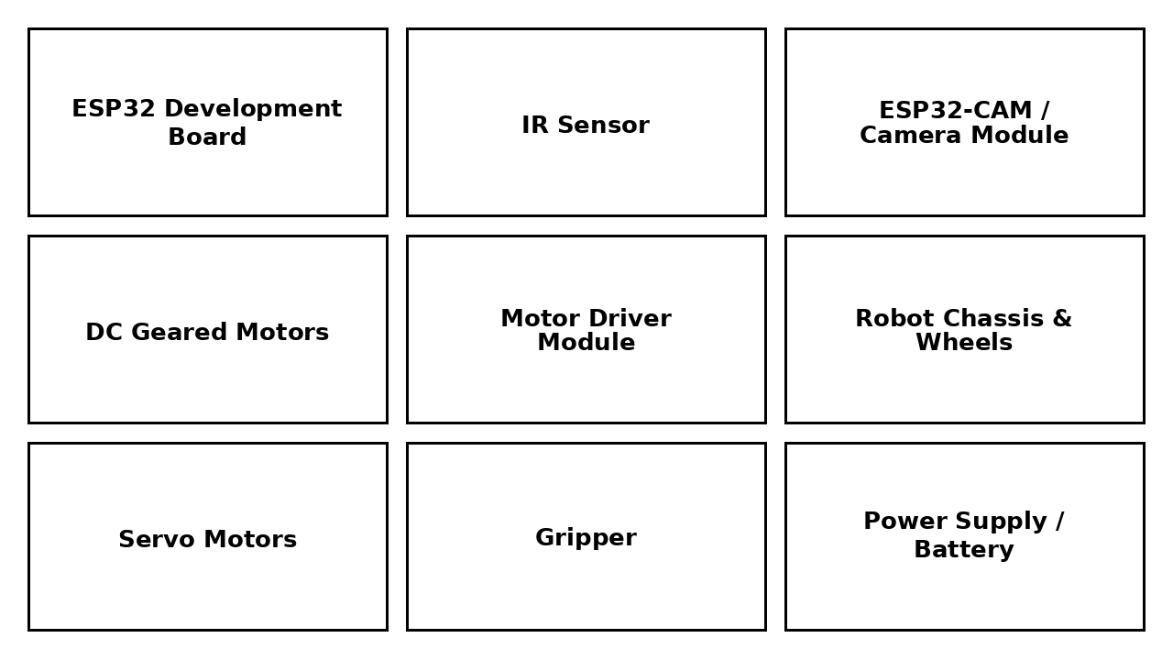
Hardware Requirements

Slide 15

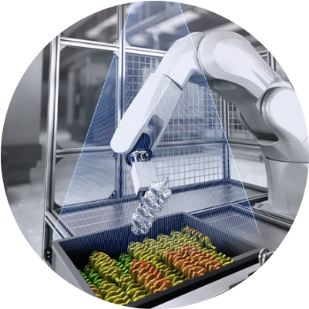
Real-World Applications
Beyond Supermarkets
While designed for smart retail stores to assist shoppers, the core mechanics of this project are highly adaptable.
Warehousing: Automated inventory handling and fulfillment operations.
Healthcare: Autonomous robots for collecting and transporting pharmaceuticals in hospitals.
Industrial: Vision-based material handling in controlled manufacturing setups.

Slide 16

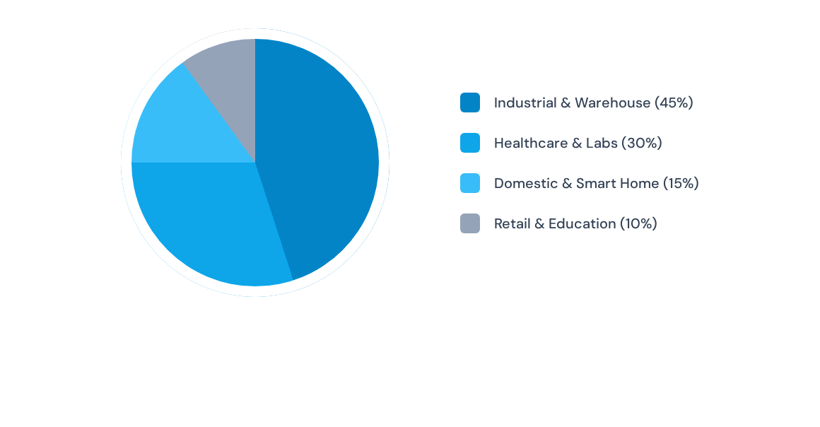

Application Domain Distribution

Slide 17
References
[1] “Development of an Intelligent Autonomous Rover with Distributed Sensors for Speed Control and Obstacle Avoidance,”
IEEE ICPEEV, 2025. IEEE Xplore⁠
[2] “Vision-Based Object Sorting in Dynamic Environments using YOLO for RoboCup ARM Challenge 2023,” IEEE CICT,
2023. IEEE Xplore⁠
[3] G. De Simone, P. Foggia, A. Saggese, and M. Vento, “Autonomous Mobile Robot for Automatic Out-of-Stock Detection
in a Supermarket,” IEEE/CVF ICCV Workshops, 2023. IEEE/CVF Open Access⁠.
[4] “Deep Learning Based Autonomous Robotic Grasping and Sorting System for Industry 4.0,” 2024 International
Conference on Robotics and Automation in Industry (ICRAI), 2024.
[5] Reference from YouTube: https://youtu.be/KeyEe2Tt25Q?si=veBqklgdOQOgzv4R

Slide 18



