Slide 1

AI-Driven Vision Robot for Product Handling in Dark Stores
Final Year Project
BATCH-3 TEAM MEMBERS:
UNDER THE GUIDANCE OF:
K. Jyothi (23331A0483)
Md. Azmath Ali (23331A04B0)
N. Naveen (23331A04B8)
K. Ganapathi Naidu (23331A0486)
Dr. T.A.N. Surya Narayana Varma
M.Tech., Ph.D.
Professor,
Department of Electronics and Communication Engineering(A)

Slide 2
Project Abstract
The AI-Driven Vision Robot for Product Handling in Dark Stores is a smart robotic system designed to automate product collection and billing.
Customers select the required products and quantities through the web application, and the order is sent to the robot.
The selected product information is transmitted to the ESP32-based robot, which uses IR sensors to follow the predefined path and reach the corresponding product location.
The robot uses a camera, computer vision, and a pick-and-place mechanism to locate, identify, and collect the required products into a shopping basket.
The robot repeats this process for all selected products and then returns to the starting position. The completed order is synchronized with the web application, which calculates the total cost and generates a digital bill.

Slide 3
Aim & Objectives
To develop an AI-driven autonomous shopping robot that receives a digital shopping list and autonomously navigates to product locations, identifies target products, and collects them into a basket.
Digital Interface: Provide a web application to select products and quantities, maintain shopping data in a database, and communicate wirelessly with the robot.
Autonomous Navigation: Enable the robot to follow a predefined store path and reach designated product locations safely.
Computer Vision: Use an onboard camera and computer vision to identify and verify the required products.
Pick & Place: Implement an autonomous mechanism to handle and place verified products into the shopping basket.
End-to-End Automation: Integrate the web interface, database, communication, navigation, vision, and product collection into one complete system.

Slide 4
Paper -1
Title: An Enhanced PID-Based Motion Control Framework for Line-Following Robot
Authors: Girish Chandrappa, Riga Technical University
DOI: 10.30574/wjarr.2025.26.3.2275
Work Done:
Developed an autonomous robot using ESP32, TCRT5000 IR sensors, L298N motor driver, and two DC motors. The IR sensors detect the predefined line/path, while the ESP32 processes the sensor data and controls the motors through the L298N driver. A PID controller is used to adjust motor speeds for smoother movement and turning. The paper also presents the physical robot platform and its sensor/motor-driver configuration.
Results:
The robot achieved stable line tracking and smoother motion, particularly during turns and sudden changes in direction, through PID-based motor-speed correction.
Limitations:
The system mainly focuses on line-following and motion control. It does not address location-specific stopping, product identification, or product handling. This creates scope for extending the predefined-path robot toward automated dark-store product transportation and handling.
Reference:
An Enhanced PID-Based Motion Control Framework for Autonomous Line-Following Robot, 2026.

Slide 5
Paper -2
Title: Robot Edukasi Object Detection Dengan Platform Edge Impulse
Authors: Tekom University researchers
Work Done:
Developed an AI-enabled robot using ESP32-CAM for vision/object detection and ESP32 as the main controller. The object-detection model was trained using Edge Impulse with the FOMO architecture and deployed directly on the embedded hardware.
Results:
The trained model achieved 99.8% training accuracy with a compact model size of 82.3 KB. The robot achieved 100% detection success under optimal lighting, while performance decreased to 80% under less favorable lighting conditions.
Limitations:
The system demonstrates embedded object detection but is not specifically designed for dark-store product recognition and autonomous product searching. It does not integrate product-location information, predefined robot paths, or product-specific handling.
Reference:
Robot Edukasi Object Detection Dengan Platform Edge Impulse, eProceedings of Engineering, Telkom University.

Slide 6
Paper -3
Title: ESP32-S3 Object Identification using Edge Impulse
Platform: XIAO ESP32-S3 + OV2640 Camera + Edge Impulse
Work Done:
Developed an embedded object-identification system using the ESP32-S3 camera platform. Images of different objects such as apple, banana, broccoli, and chilli were used to train an Edge Impulse model. The trained model was deployed on the ESP32-S3 to perform local image-based object recognition.
Results:
The ESP32-S3 successfully captured images and performed on-device predictions for the trained object classes, demonstrating that object recognition can be performed directly on a compact microcontroller-camera platform without requiring continuous cloud processing.
Limitations:
The implementation focuses on object identification as a standalone embedded-vision application. It does not integrate the recognition system with an autonomous mobile robot, predefined-path navigation, product-location searching, or dark-store product handling.
Reference: Tiny Prism Labs, “ESP32-S3 Object Identification using Edge Impulse,” GitHub.
Technical reference: XIAO ESP32-S3 + Edge Impulse Object Identification.

Slide 7
Paper -4
Title: Design and Implementation of a Low-Cost IoT-Based Robotic Arm for Product Feeding and Sorting in Manufacturing Lines
Authors: Serdar Yilmaz, Canan Akay, Feyzi Kaysi
Journal: Electronics, 2025, 14, 4801. DOI: 10.3390/electronics14244801
Work Done:
Developed a low-cost automated product handling system using an ESP32 controller, servo motors, a 4-DOF mechanism and a parallel-jaw gripper. The system identifies products and automatically picks them from a conveyor and places them at predefined destinations. The ESP32 controls the sensing, decision-making and servo actuation.
Results:
The system successfully performed automated product feeding and sorting. Experimental testing reported an average 4.8 ± 0.3 s cycle time, 98.7% product-identification accuracy, and approximately ±1.2° servo positioning error.
Limitations:
The system relies on RFID-based product identification and predefined conveyor locations. It does not perform camera/AI-based product recognition followed by autonomous searching and picking in a dark-store environment. This provides scope for integrating Edge Impulse-based vision recognition with mobile path navigation and automated product handling.

Slide 8
Paper -5
Title: Design, Development, and Experimental Validation of an Autonomous Material Handling Robot for Warehouse Automation
Authors: Chetan Zaware, Ramesh Gadakh, Pradeep Patil, Mayur Gitay, Javed Shaikh, Amol Ghule
Work Done:
Developed an autonomous warehouse robot integrating camera-based object detection, autonomous navigation, sensor fusion, and intelligent item handling. The system uses cameras, LiDAR and IMU sensors, with YOLOv5 for object detection and a Deep Q Network for navigation. An ESP32 is used in the hardware control layer.
Results:
Physical validation achieved 94.2% navigation success, 94.7% object-detection mAP, 97.8% correct- item-picking accuracy, and 87.3% robot utilization.
Limitations:
The system uses a relatively complex architecture involving LiDAR, ROS, Jetson Xavier NX, YOLOv5, SLAM and reinforcement learning. It does not specifically address lightweight ESP32-S3-based product recognition, predefined-path navigation, or a compact servo-driven product handling mechanism for dark-store applications. This creates scope for developing a simpler, low-cost integrated solution.
Reference: C. Zaware et al., “Design, Development, and Experimental Validation of an Autonomous Material Handling Robot for Warehouse Automation,” Aposta: Revista de Ciencias Sociales, vol. 24, no. 114, e1008, 2026.

Slide 9
Paper -6
Title: Vision-Based Mobile Handling for Dark Store Products
Year: 2022. DOI: 10.1155/2022/3883845
Journal: Mathematical Problems in Engineering.
Authors: M. Z. U. Rahman, M. Usman, A. Farea, N. Ahmad, I. Mahmood, M. Imran (2022)
Work Done:
Developed a mobile handling system using a 4-wheeled differential-drive platform, line-following navigation, barcode recognition (for section localization), and SIFT-based camera vision. A 5-DOF robotic arm picks the identified product and places it at the target location.
Results:
The prototype successfully validated line navigation, barcode section mapping, visual object detection, and 5-DOF pick-and-place actions. The study includes kinematic analysis (forward/inverse) and torque calculations.
Limitations:
The system uses a Raspberry Pi with traditional SIFT detection and barcodes. It lacks a lightweight edge AI setup (like ESP32-S3 + Edge Impulse) and does not integrate real-time customer orders with autonomous dark-store searching.
Citation: M. Z. U. Rahman et al., “Vision-Based Mobile Manipulator for Handling and Transportation of Supermarket Products,” Mathematical Problems in Engineering, 2022, Art. 3883845.

Slide 10
Paper -7
Title: Enhanced Force Estimation and Autonomous Force Tuning Through Fusion of Tactile Sensor and Quasi-Direct Drive Gripper
Published in: IEEE Sensors Journal, 2025
DOI: 10.1109/JSEN.2024.3504717
Work Done:
Developed a gripper system combining a tactile pressure sensor and gripper actuator to estimate grasping force and automatically adjust the gripping force. The system uses tactile feedback to determine whether sufficient force is being applied and to reduce the possibility of product slipping.
Results: The proposed sensor-fusion method improved force estimation and enabled automatic grip-force adjustment. A slip-detection and control mechanism successfully grasped and lifted different objects with more than 90% success rates.
Limitations:
The system uses a sophisticated tactile sensing and quasi-direct-drive setup. It does not specifically address a low-cost ESP32-controlled servo gripper for dark-store product handling. Your work can investigate a simpler force/contact-feedback mechanism suitable for embedded implementation.
Reference: Enhanced Force Estimation and Autonomous Force Tuning Through Fusion of Tactile Sensor and Quasi-Direct Drive Gripper, IEEE Sensors Journal, 2025, DOI: 10.1109/JSEN.2024.3504717.
IEEE Xplore — Full Paper

Slide 11
Paper -8
Title: Deep Learning LSTM-Based Slip Detection for Robotic Grasping
Conference: IEEE IECON 2023
DOI: 10.1109/IECON51785.2023.10311615
Work Done:
Developed a tactile-feedback-based system for detecting object slipping during robotic grasping. Tactile sensors were placed at the gripper fingertips and used to monitor the grasp during lifting.
Results:
The system successfully detected slipping and demonstrated that slip feedback can be used to improve grasp stability and prevent objects from being dropped.
Limitations:
The system relies on tactile imaging and deep-learning-based slip detection, which is more complex than required for your embedded robot. A simpler pressure/contact threshold with ESP32 feedback could provide a lightweight method for determining whether the product has been securely picked.
Reference: Deep Learning LSTM-Based Slip Detection for Robotic Grasping, 2023 IEEE 49th Annual Conference of the IEEE Industrial Electronics Society (IECON), DOI: 10.1109/IECON51785.2023.10311615.
IEEE Xplore — Deep Learning LSTM-Based Slip Detection

Slide 12
Research Gap
Existing studies mainly focus on individual components such as line following, object detection, or robotic handling.
Existing vision systems demonstrate object recognition on embedded platforms, but are not integrated with mobile robot navigation and product retrieval.
Product-handling systems often depend on RFID, fixed locations, or complex sensing mechanisms rather than lightweight vision-based identification.
Advanced warehouse robots use complex and costly architectures involving LiDAR, ROS, SLAM, and high-end computing platforms.
Limited work integrates customer orders, robot navigation, AI-based product verification, and automated handling into a single system.
Therefore, there is a need for a low-cost, lightweight, end-to-end vision-based robot for automated product handling in dark stores.

Slide 13
Proposed Solution
Digital Order Management:
A web application allows users to select required products and quantities, which are stored in the backend/database.
Wireless Order Transfer:
The selected order is transmitted to the ESP32-based robot for automated execution.
Autonomous Navigation:
The robot follows a predefined path using IR sensors and reaches the designated product locations.
AI-Based Product Verification:
An onboard camera and computer vision identify and verify the required product before handling.
Automated Product Handling:
A servo-driven pick-and-place mechanism collects the verified product and places it into the shopping basket.
End-to-End Automation:
The robot repeats the process for all selected products, returns to the starting point, and synchronizes the completed order with the web application for billing.

Slide 14
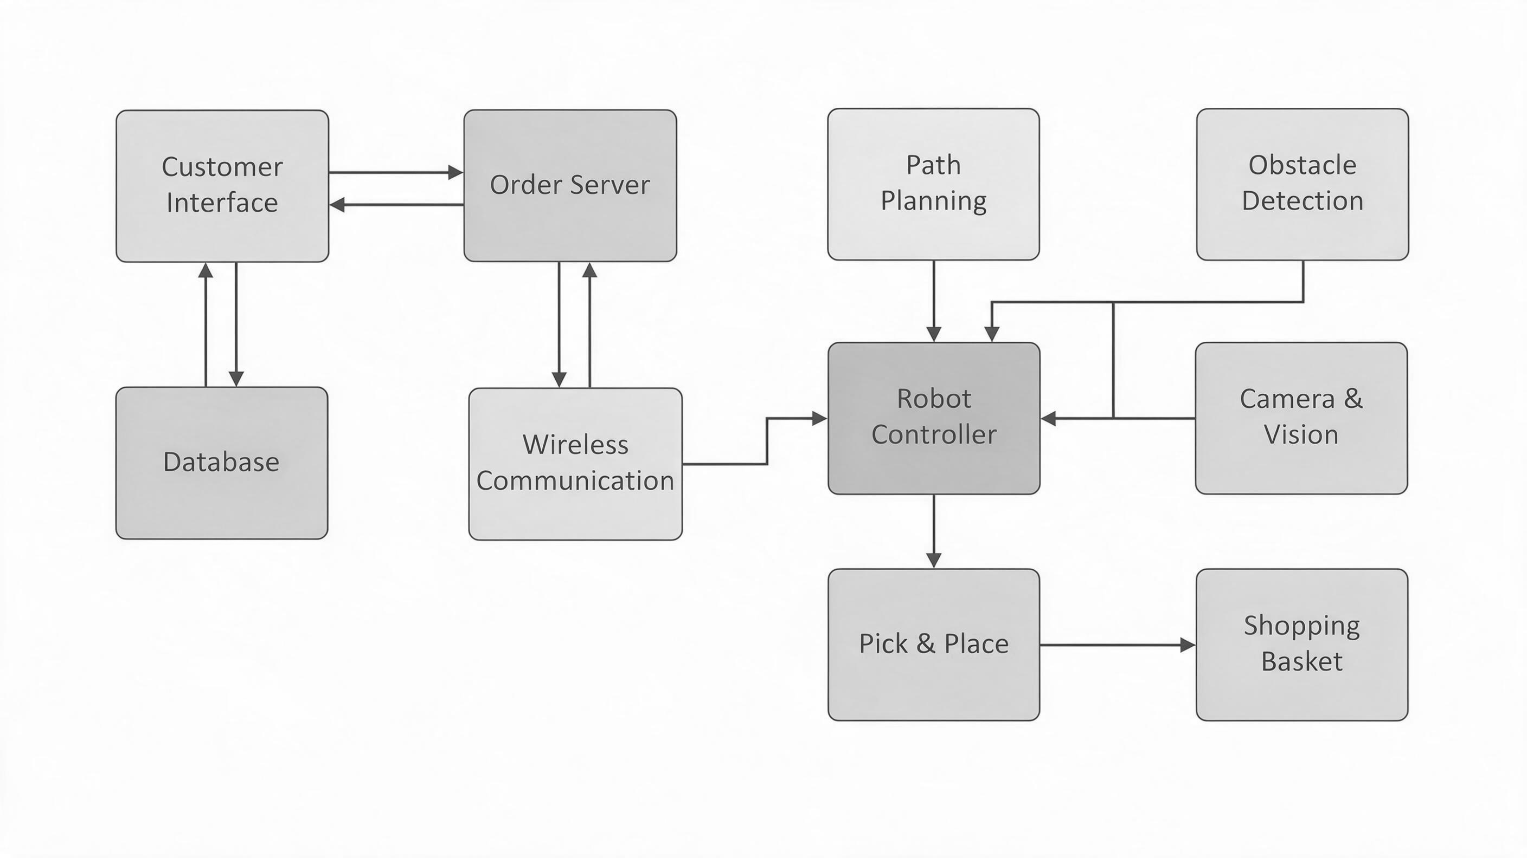
Block Diagram

Slide 15
Thank You!

