Slide 1


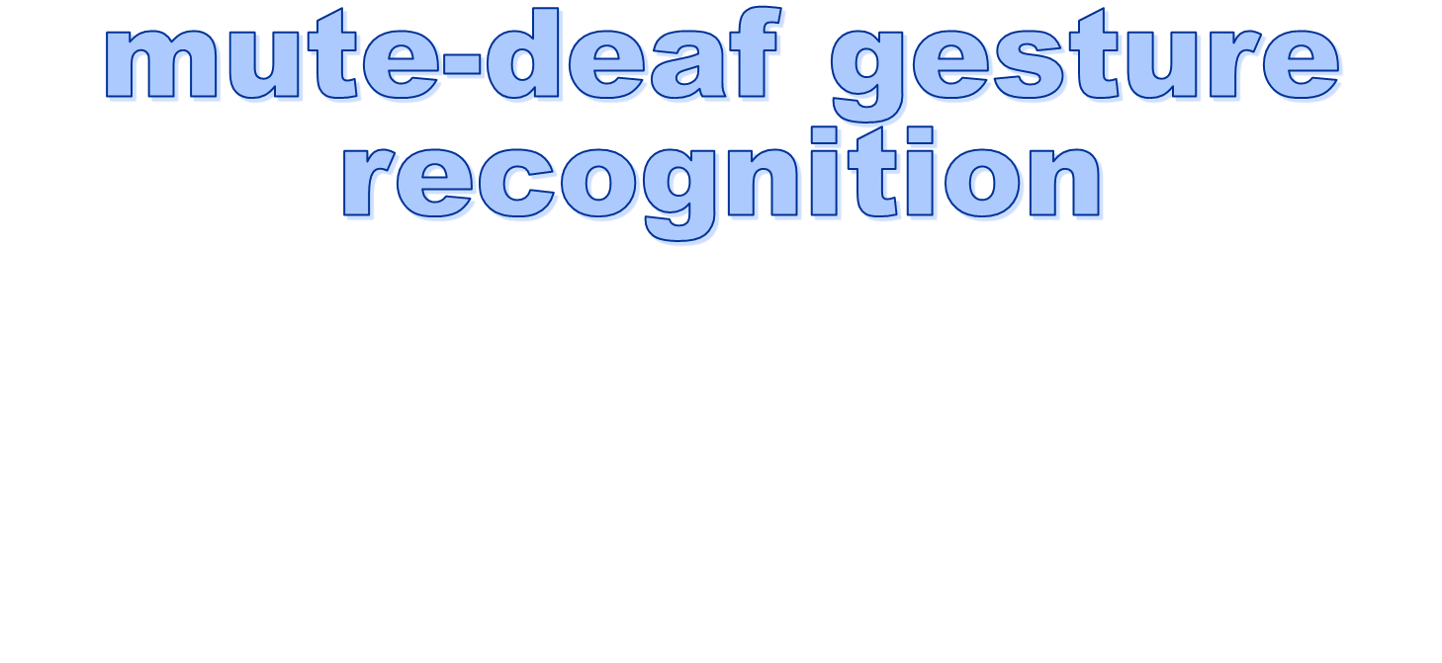

Slide 2
mute-deaf-gestures-recognition
Prof: Amr Badr
TA: Mohammed Elarnaoty
Members:
Mohamed Emad Eldein Mohamed Atta Faheem
Mahmoud Fekry Hassan Hazem Elshenawy
Mohamed Adnan Albukaai

Slide 3
Agenda
Introduction
Solution
Related work
Architecture
5. System components
A. Open CV
B. PCNN
C. Minimum distance classifier
D. machine learning
6. Result
7. Mobile Demo
8. Desktop Demo
9. Future work

Slide 4
Introduction
Mute-deaf person
Problem

Slide 5

Solution
Medical solution
Application
1. Desktop application
2. Mobile application

Slide 6
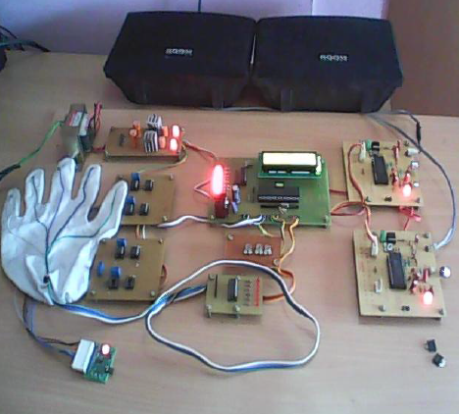
Related work
Sign Language Recognition using Sensor Gloves

Slide 7
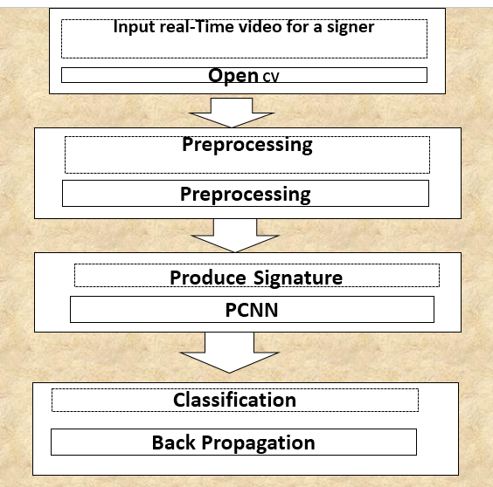
Architecture
.

Slide 8

Open CV
OpenCV (Open Source Computer Vision) is a library of programming functions mainly aimed at real-time computer vision.

Slide 9
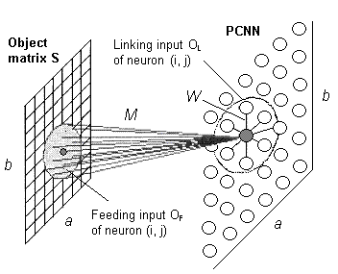
Pulse Coupled Neural Network
neural models proposed by modeling a cat’s visual cortex

Slide 10
Why we use PCNN?
PCNN Properties
Invariant to geometrical transformations
Fixed structure of neural network
Learning – free
Properties of Standard Neural Networks
Generated features are not invariant to geometrical transformations
Problem to set the optimal structure of NN and its parameters
High time consumption especially by gradient methods of learning

Slide 11
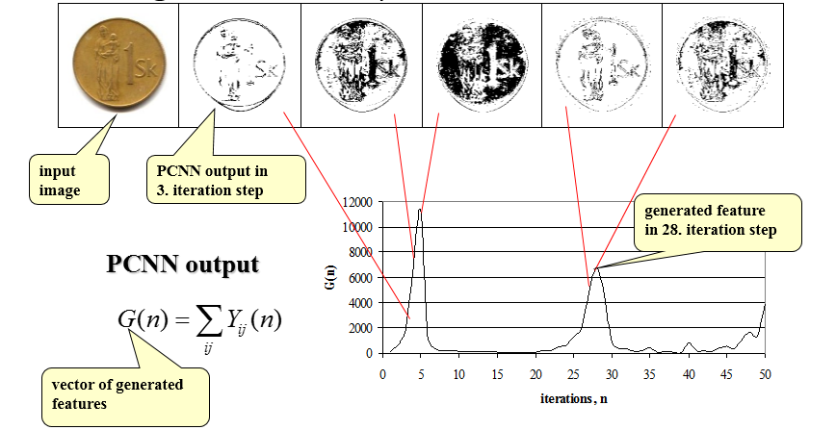
Feature generation by PCNN

Slide 12
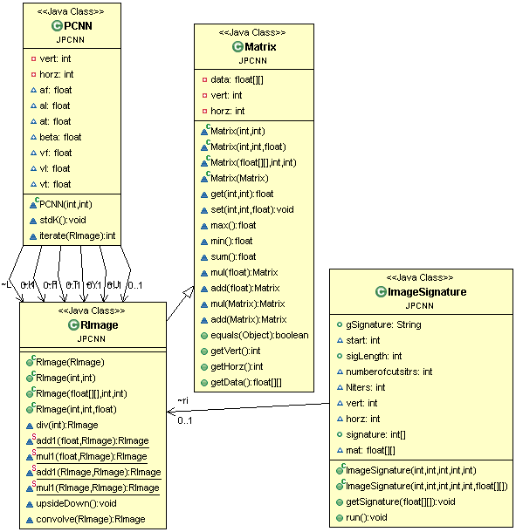
PCNN UML

Slide 13
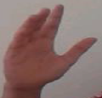
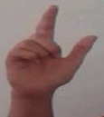
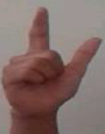
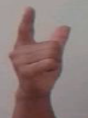

Signature of Gesture

Slide 14
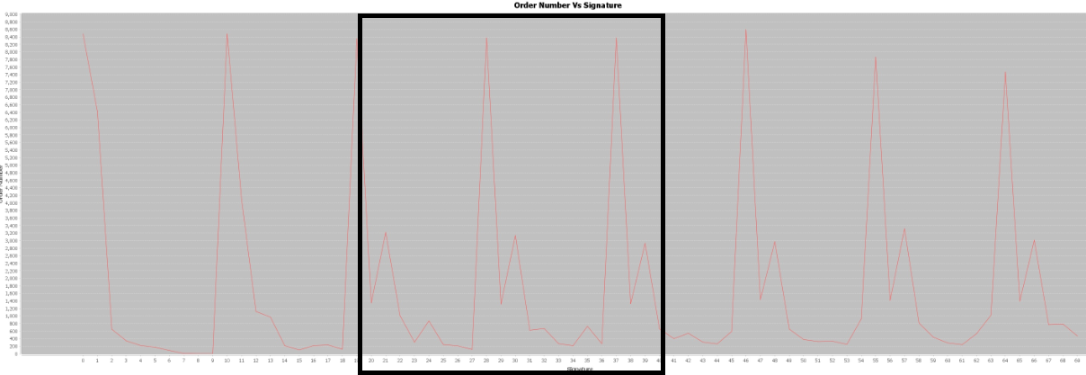
Signature length

Slide 15
Minimum distance classifier
•Training
–Separate training vectors by class
–Compute the mean for each class, μk, k = 1,… m
•Prediction
–Compute the closest mean to a test vector x’ (using Euclidean distance)
–Predict the corresponding class

Slide 16
Minimum distance classifier
•Training
–Separate training vectors by class
–Compute the mean for each class, μk, k = 1,… m
•Prediction
–Compute the closest mean to a test vector x’ (using Euclidean distance)
–Predict the corresponding class

Slide 17
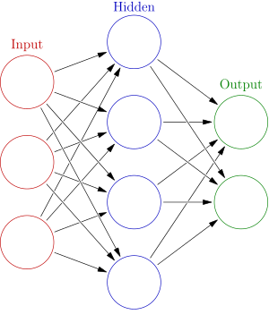
Neural Network
- Models of the brain and nervous system.
- The two fundamental components
1. Neurones (nodes)
2. Synapses (weights)
Back propagation
  Requires training set (input / output pairs)
  Starts with small random weights
  Error is used to adjust weights
  (supervised learning)

Slide 18
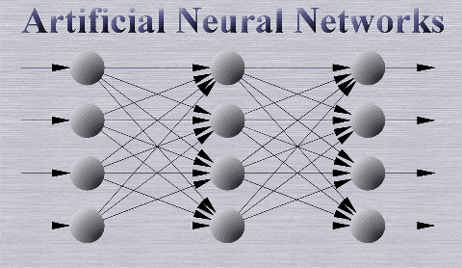
Algorithm

Slide 19
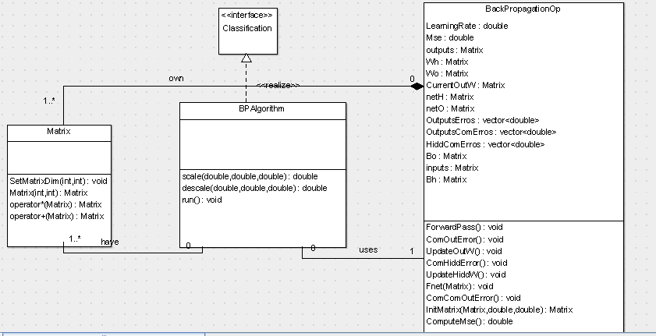
Back propagation UML

Slide 20
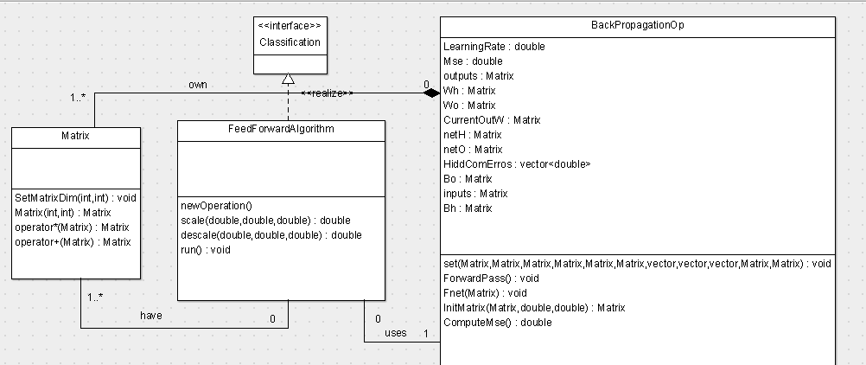
Feed Forward UML

Slide 21
Performance and accuracy
Performance
- The application take 4-5 seconds on pc to recognize one gesture on sequential way.
- The application take 1-2 second on pc to recognize one gesture with threading .
- The application take 10-13 second on mobile to recognize one gesture.
Accuracy
- The rate of correctness with the classifiers
1 - Minimum distance 80% -85%
2 – Neural network (back propagation and feed forward) 70% - 75%

Slide 22
Future Work
PCNN enhancement.
Make synchronization of capture image

Slide 23
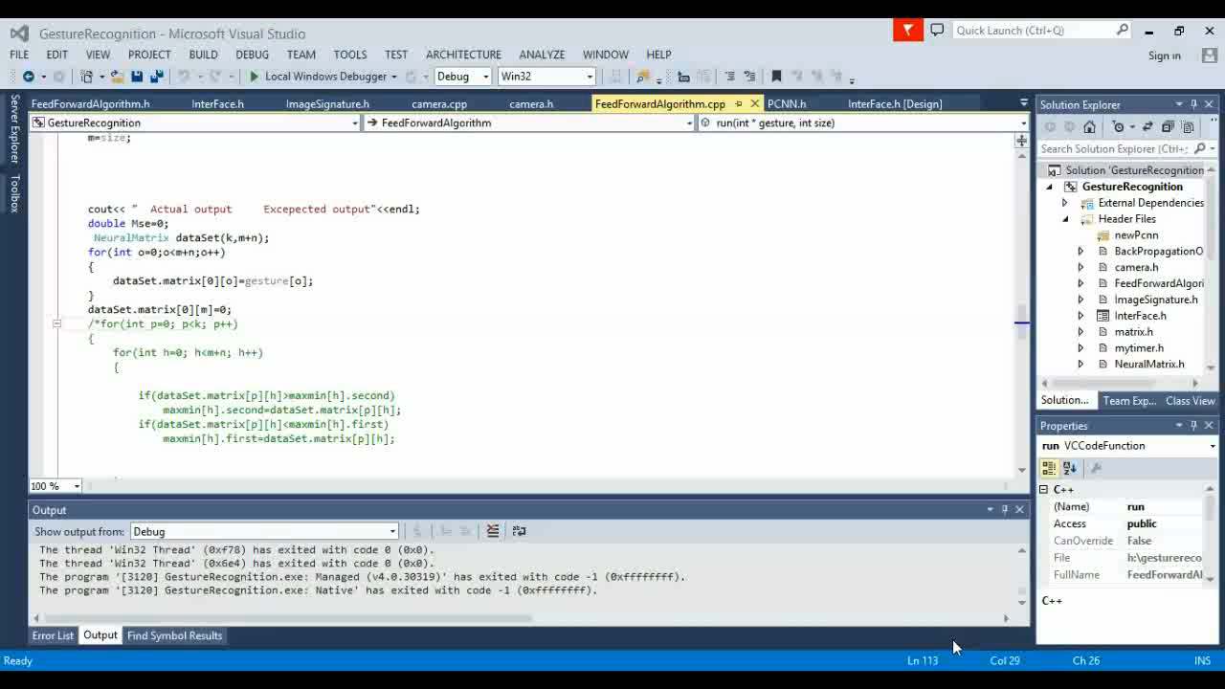
Desktop Demo

Slide 24
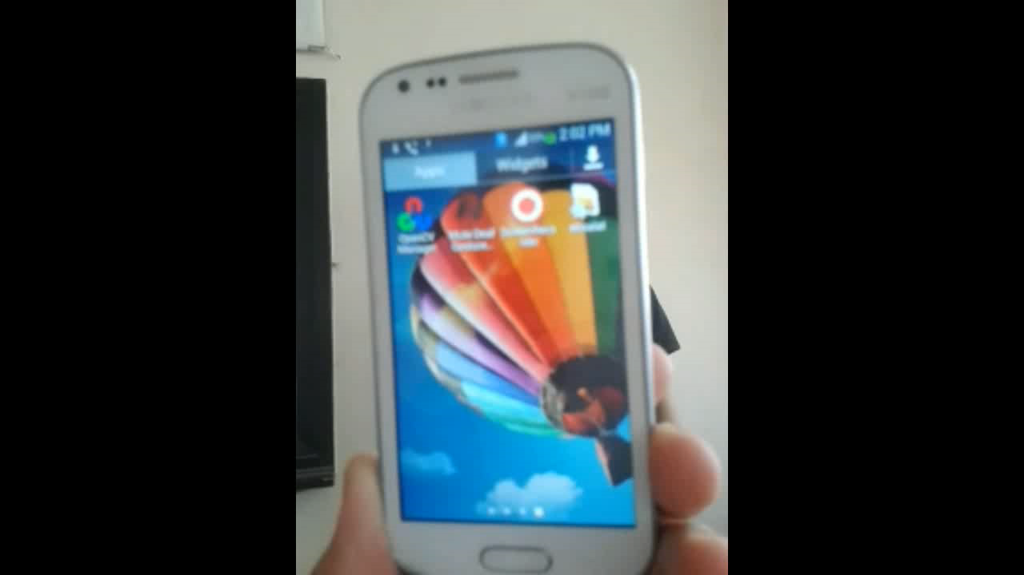
Mobile Demo

Slide 25
Any Questions

