Slide 1
Introduction
"Project Better" aims to enhance the hotel guest experience by making the lives of staff easier. Our solution is a bot that performs three functions:
Check-in for new guests.
Inquiry for existing guests.
Guest check-out.
This bot will not only simplify the staff's workload but also help identify repeat guests with ease. In doing so, we hope to create a more personalized and seamless experience for hotel guests. With "Project Better," we're committed to revolutionizing the hospitality industry.

Slide 2
Flowchart
Front Desk opens main interface
Front Desk chooses to register a new guest
Front Desk enters guest name
Front Desk enters guest ID
Front Desk enters the starting date of reservation
Front Desk enters end date of reservation
Bot assigns a room for the guest
Bot displays a message with guest’s name and how many times visited
End
Front Desk chooses to inquire about a guest
Front Desk enters room number
If room number is found in the current guests database
Bot displays a message with the guest name in that room.
End
If room number isn’t found in current guests database
Bot will display a message saying that no guest is in that room
End
Front Desk chooses guest checkout
Front Desk enters room number
If room number is found in the current guests database
Bot removes the guest from current guests database
Bot adds guest to all guests database
Bot displays a message saying that the guest has been checked out
End
If the room number isn’t found in the current guests database
Bot displays a message with no guest is in that room
End

Slide 3
Benefits of automation
Personalized guest experience
Easier access to the guest information
Saves a lot of time when compared to the manual task

Slide 4
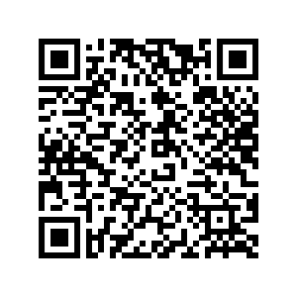
The end

