Slide 1
Organizing colors
with MiniSom
A simple example of unsupervised machine learning
Practical task 3
Notes:
English speaking script
Hello everyone. Today I will introduce MiniSom, a Python library for unsupervised machine learning. I chose it because its main idea is easy to demonstrate visually. In my example, a model learns to place similar colors near each other. I will explain the library and show the actual result of a short experiment.
توضیح فارسی
موضوع MiniSom است و مثال آن مرتب‌شدن رنگ‌های مشابه روی نقشه است. از همین ابتدا بگو این نمونه از Unsupervised Learning است. توضیح مفصل Algorithm را برای اسلاید چهار نگه دار.
Sources
https://github.com/JustGlowing/minisom

Slide 2
MiniSom at a glance
A small Python library for
Self-Organizing Maps (SOM)
Learning type
Unsupervised learning
Main dependency
NumPy
Main purpose
Explore patterns on a 2D grid
pip install minisom
02
Notes:
English speaking script
MiniSom implements Self-Organizing Maps, also called SOMs. A SOM is a type of neural network that learns patterns without class labels. It represents data using a two-dimensional grid. Similar inputs tend to have nearby locations on this grid. The base library depends on NumPy, and we can install it with pip. MiniSom is the library, while SOM is the learning method.
توضیح فارسی
MiniSom نام Library و SOM نام روش است. Model بدون Class label یاد می‌گیرد. خروجی یک نقشهٔ دوبعدی است. برای این مثال فقط CPU کافی است؛ matplotlib هم برای نمایش نتیجه استفاده می‌شود.
Sources
https://github.com/JustGlowing/minisom
https://github.com/JustGlowing/minisom/blob/master/minisom.py

Slide 3
Colors as numerical data
One color is a vector of three RGB values between 0 and 1.
Example | Red | Green | Blue
Red color | 1.0 | 0.0 | 0.0
Green color | 0.0 | 1.0 | 0.0
Purple color | 0.6 | 0.1 | 0.8
Demo dataset: 1,000 generated colors, with no class labels
03
Notes:
English speaking script
The model receives numbers rather than color names. Each input has three features: red, green and blue. For example, one, zero, zero represents red. I generated one thousand random RGB vectors for training and another five hundred for evaluation. The color names in this table only explain the numbers. The training data contains no labels and requires no dataset download.
توضیح فارسی
هر ردیف ورودی سه عدد R و G و B دارد. داده‌ها به صورت تصادفی ساخته شده‌اند: ۱۰۰۰ رنگ برای Training و ۵۰۰ رنگ جدا برای Evaluation. اسم رنگ‌های جدول فقط برای توضیح است و به Model داده نمی‌شود.
Sources
https://github.com/JustGlowing/minisom
Experiment: minisom_colors_demo.py, seed 42.

Slide 4
How a Self-Organizing Map learns
01
Choose one input color
Read its three RGB values.
02
Find the closest map cell
Compare the input with the color prototype in each cell.
03
Update the map
Move the closest prototype and its neighbors toward the input.
Each map cell stores a learned representative color.
04
Notes:
English speaking script
The map contains a grid of cells. Each cell stores a representative RGB vector, called a prototype. For each training step, the model finds the prototype closest to the input color. It then moves that prototype and nearby prototypes toward the input. Repeating these updates gradually organizes the map. The neighborhood becomes smaller during training, helping the model refine the arrangement.
توضیح فارسی
هر خانه یک Prototype، یعنی بردار RGB نماینده، دارد. Model نزدیک‌ترین Prototype را پیدا می‌کند و آن و همسایه‌هایش را کمی به رنگ ورودی نزدیک می‌کند. خروجی، Prototypeهای یادگرفته‌شده است؛ جابه‌جایی سادهٔ پیکسل‌های ورودی نیست.
Sources
https://github.com/JustGlowing/minisom/blob/master/minisom.py

Slide 5
A short Python example
import numpy as np
from minisom import MiniSom
rng = np.random.default_rng(42)
colors = rng.random((1000, 3))
som = MiniSom(16, 16, 3, sigma=2.0,
learning_rate=0.5, random_seed=42)
som.random_weights_init(colors)
before = som.get_weights().copy()
som.train_random(colors, 20000)
after = som.get_weights()
position = som.winner([1.0, 0.0, 0.0])
16 x 16 cells, 3 input features, 20,000 training updates
05
Notes:
English speaking script
The code first generates the RGB data. Sixteen by sixteen defines the map size, and three is the number of input features. Sigma controls the initial neighborhood size. The learning rate controls the size of each update. The train_random method performs twenty thousand updates using the training data. Finally, winner finds a grid location for a new color. It returns coordinates rather than a color name.
توضیح فارسی
16 و 16 ابعاد نقشه و 3 تعداد Feature است. sigma شعاع اولیهٔ همسایگی و learning_rate میزان تغییر Weight را تعیین می‌کند. ۲۰۰۰۰، تعداد Update است، نه تعداد Epoch. winner برای یک رنگ جدید، مختصات خانه را برمی‌گرداند.
Sources
https://github.com/JustGlowing/minisom
https://github.com/JustGlowing/minisom/blob/master/minisom.py
Full runnable example: minisom_colors_demo.py.

Slide 6
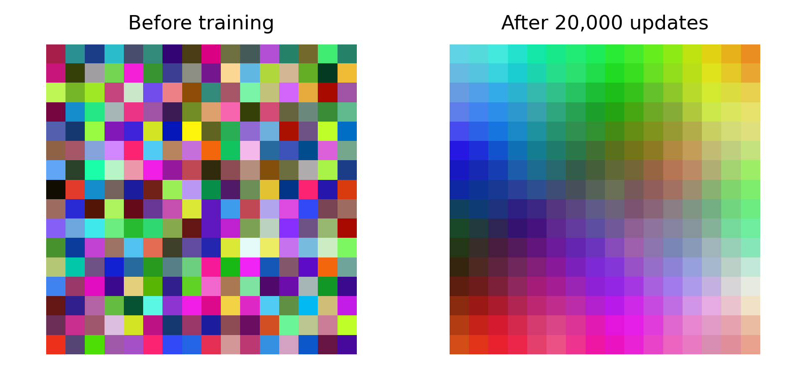
The map before and after training
06
Notes:
English speaking script
On the left, the grid starts with randomly selected training colors. Nearby cells can look very different. On the right, the same grid contains the learned prototypes after training. Similar colors now form smoother regions. These images come directly from the model weights. I did not sort the final colors separately. A different random seed can rotate or change the arrangement.
توضیح فارسی
تصویر چپ Weightهای اولیه و تصویر راست Weightهای آموزش‌دیده را نشان می‌دهد. رنگ‌ها بعد از آموزش با دستور دیگری Sort نشده‌اند. قرارگیری دقیق رنگ‌ها، جهت نقشه و شکل ناحیه‌ها ممکن است با Seed تغییر کند. GIF همراه همین Training را نمایش می‌دهد.
Sources
Experiment outputs: before_after.png and color_map.npz, generated by minisom_colors_demo.py.

Slide 7
Evaluation on 500 new colors
9.2%
Topographic error
after training
Measures neighborhood
consistency on the grid
Lower is better.
Mean RGB reconstruction distance: 0.0962 before, 0.0918 after
One demonstration run, using the same 500 evaluation colors
07
Notes:
English speaking script
I evaluated the map using five hundred colors that were not used for training. Topographic error fell from 97.6 percent to 9.2 percent. This checks how often the two closest prototypes are not neighboring cells. A lower value indicates a more consistent arrangement. The mean RGB reconstruction distance also decreased slightly. These are results from one demonstration run, and they do not measure classification accuracy.
توضیح فارسی
روی همان ۵۰۰ رنگ Test، Topographic error از 97.6٪ به 9.2٪ کاهش یافت. یعنی دو Prototype نزدیک به هر ورودی، بیشتر در خانه‌های همسایه قرار گرفته‌اند. Quantization error نیز از 0.0962 به 0.0918 رسید. این اعداد Accuracy نیستند و فقط مربوط به یک اجرای Demo هستند.
Sources
https://github.com/JustGlowing/minisom/blob/master/minisom.py
Measured results: demo_results/results.json. Training seed 42. Same 500 held-out samples in both evaluations.

Slide 8
Uses and limitations
Useful for
Things to consider
Visualizing similar samples
Exploring groups in data
Building representative color palettes
Feature scaling affects similarity.
Map size and settings affect results.
Class prediction requires
an additional labeling step.
MiniSom makes a small learning experiment easy to inspect.
08
Notes:
English speaking script
MiniSom is useful for visualizing data, exploring similar samples and building color palettes. Its main advantage here is that we can inspect what the model learns. However, feature scaling and training settings affect the result. A SOM also needs an additional labeling step if we want named classes. For this presentation, the color example shows how a small library can make unsupervised learning understandable. Thank you for listening.
توضیح فارسی
کاربردها شامل نمایش شباهت داده‌ها و ساخت Color palette است. اگر Featureها واحد یا مقیاس متفاوت داشته باشند باید Scaling را بررسی کنیم. خروجی عادی SOM مختصات و Prototype است؛ برای پیش‌بینی Class باید مرحلهٔ Labeling اضافه شود.
Sources
https://github.com/JustGlowing/minisom
https://github.com/JustGlowing/minisom/tree/master/examples
https://github.com/JustGlowing/minisom/blob/master/minisom.py

Slide 9
References
MiniSom overview and installation
https://github.com/JustGlowing/minisom
Algorithm and evaluation methods
https://github.com/JustGlowing/minisom/blob/master/minisom.py
Official examples
https://github.com/JustGlowing/minisom/tree/master/examples
Experimental figures and results: accompanying Python demo
Demo versions: MiniSom 2.3.5, NumPy 2.3.5
09
Notes:
English speaking script
These are the official sources for MiniSom. The figures and numerical results come from the accompanying Python demo.
توضیح فارسی
منابع اصلی GitHub رسمی MiniSom و کد خود Library هستند. نتیجه‌ها و تصویرها از اجرای واقعی Demo به دست آمده‌اند. لازم نیست URLها را بلند بخوانی.
Sources
https://github.com/JustGlowing/minisom
https://github.com/JustGlowing/minisom/blob/master/minisom.py
https://github.com/JustGlowing/minisom/tree/master/examples

