Slide 1
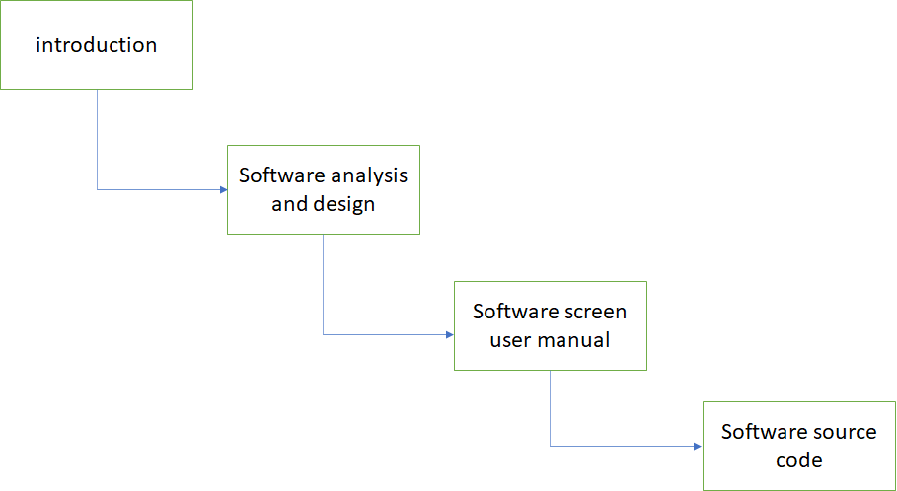

Slide 2
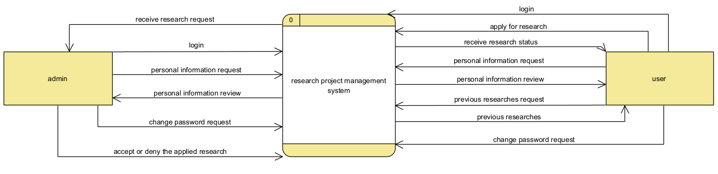

Slide 3
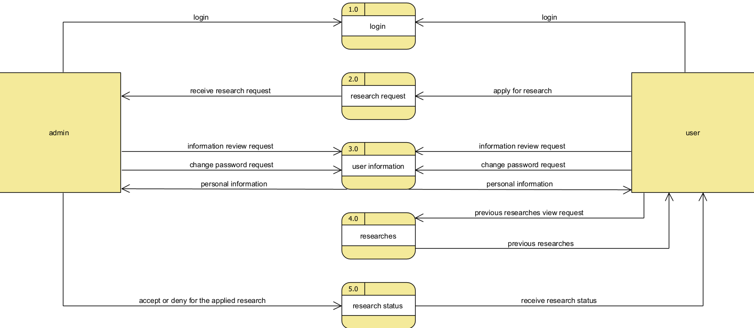

Slide 4
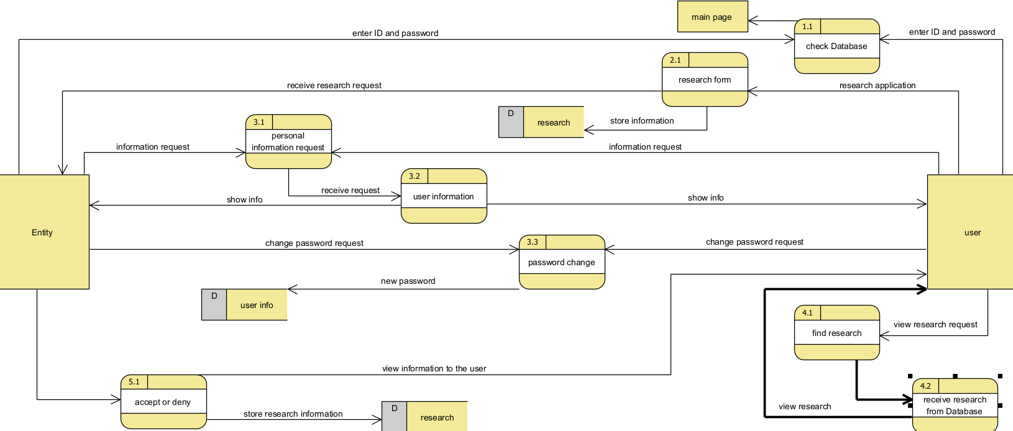

Slide 5
Research project management system
Login
apply research
Admin
View Info.
Student
Accept applied research

Slide 6
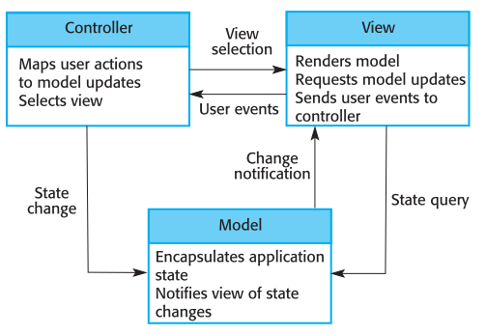

Slide 7
password
address
level
User ID
Dep
name
Dep ID
Last
name
M
work
for
1
name
user
department
First
name
Phone
number
1
manage
control
birthdate
1
N
N
N
research
Work
on
M
Research
ID
status
Research
name
information

Slide 8
Department
PK | Dep-ID
 | Dep-name
FK | User-ID
User
PK | User-ID
 | First name
 | Last name
 | Level
 | Address
 | Phone number
 | Birthdate
 | Password
FK | Dep-ID
Work-on
FK1 | User-ID
FK2 | Research-ID
Research
PK | Research-ID
 | Research-name
 | Information
 | Status
FK | Dep-ID

Slide 9
user-_id | First name | Last name | level | Phone number | address | birthdate | password | Department id | Department name | Research id | Research name
220101 | ali | ali | 1 | 079 | Amman | 1-1-1991 | 1234 | 2201 | CS | 1 | Network
220102 | Mohammad | Mohammad | 1 | 079 | Zarqa | 22-2-1990 | 1234 | 2201 | CS | 1 | Network
220201 | Ahmad | Ahmad | 1 | 079 | Irbid | 3-1-1990 | 1234 | 2202 | MIS | 1 | Network
220202 | Noor | Noor | 1 | 079 | Aqaba | 25-2-1992 | 1234 | 2202 | MIS | 2 | Computer
220203 | Huda | Huda | 1 | 079 | Amman | 3-3-1990 | 1234 | 2202 | MIS | 2 | Computer
220301 | Mustafa | Mustafa | 1 | 079 | Amman | 4-1-1990 | 1234 | 2203 | SE | 3 | Management
220302 | Noor | Noor | 1 | 079 | Zarqa | 5-2-1992 | 1234 | 2203 | SE | 4 | Class

Slide 10
user-_id | First name | Last name | level | Phone number | address | birthdate | password
220101 | ali | ali | 1 | 079 | Amman | 1-1-1991 | 1234
220102 | Mohammad | Mohammad | 1 | 079 | Zarqa | 22-2-1990 | 1234
220201 | Ahmad | Ahmad | 1 | 079 | Irbid | 3-1-1990 | 1234
220202 | Noor | Noor | 1 | 079 | Aqaba | 25-2-1992 | 1234
220203 | Huda | Huda | 1 | 079 | Amman | 3-3-1990 | 1234
220301 | Mustafa | Mustafa | 1 | 079 | Amman | 4-1-1990 | 1234
220302 | Noor | Noor | 1 | 079 | Zarqa | 5-2-1992 | 1234
Department id | Department name | Research id | Research name
2201 | CS | 1 | Network
2201 | CS | 1 | Network
2202 | MIS | 1 | Network
2202 | MIS | 2 | Computer
2202 | MIS | 2 | Computer
2203 | SE | 3 | Management
2203 | SE | 4 | Class

Slide 11
user-_id | First name | Last name | level | Phone number | address | birthdate | password
220101 | ali | ali | 1 | 079 | Amman | 1-1-1991 | 1234
220102 | Mohammad | Mohammad | 1 | 079 | Zarqa | 22-2-1990 | 1234
220201 | Ahmad | Ahmad | 1 | 079 | Irbid | 3-1-1990 | 1234
220202 | Noor | Noor | 1 | 079 | Aqaba | 25-2-1992 | 1234
220203 | Huda | Huda | 1 | 079 | Amman | 3-3-1990 | 1234
220301 | Mustafa | Mustafa | 1 | 079 | Amman | 4-1-1990 | 1234
220302 | Noor | Noor | 1 | 079 | Zarqa | 5-2-1992 | 1234
Department id | Department name
2201 | CS
2202 | MIS
2203 | SE
Research id | Research name
1 | Network
2 | Computer
3 | Management
4 | Class

Slide 12
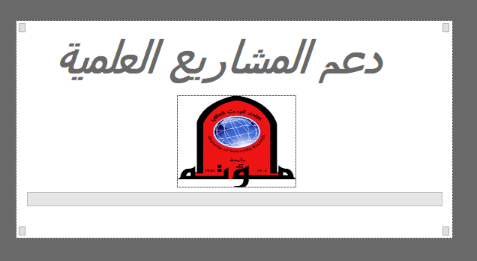

Slide 13
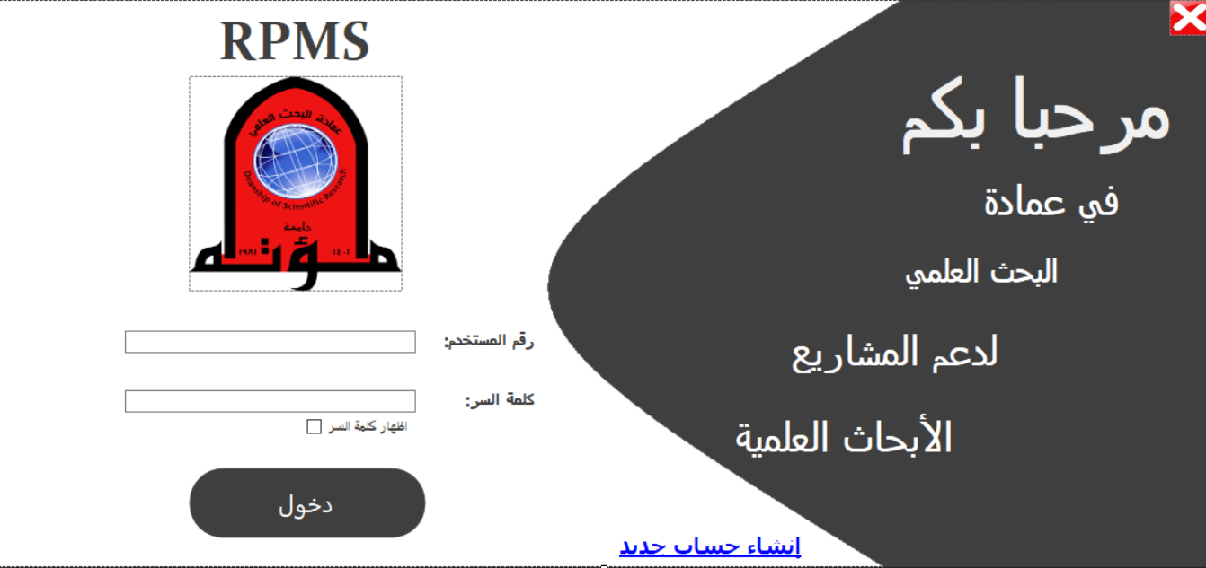

Slide 14
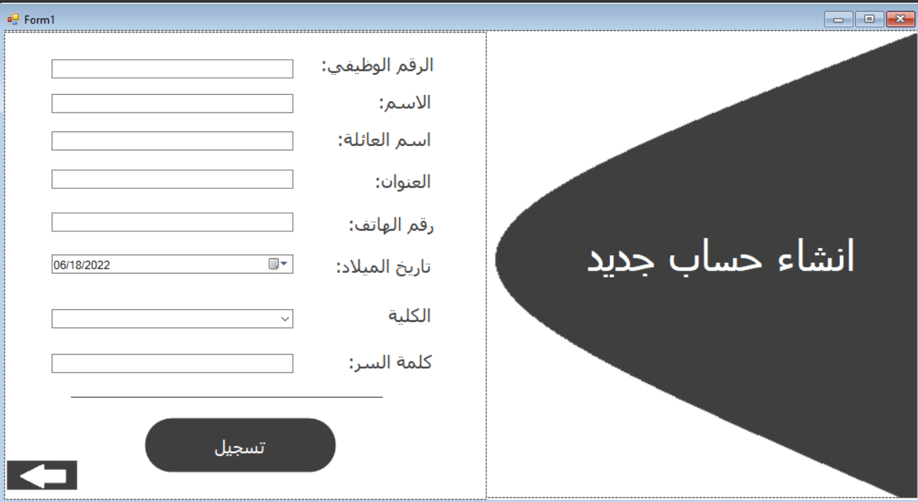

Slide 15
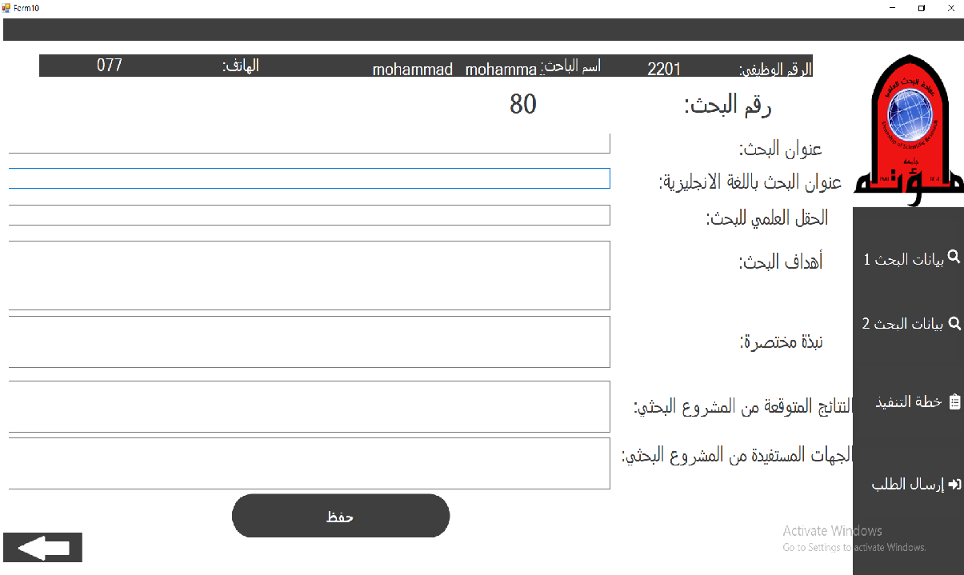

Slide 16
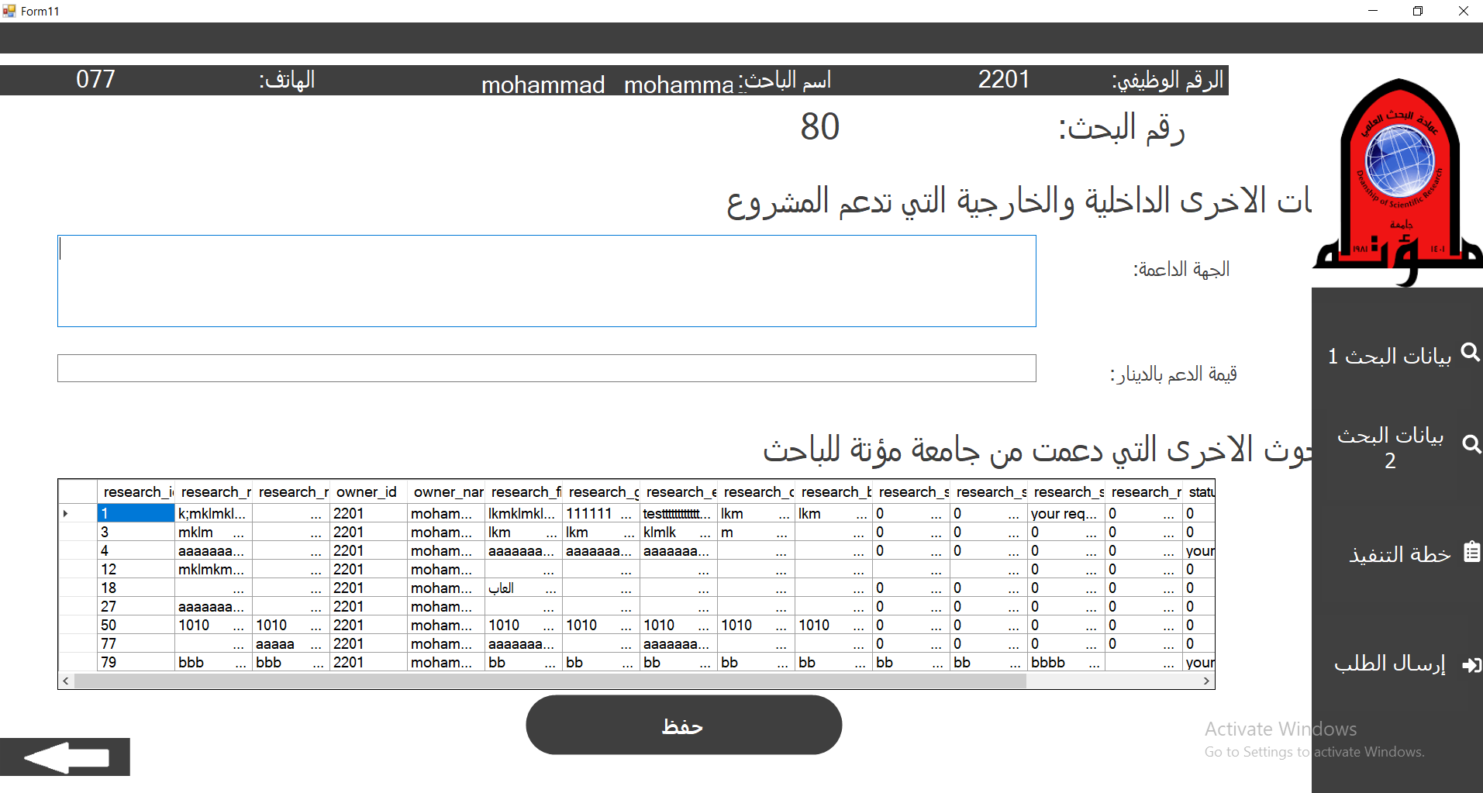

Slide 17
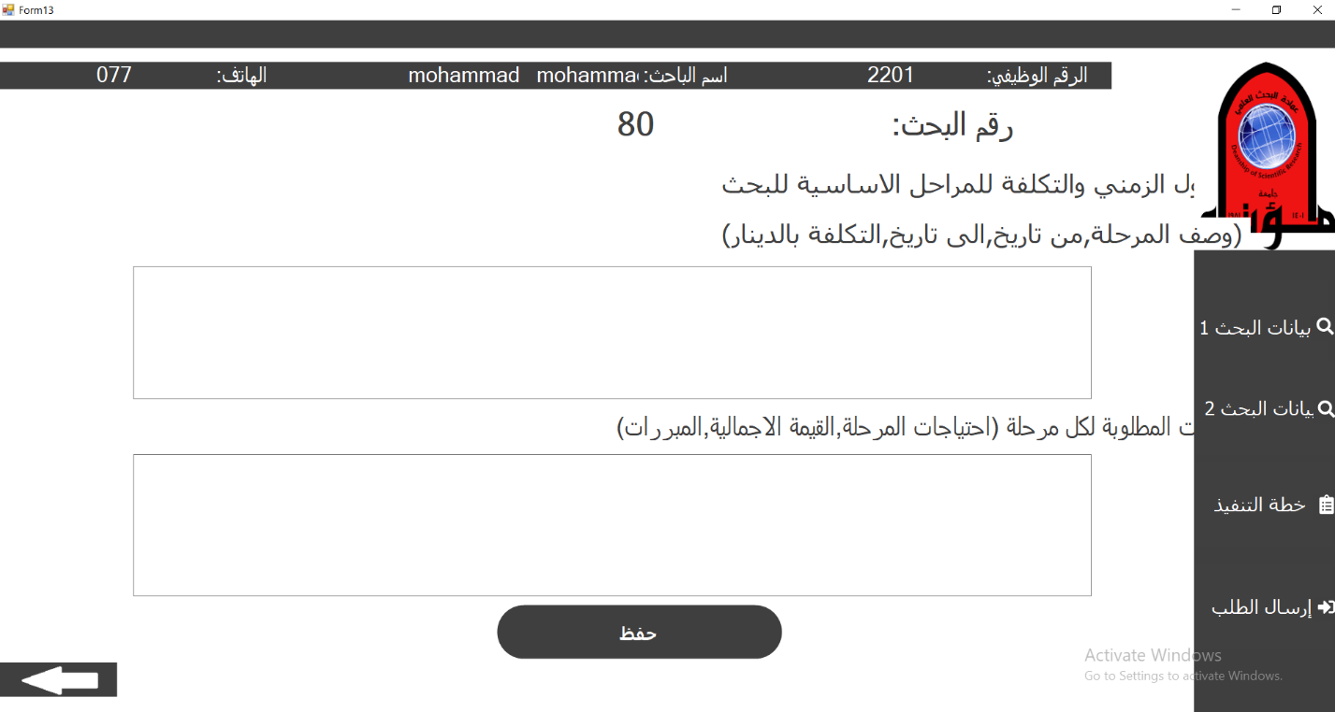

Slide 18
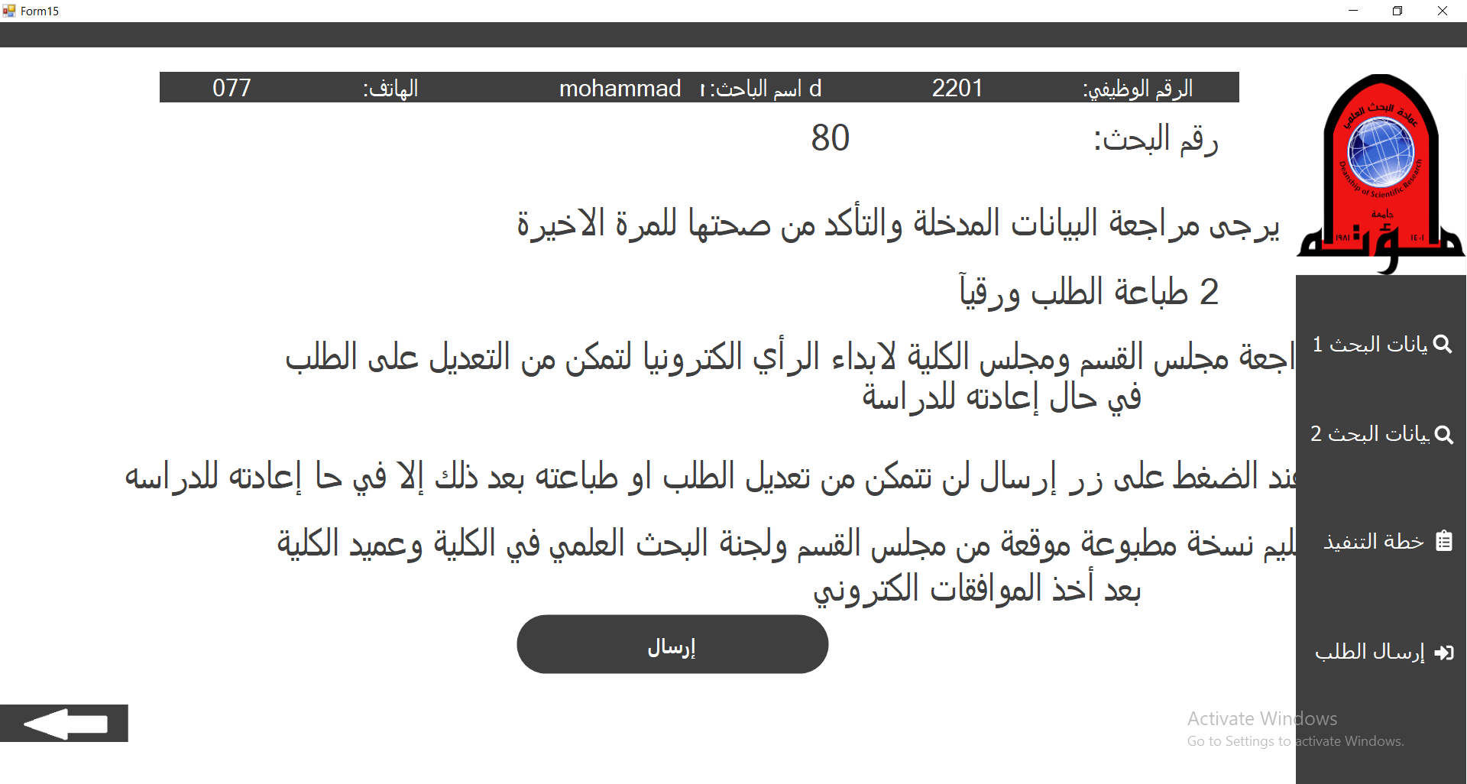

Slide 19
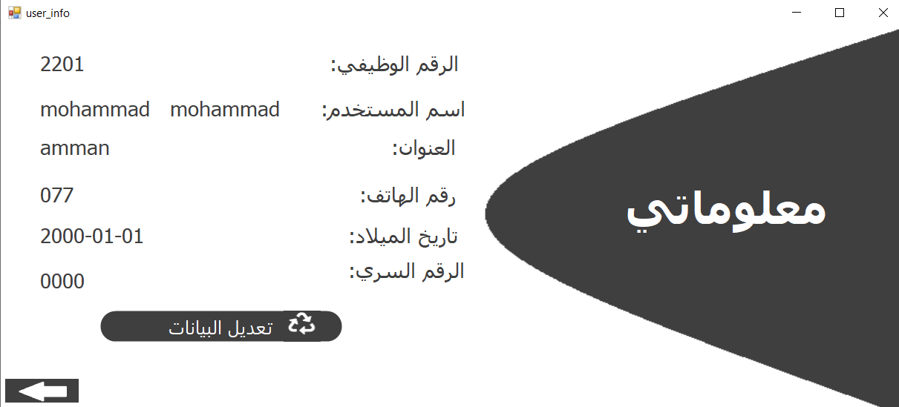

Slide 20
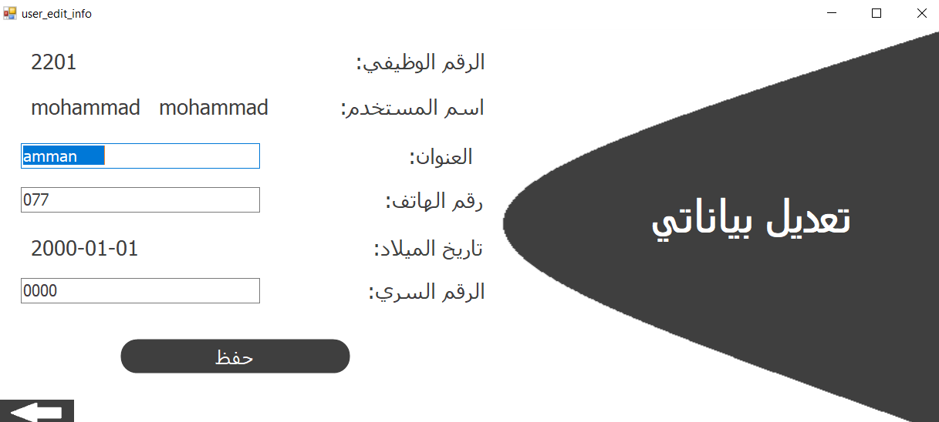

Slide 21
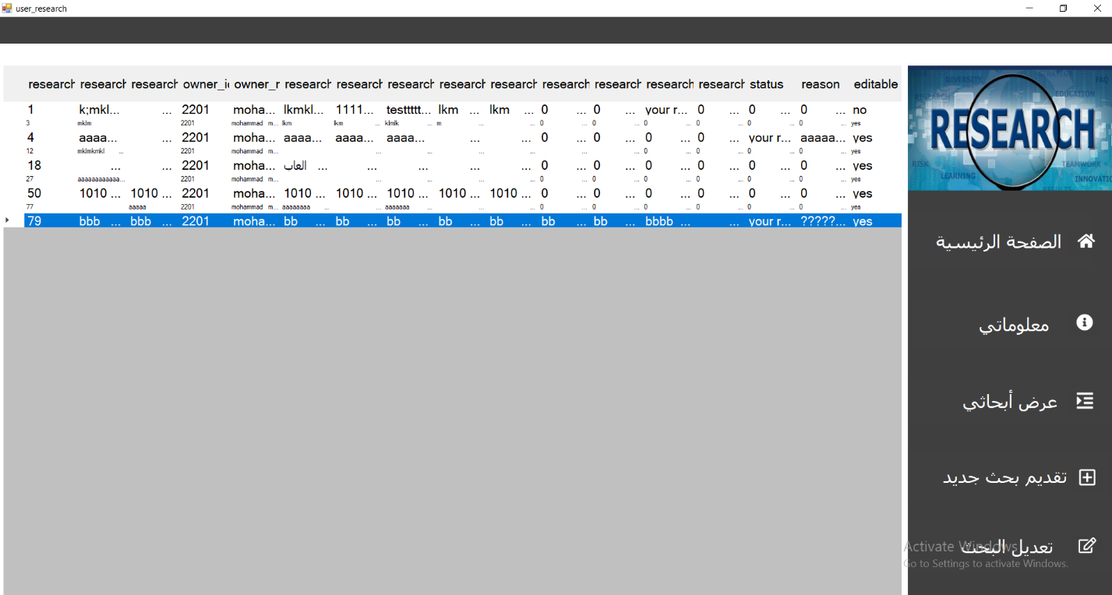

Slide 23
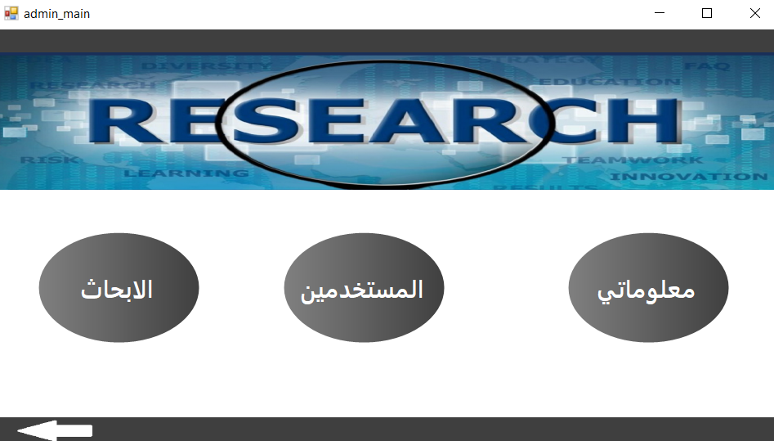

Slide 24
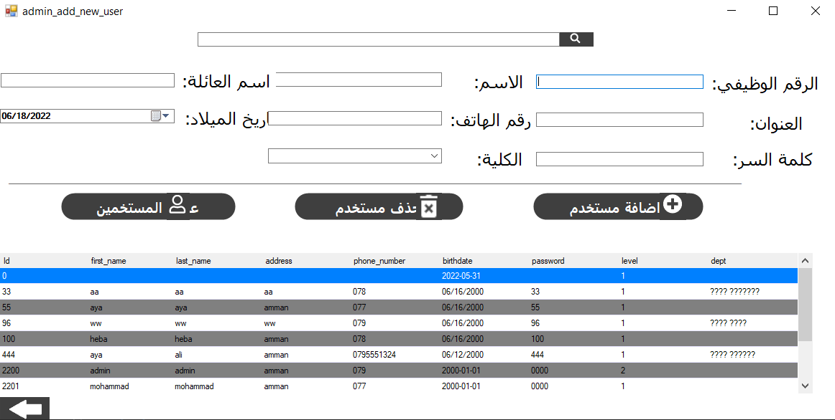

Slide 25
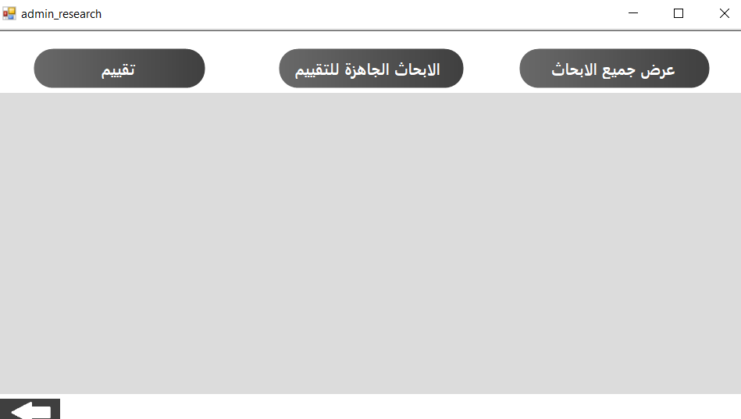

Slide 26


Slide 27
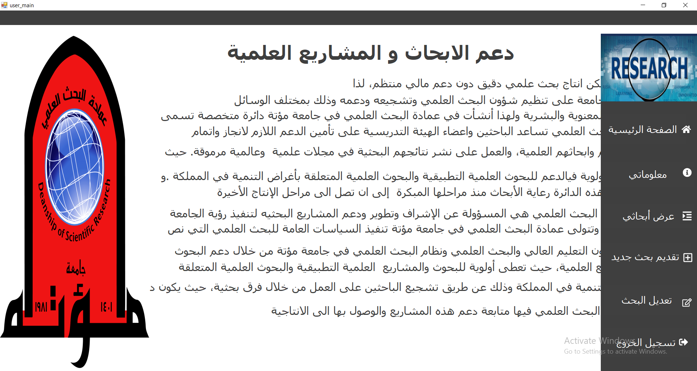

Slide 28
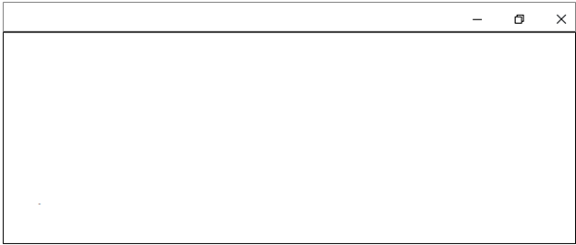

تسجيل الدخول
الرجاء التأكد من صحة رقم المستخدم و كلمة المرور

Slide 29

تقديم الطلب
تم تقديم طلبك بنجاح
والبحث الان قيد الدراسة

Slide 30

كلمة المرور
تم تغيير كلمة المرور بنجاح

Slide 31

انشاء حساب جديد
تم انشاء الحساب بنجاح

Slide 32
Enter user ID and password
Press login button

Slide 33
Show the user information
To show the user researches
To edit research
Applying for new research
To logout

Slide 34
Enter the required information
Press create new account button

Slide 35
enter all required information
Press submit button

Slide 36
Enter the required information
Press change password button
Press submit button

Slide 37
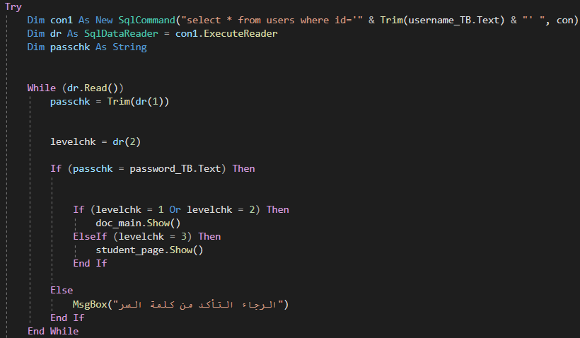

Slide 38
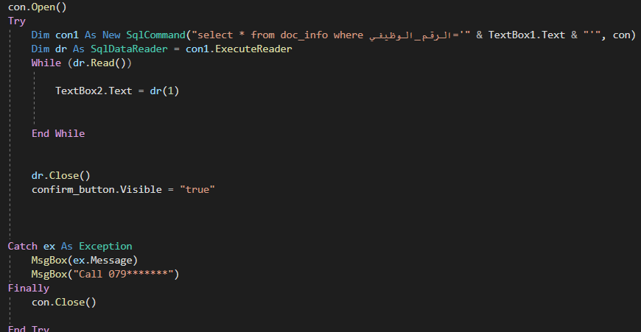

Slide 39
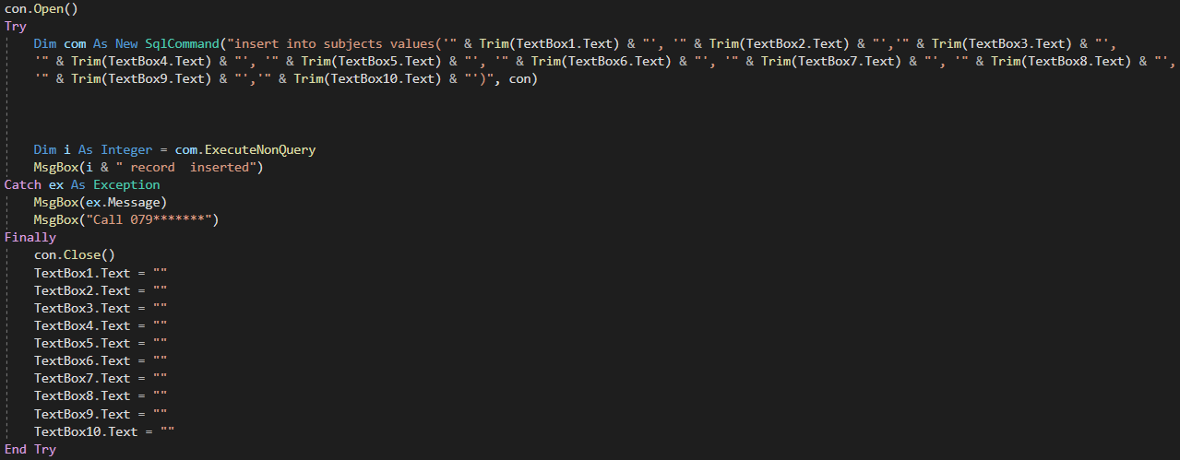

Slide 40
