Slide 1
Research Project Management System
Student Name | Student ID
Mohammad Bader | 120172203055
Ekram Qassm | 120182201027
Raghad Abu Muqadam | 120182201087
Tasneem Reyad | 120182203050
Advisor Name Dr. Ra’Fat AL-Msie’DeeN

Slide 2
Outline
Project context.
Problem statement.
Project Schedule
System Requirements
Project Analysis - Context Diagram and DFDs.
Project Analysis – Use-case Diagram.
Project Analysis – Entity Relationship Diagram.
Project Design - Relational Database Model.
Implementation
Project Design – Screen user’s manual.
Conclusion.
References

Slide 3
Project context
Research project management system is a desktop application for mutah university,
it manages the research in the Deanship of Scientific Research
this project is basically updating the traditional way of applying for research into desktop-based application so that the users can know the details of their account, the status of their research, etc.
We propose in this project a solution for existing problem by updating the system to reduce the chance of errors happened, limiting the usage of paper to save some money, reduce the time and effort from the customer so he/she does not have to apply for the research physically.

Slide 4
Problem statement
Motivation and problem:
Updating the traditional way of applying
Reduce the time taken for applying for research because the user can apply from his computer at any time he wants
Reduce the effort because the user doesn’t have to physically go and apply for his research
Reduce the cost because no longer need to use papers

Slide 5
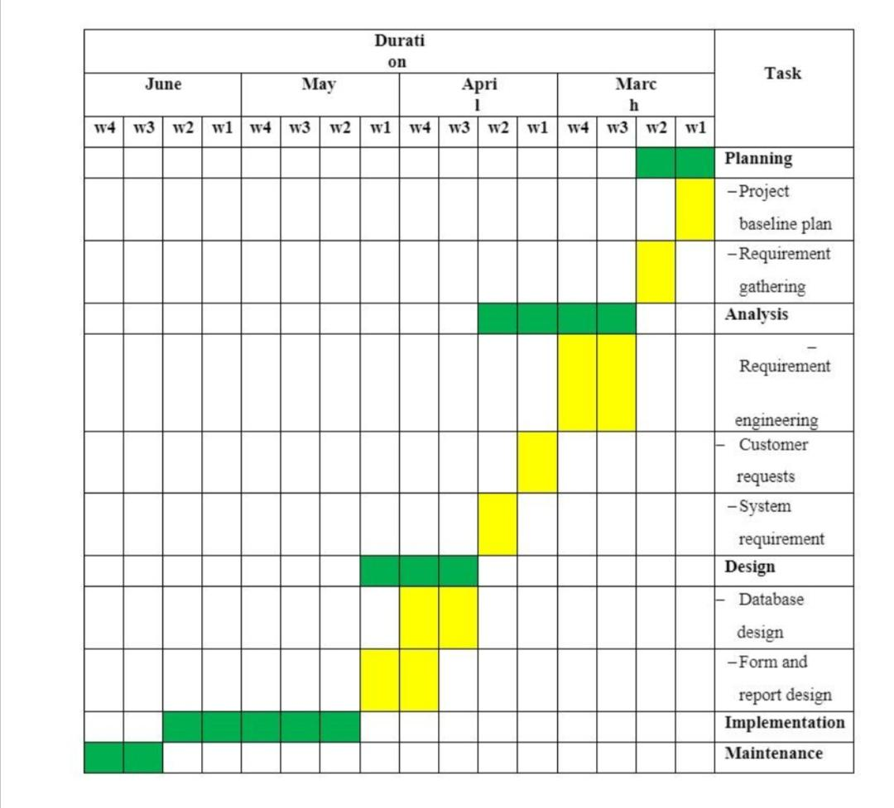
Project Schedule
Table 1 shows the project schedule via 4 months.

Slide 6
System Requirements
Functional Requirements
-In this subsection we present the functional requirements and constraints of the proposed system.
-Each requirement should be uniquely identified with a sequence number or a meaningful tag of some kind.
a.Login
b. Apply for research
c. View specific research
d. View previous research
e. View personal information
f. Change personal password
g.Accept or deny the applied research

Slide 7
System Requirements
Non-Functional Requirements
-In this subsection we present the non-functional requirements of the proposed system.
a. Performance
b. Security
c. Usability
d. Support
e. Availability
f. Safety
g. Reliability

Slide 8
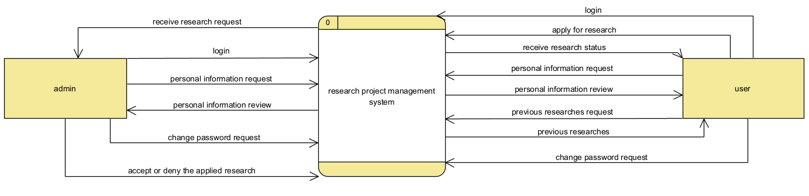
Project Analysis
Context Diagram
The figure below shows the context diagram for the proposed project

Slide 9
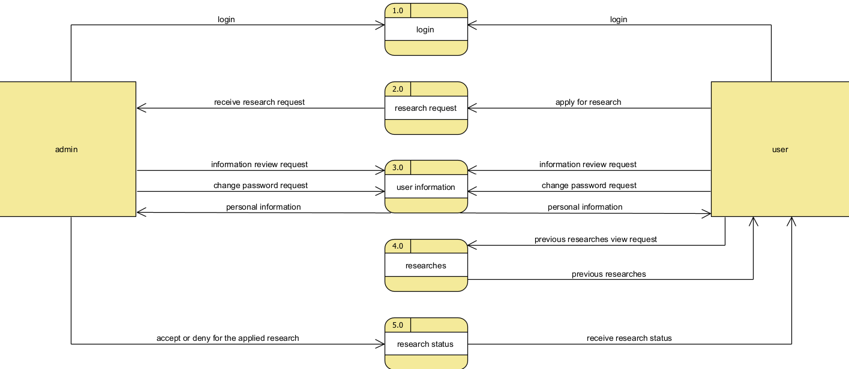
Project Analysis
Data Flow Diagram(DFD):
In this section we will propose the data flow diagram for the proposed project

Slide 10
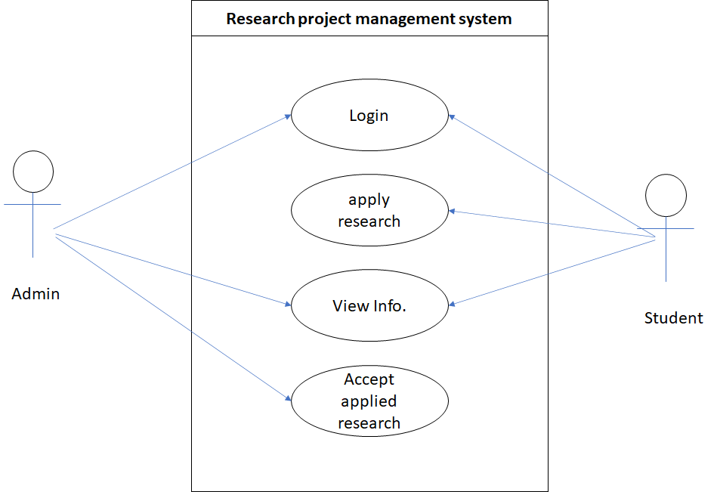
Project Analysis
Use-Case Diagram
The figure below shows the Use-Case Diagram for the proposed project

Slide 11
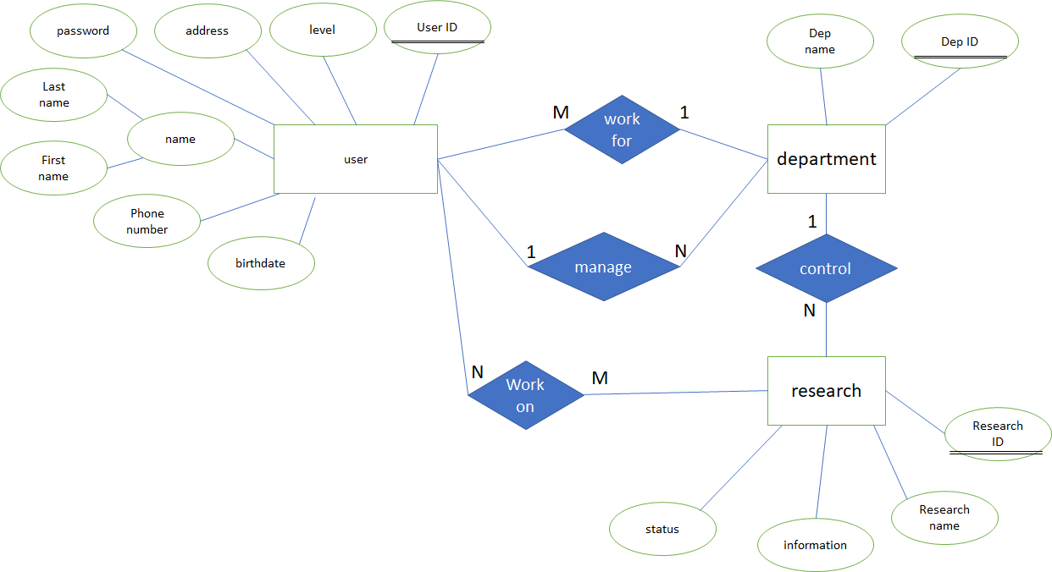
Project Analysis
Entity Relationship Diagram(ERD):
The figure below shows the Entity Relationship Diagram for the proposed project

Slide 12
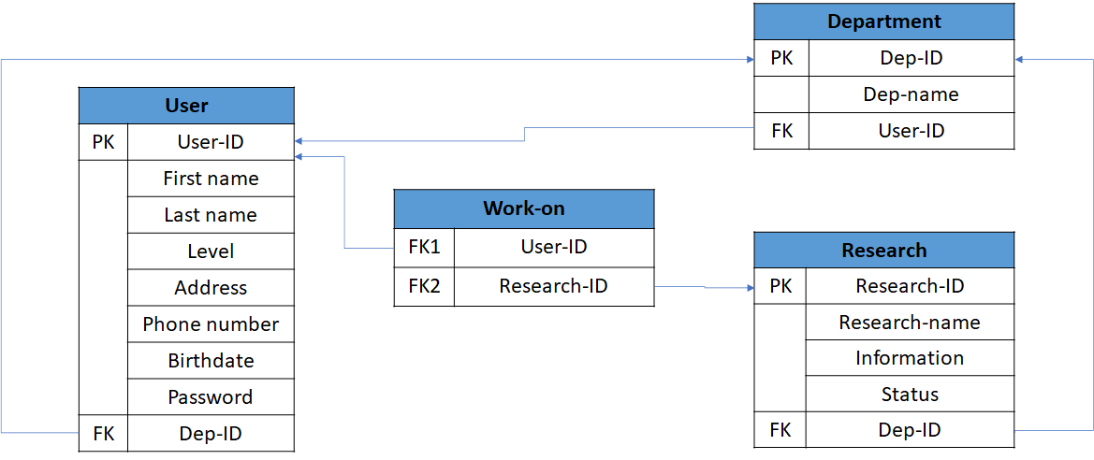
Project Design
Relational Database Model:
In this section we will show the Relational Database Model for the proposed project

Slide 13
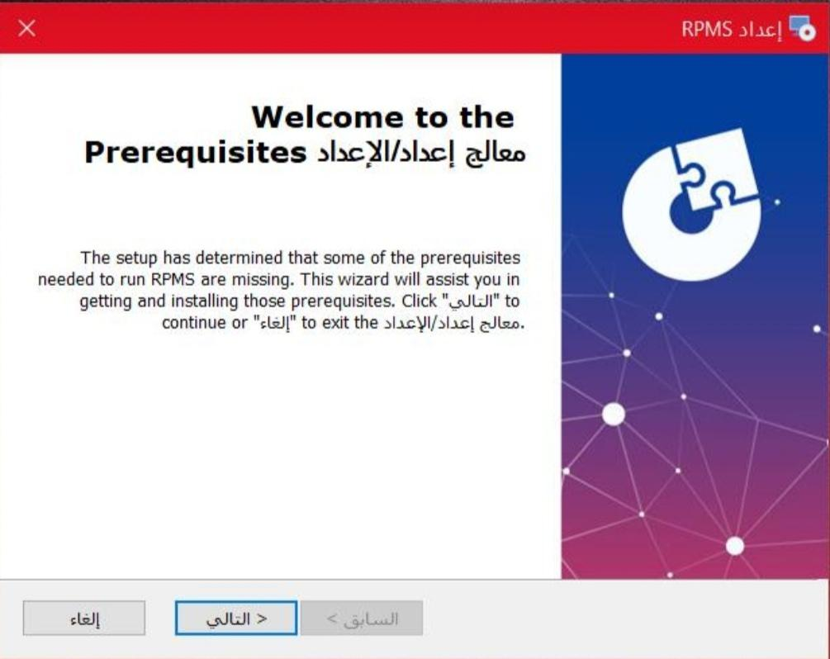
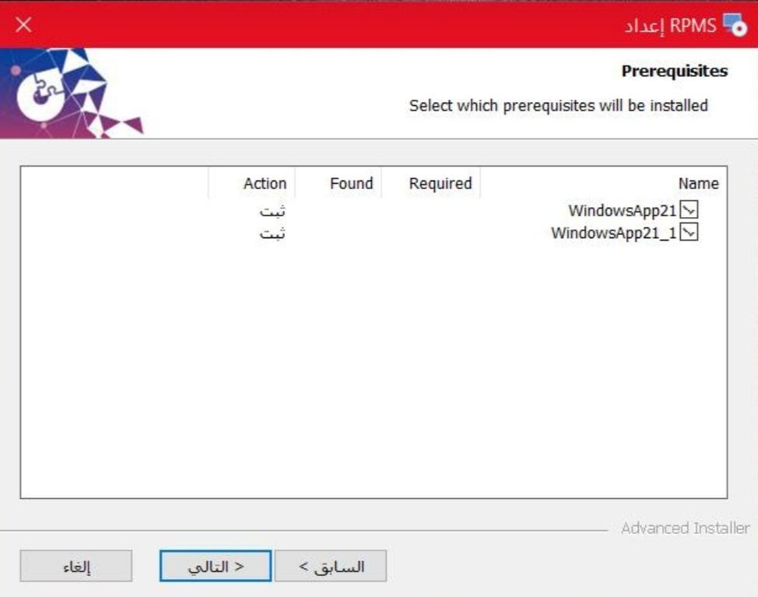
Implementation
This Implementation presents the main source code of the suggested software project

Slide 14
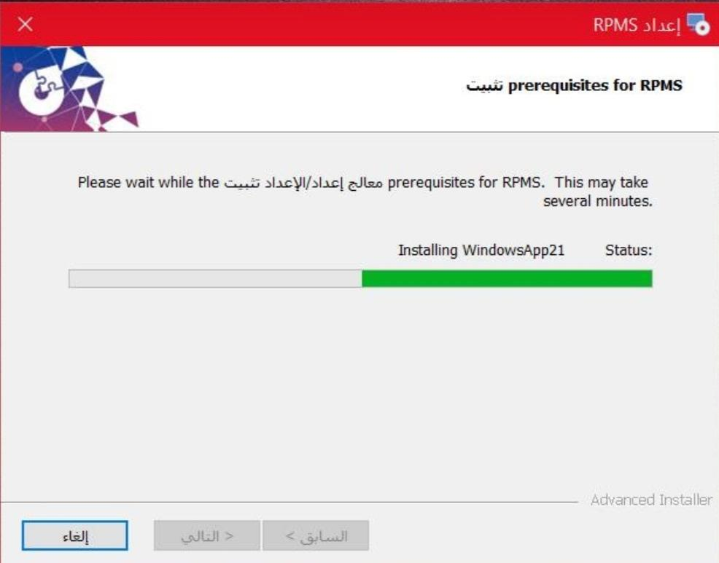
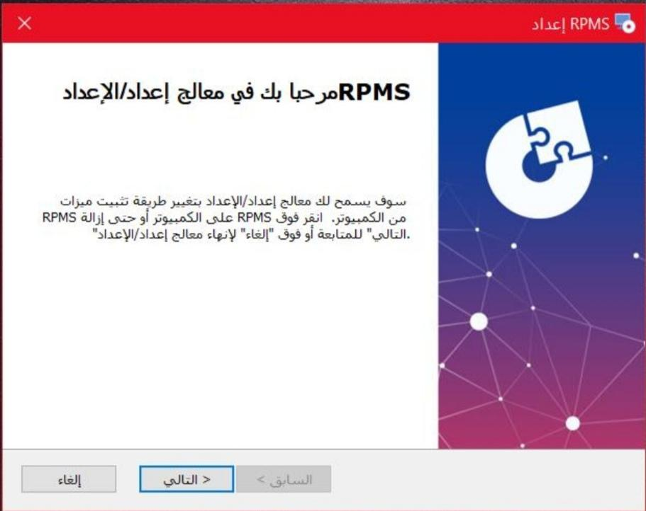
Implementation

Slide 15
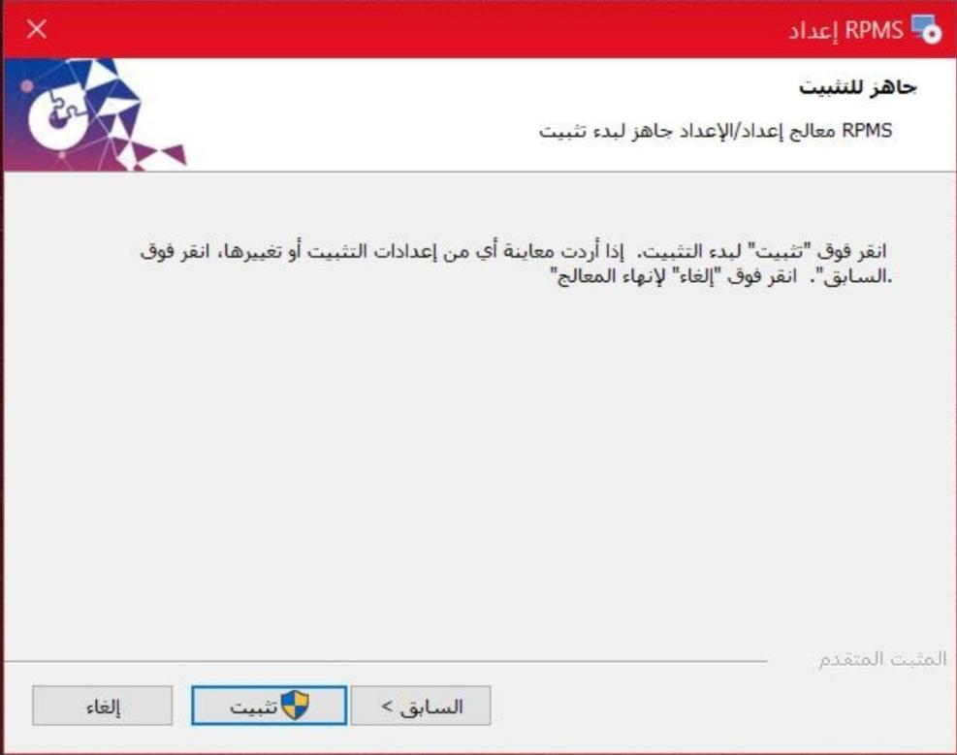
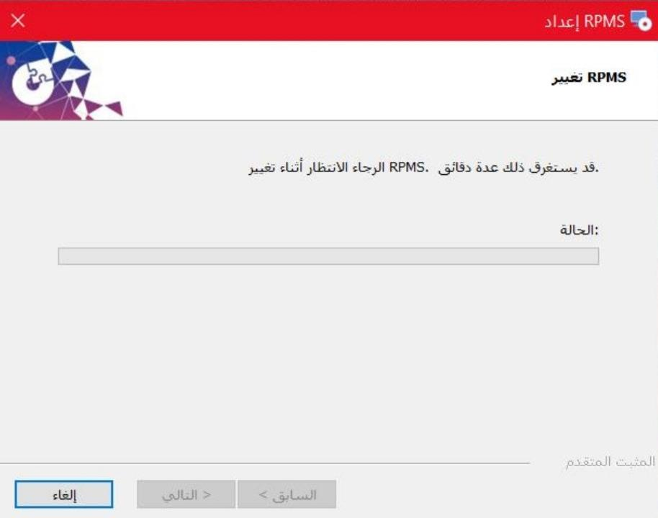
Implementation

Slide 16
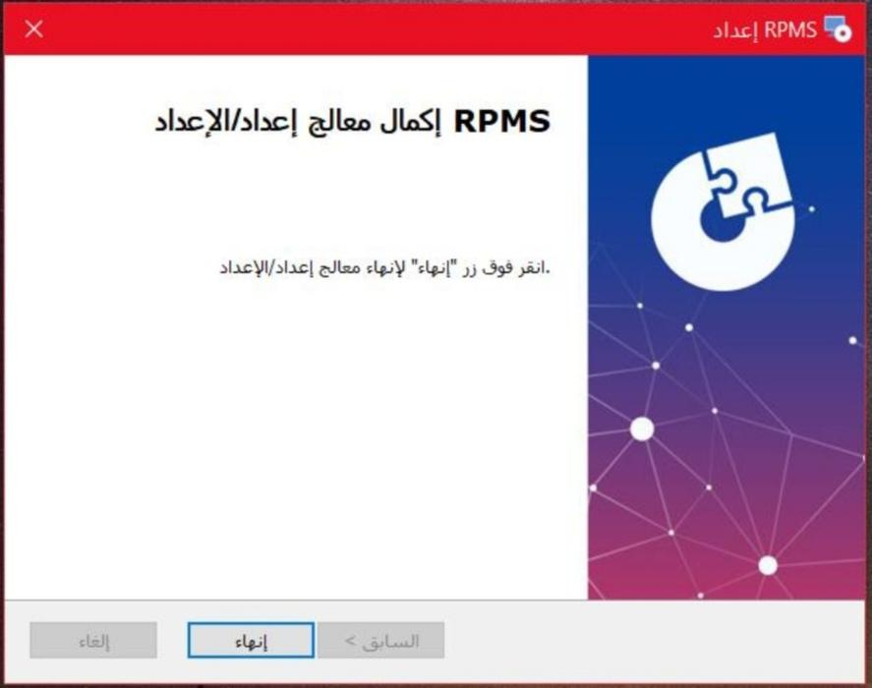
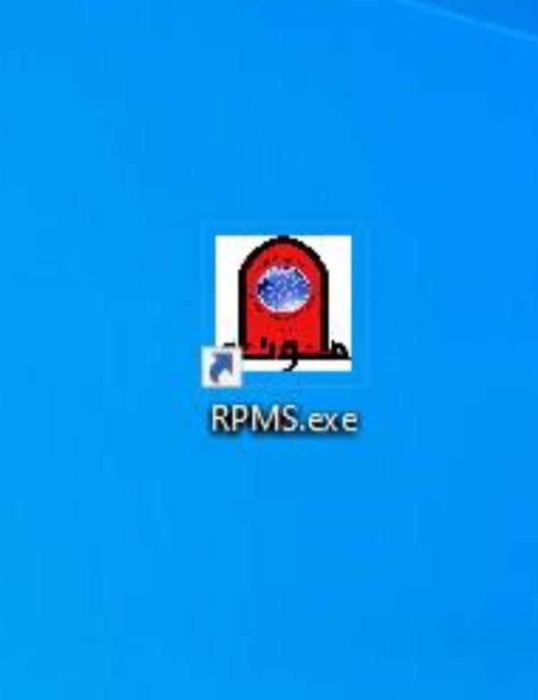
Implementation

Slide 17
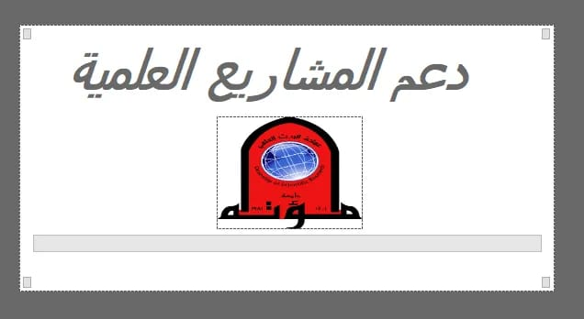
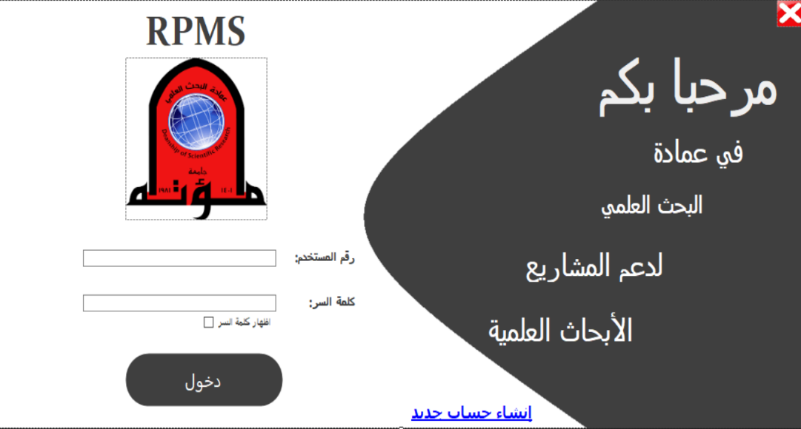
Project Design
Screen user’s manual

Slide 18
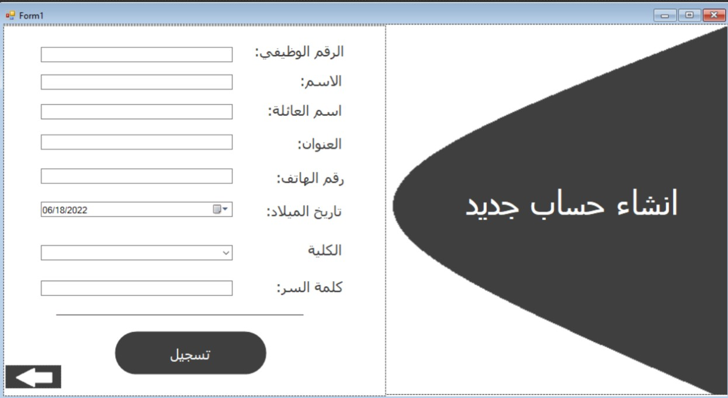
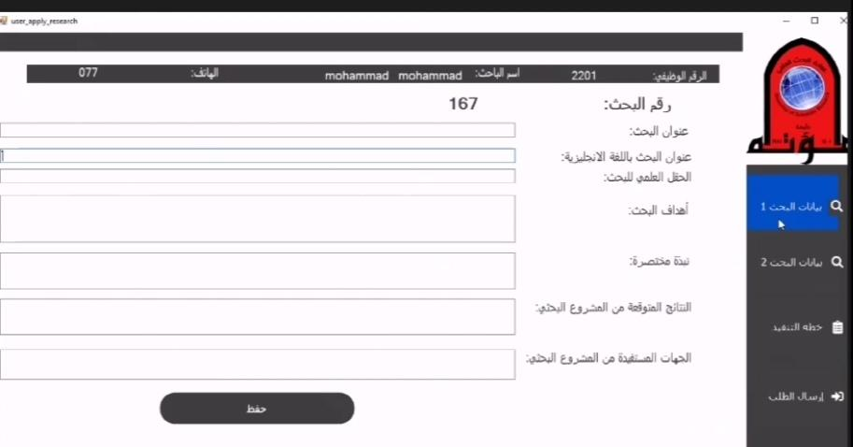
Project Design
Screen user’s manual

Slide 19
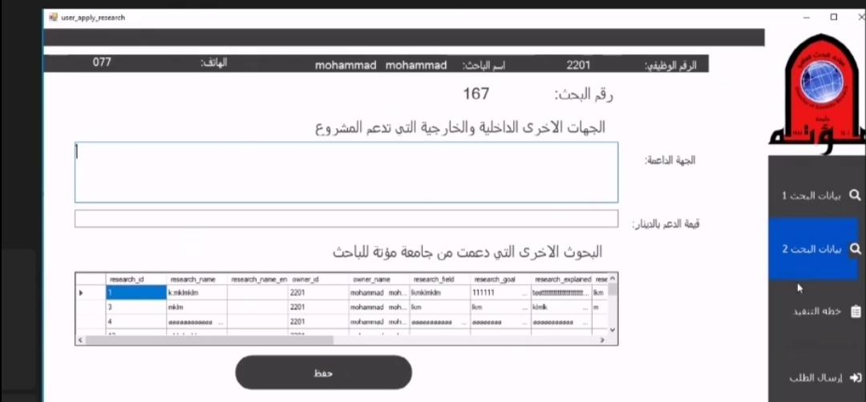
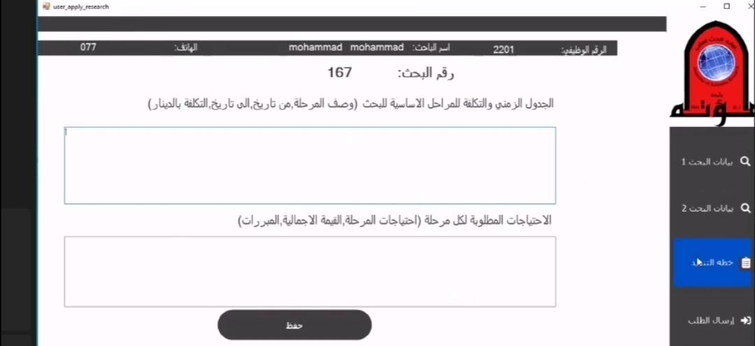
Project Design
Screen user’s manual

Slide 20
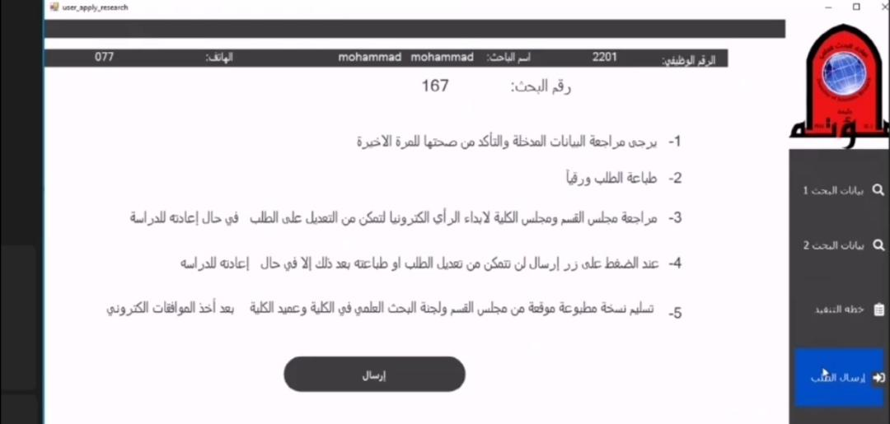
Project Design

Slide 21
Conclusion
We propose in this project a solution for existing problem by updating the system to reduce the chance of errors happened, limiting the usage of paper to save some money, reduce the time and effort from the customer so he/she does not have to apply for the research physically.

Slide 22
References
IEEE Software Requirements Specification Template.URL: https://gephi.org/users/gephi_srs_document.pdf
Joseph S. Valacich, and Joey F. George, " Modern Systems Analysis and Design", 8th
Edition, 2015.
Ian Sommerville, "Software engineering", 10th edition, 2018.
Avi Silberschatz, and Henry F. Korth, and S. Sudarshan, " Database System Concepts", 7th Edition, 2019.

Slide 23
Thank You
For
Your Attention

Slide 24
Questions
?

Slide 25
Research Project Management System
Student Name | Student ID
Mohammad Bader | 120172203055
Ekram Qassm | 120182201027
Raghad Abu Muqadam | 120182201087
Tasneem Reyad | 120182203050
Advisor Name Dr. Ra’Fat AL-Msie’DeeN

