Slide 1

UK House Price Index
An End-to-End Data Analysis Project
Python · SQL · Power BI
Data source: HM Land Registry, UK House Price Index | 1968 – 2025

Slide 2



Project Overview
A full pipeline from raw government data to an interactive dashboard — cleaning, exploring, querying, and visualizing 57 years of UK housing prices.
Data Source
HM Land Registry's UK House Price Index, the official record of residential property transactions.
Time Span
January 1968 through December 2025 — nearly six decades of monthly price data.
Scale
149,085 rows across 62 fields, covering every Local Authority, Region, Country, and the UK overall.
Data Cleaning
→
Exploratory Analysis
→
SQL Analysis
→
Power BI Dashboard

Slide 3

Step 1 — Data Cleaning
Turning a raw 34MB government export into an analysis-ready dataset.
Converted Date to proper datetime; validated — zero invalid entries
Column-by-column missing value analysis: dropped structurally-aggregate-only fields, flagged buyer-type fields as recent-data-only (2011/2012+)
Checked for duplicate Region + Date combinations — none found
Added Year, Month, Quarter, Decade
Validated AveragePrice, SalesVolume, Index — no negative values
Added PriceGrowthSinceStart — cumulative growth per region since its first record
Built GeoLevel (UK / Country / Region / Local Authority), fixing a mislabeling bug for two national aggregates
Added RegionalPriceDiff / RegionalPriceDiffPercent — each region vs. the UK average, month by month
Result: 149,085 rows × 62 columns, fully validated and ready for analysis

Slide 4




Step 2 — Exploratory Data Analysis
Four headline findings pulled directly from the data.
8,062%
2.3×
UK price growth since 1968
Detached vs. Flat price ratio
£3,311 (Apr 1968) → £270,259 (Dec 2025)
£440,564 vs. £192,826, latest month
44.7%
89 / 681
Former owner-occupiers pay more than first-time buyers
Months with negative annual growth
£354,250 vs. £244,799 (England)
Sharpest drop -15.6% (Feb 2009); fastest gain +50.4% (Jan 1973)

Slide 5





Step 3 — SQL Analysis
Written in T-SQL against a UK_HPI table, and reproduced live in the notebook with DuckDB.
GROUP BY
CASE
CTEs
Top areas & average price by geography
Price-band classification
Multi-step yearly aggregation
PARTITION BY
LAG()
RANK()
Per-region window calculations
Year-over-year price change
Top 3 priciest regions per year
WITH YearlyAvg AS (
SELECT RegionName, Year, AVG(AveragePrice) AS AvgPrice
FROM UK_HPI GROUP BY RegionName, Year
)
SELECT *, LAG(AvgPrice) OVER (PARTITION BY RegionName ORDER BY Year) AS PriorYear

Slide 6

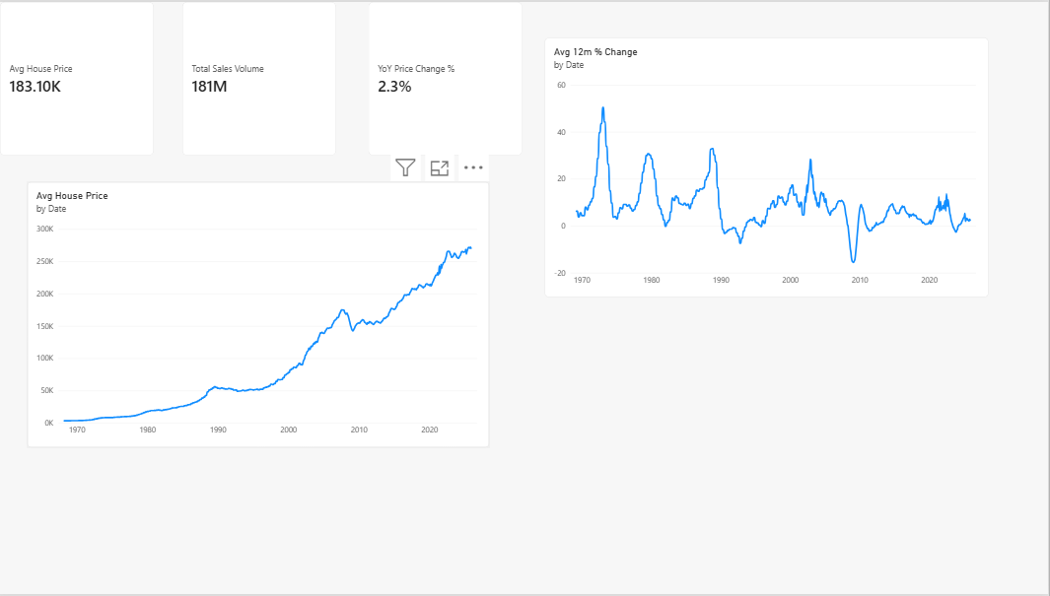
STEP 4 — POWER BI DASHBOARD
Overview Page
A 4-page interactive dashboard built on a proper star schema (Fact_HousePrices + Dim_Region + Dim_Date), with 24 DAX measures behind it.
Headline KPI cards: average price, YoY change, sales volume
UK price trend, 1968–2025
12-month price growth, with positive/negative shading

Slide 7
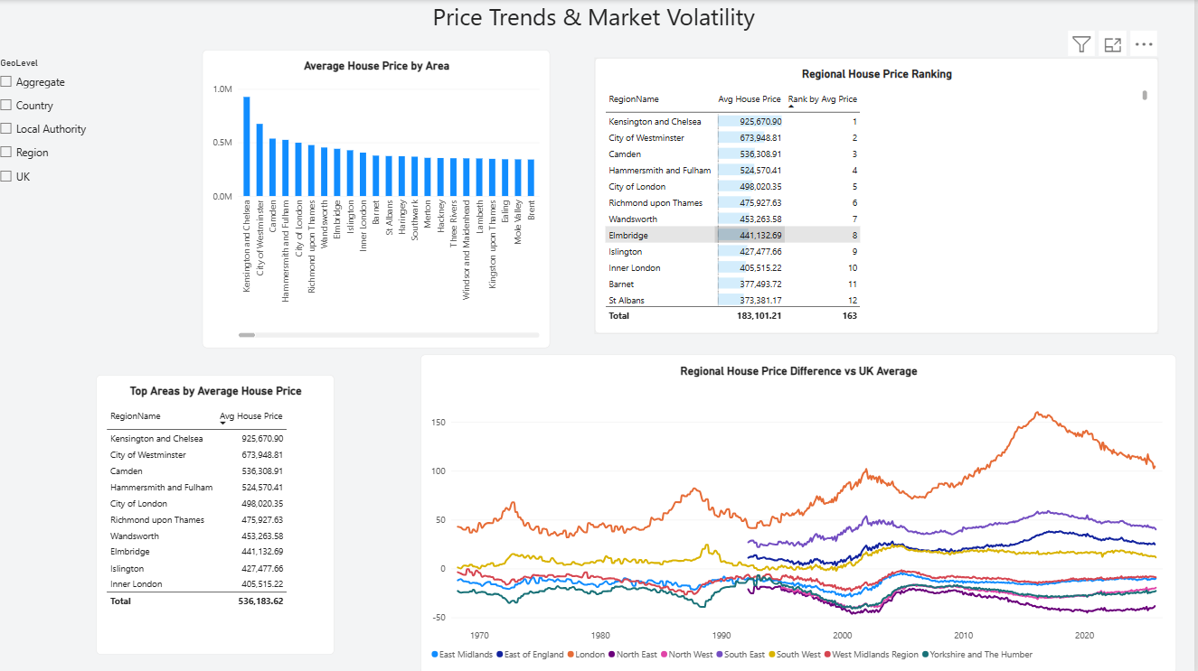
STEP 4 — POWER BI DASHBOARD
Regional Comparison
Where prices sit today, region by region — and how that ranking has shifted historically.
Average price by area, sorted highest to lowest
Live ranked table using a RANKX measure
Regional price difference vs. the UK average, over time
GeoLevel slicer: drill from Local Authority up to Country

Slide 8
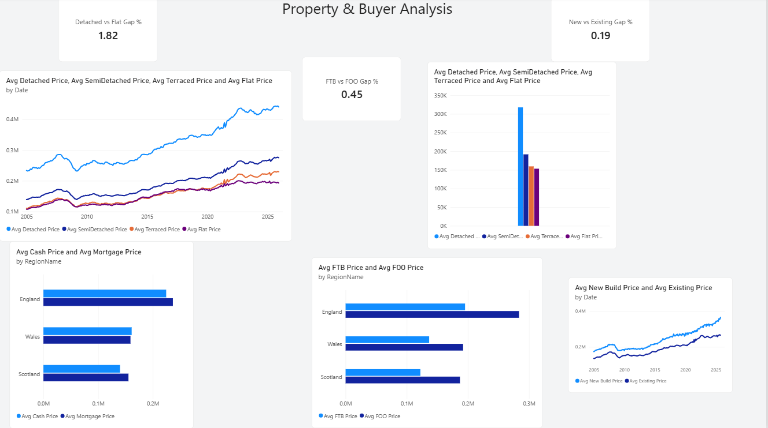
STEP 4 — POWER BI DASHBOARD
Property & Buyer Analysis
Breaking the market down by what's being bought, and by whom.
Detached / Semi-Detached / Terraced / Flat price trends
Cash vs. Mortgage buyers, by country
First-Time Buyers vs. Former Owner-Occupiers
New Build vs. Existing property prices

Slide 9
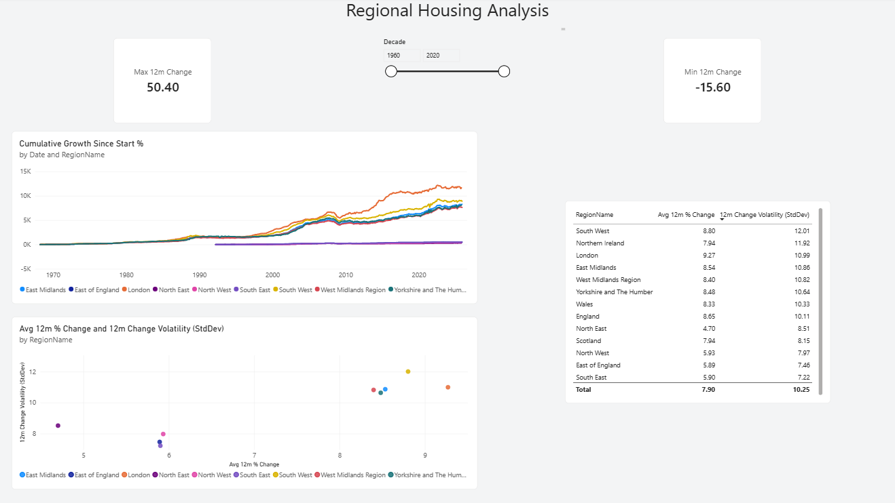
STEP 4 — POWER BI DASHBOARD
Trends & Volatility
Which regions have grown the most — and which have been the most unpredictable along the way.
Cumulative growth since 1968, by region
Growth vs. volatility scatter — risk vs. reward, by region
Regional volatility ranking (standard deviation of 12-month change)
Fastest-growth and sharpest-decline headline cards

Slide 10




Skills Demonstrated
Python & pandas
SQL
Data cleaning, validation, feature engineering at scale
CTEs, window functions, CASE logic, aggregate analysis
Data visualization
Power BI
Matplotlib for exploratory analysis, chart storytelling
Star-schema modeling, DAX measures, interactive dashboards
Full project: cleaned dataset · Jupyter notebook · standalone SQL file · Power BI dashboard
Thank you

