Slide 1

Video Quality
Great news! All videos in this course are uploaded in 1080p for the best possible viewing experience.
If you notice some initial blurriness, don't worry – it should clear up within a few seconds.
COMPLETE JAVA MASTERCLASS
Video Quality

Slide 2
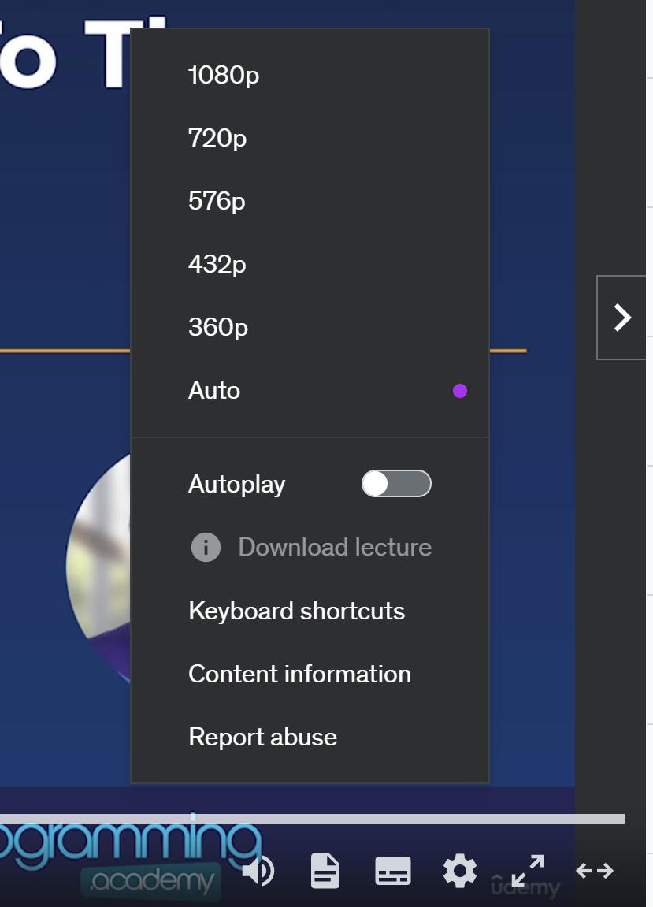
Video Quality
Here's how to ensure the best quality:
Choose "Auto": If you see the "Auto" option in the settings (little cog icon), select that. It'll automatically give you 1080p if your internet connection allows.
COMPLETE JAVA MASTERCLASS
Video Quality

Slide 3
Video Quality
Here's how to ensure the best quality:
If No "Auto": Pick "720p" for consistently good quality.
Be Patient: Sometimes videos need a moment to load fully.
COMPLETE JAVA MASTERCLASS
Video Quality

Slide 4
Video Quality
Rest assured; I want you to have the clearest learning experience possible!
Thanks for watching, and let's dive into the next video!
COMPLETE JAVA MASTERCLASS
Video Quality

