Slide 1
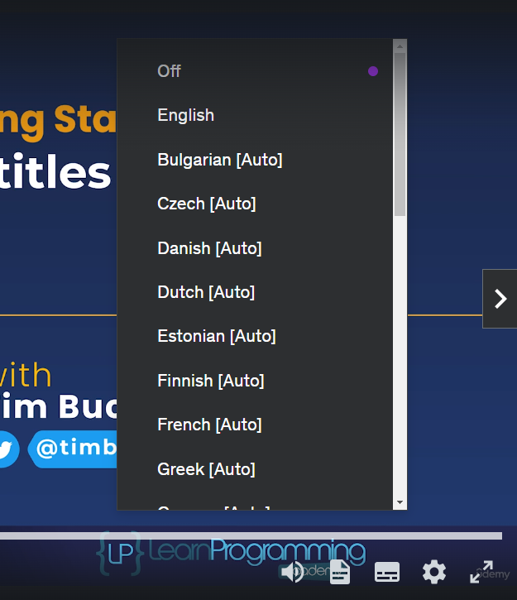

Subtitles
Hey everyone! If I sometimes speak too fast or my accent makes things a bit tricky, I totally understand.
That's where subtitles come in! Here's how to turn them on:
Click the little captions button at the bottom of your video.
Choose your preferred language.
COMPLETE JAVA MASTERCLASS
Subtitles

Slide 2
Subtitles
Important Note: This course has hand-edited English subtitles, which means they're as accurate as possible.
I put in a lot of work to make sure they help you learn!
If you notice any errors, please let me know which video and the timestamp, and I'll get it fixed right away.
For languages other than English, the subtitles are machine-generated.
They might not be perfect, but they can still be helpful.
COMPLETE JAVA MASTERCLASS
Subtitles

Slide 3
Subtitles
My goal is to make sure you have the best possible learning experience, so please use the subtitles if they make following along easier!
Alright, let's move on to the next video!
COMPLETE JAVA MASTERCLASS
Subtitles

