Slide 1

Traditional Switch Challenge
In the previous few videos, we looked at the switch statement, and how we can use it in a similar way, to an "if" statement.
We talked about the traditional version, which you'll see in older applications.
We've also looked at the enhanced version, which I would recommend if you're using JDK 14 or greater, and if you also have the luxury of not having to have your source code be compatible with older versions of Java.
In this video, I'll give you a chance to work on a challenge, using the traditional switch statement.
Let's look at the slide we saw in the last video, which describes the syntax of both.
COMPLETE JAVA MASTERCLASS
Traditional Switch Challenge

Slide 2
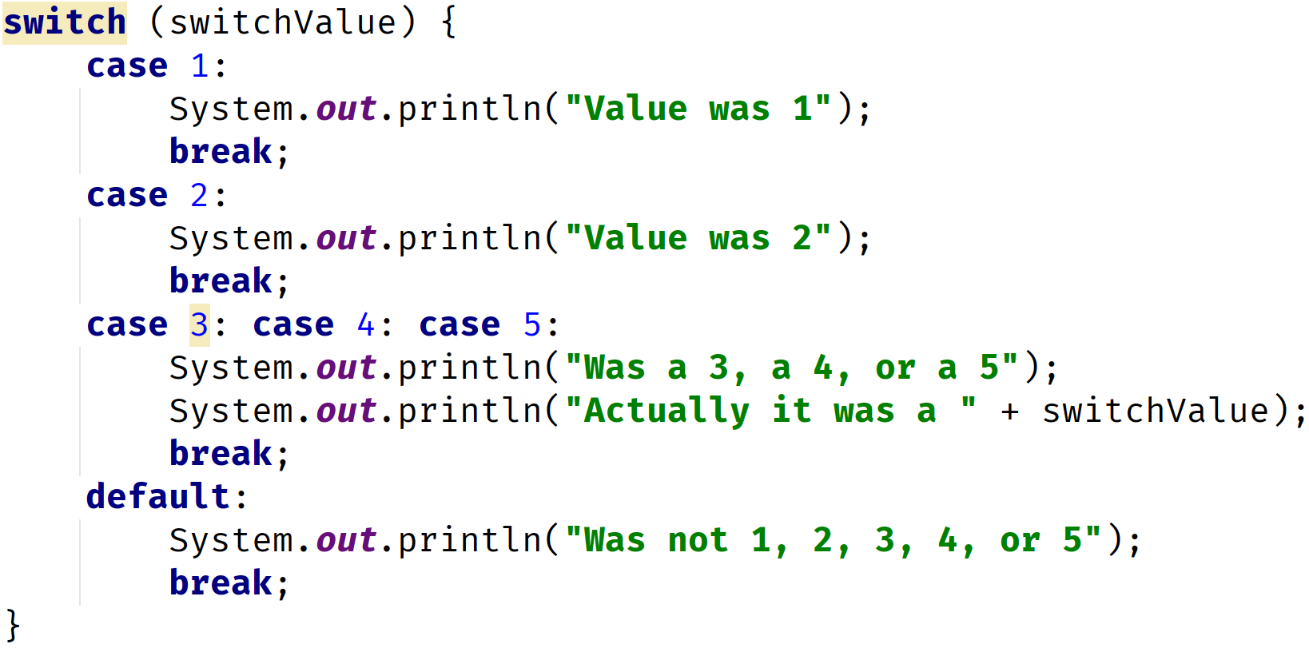
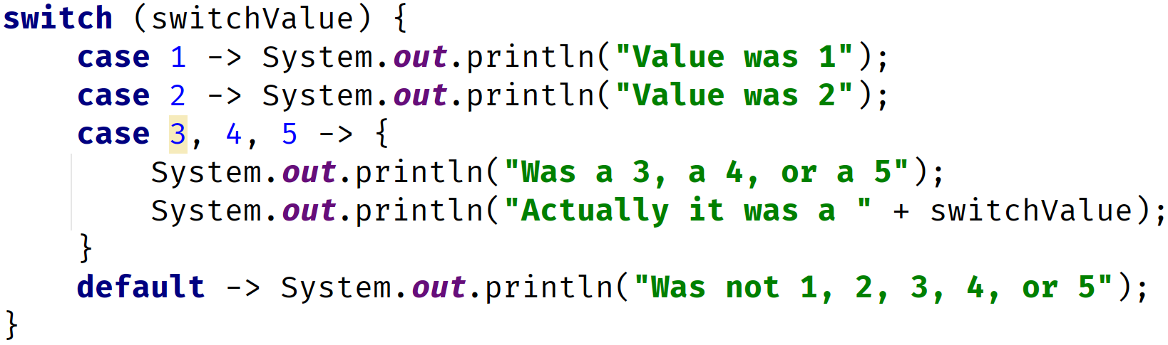
Traditional Switch Statement vs. Enhanced Switch Statement
Traditional Switch Statement | Enhanced Switch Statement
COMPLETE JAVA MASTERCLASS
Traditional Switch Challenge

Slide 3
Switch Challenge
In this challenge, we'll be using the NATO alphabet to replace a character or letter, with NATO's standardized word for that letter.
In radio transmissions, the word car, "C", "A", "R", would be read, "Charlie Able Roger", for clarity.
We'll take a single character, and return the matching word from the NATO phonetic alphabet, shown on this slide.
We'll just do this for the letters A, through E.
NATO phonetic alphabet A = Able, B = Baker, C = Charlie, D = Dog, E = Easy F = Fox, G = George, H = How, I = Item, J = Jig K = King, L = Love, M = Mike, N = Nan, O = Oboe P = Peter, Q = Queen, R = Roger, S = Sugar, T = Tare U = Uncle, V = Victor, W = William, X = X-ray, Y = Yoke, Z = Zebra
COMPLETE JAVA MASTERCLASS
Traditional Switch Challenge

Slide 4
Switch Challenge
To do this:
Create a new char variable.
Use the traditional switch statement (with a colon in case labels) that tests the value in the variable from Step 1.
Create cases for the characters, A, B, C, D, and E.
NATO phonetic alphabet A = Able, B = Baker, C = Charlie, D = Dog, E = Easy F = Fox, G = George, H = How, I = Item, J = Jig K = King, L = Love, M = Mike, N = Nan, O = Oboe P = Peter, Q = Queen, R = Roger, S = Sugar, T = Tare U = Uncle, V = Victor, W = William, X = X-ray, Y = Yoke, Z = Zebra
COMPLETE JAVA MASTERCLASS
Traditional Switch Challenge

Slide 5
Switch Challenge
To do this:
Display a message in each case block, with the letter and the NATO word, then break.
Add a default block, which displays the letter with a message saying not found.
NATO phonetic alphabet A = Able, B = Baker, C = Charlie, D = Dog, E = Easy F = Fox, G = George, H = How, I = Item, J = Jig K = King, L = Love, M = Mike, N = Nan, O = Oboe P = Peter, Q = Queen, R = Roger, S = Sugar, T = Tare U = Uncle, V = Victor, W = William, X = X-ray, Y = Yoke, Z = Zebra
COMPLETE JAVA MASTERCLASS
Traditional Switch Challenge

