Slide 1

this vs super
Let's discuss the difference between the this and super keywords.
We'll also find out about the differences between the this() and super() method calls.
COMPLETE JAVA MASTERCLASS
this vs super

Slide 2
this vs super
Let's start with the super and this keywords first.
The keyword super is used to access or call the parent class members (both variables and methods).
The keyword this is used to call the current class members (both variables and methods).
this is required when we have a parameter with the same name as an instance variable or field.
NOTE: We can use either of these two keywords anywhere in a class except for static elements such as a static method. Any attempt to do so will lead to compile time errors.
COMPLETE JAVA MASTERCLASS
this vs super

Slide 3
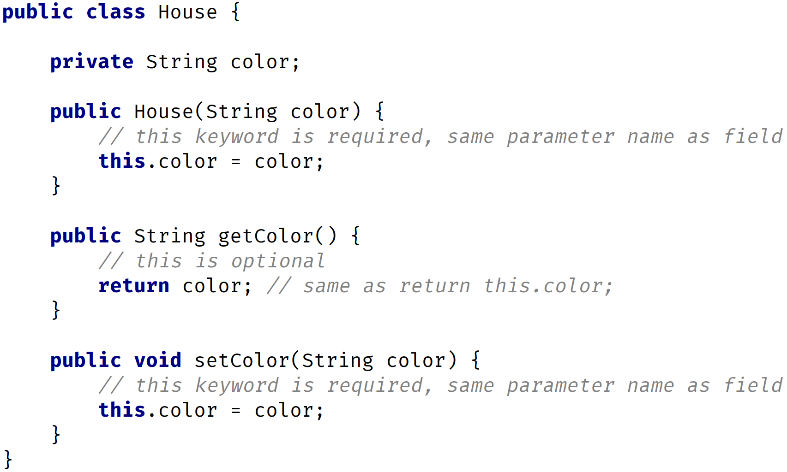
Keyword this
The keyword this is commonly used within constructors and setters and is optionally used within getters.
In this example, I'm using the this keyword in a constructor and setter since there's a parameter with the same name as the instance or field.
In the getter, I don't have any parameters so there's no conflict. Therefore, the use of this is optional there.
COMPLETE JAVA MASTERCLASS
this vs super

Slide 4
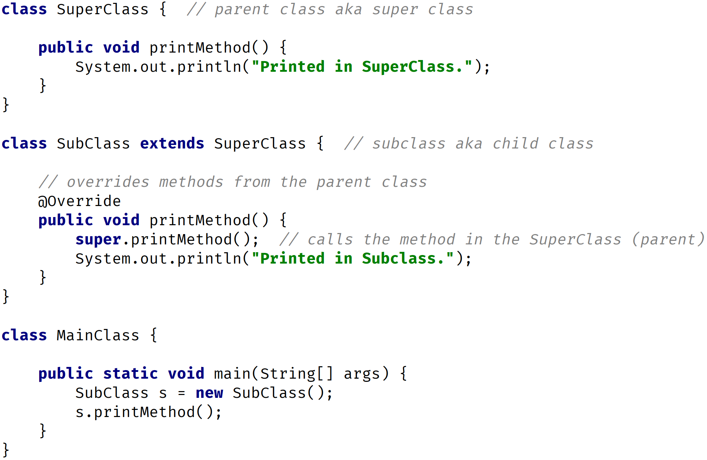
Keyword super
The keyword super is commonly used with method overriding when we call a method with the same name from the parent class.
In this example, I have a method called printMethod that calls super.printMethod.
COMPLETE JAVA MASTERCLASS
this vs super

Slide 5
this() vs super() call
In Java, we've got the this() and super() calls. Notice the parentheses.
These are known as calls since they look like regular method calls although we're calling certain constructors.
Use this() to call a constructor from another overloaded constructor in the same class.
The call to this() can only be used in a constructor, and it must be the first statement in a constructor.
It's used with constructor chaining, in other words, when one constructor calls another constructor, and it helps to reduce duplicated code.
The only way to call a parent constructor is by calling super(), which calls the parent constructor.
COMPLETE JAVA MASTERCLASS
this vs super

Slide 6
this() vs super() call
The Java compiler puts a default call to super() if we don't add it, and it's always a call to the no argument constructor, which is inserted by the compiler.
The call to super() must be the first statement in each constructor.
A constructor can have a call to super() or this(), but never both.
COMPLETE JAVA MASTERCLASS
this vs super

Slide 7
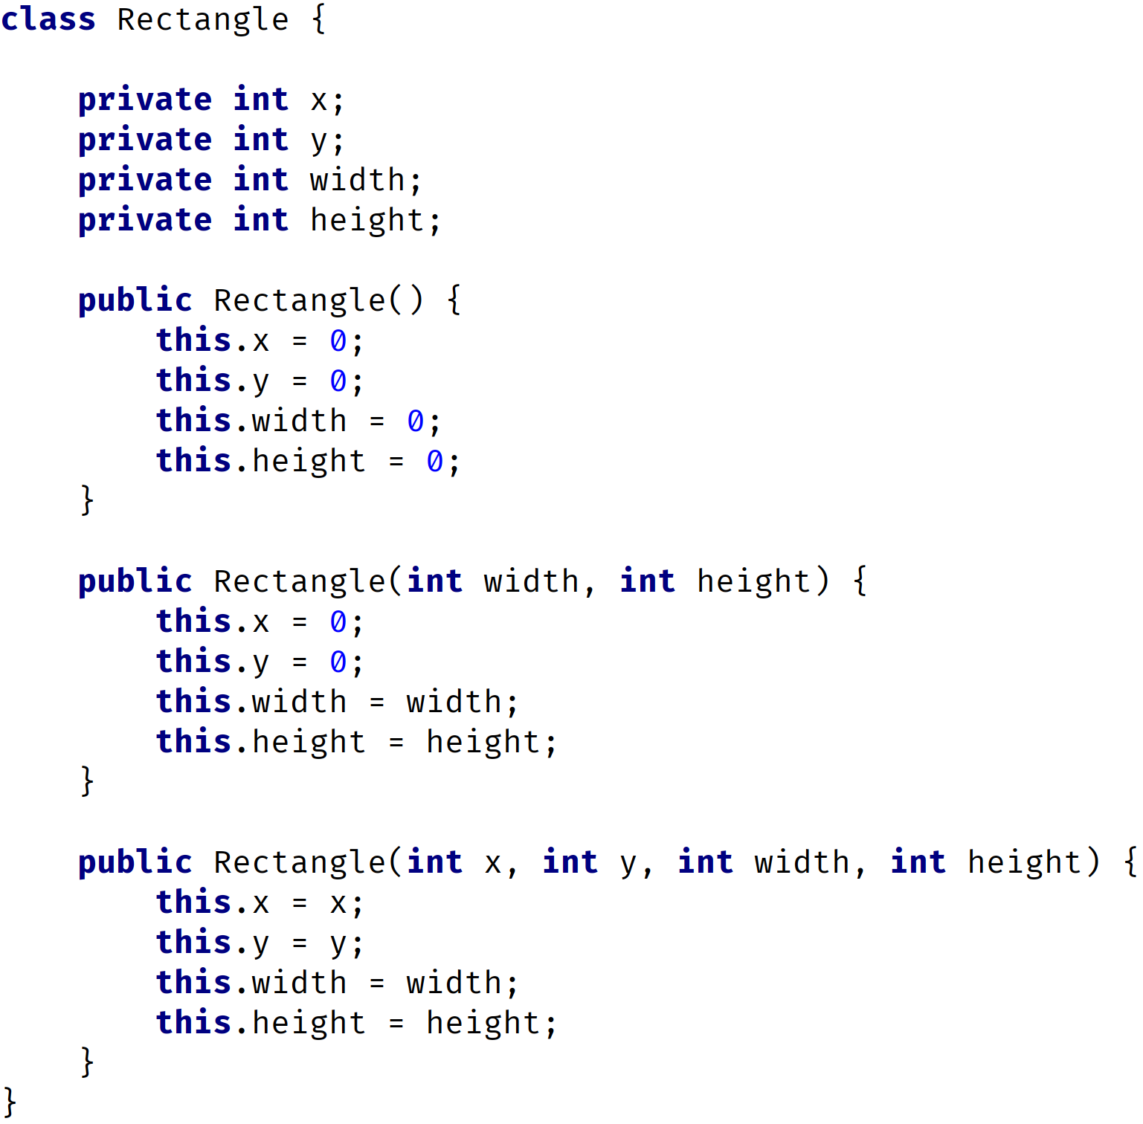
Constructors Bad Example
Here, I have three constructors.
All three constructors initialize variables.
There's repeated code in each constructor.
I'm initializing variables in each constructor with some default values.
You should never write constructors like this.
Let's look at the right way to do this by using a this() call.
COMPLETE JAVA MASTERCLASS
this vs super

Slide 8
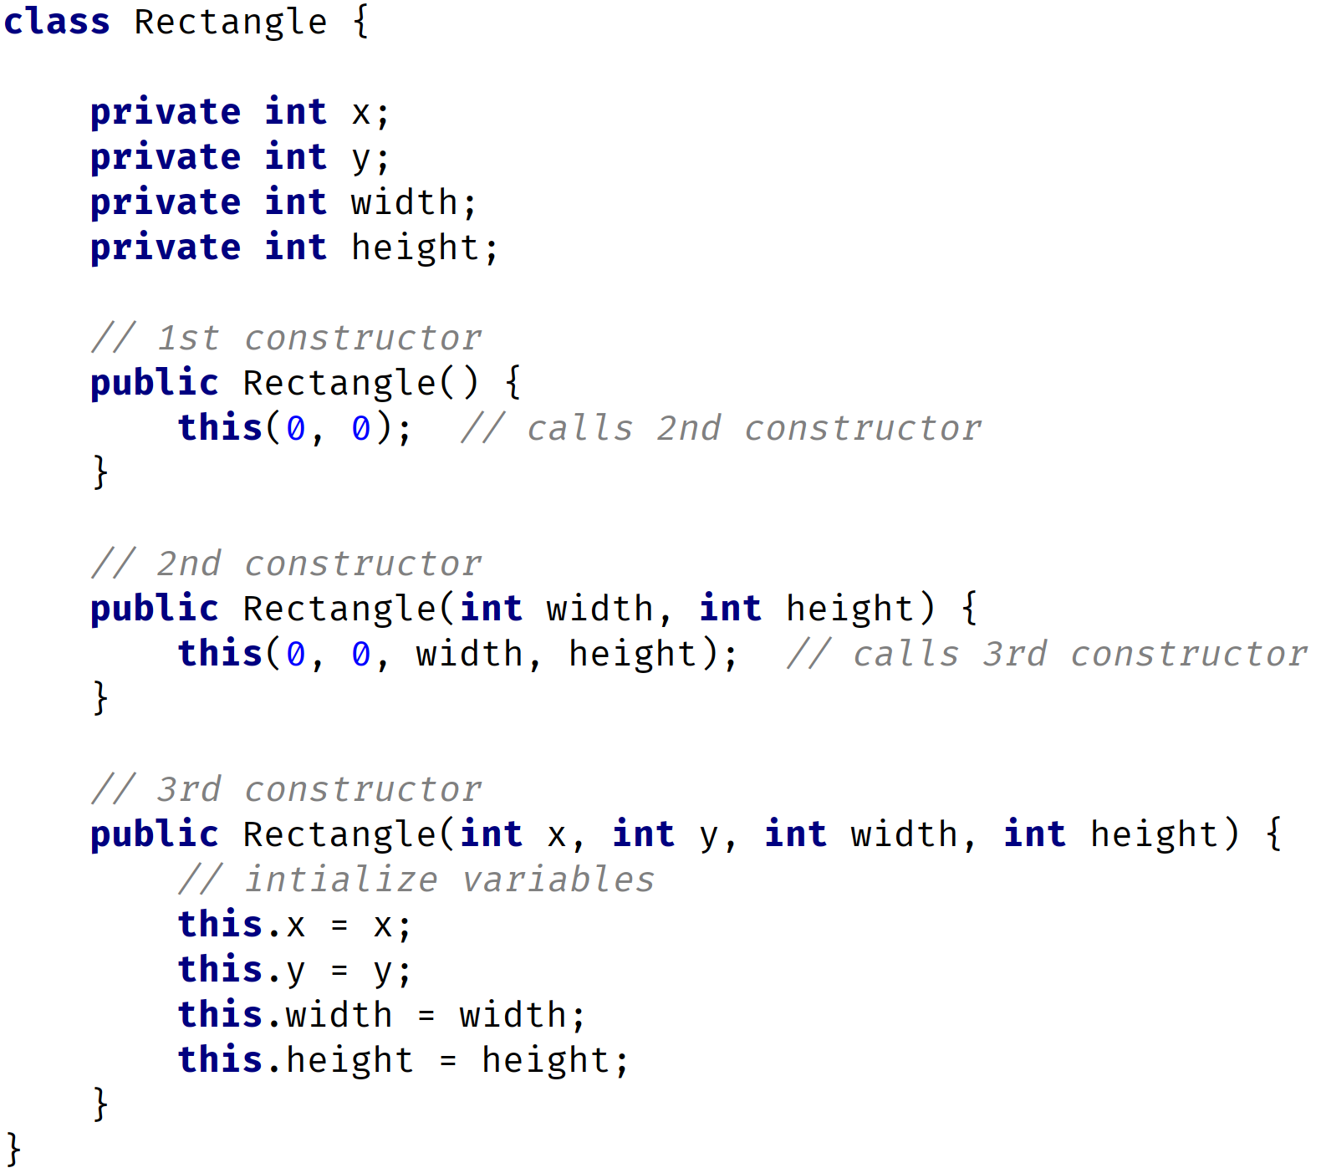
Constructors Good Example
In this example, I still have three constructors.
The 1st constructor calls the 2nd constructor, the 2nd constructor calls the 3rd constructor, and the 3rd constructor initializes the instance variables.
The 3rd constructor does all the work.
No matter what constructor I call, the variables will always be initialized in the 3rd constructor.
This is known as constructor chaining, the last constructor has the responsibility to initialize the variables.
COMPLETE JAVA MASTERCLASS
this vs super

Slide 9
Comparing Both Examples
BAD
GOOD
COMPLETE JAVA MASTERCLASS
this vs super

Slide 10
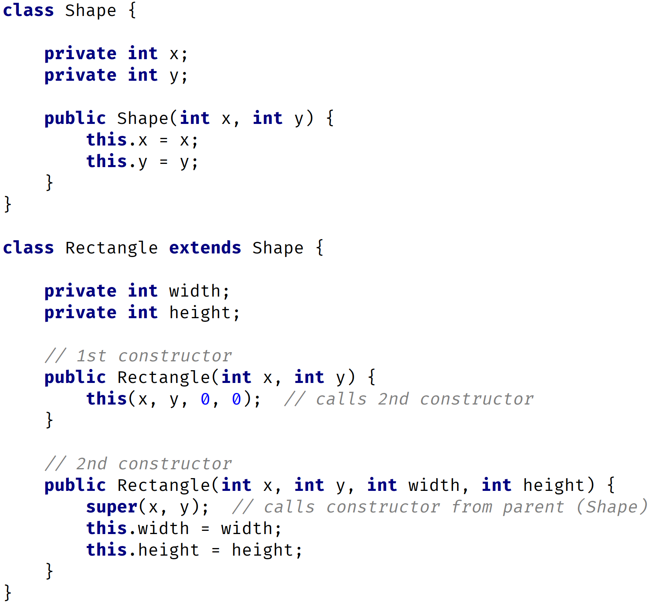
super() call example
In this example, I have a class Shape, with x and y instance variables, and class Rectangle that extends Shape with variables width and height.
In the Rectangle class, the 1st constructor is calling the 2nd constructor.
The 2nd constructor calls the parent constructor with parameters x and y.
The parent constructor will initialize the x and y variables, while the 2nd Rectangle constructor will initialize the width and height variables.
Here, I have both the super() and this() calls.
COMPLETE JAVA MASTERCLASS
this vs super

