Slide 1
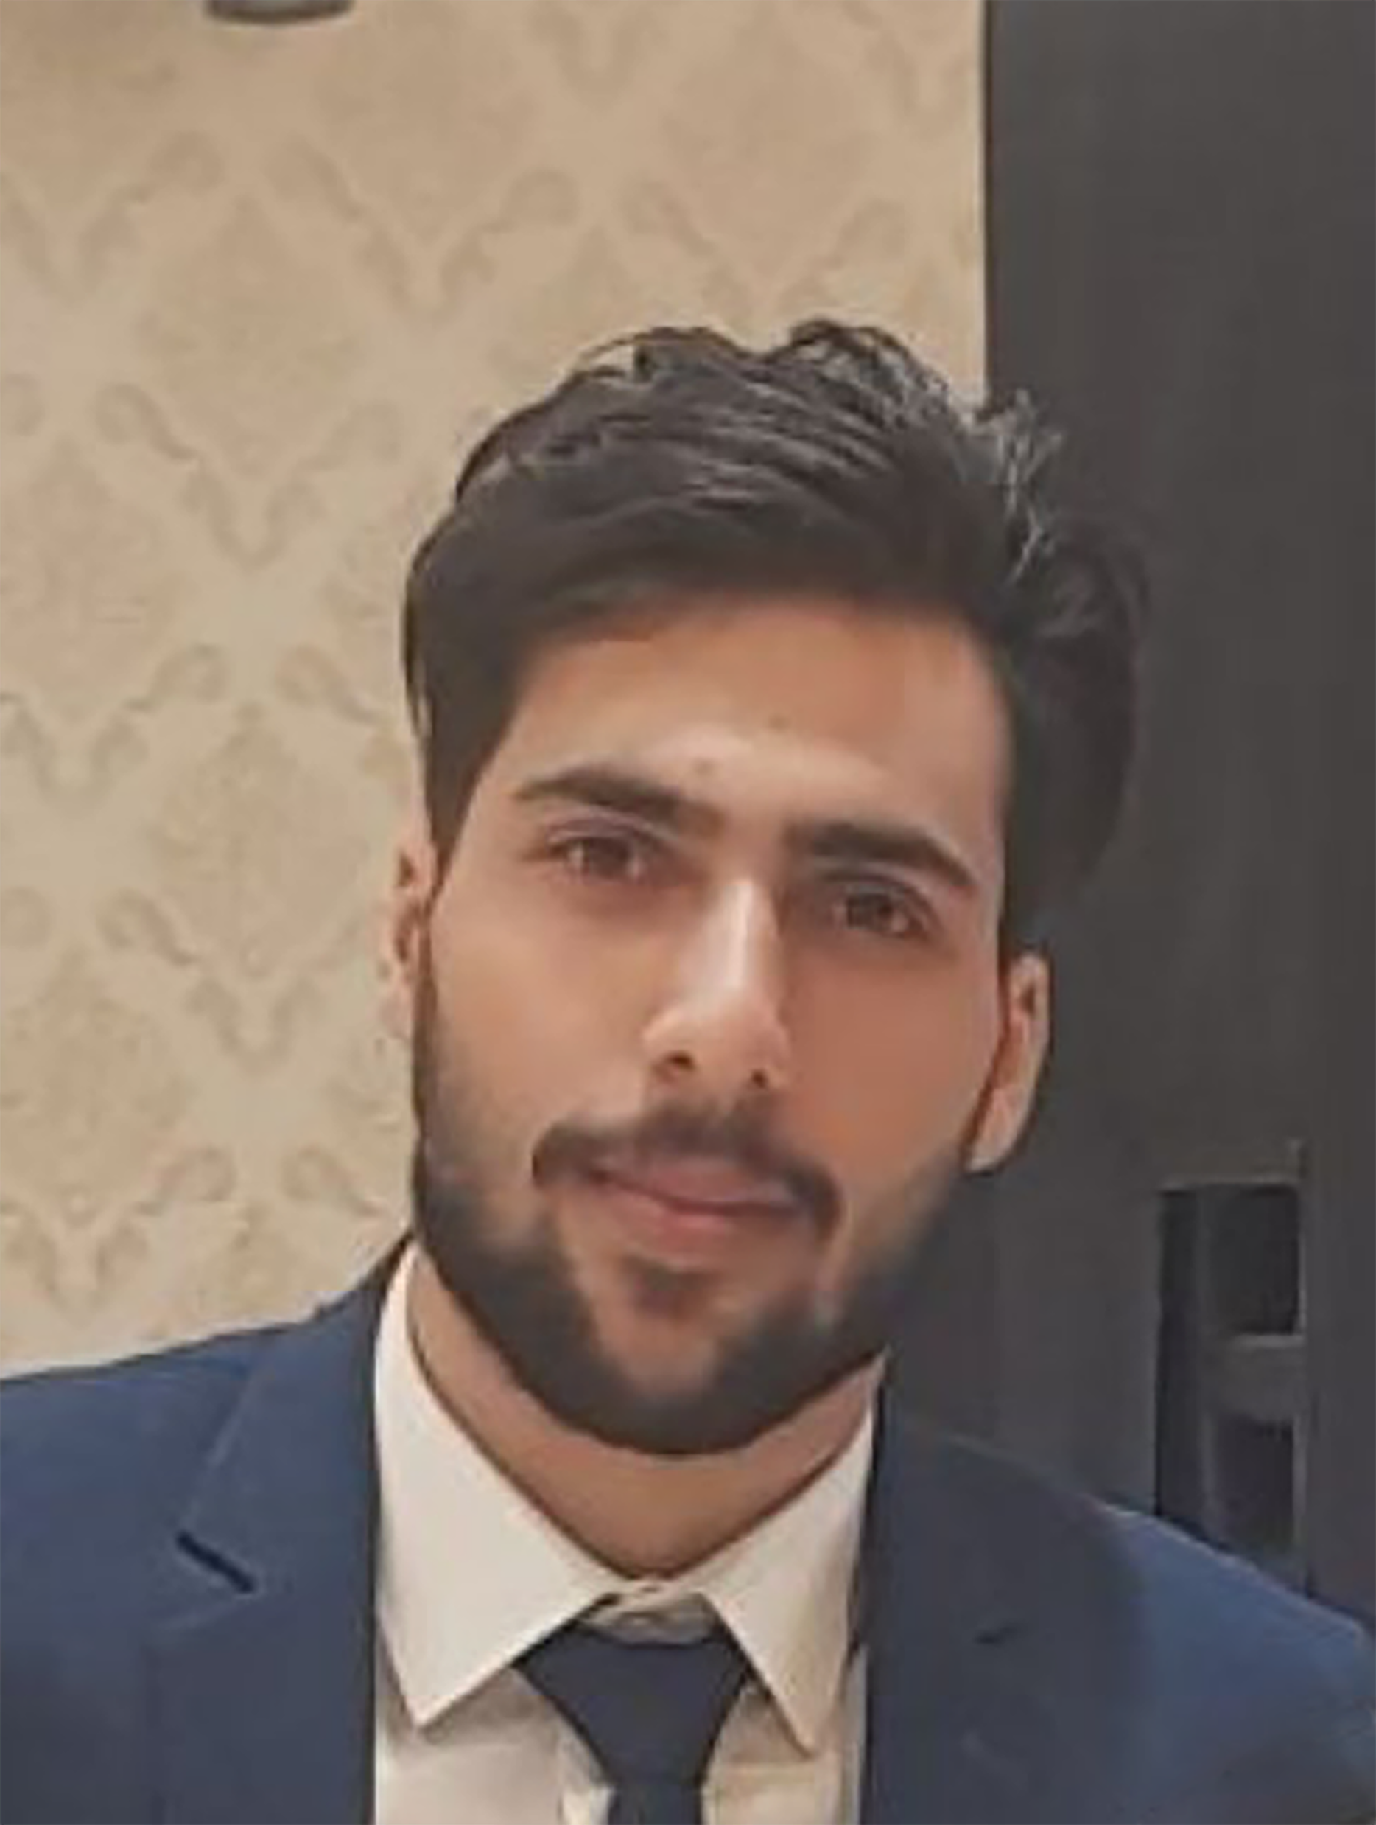





MOHAMMAD HOSSEIN
RASHIDI
LARAVEL DEVELOPER
I am Mohammad Hossein Rashidi, a backend developer with PHP language and Laravel framework with less than a year of experience, a strong interest in teamwork and increasing work experience.
EDUCATION
2015 – 2019
Technical University of Kermanshah
Bachelor of software engineering
SKILLS
PHP
OOP
Regular Expressions
Laravel
Data binding
Query builder
Authorization
Blade
Livewire
Database
Mysql
Sql Server
Side Skills
Fast typing
Git
EXPERIENCE
LEARN PHP ADVANCED TOPLEARN
create and design panel admin
LEARN LARAVEL TOPLEARN
create and design shop store
CONTACT
+989038212207
Mhr.pyt@gmail.com
Iran.Kermanshah
http://github.com/mohammad-ho3in
https://www.linkedin.com/in/mohamad-hosein-rashidi-ab869a229

