Slide 1
Seminar Cognitive Systems 2
Sliding Block
Puzzle Solver
8
7
6
1
2
5
4
3
→
3
4
5
2
1
6
7
8
BFS vs A* with Manhattan Distance Heuristic
start
target
BTU Cottbus-Senftenberg · Problem KS2.1 · July 28, 2026
Notes:
Title slide. Mention this is KS2.1 from Prof. Wolff's Seminar Cognitive Systems 2.

Slide 2
Problem Statement
8
7
6
▸
3×3 sliding block puzzle with 8 numbered tiles and one blank
5
4
3
Start State
▸
Tiles can only slide horizontally or vertically into the blank space
2
1
▸
Goal: reach a specific target configuration in as few moves as possible
→
▸
Must implement BFS (uninformed) and A* (informed with admissible heuristic)
1
2
▸
Track: node expansions · max nodes in memory · moves in solution
3
4
5
Target State
6
7
8
KS2.1 · Prof. Wolff · BTU Cottbus-Senftenberg
Notes:
Explain the puzzle setup from the assignment sheet. Highlight that the blank is in the bottom-right of start and top-right of target. Both must count and display: expansions, max memory nodes, moves.

Slide 3
Breadth-First Search
Uninformed Search
Frontier
FIFO queue (deque) — explores all nodes at depth d before d+1
Completeness
Complete — will always find a solution if one exists
Optimality
Optimal for unit-cost steps — shortest path guaranteed
Time complexity
O(bᵈ) — exponential in solution depth d
Space complexity
O(bᵈ) — must store all discovered states
Key tradeoff
Finds optimal solution but consumes large memory
Implementation: collections.deque · No external search libraries used
Notes:
BFS explores the tree level by level. Since every move costs 1, BFS is optimal. The tradeoff is memory — at depth 26 the frontier can be huge.

Slide 4
A* Search
Informed Search with Admissible Heuristic
f(n) = g(n) + h(n)
Frontier
Min-heap (heapq) ordered by f(n)
Completeness
Complete with admissible heuristic
f(n):
total estimated cost of the path through n
Optimality
g(n):
exact cost (number of moves) from start to n
Optimal — never overestimates cost
h(n):
heuristic estimate from n to goal (admissible)
Efficiency
Expands far fewer nodes than BFS
Implementation
heapq · No external libraries
Notes:
A* orders the frontier by f(n) = g(n) + h(n). With an admissible heuristic it is optimal. Our heuristic is Manhattan distance.

Slide 5
Admissible Heuristic: Manhattan Distance
h(n) = Σ |rowᵢ − row*ᵢ| + |colᵢ − col*ᵢ|
Example: Tile 8
8
7
6
✓
Each move shifts one tile exactly one step (row or column)
5
4
3
✓
Manhattan distance counts the minimum moves for each tile ignoring others
2
1
✓
It never overestimates actual moves → h(n) ≤ h*(n) → Admissible
Tile 8 is at (0,0) in start
Goal position is (2,2)
|0−2| + |0−2| = 2 + 2 = 4
✓
Blank tile is excluded (it is not numbered and has no fixed goal position)
Also implemented: Misplaced Tiles heuristic (weaker, fewer nodes than BFS but more than Manhattan)
Notes:
Walk through the Manhattan distance for tile 8. Total h for the start state is the sum across all 8 tiles. Admissibility proof: each single move reduces one tile's Manhattan distance by at most 1.

Slide 6
Experimental Results
Assignment puzzle · python3 main.py
Algorithm
Heuristic
Expansions
Max Memory
Moves
Breadth-First Search
—
178,223
180,899
28
A* Search
Manhattan distance
174
266
28
1,024×
680×
28
fewer
expansions
less
memory
moves
(both)
Notes:
Read out the numbers. Stress: both find optimal 28-move solution, but A* does it with 174 expansions vs 178,223 for BFS. The heuristic guides A* and avoids exploring the bulk of the search space.

Slide 7
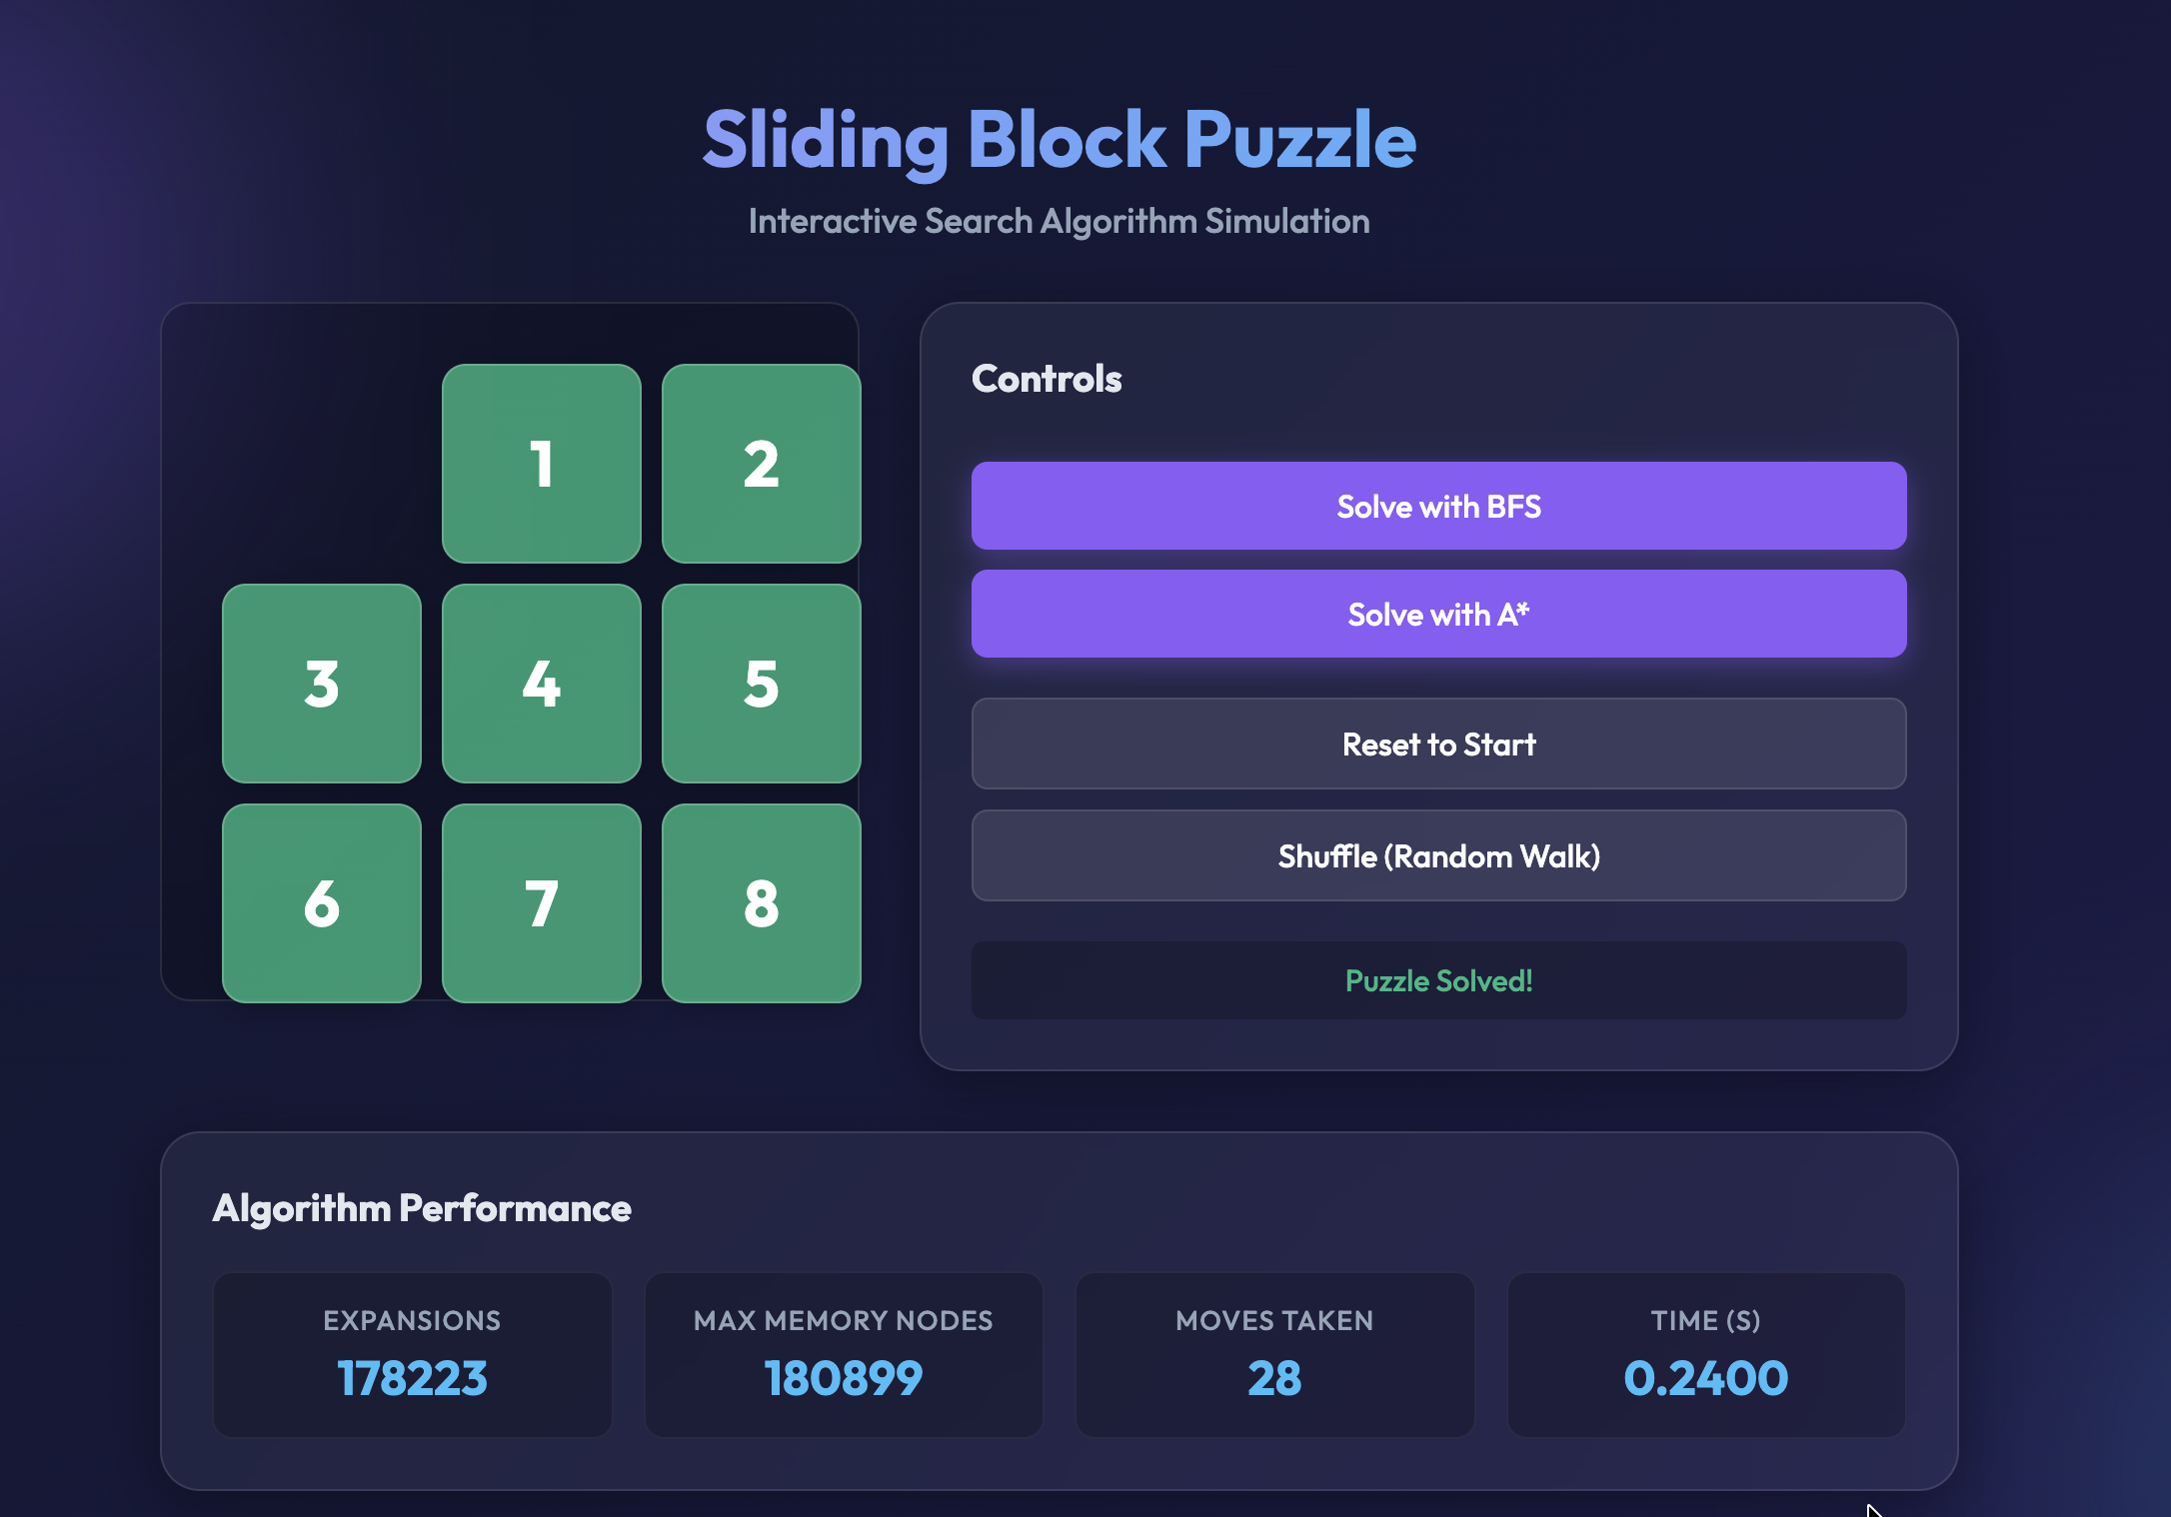

Live Demo
Screenshots from the actual running application
Breadth-First Search — solved
A* Search — solved
Same 28-move solution, same start/target puzzle · values match Experimental Results

Slide 8
Discussion
Why does A* expand ~1,024× fewer nodes than BFS?
BFS is blind
1
Without a heuristic, BFS must explore all states at each depth level. At depth 28 the frontier can hold tens of thousands of states simultaneously.
Manhattan distance is tightly informed
2
The heuristic closely mirrors the true cost — almost every state it evaluates is on or near the optimal path, so very few dead-end branches are expanded.
Same optimal result
3
Both algorithms return a 28-move solution. A* achieves this with 174 expansions; admissibility guarantees no shorter path exists.
Memory advantage
4
A* keeps only 266 nodes in memory vs 180,899 for BFS — a direct consequence of fewer branches explored.
Notes:
This is the core discussion slide. Emphasize that the heuristic acts as a "compass" — BFS stumbles in the dark while A* walks confidently toward the goal.

Slide 9
Summary
🧩
Implemented BFS and A* from scratch using only Python standard library
📐
Manhattan distance is admissible → A* guaranteed to find optimal solution
📊
A* expands 1,024× fewer nodes and holds 680× less memory than BFS
🏁
Both algorithms find the same 28-move optimal solution path
⚡
Informed search is dramatically more efficient for complex state spaces
Thank you · Questions?
Notes:
Conclude by summarizing the key takeaway: heuristics make the difference. A* is a better choice when a good admissible heuristic is available. Open the floor for questions.

