Slide 1
Effects of Dietary Chitosan for Mitigating Enteric Methane Emissions from Ruminants: A Meta-Analysis of In Vitro Experiments
Rakhmad P. Harahap, Duta Setiawan, Sri Suharti, Nahrowi, Anuraga Jayanegara
AFENUE (Animal Feed and Nutrition Modelling Research Group)

Slide 2
Penentuan Topik
Meta-analysis is one method of research synthesis.
Research synthesis may be defined as review of primary research on a given topic with purpose of integrating the findings (e.g., for creating generalizations or resolving conflicts)
Penentuan topik meta-analisis:
Update publikasi terkini (browsing internet)
Publikasi yang sedang trend
Penentuan X (independent var.) dan Y (dependent var.)
X : Kitosan; Y : Metanogenesis dan profil fermentasi rumen
AFENUE (Animal Feed and Nutrition Modelling Research Group)

Slide 3
Pengumpulan Data
Kriteria artikel yang dimasukkan dalam data base:
Artikel tersebut diterbitkan dalam Bahasa Inggris
Dosis kitosan dalam ransum dan emisi metan (CH₄)
Percobaan dilakukan dengan menggunakan sistem in vitro batch dengan sapi atau domba sebagai donor cairan rumen
Terdapat 41 studi dari 12 artikel
AFENUE (Animal Feed and Nutrition Modelling Research Group)

Slide 4
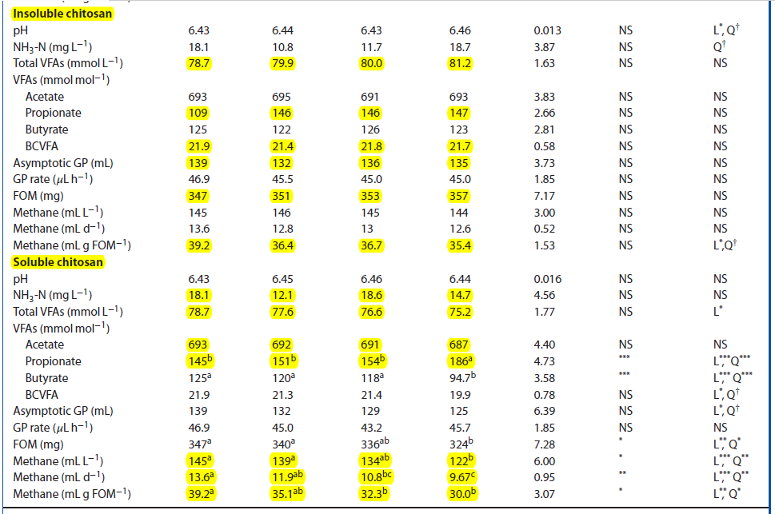
Input Data Base
Belanche et al. 2016
AFENUE (Animal Feed and Nutrition Modelling Research Group)

Slide 5
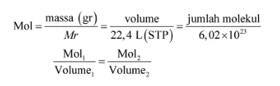
Input Data Base
 |  |  |  |  | day |  | mg | ml | g/kg dm | mmol/l | mmol/d | mmol/g dom
no | paper | study | year | repl | period | system | sampel incubation (DM) | rumen+buffer | chi | ch4v | ch4d | ch4dom/dmd
1 | belanche | 1 | 2016 | 4 | 1 | batch | 500 | 50 | 0,00 | 6,473 | 0,607 | 1,750
2 | belanche | 1 | 2016 | 4 | 1 | batch | 500 | 50 | 0,50 | 6,518 | 0,571 | 1,625
3 | belanche | 1 | 2016 | 4 | 1 | batch | 500 | 50 | 1,00 | 6,473 | 0,580 | 1,638
4 | belanche | 1 | 2016 | 4 | 1 | batch | 500 | 50 | 2,00 | 6,429 | 0,563 | 1,580
5 | belanche | 2 | 2016 | 4 | 1 | batch | 500 | 50 | 0,00 | 6,473 | 0,607 | 1,750
6 | belanche | 2 | 2016 | 4 | 1 | batch | 500 | 50 | 0,50 | 6,205 | 0,531 | 1,567
7 | belanche | 2 | 2016 | 4 | 1 | batch | 500 | 50 | 1,00 | 5,982 | 0,482 | 1,442
8 | belanche | 2 | 2016 | 4 | 1 | batch | 500 | 50 | 2,00 | 5,446 | 0,432 | 1,339
AFENUE (Animal Feed and Nutrition Modelling Research Group)

Slide 6
Model Meta-analisis (PROC. MIXED)
Menurut St-Pierre (2001):
Y_{ij} = B₀ + B₁X_{ij} + s_{i} + e_{ij}
Keterangan:
Y_{ij} = variabel dependen
B₀ = keseluruhan intercept di semua eksperimen (efek tetap)
B₁ = koefisien regresi linier Y pada X (efek tetap)
X_{ij} = nilai variabel prediktor kontinu (level penambahan kitosan)
s_{i} = efek acak percobaan i
e_{ij} = kesalahan residual yang tidak dapat dijelaskan
Disajikan dengan p-value dan root mean square error (RMSE).
Analisis statistik dilakukan dengan perangkat lunak SAS versi 9.1 (SAS Institute Inc., Cary, NC, USA)
AFENUE (Animal Feed and Nutrition Modelling Research Group)

Slide 7
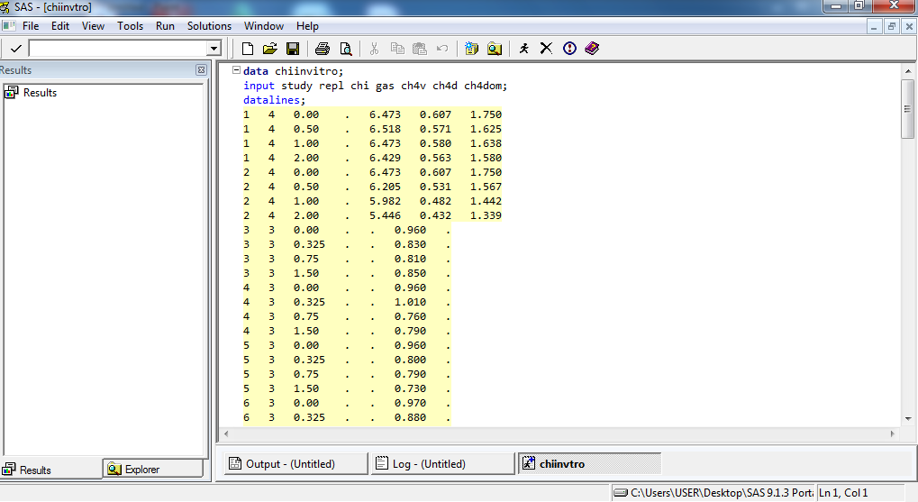
Coding SAS 9.1
AFENUE (Animal Feed and Nutrition Modelling Research Group)

Slide 8
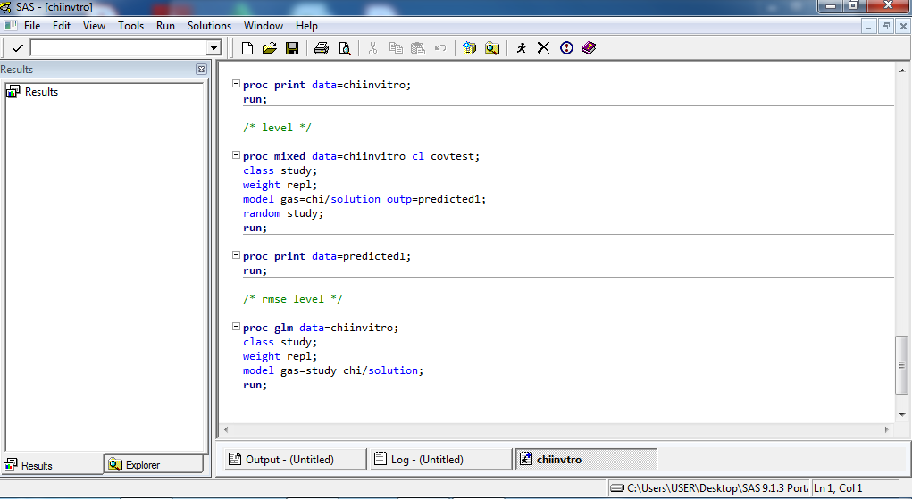
Coding SAS 9.1
AFENUE (Animal Feed and Nutrition Modelling Research Group)

Slide 9
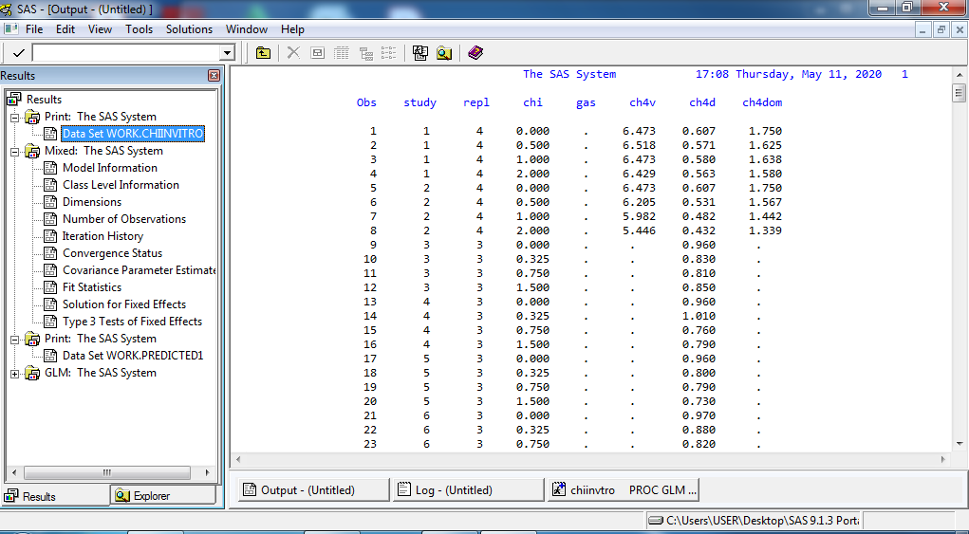
Coding SAS 9.1
AFENUE (Animal Feed and Nutrition Modelling Research Group)

Slide 10
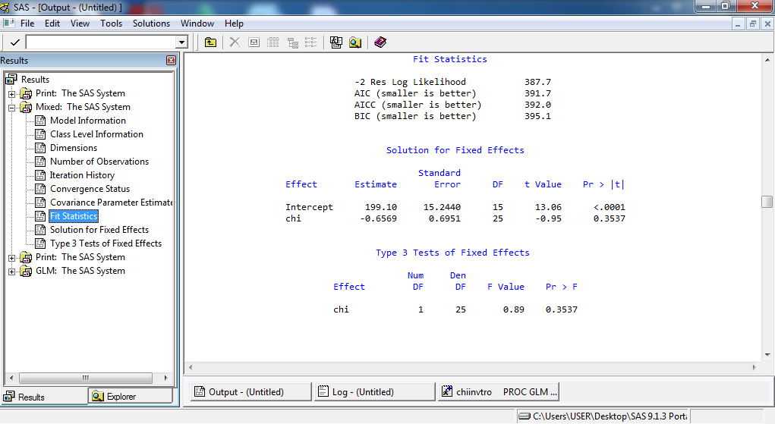
Coding SAS 9.1
AFENUE (Animal Feed and Nutrition Modelling Research Group)

Slide 11
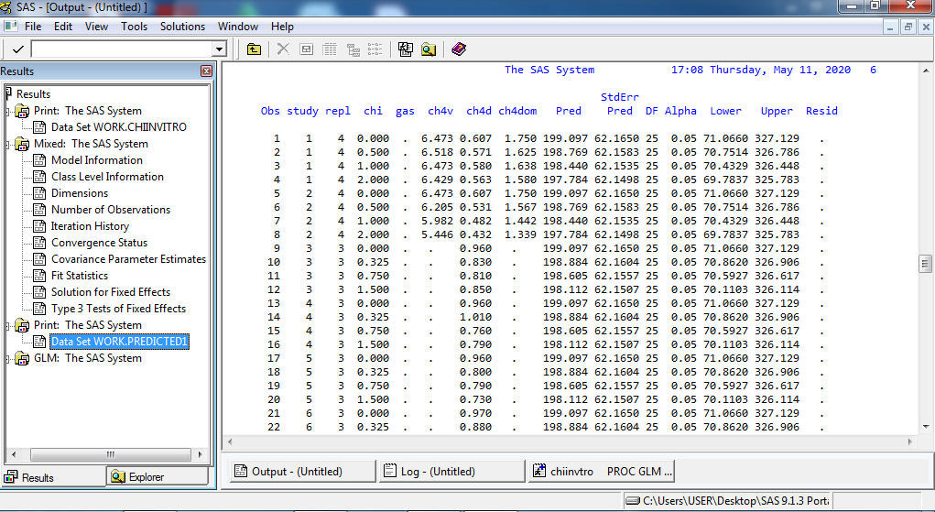
Coding SAS 9.1
AFENUE (Animal Feed and Nutrition Modelling Research Group)

Slide 12
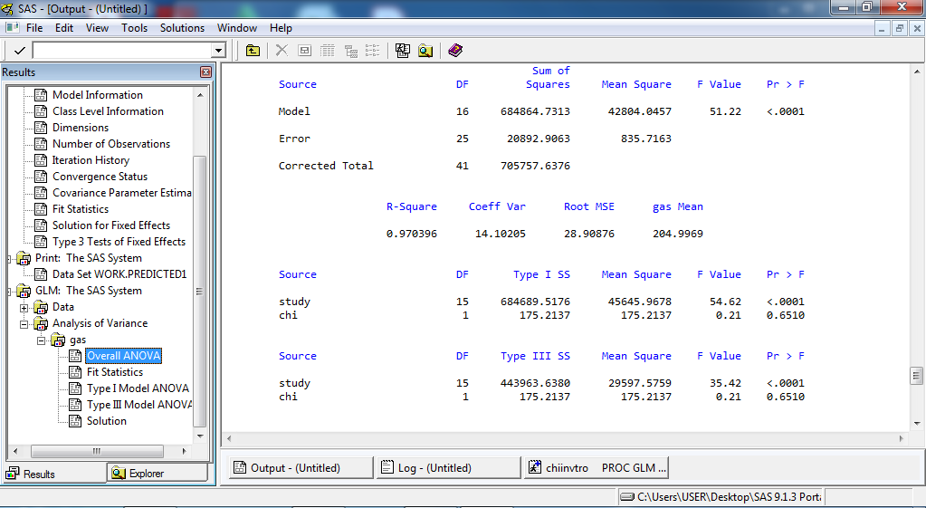
Coding SAS 9.1
AFENUE (Animal Feed and Nutrition Modelling Research Group)

Slide 13
Penyajian Data
Table 1. Effects of chitosan addition (in g/kg DM) on gas production and enteric methane (CH₄) emission of in vitro batch culture study
 |  |  | Parameter estimates |  |  |  | Model statistics
Response parameter | Unit | n | Intercept | SE intercept | Slope | SE slope | p-Value | RMSE
Gas production | ml/g DM | 42 | 199.1 | 15.2 | -0.657 | 0.695 | <.001 | 28.9
CH₄ | mmol/d | 65 | 1.03 | 0.13 | -0.072 | 0.017 | <.001 | 0.17
CH₄ | mmol/g DOM | 47 | 3.58 | 0.41 | -0.050 | 0.055 | <.001 | 1.76
H₂S | µmol/d/g DM | 6 | 5.55 | 3.72 | 0.121 | 0.046 | 0.376 | 0.79
Note: DM=dry matter, DOM=digested organic matter; n=number of treatment, RMSE=root mean square error, SE=standard error.
AFENUE (Animal Feed and Nutrition Modelling Research Group)

Slide 14
Penyajian Data
Table 2. Effects of chitosan addition (in g/kg DM) on rumen fermentation, microbial population, and enzyme CMCase activity in the in vitro batch culture study
 |  |  | Parameter estimates |  |  |  | Model statistics
Response parameter | Unit | n | Intercept | SE intercept | Slope | SE slope | p-Value | RMSE
pH |  | 82 | 6.40 | 0.05 | 0.002 | 0.004 | <.001 | 0.12
NH₃ | mg/dL | 82 | 25.2 | 1.43 | -0.044 | 0.243 | <.001 | 8.24
Total VFA | mmol/l | 89 | 67.8 | 3.19 | -0.228 | 0.366 | <.001 | 7.49
C₂ | % | 92 | 62.7 | 0.98 | -0.024 | 0.071 | <.001 | 2.29
C₃ | % | 92 | 20.4 | 0.68 | 0.304 | 0.155 | <.001 | 5.42
C₄ | % | 94 | 11.5 | 0.47 | -0.199 | 0.086 | <.001 | 2.97
iso-C₄ | % | 25 | 0.95 | 0.16 | 0.001 | 0.004 | <.001 | 0.07
C₅ | % | 27 | 2.13 | 0.17 | 0.016 | 0.009 | <.001 | 0.17
iso-C₅ | % | 25 | 1.86 | 0.33 | 0.003 | 0.011 | <.001 | 0.20
C₆ | % | 6 | 0.20 | 0.22 | 0.004 | 0.002 | 0.527 | 0.04
C₂:C₃ |  | 92 | 3.23 | 0.14 | -0.041 | 0.024 | <.001 | 0.81
BCVFA |  | 25 | 3.39 | 0.44 | -0.314 | 0.082 | <.001 | 0.87
TVFA:TDS | mmol/g DM | 36 | 8.75 | 0.53 | 1.80 | 0.227 | <.001 | 1.33
Bacteria | ×10¹⁰/g | 12 | 0.98 | 0.06 | 0.018 | 0.050 | 0.004 | 0.13
Methanogen | ×10³/g | 12 | 3.86 | 1.12 | -2.76 | 1.475 | 0.075 | 3.81
Fibrobacter succinogenes | ×10³/g | 12 | 2.26 | 1.50 | 6.20 | 1.849 | 0.272 | 4.77
Anaerobic fungi | ×10³/g | 12 | 1.86 | 0.84 | 0.014 | 0.303 | 0.158 | 0.78
Protozoa | ×10²/g | 12 | 4.96 | 0.87 | -0.636 | 0.821 | 0.030 | 2.12
CMCase | U/mL | 12 | 0.56 | 0.10 | -0.107 | 0.033 | 0.030 | 0.09
Note: C₂=acetate, C₃=propionate, C₄=butyrate, C₅=valerate, C₆=caproate, NH₃=ammonia, DM=dry matter, n=number of treatment, BCVFA=branch-chain volatile fatty acids, TVAS:TDS= total VFA-to-truly degraded substrate ratio, RMSE=root mean square error, SE=standard error.
AFENUE (Animal Feed and Nutrition Modelling Research Group)

Slide 15
Penyajian Data
Table 3. Effects of chitosan addition (in g/kg DM) on in vitro batch culture digestibility study
 |  |  | Parameter estimates |  |  |  | Model statistics
Response parameter | Unit | n | Intercept | SE intercept | Slope | SE slope | p-Value | RMSE
DMD | g/kg | 51 | 651 | 24.2 | 0.966 | 0.971 | <.001 | 71.6
CPD | g/kg | 10 | 503 | 95.2 | 3.60 | 2.999 | 0.006 | 98.7
NDFD | g/kg | 15 | 601 | 15.0 | 1.98 | 0.955 | <.001 | 73.9
Note: DMD=dry matter digestibility, OMD= organic matter digestibility, CPD=crude protein digestibility, NDFD=neutral detergent fiber digestibility, n= number of treatment, SE= standard error, RMSE= root mean square error.
AFENUE (Animal Feed and Nutrition Modelling Research Group)

Slide 16
Penyajian Data
Table 4. Effects of chitosan addition (in g/kg DM) on rumen fatty acid profile in the in vitro batch culture study
 |  |  | Parameter estimates |  |  |  | Model statistics
Response parameter | Unit | n | Intercept | SE intercept | Slope | SE slope | p-Value | RMSE
C_{14:0} | % | 18 | 2.26 | 0.34 | -2.01 | 1.68 | <.001 | 1.13
C_{15:0} | % | 18 | 2.49 | 0.32 | -2.70 | 1.38 | <.001 | 0.93
C_{16:0} | % | 18 | 22.7 | 2.51 | -18.1 | 8.38 | <.001 | 5.62
C_{17:0} | % | 18 | 1.45 | 0.27 | -0.858 | 0.702 | <.001 | 0.47
C_{18:0} | % | 18 | 36.4 | 1.67 | -39.9 | 21.1 | <.001 | 14.2
C_{18:2n6} | % | 18 | 3.34 | 1.43 | 3.15 | 3.74 | 0.048 | 2.51
CLA | % | 18 | 0.74 | 0.22 | 0.471 | 1.03 | 0.009 | 0.69
C_{18:3n3} | % | 18 | 0.74 | 0.31 | 2.39 | 1.78 | 0.043 | 1.19
SFA | % | 18 | 75.4 | 5.33 | -28.1 | 27.3 | <.001 | 18.3
MUFA | % | 18 | 19.2 | 4.38 | 23.1 | 24.3 | 0.002 | 16.3
PUFA | % | 18 | 5.53 | 1.57 | 4.11 | 6.38 | 0.008 | 4.28
Note: CLA=cis9, trans11 C_{18:2}, SFA=saturated fatty acid, MUFA=monounsaturated fatty acid, PUFA=polyunsaturated fatty acid, n=number of treatment, RMSE=root mean square error, SE=standard error.
AFENUE (Animal Feed and Nutrition Modelling Research Group)

Slide 17
Simpulan
Chitosan seems to be suitable for use as a feed additive in ruminant diets.
Chitosan addition is able to mitigate enteric methane emission, alters rumen fermentation profiles toward a favourable direction, and improves nutrient digestibility.
Further, chitosan plays a role in inhibiting biohydrogenation of fatty acids in the rumen as indicated by the increase of PUFA and the decrease of SFA.

Slide 18
Terimakasih
AFENUE (Animal Feed and Nutrition Modelling Research Group)

