Slide 1
Mohammad Saadiya final project
3/21/2024 Annual Review

Slide 2
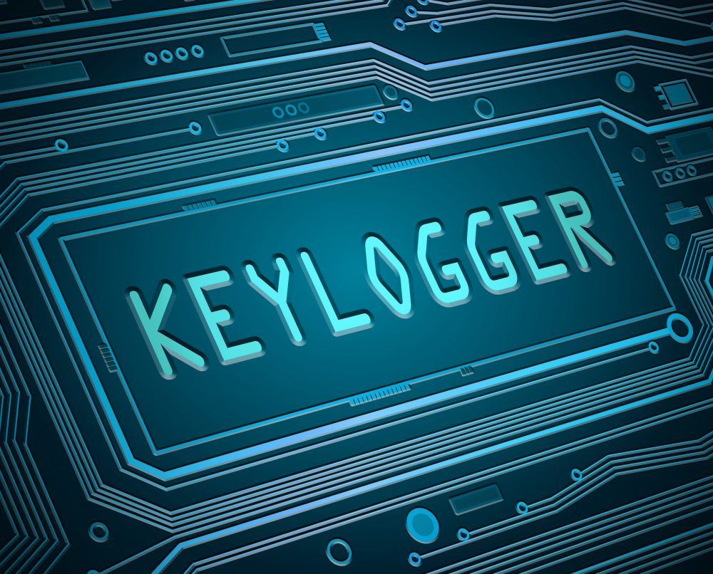

KEYLOGGER AND SECURITY A keylogger is a software or hardware tool that records the keys pressed on a computer keyboard, often without the user's knowledge or consent. This allows a person to monitor and potentially gain access to sensitive information, such as passwords and login credentials.
3/21/2024 Annual Review

Slide 3


AGENDA 1. Problem Statement A high-level look at our proposed solution 2. Project Overview We'll define the key challenge we're aiming to solve. 3. End Users Highlighting the unique advantages of our approach. 4. solution and its value proposition Highlighting the unique advantages of our approach. 5. Wow in our solution Outline the solution and its models.
3/21/2024 Annual Review

Slide 4

PROBLEM STATEMENT
Develop a keylogger to monitor and record keystrokes on a computer system to analyze user behavior, enhance security, and detect unauthorized access, while ensuring compliance with ethical guidelines and legal regulations
3/21/2024 Annual Review

Slide 5

PROJECT OVERVIEW
Key features:
Capture key presses, holds, and releases.
Log data in text and JSON files.
Simple GUI for starting and stopping the keylogger.
Technologies:
Python, Tkinter, Pynput, JSON.
Educational Goals:
Learn keylogging mechanics and GUI development.
Understand ethical considerations.
3/21/2024 Annual Review

Slide 6

WHO ARE THE END USERS?
Students and Educators:
Purpose: Learning about keylogging mechanics, Python programming, and GUI development.
Usage: Educational demonstrations and hands-on practice.
Software Developers:
Purpose: Understanding event-driven programming and creating logging tools.
Usage: Developing and testing keylogging applications or similar tools.
Cybersecurity Professionals:
Purpose: Studying the behavior of keyloggers for defensive purposes.
Usage: Creating educational materials on keylogging and its prevention.
Ethical Hackers:
Purpose: Ethical hacking and penetration testing to identify vulnerabilities.
Usage: Demonstrating keylogging attacks and improving system security.
3/21/2024 Annual Review

Slide 7
YOUR SOLUTION AND ITS VALUE PROPOSITION Solution: Python-based keylogger: Captures key presses, holds, and releases. Dual-format logging: Saves data in text and JSON files. Simple GUI: Start and stop keylogging easily with Tkinter. Value Proposition: Educational Tool: Learn Python programming, GUI development, and keylogging mechanics. Development and Testing: Reference for event handling and creating logging tools. Cybersecurity Training: Study keylogger behavior and develop defensive strategies. Ethical Hacking: Identify vulnerabilities and improve security measures. Research: Analyze user interaction patterns and input behavior.
3/21/2024 Annual Review

Slide 8

THE WOW IN YOUR SOLUTION
User-Friendly GUI:
Easy start/stop functionality.
Comprehensive Logging:
Saves keystrokes in both text and JSON formats.
Educational Value:
Hands-on experience in Python and GUI development.
Ethical Focus:
Promotes responsible and legal use.
Practical Applications:
Useful for cybersecurity training and ethical hacking.
Expandable:
Solid foundation for future enhancements.
3/21/2024 Annual Review
8

Slide 9
MODELLING
Start Keylogger:
User initiates the keylogging process via the GUI.
Capture Keystrokes:
Keystrokes are captured and categorized as pressed, held, or released.
Log Data:
Keystroke data is saved in both text and JSON formats.
Stop Keylogger:
User stops the keylogging process via the GUI.
3/21/2024 Annual Review
9

Slide 10
RESULTS Practical Applications: Valuable tool for cybersecurity training, helping users learn how to detect and analyze keystroke patterns. Provides a foundation for developing more sophisticated security tools. Effective Keystroke Logging: Successfully captures and logs all keystrokes, including press, hold, and release events. Generates comprehensive text and JSON logs for detailed analysis. Structured Data Output: Text logs offer a straightforward view of keystroke activity. JSON logs provide structured data, facilitating advanced analysis and integration with other tools.
3/21/2024 Annual Review
10

