Slide 1

Applications of STAR-RIS in Communication Systems
Electrical Engineering Department
Student
Mohammad Sefid
Supervisor
Dr. Bastami

Slide 2
Content list
Introduction
Background
Applications of STAR-RIS in Wireless Communications
Conclusion

Slide 3
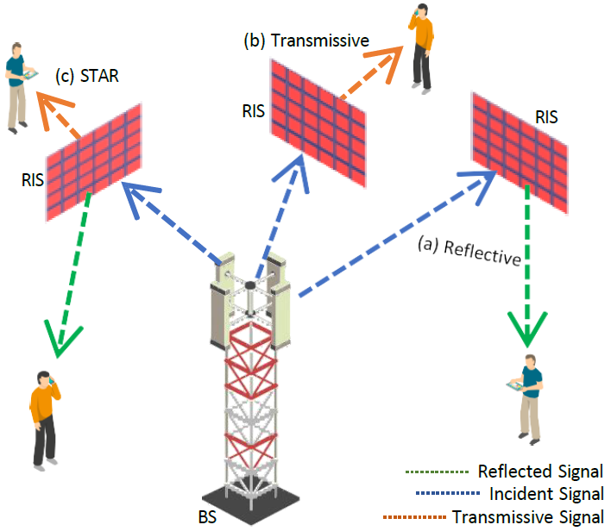
iNTRODUCTION
An illustration of various signal propagation modes: a) full reflection (RIS acting solely as a reflector); c) full transmission; d) simultaneous transmission and reflection (STAR-RIS) [1]
[1] Ahmed, Manzoor, Fang Xu, Yuanlin Lyu, Aized Amin Soofi, Yongxiao Li, Feroz Khan, Wali Ullah Khan, Muhammad Sheraz, Teong Chee Chuah and Min Deng. “RIS-Driven Resource Allocation Strategies for Diverse Network Environments: A Comprehensive Review.” ArXiv abs/2501.03075 (2025)

Slide 4
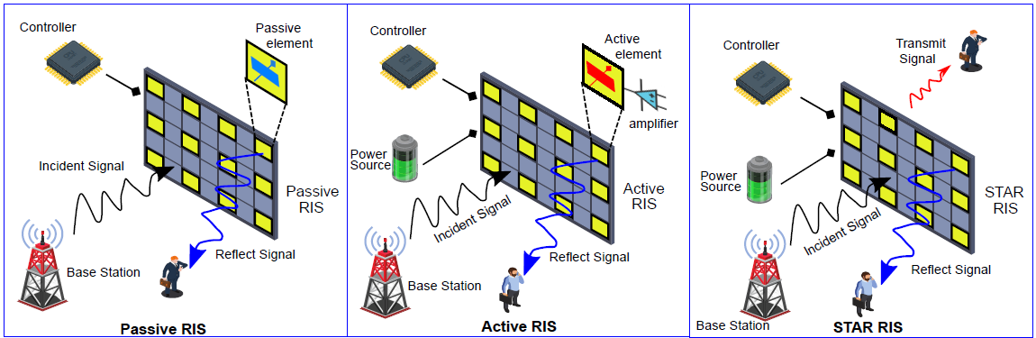
Background – Introduction to RIS
Passive RIS
Active RIS
STAR-RIS [2]
Types of RIS, which include Passive, Active, and STAR-RIS [2]
[2] M. Ahmed et al., "A Survey on STAR-RIS: Use Cases, Recent Advances, and Future Research Challenges," in IEEE Internet of Things Journal, vol. 10, no. 16, pp. 14689-14711, 15 Aug.15, (2023)

Slide 5
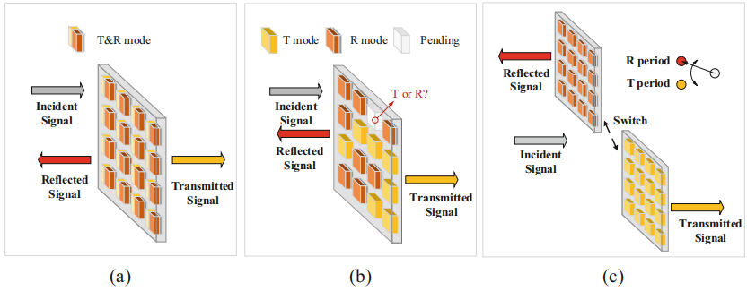
Background - STAR-RIS Performance Protocols
Energy Splitting (ES)
Mode Switching (MS)
Time Switching (TS) [3]
Three STAR-RIS operational protocols: ​​(a) ES-STAR, (b) MS-STAR, (c) TS-STAR [4]
[3] Liu, Yuanwei & Xu, Jiaqi & Wang, Zhaolin & Mu, Xidong & Zhang, Jianhua & Zhang, Ping. (2023). Simultaneously Transmitting and Reflecting (STAR) RIS for 6G: Fundamentals, Recent Advances, and Future Directions
[4] Mu, Xidong & Xu, Jiaqi & Liu, Yuanwei. (2023). Reconfigurable Intelligent Surfaces Toward 6G: From Reflection Only to Simultaneous Transmission and Reflection (STAR), Fundamentals of 6G Communications and Networking. Signals and Communication Technology. Springer, Cham

Slide 6
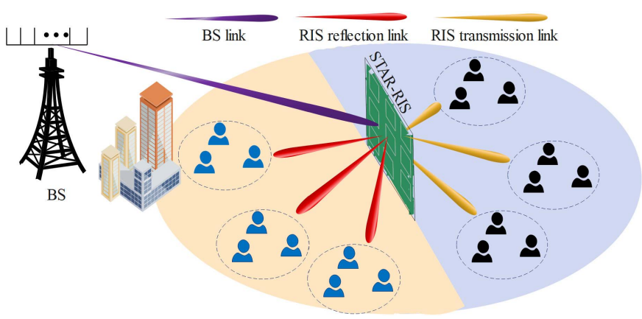
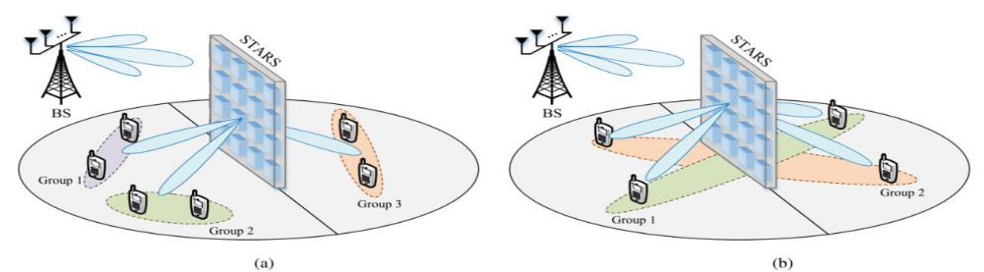
Applications of STAR-RIS in Wireless Communications
Non-Orthogonal Multiple Access (NOMA)
STAR-RIS-NOMA systems [5]
An illustration of two user clustering strategies in STAR-NOMA [6]
[5] J. Zuo, Y. Liu, Z. Ding, L. Song and H. V. Poor, "Joint Design for Simultaneously Transmitting and Reflecting (STAR) RIS Assisted NOMA Systems," in IEEE Transactions on Wireless Communications, vol. 22, no. 1, pp. 611-626, Jan. 2023
[6] X. Mu, J. Xu, Z. Wang and N. Al-Dhahir (2024) "Simultaneously Transmitting and Reflecting Surfaces for Ubiquitous Next Generation Multiple Access in 6G and Beyond," in Proceedings of the IEEE

Slide 7
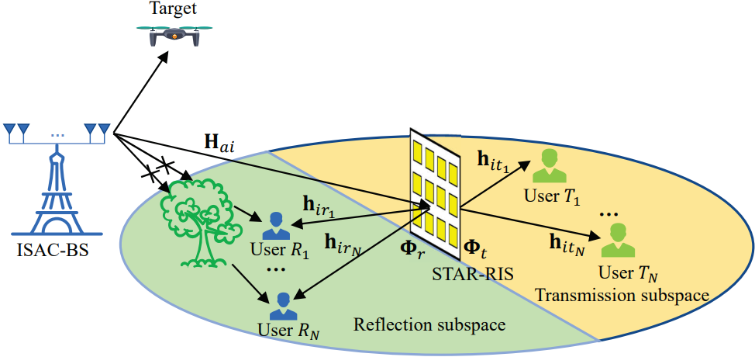
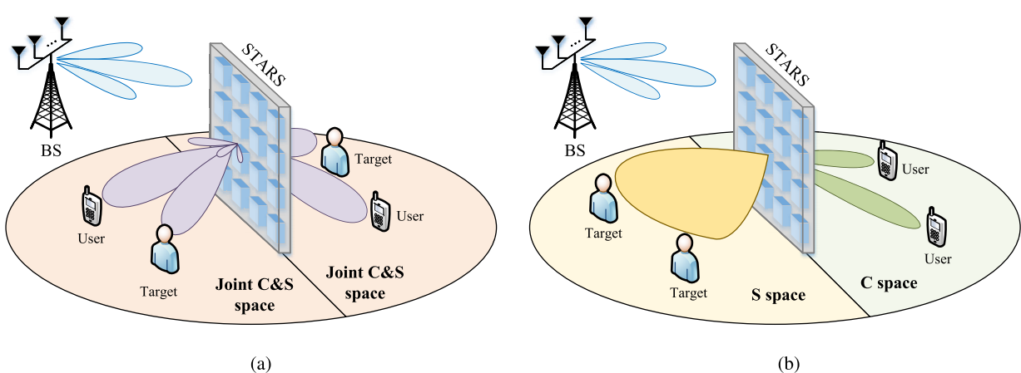
Applications of STAR-RIS in Wireless Communications
Integrated Sensing and Communication (ISAC)
System Configurations
ISAC assisted STAR-RIS [7]
Illustration of dual-system configurations for STAR-ISAC systems: (a) IFS configuration (b) SHS configuration [6]
[6] X. Mu, J. Xu, Z. Wang and N. Al-Dhahir (2024) "Simultaneously Transmitting and Reflecting Surfaces for Ubiquitous Next Generation Multiple Access in 6G and Beyond," in Proceedings of the IEEE
[7] J. Zhang et al., "Joint Design for STAR-RIS Aided ISAC: Decoupling or Learning," in IEEE Transactions on Wireless Communications, vol. 23, no. 10, pp. 14365-14379, Oct. 2024

Slide 8
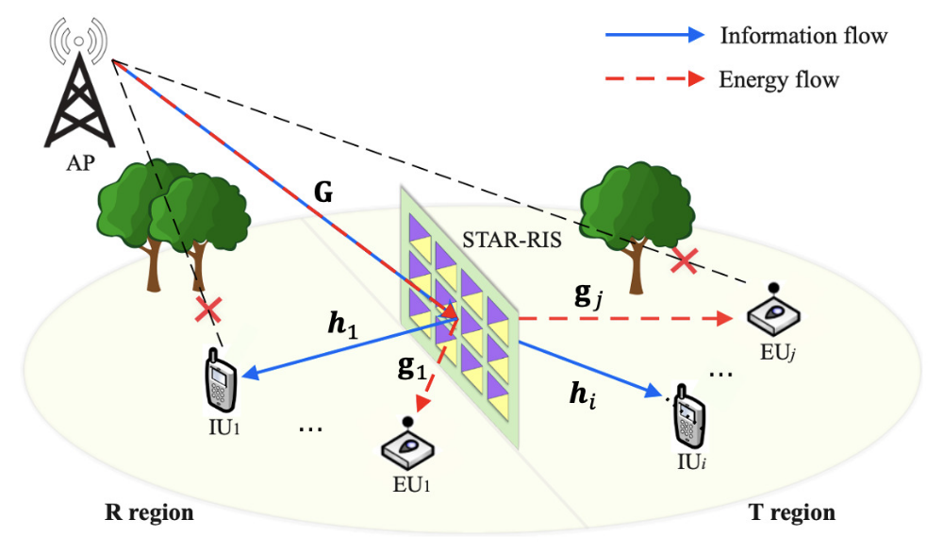
Applications of STAR-RIS in Wireless Communications
Simultaneous Wireless Information and Power Transfer (SWIPT)
An illustration of the application of STAR in SWIPT [8]
[8] G. Zhu, X. Mu, L. Guo, A. Huang and S. Xu, "," in IEEE Transactions on Wireless Communications, vol. 23, no. 6, pp. 5616-5631, June 2024Robust Resource Allocation for STAR-RIS Assisted SWIPT Systems

Slide 9
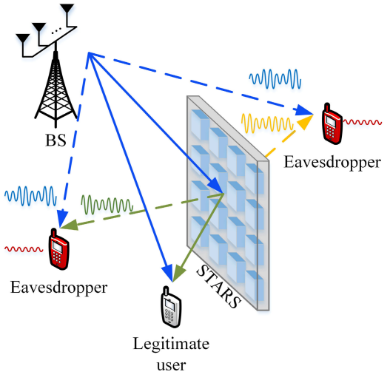
Applications of STAR-RIS in Wireless Communications
Physical Layer Security (PLS)
An illustration of a full-space PLS scenario facilitated by STAR, where the received signal power at eavesdroppers on both sides can be reduced through transmission and reflection [6]
[6] X. Mu, J. Xu, Z. Wang and N. Al-Dhahir (2024) "Simultaneously Transmitting and Reflecting Surfaces for Ubiquitous Next Generation Multiple Access in 6G and Beyond," in Proceedings of the IEEE

Slide 10
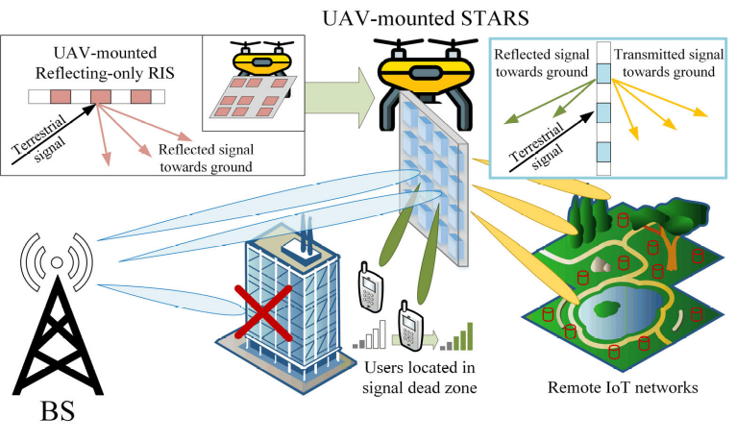
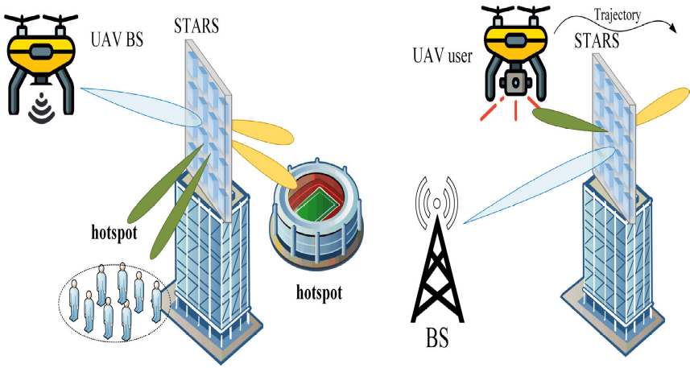
Applications of STAR-RIS in Wireless Communications
Unmanned Aerial Vehicle (UAV) Communications
Applications of STAR in drone communications: (a) Communication assisted by a STAR mounted on a drone; (b) Drone communication assisted by STAR [6]
[6] X. Mu, J. Xu, Z. Wang and N. Al-Dhahir (2024) "Simultaneously Transmitting and Reflecting Surfaces for Ubiquitous Next Generation Multiple Access in 6G and Beyond," in Proceedings of the IEEE

Slide 11
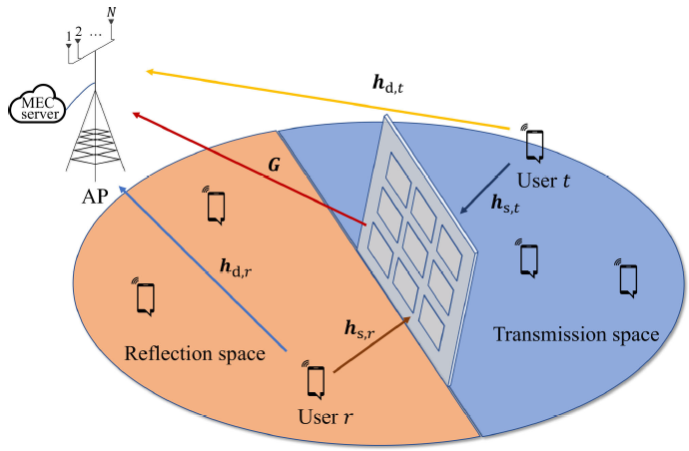
Applications of STAR-RIS in Wireless Communications
Mobile Edge Computing (MEC)
MEC systems assisted by STAR-RIS [9]
[9] Z. Liu, Z. Li, M. Wen, Y. Gong and Y. -C. Wu, "STAR-RIS-Aided Mobile Edge Computing: Computation Rate Maximization With Binary Amplitude Coefficients," in IEEE Transactions on Communications, vol. 71, no. 7, pp. 4313-4327, July 2023

Slide 12
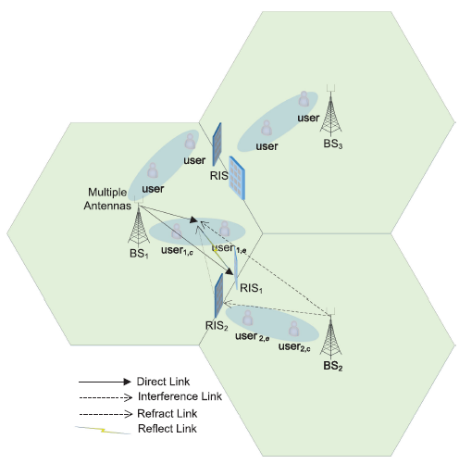
Applications of STAR-RIS in Wireless Communications
Coordinated Multi-Point (CoMP)
A general system model for STAR-RIS-enhanced NOMA-CoMP networks [10]
[10] T. Hou, J. Wang, Y. Liu, X. Sun, A. Li and B. Ai, "A Joint Design for STAR-RIS Enhanced NOMA-CoMP Networks: A Simultaneous-Signal-Enhancement-and-Cancellation-Based (SSECB) Design," in IEEE Transactions on Vehicular Technology, vol. 71, no. 1, pp. 1043-1048, Jan. 2022

Slide 13
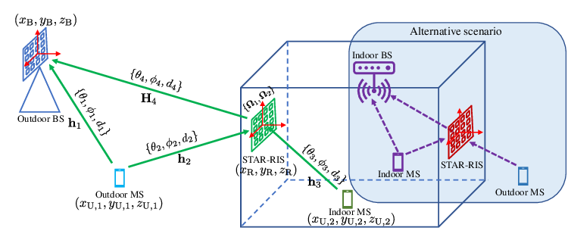
Applications of STAR-RIS in Wireless Communications
3D Localization
Simultaneous Indoor and Outdoor Localization via STAR-RIS [11]
[11] Zhao, Yajun & He, Jiguang. (2023). RISTA - Reconfigurable Intelligent Surface Technology White Paper (2023)

Slide 14
cONCLUSION
STAR-RIS vs. RIS
Operational Protocols of STAR-RIS
Key Applications in Wireless Communications

Slide 15
Thank you for the attention of professors and students.

