Slide 1
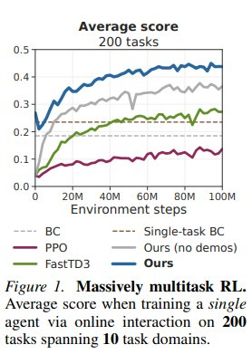
Université d'Ottawa | University of Ottawa
Result 1: Massively Multitask RL (Figure 1)
①
Newt leads overall
Highest avg. normalized score across 200 tasks vs. all baselines at 100M steps
②
More data-efficient
Newt rises faster than PPO and FastTD3, reaching higher scores with fewer steps
③
BC plateaus early
BC starts strong (high-quality demos) but cannot improve beyond imitation ceiling
④
Demos matter
"Ours (no demos)" is noticeably worse — pretraining on demonstrations is essential
Source: Figure 1 — Hansen et al., 2025
uOttawa
R1

Slide 2
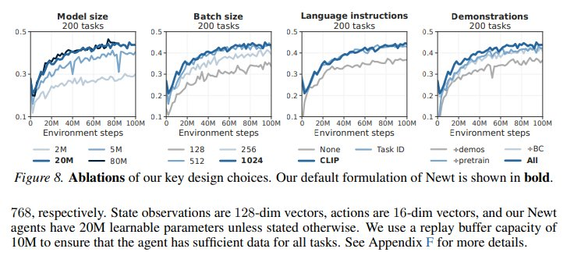
Université d'Ottawa | University of Ottawa
Result 2: Per-Domain Performance (Figure 7)
Key takeaway: Newt (dark blue) leads in most domains but gains are uneven — ManiSkill & Meta-World show strong improvement; MuJoCo & Atari are more competitive. This is an honest limitation the authors acknowledge.
uOttawa
Source: Figure 7 — Hansen et al., 2025
R2

Slide 3
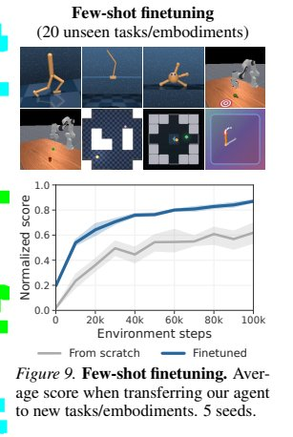
Université d'Ottawa | University of Ottawa
Result 3: Few-Shot Adaptation to Unseen Tasks (Figure 9)
What is being tested?
Transfer Newt (pretrained on 200 tasks) to 20 completely unseen tasks & embodiments using only a small number of fine-tuning steps.
→
Finetuned Newt
Starts at ~0.4 and reaches ~0.85 normalized score by 100k steps
→
From Scratch
Starts near 0 and only reaches ~0.55 — much slower, much lower ceiling
★
~15× zero-shot advantage
Newt scores ~0.192 at step 0 vs. ~0.013 for scratch — pretrained representations transfer immediately
Source: Figure 9 — Hansen et al., 2025
uOttawa
R3

Slide 4
Université d'Ottawa | University of Ottawa
Result 4: Open-Loop Control & Summary
What is Open-Loop Control?
Results Summary
Normal (closed-loop): Agent observes → acts → observes → acts... Open-loop: Agent plans a sequence of actions and executes them ALL without re-observing the environment.
Newt's world model allows it to simulate future states internally — making open-loop control feasible.
~0.45
~0.25
Newt avg. score
(200 tasks, 100M steps)
FastTD3 avg. score
(best model-free baseline)
15×
20M
Zero-shot advantage
over training from scratch
Optimal model size
(sweet spot for 200 tasks)
Why it matters: Critical for robotics where sensors are slow, expensive, or unreliable in the real world.
uOttawa
R4

Slide 5
Université d'Ottawa | University of Ottawa
Ablation Study: Every Design Choice Matters (Figure 8)
Model Size
Batch Size
Language (CLIP)
Demonstrations
20M is the sweet spot. Bigger ≠ always better — 80M gives diminishing returns.
Larger batches consistently help. 200 tasks need large batches for stable gradients.
CLIP >> Task ID >> None. Semantic language understanding generalizes far better.
All components compound. Removing any one (demos, pretraining, BC) hurts performance.
uOttawa
Source: Figure 8 — Hansen et al., 2025
R5

