Slide 1

Université d'Ottawa | University of Ottawa
Learning Massively Multitask
World Models for Continuous Control
By Nicklas Hansen, Hao Su, Xiaolong Wang
Presented by: Mariana Chávez Flores, Mohammad
CSI5340-F00 / ELG 5214-F00 · ICLR 2026
uOttawa
1

Slide 2
Université d'Ottawa | University of Ottawa
The Big Picture
Online RL can scale to hundreds of continuous-control tasks
when combined with a massively multitask benchmark,
a language-conditioned world model,
and demonstration-based pretraining.
uOttawa
uOttawa
2

Slide 3
Université d'Ottawa | University of Ottawa
Motivation
Can one agent be trained online across hundreds of tasks?
Continuous-control RL is still mostly single-task or offline
Foundation model recipe (pretrain → RL) works for games & reasoning — why not control?
Imitation-heavy scaling is limited by data quantity & demonstration quality
No benchmark for massively multitask online RL existed
Single-task RL
Multitask RL
(offline)
Massively
Multitask
Online RL ✓
•Can one agent be trained online across hundreds of tasks?
uOttawa
3

Slide 4
Université d'Ottawa | University of Ottawa
Background: RL & World Models
Reinforcement Learning
World Models (Model-Based RL)
Agent interacts with environment
Learns policy π(a|s) to maximize cumulative reward
Key challenge: exploration + sample efficiency
Agent learns a model of environment dynamics
Enables planning in latent space (no decoder needed)
TD-MPC2: state-of-art for continuous control tasks
J(π) = E[Σ γᵗ rₜ]
z' = d(z, a, g)
uOttawa
4

Slide 5
Université d'Ottawa | University of Ottawa
The Lineage: TD-MPC → TD-MPC2 → Newt
TD-MPC
(ICML 2022)
TD-MPC2
(ICLR 2024)
Newt / MMBench
(ICLR 2026)
Latent trajectory
optimization
Single-task
104 tasks, single
hyperparameter set
317M multitask agent
(offline)
200 tasks online
Language-conditioned
Demo pretraining
+ online RL
→
→
This paper = Newt + MMBench: scaling online RL to 200 tasks for the first time
uOttawa
5

Slide 6
Université d'Ottawa | University of Ottawa
Paper Contributions
①
MMBench
②
Newt Agent
First benchmark for massively multitask online RL
200 tasks · 10 domains · language instructions · demos · optional images
Language-conditioned world model based on TD-MPC2
Pretrained on demos → jointly optimized with online RL across all tasks
③
Scalable Online RL
④
Open Release
Demonstrates online RL can scale to continuous control
Outperforms BC, PPO, FastTD3 — enables few-shot adaptation to new tasks
200+ model checkpoints · environments · demonstrations · training code
All released publicly for community benchmarking
uOttawa
6

Slide 7
Université d'Ottawa | University of Ottawa
MMBench: A New Benchmark for Massively Multitask RL
200
10
41
∞
Diverse Tasks
Task Domains
New Tasks
Online RL
Task Domains Include:
Each task includes:
DMControl (locomotion)
Meta-World (manipulation)
ManiSkill2 (dexterous manipulation)
MyoSuite (musculoskeletal control)
MiniArcade (19 new arcade-style tasks)
Language instruction describing the task
Expert demonstrations for pretraining
Optional RGB image observations
Normalized [0,1] reward signal
uOttawa
7

Slide 8
Université d'Ottawa | University of Ottawa
Newt: Architecture Overview
INPUTS
WORLD MODEL (Newt)
PLANNING
State s
(proprioception)
Encoder z = h(s, x, g)
Latent-space
trajectory
optimization
Samples → simulate
→ evaluate
→ best action
Dynamics z' = d(z, a, g)
Language g
(CLIP-ViT/B)
→
Reward r̂ = R(z, a, g)
→
Image x
(DINOv2/B, opt.)
Value Q̂ = Q(z, a, g)
Policy Prior π(a|z, g)
uOttawa
8

Slide 9
Notes:
“The paper’s setup is massively multitask online RL: one policy trained across many heterogeneous tasks. At this scale, task IDs are not enough because they do not generalize to unseen tasks, so the benchmark uses language instructions. It also provides demonstrations, which the paper frames as a practical way to reduce exploration burden and make this scale of online RL trainable.”

Slide 10
Training Strategy: Two-Phase Learning
Phase 1: Pretraining on Demonstrations
Phase 2: Online RL Across All 200 Tasks
200 expert demo datasets (collected by specialist TD-MPC2 agents)
Optimizes world model: dynamics, reward, value, policy prior
Agent learns task-aware representations & action priors
No environment interaction — offline only
Agent interacts with all 200 environments simultaneously
Joint optimization: world model + actor + critic
Additional action supervision during RL policy updates
Drastically accelerated training pipeline
→
Inspired by LLM recipe: large pretraining → fine-tune with RL
uOttawa
9

Slide 11
Experimental Setup
Tools: MMBench
Evaluations Structure: The experiments are organized around this questions
200 tasks, 10 domains, 100M total env steps
20M parameter agents (default)
State observations: 128-d vectors
Actions: 16-d vectors (masked for invalid dims)
Language: CLIP-ViT/B (512-d)
Images: DINOv2/B (768-d, optional)
Replay buffer: 10M capacity
Training: ~4.6 days on 2× RTX 5090
Q1: Performance : Can a single agent train on hundreds of unique task
Q2: Learning from demonstrations: Do they alleviate the difficulty of exploration.
Q3: Model Capabilities: Downstream capabilities of NEWT and can we leverage it for zero-shot transfer.
Q4: Analysis and Ablation: what is a good multitask world model.
→
Inspired by LLM recipe: large pretraining → fine-tune with RL
uOttawa
9

Slide 12
Experimental Setup
Baselines compared against Newt:
Behavior Cloning (BC)
PPO
Imitation learning only — no RL. Upper bound of demo quality.
Standard model-free on-policy RL. Extended with language conditioning.
FastTD3
Single-task TD-MPC2 ×200
Modern model-free off-policy RL with parallel envs. + language conditioning.
Specialist per-task agent trained for 5M steps each (~1B steps total).
Metric: Average normalized score [0,1] per task · 5 seeds per experiment
uOttawa
10

Slide 13
Key Results
①
②
Best Multitask Performance
Better Data Efficiency
Newt outperforms BC, PPO, and FastTD3 on average normalized score across all 200 tasks
Achieves higher scores with fewer environment steps than model-free baselines
③
④
Scaling Helps in Multitask
Few-Shot Adaptation
Unlike single-task RL, larger models improve performance — clear benefit up to 20M+ parameters
Pretrained Newt adapts rapidly to unseen tasks and embodiments with minimal fine-tuning
uOttawa
11

Slide 14
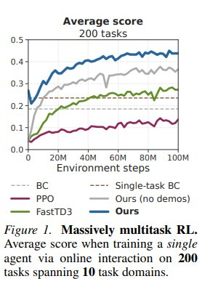
Result 1: Massively Multitask RL (Figure 1)
①
Newt leads overall
Highest avg. normalized score across 200 tasks vs. all baselines at 100M steps
②
More data-efficient
Newt rises faster than PPO and FastTD3, reaching higher scores with fewer steps
③
BC plateaus early
BC starts strong (high-quality demos) but cannot improve beyond imitation ceiling
④
Demos matter
"Ours (no demos)" is noticeably worse — pretraining on demonstrations is essential
Source: Figure 1 — Hansen et al., 2025
uOttawa
R1

Slide 15
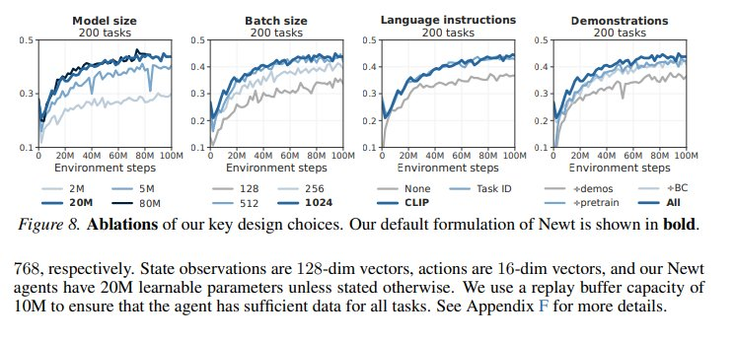
Result 2: Per-Domain Performance (Figure 7)
Key takeaway: Newt (dark blue) leads in most domains but gains are uneven — ManiSkill & Meta-World show strong improvement; MuJoCo & Atari are more competitive. This is an honest limitation the authors acknowledge.
uOttawa
Source: Figure 7 — Hansen et al., 2025
R2

Slide 16
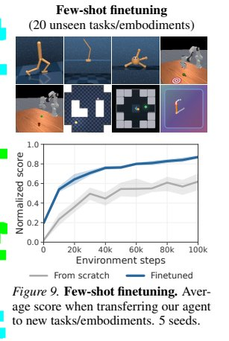
Result 3: Few-Shot Adaptation to Unseen Tasks (Figure 9)
What is being tested?
Transfer Newt (pretrained on 200 tasks) to 20 completely unseen tasks & embodiments using only a small number of fine-tuning steps.
→
Finetuned Newt
Starts at ~0.4 and reaches ~0.85 normalized score by 100k steps
→
From Scratch
Starts near 0 and only reaches ~0.55 — much slower, much lower ceiling
★
~15× zero-shot advantage
Newt scores ~0.192 at step 0 vs. ~0.013 for scratch — pretrained representations transfer immediately
Source: Figure 9 — Hansen et al., 2025
uOttawa
R3

Slide 17
Result 4: Open-Loop Control & Summary
What is Open-Loop Control?
Results Summary
Normal (closed-loop): Agent observes → acts → observes → acts... Open-loop: Agent plans a sequence of actions and executes them ALL without re-observing the environment.
Newt's world model allows it to simulate future states internally — making open-loop control feasible.
~0.45
~0.25
Newt avg. score
(200 tasks, 100M steps)
FastTD3 avg. score
(best model-free baseline)
15×
20M
Zero-shot advantage
over training from scratch
Optimal model size
(sweet spot for 200 tasks)
Why it matters: Critical for robotics where sensors are slow, expensive, or unreliable in the real world.
uOttawa
R4

Slide 18
Ablation Study: Every Design Choice Matters (Figure 8)
Model Size
Batch Size
Language (CLIP)
Demonstrations
20M is the sweet spot. Bigger ≠ always better — 80M gives diminishing returns.
Larger batches consistently help. 200 tasks need large batches for stable gradients.
CLIP >> Task ID >> None. Semantic language understanding generalizes far better.
All components compound. Removing any one (demos, pretraining, BC) hurts performance.
uOttawa
Source: Figure 8 — Hansen et al., 2025
R5

Slide 19
Strengths
✓
First Massively Multitask Online RL Benchmark
MMBench fills a real gap — no prior benchmark enabled online RL across 200+ continuous-control tasks with diverse embodiments
✓
Effective Foundation Model Recipe
Demo pretraining → online RL is a principled and reproducible methodology. Ablations confirm every component contributes
✓
Strong Empirical Evaluation
5 seeds, 200 tasks, multiple baselines, domain-level breakdowns, scaling analysis, and few-shot transfer — comprehensive
✓
Open & Reproducible
Full code, 200+ checkpoints, demonstrations, and environments released — community can build directly on this work
uOttawa
12

Slide 20
Limitations & Weaknesses
✗
Simple MLP Architecture
All world model components are deterministic MLPs. No Transformers or diffusion policy despite their proven benefits. Authors acknowledge this as a clear future direction.
✗
Primarily State-Based
Most experiments use proprioceptive state as input. Visual RL (from RGB images) is supported but less thoroughly evaluated. Limits real-world applicability.
✗
Uneven Domain Performance
Per-domain results show large variance — online RL benefits some domains much more than others. Not all 200 tasks are solved well.
✗
Compute Requirements
Training a single agent on 200 tasks simultaneously requires significant GPU resources. Not accessible to all researchers without HPC infrastructure.
uOttawa
13

Slide 21
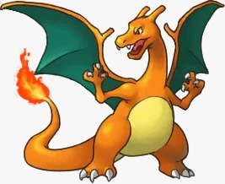
Discussion & Future Directions
What research directions does this paper open up?
→
Transformer / Diffusion Architectures Replace MLP components with attention-based models or diffusion policies for richer representations
→
Visual RL at Scale Extend Newt to fully image-based control across all 200 tasks — a major open challenge
→
Fine-Tuning VLAs with Online RL Use MMBench to fine-tune vision-language-action models (GPT-4V, Gemini) with online RL — direct future work cited in paper
→
Curriculum & Task Scheduling Smarter multi-task training order (easy → hard, domain grouping) could improve convergence
→
Broader Embodiments Extend to humanoid robots, autonomous vehicles, or real-world hardware deployment
uOttawa
14

Slide 22
Conclusion
✓
Massive multitask online RL is feasible in continuous control
✓
Language instructions enable task generalization across embodiments
✓
World models (Newt) are promising for generalist RL agents
✓
MMBench provides a reproducible benchmark for the community
"Online RL can scale to hundreds of continuous-control tasks — the generalist RL agent is within reach."
uOttawa
15

