Slide 1
Sentiment Analysis – Applied ML
Project Presentation
Mohammad Ahmed
University of Ottawa

Slide 2
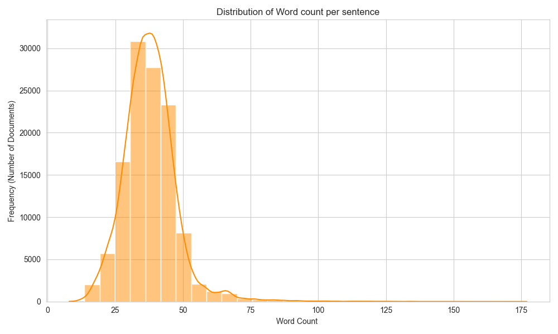
Word Count Distribution
Visualization

Slide 3
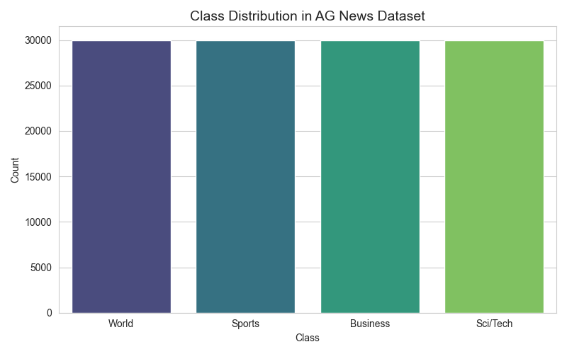
Class Distribution
Visualization

Slide 4
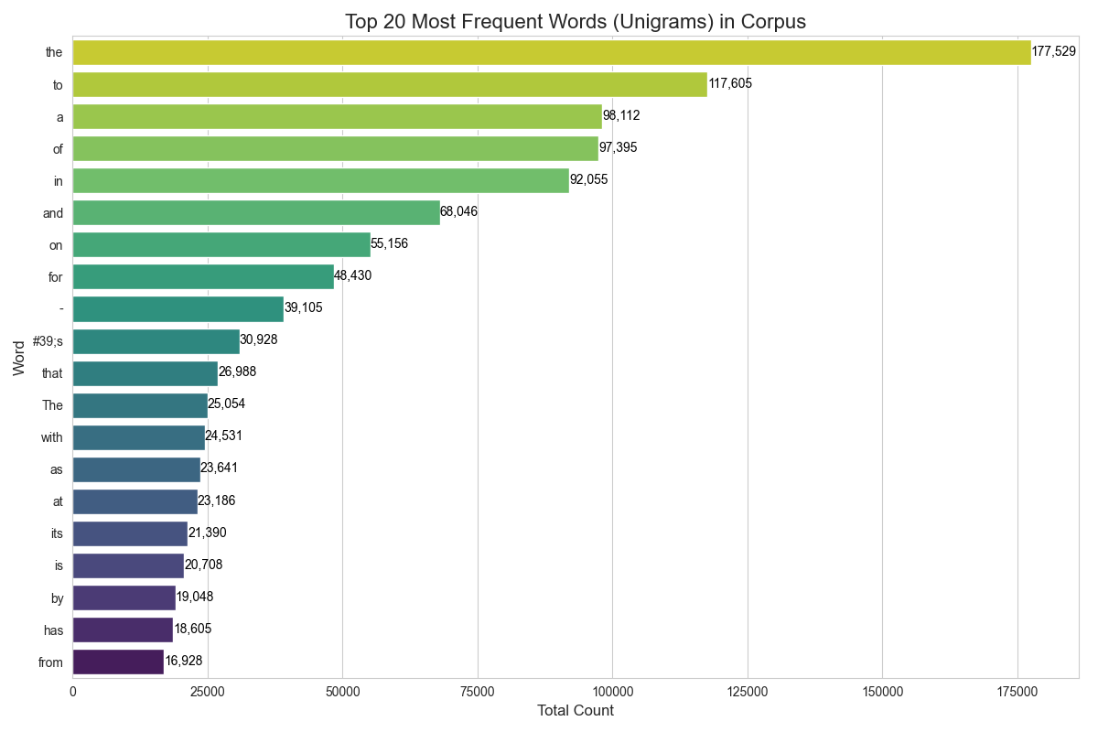
Top 20 Words
Visualization

Slide 5
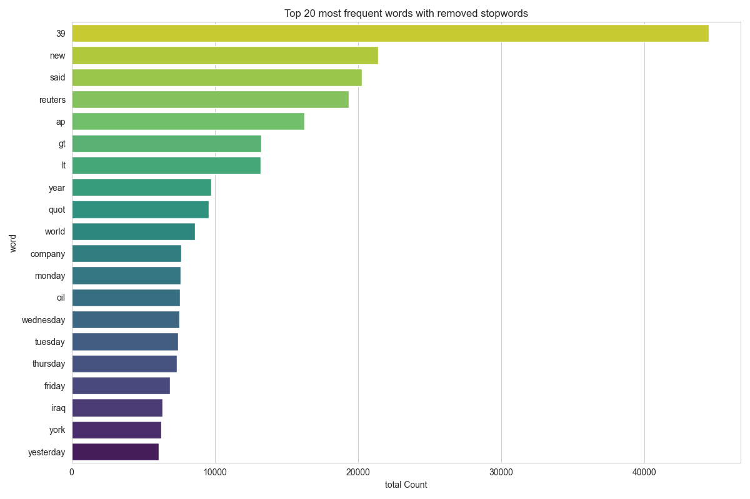
Top 20 Cleaned Words
Visualization

Slide 6
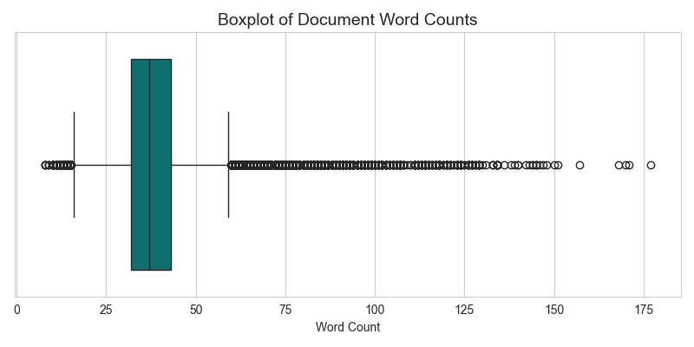
Boxplot Word Count
Visualization

Slide 7
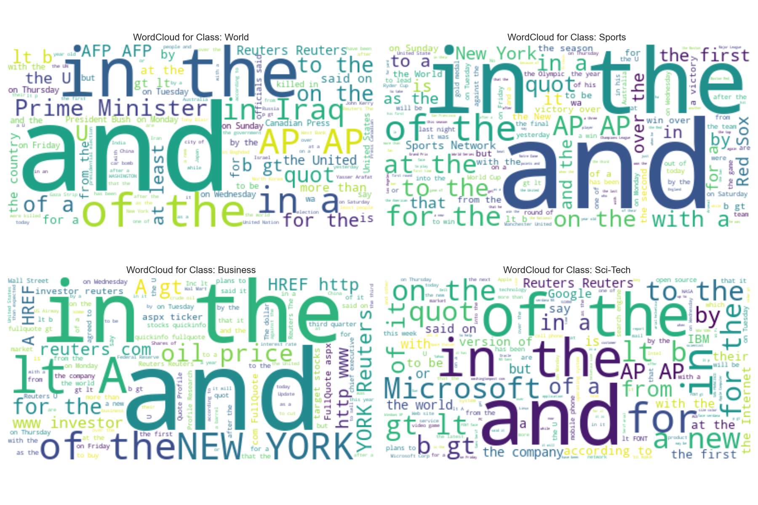
Word Cloud Per Class
Visualization

