Slide 1

Comparing Exploration Mechanisms for On and Off-policy RL in Sparse Reward Environments
Anthony Nasr, Mariana Chávez, Md Mosarraf, Mohammad AlhusseinMosarraf, Mohammad .
CSI5340-F00 / ELG 5214-F00

Slide 2
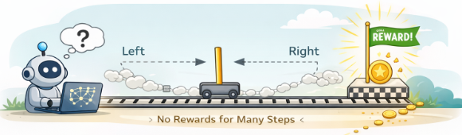
Motivation
In sparse-reward environments → long time before any useful learning signal.
This makes policy optimization slower, noisier, and more unstable.
Exploration matters, but we aim to find which exploration mechanism is most effective under matched compute.
Should we use Entropy Regularization, RND, or ICM?
Notes:
Fundamental Question: Can one..
Paper argues that right now: 1-2
But: 3
- Their inspiration: 4 large-scale pretraining first, followed by lighter online RL improvement.

Slide 3

Background: Baselines & Curiosity
Established baselines
DQN → Off-policy baseline
PPO → On-policy
Intrinsic Reward Methods
RND rewards novelty through prediction error
ICM uses a learned dynamics model
Entropy Regularization
Increase stochasticity directly through the entropy term.
Notes:
To understand the problem setting we define….
Mass multi…
This is already hard, but two additional ingredients matter a lot.
- Language ins vs tasks id
- Demos: Importat for large, diverse tasks

Slide 4
So, What is missing?
Prior studies do not clearly show which exploration method works best when algorithm family, reward density, and compute budget are all controlled together.
Notes:
The big picture of this paper is …
- Not only a new agent but a new way to study generalis RL in continuous control

Slide 5


Research Questions
Primary
Under sparse rewards and matched compute, do RND or ICM improve sample efficiency more for PPO than for DQN, or can entropy regularization alone close most of the gap?
Secondary
Does ICM produce different gains than RND and does that difference change with algorithm family and reward density?
Notes:
The big picture of this paper is …
- Not only a new agent but a new way to study generalis RL in continuous control

Slide 6

Methodology
Environments | Agents
Gymnax Cartpole-v1 Gymnax MountainCar-v0 Dense & Sparse variants | PPO → MLP: 2 x 64 ReLU DQN → MLP: 2 x 64 ReLU
Exploration | Evaluation
Entropy Regularization RND ICM | 10 seeds / configuration 500 episodes / configuration Greedy rollouts per 50 episodes
Hyperparameters
LR ∈ {0.01, 0.001, 0.0005} Discount factor → Γ ∈ {0.9, 0.99} Eta → η ∈ {0.1, 1.0} | Entropy coeff. → α ∈ {0.01, 0.05} Reward scale → β ∈ {0.1, 1.0}

Slide 7
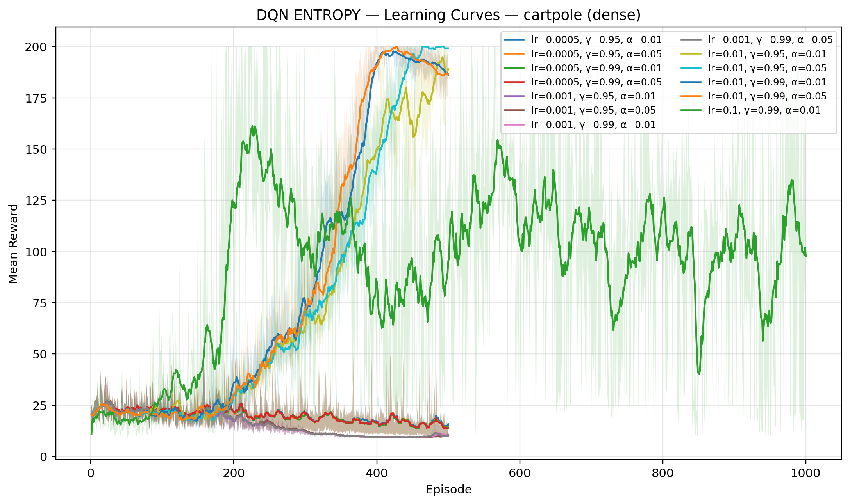
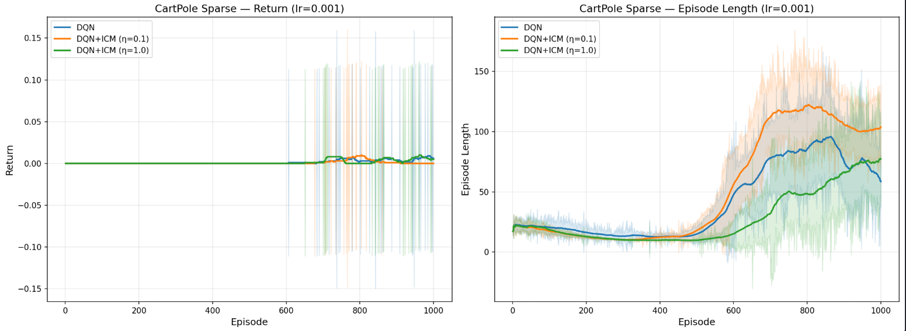
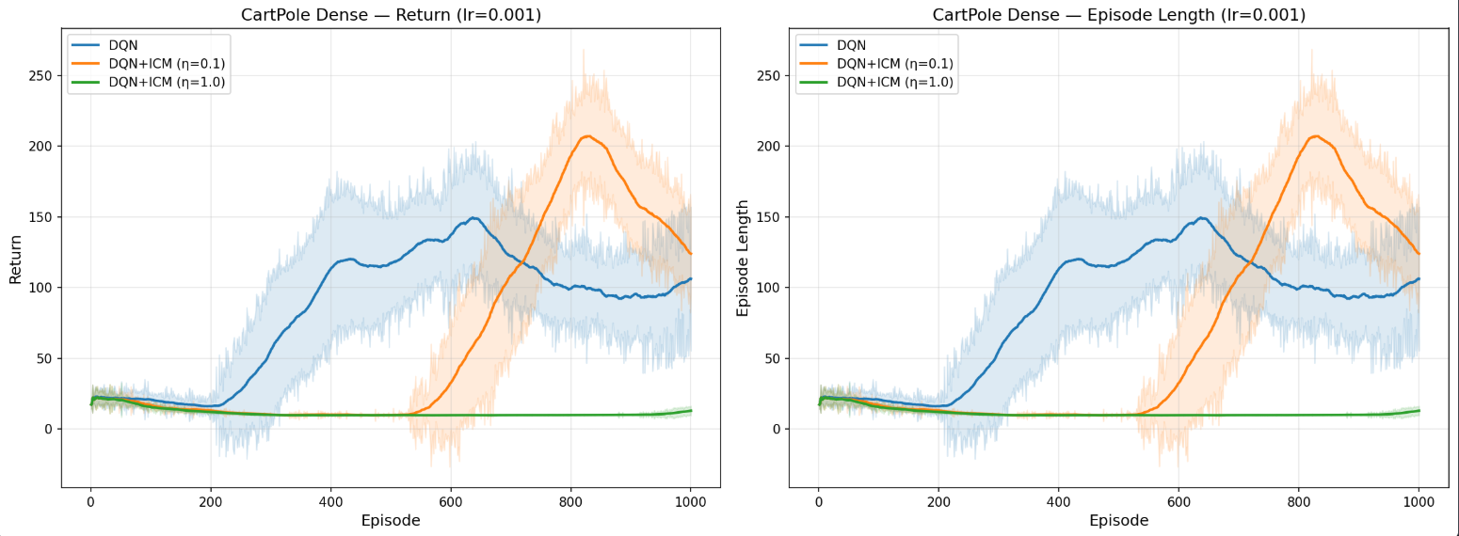
Results 1: DQN+Entropy: CartPole Dense Learning Curves
Best configs reach 200 reward (early stopping)

Slide 8
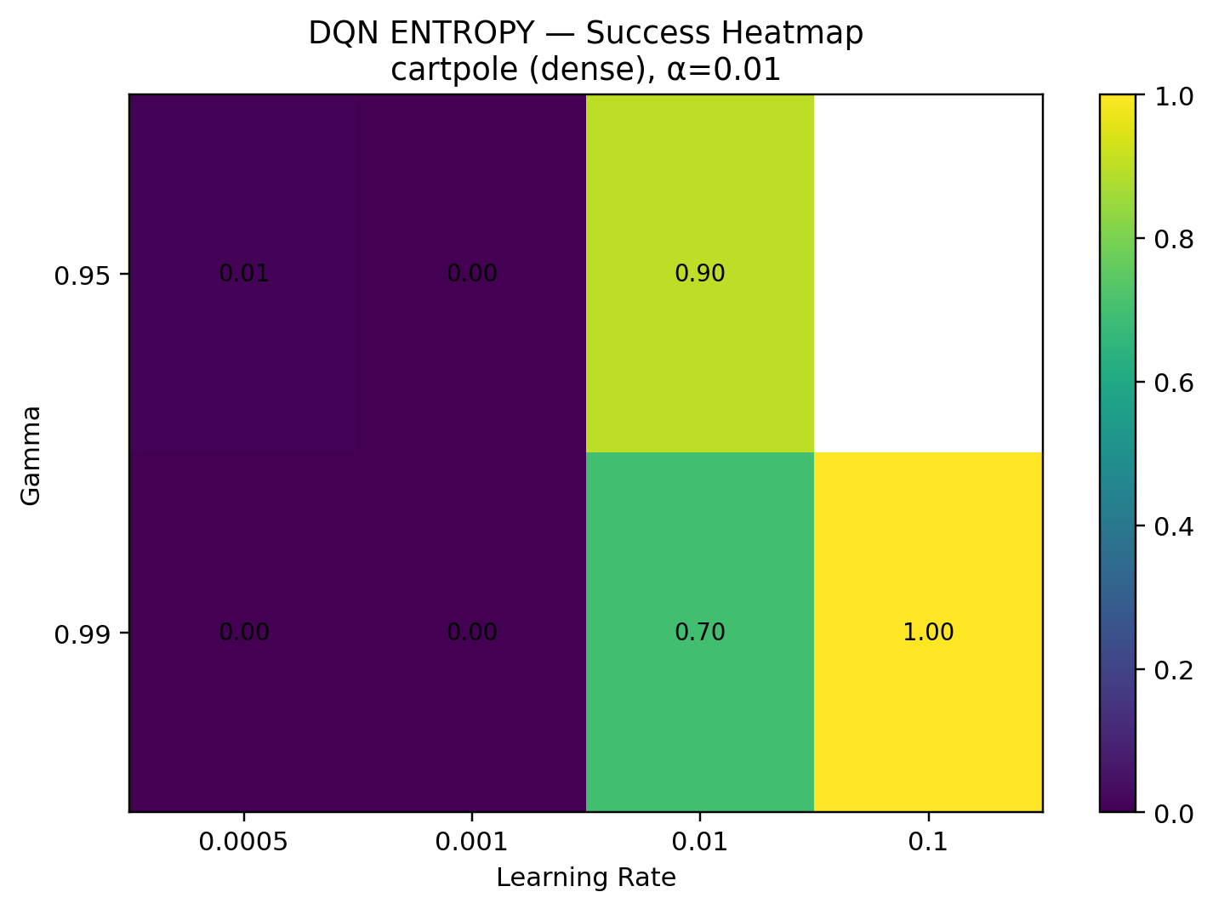
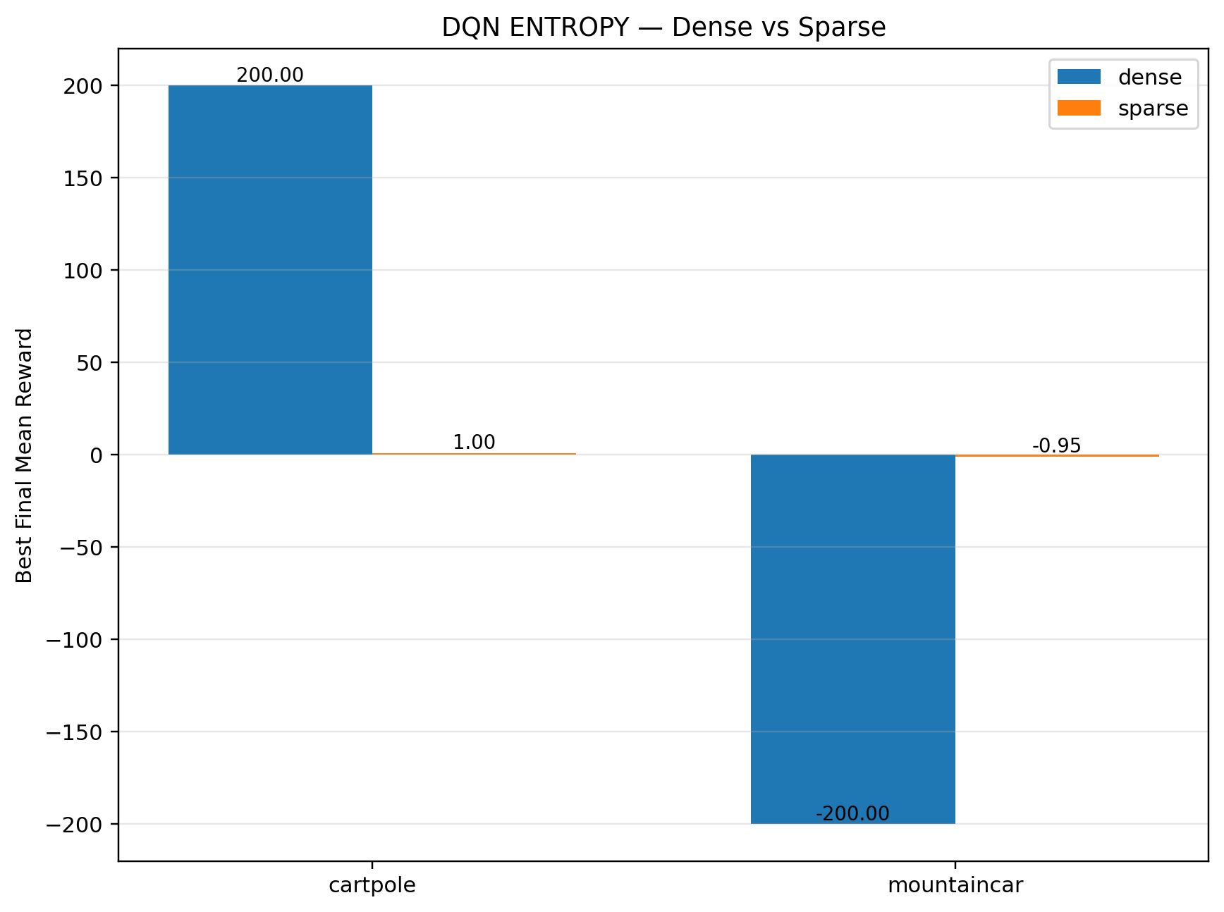
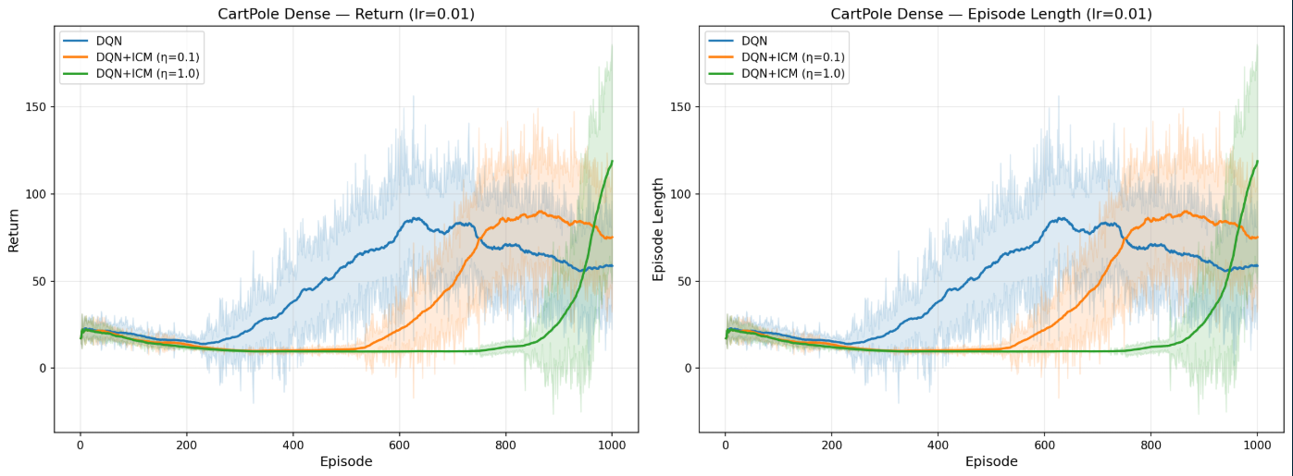
Results 1: DQN+Entropy: Success Heatmap & Dense vs Sparse

Slide 9
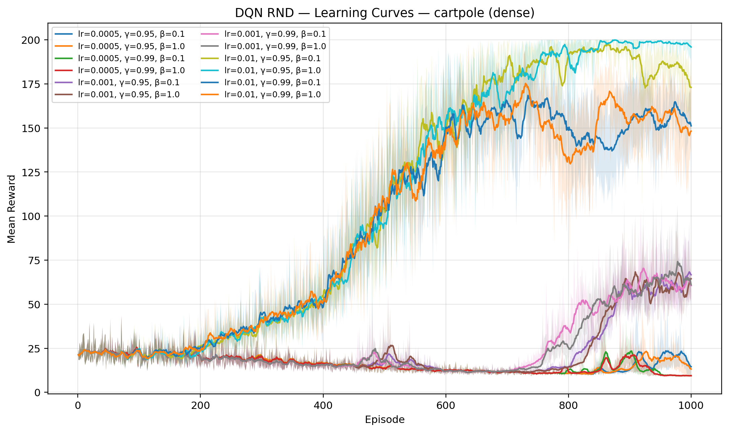
Results 2: DQN+RND CartPole Dense Learning Curves

Slide 10
Analysis & Insights
DQN + Entropy Regularization
• Solves CartPole dense (reward=200, success=1.0) with lr=0.01, γ=0.99, α=0.01
• Fails on MountainCar sparse: entropy saturates at maximum, no reward gradient to shape policy
• Higher α (0.05) slightly degrades CartPole dense performance vs α=0.01
DQN + RND
• CartPole dense: best success = 0.92, slightly below entropy (1.0)
• Intrinsic reward remains low (~0.005-0.02) — limited novelty in CartPole state space
• MountainCar dense: both methods fail (reward = -200) — environment is inherently harder
Key Insight: Entropy alone works well in dense-reward, easy environments but completely fails when sparse rewards remove the learning signal.

Slide 11
Key Results
①
②
Entropy succeeds on CartPole Dense Best config: lr=0.01, γ=0.99, α=0.01 Reward: 200 | Success: 1.0 Early stopping triggered
Entropy fails on MountainCar Sparse Max entropy saturation observed No reward signal → no policy improvement Success: 0.03 (near random)
③
④
RND achieves 0.92 on CartPole Dense Slightly below entropy baseline Intrinsic reward low (~0.01) Slower convergence than entropy
lr=0.1 causes divergence Confirmed across both methods Optimal range: 0.001–0.01 Higher LR → unstable Q-values

Slide 12
Limitations & Future Work
Limitations
• Only 2 simple Gymnax environments (CartPole, MountainCar) — results may not generalize to harder domains
• MountainCar dense unsolved by both methods — may need different network architecture or longer training
• PPO results (from teammates) still in progress — cross-algorithm comparison incomplete
• No ICM results yet from DQN side — limits the 3-way exploration mechanism comparison
• Limited compute (RTX 5060, 8GB VRAM) constrains sweep size and environment complexity
Future Work
• Complete PPO sweeps for entropy, RND, and ICM to enable full on-policy vs off-policy comparison
• Test on harder Gymnax environments (e.g., Acrobot, Pendulum) with continuous action spaces
• Investigate reward normalization and adaptive intrinsic reward scaling
• Statistical analysis with confidence intervals (Agarwal et al. 2021 recommendations)

Slide 13
Conclusion
✓
Entropy regularization is sufficient for DQN on dense-reward CartPole (reward=200, success=1.0)
✓
Entropy fails on MountainCar sparse — entropy saturates at max with no reward gradient
✓
RND provides competitive results on CartPole dense (0.92 success) but does not yet outperform entropy
✓
Exploration mechanism choice depends critically on reward density and environment complexity
Takeaway: Simple entropy works for easy dense environments, but sparse/hard tasks need dedicated exploration mechanisms like RND or ICM.

Slide 14
Thank you!
Q&A

