Slide 1

Comparing Exploration Mechanisms for On and Off-policy RL in Sparse Reward Environments
Anthony Nasr, Mariana Chávez, Md Mosarraf, Mohammad .
CSI5340-F00 / ELG 5214-F00

Slide 2

Motivation
In sparse-reward environments → long time before any useful learning signal.
This makes policy optimization slower, noisier, and more unstable.
Exploration matters, but we aim to find which exploration mechanism is most effective under matched compute.
Should we use Entropy Regularization, RND, or ICM?
Notes:
Fundamental Question: Can one..
Paper argues that right now: 1-2
But: 3
- Their inspiration: 4 large-scale pretraining first, followed by lighter online RL improvement.

Slide 3

Background: Baselines & Curiosity
Established baselines
DQN → Off-policy baseline
PPO → On-policy
Intrinsic Reward Methods
RND rewards novelty through prediction error
ICM uses a learned dynamics model
Entropy Regularization
Increase stochasticity directly through the entropy term.
Notes:
To understand the problem setting we define….
Mass multi…
This is already hard, but two additional ingredients matter a lot.
- Language ins vs tasks id
- Demos: Importat for large, diverse tasks

Slide 4
So, What is missing?
Prior studies do not clearly show which exploration method works best when algorithm family, reward density, and compute budget are all controlled together.
Notes:
The big picture of this paper is …
- Not only a new agent but a new way to study generalis RL in continuous control

Slide 5


Research Questions
Primary
Under sparse rewards and matched compute, do RND or ICM improve sample efficiency more for PPO than for DQN, or can entropy regularization alone close most of the gap?
Secondary
Does ICM produce different gains than RND and does that difference change with algorithm family and reward density?
Notes:
The big picture of this paper is …
- Not only a new agent but a new way to study generalis RL in continuous control

Slide 6

Methodology
Environments | Agents
Gymnax Cartpole-v1 Gymnax MountainCar-v0 Dense & Sparse variants | PPO → MLP: 2 x 64 ReLU DQN → MLP: 2 x 64 ReLU
Exploration | Evaluation
Entropy Regularization RND ICM | 10 seeds / configuration 1000 episodes / configuration Greedy rollouts per 50 episodes
Hyperparameters
LR ∈ {0.1, 0.01, 0.001} Discount factor → Γ ∈ {0.9, 0.99} Eta → η ∈ {0.1, 1.0} | Entropy coeff. → α ∈ {0.01, 0.05} Reward scale → β ∈ {0.1, 1.0}

Slide 7
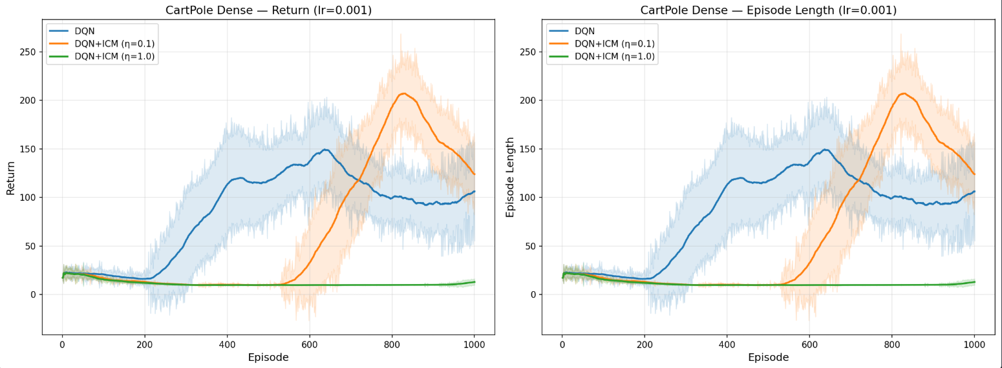
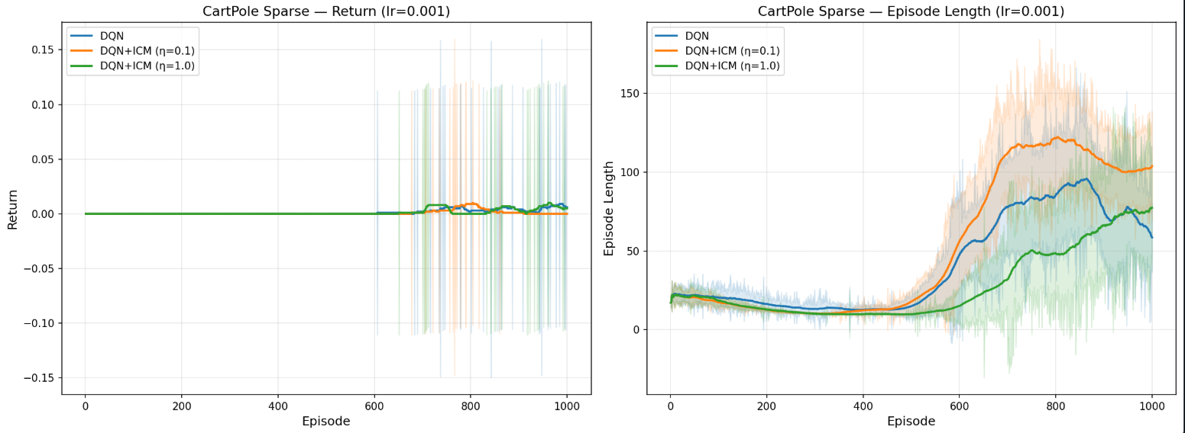
Results 1: Vanilla DQN vs DQN + ICM on CartPole-v1
Lr = 0.001

Slide 8
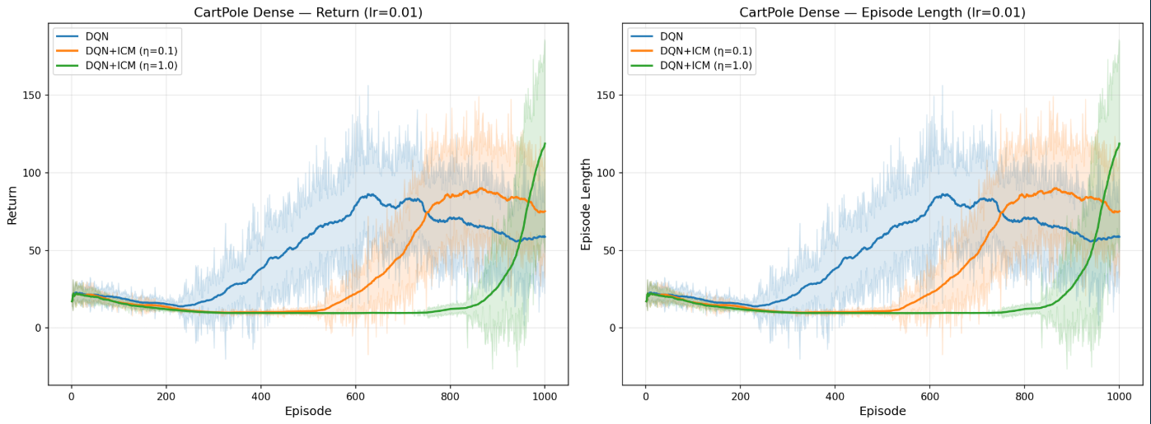
Results 1: Vanilla DQN vs DQN + ICM on CartPole-v1
Lr = 0.01

Slide 9
Results 2: Other results...

Slide 10
Analysis & Insights

Slide 11
Key Results
①
②
③
④

Slide 12
Limitations & Future Work

Slide 13
Conclusion
✓
✓
✓
✓

Slide 14
Thank you!
Q&A

